Slide 1


























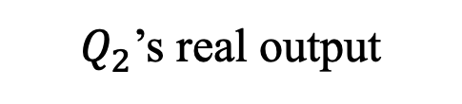
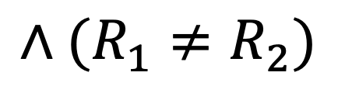
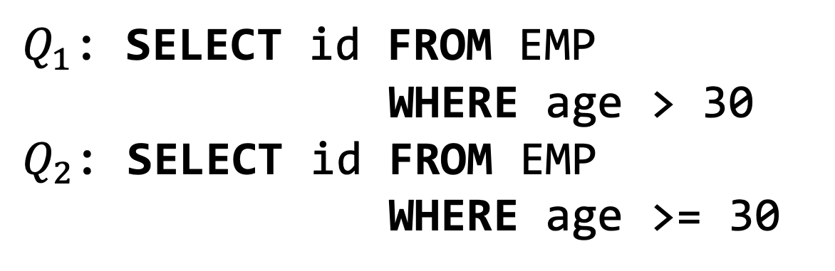
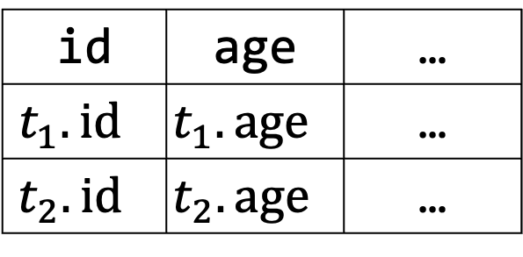



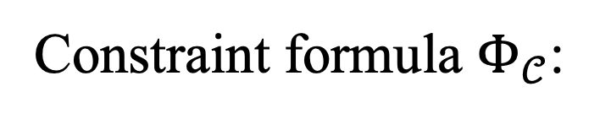





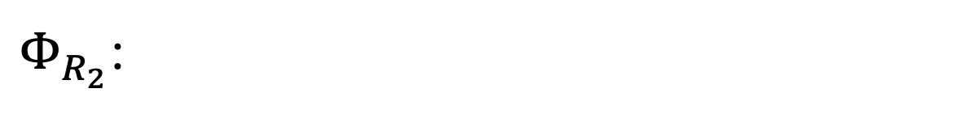
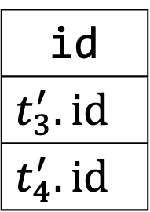

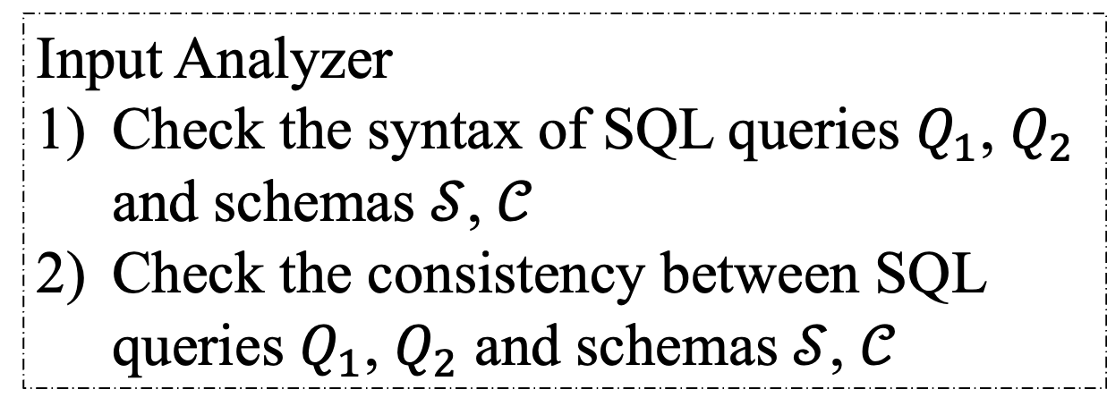


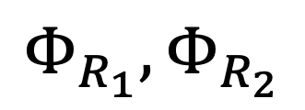
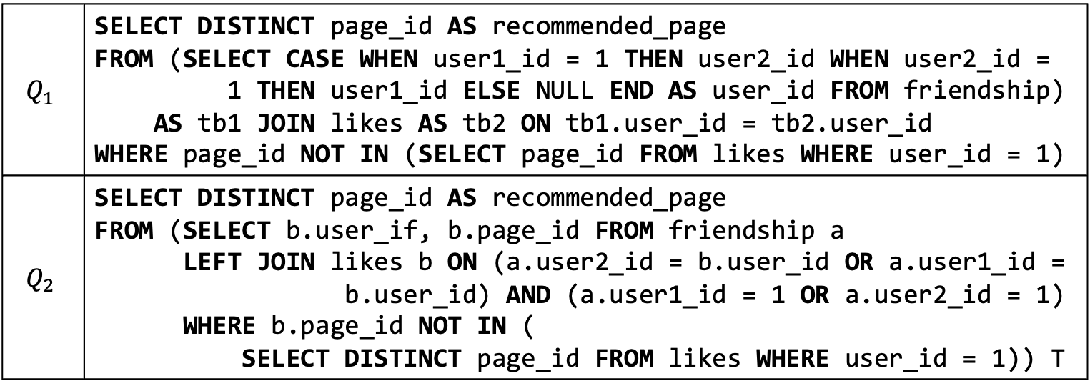

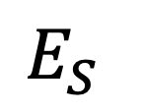
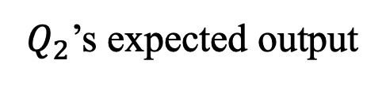

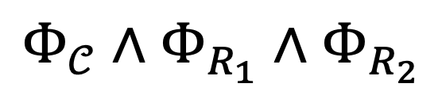




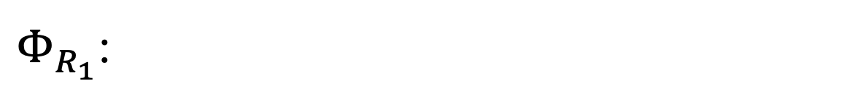
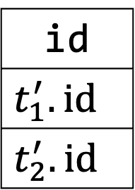

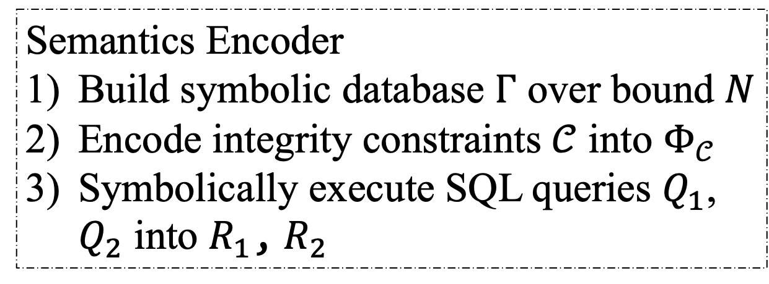
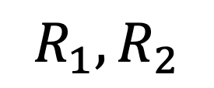
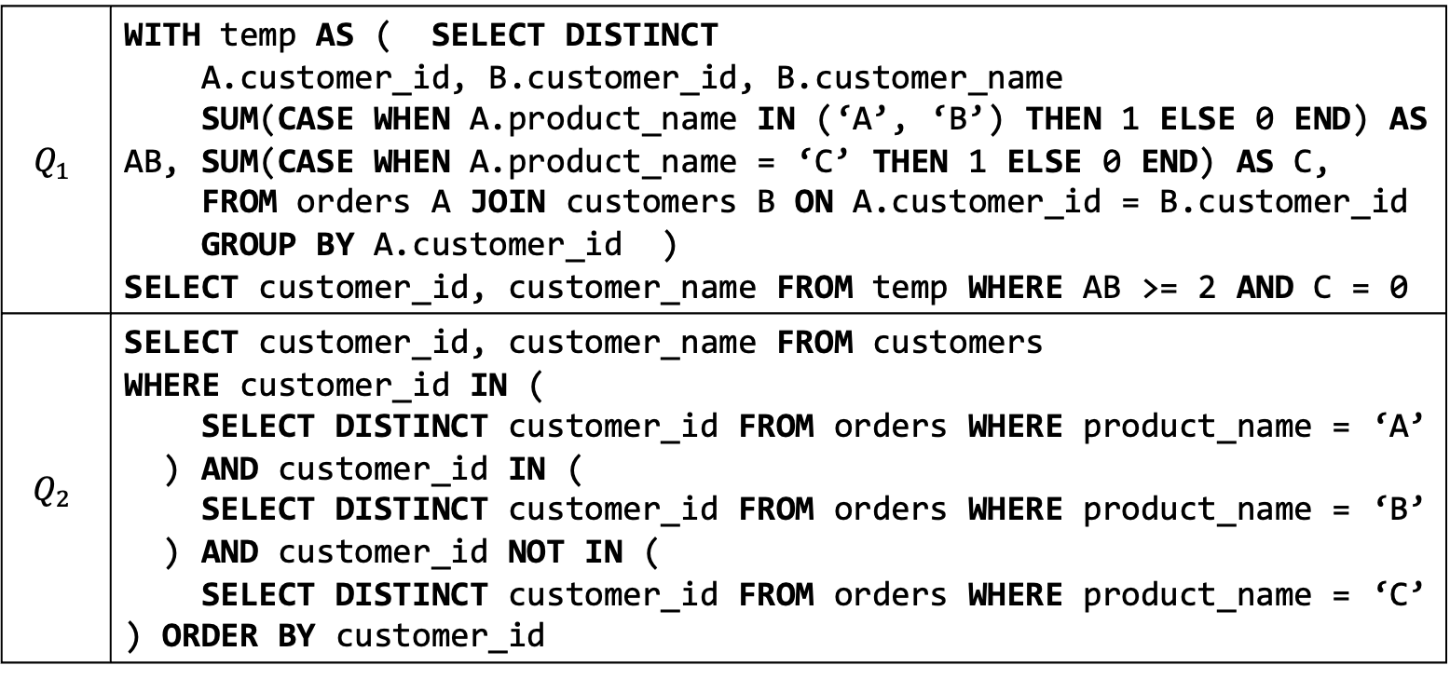


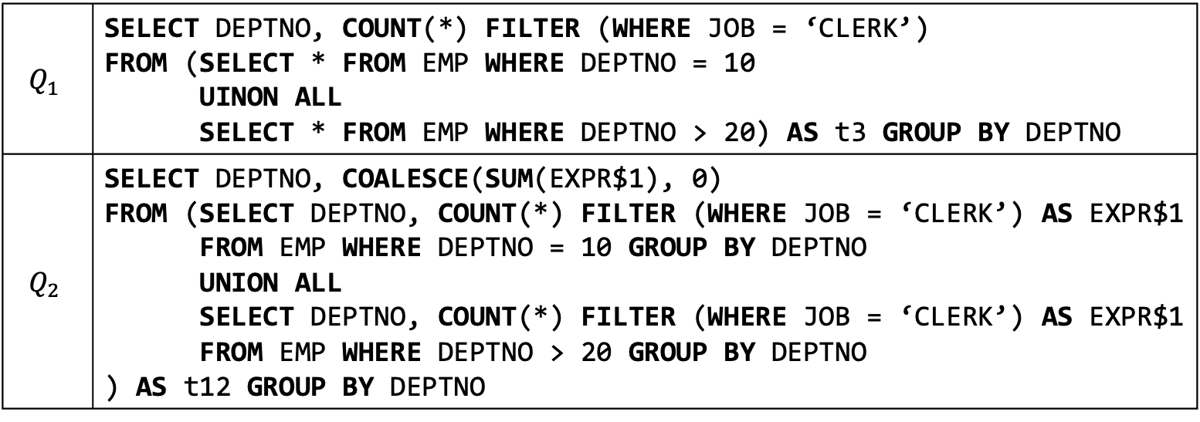

Demonstration of the VeriEQL Equivalence Checker for Complex SQL Queries
Pinhan Zhao¹*, Yang He²*, Xinyu Wang¹, Yuepeng Wang²
¹University of Michigan, USA ²Simon Fraser University, Canada
Motivation
Technique
Highlights
Why is equivalence checking of SQL queries important?
This task has a wide variety of application scenarios.
Key idea: VeriEQL reduces the equivalence checking problem into an SMT problem using symbolic reasoning and utilizes off-the-shelf constraint solvers to determine the satisfiability of SMT formulas.
Expressive query language. VeriEQL supports SPJ, GROUP BY, aggregate functions, three-valued semantics, set/bag operations, conditional statements, etc.
Genuine counterexample. VeriEQL refutes non-equivalent SQL queries with concrete database instances and SMT formulas.
Rewrite Validation
Auto-grading
Bug Detection
Equivalence Checking Problem
Dialects. VeriEQL supports different SQL dialects, i.e., MySQL, MariaDB, Oracle, and PostgreSQL.
Problem Statement
Good ﻿scalability. VeriEQL can check 70% of the 15,200 benchmarks with bound 5 in 5 minutes.
Bounded equivalence verification: Given two SQL queries under a database schema, VeriEQL aims to verify whether these two queries always produce identical results on all possible input databases up to a bounded size that conform to the schema.
SMT Problem
Symbolic Execution
SMT Solver
﻿Small-Scope Hypothesis. ﻿96% of non-equivalent benchmarks are refuted with less than 3 tuples.
System Overview
Input Analyzer
Check the syntax of SQL queries $Q_{1}$, $Q_{2}$ and schemas $𝒮$, $𝒞$
Check the consistency between SQL queries $Q_{1}$, $Q_{2}$ and schemas $𝒮$, $𝒞$
Semantics Encoder
Build symbolic database $Γ$ over bound $N$
Encode integrity constraints $𝒞$ into $Φ_{𝒞}$
Symbolically execute SQL queries $Q_{1}$, $Q_{2}$ into $R_{1}$, $R_{2}$
Equality Checker
Check the satisfiability of
$$Φ_{𝒞}∧Φ_{R_{1}}∧Φ_{R_{2}}∧(R_{1}≠R_{2})$$
using Z3
Counterexample Generator
Generate executable counterexample (i.e., SQL codes)
Compare symbolic results against execution results using DBMSs
Trigger alerts for manual inspection if potential DBMS bugs are found
Input Analyzer
Semantics Encoder
1
Schema
2
Equality Checker
Counterexample Generator
Schema
I.C.
$$E_{S}$$
$$Φ_{𝒞}$$
3
$$Φ_{𝒞}∧Φ_{R_{1}}∧Φ_{R_{2}}$$
4
$$𝒮$$
$$𝒞$$
$$∧(R_{1}≠R_{2})$$
Symbolic
results
Bound $N$
$$Γ$$
SAT
DBMS bug
Queries
$$Φ_{R_{1}},Φ_{R_{2}}$$
Counter-
example
Checker
$$Q_{1}$$
$$Q_{2}$$
$$E_{R}$$
Z3 Solver
Non-equivalent
S
SQL
$$R_{1},R_{2}$$
UNSAT
Equivalent
Backend DBMSs
Symbolic table $Γ$ ($N=2$):
$Φ_{R_{1}}$:
Schema $𝒮$:
$$\left(t_{1}.age>30→¬Del\left(t_{1}^{′}\right)∧t_{1}^{′}.id=t_{1}.id\right)∧\left(t_{1}.age≤30→Del\left(t_{1}^{′}\right)\right)$$
EMP: {id: int, age: int, …}
EMP
$$∧ \left(t_{2}.age>30→¬Del\left(t_{2}^{′}\right)∧t_{2}^{′}.id=t_{2}.id\right)∧\left(t_{2}.age≤30→Del\left(t_{2}^{′}\right)\right)$$
Integrity constraints $𝒞$:
$Φ_{R_{2}}$:
PK: EMP.id
$$t_{1}$$
id | age | …
$$t_{1}.id$$ | $$t_{1}.age$$ | …
$$t_{2}.id$$ | $$t_{2}.age$$ | …
$$\left(t_{1}.age≥30→¬Del\left(t_{3}^{′}\right)∧t_{3}^{′}.id=t_{1}.id\right)∧\left(t_{1}.age<30→Del\left(t_{3}^{′}\right)\right)$$
$$∧ \left(t_{2}.age≥30→¬Del\left(t_{4}^{′}\right)∧t_{4}^{′}.id=t_{2}.id\right)∧\left(t_{2}.age<30→Del\left(t_{4}^{′}\right)\right)$$
$$t_{2}$$
where $Del$ is an uninterpreted function.
SQL queries:
Constraint formula $Φ_{𝒞}$:
Symbolic results
$Q_{1}$: SELECT id FROM EMP
WHERE age > 30
$Q_{2}$: SELECT id FROM EMP
WHERE age >= 30
$$−2^{31}≤t_{1}.id≤2^{31}−1∧−2^{31}≤t_{1}.age≤2^{31}−1$$
$$R_{1}$$
$$R_{2}$$
$$∧−2^{31}≤t_{2}.id≤2^{31}−1∧−2^{31}≤t_{2}.age≤2^{31}−1$$
$$t_{1}^{′}$$
id
$$t_{1}^{′}.id$$
$$t_{2}^{′}.id$$
$$t_{3}^{′}$$
id
$$t_{3}^{′}.id$$
$$t_{4}^{′}.id$$
$$∧t_{1}.id≠t_{2}.id∧t_{1}.id≠Null∧t_{2}.id≠Null$$
$$t_{2}^{′}$$
$$t_{4}^{′}$$
Demonstration Scenarios
VeriEQL can validate optimized SQL queries.
VeriEQL can auto-grade queries from LeetCode.
VeriEQL can find bugs of DBSMs.
$$Q_{1}$$ | SELECT DEPTNO, COUNT(*) FILTER (WHERE JOB = ‘CLERK’) FROM (SELECT * FROM EMP WHERE DEPTNO = 10 UINON ALL SELECT * FROM EMP WHERE DEPTNO > 20) AS t3 GROUP BY DEPTNO
$$Q_{2}$$ | SELECT DEPTNO, COALESCE(SUM(EXPR$1), 0) FROM (SELECT DEPTNO, COUNT(*) FILTER (WHERE JOB = ‘CLERK’) AS EXPR$1 FROM EMP WHERE DEPTNO = 10 GROUP BY DEPTNO UNION ALL SELECT DEPTNO, COUNT(*) FILTER (WHERE JOB = ‘CLERK’) AS EXPR$1 FROM EMP WHERE DEPTNO > 20 GROUP BY DEPTNO ) AS t12 GROUP BY DEPTNO
$$Q_{1}$$ | WITH temp AS ( SELECT DISTINCT A.customer_id, B.customer_id, B.customer_name SUM(CASE WHEN A.product_name IN (‘A’, ‘B’) THEN 1 ELSE 0 END) AS AB, SUM(CASE WHEN A.product_name = ‘C’ THEN 1 ELSE 0 END) AS C, FROM orders A JOIN customers B ON A.customer_id = B.customer_id GROUP BY A.customer_id ) SELECT customer_id, customer_name FROM temp WHERE AB >= 2 AND C = 0
$$Q_{2}$$ | SELECT customer_id, customer_name FROM customers WHERE customer_id IN ( SELECT DISTINCT customer_id FROM orders WHERE product_name = ‘A’ ) AND customer_id IN ( SELECT DISTINCT customer_id FROM orders WHERE product_name = ‘B’ ) AND customer_id NOT IN ( SELECT DISTINCT customer_id FROM orders WHERE product_name = ‘C’ ) ORDER BY customer_id
$$Q_{1}$$ | SELECT DISTINCT page_id AS recommended_page FROM (SELECT CASE WHEN user1_id = 1 THEN user2_id WHEN user2_id = 1 THEN user1_id ELSE NULL END AS user_id FROM friendship) AS tb1 JOIN likes AS tb2 ON tb1.user_id = tb2.user_id WHERE page_id NOT IN (SELECT page_id FROM likes WHERE user_id = 1)
$$Q_{2}$$ | SELECT DISTINCT page_id AS recommended_page FROM (SELECT b.user_if, b.page_id FROM friendship a LEFT JOIN likes b ON (a.user2_id = b.user_id OR a.user1_id = b.user_id) AND (a.user1_id = 1 OR a.user2_id = 1) WHERE b.page_id NOT IN ( SELECT DISTINCT page_id FROM likes WHERE user_id = 1)) T
$Q_{1}$: the optimized query, $Q_{2}$: the original query
$Q_{1}$: a user-provided answer, $Q_{2}$: the ground-truth
﻿The testPushCountFilterThroughUnion test case of Apache Calcite.
$Q_{1}$: a user-provided answer, $Q_{2}$: the ground-truth
Question sourced from
https://leetcode.com/problems/page-recommendations/
Question sourced from https://leetcode.com/problems/customers-who-bought-products-a-and-b-but-not-c/
friendship
page_id
NULL
﻿Time to check query equivalence on different input sizes for validating query optimizations.
orders
user1_id | user2_id
0 | 1
$Q_{2}$’s expected output
order_id | customer_id | product_name
0 | 0 | B
1 | 0 | B
customer_id | customer_name
0 | Alice
likes
page_id
Size | 1 | 2 | 3 | 4 | 5 | 6 | 7 | 8 | 9
Time (s) | 0.2 | 0.4 | 0.6 | 1.0 | 2.4 | 6.6 | 19.7 | 98.5 | 118.2
user_id | page_id
-1 | 0
$Q_{1}$’s output
page_id
customers
$Q_{1}$’s output
$Q_{2}$’s real output
Good scalability
customer_id | product_name
0 | Alice
1 | Bob
customer_id | customer_name
An implementation bug in MySQL v8.0.32.
https://bugs.mysql.com/bug.php?id=110244
$Q_{2}$’s output
https://github.com/whatsmyname/VeriEQL-demo

