Slide 1

Synthesizing Document Database Queries using Collection Abstractions
Qikang Liu, Yang He, Yanwen Cai, Byeongguk Kwak, Yuepeng Wang
Simon Fraser University
Notes:
Today I am presenting the paper Synthesizing Document Database Queries using Collection Abstractions.
I am Qikang Liu from Simon Fraser University, this is a joint work with Yang He, Yanwen Cai, Byeongguk Kwak, Yuepeng Wang

Slide 2
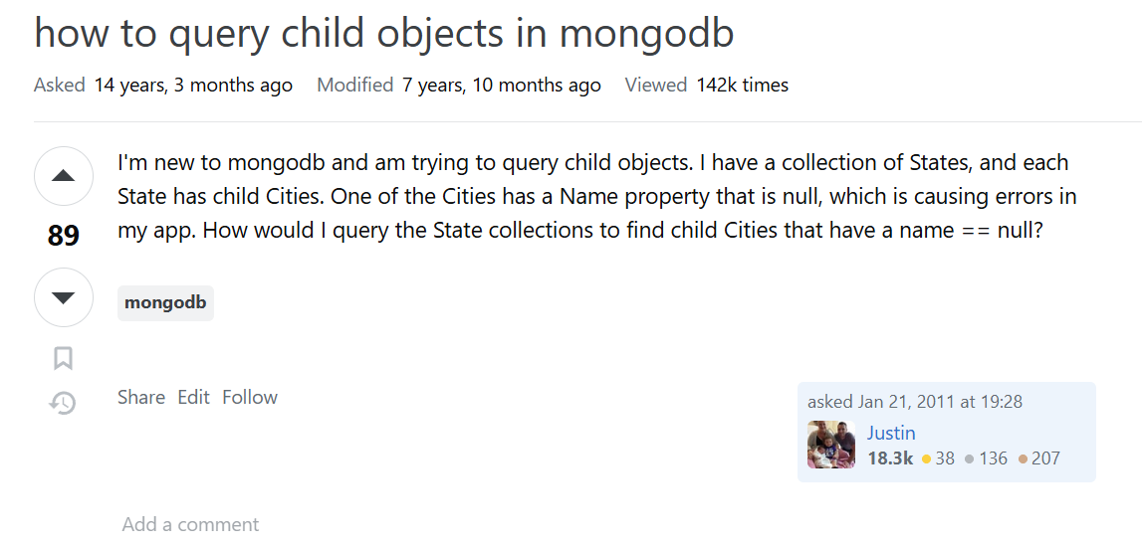
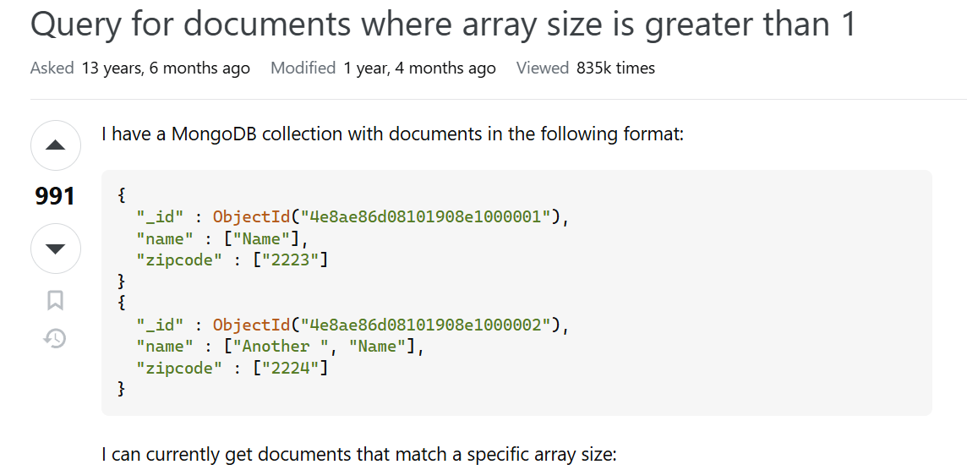
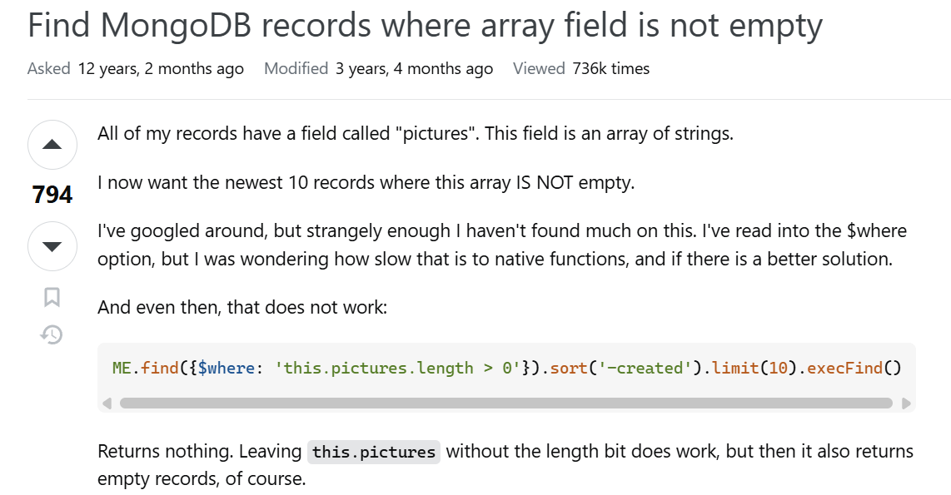


Motivation
Document databases are popular
Challenging to write queries
Notes:
[click]
Document databases such as MongoDB are increasingly popular in social media and online shopping platforms.
[click]
However, it's challenging to write queries due to the complex data model and query language.
[click]
From stackoverflow we can find many users asking about how to write a mongodb query.
[click] * 2
The high number of views and votes reflects users' need for assisting with writing queries.

Slide 3
Document database
Document as a data record
List of documents as a collection
{"student":
[
{
"info": {"name": "Alice"},
"score": [50, 90]
},
{
"info": {"name": "Bob"},
"score": [70, 80]
}
]
}
document
database
collection
Notes:
Document database uses document as a data record. Collection is a list of documents.
[click]
Here is an example,
[click]
This json-like structure is called a document.
[click]
The document list is called a collection
[click]
The entire structure is a document database, which maps collection name to collection. Here the collection name is student.

Slide 4
Motivating Example
Find scores higher than 50, then output score and info
db.student.aggregate([
{$unwind: "$score"},
{$match: {score: {$gt: 50}}}
])
Challenging to write due to unwind
{"student": [
{"info": {"name": "Alice"},
"score": [50, 90]},
{"info": {"name": "Bob"},
"score": [70, 80]}
]}
[{"info": {"name": "Alice"},
"score": 90},
{"info": {"name": "Bob"},
"score": 70},
{"info": {"name": "Bob"},
"score": 80}]
Notes:
Here is a motivating example of the query.
[click]
With the previous database, we want to find scores that is higher than 50, then output the score and the info attribute.
[click]
We can write the following query.
[click]
Running this query on the database, we can get this document list as output.
[click]
However, it can be challenging for a new user to write as unwind operator can be difficult to understand.
How can we help users to write queries?

Slide 5



Program Synthesis by Examples
Given IO examples, automatically generate query
Satisfy examples
Synthesizer
IO Examples
MongoDB query
Notes:
Here comes to the program synthesis technique.
Given input-output examples, the synthesizer can automatically generate a MongoDB query that satisfies all the examples.
[click]
Here, satisfying examples means that, running the querying on input example will produce the output example

Slide 6
Challenges
Complex data model and query semantics
Document and array attributes create a deeply nested structure
Specialized query operators for the nested structure have complicated semantics
Large search space
Many different query operators
Numerous argument choices for each operator
Huge number of combinations
{"a":
{"b":
{"c":
[{"d": 10}]}}}
db.student.aggregate([
{$unwind: ?},
{$match: ?},
{$project: ?}])
Notes:
But there exists some challenges to synthesize these queries.
[click]
First, the data model and query semantics in document database are complex.
[click]
Specifically, document and array attribute, can create a deeply nested structure.
[click]
For example, this document is deeply nested with an array. Data like this can be over complex.
[click]
In addition, specialized query operators for the nested structure, such as unwind, have complicated semantics
[click]
Second, the search space of the candidate queries is large.
[click]
There are many different query operators.
[click]
For each operator, there are numerous argument choices.
[click]
In this example query, the argument of the unwind operator can be any array attributes. match and project operator have more possibilities.
[click]
What's more, there exists many different operator combinations, thus creating a huge search space.

Slide 7
Pruning Infeasible Sketches using Abstractions
A sketch is a partial query with unknown arguments that can represent many concrete queries
Prune many queries in one step by pruning an infeasible sketch
An infeasible sketch represents queries that are never correct no matter what arguments are
Over-approximate the complex data using an abstraction based on document type and collection size
Determine the feasibility of the sketch based on the abstraction
db.student.aggregate([{$unwind: ?}])
Notes:
How can we make the synthesis more efficient? Our key idea is pruning infeasible sketches using abstractions
[click]
A sketch is a partial query with unknown arguments that can represent many concrete queries. For example, this sketch represents many concrete queries as there exists many different argument choices for unwind operator.
[click]
To speed up the synthesis, we prune many queries in one step by pruning an infeasible sketch.
[click]
This is because an infeasible sketch represents queries that are never correct no matter what arguments are.
So, how to prune a sketch?
[click]
We use abstraction, which contains the document type and collection size, to over-approximate the complex data.
Here, collection size refers to the number of documents. We will give more details about the abstraction later.
[click]
Now, we can determine the feasibility of the sketch based on the abstraction.

Slide 8
Workflow
IO Examples
Add one more query operator
Sketch Generation
Sketch
Deduction
Fail
Fail
Sketch Completion
Feasible sketch
db.student.aggregate([
{$unwind: "$score"},
{$match: {score: {$gt: 50}}}])
Synthesized Query
Notes:
Here is our workflow based on the key idea.
[click]
Given IO examples.
[click]
The sketch generation will first generate a sketch, this can be done by adding one more query operator to the initial or previous sketch.
[click]
Then, we send to the sketch to the deduction engine to check its feasibility.
[click]
If it is not feasible, we generate the next sketch, and we repeat the process.
[click]
If it is feasible, we will try to fill all the unknown arguments through sketch completion. This will produce many concrete queries.
[click]
If we can find a concrete query that satisfies all examples, we return it, and the synthesis ends.
[click]
Otherwise, we generate the next sketch again and repeat the process
[click]
As the deduction is the most important component, next we will focus on it.

Slide 9
Computing Abstraction
Abstract collection – document type and collection size
Abstract database – maps collection name to abstract collection
document type
{"student":[
{
"info": {"name": "Alice"},
"score": [50, 90]
},
{
"info": {"name": "Bob"},
"score": [70, 80]
}
]}
{"student":
}
{
"info": {"name": String},
"score": Arr<Num>
}
size = 2
collection size
Notes:
We use abstraction for deduction.
[click]
An abstract collection contains document type and collection size.
[click]
Given this document database
[click]
We first compute the type. Here, the info attribute is a nested type. It has a name attribute with string type. The score attribute is an array of number type.
[click]
Then, we compute the size, which is 2 here.
We call this structure, that combines type and size, an abstract collection.
[click]
An abstract database simply maps collection name to abstract collection

Slide 10


Pruning Infeasible Sketches
Evaluate the sketch on abstract input using abstract semantics
If the abstract output does not over-approximate output example, the sketch is infeasible
Abstract input
Sketch
$$⊆$$
Output example
Abstract output
Notes:
How can we prune infeasible sketches use the abstraction?
[click]
Given a sketch and an abstract input example, we evaluate the sketch based on abstract semantics. The output will be an abstract collection.
[click]
Then, if the abstract output does not over-approximate the output example, we can determine that the sketch is infeasible and can be pruned.

Slide 11
Evaluating Sketch by Abstract Semantics
{"student":
}
Evaluate collection name then operators in order
{
"info": {"name": String},
"score": Arr<Num>
}
db.student.aggregate([
{$match: ?}
])
size = 2
Abstract output
student
{
"info": {"name": String},
"score": Arr<Num>
}
{
"info": {"name": String},
"score": Arr<Num>
}
match
size = 2
size <= 2
Notes:
How to evaluate a sketch?
[click]
Given the abstract input on the left and the sketch on the right.
[click]
The evaluation starts from the collection name, then query operators in order.
[click]
We first evaluate student.
[click]
The result will be the corresponding abstract collection.
[click]
Next, we evaluate the match operator.
[click]
The result will be this. Match does not change the type, so it keeps the same. However, it filters documents, so the size becomes smaller. Now it is less than 2.
There are no more operators, so the evaluation ends here. This abstract collection is our abstract output.

Slide 12


Checking Over-approximation
Check whether output example matches document type and collection size of the abstract output
[{"info": {"name": "Alice"},"score": 90},
{"info": {"name": "Bob"},"score": 70},
{"info": {"name": "Bob"},"score": 80}]
db.student.aggregate([
{$match: ?}
])
db.student.aggregate([
{$unwind: ?},
{$match: ?}])
{
"info": {"name": String},
"score": Arr<Num>
}
{
"info": {"name": String},
"score": Num
}
size <= 2
size = ?
Notes:
Now, with the abstract output, we check the feasibility by checking over-approximation.
More specifically, it is checking whether the output example matches the document type and collection size of the abstract output.
[click]
Given this output example,
[click]
The previous sketch and its abstract output.
[click]
Compare the abstract output with the output example, we can find the type of score does not match. One is number but another is array.
[click]
Therefore, this sketch is infeasible and can be pruned.
[click]
Look at another sketch and its abstract output.
We can find the type matches. The size also matches as it is unbounded.
[click]
So, this one is feasible. Then we try to complete it and get the correct query.

Slide 13


Evaluation
We implemented a tool called Nosdaq
We evaluated it on 110 benchmarks within a 5-minute time limit
Nosdaq can solve 108 benchmarks in an average of 14s
Notes:
Next part is the evaluation of our technique.
[click]
We implemented a synthesizer called nosdaq.
[click]
We evaluated it on 110 benchmarks within a 5-minute time limit
[click]
Benchmarks are from stackoverflow, mongodb official document, twitter api document, and Kaggle competition.
[click]
As a result, nosdaq can solve 108 benchmarks in an average time of 14 seconds. This demonstrates the effectiveness and efficiency of out technique.

Slide 14
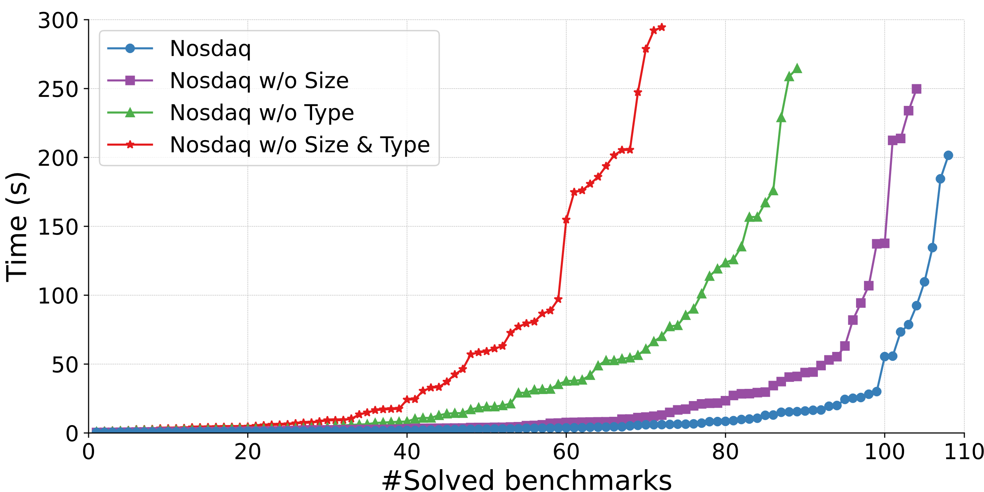
Ablation Study
Document type and collection size are important
Notes:
To learn the effectiveness of our abstraction, we did an ablation study.
In this figure, X-axis is the number of solved benchmarks. Y-axis is the solving time. Thus, lower line performs better.
The blue line is the original synthesizer. The other three lines are removing the size, type and both.
[click]
From this figure, we can conclude that both type and size are effective in pruning the search space.
//if really cannot finish remove this. < 11min

Slide 15
Comparison with Baselines
Nosdaq is more effective than other two baselines
Notes:
We also compared with two baselines.
One is EUSolver, a state of art synthesizer using enumerative search. It solved 25 benchmarks.
Another one is the LLM based approach. We chose ChatGPT-4o and provided it with the same input-output examples. As a result, it solved 77 benchmarks.
[click]
By the comparison, we can conclude that nosdaq is more effective than other two baselines.

Slide 16


Conclusion
Nosdaq uses a novel collection abstraction to synthesize document database queries over complex data model and query language
Nosdaq
IO Examples
MongoDB query
qla116@sfu.ca
https://github.com/simpl-group/nosdaq
Notes:
[click]
In summary, we propose a novel collection abstraction to synthesize document database queries over complex data model and query language.
Thanks for your listening.

