Slide 1


Graphiti: Bridging Graph and Relational Database Queries
Yang He†, Ruijie Fang‡, Isil Dillig‡, Yuepeng Wang†
†Simon Fraser University, Canada
‡University of Texas at Austin, USA
†
‡
Notes:
Hi everyone! My name is Yang He from SFU. I am going to present our paper: [title]. It is a joint work with RF and ID from UT, and YW from SFU as well.

Slide 2
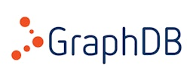



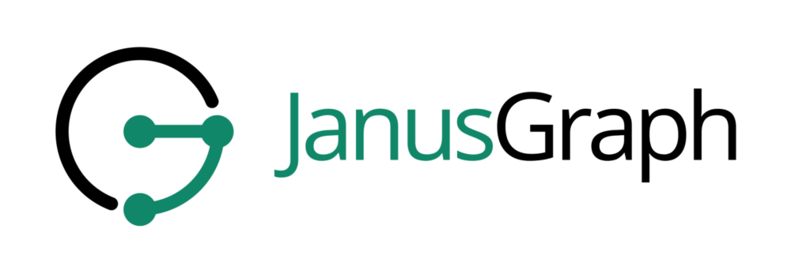


Motivation
Graph database is popular due to the flexible data models.
Azure Cosmos DB
Many developers migrate relational database applications to graph databases.
Notes:
Over the past decades, GDBs have become increasingly popular in both industry and academia due to the flexible data models.
👆Nowadays, we have many GDBMSs such as Neo4j and cosmos DB, designed for graph-centric Apps like social networks and recommendation systems. Therefore, [XX].

Slide 3
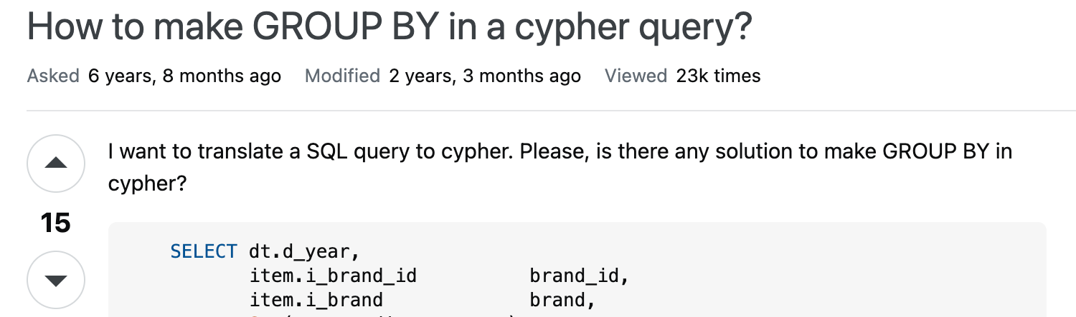
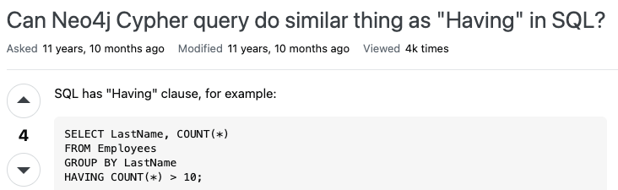
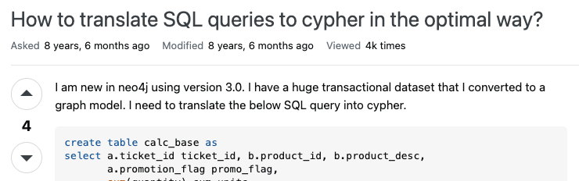
Motivation
Writing graph queries equivalent to original SQL queries is error-prone.
Lack of methods to check the correctness of migration
Notes:
However, transition between G and R DBs often requires rich expertise, and writing G queries that are equivalent to the original SQL queries is error-prone.
👆For instance, many stackoverflow posts reveal that translation between R and G queries can be quite challenging due to misunderstandings of agg semantics, JOINs vs relationships and other complexities.
👆However, to our best knowledge, there is no prior method to check the correctness of migration, resulting in subtle bugs hidden in these posts and even the official tutorials.

Slide 4

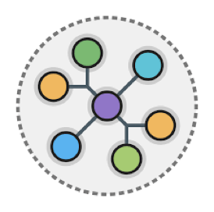


Goal
Check equivalence between graph and relational database queries
?
$$≡$$
Cypher
SQL
Graph queries
Relational queries
Notes:
To fill in this gap, we propose a method to [check XX].
Specifically, in a migration setting where developers have refactored R tables into a G structure and rewritten SQL queries in the Cypher language, our goal is to ensure these two queries consistently produce the same results.

Slide 5

Equivalence between graph and relational queries
?
What is the equivalence definition?
Problem: Equivalence is ill-defined if the relationship between data stored in graph and relational databases is unknown.
!
Solution: Use a user-provided transformer to specify data equivalence between graph and relational databases and to define query equivalence.
Notes:
However, this problem is non-trivial and presents a natural question: what does it mean for two queries to be equivalent?
👆If we do not know the relationship between data stored in graph and relational databases, then equivalence would be ill-defined.
👆This requires us to find a mechanism to align graph and relational DBs. The solution is to introduce the concept of a user-provided transformer which is inspired by schema mapping from the DB community. It specifies data equivalence between G and R DBS and thereby enables us to define query equivalence.

Slide 6
Specifying user-provided transformers
?
How to specify user-provided transformers?
Insight: Specify transformers via Datalog rules.
Even though graph databases do not have explicit relations, we can think of each node and edge type as a relation.
Notes:
Using user-provided transformers as specifications sounds good. But how do we specify these transformers.
👆The insight is that we can naturally [specify XX].
👆[Even XX]

Slide 7
User-provided transformer
Graph database
Relational database
DEPT
Emps
Depts
EMP
WORK
id
name
did
id
name
Alice
IT
1
Alice
10
10
IT
2
Bob
10
11
MRK
Bob
MRK
For each path from EMP to DPET through a WORK edge, there is a row in Emps.
Database transformer:
EMP(eid, _), WORK(_, eid, did), DEPT(did, _) -> Emps(eid, _, did)
Notes:
To make this concept more concrete, let's consider a UpT example in practice. 👆Here, we have a GDB where EMP and DEPT nodes are connected via a WORK edge. Specifically, it indicates that both Alice and Bob work in the IT dept. 👆In contrast, the RDB only has two tables: Emps and Depts, with a FK DID to maintain relationships. And this foreign key also indicates Alice and Bob work in the IT dept. To ensure those two DBs maintain the same data, we use a DT to align their structures and semantics. 👆Take the WORK edge for example. This rule specifies that [for eachXXX]. This is one of the rules in the transformer and we have other rules to align nodes and tables.

Slide 8

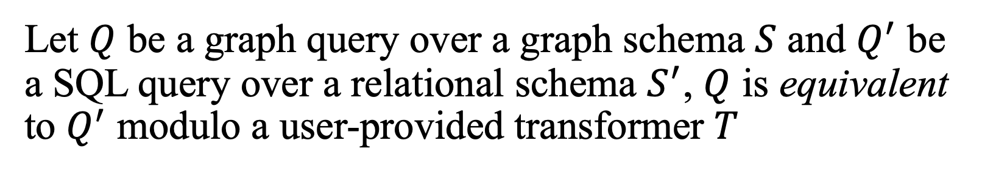
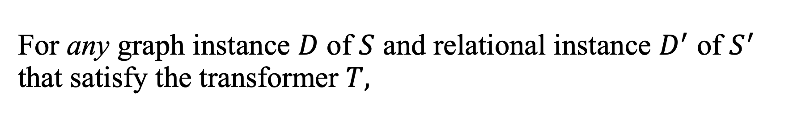
Formal definition of query equivalence
Let $Q$ be a graph query over a graph schema $S$ and $Q^{′}$ be a SQL query over a relational schema $S^{′}$, $Q$ is equivalent to $Q^{′}$ modulo a user-provided transformer $T$
iff
For any graph instance $D$ of $S$ and relational instance $D^{′}$ of $S^{′}$ that satisfy the transformer $T,$
executing $Q$ on $D$ yields the same result as executing $Q^{′}$ on $D^{′}$.
Notes:
Now that we have a way of specifying data correspondence, we can define equivalence as follows:

Slide 9


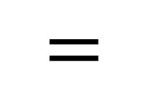
Equivalence between graph and relational queries
Graph DB
Graph query
Result
Cypher
$$≡$$
$$=$$
User-provided transformer
SQL
Relational DB
Relational query
Result
Notes:
Since The formal definition is a bit abstract to understand. Next, let me explain it in more detail.
👆Suppose we have an arbitrary GDB and a RDB that satisfy the UpT.
👆 A G query produces a tabular result when operate on the GDB ; meanwhile, a R query returns another table when run on the RDB.
👆 If the resulting tables from both queries are identical,
👆 then the queries are considered equivalent.

Slide 10


Verification methodology
Strawman idea: Symbolically encode query semantics in SMT and directly check the definition.
Problem: Need an SMT encoding that can simultaneously describe graph and tabular data.
!
It does not work well.
Notes:
Now, we have an equivalence definition between G/R queries, but how do we check it?
👆A strawman idea is to [symbolically XX].
👆However, checking equivalence in this way presents a problem. We [need XX].
👆Unfortunately, from our preliminary experience, such an SMT encoding does not work well in this verification task.

Slide 11

Verification methodology
Solution: Reduce the original problem to ﻿SQL equivalence checking using a correct-by-construction transpilation technique.
Transpilation
Equivalence between graph/relational queries
Equivalence over relational queries
Notes:
To solve this issue, we [reduce XXX].
👆Concretely, we first translate the G query into a R query using transpilation, and then leverage existing methods to verify = over two R queries.

Slide 12
Why need verification?
!
If we can do transpilation, why do we need verification?
A graph schema only can be transpiled to some relational schema but it may differ from the target relational schema.
Graph schema
Relational schema
Transpilation
Emps
Depts
WORK
EMP
DEPT
id
name
did
id
name
Notes:
If we can automatically transpile graph queries into relational queries, why do need to verify equivalence between the two relational queries?
👆The reason is that: [A graph schema XXX]
👆More specifically, let‘s consider this example.
Given these two schemas, it’s difficult to transpile a G query over this G schema to a R query over this target R schema; instead generating a R query over another R schema that has 3 tables corresponding to this G schema is more straightforward.

Slide 13
Insights about transpilation
Insight 1: Transpilation to certain shape is easy.
✓
Use a standard transformer to capture the shape, which directly maps nodes and edges to relational tables with the same attributes.
Insight 2: Reduced to an easier SQL equivalence checking problem over different schemas.
✓
Lots of prior work can be used to check SQL query equivalence.
Notes:
👆Therefore, the 1st insight is that transpiling a G database into a R one of certain shape is easy.
👆We capture this shape using the notion of a ST, which directly maps nodes and edges to relational tables with the same attributes. Additionally, G queries can be translated into R queries over these new tables.
👆The 2nd insight is that transpilation reduces the original problem to an easier SQL equivalence checking problem over different schemas.
👆This area has been well studied, and we have many existing tools to check SQL equivalence by verification or falsification.

Slide 14


Reduction to SQL equivalence checking
User-provided transformer
Standard
transformer
Residual
transformer
Graph DB
Induced relational DB
Relational DB
Transpilation
?
?
Cypher
$$≡$$
$$≡$$
Cypher
Cypher
Graph query
Transpiled relational query
Relational query
Notes:
More concretely, here is how our verification method works.
The original verification task aims to check = between G and R queries modulo a UpT. Since this direct verification problem is challenging, we reduce it to a well-studied problem: SQL = checking.
👆Our method first derives a so-called ST to convert the original GDB to an induced RDB. 👆It then applies a correct-by-construction transpilation technique to generate a transpiled R query that is provably equivalent to the G query modulo this ST. 👆Based on those two transformers, we construct a RT to ensure data = between the two RDBs and serves as a spec for the subsequent verification process. 👆Finally, an off-the-shelf SQL = checker is used to check = for these two R queries.

Slide 15


Verification methodology through example
Graph schema
Relational schema
Emps
Depts
WORK
EMP
DEPT
id
name
did
id
name
?
MATCH (e:EMP)-[:WORK]->(d:DEPT)
WHERE d.name = “IT”
RETURN COUNT(e.id)
$$≡$$
SELECT COUNT(Emps.id) FROM Emps JOIN Depts ON Emps.did = Depts.id
WHERE Depts.name = “IT”
User-provided transformer
EMP(id, name) -> EMP(id, name, _)
DEPT(id, name) -> DEPT’(id, name)
EMP(eid, _), WORK(_, eid, did), DEPT(did, _) -> Emps(eid, _, did)
Notes:
Now, let’s walk through an example to better understand how our method works.
Suppose we have a graph query over this graph schema, a relational query over a R schema, and a user-provided transformer to align the schemas.
👆Are these two queries equivalent modulo this transformer? 👆The answer is YES, and I will show you how our methodology proves this.

Slide 16
Reduction to SQL equivalence checking
User-provided transformer
Standard
transformer
Graph DB
Induced relational DB
Relational DB
Cypher
Cypher
Graph query
Relational query
Notes:
Our method first automatically derives a ST. It is basically a set of rules that convert nodes and edges into R tables where attributes become columns.

Slide 17
Standard transformer
EMP(id, name) -> EMP’(id, name)
DEPT(id, name) -> DEPT’(id, name)
WORK(wid, src, tgt) -> WORK’(wid, src, tgt)
Graph database
Induced relational database
EMP
DEPT
EMP’
WORK’
DEPT’
WORK
Alice
IT
id
name
wid
src
tgt
id
name
1
Alice
…
1
10
10
IT
Bob
MRK
2
Bob
…
2
10
11
MRK
Standard transformer converts any graph database into a relational one.
Notes:
Consider a ST.
👆By applying these rules to the previous GDB, we can construct three induced tables correponding to the nodes and edges in the G.
👆 In general, a ST can convert any GDB into a R one, which means our method can check = for queries that conforms to arbitrary schemas.

Slide 18
Reduction to SQL equivalence checking
User-provided transformer
Standard
transformer
Graph DB
Induced relational DB
Relational DB
Transpilation
Cypher
Cypher
Cypher
Graph query
Transpiled relational query
Relational query
Notes:
Next, we transpile the G query into an equivalent R query using a correct-by-construction transpilation technique.

Slide 19
Transpiling graph queries to SQL queries
Based on standard transformers, we define correct-by-construction translation rules and prove them correct in our paper.
Graph query
Transpiled relational query
SELECT COUNT(e.id)
FROM EMP’ AS e JOIN WORK’ JOIN DEPT’ AS d ON ...
WHERE d.name = “IT”
MATCH (e:EMP)-[:WORK]->(d:DEPT)
WHERE d.name = “IT”
RETURN COUNT(e.id)
Notes:
[Based on XXX]
I won't explain how the translation works; plz refer to our paper for details.
👆For this example, transpilation produces a transpiled R query that is provably equivalent to the original G query modulo the ST.

Slide 20
Reduction to SQL equivalence checking
User-provided transformer
Standard
transformer
Residual
transformer
Graph DB
Induced relational DB
Relational DB
Transpilation
Cypher
Cypher
Cypher
Graph query
Transpiled relational query
Relational query
Notes:
Before checking SQL =, we must construct a RT to align the induced and target RDBs.

Slide 21

Residual transformer
Residual transformer describes data equivalence between two relational databases and serves as the specification for SQL equivalence checking.
We can automatically infer a residual transformer from a user-provided transformer and a standard transformer.
Notes:
Recall that [RT XX].
👆And [our method XX].

Slide 22
Residual transformer
User-provided transformer:
EMP(eid, _), WORK(_, eid, did), DEPT(did, _) -> Emps(eid, _, did)
Standard transformer:
WORK(wid, src, tgt) -> WORK’(wid, src, tgt)
Residual transformer:
EMP’(eid, _), WORK’(_, eid, did), DEPT’(did, _) -> Emps(eid, _, did)
EMP’(id, name) -> Emps(id, name, _)
DEPT’(id, name) -> Dept(id, name)
Notes:
For instance, the rule from the UpT preserves the same relationship between the WORK edge and the Emps table, and the rule from the ST ensures data = between the WORK edge and the WORK' table.
👆then we can infer a residual rule that maintains a consistent relationship between the WORK' and Emps tables.
👆Similarly, we can infer other rules for the remaining tables in the induced RDB, namely EMP' and DEPT’.
Conceptually, the residual transformer tells SQL = checkers how to align the induced and the target RDBs over diff schemas.

Slide 23
Reduction to SQL equivalence checking
User-provided transformer
Standard
transformer
Residual
transformer
Graph DB
Induced relational DB
Relational DB
Transpilation
?
Cypher
Cypher
$$≡$$
Cypher
Graph query
Transpiled relational query
Relational query
Notes:
With all those components in place, we finally can check = for those two R queries.

Slide 24


SQL equivalence modulo residual transformer
Transpiled relational query
Relational query
Residual
transformer
SELECT COUNT(e.id)
FROM EMP’ AS e JOIN WORK’ JOIN DEPT AS d ON ...
WHERE d.name = “IT”
SELECT COUNT(e.id)
FROM Emps AS e JOIN Depts AS d ON e.did = d.id
WHERE d.name = “IT”
$$≡$$
Graph query
Relational query
MATCH (e:EMP)-[:WORK]->(d:DEPT)
WHERE d.name = “IT”
RETURN COUNT(e.id)
User-provided transformer
SELECT COUNT(e.id)
FROM Emps AS e JOIN Depts AS d ON e.did = d.id
WHERE d.name = “IT”
$$≡$$
The original graph-relational query pair is equivalent.
Notes:
Using an existing SQL = checker, we can prove the transpiled query is equivalent to the target R query modulo the RT.
👆That's to say, [XX] modulo the UpT.
This is the whole verification process about this work.
Next, lets move to the evaluation part.

Slide 25
Implementation
Implemented a tool called Graphiti and instantiated it with two existing SQL checkers:
Bounded model checker: VeriEQL [OOPSLA'24]
No false positives
Deductive verifier: Mediator [POPL'18]
No false negatives
Notes:
We [implemented XX].
The 1st one is a bounded model checker called VeriEQL proposed in OOPSLA24. It disproves equivalence by generating counterexamples and produces no false positives . The 2nd checker is a deductive verifier named Mediator proposed in POPL18. It proves equivalence for SQL Apps and produces no false negatives.

Slide 26
Evaluation
?
Can these instantiations of Graphiti find bugs / verify equivalence?
Evaluated on 410 equivalence verification tasks between Cypher and SQL queries.
Tasks are sourced from Stack Overflow posts, online tutorials, prior literature, and GPT-4o translations.
Notes:
In thit work, we explored two RQs: [Can XX]
👆and [evaluated XXX]
👆[Those tasks XXX]

Slide 27
Evaluation – bounded model checker backend
Dataset | # | # Checked | Avg Checked Bound | # Non- Equivalent | Avg Refutation Time (s)
Total | 410 | 376 | 19.6 | 34 | 23.4
376
19.6
34
23.4
Takeaway: Using a bounded model checking backend, Graphiti can identify 34 bugs.
Notes:
When using VeriEQL as the backend, we can check = for all benchmarks.
👆Among them, 376 pairs are proved equivalent with an avg bound of ~20.
👆And only 34 benchmarks are refuted with counterexamples in an avg refutation time of 23.4s. We manually inspected all counterexamples by executing them on MySQL and Neo4j DBs, and confirmed that they are all valid and can produce different results. This demonstrates that Graphiti can identify subtle bugs in a short time.
👆The main takeaway is that when [using XX].

Slide 28
Evaluation – deductive verifier backend
Dataset | # | # Supported | # Equivalent | # Unknown | Avg Running Time (s)
Total | 410 | 196 | 152 | 44 | 16.8
196
152
44
16.8
Takeaway: Using a deductive verifier, Graphiti can prove equivalence between ~80% of supported bechmarks.
Notes:
When using Mediator as the backend, we only supports
👆less than half of the benchmarks because Mediator only supports a limited subset of SQL. Among those supported pairs, we can prove that
👆152 of them are equivalent which are also confirmed by BMC. And the Mediator returns unknown for
👆the remaining benchmarks because it needs to find complex invariants for long JOIN chains which leads to expensive SMT queries and thereby triggers timeouts. The average running time of this verification task is
👆~17s.
👆The takeaway from this experiment is that [using XX].

Slide 29
Summary
We propose Graphiti, the first technique for reasoning about equivalence between graph and relational queries modulo user-provided transformers.
Yang He, yha244@sfu.ca
Notes:
Overall, in this work, [XX].

Slide 30
Statistics of benchmarks
Dataset | # | Avg SQL size | Avg Cypher size | Avg Transformer size
Total | 410 | 28.2 | 45.7 | 5.9

Slide 31
Contributions
The first work to check equivalence for graph and relational queries.
Formally define equivalence between graph and relational queries
We propose a correct-by-construction transpilation technique with soundness and completeness guarantees.
The experimental results on real-world benchmark reveals our method is effective in verification and falsification.
Notes:
Q1: main contributions: 1st work, definition, transpilation, effective
Q2: why transpilation? Encoding for direct verificatoin is hard. Therefore, we reduce it into a well-studied problem: SQL equivalence checking and leverage existing SQL checkers to solver it.
Q3: Diff between SM and DT? They are very similar. Schema mapping is typically used for R-Doc schema, we adapted it to describes the correspondence between G/R.
Q4: Expressive about SQL and Cypher? while some Cypher and SQL queries do indeed fall outside our fragment, our evaluation on a diverse set of benchmarks, including real-world queries, demonstrates that our subset is expressive enough for practical use.
Q5: SQL: recursion, Cypher: variable-length pattern matching
Q6: Why Cypher queires return tabular results? Under a migration setting, Verify between Graph and relational queries.
Q7: Why GPT translations? LLMs are increasingly used by people for coding and transpilation tasks; hence, we included GPT translations to test Graphiti’s ability to detect errors in automated translations. Our experiments show that GPT often introduces subtle semantic bugs during translation, and Graphiti effectively identifies these issues. demonstrates Graphiti’s practical value for users relying on LLM-generated queries.
Q8: Any other transpilation tech? We compared a transpilation tool called OpenCypherTranspiler. And found that it may generate incorrect SQL queries sometimes. We believe it’s a "best-effort" tool without any soundness guarantees about the result of transpilation.
Q9: whats CbyC: correct means equivalent. they are basically a set of syntax-directed rules that translate the cypher query or stmts into = sql counterparts.

Slide 32
Execute graph query
MATCH (e:EMP)-[:WORK]->(d:DEPT)
WHERE d.name = “IT”
EMP
DEPT
Graph database
WORK
Alice
IT
EMP
DEPT
WORK
Bob
IT
Alice
IT
Bob
MRK
RETURN COUNT(e.id)
COUNT(e.id)
2

