Slide 1
User-Oriented FEC Decoding Scheme for Wireless Sensor Networks with Star Topologies

Slide 2
Abstract
In recent years, wireless sensor networks (WSNs) have attracted a great deal of research attention from both academia and industry. In most cases, WSNs employ the adaptive forward error correction (FEC) coding schemes dynamically adapting to the channel, while paying less attention to user’s requirements.
Sometimes, the decoding delay and the decoding performance of WSNs are more crucial than the power consumption for users. We propose an FEC decoder for the trade-off among decoding delay, complexity, and performance according to user’s needs.

Slide 3
Abstract
The proposed decoder designed for short packet transmission is a two-stage hybrid decoder (TSHD) including a serial min-sum decoder and an adaptive list decoder. For hard decision decoding, our simulation results show that the proposed TSHD scheme outperforms the existing schemes with less average complexity.

Slide 4
EXISTING SYSTEM:
Wireless sensor networks (WSNs) are widely used in industry, medical assistance, video surveillance, etc. In WSNs, a large number of small sensor nodes are deployed surround the sensed object to collect data for users. The most important challenge is to design sensors efficiently to minimize the wireless sensor resource. In order to lower the decoding latency and reduce the transmitting power, WSNs tend to include an forward error correction (FEC) coding to avoid retransmissions.

Slide 5
EXISTING SYSTEM
Traditionally, LDPC decoders and trellis decoders are performed separately based on their own code structures, since convolutional codes decoded by BP algorithms directly always results in poor performance, this is mainly due to a large number of short cycles (especially 4-cycles) in its parity check matrix.

Slide 6
PROPOSED SYSTEM:
In our proposed scheme, the SFCC-N4 code is used as the encoder and its associated decoder is a two-stage hybrid decoder (TSHD) with a modified serial min-sum decoder and an adaptive list decoder.
The TSHD has several merits such as adaptive optimization, low average computation without performance loss, suitable for short packet transmissions. As we will show, the TSHD has a good trade-off among complexity, decoding delay, and performance.

Slide 7
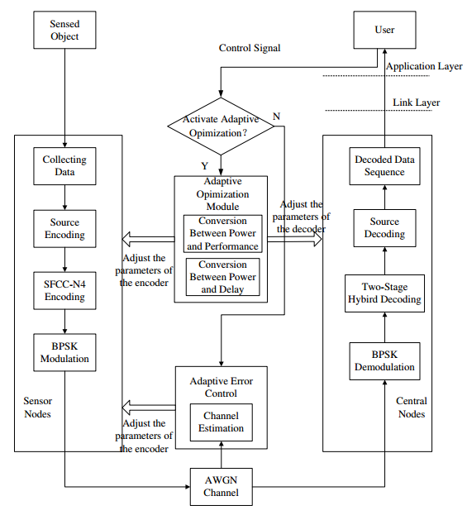
ARCHITECTURE:

Slide 8
HARDWARE & SOFTWARE REQUIREMENTS
HARDWARE REQUIREMENTS:
System : Pentium IV 2.4 GHz.
Hard Disk : 40 GB.
Floppy Drive : 1.44 Mb.
Monitor : 15 VGA Colour.
Mouse : Logitech.
Ram : 512 MB.

Slide 9
S/W System Configuration:-
Operating System : Windows XP/7/8
Front End : Java Swing
Technology used : Java.

Slide 10
CONCLUSION:
In this paper, an FEC scheme was presented for the tradeoff among decoding delay, complexity, and performance according to user’s needs. The proposed scheme combining two decoders without interleaver has at least three merits:
1) Adaptive optimization;
2) Low average computation without performance loss;
3) Suitable for short packet transmissions.
The adaptive list decoder is superior to the single M -algorithm decoder with small survivor paths. Compared with SMAD in medium-to-high SNR region, the ALD has noticeable computational savings by hard decision decoding without performance loss.

