Slide 1
User-Oriented FEC Decoding Scheme for Wireless Sensor Networks with Star Topologies

Slide 2
Abstract
In recent years, wireless sensor networks (WSNs) have attracted a great deal of research attention from both academia and industry. In most cases, WSNs employ the adaptive forward error correction (FEC) coding schemes dynamically adapting to the channel, while paying less attention to user’s requirements.
Sometimes, the decoding delay and the decoding performance of WSNs are more crucial than the power consumption for users. We propose an FEC decoder for the trade-off among decoding delay, complexity, and performance according to user’s needs.

Slide 3
Abstract
The proposed decoder designed for short packet transmission is a two-stage hybrid decoder (TSHD) including a serial min-sum decoder and an adaptive list decoder. For hard decision decoding, our simulation results show that the proposed TSHD scheme outperforms the existing schemes with less average complexity.

Slide 4
EXISTING SYSTEM:
Wireless sensor networks (WSNs) are widely used in industry, medical assistance, video surveillance, etc. In WSNs, a large number of small sensor nodes are deployed surround the sensed object to collect data for users. The most important challenge is to design sensors efficiently to minimize the wireless sensor resource. In order to lower the decoding latency and reduce the transmitting power, WSNs tend to include an forward error correction (FEC) coding to avoid retransmissions.

Slide 5
EXISTING SYSTEM
Traditionally, LDPC decoders and trellis decoders are performed separately based on their own code structures, since convolutional codes decoded by BP algorithms directly always results in poor performance, this is mainly due to a large number of short cycles (especially 4-cycles) in its parity check matrix.

Slide 6
PROPOSED SYSTEM:
In our proposed scheme, the SFCC-N4 code is used as the encoder and its associated decoder is a two-stage hybrid decoder (TSHD) with a modified serial min-sum decoder and an adaptive list decoder.
The TSHD has several merits such as adaptive optimization, low average computation without performance loss, suitable for short packet transmissions. As we will show, the TSHD has a good trade-off among complexity, decoding delay, and performance.

Slide 7
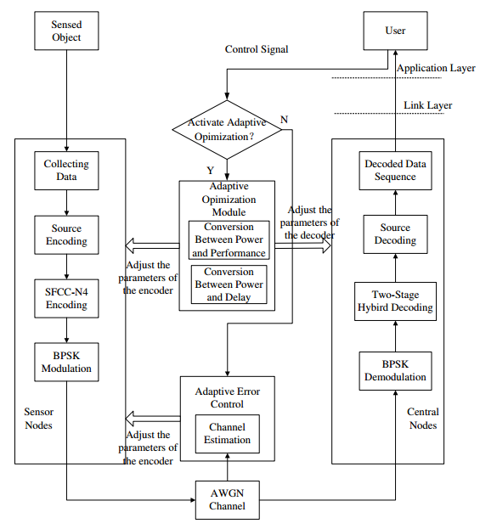
ARCHITECTURE:

Slide 8
MODULE DESCRIPTION:
A. Source Encoding and decoding
A regular binary (2N,J,2J) LDPC code with J ”1”s in each column and 2J ”1”s in each row can be described by a sparse parity check matrix H of size M × 2N . The minsum algorithm is composed of two phases of message passing, i.e., the variable-to-check node message passing L(qnm ) and the check-to-variable node message passing L(r mn). L(q n ) denotes the a posteriori log-likelihood ratio (LLR) of variable n. L(p n ) represents the a priori LLR of variable n. Moreover, N (m) = {n|h mn = 1} denotes the set of variable nodes connecting to check node m, and M (n) = {m|h mn = 1} denotes the set of check nodes connecting to variable node n. N (m)\{n} represents the set N (m) other than variable node n, similarly, M (n)\{m} represents the set M (n) other than check node m.

Slide 9
MODULE DESCRIPTION:
B. SFCC-N4 Encoding:
The systematic feed-forward convolutional codes with no 4-cycles (SFCC-N4) which has a sparse parity check matrix and is suitable for BP decoding. we try to combine the LDPC decoder and the trellis decoder together for application in star-WSNs. In our proposed scheme, the SFCC-N4 code is used as the encoder and its associated decoder is a two-stage hybrid decoder (TSHD) with a modified serial min-sum decoder and an adaptive list decoder.

Slide 10
MODULE DESCRIPTION:
C. THE TWO-STAGE HYBRID DECODER:
In TSHD, the first stage employs low complexity modified serial min-sum decoder to explore the received vector, and the second stage applies the powerful M-algorithm to correct rest errors. In the modified serial min-sum decoder, the variable nodes are updated one-by-one in sequence and a check node is activated whenever its message is demanded by a neighboring variable node.
At the first stage, the modified serial min-sum decoder generates a binary estimated coded sequence, which might not be a valid codeword. Whenever the path departs from a valid codeword at trellis depth t (or time t), the adaptive list decoder applies M-algorithm to re-decode the erroneous segment from time t ′ to t by extending the single path to Mp survivor paths, where Mp is the list size of the M-algorithm decoder.

Slide 11
HARDWARE & SOFTWARE REQUIREMENTS
HARDWARE REQUIREMENTS:
System : Pentium IV 2.4 GHz.
Hard Disk : 40 GB.
Floppy Drive : 1.44 Mb.
Monitor : 15 VGA Colour.
Mouse : Logitech.
Ram : 512 MB.

Slide 12
S/W System Configuration:-
Operating System : Windows XP/7/8
Front End : Java Swing
Technology used : Java.

Slide 13
CONCLUSION:
In this paper, an FEC scheme was presented for the tradeoff among decoding delay, complexity, and performance according to user’s needs. The proposed scheme combining two decoders without interleaver has at least three merits:
1) Adaptive optimization;
2) Low average computation without performance loss;
3) Suitable for short packet transmissions.
The adaptive list decoder is superior to the single M -algorithm decoder with small survivor paths. Compared with SMAD in medium-to-high SNR region, the ALD has noticeable computational savings by hard decision decoding without performance loss.

