Slide 1
Kalman Filtering

Slide 2

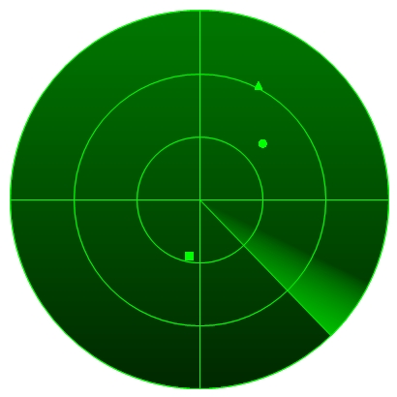
Kalman Filtering
(Optimal) estimation of the (hidden) state of a
linear dynamic process of which we obtain noisy (partial) measurements
Example: radar tracking of an airplane.
What is the state of an airplane given noisy radar measurements of the airplane’s position?

Slide 3
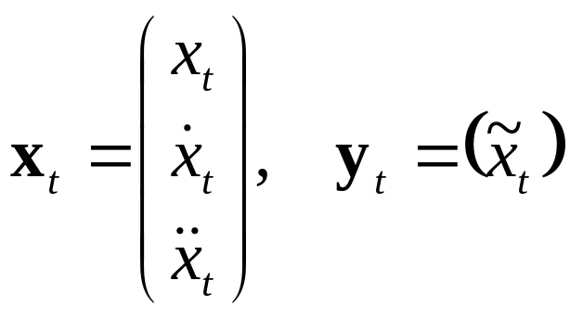
Model
Discrete time steps, continuous state-space
(Hidden) state: x_{t} , measurement: y_{t}
Airplane example:
Position, speed and acceleration

Slide 4
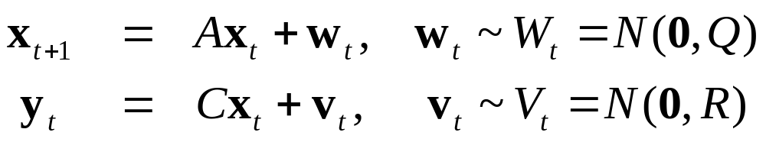
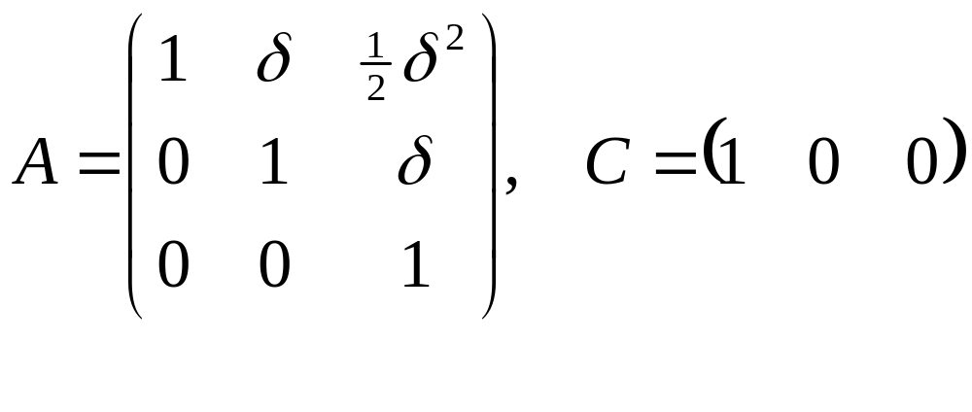
Dynamics and Observation model
Linear dynamics model describes relation between the state and the next state, and the observation:
Airplane example (if process has time-step δ):

Slide 5
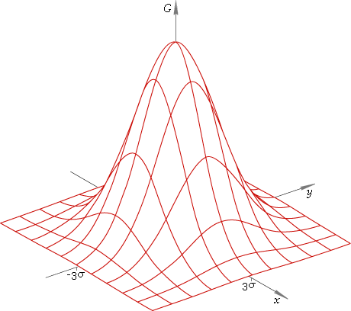
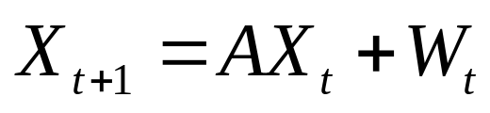
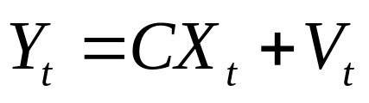
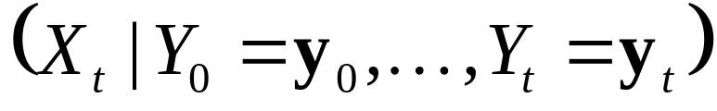
Normal distributions
Let X₀ be a normal distribution
of the initial state x₀
Then, every X_{t} is a normal distribution of hidden state x_{t}. Recursive definition:
And every Y_{t} is a normal distribution of observation y_{t}. Definition:
Goal of filtering: compute conditional distribution

Slide 6
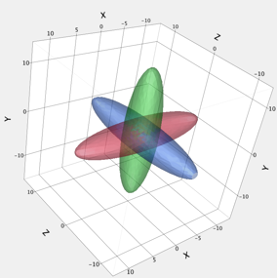

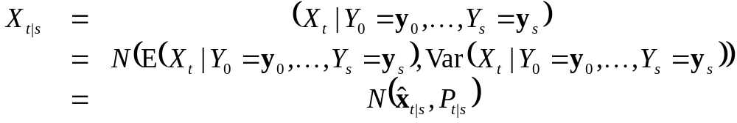
Normal distribution
Because X_{t}’s and Y_{t}’s are normal
distributions,
is also a normal distribution
Normal distribution is fully
specified by mean and covariance
We denote:
Problem reduces to computing x_{t|t} and P_{t|t}

Slide 7
Recursive update of state
Kalman filtering algorithm: repeat…
  Time update:
  from X_{t|t}, compute a priori distrubution X_{t+1|t}
  Measurement update:
  from X_{t+1|t} (and given y_{t+1}), compute a posteriori distribution X_{t+1|t+1}
X₀
X₁
X₂
X₃
X₄
X₅
…
Y₁
Y₂
Y₃
Y₄
Y₅

Slide 8
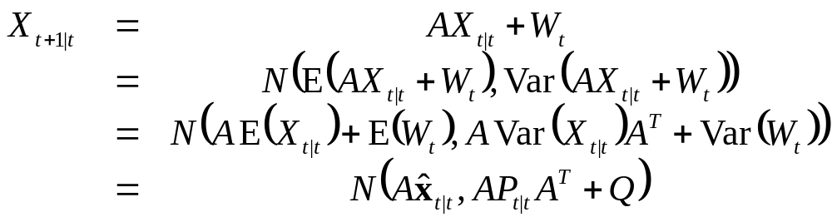
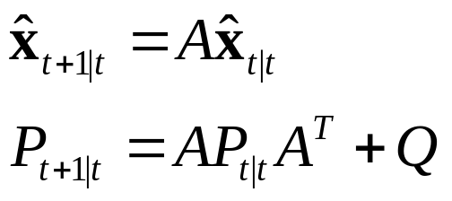
Time update
From X_{t|t}, compute a priori distribution X_{t+1|t}:
So,

Slide 9
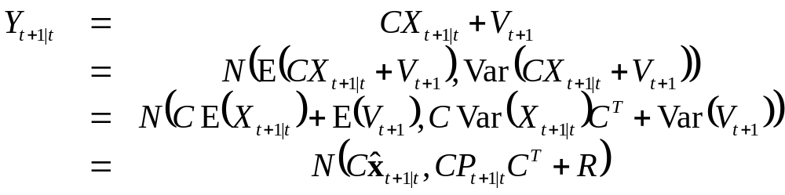
Measurement update
From X_{t+1|t} (and given y_{t+1}), compute X_{t+1|t+1}.
1. Compute a priori distribution of the observation Y_{t+1|t} from X_{t+1|t}:

Slide 10
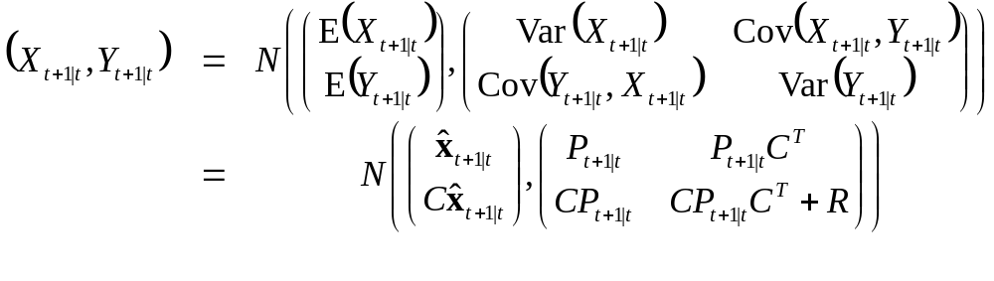
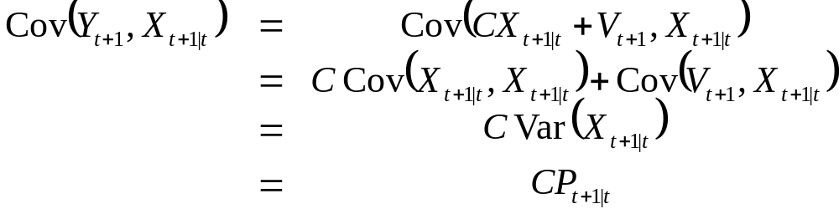
Measurement update (cont’d)
2. Look at joint distribution of X_{t+1|t} and Y_{t+1|t}:
where

Slide 11
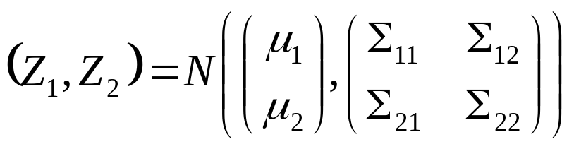
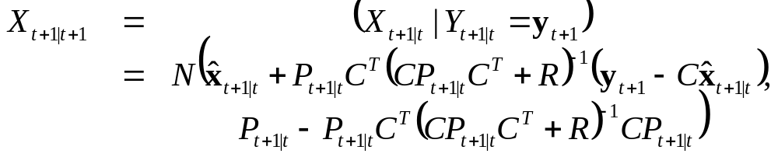
Measurement update (cont’d)
Recall from undergrad that if
then
3. Compute X_{t+1|t +1} = (X_{t+1|t}|Y_{t+1|t} = y_{t+1}):

Slide 12
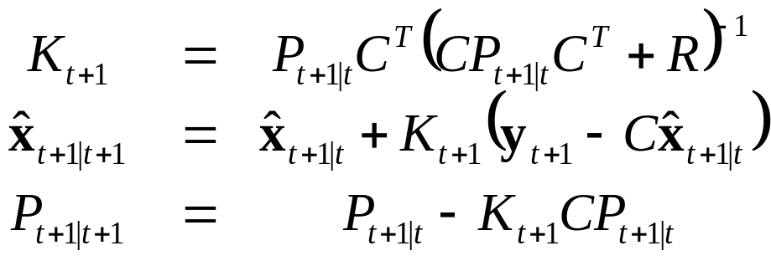
Measurement update (cont’d):
Often written in terms of Kalman gain matrix:

Slide 13
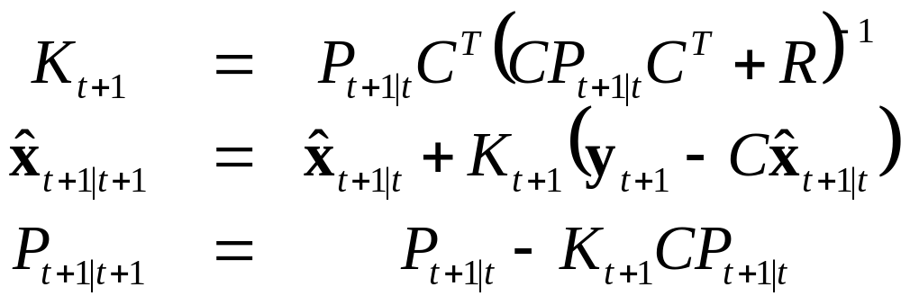
Kalman filter summary
Model:
Algorithm: repeat…
  Time update:
  Measurement update:

Slide 14
Initialization
Choose distribution of initial state by picking x₀ and P₀
Start with measurement update given measurement y₀
Choice for Q and R (identity)
  small Q: dynamics “trusted” more
  small R: measurements “trusted” more

Slide 15
Conclusion
Kalman filter can be used in real time
Use x_{t|t}’s as optimal estimate of state at time t, and use P_{t|t} as a measure of uncertainty.

Slide 16
Extensions
Dynamic process with known control input
Non-linear dynamic process
Kalman smoothing: compute optimal estimate of state x_{t} given all data y₁, …, y_{T},
with T > t (not real-time).
Automatic parameter (Q and R) fitting using EM-algorithm

Slide 17
Kalman Smoothing

Slide 18

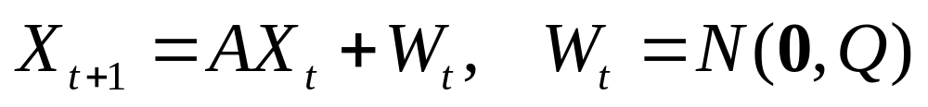
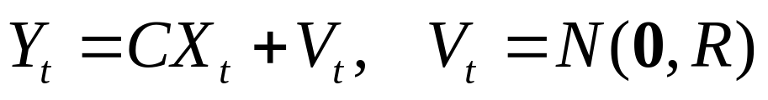
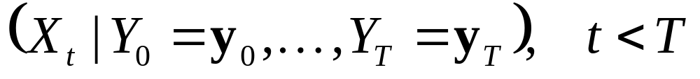
Kalman Filtering vs. Smoothing
Dynamics and Observation model
Kalman Filter:
  Compute
  Real-time, given data so far
Kalman Smoother:
  Compute
  Post-processing, given all data

Slide 19
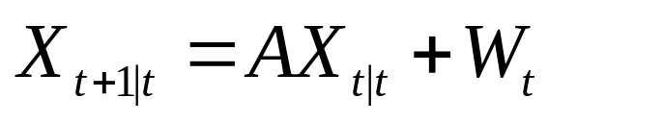
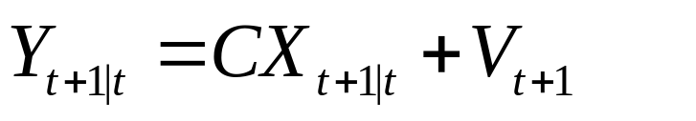
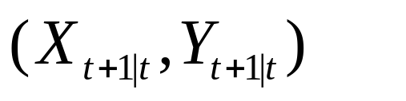
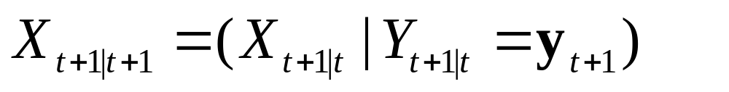
Kalman Filtering Recap
Time update
Measurement update:
  Compute joint distribution
  Compute conditional
X₀
X₁
X₂
X₃
X₄
X₅
…
Y₁
Y₂
Y₃
Y₄
Y₅

Slide 20
Kalman filter summary
Model:
Algorithm: repeat…
  Time update:
  Measurement update:

Slide 21
Kalman Smoothing
Input: initial distribution X₀ and data y₁, …, y_{T}
Algorithm: forward-backward pass
(Rauch-Tung-Striebel algorithm)
Forward pass:
  Kalman filter: compute X_{t+1|t} and X_{t+1|t+1} for 0 ≤ t < T
Backward pass:
  Compute X_{t|T} for 0 ≤ t < T
  Reverse “horizontal” arrow in graph

Slide 22
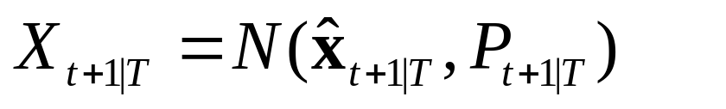
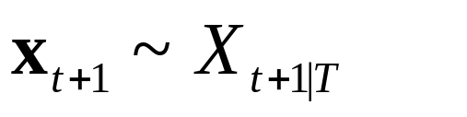
Backward Pass
Compute X_{t|T} given
Reverse arrow: X_{t|t} → X_{t+1|t}
Same as incorporating measurement in filter
  1. Compute joint (X_{t|t}, X_{t+1|t})
  2. Compute conditional (X_{t|t} | X_{t+1|t} = x_{t+1})
New: x_{t+1} is not “known”, we only know its distribution:
  3. “Uncondition” on x_{t+1} to compute X_{t|T} using laws of total expectation and variance

Slide 23
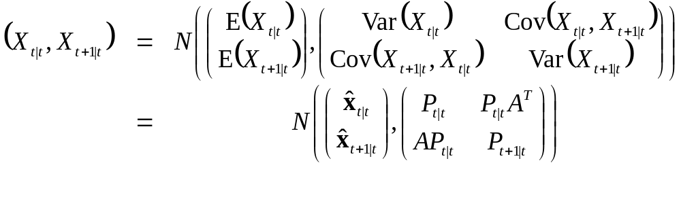
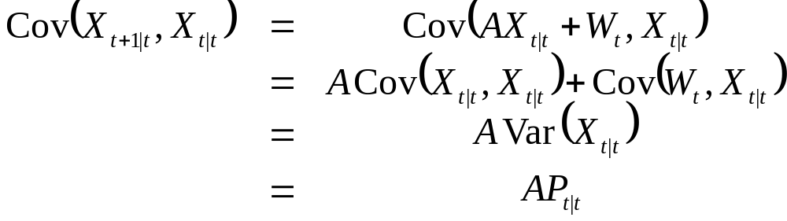
Backward pass. Step 1
Compute joint distribution of X_{t|t} and X_{t+1|t}:
where

Slide 24
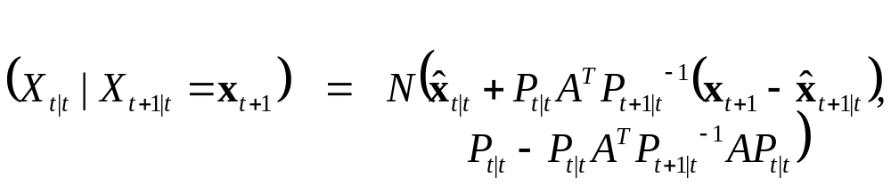
Backward pass. Step 2
Recall that if
then
Compute (X_{t|t}|X_{t+1|t} = x_{t+1}):

Slide 25
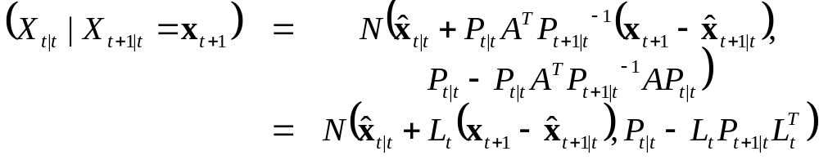
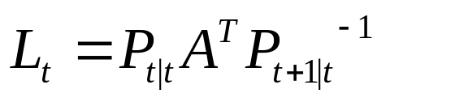
Backward pass Step 3
Conditional only valid for given x_{t+1}.
  Where
But we don’t know its value, but only its distribution:
Uncondition on x_{t+1} to compute X_{t|T} using law of total expectation and law of total variance

Slide 26
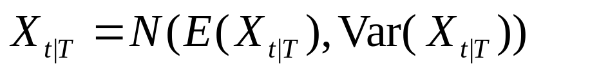
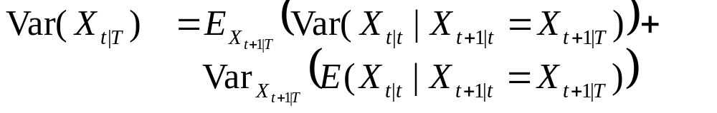
Law of total expectation/variance
Law of total expectation:
  E(X) = E_{Z}( E(X|Y = Z) )
Law of total variance:
  Var(X) = E_{Z}( Var(X|Y = Z) ) + Var_{Z}( E(X|Y = Z) )
Compute
  where

Slide 27
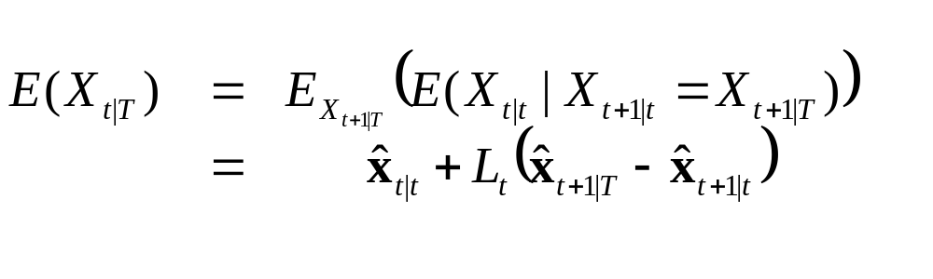
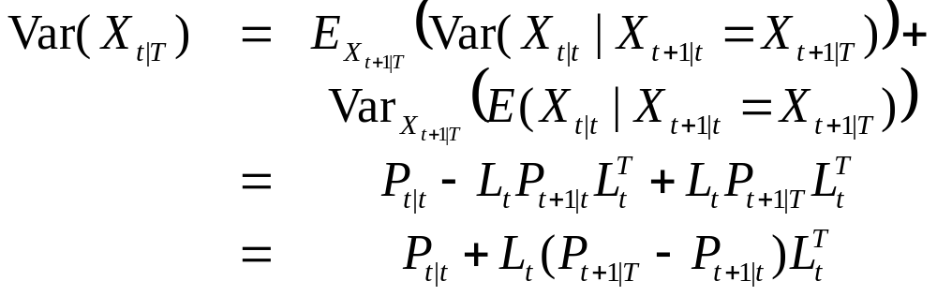
Unconditioning
Recall from step 2 that
So,

Slide 28
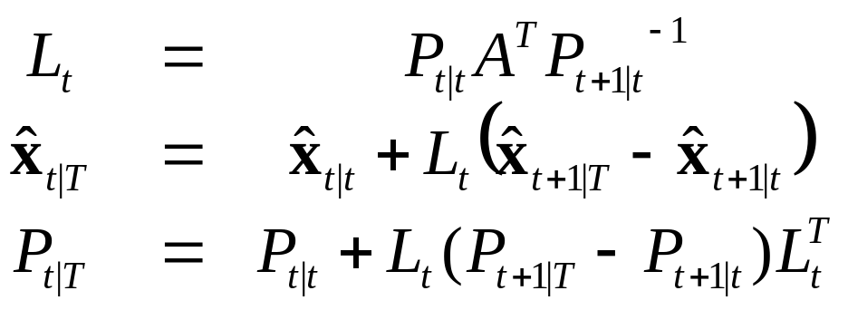
Backward pass
Summary:

Slide 29
Kalman smoother algorithm
for (t = 0; t < T; ++t) // Kalman filter
for (t = T – 1; t ≥ 0; --t) // Backward pass

Slide 30
Conclusion
Kalman smoother can in used a post-processing
Use x_{t|T}’s as optimal estimate of state at time t, and use P_{t|T} as a measure of uncertainty.

Slide 31
Extensions
Automatic parameter (Q and R) fitting using EM-algorithm
  Use Kalman Smoother on “training data” to learn Q and R (and A and C)

