Slide 1
Hybrid Random-Deterministic Parallel Algorithms for Optimization
Amir Daneshmand
Presented by Jared, USTC

Slide 2

Optimization
Solve the minimization of the sum of a smooth function F and a non-smooth convex one G:
$$\min_{x∈X}{V\left(x\right)=F\left(x\right)+G(x)}$$
Where X is a closed convex set with a
cartesian product structure: $X=\prod_{i=1}^{N}{X_{i}}∈ℝ^{N}$

Slide 3
Solutions
BCD(Basic Block Coordinate Descent)
Parallel BCD
RBCD(Random BCD)
Use of “more-than-first-order” info

Slide 4
BCD (Block Coordinate Descent)
Definition: at each iteration, one block of variables is updated using first order info
Pros: low-cost per-iteration and scalability
Cons: inefficient when the dimension increases

Slide 5
Parallel BCD
Definition: several blocks of variables are updated simultaneously in a parallel environment
Pros: can solve big data problem
Cons: only for convex problems

Slide 6
Random BCD
Definition: random selection of blocks of variables to update
Pros: simple and useful for distributed environments
Cons: remain disconnected from the status of the optimization process

Slide 7
Use of “more-than-first-order”
Definition: use of “more-than-first-order”, the key is the trade-off between cost-per-iteration and overall cost of the optimization process
Pros: converges faster
Cons: the trade-off is difficult

Slide 8
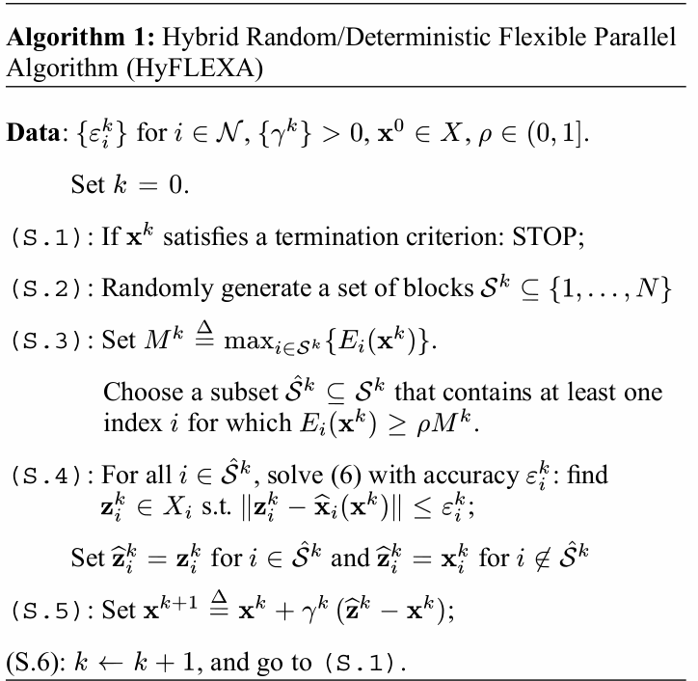
Our Solution
Hybrid Random-Deterministic Parallel Algorithms

Slide 9


Random Choice of $S^{k}$
Uniform sampling
All blocks get selected with the same probability
Double Uniform sampling
All sets $S$ of equal cardinality are generated with equal probability

Slide 10


Choice of the step-size $γ^{k}$
An example rule
$$γ^{k}=γ^{k−1}(1−θγ^{k−1})$$
where $θ∈(0,1)$ is a given constant

Slide 11
Features of Our Solutions
It uses a random selection rule for the blocks, followed by a deterministic sub-selection
It can tackle separable convex function G, but also non-separable function G
It can deal with a non-convex function F
It is parallel
It can use inexact updates
It converges almost surely

Slide 12
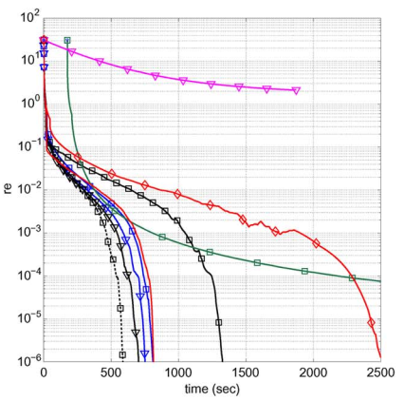
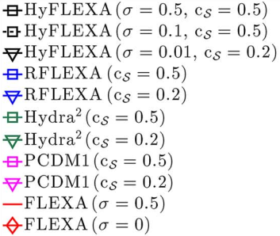
Numerical Results
LASSO with 100,000 variables, 8 cores; Relative Error vs. Time

Slide 13
Conclusion
New solution
Hybrid random-deterministic
Parallel
For convex and non-convex functions
For big data problems

Slide 14
Conclusion
Our experiments on LASSO problems showed the superiority of the proposed scheme with respect to state-of-art random and deterministic algorithms

Slide 15
Future Work
Perform experiments on more varied classed of problems

