Slide 1
DCell: A Scalable and Fault-Tolerant Network Structure for Data Centers
Chuanxiong Guo, Haitao Wu, Kun Tan, Lei Shi, Yongguang Zhang, Songwu Lu
SIGCOMM 2008
Presented by Ye Tian for Course CS05112

Slide 2
Overview
DCN motivation
DCell Network Structure
Routing in DCell
Simulation Results
Implementation and Experiments
Review

Slide 3
Data Center Networking (DCN)
Increasing scale
Google has 450,000 servers in 2006
Microsoft doubles its number of servers in 14 months
The expansion rate exceeds Moore’s Law
Two motivations
First, data center is growing large and the number of servers is increasing at an exponential rate.
Second, many infrastructure services request for higher bandwidth due to operations such as file replications in GFS and all-to-all communications in MapReduce. Therefore, network bandwidth is often a scarce resource

Slide 4

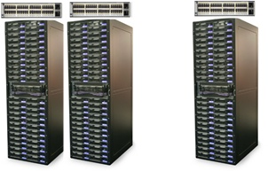
Existing Tree Structure
Existing tree structure does not scale
First, the servers are typically in a single layer-2 broadcast domain. (the network is broadcast in nature)
Second, core switches, as well as the rack switches, pose as the bandwidth bottlenecks.
The tree structure is also vulnerable to “single-point-of-failure"

Slide 5
Three Design Goals
Scaling:
It must physically interconnect hundreds of thousands or even millions of servers at small cost
It has to enable incremental expansion by adding more servers into the already operational structure.
Fault tolerance:
There are various server, link, switch, rack failures due to hardware, software, and power outage problems.
Fault tolerance in DCN requests for both redundancy in physical connectivity and robust mechanisms in protocol design.

Slide 6
Three Design Goals
High network capacity:
Distributed file system: When a server disk fails, re-replication is performed. File replication and re-replication are two representative, bandwidth-demanding one-to-many and many-to-one operations.
MapReduce: a Reduce worker needs to fetch intermediate files from many servers. The traffic generated by the Reduce workers forms an all-to-all communication pattern.

Slide 7
Overview
DCN motivation
DCell Network Structure
Routing in DCell
Simulation Results
Implementation and Experiments
Review

Slide 8
DCell Physical Structure
DCell₀ is the building block to construct larger DCells. It has n servers and a mini-switch. All servers in DCell₀ are connected to the mini-switch.
n is a small integer (say, n=4).
DCell₁ has n+1 =5 DCell₀s. DCell₁ connects the 5 DCell₀s as follows. Assign each server a 2-tuple [a₁, a₀], where a₁ and a₀ are the level-1 and level-0 IDs, respectively. Then two servers with 2-tuples [i, j-1] and [j, i] are connected with a link for every i and every j > i.

Slide 9
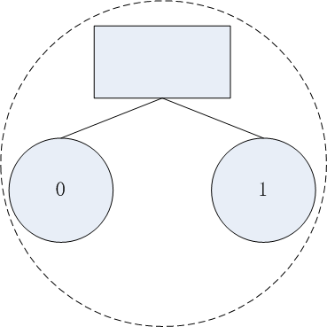
DCell Physical Structure
Dcell_0
Mini-switch
Server
n servers in a DCell_0
n=2, k=0

Slide 10
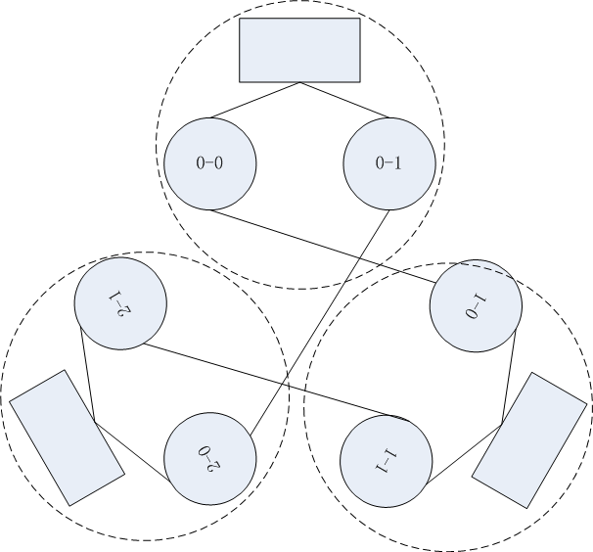
DCell Physical Structure
DCell_1
n=2, k=1

Slide 11
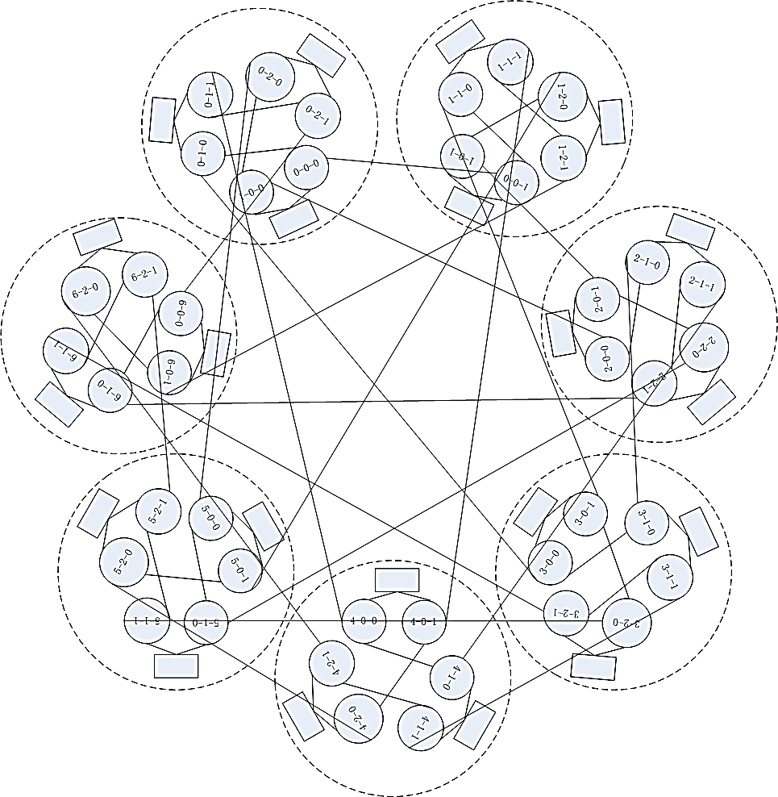
DCell Physical Structure
DCell_2
n=2, k=2

Slide 12
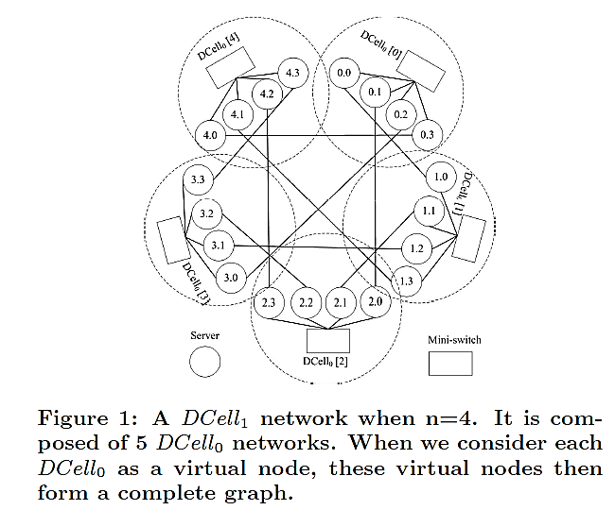
DCell Physical Structure

Slide 13
DCell Physical Structure
For building DCell_{k}, if we have built DCell_{k-1} and each DCell_{k-1} has t_{k-1} servers, then we can create a maximum t_{k-1} + 1 of DCell_{k-1} s.
The number of DCell_{k-1}s in a DCell_{k}, g_{k}, and the total number of servers in a DCell_{k} (i.e., t_{k}) are
g_{k}=t_{k-1}+1;
t_{k}=g_{k}*t_{k-1}

Slide 14
DCell Physical Structure
Each server in a DCell_{k} is assigned a (k+1)-tuple [a_{k}, a_{k-1}, … , a₁, a₀], where a_{i}<g_{i}
We further denote [a_{k}, a_{k-1}, … , a_{i+1}] (i > 0) as the prefix to indicate the DCell_{i} this node belongs to.
Each server can be equivalently identified by a unique ID uid_{k}, taking a value from [0, t_{k}).
A server in DCell_{k} is denoted as [a_{k}, uid_{k-1}], where a_{k} is the DCell_{k-1} this server belongs to, and uid_{k-1} is the unique ID of the server inside this DCell_{k-1} .

Slide 15
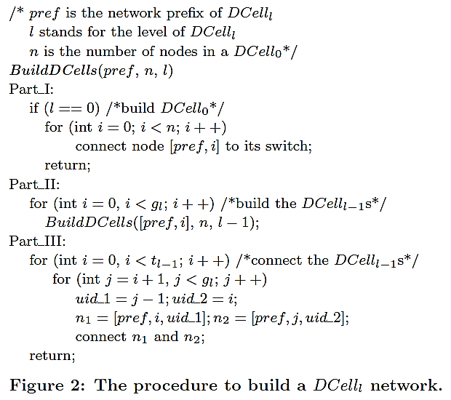
Build DCells

Slide 16
Build DCells
Part I checks whether it constructs a DCell₀.
Part II recursively constructs g_{l} number of DCell_{l-1}s.
Part III interconnects these DCell_{l-1}s, where any two DCell_{l-1}s are connected with one link.
Each server in a DCell_{k} network has k+1 links.
The first link, called a level-0 link, connects to a switch that interconnects DCell₀.
The second link, a level-1 link, connects to a node in the same DCell₁ but in a different DCell₀.
Similarly, the level-i link connects to a different DCell_{i-1} within the same DCell_{i}; Connect [pref, i, j-1] and [pref, j, i]

Slide 17
Properties of DCell
Scalability: The number of servers scales doubly exponentially When number of servers in a DCell₀ is 8 (n=8) and the number of server ports is 4 (i.e., k=3) -> N=27,630,792
Fault-tolerance: The bisection width is larger than
Bisection width denotes the minimal number of links to be removed to partition a network into two parts of equal size.

Slide 18
Overview
DCN motivation
DCell Network Structure
Routing in DCell
Simulation Results
Implementation and Experiments
Review

Slide 19
DCellRouting
Consider two nodes src and dst that are in the same DCell_{k} but in two different DCell_{k-1}s.
When computing the path from src to dst in a DCell_{k}, we first calculate the intermediate link (n₁, n₂) that inter-connects the two DCell_{k-1}s.
Routing is then divided into how to find the two sub-paths from src to n₁ and from n₂ to dst. The final path of DCellRouting is the combination of the two sub-paths and (n₁, n₂).

Slide 20
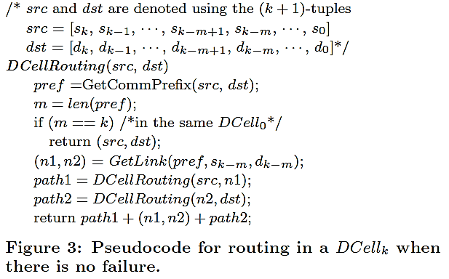
DCellRouting
src
n1
n2
dst

Slide 21
Routing Properties
Path length: The maximum path length in DCellRouting is at most
Network diameter: The maximum path length using DCellRouting in a DCell_{k} is at most
But:
DCellRouting is NOT a shortest-path routing
is NOT a tight diameter bound for DCell
Yet:
DCellRouting is close to shortest-path routing
DCellRouting is much simpler: O(k) steps to decide the next hop

Slide 22
Routing Properties
Routing Properties
n | k | N | Shortest-path |  | DCellRouting
 |  |  | Mean | Max | Mean | Max
4 | 2 | 420 | 4.87 | 7 | 5.16 | 7
5 | 2 | 930 | 5.22 | 7 | 5.50 | 7
6 | 2 | 1806 | 5.48 | 7 | 5.73 | 7
4 | 3 | 176,820 | 9.96 | 15 | 11.29 | 15
5 | 3 | 865,830 | 10.74 | 15 | 11.98 | 15
6 | 3 | 3,263,442 | 11.31 | 15 | 12.46 | 15

Slide 23
Traffic Distribution in DCellRouting
All-to-all communication model:
Consider an all-to-all communication model for DCell_{k} where any two servers have one flow between them. The number of flows carried on a level-i link is less than t_{k}2^{k-i} when using DCellRouting.
The bottle links are the lowest links instead of the highest links
k is small, so the difference is not large
For example k=3

Slide 24
Traffic Distribution in DCellRouting
One-to-Many and Many-to-One communication models:
Given a node src, the other nodes in a DCell_{k} can be classified into groups based on which link node src uses to reach them. The nodes reached by the level-i link of src belong to Group_{i}.
The number of nodes in Group_{i} is
When src communicates with m other nodes, it can pick a node from each of Group₀, Group₁, etc. The maximum aggregate bandwidth at src is min(m, k+1)

Slide 25
DCellBroadcast
In DCellBroadcast, a sender delivers the broadcast packet to all its k+1 neighbors when broadcasting a packet in a DCell_{k}.
The receiver drops a duplicate packet but broadcasts a new packet to its other k links.
Limit the broadcast scope by encoding a scope value k into each broadcast message. The message is broadcasted only within the DCell_{k} network that contains the source node.

Slide 26
Fault-tolerant Routing
DFR handles three types of failures: server failure, rack failure, and link failure.
DFR uses three techniques of local reroute, local link-state, and jump-up to address link failure, server failure, and rack failure, respectively.

Slide 27
Link-state Routing
Use link-state routing (with Dijkstra algorithm) for intra-DCell_{b} routing and DCellRouting and local reroute for inter-DCell_{b} routing.
In a DCell_{b}, each node uses DCellBroadcast to broadcast the status of all its (k+1) links periodically or when it detects link failure. A node thus knows the status of all the outgoing/incoming links in its DCell_{b}.

Slide 28
Local-reroute and Proxy
Let nodes src and dst be in the same DCell_{k}. Compute a path from src to dst using DCellRouting.
Assume an intermediate link (n₁, n₂) has failed. Local-reroute is performed at n₁ as:
First calculates the level of (n₁, n₂), denoted by l. Then n₁ and n₂ are known to be in the same DCell_{l} but in two different DCell_{l-1}s. Since there are g_{l} DCell_{l-1} subnetworks inside this DCell_{l}, it can always choose a DCell_{l-1}.
There must exist a link, denoted as (p₁, p₂), that connects this DCell_{l-1} and the one where n₁ resides. Local-reroute then chooses p₂ as its proxy and re-routes packets from n₁ to the selected proxy p₂.

Slide 29
Link-state Routing
Using m₂ as an example: m₂ uses DCellRouting to calculate the route to the destination node dst. It then obtains the first link that reaches out its own DCell_{b} (i.e., (n₁, n₂)). m₂ then uses intra-DCell_{b} routing, a local link-state based Dijkstra routing scheme, to decide how to reach n₁. Upon detecting that (n₁, n₂) is broken, m₂ invokes local-reroute to choose a proxy. It chooses a link (p₁, p₂) with the same level as (n₁, n₂) and sets p₂ as the proxy.

Slide 30
Jump-up for Rack Failure
Upon receiving the rerouted packet (implying (n₁, n₂) has failed), p₂ checks whether (q₁, q₂) has failed or not. If (q₁, q₂) also fails, it is a good indication that the whole i₂ failed. p₂ then chooses a proxy from DCells with higher level (i.e., it jumps up). Therefore, with jump-up, the failed DCell i₂ can be bypassed.
If dst is in i₂, packet should be dropped
First, a retry count is added in the packet header.
Second, each packet has a time-to-live (TTL) field, which is decreased by one at each intermediate node.

Slide 31
Local-reroute and Proxy
DCell_{b}
L
i₂
dst
DCell_{b}
src
i₁
n₂
r₁
m₂
n₁
m₁
q₂
p₁
L
Proxy
Proxy
q₁
p₂
L+1
s₂
Servers in a same
share local link-state
s₁
DCell_{b}
i₃

Slide 32
Overview
DCN motivation
DCell Network Structure
Routing in DCell
Simulation Results
Implementation and Experiments
Review

Slide 33
Simulations
Compare DFR with the Shortest-Path Routing (SPF), which offers a performance bound.
Two DCells:
n=4, k=3 -> N=176,820
n=5, k=3 -> N=865,830
Node failures, DFR performs almost identical to SPF; moreover, DFR performs even better as n gets larger.

Slide 34
Simulations
Rack failure
The impact of rack failure on the path length is smaller than that of node failure.

Slide 35
Simulations
Link failure
The path failure ratio of DFR increases with the link failure ratio.
DFR cannot achieve such performance since it is not globally optimal.
When the failure ratio is small, DFR is still very close to SPF.

Slide 36
Overview
DCN motivation
DCell Network Structure
Routing in DCell
Simulation Results
Implementation and Experiments
Review

Slide 37
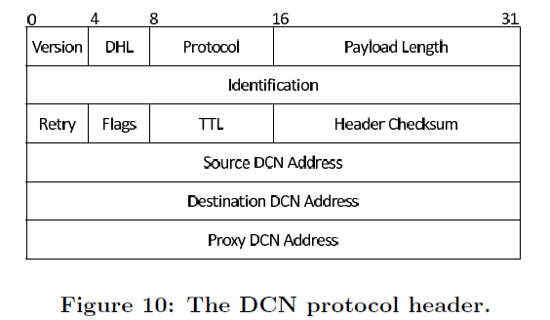
Protocol Suite
Addressing: use 32-bit uid to identify a server. The most significant bit (bit-0) is used to identify the address type.
0 for server; 1 for multicast.
Header: borrows heavily from IP
Neighbor maintenance: two mechanisms
Node transmits heart-beat messages over all out-bound links periodically
Use link-layer medium sensing to detect neighbor states.

Slide 38
Layer-2.5 DCN Prototyping
On Windows Server 2003
The DCN protocol suite is implemented as a kernel-mode driver, which offers a virtual Ethernet interface to the IP layer and manages several underlying physical Ethernet interfaces.
Operations of routing and packet forwarding are handled by CPU.
APP
TCP/IP
DCN (routing, forwarding, address mapping, )
Ethernet

Slide 39

Testbed
Testbed of a DCell₁ with over 20 server nodes. This DCell₁ is composed of 5 DCell₀s, each of which has 4 servers.
Each server also installs an Intel PRO/1000 PT Quad Port Ethernet adapter.
Intel® PRO/1000 PT Quad Port Server Adapter

Slide 40
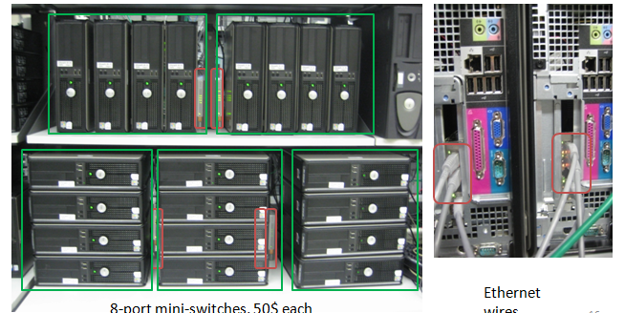
Testbed
The Ethernet switches used to form the DCell₀s are D-Link 8-port Gigabit switches DGS-1008D, $50 each.

Slide 41
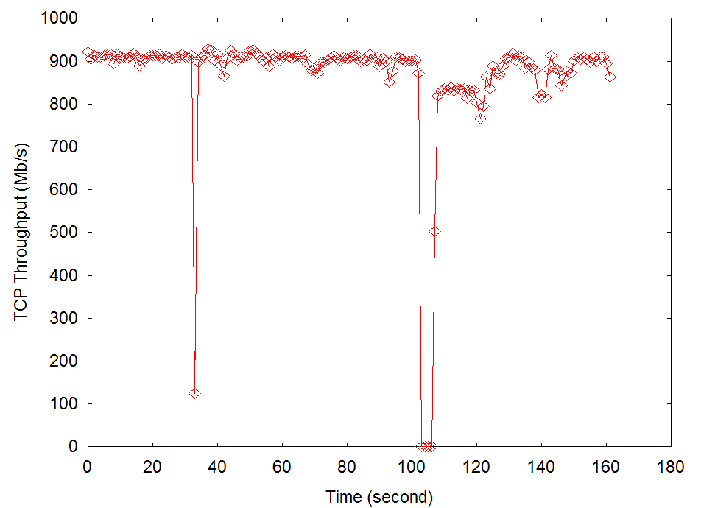
Experiment
Fault-tolerance:
Set up a TCP connection between servers [0,0] and [4,3] in the topology.
Unplugged the link ([0,3], [4,0]) at time 34s.
Routing path is changed to [0,0], [1,0], [1,3], [4,1], [4,3].

Slide 42
Experiment
Throughput: target to MapReduce Scenario
Each server established a TCP connection to each of the remaining 19 servers, and each TCP connection sent 5GB data.
The transmission in DCell completed at 2270 seconds, but lasted for 4460 seconds in the tree structure.
The 20 one-hop TCP connections using the level-1 link had the highest throughput and completed first at the time of 350s.
Tree approach: The top-level switch is the bottleneck and soon gets congested.

Slide 43
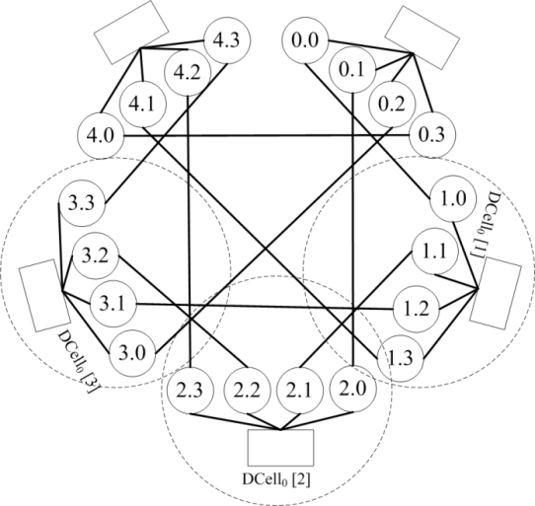
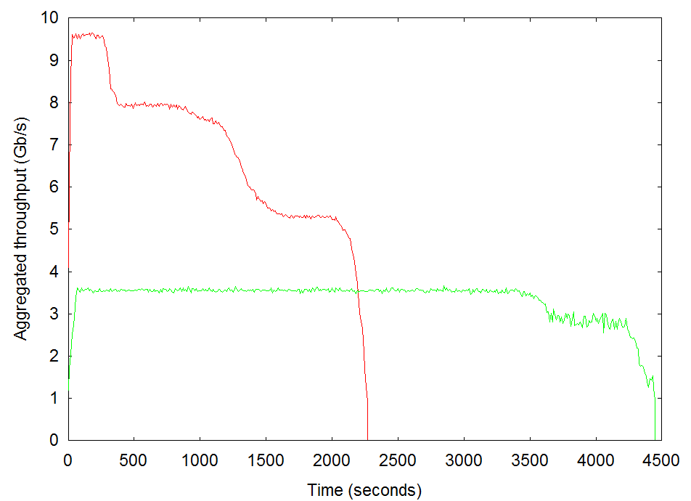
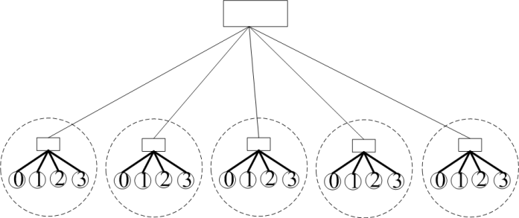
Experiment

Slide 44
Review
What is the physical structure of DCell?
DCell properties:
Scalability
Fault-tolerance
How DCell route data flows?
How to handle different types of failures.

