Slide 1
Inside the Social Network’s (Datacenter) Network
Arjun Roy, Hongyi Zeng, Jasmeet Bagga, George Porter, and Alex C. Snoeren
SIGCOMM 2015
Presented by Ye Tian for Course CS05112

Slide 2
Overview
Facebook Datacenter
Provisioning
Traffic Engineering
Switching

Slide 3
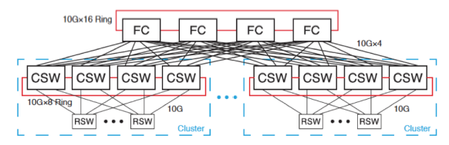
Datacenter Topology
Unit of deployment: cluster
Conventional 3-tier topology
Machines are connected to top-of-rack switch (RSW) with 10-Gpbs links
Each RSW is connected by 10-Gbps links to 4 cluster switches (CSW)
Servers connected by a same set of CSW is a cluster
CSWs are inter- connected with Fat Cats (FC)

Slide 4
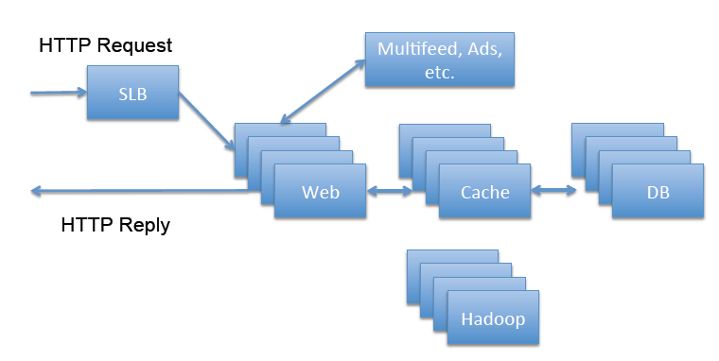
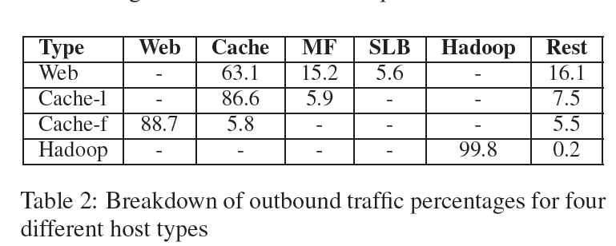
Servers
Web servers
MySQL servers
Cache
Leader: handles cache coherency
Follower: caches most read content
Hadoop servers: offline data mining
Multifeed servers: assemble news feed
All physical servers, no virtual servers

Slide 5
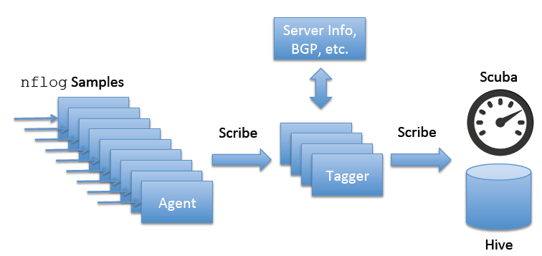
Data Collection
Fbflows:
Facebook’s monitoring system
Two components: agents and taggers
Agent
1:30000 sampling rate
On every machine
Extract header information: src/dst IP addr., port, protocol
Tagger
On a subset of machins
Annotate header with additional information such as rack and cluster

Slide 6
Data Collection
Port mirroring
Monitor hosts in five different racks
Web server / Hadoop node / cache leader / cache follower / multifeed node
tcpdump
Collect data without loss

Slide 7
Overview
Facebook Datacenter
Provisioning
Traffic Engineering
Switching

Slide 8
Utilization
Access links (links between hosts and their RSW)
Quite low: average 1-minute link utilization less than 1%
Links between RSW and CSW
median utilization varies between 10–20% across clusters, with the busiest 5% of the links seeing 23–46% utilization.
Links between CSWs and FC
Still high

Slide 9
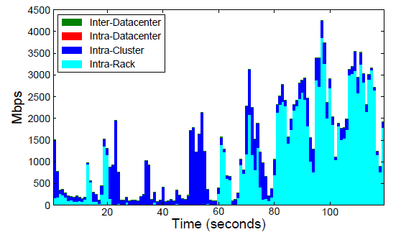
Locality and stability
Hadoop server traffic breakdown
Show both rack- and cluster-level locality
99.8% of all traffic sent by the server is destined to other Hadoop servers: 75.7% of that traffic is destined to servers in the same rack
Hadoop server communicates with 1.5% of the other servers in the cluster—spread across 95% of the racks—though only 17% of the racks receive over 80% of the server’s traffic
consequence of a combination of job size and the distinct phases that a Hadoop job undergoes

Slide 10
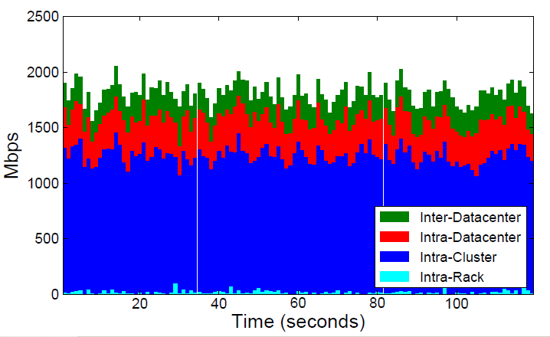
Locality and stability
web server traffic break down
only a minimal amount of rack-local traffic is present
inter-datacenter traffic is present in larger quantities (web)

Slide 11
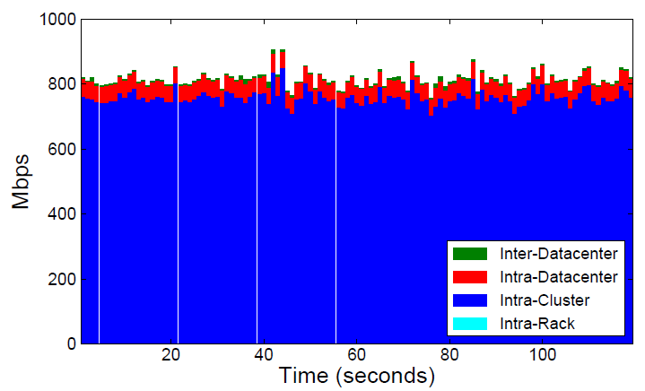
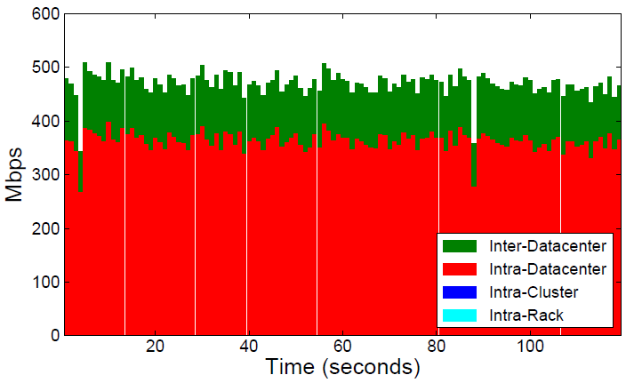
Locality and stability
Cache system traffic breakdown
Frontend cache followers primarily send traffic in the form of responses to Web servers—intra-cluster traffic
Cache leaders maintain coherency across clusters and the backing databases, engaging primarily in intra- and inter-datacenter traffic

Slide 12

Traffic Matrix
Rack-to-rack, Hadoop cluster
Strong diagonal
cluster-wide uniformity outside the local rack accounts for intra-cluster traffic representing over 80% of Hadoop traffic
Map tasks are placed to maximize read locality, but there are a large number of concurrent jobs which means that it is possible that any given job will not fit entirely within a rack.

Slide 13
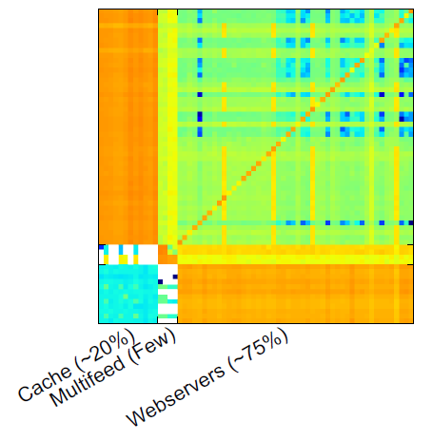
Traffic Matrix
Frontend cluster
Strong bipartite traffic pattern between the Web servers and the cache followers
Web servers talk primarily to cache servers and vice versa, and servers of different types are deployed in distinct racks

Slide 14
Implication
non-uniform fabric technologies that can deliver higher bandwidth to certain locations than others may find use.
stability of the traffic patterns suggest that rapid reconfigurability may not be as necessary as some have assumed.
lack of significant levels of intra-rack locality hints that RSWs (i.e., top-of-rack switches) that deliver something less than full non-blocking line-rate connectivity between all of their ports may be viable.

Slide 15
Overview
Facebook Datacenter
Provisioning
Traffic Engineering
Switching

Slide 16
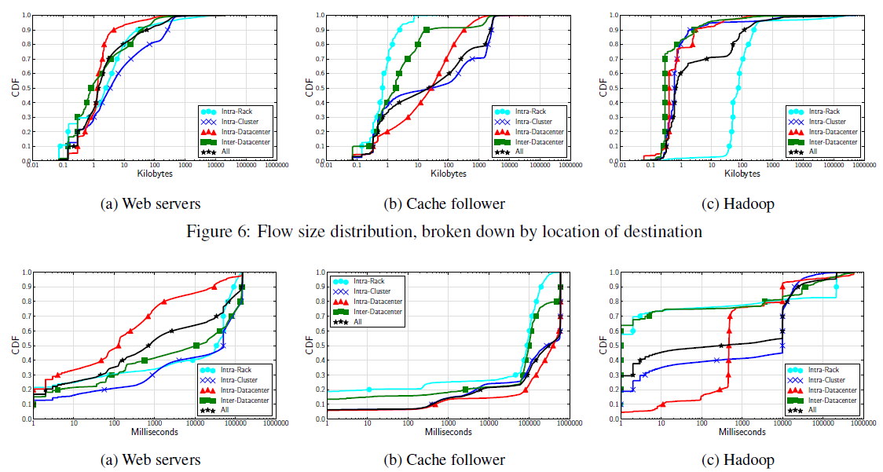
Flow Characteristics
Flow size and duration

Slide 17
Flow Characteristics
Hadoop server:
Most flows are short and small
70% of flows send less than 10 KB and last less than 10 seconds
Other servers:
Connection pooling leads to long-lived connections with relatively low throughput.
Connection pooling is prevalent in cache followers (leaders), and 40(25)% of flows exceeding our 10-minute capture period.

Slide 18
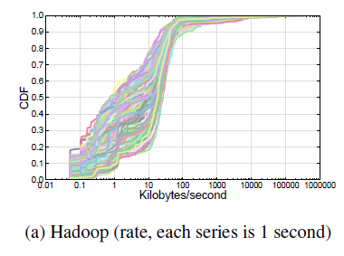
Load Balancing
Method: examine the distribution of flow rates, aggregated by destination rack, per second over a two-minute period and compare each second to the next. Intuitively, the better the load balancing, the closer one second appears to the next.
Hadoop: poorly balanced
widely varying rates
Hadoop is likely to see a myriad jobs of varying sizes.

Slide 19
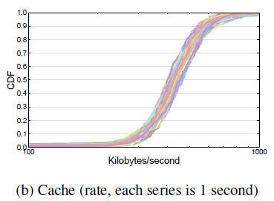
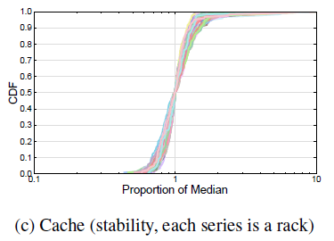
Load Balancing
Frontend: well balanced
distribution of per-second flow rates from a single cache follower node to distinct Web server racks during a two minute period are similar.
distributions for each of the 120 seconds are similar, and all are relatively tight,

Slide 20
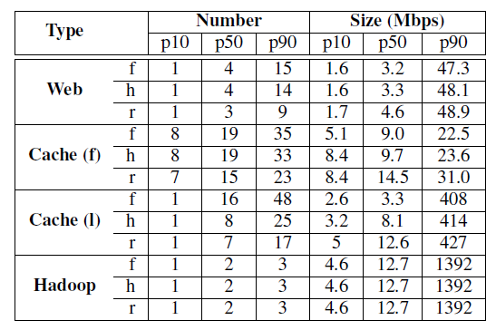
Heavy Hitters
Heavy hitters: the minimum set of flows (or hosts, or racks in the aggregated case) that is responsible for 50% of the observed traffic volume (in bytes) over a fixed time period.
Number and size of heavy hitters in 1-ms intervals for each of flow(f), host(h), and rack(r) levels of aggregation

Slide 21
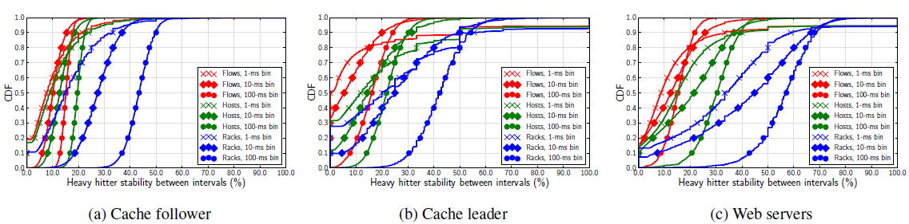
Heavy Hitters
Persistence
fraction of the heavy hitters that remain in subsequent time intervals.
Heavy hitter persistence is low for individual flows (red)
Host-level aggregation (green) fares little better
Considering rack-level flows (blue), heavy hitters are particularly stable.

Slide 22
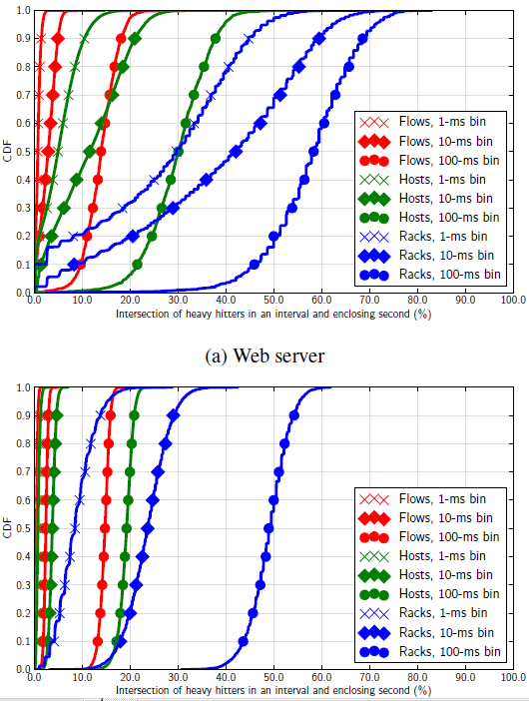
Heavy Hitters
CDF of the fraction of a second’s overall heavy hitters that are instantaneously heavy in each 1/10/100-ms interval within the second
Rack-level predictions are much more effective
Host-level predictions are more useful for Web servers than cache nodes, but only the 100-ms case is more than 30% effective.

Slide 23
Implication
Many existing techniques work by identifying heavy hitters and then treating them differently
provisioning a circuit, moving them to a lightly loaded path, employing alternate buffering strategies
Benefits are limited
Challenging to predict heavy hitters
heavy hitters are frequently not particularly heavy for the vast majority of the period.

Slide 24
Overview
Facebook Datacenter
Provisioning
Traffic Engineering
Switching

Slide 25
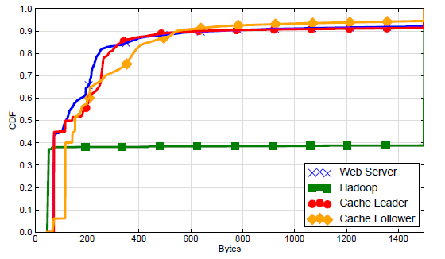
Per-packet Feature
Packet size distribution
Median: 250 bytes
Hadoop server: almost all packets are either MTU length (1500 bytes) or TCP ACKs

Slide 26
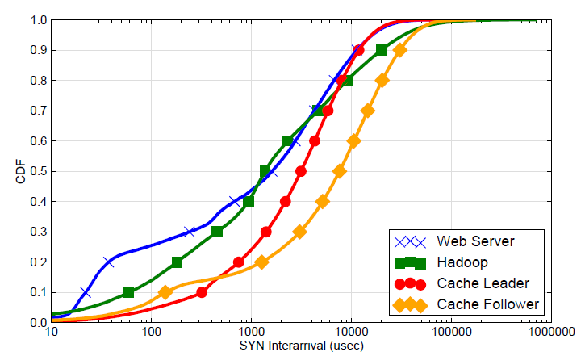
Arrival Pattern
TCP SYN inter-arrival time
Hadoop nodes and Web servers see an order-of- magnitude increase in flow intensity.
cache leaders see a slightly higher arrival rate than followers.

Slide 27
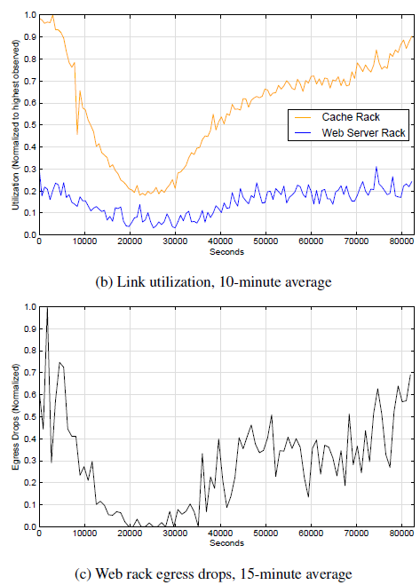
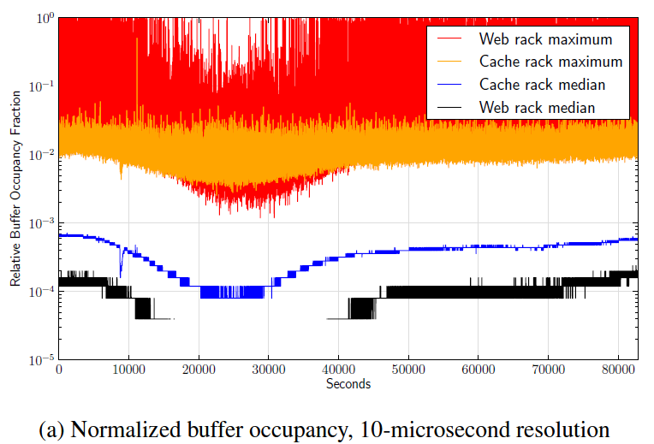
Buffer Utilization
Buffer occupancies are non-trivial, and can be quite high in the Web-server case.

Slide 28
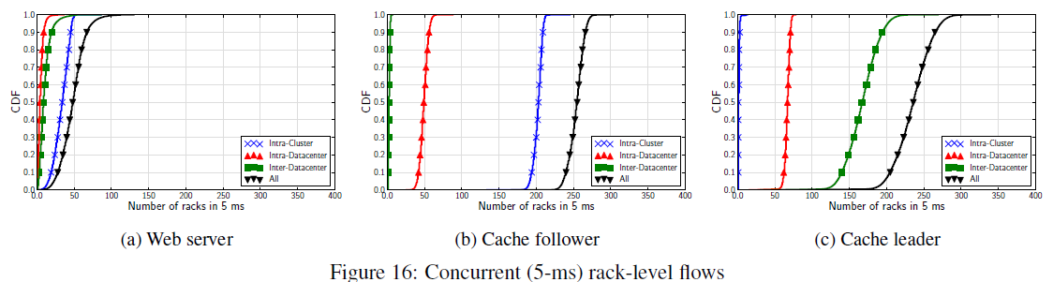
Concurrent Flows
Web servers and cache hosts have 100s to 1000s of concurrent connections, while Hadoop nodes have approximately 25 concurrent connections on average

Slide 29
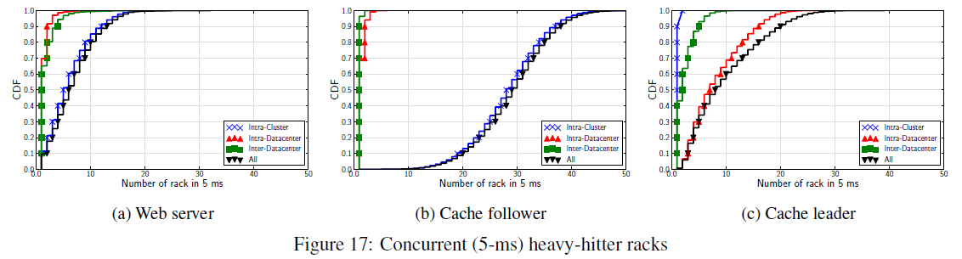
Concurrent Flows
consider flows at the rack level
the number of different racks with which an individual host is communicating with

Slide 30
Review
Facebook’s datacenter fabric
Traffic locality
Heavy hitters

