Slide 1
A Scalable, Commodity Data Center Network Architecture
Mohammad Al-Fares, Alexander Loukissas, Amin Vahdat
SIGCOMM 2008
Presented by Ye Tian for Course CS05112

Slide 2
Overview
Background
Fat tree based solution
Implementation and evaluation
Review

Slide 3


Data centers
Clusters of thousands of computers
Where the Internet lives
Google
Facebook
http://www.google.com/about/datacenters/inside/streetview/

Slide 4
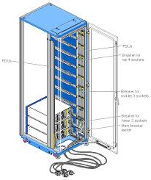
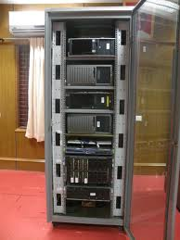
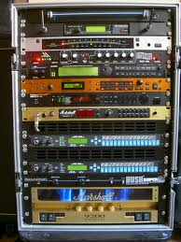
Data center racks

Slide 5

What is datacenter?

Slide 6
DC Communications
Plenty of M2M communications, the principle bottleneck in large-scale clusters is often inter-node communication bandwidth.
MapReduce: must perform significant data shuffling to transport the output of its map phase before proceeding with its reduce phase.
Web search engine: often requires parallel communication with every node in the cluster hosting the inverted index to return the most relevant results
Managed by one single authority

Slide 7
Two approaches for DC network
Approach 1: Specialized hardware and communication protocols
For example: InfiniBand, Myrinet
Do not leverage commodity parts, expensive
Not compatible with TCP/IP applications
Approach 2: Leverages commodity Ethernet switches and routers to interconnect cluster machines.
But how?
Notes:
leverage:n. 手段，影响力；杠杆作用；杠杆效率v. 利用；举债经营 commodity:商品
compatible:兼容的
Ethernet:以太网

Slide 8
Desired Properties for a DC Network Architecture
Scalable interconnection bandwidth: an arbitrary host in the data center can communicate with any other host in the network at the full bandwidth of its local network interface.
Economies of scale: make cheap off-the-shelf Ethernet switches the basis for large scale data center networks.
Backward compatibility: the entire system should be backward compatible with hosts running Ethernet and IP.
Notes:
可度量的互联带宽
经济度量
向后兼容

Slide 9
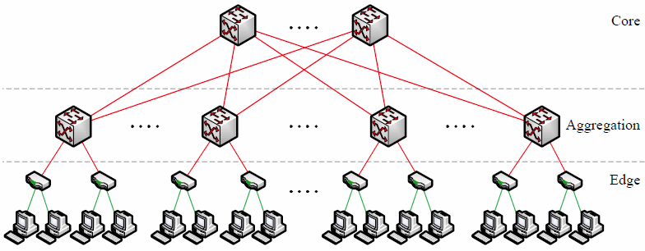
Current Data Center Network Topologies

Slide 10
Current Data Center Network Topologies
Three tiers: core, aggregation, edge (ToR switch)
Two types of switches:
48-port GigE switch, with four 10 GigE uplinks, used at the edge of the tree
128-port 10 GigE switch for higher levels of a communication hierarchy

Slide 11
Problems of the Topology
Oversubscription: the ratio of the worst-case achievable aggregate bandwidth among the end hosts to the total bisection bandwidth of a particular communication topology.
Ideal: 1:1: all hosts may potentially communicate with arbitrary other hosts at the full bandwidth of their network interface
Typical designs are oversubscribed by a factor of 2.5:1 (400 Mbps) to 8:1 (125 Mbps)
Notes:
ratio：比率

Slide 12
Problems of the Topology
Multi-path Routing: Delivering full bandwidth between arbitrary hosts in larger clusters requires a “multi-rooted” tree with multiple core switches
ECMP performs static load-balance, not a good choice （各路径的带宽、时延和可靠性等不一样，Cost = hop count，不能很好地利用带宽，尤其在路径间差异大时，效果会非常不理想）
Notes:
ECMP（Equal-CostMultipathRouting）等价多路径，存在多条不同链路到达同一目的地址的网络环境中，如果使用传统的路由技术，发往该目的地址的数据包只能利用其中的一条链路，其它链路处于备份状态或无效状态，并且在动态路由环境下相互的切换需要一定时间，而等值多路径路由协议可以在该网络环境下同时使用多条链路，不仅增加了传输带宽，并且可以无时延无丢包地备份失效链路的数据传输。
ECMP最大的特点是实现了等值情况下，多路径负载均衡和链路备份的目的，在静态路由和OSPF中基本上都支持ECMP功能。
但是实际情况是，各路径的带宽、时延和可靠性等不一样，把Cost认可成一样，不能很好地利用带宽，尤其在路径间差异大时，效果会非常不理想。例如，路由器两个出口，两路径，一个带宽是100M，一个是2M，如果部署是ECMP，则网络总带宽只能达到4M的利用率。

Slide 13
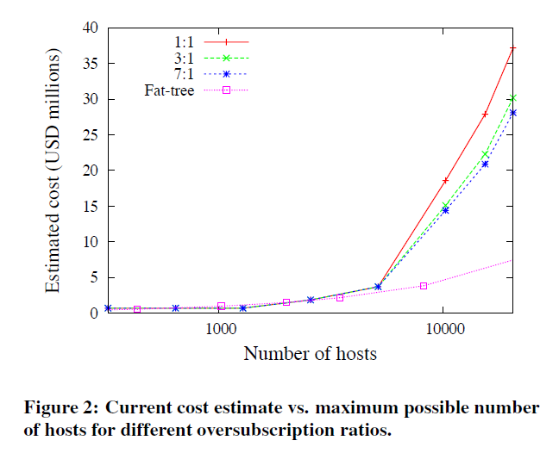
Problems of the Topology
Cost: 保证一定的oversubscription，cost会随规模急剧增加。
Notes:
topology:拓扑学

Slide 14
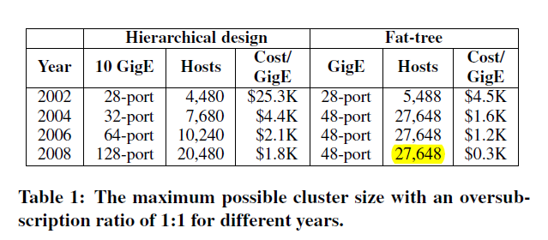
Problems of the Topology
Cost:
Using the largest 10 GigE and GigE switches to build a datacenter with 1:1 oversubscription
A cluster can be up to 27,648 hosts

Slide 15
Overview
Background
Fat tree based solution
Implementation and evaluation
Review

Slide 16
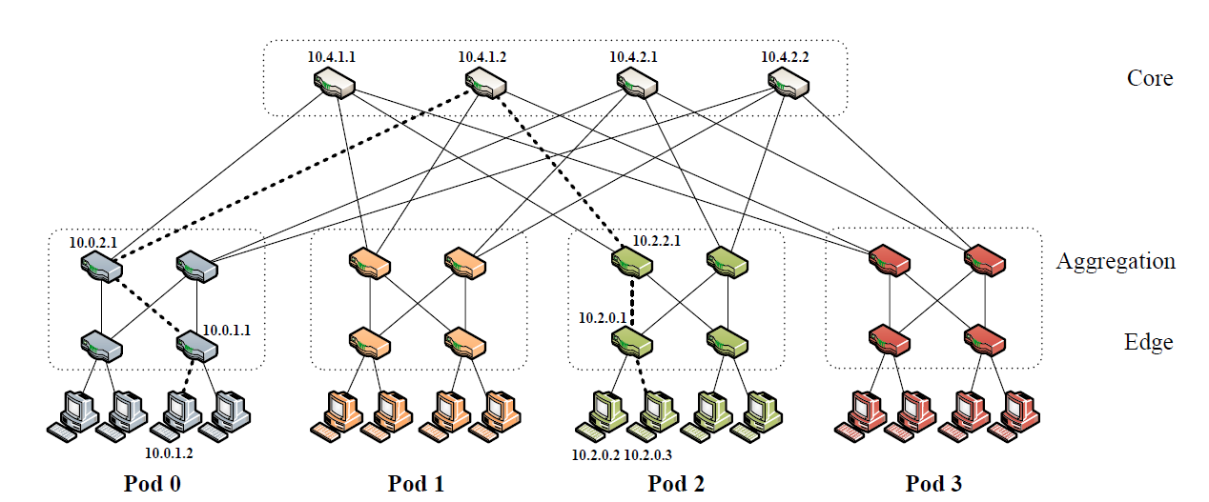
Fat-tree

Slide 17
Fat-tree
k pods, each containing two layers of k/2 switches.
Each k-port switch in the lower layer is directly connected to k/2 hosts. Each of the remaining k/2 ports is connected to k/2 of the k ports in the aggregation layer.

Slide 18
Fat-tree
(k/2)² k-port core switches. Each has one port connected to each of k pods. The i^{th} port of any core switch is connected to pod i such that consecutive ports in the aggregation layer of each pod switch are connected to core switches on (k/2) strides.
Notes:
consecutive:连续的

Slide 19
Fat-tree
Focus on designs up to k = 48.
Use identical 48-port GigE switches.
The network supports 27,648 hosts, made up of 1,152 subnets with 24 hosts each. There are 576 equal-cost paths between any given pair of hosts in different pods.
The cost of deploying such a network architecture would be $8.64M, compared to $37M for the traditional techniques.
Notes:
27648 = 24*24*48

Slide 20
Architecture Design
Motivation
There are (k/2)² shortest-paths between any two hosts on different pods, but only one is chosen.
Protocols like OSPF selects path based on hop counts. it is possible for a small subset of core switches, perhaps only one, to be chosen as the intermediate links between pods.
Need a simple, fine-grained method of traffic diffusion.

Slide 21
Addressing
All IP addresses in the network within the private 10.0.0.0/8 block.
The pod switches are given addresses of the form 10.pod.switch.1,
pod denotes the pod number (in [0, k−1]),
switch denotes the position of that switch in the pod (in [0, k−1], starting from left to right, bottom to top).
Give core switches addresses of the form 10.k.j.i,
j and i denote that switch’s coordinates in the (k/2)² core switch grid (each in [1, (k/2)], starting from top-left).

Slide 22
Two-level Routing Table
Each entry in the main routing table will potentially have an additional pointer to a small secondary table of (suffix, port) entries.
A first-level prefix is terminating if it does not contain any second level suffixes,
A secondary table may be pointed to by more than one first-level prefix.

Slide 23
Two-level Routing Table
Entries in the primary table are left-handed (i.e., /m prefix masks of the form 1^{m}0^{32−m}), entries in the secondary tables are right-handed (i.e. /m suffix masks of the form 0^{32−m}1^{m}).
If the longest-matching prefix search yields a non-terminating prefix, then the longest-matching suffix in the secondary table is found and used.
Notes:
Not the longest prefix/suffix match, it is exact match.

Slide 24
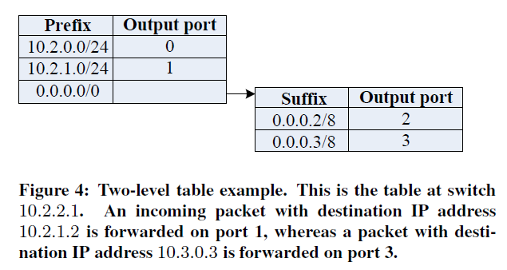
Two-level Routing Table
The routing table of any pod switch will contain no more than k/2 prefixes and k/2 suffixes.

Slide 25
Routing Algorithm
Pod switches
If a host sends a packet to another host in the same pod but on a different subnet, then all upper-level switches in that pod will have a terminating prefix pointing to the destination subnet’s switch.

Slide 26
Routing Algorithm
Pod switches
For all other outgoing inter-pod traffic, the pod switches have a default /0 prefix with a secondary table matching host IDs. Employ the host IDs as a source of deterministic entropy; they will cause traffic to be evenly spread upward among the outgoing links to the core switches3

Slide 27
Routing Algorithm
Aggregation switches
Once a packet reaches its destination pod, the receiving upper-level pod switch will also include a (10.pod.switch.0/24, port) prefix to direct that packet to its destination subnet switch, where it is finally switched to its destination host.

Slide 28
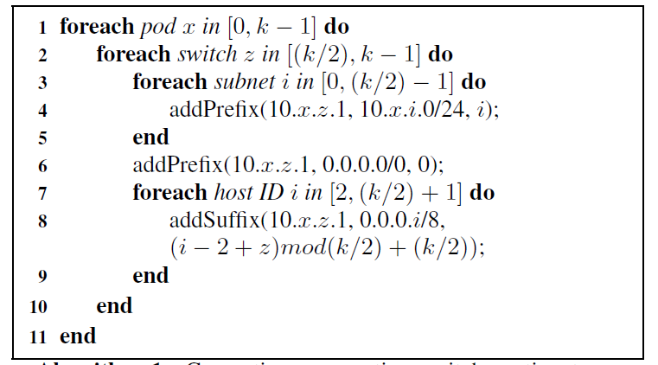
Generating upper aggregation switch routing table;
For lower switches, omit line 3-5.
Notes:
前者确定上层的switch，后者确定连接的端口后，因为下层的swith肯定是确定的

Slide 29
Routing Algorithm
Core switches
Assign terminating first-level prefixes for all network IDs, each pointing to the appropriate pod containing that network.
Once a packet reaches a core switch, there is exactly one link to its destination pod, and that switch will include a terminating /16 prefix for the pod of that packet (10.pod.0.0/16, port).

Slide 30
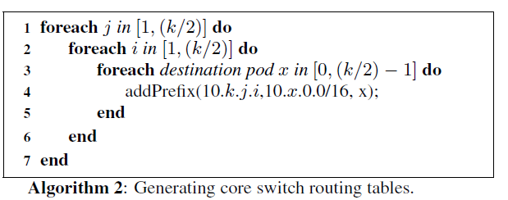
Notes:
pod的数目应该是 0 ~ k-1

Slide 31
An Example
Source: 10.0.1.2; destination: 10.2.0.3
At the gateway switch (10.0.1.1), matches with the /0 first-level prefix, then matches with the 0.0.0.3/8 secondary-level suffix, then forward to port 2, and routed to the pod switch 10.0.2.1.
(i=3, z=1)
Follow the same steps and forwards on port 3, and routed to the core switch at 10.4.1.1;
(i=3, z=2)

Slide 32
An Example
Matches a terminating 10.2.0.0/16 prefix, which points to pod 2 on port 2, and switch 10.2.2.1.
Matches a terminating prefix 10.2.0.0/24, which points to the switch responsible for that subnet, 10.2.0.1 on port 0.
How about the destination becomes 10.2.0.2?

Slide 33
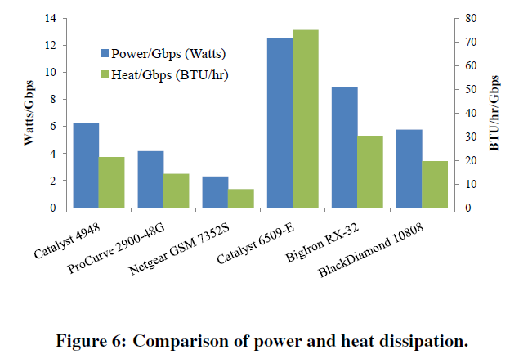
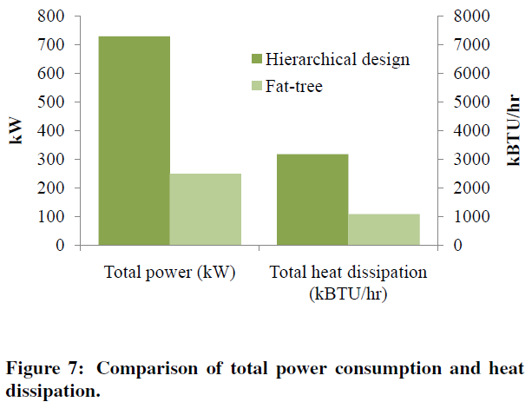
Power and Heat Issues
不同Switch的能耗效率，后三个是10GigE的switch
Employs more individual switches, is superior to those incurred by current data center designs, with 56.6% less power consumption and 56.5% less heat dissipation.

Slide 34
Overview
Background
Fat tree based solution
Implementation and evaluation
Review

Slide 35
Implementation
Implement router prototype with Click.
Support the two-level routing table
4-ports
The Click Modular Router Project
a new software architecture for building flexible and configurable routers
http://read.cs.ucla.edu/click/

Slide 36
Experiment Description
Implement a 4-port fat-tree (k=4): there are 16 hosts, four pods (each with four switches), and four core switches.
Multiplex these 36 elements onto ten physical machines, interconnected by a 48-port ProCurve 2900 switch with 1 Gigabit Ethernet links.
Each pod of switches is hosted on one machine; each pod’s hosts are hosted on one machine; and the two remaining machines run two core switches each.

Slide 37
Experiment Description
For the comparison case of the hierarchical tree network, four machines running four hosts each, and four machines each running four pod switches with one additional uplink.

Slide 38
Benchmark Suite
Random: A host sends to any other host in the network with uniform probability.
Stride(i): A host with index x will send to the host with index (x+i) mod 16.
Staggered Prob (SubnetP,PodP): Where a host will send to another host in its subnet with probability SubnetP, and to its pod with probability PodP, and to anyone else with probability 1−SubnetP−PodP.

Slide 39
Benchmark Suite
Inter-pod Incoming: Multiple pods send to different hosts in the same pod, and all happen to choose the same core switch. That core switch’s link to the destination pod will be oversubscribed. The worst-case local oversubscription ratio for this case is (k−1):1.

Slide 40
Benchmark Suite
Same-ID Outgoing: Hosts in the same subnet send to different hosts elsewhere in the network such that the destination hosts have the same host ID byte. Static routing techniques force them to take the same outgoing upward port. The worst-case ratio for this case is (k/2):1.

Slide 41
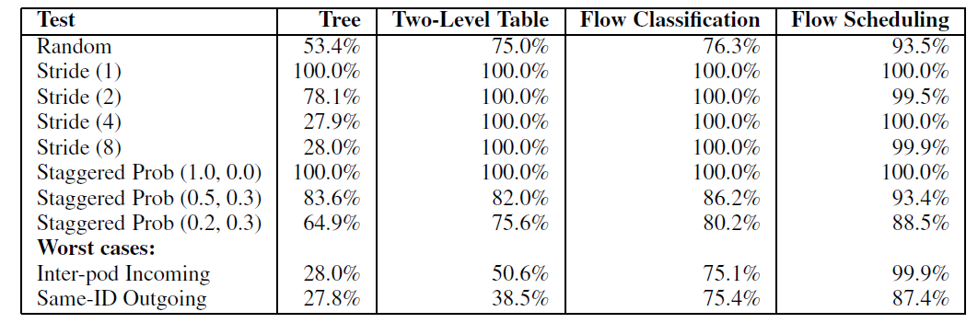
Results
Aggregate Bandwidth of the network, as a percentage of ideal bisection bandwidth. The ideal bisection bandwidth for the fat-tree network is 1.536Gbps

Slide 42
Review
What is the datacenter network? What is the desired property of the datacenter network?
What is the traditional three-tier topology for the datacenter, its limitations?
How Fat-tree differs from the traditional design? In
Topology
Addressing
Routing paradigm

