Slide 1
PortLand: A Scalable Fault-Tolerant Layer 2 Data Center Network Fabric
Radhika Niranjan Mysore, Andreas Pamboris, Nathan Farrington, Nelson Huang, Pardis Miri, Sivasankar Radhakrishnan, Vikram Subramanya, Amin Vahdat
SIGCOMM 2009
Presented by Ye Tian for Course CS05112

Slide 2
Overview
Background
Design
Implementation
Evaluation

Slide 3
Cloud Datacenters
Mega data centers
Increasing trend toward migrating applications, computation and storage into data centers.
A web search request may involve thousands of servers.
Current layer 2 and layer 3 network protocols impose significant management overhead at this scale.
Not scalable, not efficient
Ideally, data center network architects and administrators would have “plug-and-play” deployment for switches.

Slide 4
Requirements for Future
R1. Any VM may migrate to any physical machine.
should not have to change their IP addresses as doing so will break pre-existing TCP connections and application-level state.
R2. An administrator should not need to configure any switch before deployment.
DHCP/subnet require configuration
R3. Any end host should be able to efficiently communicate with any other end host in the data center along any of the available physical communication paths.
R4. There should be no forwarding loops.
R5. Failures will be common at scale, so failure detection should be rapid and efficient.

Slide 5
Limitations of current protocols
R1 and R2
Can be satisfied with a single layer 2 fabric, but layer 2 fabrics not scalable, need to support broadcasting.
A layer 3 fabric can not support VM migration .
R3
Layer 2: Require large number of MAC forwarding table entries, not feasible
R4 and R5
Layer 2 and 3 protocols (i.e. IS-IS, OSPF) are broadcast based, not efficient enough

Slide 6
Background
Topology: hierarchical network tree
Fat-tree
Forwarding:
Layer 3 forwarding will impose administrative burden. Manual configuration on switches (e.g., DHCP)
An error prone process
Layer 2 forwarding does not scale to networks with tens of thousands of hosts. And STP (spanning tree protocol) would limit performance.

Slide 7
Background
End Host Virtualization
Why? Packing VMs on smallest physical footprint; changing communication patterns; saving energy
To migrate a VM from one physical machine to another, layer 2 and Layer 3 both have some challenges.
Layer 3: need to configure new IP address based on subnet
Layer 2: scaling ARP and performing routing/forwarding on millions of at MAC addresses

Slide 8
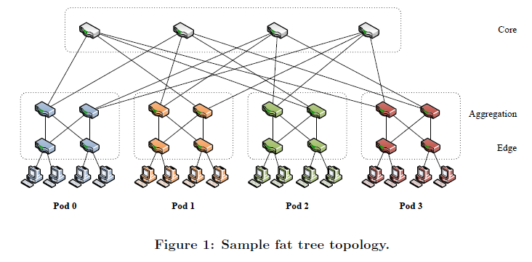
Fat Tree Networks
A three-stage fat tree built from k-port switches can support non-blocking communication among k³/4 end hosts using 5k²/4 individual k-port switches. We split the fat tree into three layers, labeled edge, aggregation and core as in Figure 1. The fat tree as a whole is split into k individual pods, with each pod supporting non-blocking operation among k²/4 hosts.

Slide 9
Overview
Background
Design
Implementation
Evaluation

Slide 10
Fabric Manager
PortLand employs a logically centralized fabric manager that maintains soft state about network configuration information such as topology.
In PortLand, we restrict the amount of centralized knowledge and limit it to soft state. In this manner, we eliminate the need for any administrator configuration of the fabric manager (e.g., number of switches, their location, their identifier).
Replicated with a primary asynchronously updating state on one or more backups.

Slide 11
Positional Pseudo MAC Addresses
PMAC : encodes the location of an end host in the topology.
The end hosts remain unmodified actual MAC (AMAC) addresses.
Hosts performing ARP requests receive the PMAC of the destination host.
All packet forwarding proceeds based on PMAC addresses.
Egress switches perform PMAC to AMAC header rewriting to maintain unmodified MAC at the destination host.

Slide 12
PMAC
AMAC

Slide 13
PMAC
PortLand edge switches learn a unique pod number and a unique position number within each pod.
48-bit PMAC: pod:position:port:vmid
pod (16 bits): the pod number of the edge switch
position (8 bits): edge switch’s position in the pod
port (8 bits): the switch-local view of the port number the host is connected to.
vmid (16 bits): multiplex multiple virtual machines on the same physical machine
PortLand times out vmid's without any tracffic and reuses them.

Slide 14
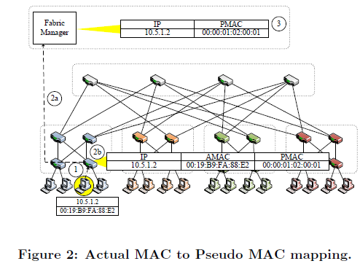
PMAC

Slide 15
PMAC
Step1: When an ingress switch sees a source MAC address never observed before, the packet is vectored to the switch software.
Step 2a: The software creates an entry in a local PMAC table mapping the host's AMAC and IP address to its PMAC.
Step 2b: The switch constructs the PMAC as described above and communicates this mapping to the fabric manager.
Step 3: The fabric manager uses this state to respond to ARP requests. The switch also creates the appropriate flow table entry to rewrite the PMAC destination address for any traffic destined to the host.
Implemented with OpenFlow

Slide 16
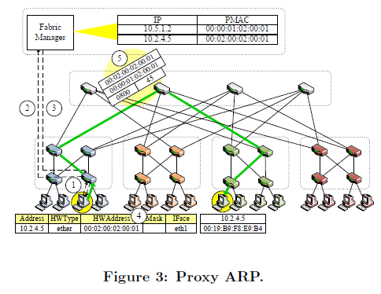
Proxy-based ARP

Slide 17
Proxy-based ARP
Step 1-2: An edge switch intercepts an ARP request for an IP to MAC address mapping and forwards the request to the fabric manager.
Step 3: The fabric manager consults its PMAC table to see if an entry is available for the target IP address. If so, it returns the PMAC to the edge switch.
Step 4: The edge switch creates an ARP reply and returns it to the original host.

Slide 18
Proxy-based ARP
If the fabric manager does not have the IP to PMAC mapping available, the fabric manager will fall back to broadcast to all end hosts to retrieve the mapping.
The ARP is transmitted to any core switch, which in turn distributes it to all pods and finally all edge switches. The target host will reply with its AMAC, which will be rewritten by the ingress switch to the appropriate PMAC before forwarding to both the querying host and the fabric manager.
Forwarding in each switch requires just O(k) state using hierarchical PMAC addresses.

Slide 19
Distributed Location Discovery
A Location Discovery Protocol (LDP)
PortLand switches periodically send a Location Discovery Message (LDM) out all of their ports, both to set their positions and to monitor liveness in steady state, including:
Switch identifier (switch id): a globally unique identifier for each switch, e.g., the lowest MAC address of all local ports.
Pod number (pod): a number shared by all switches in the same pod.
Position (pos): a number assigned to each edge switch, unique within each pod.
Tree level (level): 0, 1, or 2 depending on whether the switch is an edge, aggregation, or core switch.
Up/down (dir): Up/down is a bit which indicates whether a switch port is facing downward or upward in the multi-rooted tree.
Initially, all values other than the switch identifier and port number are unknown

Slide 20
Distributed Location Discovery
Figure out the tree level:
Edge switches learn their level by determining that some fraction of their ports are host connected.
Aggregations switches set their level once they learn that some of their ports are connected to edge switches.
Finally, core switches learn their levels once they confirm that all ports are connected to aggregation switches.

Slide 21
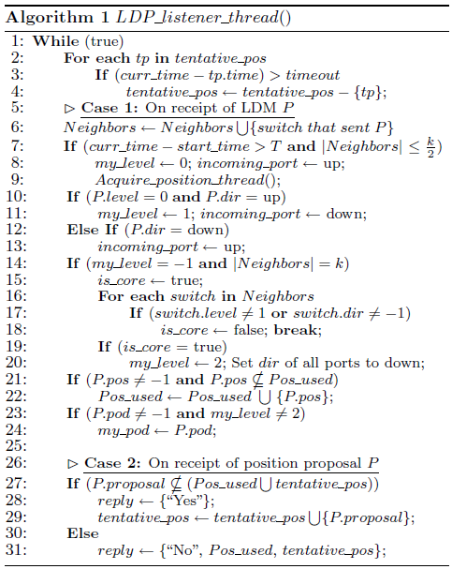
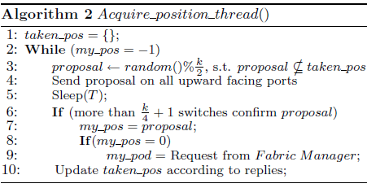

Slide 22
Distributed Location Discovery
Edge switch: if a switch is not connected to more than k/2 neighbor switches for sufficiently long, it concludes that it is an edge switch.
On any subsequent LDM it receives, an edge switch infers that the corresponding incoming port is an upward facing one.
Aggregation switch: a switch receiving an LDM from an edge switch on an upward facing port concludes that it must be an aggregation switch and that the corresponding incoming port is a downward facing port.

Slide 23
Distributed Location Discovery
Core switch: A switch that has not yet established its level first verifies that
all of its active ports are connected to other PortLand switches.
all neighbors are aggregation switches that have not yet set the direction of their links .
If these conditions hold, the switch can conclude that it is a core switch and set all its ports to be downward facing.

Slide 24
Distributed Location Discovery
Edge switches must acquire a unique position number in each pod in the range of 0 .. k/2-1.
Each edge switch proposes a randomly chosen number in the appropriate range to all aggregation switches in the same pod. If the proposal is verified by a majority of these switches as unused and not tentatively reserved, the proposal is finalized and this value will be included in future LDMs from the edge switch.
The edge switch that adopts position 0 requests a pod number from the fabric manager.

Slide 25
Provably Loop Free Forwarding
Once switches establish their local positions using LDP, they employ updates from their neighbors to populate their forwarding tables.
Core switches learn the pod number of directly-connected aggregation switches.
Aggregation switches learn the position number of all directly connected edge switches.
For aggregation switches, if the destination is in the same pod, then forward it according to the position entry in PMAC; if the dest is not in the same pod, then should forward it to the core layer. Choose a load-balancing technique.
Once a packet begins to travel down, it is not possible for it to travel back up the topology.
No loop

Slide 26
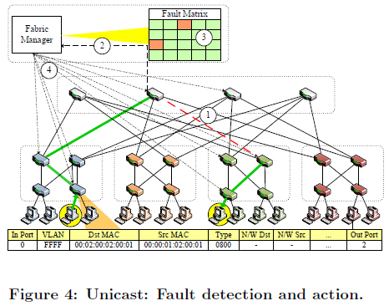
Fault Tolerant Routing

Slide 27
Fault Tolerant Routing
Step 1: Upon not receiving an LDM (also referred to as a keepalive in this context) for some configurable period of time, a switch assumes a link failure.
Step 2: The detecting switch informs the fabric manager about the failure.
Step 3: The fabric manager maintains a logical fault matrix with per-link connectivity information for the entire topology and updates it with the new information in step 3.
Step 4: The fabric manager informs all affected switches of the failure, which then individually recalculate their forwarding tables based on the new version of the topology.

Slide 28
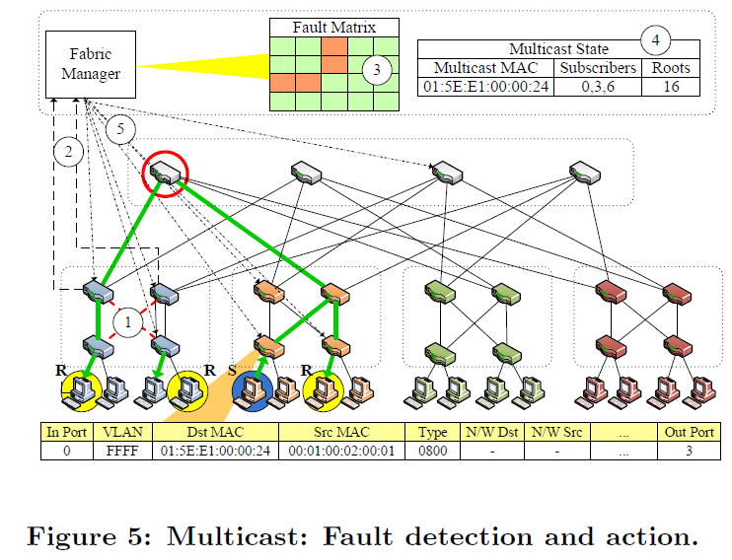
Fault Tolerant Routing for Multicast

Slide 29
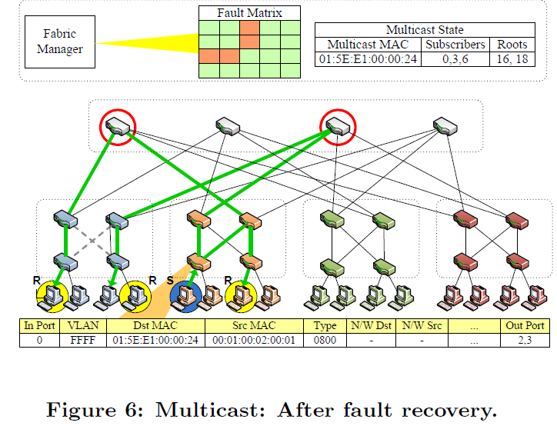
Fault Tolerant Routing for Multicast

Slide 30
Fault Tolerant Routing for Multicast
Step 1: two highlighted links in pod 0 simultaneously fail.
Step 2: two aggregation switches detect the failure .
Step 3: the switches notify the fabric manager, which in turn updates its fault matrix.
Step 4: The fabric manager calculates forwarding entries for all affected multicast groups.

Slide 31
Fault Tolerant Routing for Multicast
Recovering from the failure requires forwarding through two separate aggregation switches in pod 0.
However, there is no single core switch with simultaneous connectivity to both aggregation switches.
A set cover problem (集合覆盖问题), can be greedily solved. (Step 5)

Slide 32
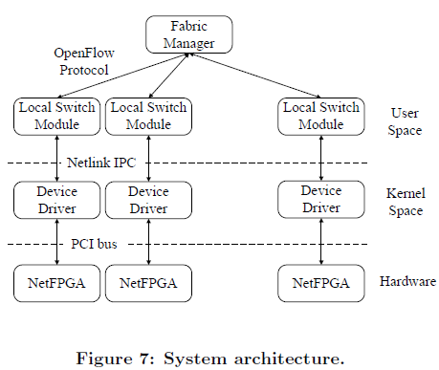
Implementation
Testbed consists of 20 4-port NetFPGA PCI card switches. The switches run OpenFlow v0.8.9r2, which provides the means to control switch

Slide 33
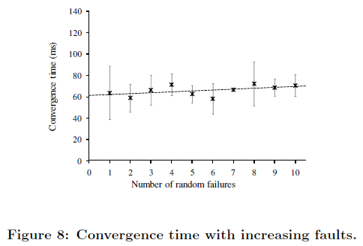
Evaluation – UDP
A 250Mbps inter-pod UDP flow, at least one of the failures falls on the default path between sender and receiver.

Slide 34
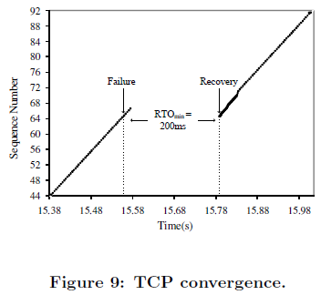
Evaluation – TCP
Inject a link failure along the path between sender and receiver
Convergence for TCP flows takes longer than the baseline for UDP because TCP loses an entire window worth of data. TCP's RTOmin set to 200ms in our system.

Slide 35
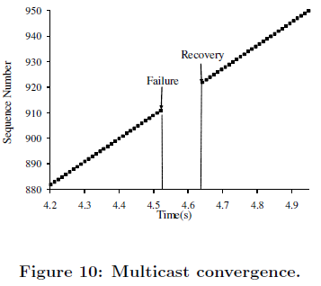
Evaluation – Multicast
Sender transmits a multicast flow to a group consisting of 3 subscribers
At 4.5 sec, inject two failures causing one receiver to lose connectivity
After 110ms, connectivity is restored. Individual switches detect the failures and notify the fabric manager, which in turn reconfigures appropriate switch forwarding tables.

Slide 36
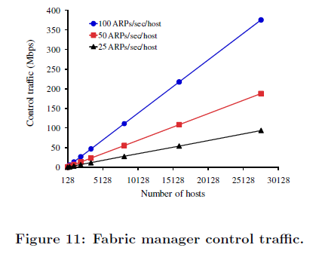
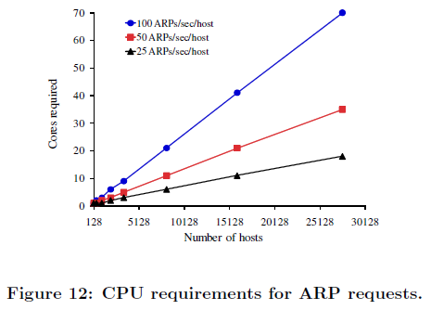
Evaluation – Scalability
Bandwidth and CPU usage for fabric manager
ARP requests can be handled in parallel

Slide 37
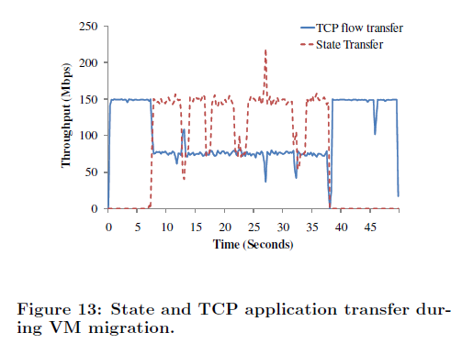
Evaluation – VM Migration
A sender transmits data at 150 Mbps to a virtual machine (hosted on Xen) running on a physical machine in one pod.
We then migrate the virtual machine to a physical machine in another pod.

Slide 38
Conclusions
A single plug-and-play fabric.
Ethernet-compatible routing, forwarding, and address resolution protocols specifically tailored for data center deployments.
Enable a more flexible, efficient, and fault tolerant cloud datacenter network

Slide 39
Review
Why existing L2 and L3 techniques have limitations in satisfying R1-5 for the cloud datacenter?
How PortLand satisfies R1 – R5?

