Slide 1
Networking Named Content
Van Jacobson, Diana K. Smetters, James D. Thornton, Michael F. Plass, Nicholas H. Briggs, Rebecca L. Braynard
CoNEXT 2009
Presented by Ye Tian for Course CS05112

Slide 2
Overview
Motivation and Introduction
CCN Node Model
Transport
Routing
Content-based Security
Evaluation
Review

Slide 3
Motivation
Network use has evolved since IP was designed
Usage of the Internet is in terms of what not where
Issues:
Availability: awkward, pre-planned, application-specific mechanisms are required. Example: P2P, CDN.
Security: Trust in content is easily misplaced, relying on untrustworthy location and connection information.
Location-dependence: Mapping content to host locations complicates configuration as well as implementation.
Attack DNS.

Slide 4
Motivation
Evolutionary approaches:
IPv6
IPSec
Mobile IP
DiffServ
DHT

Slide 5
Introduction
Host-Centric Networking
In 1960’s and 1970’s – resource sharing
Computers, disk drives, tape drives, printers etc. needed to be shared
This lead into a communication model with two machines – one using and one providing resources over the network
IP packets with source and destination
Most of the traffic is TCP connections

Slide 6
Introduction
Content-Centric Networking (CCN)
In 2009 alone 500 exabytes (5 x 10²⁰ B) of content created.
Users are interested in what content – not where it is
CCN – a communication architecture built on named data
“Address” names content – not location
Preserve the design decisions that make TCP/IP simple, robust and scalable

Slide 7
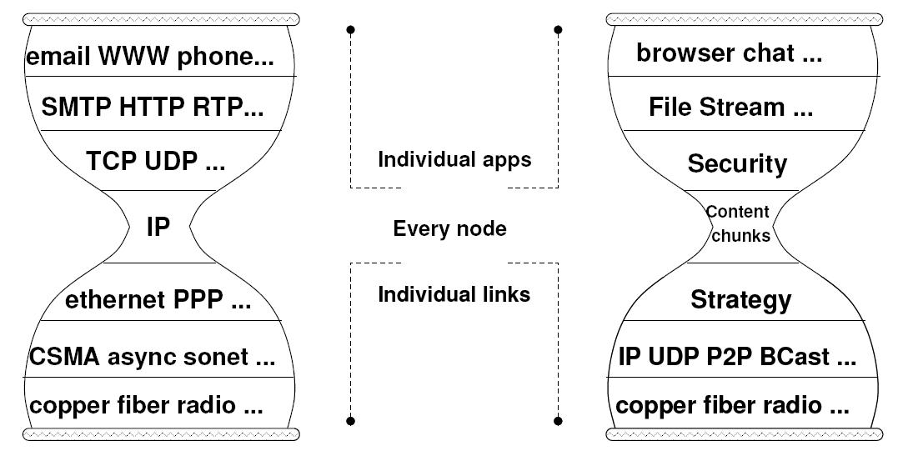
Introduction
From IP to chunks of named content
Only layer 3 requires universal agreement

Slide 8
Overview
Motivation
CCN Node Model
Transport
Routing
Content-based Security
Evaluation
Review

Slide 9
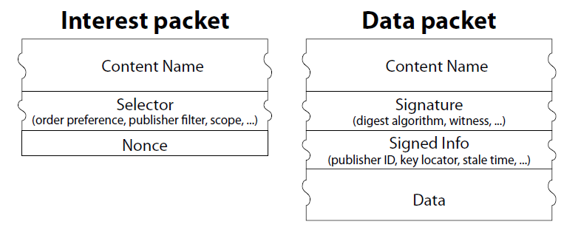
CCN Node Model
Two packet types: Interest and Data

Slide 10
CCN Node Model
CCN node has 3 components: FIB, Content Store and PIT
FIB: Forwarding table, allows multiple output faces
Content Store: Buffer, also caches Data packets
PIT: Pending Interest Table
Consumer broadcasts its Interest over all available connectivity
Data is transmitted only in response to Interest and consumes that Interest
Data satisfies an Interest if ContentName in the Interest is a prefix of that in the Data, e.g.,
Interest: cn/edu/ustc/cs/
Data: cn/edu/ustc/cs/welcome.msg

Slide 11
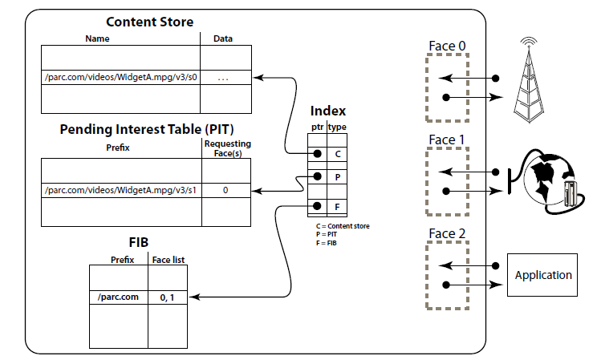
CCN Node Model

Slide 12
CCN Node Model
FIB allows a list of outgoing interfaces – multiple sources of data
Content Store w/ LRU or LFU replacement
PIT keeps track of Interest forwarded up-stream => Data can be sent downstream
Interest packets are routed upstream – Data packets follow the same path down
Each PIT entry is a “bread crumb” marking the path and is erased after it’s been used

Slide 13
CCN Node Model
Processing an Interest:
Matching Data is found in the Content Store => send it and consume Interest
Pending Interest in PIT => add this face to RequestingFaces list
Use FIB to forward Interest on outgoing faces, add to PIT
Processing Data:
Data follows a chain of PIT entries back to the source
Duplicate and unsolicited Data is discarded

Slide 14
CCN Node Model
Example FIB:
Name prefix | Face list | Next hop
cn/edu/ustc/ | 1 2 | B
cn/edu/ustc/cs/ | 1 3 | C
Example PIT:
Interest | Requesting Faces
cn/edu/ustc/badge.jpg | 3
cn/edu/ustc/cs/welcome.msg | 3 4

Slide 15
Overview
Motivation
CCN Node Model
Transport
Routing
Content-based Security
Evaluation
Review

Slide 16
Transport
CCN transport is designed to operate on unreliable packet delivery services
Senders are stateless
Receivers keep track of unsatisfied Interests and ask again after a time-out
The receiver’s strategy layer is responsible for retransmission, selecting faces, limiting the number of unsatisfied Interests, priority
One Interest retrieves at most one Data packet => flow balance

Slide 17
Transport: Flow
Flow balance allows for efficient communication between machines with highly different speeds
In CCN, all communication is local and flow balance is maintained over each hop
This leads into end-to-end flow control without any end-to-end mechanisms

Slide 18
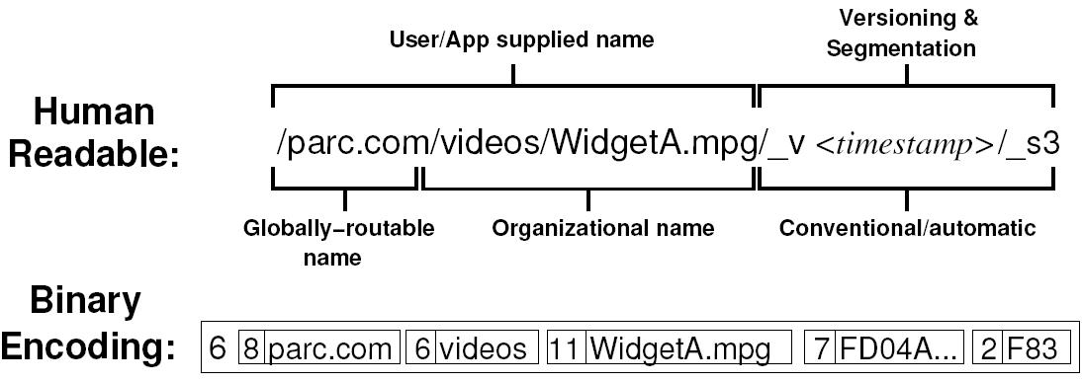
Transport: Naming
CCN is based on hierarchical, aggregatable names at least partly meaningful to humans
The name notation used is like URI

Slide 19
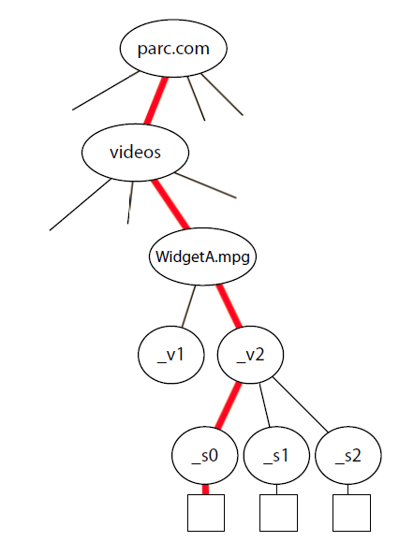
Transport: Naming
An Interest can specify the content exactly
Content names can contain automatically generated endings used like sequence numbers
The last part of the name is incremented for the next chunk (e.g. a video frame)
The names form a tree which is traversed in preorder
In this way, the receiver can ask for the next Data packet in his Interest packet

Slide 20
Overview
Motivation
CCN Node Model
Transport
Routing
Content-based Security
Evaluation
Review

Slide 21
Routing: Intra-Domain Routing
Like IPv4 and IPv6 addresses, CCN ContentNames are aggregateable and routed based on longest match
However, ContentNames are of varying length and longer than IP addresses
The TLV (Type Label Value) of OSPF or IS-IS can distribute CCN content prefixes
Therefore, CCN Interest/Data forwarding can be built on existing infrastructure without any modification to the routers

Slide 22
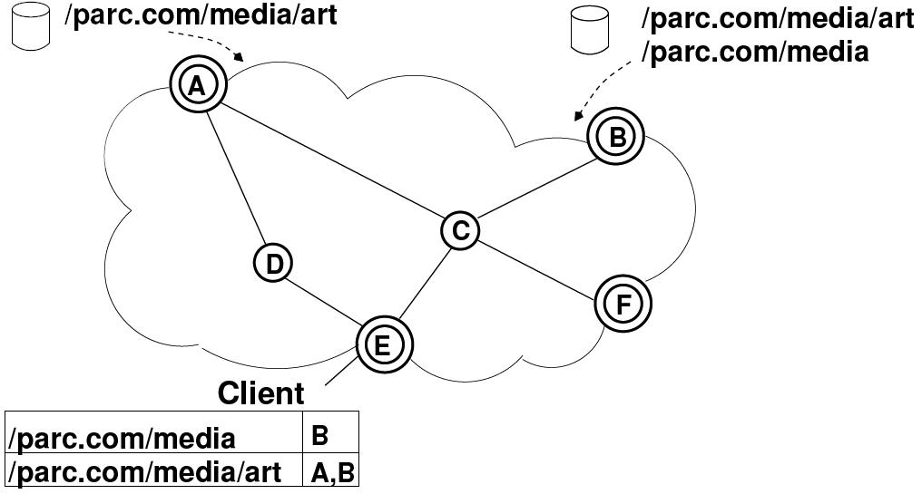
Routing: Intra-Domain Routing
An example of intra-domain routing

Slide 23
Routing: Inter-Domain Routing
The current BGP version has the equivalent of the IGP TLV mechanism
Through this mechanism, it is possible to learn which domains serve Interests in some prefix and what is the closest CCN-capable domain on the paths towards those domains
Therefore, it is possible to deploy CCN in the existing BGP infrastructure

Slide 24
Overview
Motivation
CCN Node Model
Transport
Routing
Content-based Security
Evaluation
Review

Slide 25
Content-based Security
In CCN, the content itself (rather than its path) is protected
One can retrieve the content from the closest source and validate it
All content is digitally signed
Signed info includes hash of the public key used for signing
We still need some kind of a Public Key Infrastructure (PKI)

Slide 26
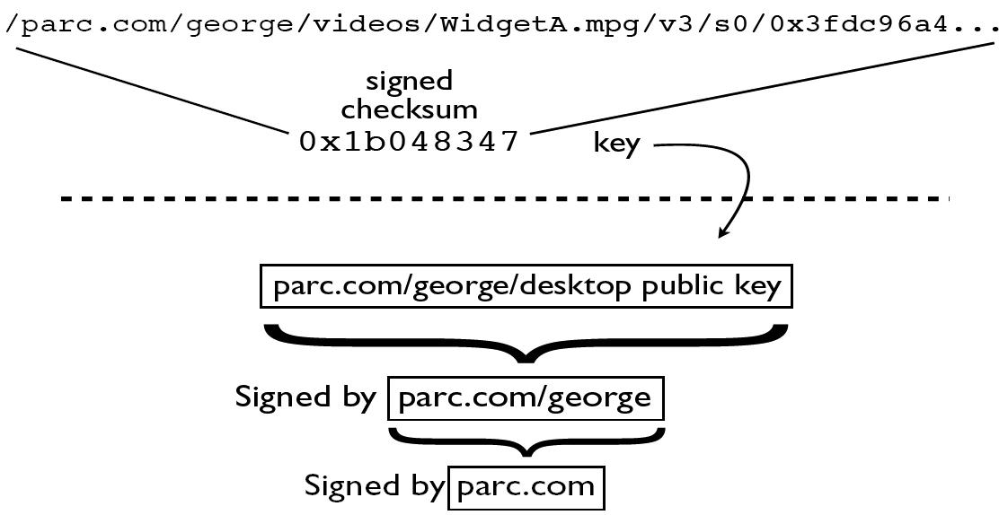
Content-based Security
Associating name spaces with public keys
Key for parc.com authorizing that of user george, who then authorizes the key for his desktop computer.

Slide 27
Overview
Motivation
CCN Node Model
Transport
Routing
Content-based Security
Evaluation
Review

Slide 28
Evaluation
The CCN architecture described has been implemented and evaluated
Voice over CCN and Content Distribution were tested with small networks
The results are interesting but don’t really tell us anything about the scalability of the design

Slide 29
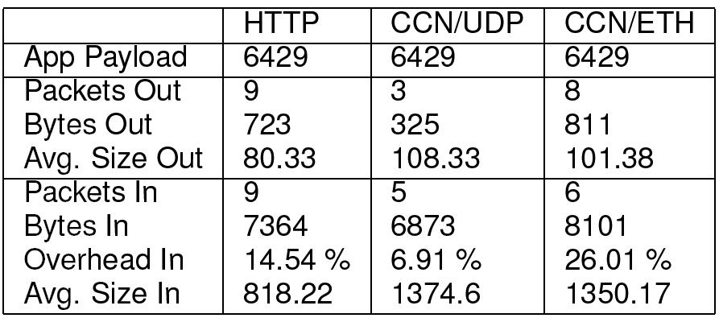
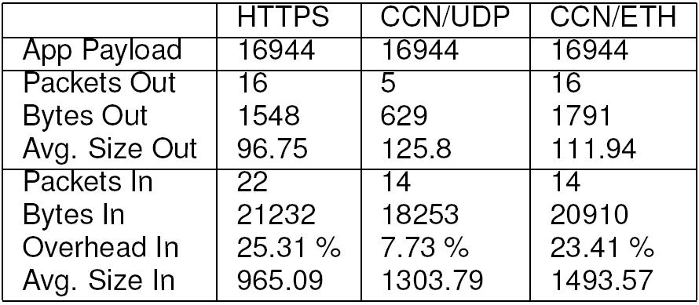
Evaluation: Data Transfer
Download a HTML file
Content transfer via CCN is always secure, yet the results show that it matches the performance of unsecured HTTP and substantially outperforms secure HTTPS.

Slide 30
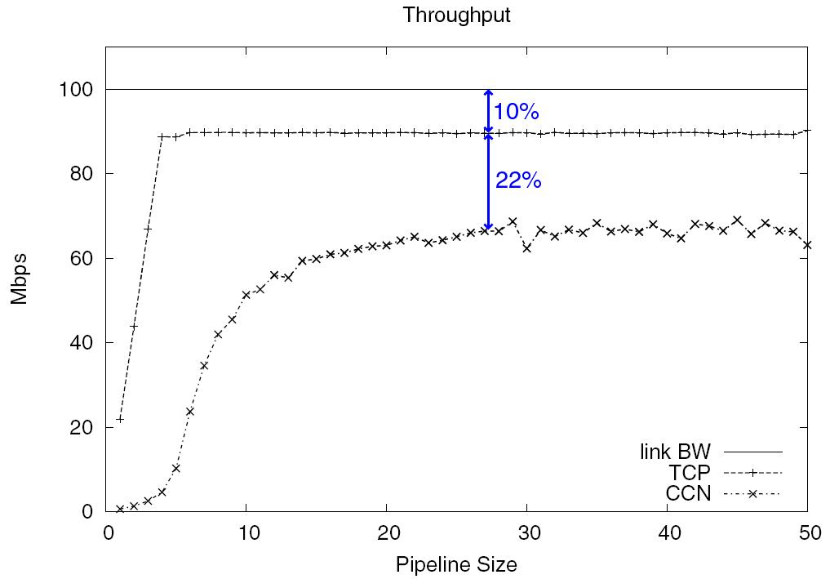
Evaluation: Data Transfer
Transfer a 6MB file as a function of the window size (TCP) and number of outstanding Interests (CCN).
Bulk data transfer efficiency of CCN is comparable to TCP
but lower due to its larger header overhead.

Slide 31
Evaluation: Content Distribution
A source node connected over a 10 Mbps shared link to a cluster of 6 sink nodes all interconnected via 1 Gbps links.
The machines were of various architectures (Intel, AMD, PowerPC G5) and operating systems (Mac OS X 10.5.8, FreeBSD 7.2, NetBSD 5.0.1, Linux 2.6.27).
The sinks simultaneously pulled a 6MB data file from the source.
For the TCP tests this file was made available via an http server on the source and retrieved by the sinks using curl.

Slide 32
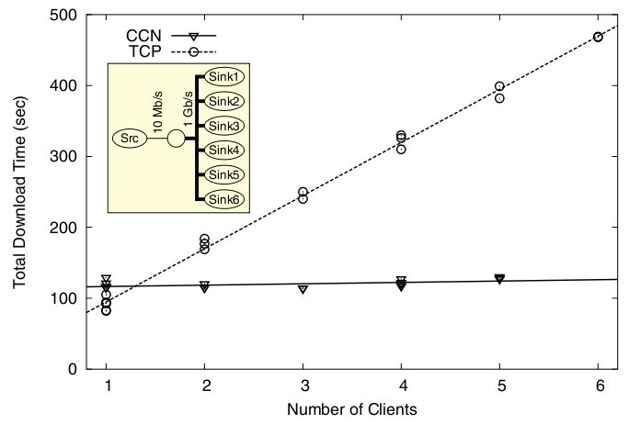
Evaluation: Content Distribution

Slide 33
Evaluation: Voice-over-CCN
Exploit two properties:
Can send Interest out multiple faces
A CCN node is guaranteed to see the Data sent in response to its Interest
The strategy layer to run experiments where an Interest is occasionally sent out all faces associated with the prefix.
If a face responds faster than the current best, it will become the new best and be used exclusively for the prefix’s Interests, until it is time for the next experiment.

Slide 34
Evaluation: Voice-over-CCN
Secure Voice over CCN was implemented using Linphone 3.0 and its performance evaluated
Caller encodes SIP INVITE as CCN name and sends it as an interest
On receipt of the INVITE, the callee generates a signed Data packet with the INVITE name as its name and the SIP response as its payload
From the SIP messages, the parties derive paired name prefixes under which they write RTP packets

Slide 35
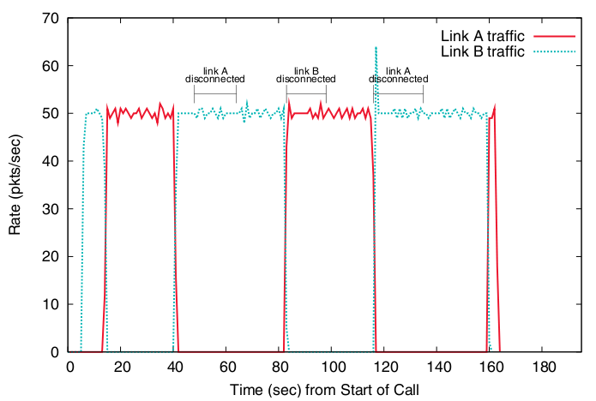
Evaluation: Voice-over-CCN

Slide 36
Discussion
Merits of CCN
Very understandable scheme
Shown to work also with streamed media
Clever reuse of existing mechanisms
Easy to implement based on current routing software
Easy to deploy on existing routing protocols and IP networks
Easy, human-readable naming scheme

Slide 37
Discussion
Concerns:
The simple hierarchical (URI-like) naming scheme is also a limitation
Will CCN scale to billions of nodes?
Flooding (send out through all available faces)
Flow balance – an Interest for every Data
How large can the FIB grow (soft state)?
Data takes the same (possibly non-optimal) path as Interest
Are the performance measurements made with only a couple of hosts convincing?
Security architecture looks very conventional

Slide 38
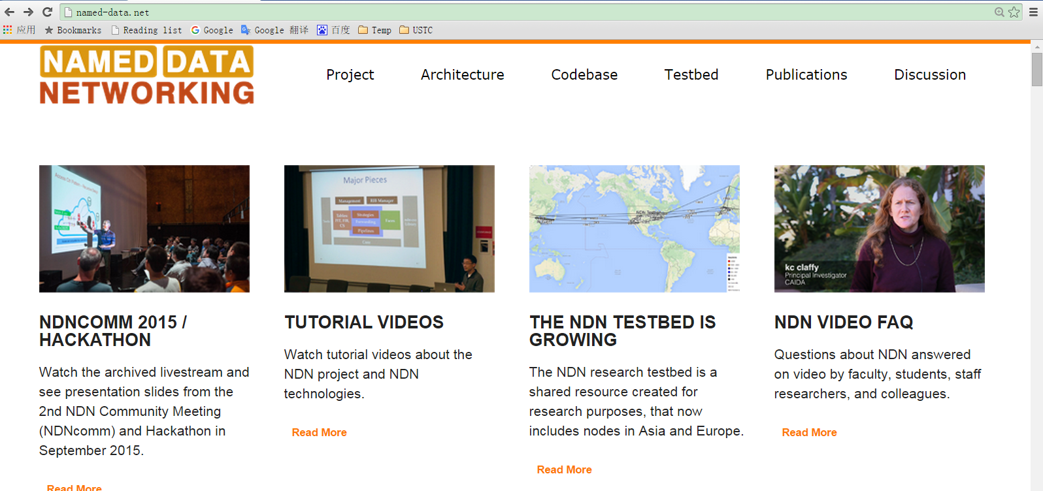
The NDN Project
One of four Future Internet Architecture projects funded by NSF (since 2011)
PI: Prof. Lixia Zhang (UCLA)
http://named-data.net/

Slide 39
Review
Name some of evolutionary approaches for Internet development.
What is the major issue on evolutionary approach?
What is the other way for developing the Internet?
Three components of the CCN node, two types of packets in CCN.
How users request contents?
How CCN node handles CCN packets?
How CCN name the content?
URI-like, hierarchical names
Names can be form a tree

