Slide 1
A Data-Oriented (and Beyond) Network Architecture
Teemu Koponen, Mohit Chawla, Byung-Gon Chun, Andrey Ermolinskiy, Kye Hyun Kim, Scott Shenker, Ion Stoica
SIGCOMM 2007
Presented by Ye Tian for Course CS05112

Slide 2
Overview
Introduction
Basic Design
Using DONA’s functionality
Extending Resolution handler (RH) functionality
Feasibility
Broader Architectural Implications

Slide 3
Introduction
From host-centric to data-centric applications
In the beginning…
first applications strictly focused on host-to-host communication: remote login, file transfer,…
Internet was built around this host-to-host model
Architecture is well-suited for communication between pairs of stationary hosts.

Slide 4
Introduction
…while today
Vast majority of Internet usage is data retrieval and service access
Users care about the content and are oblivious to location. Consider:
Fetching headlines from CNN, videos from YouTube
Accessing a bank account at “www.bank.com”
It doesn’t fit comfortably within the host-to-host model.

Slide 5
User-relevant issues
Persistence:
a data or service name remains valid as long as the data or service is available.
Availability:
access to data and service should be reliable and have low-latency.
Authenticity:
data came from the appropriate source, rather than from a adversary.

Slide 6
User-relevant issues
What do we have today?
 | Mechanism | Issue(s)
Persistence | DNS, HTTP redirect | Neither work if data moving across domains
Availability | CDNs, P2P | Rely on application-specific and ad hoc mechanisms
Authenticity | IPsec, PKI,TLS | Focus on the channel, not on content

Slide 7
Way to solve these issues
We propose replacing DNS names with flat, self-certifying names, and replacing DNS name resolution with a name-based anycast primitive that lives about the IP layer.
We call the resulting design the Data-Oriented Network Architecture (DONA)

Slide 8
Overview
Introduction
Basic Design
Using DONA’s functionality
Extending Resolution handler (RH) functionality
Feasibility
Broader Architectural Implications

Slide 9
Basic Design
Data approach:
 | Handled by | Provided by
Persistence | Names | Flat names, remain invariant
Authenticity | Names | Self-certifying names, enable easy authentication
Availability | Name resolution | Route-by-name paradigm

Slide 10
Naming
Naming organized around principals
Each principal is associated with a public-private key pair, and each datum or service or any other named entity is associated with a principal
Names are of the form P:L
P is the cryptographic hash of the principal’s public key
L is a label chosen by the principal, who ensures that these names are unique

Slide 11
Naming
Granularity of naming is left up to principals
a principal might choose to just name her web site, or name her web site and each page within it, or name at a finer granularity
Names are “flat”

Slide 12
Self-certifying names
Principals are considered to own their data. A piece of data comes with the principal’s public key and the principal’s signature of the data.
Client receives the triplet <data, public key, signature>
If the client receive a piece of data with the name P:L, it can verify the data did come from the principal by
Checking the public key hashes into P
Validating that the signature corresponds to the public key
Challenge is to resolve the flat names into the appropriate location.

Slide 13
Name Resolution
DONA uses the route-by-name paradigm for name resolution. Resolution infrastructure consists of Resolution handlers (RH).
Each domain will have one logical RH.
Name resolution is accomplished through the use of two basic primitives:
FIND(P:L) and REGISTER(P:L)
FIND(P:L) locate the object named P:L
REGISTER messages set up the state necessary for the RHs to route FINDs effectively

Slide 14
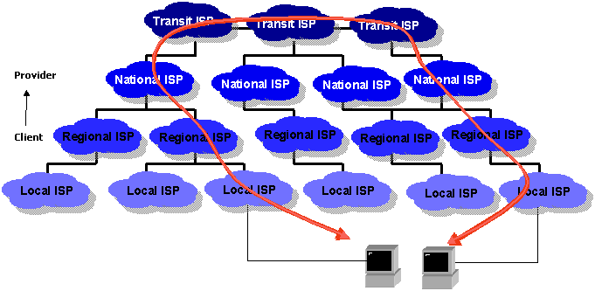
ISP hierarchy

Slide 15
Establishing REGISTER state
RH_{X} is the provider/customer/peer (or, alternatively, parent/child/peer) of RH_{Y} if X is the provider/customer/peer of Y in terms of AS-level relationships.
Each client knows the location of its local RH through some local configuration
Like they know about their local DNS server.
Any machine authorized to serve a datum or service with name P:L sends a REGISTER(P:L) command to its local RH.
REGISTER(P:*), register anything served by P

Slide 16
Establishing REGISTER state
RH maintains a registration table that maps a name to both a next-hop RH and the distance to the copy (in some metric)
Separate entry for P:*

Slide 17
Establishing REGISTER state
Handling REGISTER
If RH_{X} receives a REGISTER from a child (i.e., customer), it does not forward it onward unless no such record exists or the new REGISTER comes from a copy closer than the previous copy. If so, RH_{X} forwards the REGISTER to its parents and peers (after updating its registration table).
If the REGISTER comes from a peer, the entry can be forwarded or not based on local policy (depending, for example, on whether the AS is willing to serve as a transit AS for content).

Slide 18
Establishing REGISTER state
When FIND arrives, forwarding rule
If there is an entry in the registration table, the FIND is sent to the next-hop RH (and if there is more than one, the choice is based on the local policy and which entry is closest);
Otherwise, the RH forwards the FIND towards its parent (i.e., its provider) using its local policy to choose among them if the RH is multi-homed.
Use FIND(*:L) which indicates that the client is willing to receive the (self-certified) data from any purveyor.

Slide 19
Establishing REGISTER state
If the FIND request reaches a Tier-1 AS and doesn’t find a record associated with that principal, then the Tier-1 RH returns an error message to the source of the FIND.
If the FIND does locate a record, the responding server returns a standard transport-level response.
Transport protocols should bind to names, not addresses.

Slide 20
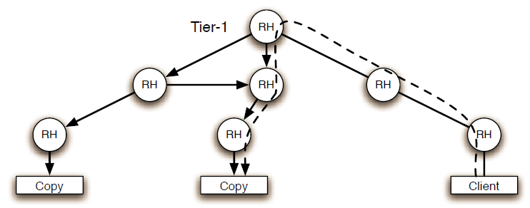
Forwarding FIND(P:L)
The FIND packet does not just resolve the name, it also initiates the transport exchange
Registration state (solid arrows) in RHs after copies have registered themselves. RHs route client-issued FIND (dashed arrow) to a nearby copy.
Notes:
Registration的箭头反了

Slide 21
Challenges
 | Concern | Approach
Security | Private key will get compromised | Key revocation mechanism needed
Usability | Flat names are hard to remember | External mechanisms needed
Scalability | Huge flat namespace | More shortly…(local address)

Slide 22
Overview
Introduction
Basic Design
Using DONA’s functionality
Extending Resolution handler (RH) functionality
Feasibility
Broader Architectural Implications

Slide 23
Using DONA’s functionality
Using name-based anycast
Server Selection
Each server (or datacenter) authorized by a principal P to host a service or datum named P:L simply registers P:L at their local RH. DONA routes any FIND(P:L) to the closest such server
P2P applications could also employ this primitive, and would probably use immutable names where the principal would identify the particular P2P infrastructure (peers have different degrees of reliability and coverage).

Slide 24
Using DONA’s functionality
Mobility and Multihoming
A roaming host can first unregister from one location and then re-register at its new location. Subsequent FINDs will be routed to the new location as soon as the new registrations have installed the necessary state.
A multihomed host registers with each local RH and a multihomed domain forwards its REGISTERs to each provider. This allows FINDs, and thus the resulting data connections, to make use of multiple paths.

Slide 25
Using DONA’s functionality
Session Initiation
SIP INVITE messages translate to FINDs and the SIP and DONA REGISTER messages play the same role. Thus, SIP’s rendezvous functionality can be provided by DONA and SIP’s negotiation functionality could be implemented directly on top of DONA’s REGISTER and FIND.

Slide 26
Using DONA’s functionality
Multicast State Establishment
DONA’s anycast primitive provides the tree discovery function, allowing a domain’s border router that has local members in a multicast group G to discover and establish connectivity with other domains that have members in the group.
To transmit a multicast packet destined for a particular group P:G, the sender’s border router R similarly issues a FIND packet to locate a nearby domain that belongs to the group and forwards the packet to that domain’s border router, which in turn initiates the packet’s dissemination.

Slide 27
Overview
Introduction
Basic Design
Using DONA’s functionality
Extending Resolution handler (RH) functionality
Feasibility
Broader Architectural Implications

Slide 28
Extending RH functionality
DONA’s name-based anycast primitive provides support for a range of discovery-like tasks. Even restricted to this capability, we believe DONA would be a better naming foundation for the Internet than the current DNS system.

Slide 29
Improving content delivery
DONA can provide better support for content delivery in three ways
Caching
An RH should first populate its cache, by changing the source IP address of an incoming FIND packet to be its own before forwarding the FIND to the next-hop RH.
This ensures that the response to the FIND will traverse this RH, so the RH will receive the returning data and can install it in its cache.
When a FIND arrives and there is a cache hit, the RH responds to the FIND’s source IP address, returning appropriate transport response which then will proceed into a standard application-level exchange.
If the RH does not understand the transport or application-level protocol for a particular FIND, it does not provide caching for that request.

Slide 30
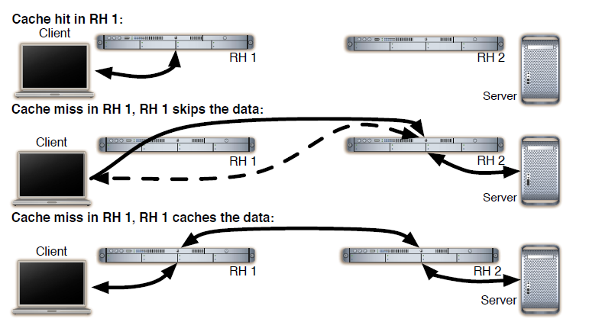
Improving content delivery
Three cases of processing a FIND packet when caching is supported: serve from the cache, skip (merely forward the FIND), and cache.
RH 2 is a middlebox for all traffic.

Slide 31
Improving content delivery
Subscriptions
Often clients would like to subscribe for updates, as in RSS. This can be easily accomplished by adding TTLs to FINDS.
When the server responds to such a TTL’ed FIND, it notes whether and how long it will provide updates to the FIND.
When a server updates a piece of content that has a pending TTL’ed FIND, it sends the update to the source of the FIND.

Slide 32
Improving content delivery
Avoiding Misbehaving and Overloaded Servers
In general, RHs will route FINDs to nearby copies of the data. However, some of these servers may be misbehaving in a way that is not visible to the RHs but which deprives a client of a valid copy of data.
To make sure that clients can still access the data, we allow the client to ask that its FIND be routed to a different server.

Slide 33
Improving content delivery
Several ways:
Amend the REGISTER commands to keep track of the number of servers below a particular RH
Incremented by one when a REGISTER is sent upwards
Amend the FIND command to allow the client to request access to the k’th closest server, rather than the closest one.
We can also augment DONA to allow overloaded servers to indicate they are overloaded, so the RHs can then direct excess load to other less-loaded, servers.

Slide 34
Delay-Tolerant Networking
The key concept in designing a delay-tolerant network (DTN) architecture is message-level custody transfer
Rather than the communication being end-to-end, there are intermediate elements that take custody of the message and then are responsible for making sure it is forwarded onward. The RHs can act as these custody agents.

Slide 35
Feasibility
Where is the Challenge?
RH need only keep routing state for data that lie below or equal to it in the AS hierarchy
Toughest requirement will be on the Tier-1 providers, whose RHs must keep everything in their registration tables—below is easy

Slide 36
Computational requirement
Registration processing requirement for a single Tier-1 ISP:
10¹¹ names (2005) , 42 bytes per entry (40 for the name and 2 for a next-hop RH) = Routing table 4TB
Average registration lifetime 2 weeks = 83000 registration/s a Tier-1RH must handle (initial estimate)
Each of these registrations involves
expensive cryptographic operations: using 40 CPUs running at 3 GHz could handle

Slide 37
Required hardware
Forwarding requirements
Estimate that a fully-loaded Gbps link will generate about 20000 FINDs/s (by statistic of the experiment in 2005)
these FINDs consume about 24Mbps, only 2.4% of the link.
Store routing table: (FINDs can be processed either from RAM or from disk)
In RAM: 500 PCs with 8GBs of RAM, or
On Disk: 50 disks per every 1 Gbit/s worth of traffic
What’s the mix and (physical) distribution of RAM and disk depends on aggregate load and other factors (cache hit rate)

Slide 38

Required hardware
Reasonable requirements: Consider Sun Blackbox (250 multi-core processors, 7TB RAM)

Slide 39
Review
How the host-centric networking causes the persistence, availability, and authentication issues.
How DONA names the network entity?
How a data is authenticated in DONA?
How name is resolved in DONA?

