Slide 1
Serval: An End-Host Stack for Service-Centric Networking
Erik Nordstrom, David Shue, Prem Gopalan, Robert Kiefer
Matvey Arye, Steven Y. Ko, Jennifer Rexford, Michael J. Freedman
NSDI 2012
Presented by Ye Tian for Course CS05112

Slide 2
Overview
Rethink the Network Stack
Serval Abstraction
The Serval Network Stack
Experiments

Slide 3
Modern Internet Service
Multiplicity (多重性)
Multiple replicas
Multiple interfaces
Multiple paths
Dynamism(动态性)
Replica failure and recovery
Service migration
Client mobility
Matches poorly with today’s TCP/IP stack

Slide 4
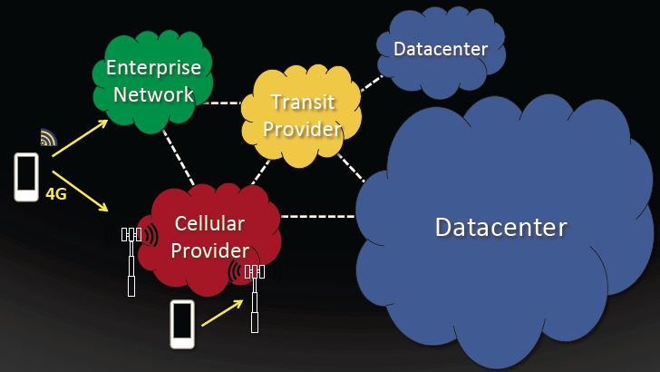
Service Access Today

Slide 5
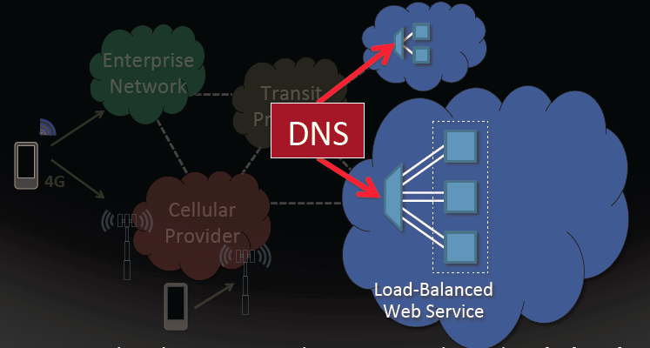
DNS binds service to location at client (early binding)

Slide 6
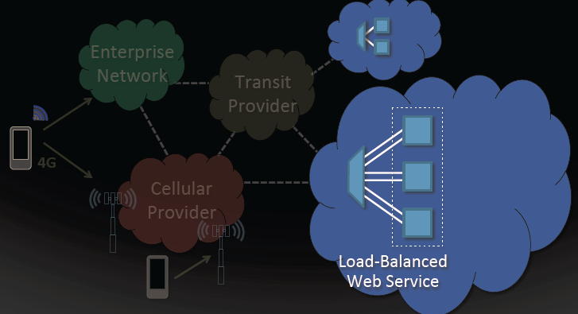
Datacenter LB maps single IP to multiple servers

Slide 7
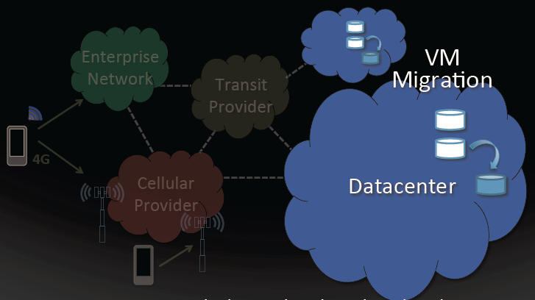
Migrate VMs to balance load in the cloud

Slide 8
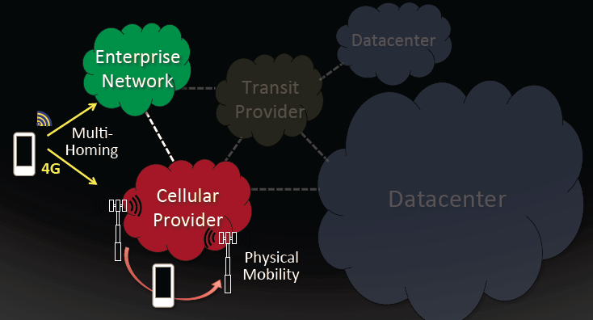
Flows break when switching networks or interfaces

Slide 9
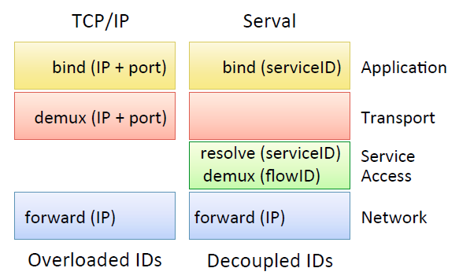
Rethink the Network Stack

Slide 10
Rethink the Network Stack
Application-layer
Today’s applications operate on two low-level identifiers (IP address and TCP/UDP port)
Clients must “early bind” to these identifiers using out-of-band lookup mechanisms (e.g., DNS) or a priori knowledge (e.g., Web is on port 80) before initiating communication.
Socket programming on IP address and port
Serval: applications communicate over active sockets using serviceID, enables late binding of serviceID to a service instances.

Slide 11
Rethink the Network Stack
Transport layer
Today’s stack uses a five-tuple <remote IP, remote port, local IP, local port, protocol> to demultiplex an incoming packet to a socket.
The interface addresses cannot change without disrupting ongoing connections – lack of mobility
Serval: transport protocols deal only with data delivery across one or more flows, including retransmission and congestion control; Demux is at the SAL layer based on flowID

Slide 12
Rethink the Network Stack
Network layer
Today’s network layer uses hierarchical IP addressing to efficiently deliver packets.
Challenged by the need for end-host mobility in a stack where upper-layer protocols fail when addresses change.
Serval: the network layer unchanged.

Slide 13
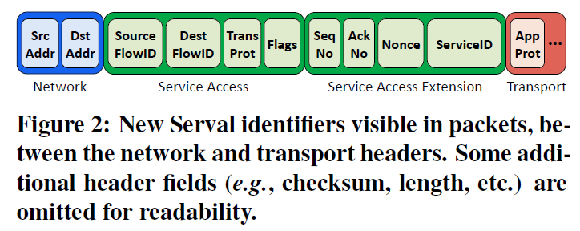
Group-Based Service Naming
A Serval service name, called a serviceID, corresponds to a group of one or more (possibly changing) processes offering the same service.

Slide 14
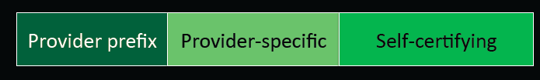
ServiceID
Service names do not dictate the granularity
Can be a single SSH daemon, a cluster of printers, a set of peers distributing a common file
Format
Provider prefix
Prefix-based aggregation and LPM
Securing communication and registration:
End with a self-certifying bitstring

Slide 15
Explicit Host-Local Flow Naming
Serval provides explicit host-local flow naming through flowIDs that are assigned and exchanged during connection setup.
Benefits:
Network-layer oblivious: identify flows without knowing the network-layer address.
Mobility and multiple paths: FlowIDs help identify flows across a variety of dynamic events, such as migration, address change, etc.

Slide 16
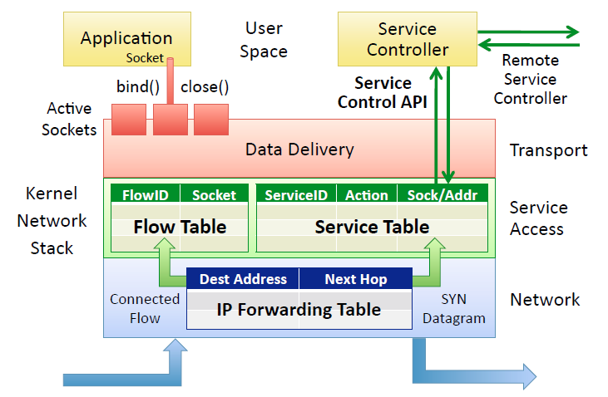
The Serval Network Stack

Slide 17
The Serval Network Stack
The user-space service controller
Manage service resolution based on policies
Listen for service-related events, monitor service performance, and communicate with other controllers
The Service Access Layer (SAL) provides a service-level data plane
responsible for connecting to services through forwarding over service tables.
Once connected, the SAL maps the new flow to its socket in the flow table, ensuring packet demultiplexed.

Slide 18
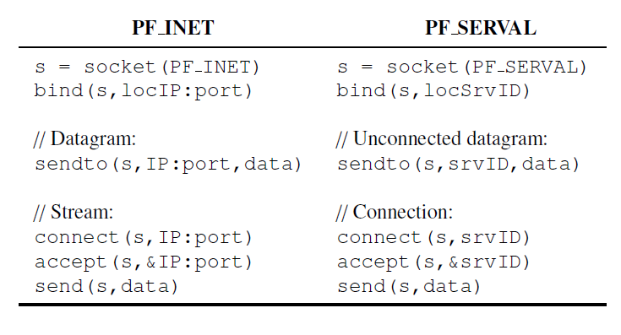
Active Socket
Retain the standard BSD socket interface.
A serviceID is automatically registered on a call to bind, and unregistered on close, process termination, or timeout.
On a local service registration event, the stack updates the local service table and notifies the service controller, which may notify upstream service controllers.
A local unregistration event triggers the removal of local rules and notification of the service controller.
Resolving a serviceID to network addresses is delegated to the SAL—applications just call the socket interface using serviceIDs and never see network addresses.

Slide 19
A Service-Level Data Plane
The first packet of a new connection (or an unconnected datagram) includes a serviceID
The stack performs longest prefix matching (LPM) on the serviceID to select a rule from the service table.

Slide 20
Actions
FORWARD:
include an associated set of one or more IP addresses
either selects all addresses or uses weighted sampling to select one of the addresses.
For each selected destination, the stack passes a packet to the network layer for delivery.
DEMUX:
deliver a received packet to a local socket, when an application is listening on the serviceID.
Added by an active socket’s bind event

Slide 21
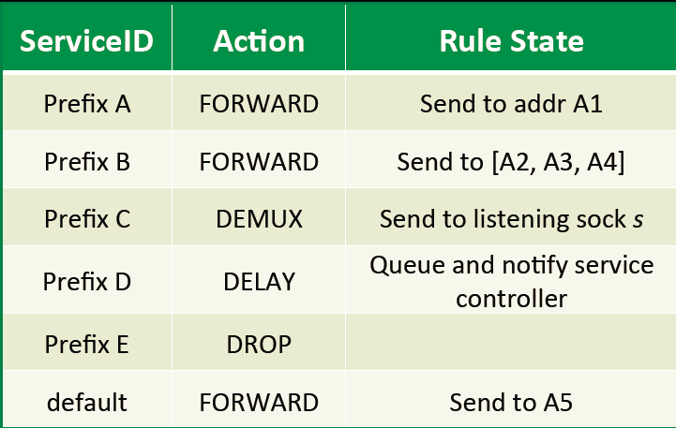
Actions
DELAY:
queue the packet and notify the service controller of the serviceID.
allow a rule to be installed “on-demand”
DROP:
Discard unwanted packet

Slide 22
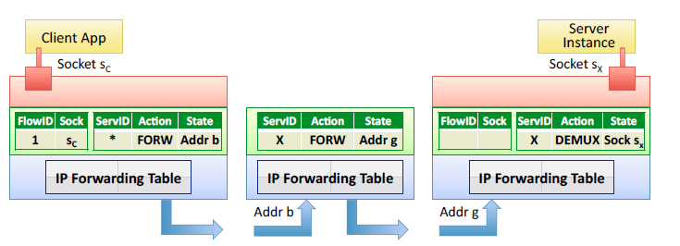
Example: Connection-less datagram communication
Service router (SR)

Slide 23
A client application initiates communication on serviceID X, which is matched in the client’s service table to SR’s address.
Upon receiving a packet, the SR looks up the serviceID in its own service table; given a FORWARD rule, it forwards the packet to the server.
At the server, the DEMUX rule delivers the packet to the socket of the listening application.

Slide 24
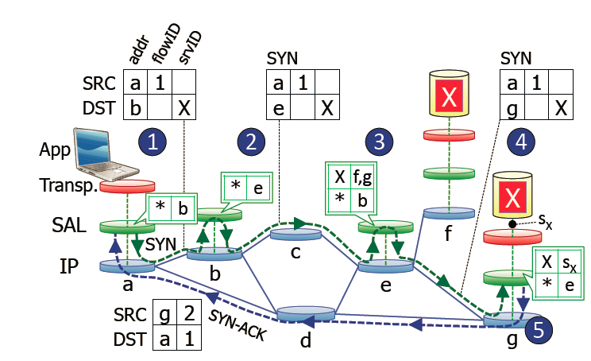
Example: Connection establishment

Slide 25
When client a attempts to connect to service X, the client’s SAL assigns a local flowID to the socket, and then adds an entry in its flow table.
A SYN packet is generated with the serviceID from the connect call, along with the new flowID
The SAL then looks up the requested serviceID in its service table, the request is sent to the IP address b of the default FORWARD rule

Slide 26
Forwarding continues recursively through e
Until reaching a listening service endpoint s_{x} on host g, which then creates a responding socket with a new flowID, also updating its flow table.
End-host g’s SYN-ACK response includes its own address, flowID
The SYN-ACK and all subsequent traffic in both directions travel directly between the end-points, bypassing SRs b, c and e.
After the first packet, all remaining packets can be demultiplexed by the flow table based on destination flowIDs.

Slide 27
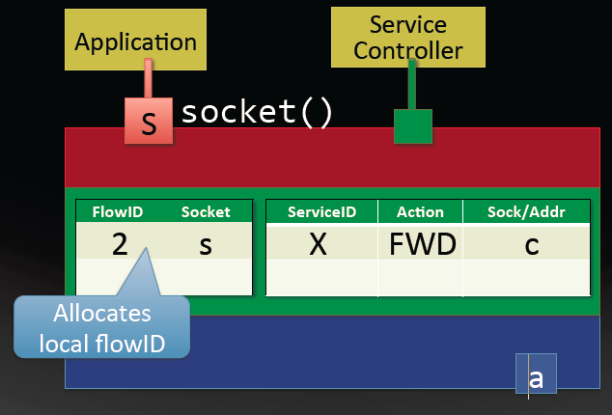
An other example
Client a connects to server e

Slide 28
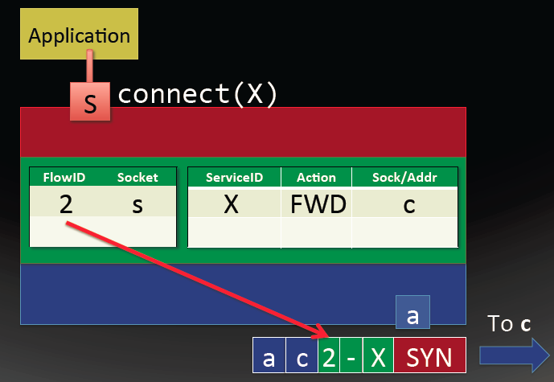

Slide 29
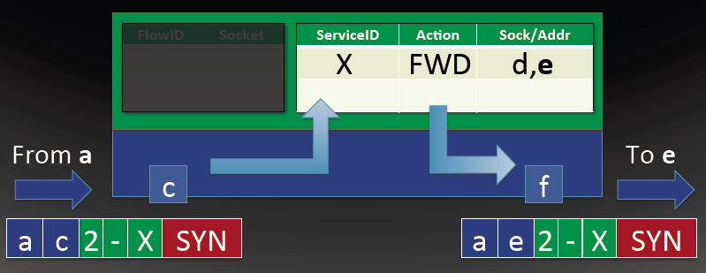

Slide 30
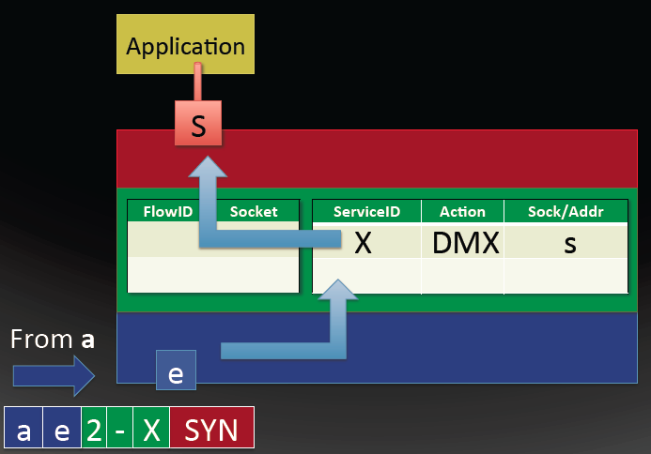

Slide 31
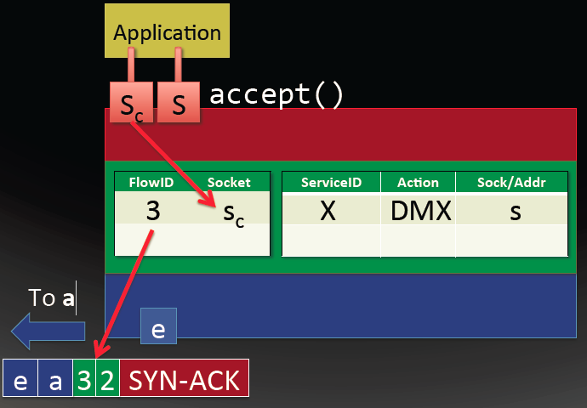

Slide 32
A Service Control Plane for Extensible Service Discovery
A server’s controller can “announce” a new service instance to an upstream service controller that, in turn, disseminates reachability information to a larger network of controllers.
serviceIDs can be aggregated by administrative entities for scalability and resolution control.
On the client, the service table would have FORWARD rules to direct a SYN packet to its local service router, which in turn directs the request up the service router hierarchy to reach a service instance.

Slide 33
A controller installs a DELAY rule, and matching packets are buffered while the controller resolves their serviceIDs.
A returned mapping is installed as a FORWARD rule and the controller signals the stack to re-match the delayed packets.

Slide 34
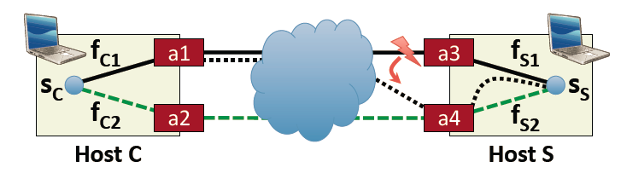
Multi-homing and multi-pathing
Serval can split a socket’s data stream across multiple flows established and maintained by the SAL on different paths.
On any packet, either host can piggyback a list of other available interfaces in a SAL extension header, to enable the other host to create additional flows using a similar three-way handshake.
E.g., if S ’s SYN-ACK packet piggybacks information about interface address a4, C could initiate a second flow from a2 to a4.

Slide 35
The SAL can freely migrate a flow from one address, interface, or path to another.
Example: To migrate the flow, S sends C an RSYN packet (for “resynchronize”) with flowIDs <f_{S1}, f_{C1}> and the new address a₄. The client returns an RSYN-ACK, while waiting for a final acknowledgment to confirm the change.

Slide 36
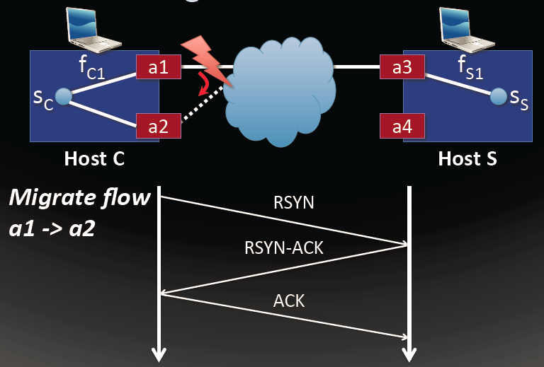

Slide 37
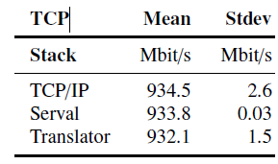
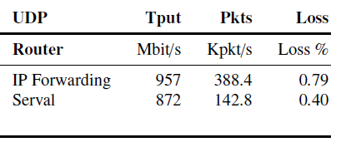
Performance
Prototype of 28,000 lines of C code
Client-server throughput comparison with TCP
Comparing service router with IP router

Slide 38
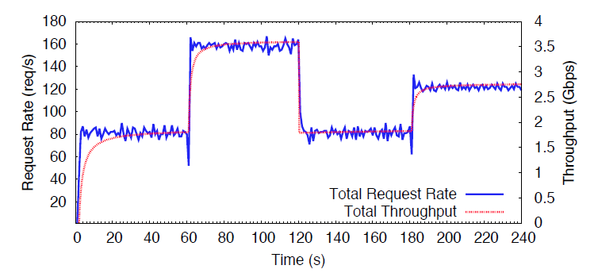
Case Experiment: Replicated Web Services
Four clients running the Apache benchmark generate requests to a Serval web service with an evolving set of Mongoose service instances.
each client requests a 3MB file and maintains an open window of 20 HTTP requests
At time 60, two new service instances start, register with the service router
At time 120, we force the first two servers to gracefully shut down, which causes them to close their listening socket
Start another server at time 180,

Slide 39
Case Experiment: Back-End Distributed Storage
Implemented a dynamic Memcached system.
Memcached provides a simple key-value GET/SET caching service, where “keyspace” partitions are spread over a number of servers for load balancing
Clients issue requests directly to a serviceID.
The SAL then maps the serviceID to a partition using LPM in the service table, and ultimately forwards the request to a responsible server that listens on the common prefix.
When Memcached servers register and unregister with the network, the control plane reassigns partition(s) by simply changing rules in service tables.
One client, four servers, and an intermediate service router in the experiment

Slide 40
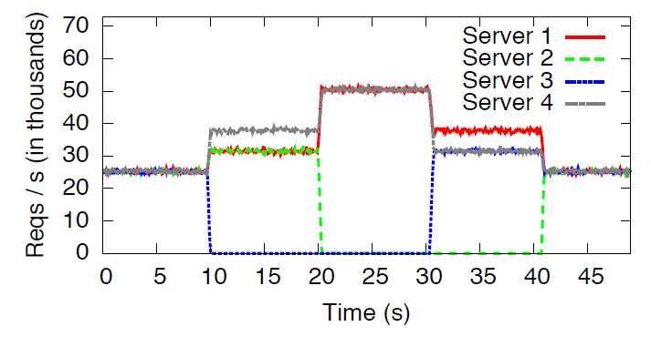
Client issues SET requests with random keys 100,000 per sec.
Time 0, all four servers are working
Time 10, remove one server, SR re-partitions among the three servers.
Time 20, remove another server, SR evenly partitions among the two servers.
Time 30 and 40, failed servers join again.

Slide 41
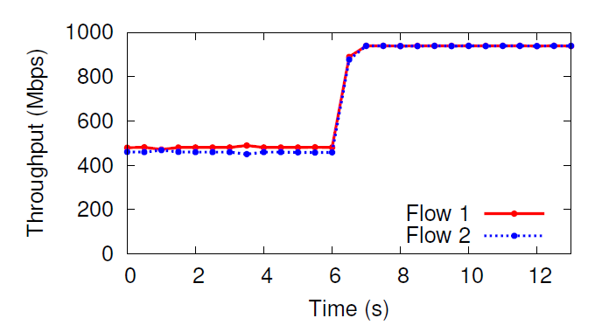
Case Experiment: Interface Load Balancing and Virtual Machine Migration
Two iperf clients then connected to the server and began transfers to measure maximum throughput.
Six seconds into the experiment, the server’s service controller signals the SAL to migrate one flow to its second interface.

Slide 42
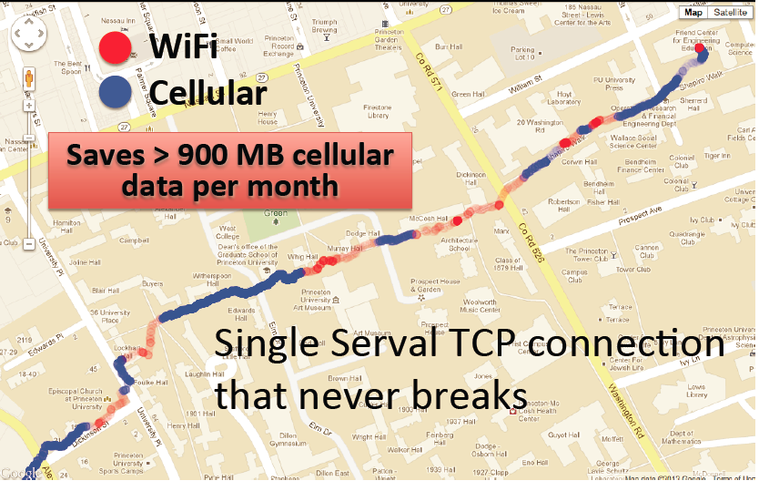

Slide 43
Review
What are the features of the modern Internet service
Multiplicity
Dynamism
The Serval abstraction
Application layer/Transport layer/Service access layer(SAL)/Network layer
Active socket vs. BSD socket
Network stack
Service table
Flow table
Service controller

