Slide 1
XIA: Efficient Support for Evolvable Internetworking
Dongsu Han, Ashok Anand, Fahad Dogar, Boyan Li et al.
NSDI 2012
Presented by Ye Tian for Course CS05112

Slide 2
Outline
Motivation
XIP
XIA Addresses in Action
Evaluation

Slide 3
Evolvability
Internet is hard to evolve
Takes 15+ years to deploy IPv6
Serious barriers to Internet evolvability
Protocols, formats, and information must be agreed upon by a large number of independent actors in the architecture
no built-in mechanism that supports incremental deployment of new functionality with minimal friction.
Present a new Internet architecture, called the eXpressive Internet Architecture, or XIA

Slide 4
Design Philosophy
do not believe we can predict the usage models for the Internet of 50 years hence.
Content centric?
Service centric?
Mobility first?
…
a new network architecture should facilitate any or all of these capabilities, and it must be possible to enable or disable “native” support for them.

Slide 5

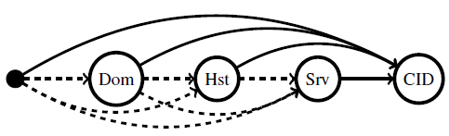
Fundamental Ideas of XIA
Expressing intent
Example: retrieve a content (CID) using today’s host-to-host Internet
Srv (http)
CID (web page)
In XIA, the destination address as a directed acyclic graph, not a single address,

Slide 6
Fundamental Ideas of XIA
Give flexibility to the network to satisfy the intent.
A router can directly routes to content, if it already has both the information it needs and permission to do so.
A router or other network element that does not know how to operate on, e.g., the content ID, would simply route the packet to the furthest-along node that it does know (the domain or the host in this example).

Slide 7
Fundamental Ideas of XIA
XIA terms the types of nodes in the address principals
Domains, hosts, services, content IDs, etc.
Supports an open-ended set of principal types: applications or protocols may start to use these new principal types at any time, even before the network has been modified to natively support the new function.

Slide 8
Outline
Motivation
XIP
XIA Addresses in Action
Evaluation

Slide 9
Building Blocks
First, the basic building block of per-hop communication is the core eXpressive Internet Protocol, or XIP.
A key element of XIP is a flexible format for specifying multiple paths to a destination principal,
Allow for “fallback” or “backwards-compatible” paths that use, e.g., more traditional autonomous system and host-based communication.
The second component is the per-hop processing for each principal type.
focus on host, service, content, and administrative domain principals
HID, SID, CID, AD

Slide 10
Principals
The specification of a principal type must define:
The semantics of communicating with a principal of that type.
A unique XID type, a method for allocating XIDs and a definition of the intrinsic security properties of any communication involving the type.
Any principal-specific per-hop processing and routing of packets that must either be coordinated or kept consistent in a distributed fashion.

Slide 11
Some Principals
Network and host principals represent autonomous routing domains and hosts that attach to the network.
Services represent an application service running on one or more hosts within the network.
E.g., SSH daemon, HTTP server
Typically application processes
The content principal allows applications to express their intent to retrieve content without regard to its location.

Slide 12

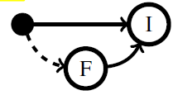
XIP Addressing
Core concepts
express intent by specifying a typed XID as part of the XIP destination address.
intent that may not be globally understood must be expressed with an alternative backwards compatible route, called fallback

Slide 13

XIP Addressing
Core concepts
Allowing the application to refine its intent using hierarchical scoping using ADs, HIDs, or SIDs to help specify the CID’s location
Using refinement of intent, we give the XID at each scoping step the opportunity to satisfy the intent directly without having to traverse the remainder of the scoping hierarchy.

Slide 14
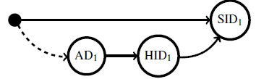
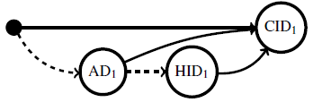
Example
Supporting evolution:
A router outside of AD₁ that does not know how to route based on intent SID₁ directly will instead route to AD₁.
Iterative refinement:
every node includes a direct edge to the intent, with fallback to domain and host-based routing.

Slide 15
Example
Service binding
In the case of legacy HTTP, while the initial packet may go to any host handling the web service, subsequent packets of the same “session” (e.g., HTTP keep-alive) must go to the same host.
the initial packet destined for: •→AD₁→SID₁. A router inside AD₁ routes the request to a host that provides SID₁. The service replies with a source address bound to the host, : •→AD₁→HID₁→SID₁, to which subsequent packets can be sent.

Slide 16
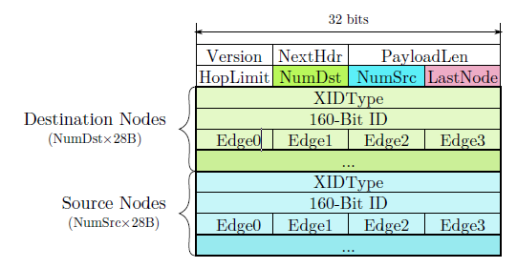
XIP Header Format
Variable-length
NumDst and NumSrc indicate the size of the destination and source address.
LastNode points to the previously visited node in the destination address, for routers to know where to begin forwarding lookups.
DAGs are stored as adjacency lists.
Each node in the adjacency list contains three fields:
an XID Type;
a 160-bit XID;
an array of the node indices that represent the node’s outgoing edges in the DAG.

Slide 17
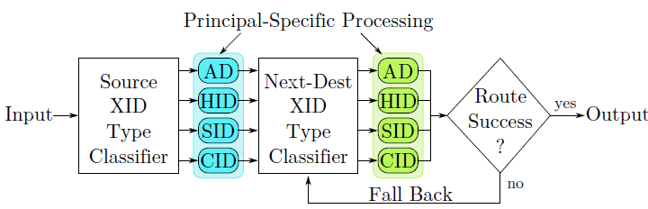
Per-hop Processing
a router first performs source XID-specific processing based upon the XID type of the sink node of the source DAG.
E.g., for caching a CID

Slide 18
Per-hop Processing
iteratively examine the outbound edges of the last-visited node of the DAG in priority order. For the destination
If the router supports that principal type, it invokes a principal-specific component based on the type, and if it can forward the packet using the adjacency, it does so.
If the router does not support the principal type or does not have an appropriate forwarding rule, it moves on to the next edge.
If no outgoing edge of the last-visited node can be used for forwarding, the destination is considered unreachable and an error is generated.

Slide 19
Optimization for High Performance
Packet-level parallelism
process packets destined for ADs and HIDs in parallel
Intra-packet parallelism
different next hops can be evaluated in parallel, the results of these lookups must be combined and only the highest priority next-hop candidate with a successful lookup should be used.
Fast-path
Employ a look-aside cache that keeps a collision-resistant fingerprint of the destination DAG address and the forwarding result.

Slide 20
Outline
Motivation
XIP
XIA Addresses in Action
Evaluation

Slide 21
Bootstrapping Addresses
Attaching hosts to a network
Each host has a public/private key pair.
each host listens for a periodic advertisement that its AD sends out.
Host sends an association packet to the AD, which will be forwarded by the AD routers to authentication service.

Slide 22
Bootstrapping Addresses
Advertising services and content:
Develop an XIA socket API.
A process on a host first calls bind() to bind itself to a public key of the service.
This binding inserts the SID (hash of the service’s public key) into the host’s routing table.
Likewise, putContent() stores the CID (the hash of the content) in the host’s routing table.
Enables •→AD→HID→SID/CID
AD can support direct routing to services and content within its domain using an intra-domain routing protocol that propagates the SIDs and CIDs to routers

Slide 23
Bootstrapping Addresses
Obtaining XIP addresses:
when a principal generates a packet, the source address is generally •→AD→HID→XID
The AD-prefix is given by the AD when a host attaches to the network
The HID is known by the host;
The XID is provided by the application, allowing the socket layer to create the source address.

Slide 24
Bootstrapping Addresses
Obtaining XIP addresses:
Use a name resolution service to resolve destination XIP addresses from human readable names.
a Web service can embed URLs in its pages that include an intent CID
Client ADs may have policies for what addresses are allowed.
May want to specify that all packets entering or leaving the AD go through a firewall.
This can be achieved by inserting an SID_{Firewall} in the address, e.g., •→AD→SID_{Firewall}→HID→SID for a source address.

Slide 25
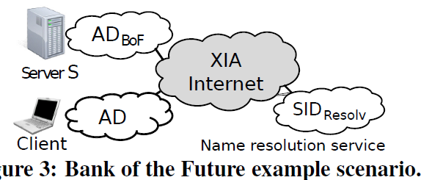
Simple Application Scenarios
Publishing the service:
process P_{S} starts on the server S, it binds an SID socket to SID_{BoF} by calling bind() with its public/ private key pair.
This SID binding adds SID_{BoF} to the server’s (HID_{S}) routing table, and the route to SID_{BoF} is advertised in the BoF network AD_{BoF} .
also publishes the association between a human readable service name and •→AD_{BoF}→SID_{BoF} through a global name resolution service (SID_{Resolv})

Slide 26
Simple Application Scenarios
Connection initiation and binding:
When a client wants to connect to the service, it first contacts the name resolution service SID_{Resolv} to obtain the service address.
It then initiates a connection by sending a packet destined to •→AD_{BoF}→SID_{BoF} using the socket API.
The source address is •→AD_{C}→HID_{C}→SID_{C}. This packet is routed to AD_{BoF} and then to an instance of SID_{BoF}.
Because of this session state, the client needs to continue to communicate with the same server, the client changes the destination address to •→AD_{BoF}→HID_{S}→SID_{BoF}

Slide 27
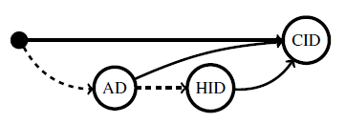
Support for Richer Scenarios
Network evolution for content support
At the beginning, content CID is served by host HID
Follow •→AD→HID→CID
Later, ISP may deploy on-path cache, allow routers to cache and serve static content,
Follow •→AD→CID

Slide 28
Support for Richer Scenarios
Process migration
P_{S} migrates to another machine, namely HID_{T}
At the start of migration, the route to SID_{BoF} is removed from the old server and added to the new server’s routing table.
After migration, the client OS notifies the ongoing connections of the new HID, and the binding is changed to •→AD_{BoF}→HID_{T}→SID_{BoF} at the socket layer.
Notification of the binding change propagates to the client via a packet containing the message authentication code (MAC) signed by SID_{BoF}

Slide 29
Support for Richer Scenarios
Client mobility
When a client moves and attaches to another AD, AD_{new}, the new source address of the client becomes: •→AD_{new}→HID_{C}→SID_{C}.
When a rebind message arrives at the server, the server updates the binding of the client’s address.

Slide 30
Outline
Motivation
XIP
XIA Addresses in Action
Evaluation

Slide 31
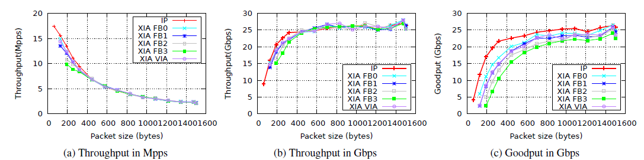
Router Design and Performance
Implementation
Software router using Click
Forwarding performance
Destination addresses FB0, FB1, FB2, FB3, FB4, FB5, VIA
FBi: a DAG which causes the XIA router to evaluate exactly i fallbacks and to then forward based on the (i+1)-th route lookup.
VIA: an intermediate node in the DAG has been reached, the router must additionally update the last-visited node

Slide 32
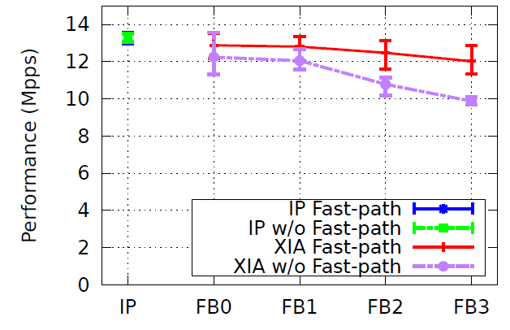
Router Design and Performance
Fast-path processing
The key used for table lookups is a collision- resistant hash of the partial DAG consisting of the last visited node and all its outbound edges.

Slide 33
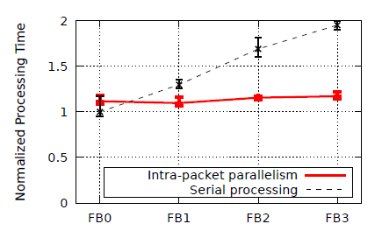
Router Design and Performance
Intra-packet parallelism
a comparison between serial and four way parallel lookup costs

Slide 34
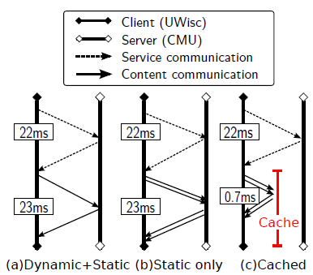
Application Design and Performance
Content transfer and support for evolution
Created a wide-area testbed spanning two universities (CMU-UWisc)
steps and time taken to retrieve the dynamic and static Web page.
1) With in-network cache
2) Do not use XIA’s fallback:
•→AD_{BoF}→CID, dropped by intermediate router,
Timeout and resend •→ AD_{BoF}→HID→CID
Takes 87 ms.

Slide 35
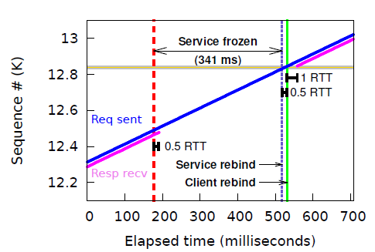
Application Design and Performance
Service migration
Initially this session is bound to: •→AD_{BoF}→HID_{S}→SID_{C}.
Freeze the service during the migration.
After the final state transfer, the VM and the service resume at HID_{T}. At this time, the service rebinds to HID_{T} .
The service then notifies the client of the new binding: •→AD_{BoF}→HID_{T}→SID_{C}. When the client receives this message, it rebinds to the new DAG after verification.

Slide 36
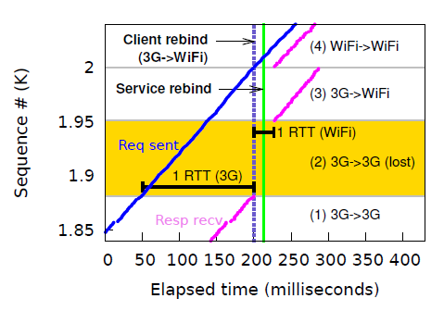
Application Design and Performance
Client mobility
a client moves from a 3G network (RTT=150ms) to a WiFi network (RTT=25ms).
After connecting to the WiFi network, the client sends a cryptographically signed rebind message, notifying the server of the new binding: •→AD_{new}→HID_{C}→SID_{C}.
Only the packets in flight at Client rebind are lost (shaded area, region (2)) since they are sent to the 3G network, to which the client is no longer connected
due to the difference in the round-trip times of the 3G and the WiFi network, packet reordering happens at the server-side

Slide 37
Review
Motivation of XIA
Core concept of XIP address
Intent, fallback, scoping, refinement
How to handle
Service binding
Service migration
Client mobility

Slide 38
复习
Datacenter network
Concept + Algorithm
FatTree、Dcell、Portland
Software-defined networking
Concept, model + programming
OpenFlow、P4、Pyretic
Future Internet
Motivation
Concept: protocol layers
self certifying, migration and mobility support

Slide 39
Pay attention to course page for further notice
Submit project 2 and 3 on time, pay attention to the re-submit list.

