Slide 1
B4: Experience with a Globally-Deployed Software Defined WAN
Sushant Jain, Alok Kumar, Subhasree Mandal, Joon Ong, et al.
ACM SIGCOMM, 2013
Presented by Ye Tian for Course CS05112

Slide 2
Outline
Background
Design
Traffic Engineering
TE Protocol and OpenFlow
Evaluation

Slide 3
Motivation
WAN links are typically provisioned to 30~40% average utilization.
Deliver admirable reliability
With over-provisioning and high-end routing gear
Google’s data center WAN
We control the applications, servers, and the LANs all the way to the edge of the network
Most bandwidth-intensive applications can adapt their transmission rate based on available capacity
No more than a few dozen data center deployments, making central control of bandwidth feasible.

Slide 4
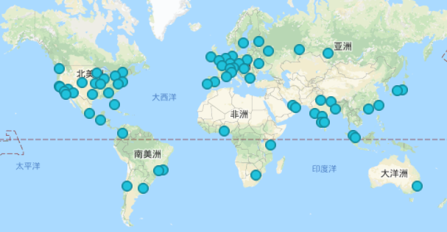
Two WANs of Google
User-facing network
peers with and exchanges traffic with other Internet domains at Google’s Edge Points of Presence (PoPs)
http://peering.google.com

Slide 5
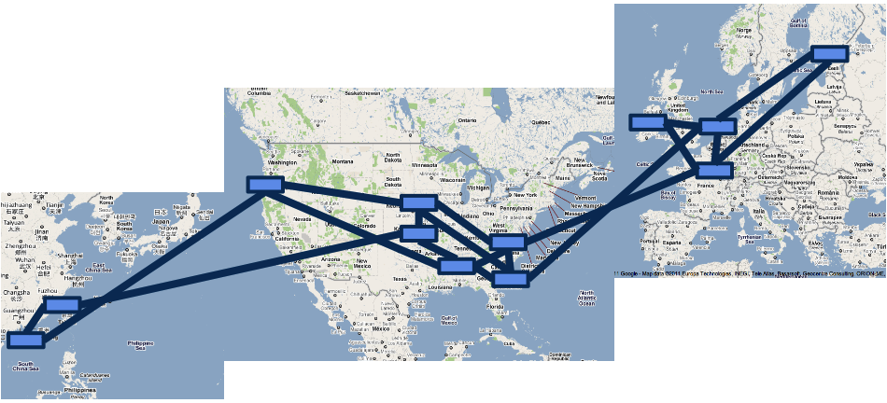
Two WANs of Google
The B4 WAN
Provides connectivity among data centers
First and largest SDN/OpenFlow deployments.
Making Google one of the largest ISPs in the world

Slide 6
B4 Applications
Applications (increasing volume, decreasing latency sensitivity)
user data copies to remote data center
remote storage access for computation over inherently distributed data sources
large-scale data push synchronizing state across multiple data centers.

Slide 7
B4 Characteristics
Elastic bandwidth demands
can tolerate periodic failures with temporary bandwidth reductions.
Moderate number of sites
A few dozen
End application control
Can control application priorities and control bursts, rather than overprovision
Cost sensitivity
traditional WAN (30~40% overprovision) is prohibitively expensive.

Slide 8
Outline
Background
Design
Traffic Engineering
TE Protocol and OpenFlow
Evaluation

Slide 9
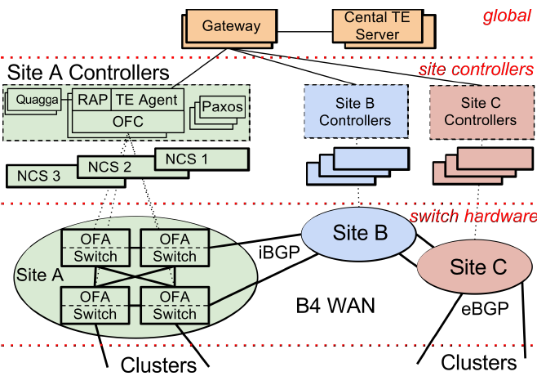
Overview
Each B4 site
Switch hardware layer
Site controller layer
Consist of Network Control Servers (NCS), hosting both OpenFlow controllers (OFC) and Network Control Applications (NCAs).

Slide 10
Overview
Global layer
Centralized application: SDN Gateway and a central TE server
Each server cluster is a logical AS with a set of IP prefixes. Each cluster contains a set of BGP routers that peer with B4 switches at each WAN site.
Design choices
Has to support existing distributed routing protocols
Build one integrated, centralized service combining routing (e.g., ISIS functionality) and traffic engineering
Deploy routing and traffic engineering as independent services, with the standard routing service deployed initially and central TE subsequently deployed as an overlay

Slide 11
Overview
Each B4 site consists of multiple switches with potentially hundreds of individual ports linking to remote sites.
The TE abstracts each site into a single node with a single edge of given capacity to each remote site.
All traffic crossing a site-to-site edge must be evenly distributed across all its constituent links.
B4 routers employ a custom variant of ECMP hashing to achieve the necessary load balancing.

Slide 12
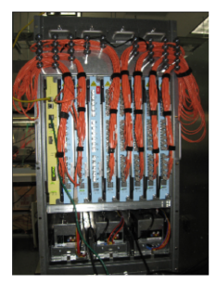
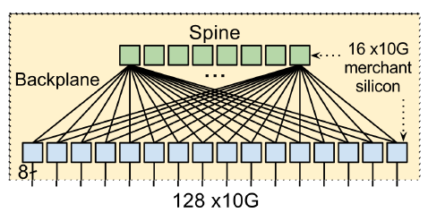
Switch Design
Build B4 switch from multiple merchant silicon switch chips
128-port 10GE switch with 24 16×10GE chips.
Contains an embedded Linux processor
Run OpenFlow agent (OFA): translates OF messages into driver commands to set chip forwarding table entries.

Slide 13
Network Control Functionality
Most B4 functionality runs on NCS in the site controller layer co-located with the switch hardware
NCS and switches share a dedicated out-of-band control-plane network.
Paxos handles leader election for all control functionality.
Use a modified version of Onix as OpenFlow Control (OFC).
Maintain Network Information Base (NIB)
OFAs maintain active connections to multiple OFCs, communication is active to only one OFC at a time and only a single OFC maintains state for a given set of switches.

Slide 14
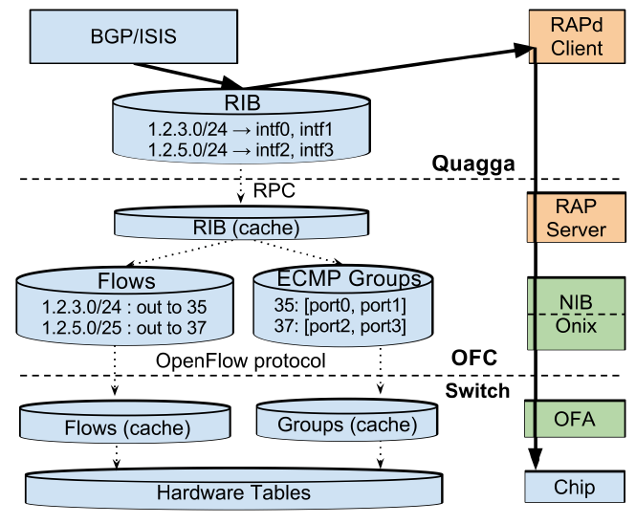
Routing
Open source Quagga for BGP/ISIS on NCS
Routing Application Proxy (RAP) as an SDN application to provide connectivity between Quagga and OF switches
BGP/ISIS route updates
routing-protocol packets between switches and Quagga
interface updates from the switches to Quagga.

Slide 15
RAP
Create tuntap interfaces corresponding to each physical switch port Quagga manages.
translates each RIB entry into two OpenFlow tables
A Flow table which maps prefixes to entries into a ECMP Group table.
Multiple flows can share entries in the ECMP Group Table.
Proxy routing-protocol packets between the Quagga control plane
Upon detecting a port state change, RAPd changes the netdev state for each interface change, which propagates to Quagga for routing protocol updates.

Slide 16
Outline
Background
Design
Traffic Engineering
TE Protocol and OpenFlow
Evaluation

Slide 17
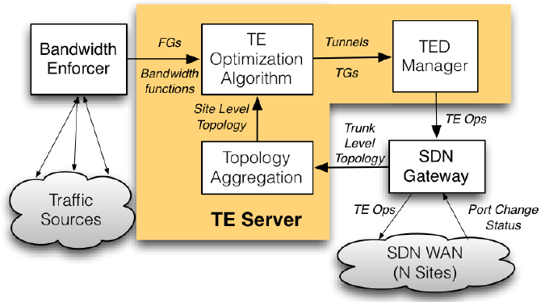
General Architecture
TE server operates on:
Network Topology: a graph represents sites as vertices and site to site connectivity as edges.
Flow Group (FG): a {source site, dest site, QoS} tuple
A Tunnel (T) represents a site-level path
A Tunnel Group (TG) maps FGs to a set of tunnels and corresponding weights.
Output Tunnel Groups to SDN gateway, gateway forwards Tunnels and Flow Groups to OFC and install on Switch using Open Flow

Slide 18
Bandwidth Function
Application’s bandwidth function
bandwidth allocation to an application given the flow’s relative priority (called fair share)
FG’s bandwidth function
Piecewise linear additive composition of per-application bandwidth functions.

Slide 19
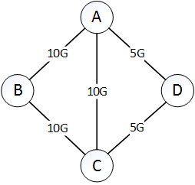
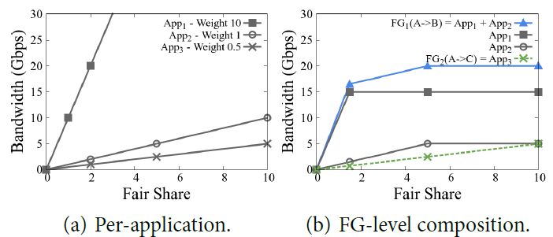
Example
FG1=App1+App2
FG2=App3
Bandwidth enforcer measures
App1 demand: 15Gbps A → B
App2 demand: 5Gbps A→B
App3 demand: 10Gbps A→C

Slide 20
Tunnel Group Generation
A greedy algorithm
allocates edge capacity among FGs according to their bandwidth function such that all competing FGs on an edge either receive equal fair share or fully satisfy their demand.
iterates by finding the bottleneck edge when filling all FGs together by increasing their fair share on their preferred tunnel.
freeze all tunnels cross the bottleneck edge, move to the next preferred tunnel.

Slide 21
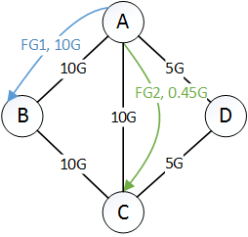
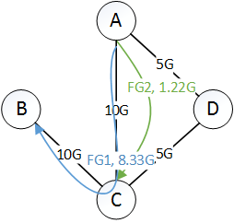
Example
T_{x,y}: y^{th} most preferred tunnel for FG_{x}.
T_{1,1}=A→B, T_{2,1}=A→C, at share 0.90. A→B becomes bottleneck
T_{1,2}=A→C→B, at share 3.33, A→C becomes bottleneck

Slide 22
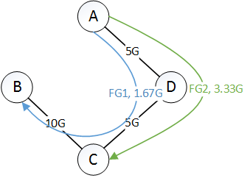
Example
T_{1,3}=A→D→C→B, T_{2,2}=A→D→C, at share 10,
FG2 is allocated a fair share of 10 while FG1 is allocated infinite fair share as its demand is fully satisfied

Slide 23
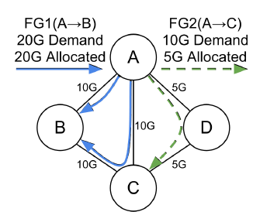
Tunnel Group Quantization
Example
split the above allocation in multiples of 0.5
FG2, (0.3, 0.7) → (0.0, 1.0)
FG1, (0.5, 0.4, 0.1) → (0.5, 0.5, 0.0)

Slide 24
Outline
Background
Design
Traffic Engineering
TE Protocol and OpenFlow
Evaluation

Slide 25
TE State and OpenFlow
A switch maps packets to an FG when their destination IP address matches the prefixes associated with the FG.
Each incoming packet hashes to one of the Tunnels associated with the TG in the desired ratio.
Source site switches encapsulate the packet with an outer IP header whose destination IP address uniquely identifies the tunnel.
The outer destination-IP address is a tunnel-ID rather than an actual destination.

Slide 26
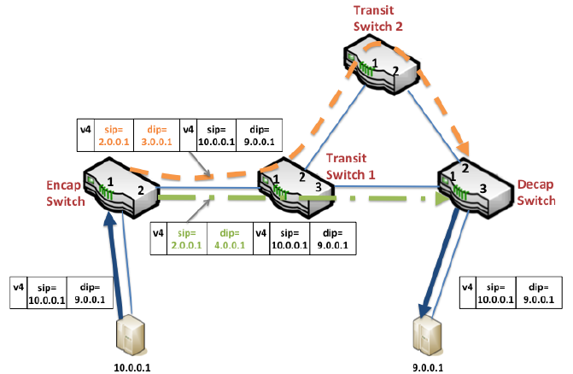
Example

Slide 27
Example
Half the flows are encapsulated with outer IP src/dest IP addresses 2.0.0.1, 4.0.0.1 and forwarded along the shortest path
The remaining flows are encapsulated with the label 2.0.0.1, 3.0.0.1 and forwarded through a transit site.
After decapsulation, the switch forwards to the destination based on the inner packet header, using Longest Prefix Match (LPM) entries (from BGP)

Slide 28
Composing Routing with TE
Routing/BGP populates the LPM table with appropriate entries
TE uses the Access Control List (ACL) table to set its desired forwarding behavior.
Incoming packets match against both tables in parallel. ACL rules take strict precedence over LPM entries.

Slide 29
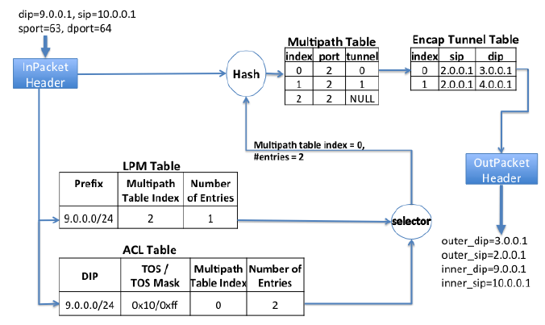
Example

Slide 30
Example
The LPM entry indicates that the packet should be forwarded through output port 2 without tunneling.
ACL entry takes precedence and indexes into a third table, the Multipath Table, at index 0 with 2 entries.
in parallel, the switch hashes the packet header contents, modulo the number of entries output by the ACL entry.
i.e., ECMP hashing
distributing flows destined to 9.0.0.0/24 evenly between two tunnels.

Slide 31
Coordinating TE States Across Sites
TE optimization output to a per-site Traffic Engineering Database (TED)
key-value datastore for global Tunnels, Tunnel Groups, and Flow Groups.
Compute per-site TED based on TGs, FGs, and Tunnels output by the TE algorithm.
a single TE operation (TE op) can add/delete/modify exactly one TED entry
The OFC converts the TE op to flow-programming instructions at all devices in that site.

Slide 32
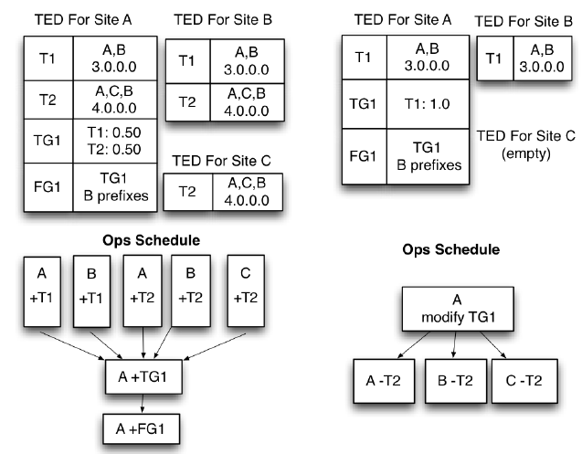
Example
Dependence
Configure tunnel before TG and FG
Cannot delete tunnel before removing affected entries

Slide 33
Outline
Background
Design
Traffic Engineering
TE Protocol and OpenFlow
Evaluation

Slide 34
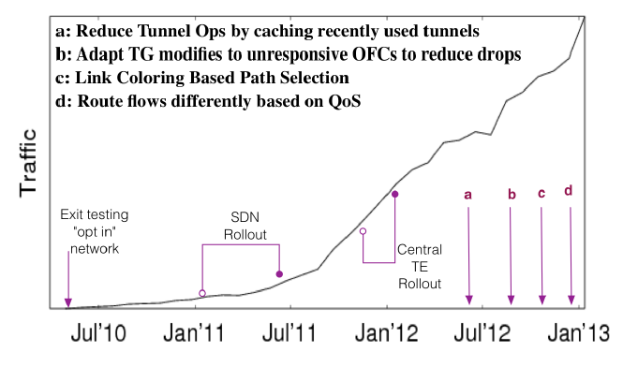
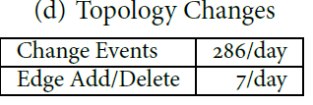
Deployment and Evolution
B4 traffic growth
B4 topology change
links are susceptible to frequent port flaps and benefit from dynamic centralized management.

Slide 35
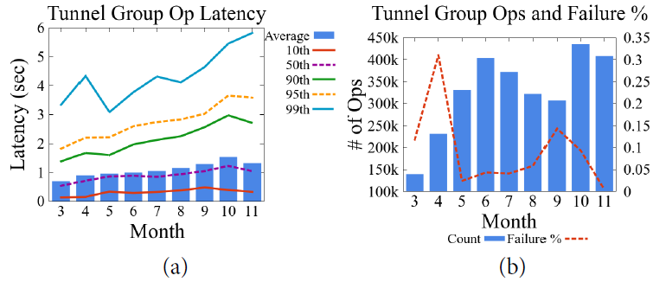
TE Ops Performance

Slide 36
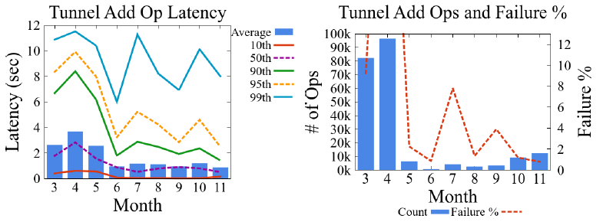
TE Ops Performance

Slide 37
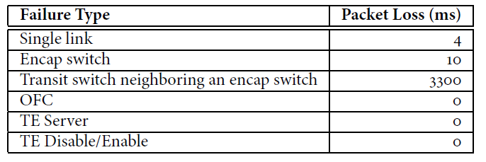
Impact of Failures
observed traffic between two sites and measured the duration of any packet loss after six types of events:
the failure of a transit router that is a neighbor to an encap router requires a much longer convergence time

Slide 38
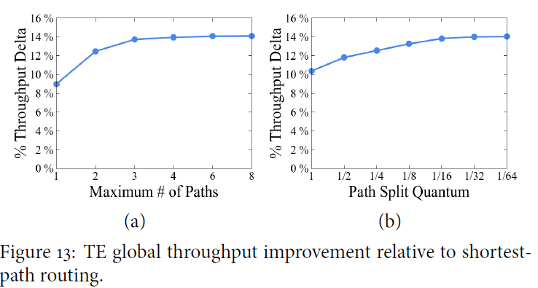
TE Algorithm Evaluation
(a) assume a 1/64 path-split quantum, to focus on sensitivity to the number of available paths.
(b) fix the maximum number of paths at 4, to show the impact of path-split quantum

Slide 39
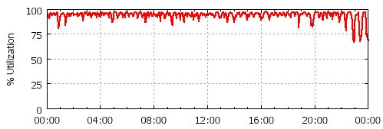
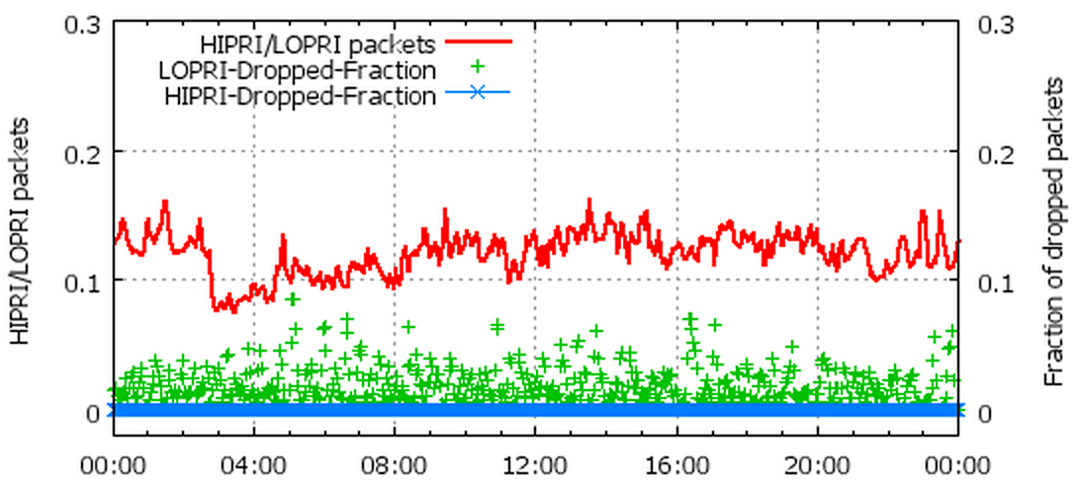
Link Utilization and Hashing
100% utilization
ratio of high priority to low priority packets, and packet-drop fractions for each priority.

Slide 40
Review
Why Google wants to build a WAN?
B4 network’s system architecture.
Each site
Global layer
TE algorithm
Forwarding rules

