Slide 1
Ethane: Taking Control of the Enterprise
Martìn Casado, Michael J. Freedman, Justin Pettit, Jianying Luo, Scott Shenker
ACM SIGCOMM, 2007
Presented by Ye Tian for Course CS05112

Slide 2
Overview
Motivation
Overview of Ethane Design
Ethane in More Detail
The POL-ETH Policy Language
Prototype and Performance

Slide 3
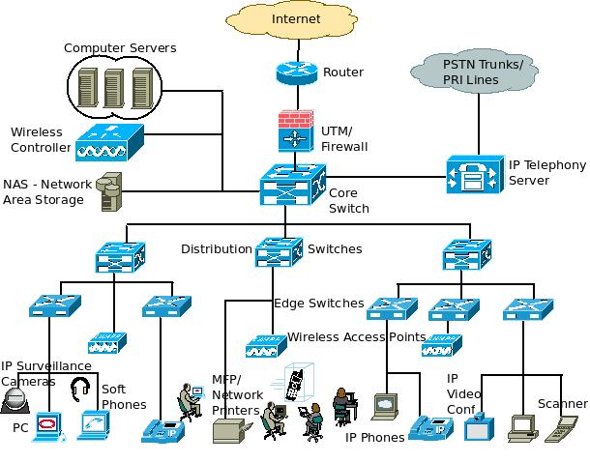
Motivation
Enterprise network
Run a wide variety of applications and protocols
Operate under strict reliability and security constraints

Slide 4
Motivation
Need manual configuration
Expensive and error-prone
62% of network downtime in multi-vendor networks comes from human-error
80% of IT budgets is spent on maintenance and operations
Network management approaches
Introduces proprietary middle-boxes, placed at network choke-points. E.g, firewall
Add functionality to existing networks. E.g., add ACL on switch
Only hide the complexity, not reduce it.

Slide 5
Motivation
Question: How could we change the enterprise network architecture to make it more manageable?
Three fundamental principles:
The network should be governed by policies declared over high-level names.
Policy should determine the path that packets follow.
Policy might require packets to pass through an intermediate middlebox;
Traffic can receive more appropriate service if its path is controlled;
The network should enforce a strong binding between a packet and its origin.

Slide 6
Overview
Motivation
Overview of Ethane Design
Ethane in More Detail
The POL-ETH Policy Language
Prototype and Performance

Slide 7
Overview
Ethane controls the network by not allowing any communication between end-hosts without explicit permission.
Two components
A central Controller
Contains the global network policy and topology
Performs route computation for permitted flows.
A set of Ethane switches
Simple and dumb
Consisting of a simple flow table and a secure channel to the Controller
Forward packets under the direction of the Controller.

Slide 8
Names, Bindings, and Policy Language
Keep the namespace consistent as components join, leave and move around the network.
How (machine – address – user)
Ethane takes over all the binding of addresses, behave as a DHCP server
Machine is registered on the network
Users are required to authenticate with the network
Such as the ones in WiFi hotpot.
Benefits:
The Controller can keep track of where any entity is located;
The Controller can journal all bindings and flow-entries in a log for network event reconstruction.

Slide 9
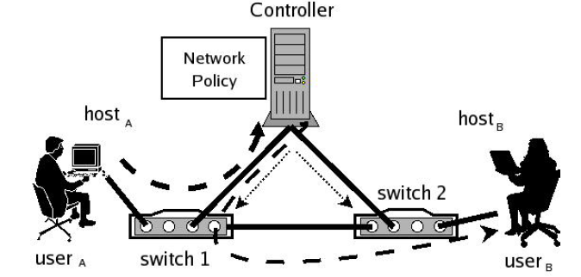
Ethane in Use
Registration
All switches, users, and hosts are registered at the Controller with the credentials necessary to authenticate them.

Slide 10
Ethane in Use
Bootstrap
Switches bootstrap connectivity by creating a spanning tree rooted at the Controller.
Each switch authenticates with and creates a secure channel to the Controller.

Slide 11
Ethane in Use
Authentication
User_{A} joins the network with host_{A}, switch 1 initially forward all of host_{A}’s packets to the Controller;
Host_{A} sends a DHCP request to the Controller. The Controller binds host_{A} to IP_{A}, IP_{A} to MAC_{A}, and MAC_{A} to a physical port on switch 1.
User_{A} opens a web browser, whose traffic is directed to the Controller, and authenticates through a web-form.

Slide 12
Ethane in Use
Flow Setup
Switch 1 forwards the packet to the Controller after determining that the packet does not match any active entries in its flow table.
The Controller decides whether to allow or deny the flow, or require it to traverse a set of waypoints.
The Controller computes the flow’s path, adds a new entry to the flow tables of all the Switches along the path.
What is a flow?
A sequence of packets from a source computer to a destination, which may be another host, a multicast group, or a broadcast domain.

Slide 13
Ethane in Use
Forwarding
If path is allowed, the Controller sends the packet back to switch 1 which forwards it based on the new flow entry.
Subsequent packets from the flow are forwarded directly by the Switch, and are not sent to the Controller.
The flow-entry is kept in the switch until it times out.

Slide 14
Overview
Motivation
Overview of Ethane Design
Ethane in More Detail
The POL-ETH Policy Language
Prototype and Performance

Slide 15
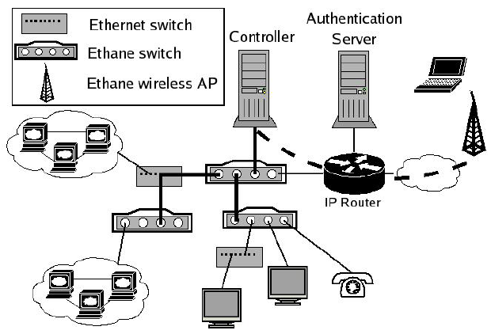
An Ethane Network

Slide 16
Ethane Switch
An Ethane switch is much simpler than conventional Ethernet switch
Doesn’t need to learn addresses, support VLANs, check for source-address spoofing, or keep flow-level statistics.
If layer3, doesn’t need to run routing protocols such as OSPF, ISIS, and RIP.
Ethane switch’s flow table can be much smaller than the forwarding table in an equivalent Ethernet switch.
Ethernet switch needs to remember all the addresses it’s likely to encounter.
Ethane Switch only needs to keep track of flows in-progress.

Slide 17

Flow Table and Flow Entries
Two common types of entry in the flow table:
Per-flow entries for flows that should be forwarded,
Per-host entries for misbehaving hosts whose packets should be dropped.
Entries are removed because
Timeout due to inactivity
Revoked by the Controller.

Slide 18
Local Switch Manager
To establish and maintain the secure channel to the Controller
Two ways:
For Switches that are part of the same physical network as the Controller, use Minimum Spanning Tree protocol.
For the Switch that is not within the same broadcast domain as the Controller, create an IP tunnel to it.
Switches maintain a list of neighboring switches by broadcasting and receiving neighbor-discovery messages.
Neighbor lists are sent to the Controller periodically every 15 seconds.

Slide 19
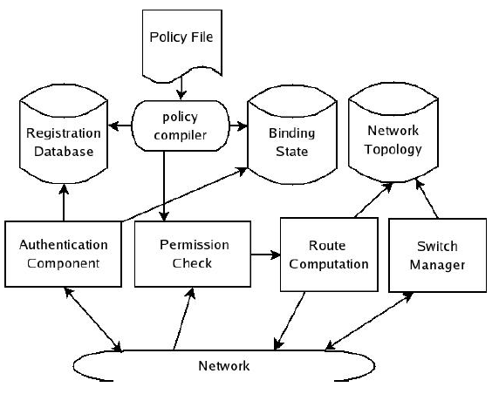
Controller
The Controller holds the policy file, which is compiled into a fast lookup table
The route computation uses the network topology to pick the flow’s route.
The topology is maintained by the switch manager, which receives link updates from the Switches.

Slide 20
Controller
Registration
All entities that are to be named by the network (i.e., hosts, protocols, Switches, users, and access points7) must be registered. They make up the policy namespace and is used to statically check the policy.
Authentication.
Does not specify a particular host authentication mechanism: e.g., 802.1X

Slide 21
Controller
Tracking bindings
Track all the bindings between names, addresses, and physical ports on the network event as Switches, hosts, and users join, leave, and move around the network.

Slide 22
Controller
Namespace interface
In current networks, it is almost impossible to figure out user activities very quickly
An Ethane Controller can journal all the authentication and binding information, it is possible to determine exactly which user sent a packet, when it was sent, the path it took, and its destination.

Slide 23
Controller
Permission Check and Access Granting
Upon receiving a packet, the Controller checks the policy to see what actions apply to it
Enforcing Resource Limits
Controller can limit a flow’s rate, limit the rate at which new flows are setup, or limit the number of IP addresses allocated.

Slide 24
Broadcast and Multicast
Handling multicast:
The Switch keeps a bitmap for each flow to indicate which ports the packets are to be sent to along the path. The Controller can calculate the broadcast or multicast tree and assign the appropriate bits during path setup.
Handling broadcast discovery protocols:
A host is trying to find a server or an address; e.g, ARP, DHCP
Given that the Controller knows all, it can reply to a request without creating a new flow and broadcasting the traffic.

Slide 25
Replicating the Controller: Fault-Tolerance and Scalability
Three techniques for replicating
Cold standby: Backup Controllers sit idly-by waiting to take over if needed.
If failure, the network will converge on a new root for MST.
The backups need only contain the registration state and the network policy.
The main advantage is simplicity; the downside is that hosts, Switches, and users need to re-authenticate and re-bind upon the primary’s failure.

Slide 26
Replicating the Controller
Warm-standby: a separate MST is created for every Controller.
The Controllers monitor one another’s liveness and, upon detecting the primary’s failure, a secondary Controller takes over based on a static ordering.
Need to replicate bindings across Controllers.
Some new users and hosts need to re-authenticate.

Slide 27
Replicating the Controller
Fully-replication: two or more active Controllers.
A Switch need only authenticate itself to one Controller and can then spread its flow-requests over the Controllers (e.g., hashing or round-robin)
Gossip to provide a weakly-consistent ordering over events.

Slide 28
Others
Link failure
The Switch removes all flow table entries tied to the failed port and sends its new link-state information to the Controller.
The Controller learns the new topology.
Bootstraping
On startup, the network creates a minimum spanning tree with the Controller advertising itself as the root.
If a Switch finds a shorter path to the Controller, it attempts two-way authentication before advertising that path as a valid route.

Slide 29
Overview
Motivation
Overview of Ethane Design
Ethane in More Detail
The POL-ETH Policy Language
Prototype and Performance

Slide 30
Overview
Ethane network policy is declared as a set of rules, each consisting of a condition and a corresponding action. Example
Condition: if the user initiating the flow is “bob” and the flow protocol is “HTTP” and the flow destination is host “websrv”
Action: Actions include allow, deny, waypoints, and outbound-only.
Rules are independent and don’t contain an intrinsic ordering

Slide 31
Example
Two parts: group declarations and rules
# Groups —
desktops = ["griffin","roo"];
laptops = ["glaptop","rlaptop"];
phones = ["gphone","rphone"];
server = ["http_server","nfs_server"];
private = ["desktops","laptops"];
computers = ["private","server"];
students = ["bob","bill","pete"];
profs = ["plum"];
group = ["students","profs"];
waps = ["wap1","wap2"];

Slide 32
Example
# Rules —
[(hsrc=in("server")^(hdst=in("private"))] : deny;
# Do not allow phones and private computers to communicate
[(hsrc=in("phones")^(hdst=in("computers"))] : deny;
[(hsrc=in("computers")^(hdst=in("phones"))] : deny;
# NAT-like protection for laptops
[(hsrc=in("laptops")] : outbound-only;
# No restrictions on desktops communicating with each other
[(hsrc=in("desktops")^(hdst=in("desktops"))] : allow;
# For wireless, non-group members can use http through
# a proxy. Group members have unrestricted access.
[(apsrc=in("waps"))^(user=in("group"))] :allow;
[(apsrc=in("waps"))^(protocol="http)] : waypoints("http-proxy");
[(apsrc=in("waps"))] : deny;
[]: allow; # Default-on: by default allow flows
Rules

Slide 33
Overview
Motivation
Overview of Ethane Design
Ethane in More Detail
The POL-ETH Policy Language
Prototype and Performance
Review

Slide 34
Implementation: Switch
Three different Ethane Switches:
An 802.11g wireless access point (based on a commercial access point)
A wired 4-port Gigabit Ethernet Switch that forwards packets at line-speed (based on the NetFPGA programmable switch platform and written in Verilog)
A wired 4-port Ethernet Switch in Linux on a desktop PC
Flow table
The main table—for packets that should be forwarded—has 8,192 flow entries
A second table with 32K entries

Slide 35
Implementation: Controller
Policy compiler: a source-to-source compiler that generates C++ from a Pol-Eth policy file.
Implemented the Controller on a standard Linux PC
Registration: standard database
Authentication: use university authentication system
Bind Journal and Namespace Interface: use BerkeleyDB for the log
Route Computation: using an all pairs shortest path algorithm.

Slide 36
Deployment
Stanford CS department
19 Ethane switches: 11 wired and 8 wireless; About 300 hosts
Policy
Non-servers are protected from outbound connections from servers.
Workstations can communicate uninhibited.
Hosts must register a MAC address, but no user authentication.
Wireless nodes do not require user authentication.

Slide 37
Deployment
Policy
Open wireless access points require users to authenticate.
The VoIP phones are restricted from communicating with non-phones and are statically bound to a single access point to prevent mobility.

Slide 38
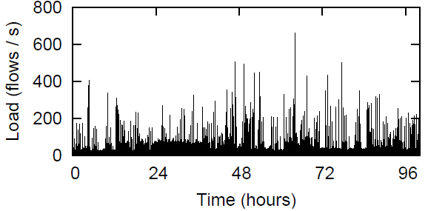
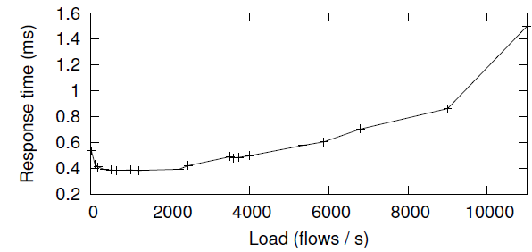
Performance: Controller Scalability
Experiment: 30-40 new flow requests per second with a peak of 750 flow requests per second.
A single Controller could comfortably handle 10,000 new flow requests per second.

Slide 39
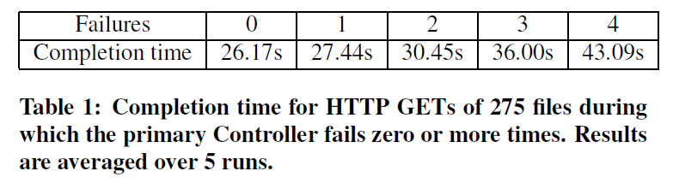
Performance During Failures
Controller failure: measure the completion time of 275 consecutive HTTP requests, retrieving 63MB in total.
While the requests were ongoing, we crashed the Controller and restarted it multiple times.

Slide 40
Performance During Failures
Link failure:
All outstanding flows re-contact the Controller in order to re-establish the path
Created a topology with redundant paths—so the network can withstand a link-failure—and measured the latencies experienced by packets.

Slide 41
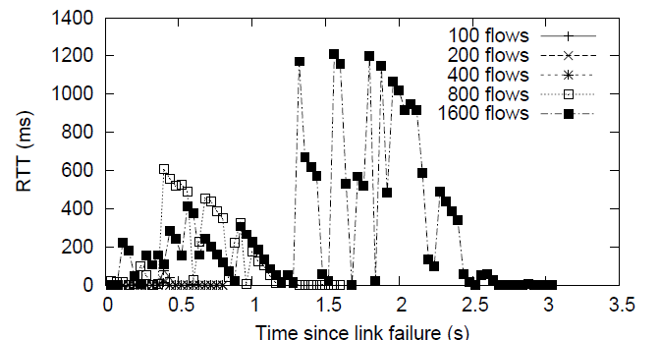
Performance During Failures
Path re-converges in under 40ms, but a packet could be delayed up to a second while the Controller handles the flurry of requests.

Slide 42
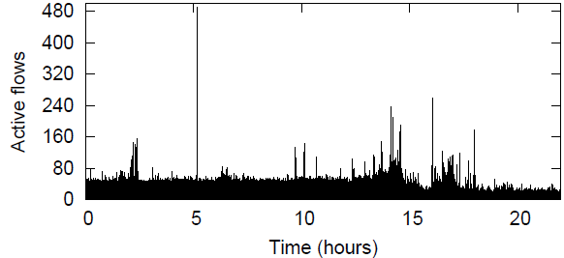
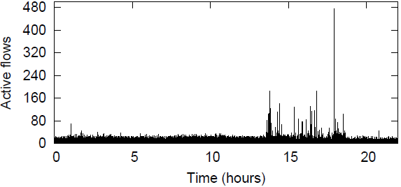
Performance: Flow Table Sizing
Use two network database:
An 8,000-host network at Lawrence Berkeley National LAB
A 22,000-host network at Stanford
Active flows
Never exceed 500

Slide 43
Performance: Flow Table Sizing
Switches closer to the edge will see a number of flows proportional to the number of hosts they connect to.
A Switch at the center of a network will likely see more active flows, and so we assume it will see all active flows.

Slide 44
Overview
Motivation
Overview of Ethane Design
Ethane in More Detail
The POL-ETH Policy Language
Prototype and Performance
Ethane’s shortcoming
Review

Slide 45
Ethane’s shortcoming
Broadcast and Service Discovery Protocols
Create large numbers of flow entries, lead to lots of traffic.
Unless Ethane can interpret the protocol and respond on its behalf.
Application-layer routing
Ethane’s policy can be compromised by communications at a higher layer.
For example, if A is allowed to talk to B but not C, and if B can talk to C, then B can relay messages from A to C.
Example, Tor

Slide 46
Ethane’s shortcoming
Knowing what the user is doing
Ethane’s policy assumes that the transport port numbers indicate what the user is doing.
Colluding malicious users or applications can fool Ethane by agreeing to use nonstandard port numbers.
Spoofing Ethernet addresses
Ethane Switches rely on the binding between a user and Ethernet addresses to identify flows.
If a user spoofs a MAC address, it might be possible to fool Ethane into delivering packets to an end-host.

Slide 47
Ethane’s shortcoming
Deny of service attack
On switch: flush the flow table
On controller

Slide 48
Review
Component of Ethane
Controller
Ethane switch
Name binding in a Ethane network
Why need name binding?
How two hosts communicate in a Ethane network?
Controller replicating
Policy Language

