Slide 1
Can the Production Network Be the Testbed?
Glen Gibb, KK Yap, Guido Appenzeller, Martin Cassado, Nick McKeown, Guru Parulkar
OSDI, 2010
Presented by Ye Tian for Course CS05112

Slide 2
Problem:
Realisticly evaluating new network services is hard
services that require changes to switches and routers
e.g.,
routing protocols
traffic monitoring services
IP mobility
Result: Many good ideas don't gets deployed;
Many deployed services still have bugs.
Notes:
"services means a lot of things to a lot of people, specifically, I mean..."
"this is frustrating to the networking community because the result is..."

Slide 3
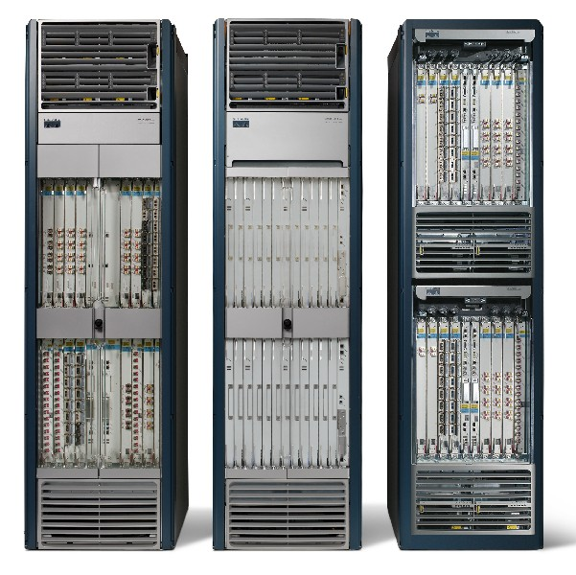
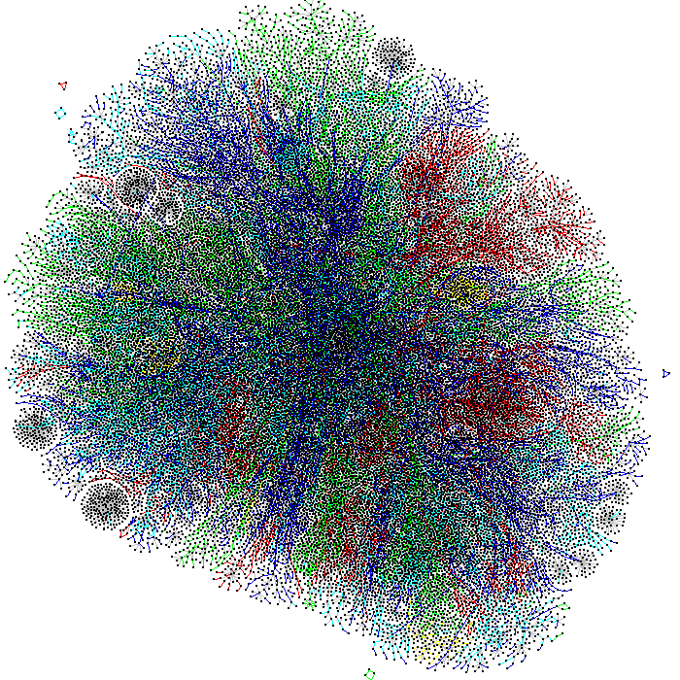



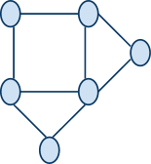
Why is Evaluation Hard?
Real
Networks
Testbeds
Notes:
real networks are:
closed, high performance systems with 100s of interfaces
10^6 nodes, complex topology
(so complex, discovering this topology is itself an open problem)
and traffic on it is generated by
real people who have come to
depend on Internet as a production service
unfortunately, for reasons of programability, costs, and isolation, network evaluations typically happen on independent testbeds
so software routers have become the norm, with slower performance and lower fanout
orders of magnitude fewer nodes configured in topologies of unknown realism
and using synthetic traffic, trying our best guess to act like real users
result: lessons learned from testbeds do not provide sufficient confidence about how things will work on the real network

Slide 4
Not a New Problem
Build open, programmable network hardware
NetFPGA, network processors
but: deployment is expensive, fan-out is small
Build bigger software testbeds
VINI/PlanetLab, Emulab
but: performance is slower, realistic topologies?
Convince users to try experimental services
personal incentive, SatelliteLab
but: getting lots of users is hard

Slide 5
Solution Overview: Network Slicing
Divide the production network into logical slices
each slice/service controls its own packet forwarding
users pick which slice controls their traffic: opt-in
existing production services run in their own slice
e.g., Spanning tree, OSPF/BGP
Enforce strong isolation between slices
actions in one slice do not affect another
Allows the (logical) testbed to mirror the production network
real hardware, performance, topologies, scale, users
Notes:
very text heavy; think about a picture (what!?)
"systems solution to a networking problem (this is why it's at OSDI)"

Slide 6


Current Network Devices
Switch/Router
Computes forwarding rules
“128.8.128/16 --> port 6”
Pushes rules down to data plane
Control
Plane
General-purpose
CPU
Rules
Control/Data Protocol
Excepts
Enforces forwarding rules
Exceptions pushed back to control plane
e.g., unmatched packets
Data
Plane
Custom
ASIC
Notes:
"before I can tell you about slicing, let me tell you a bit about how current switches and routers work..."
"simplified view"
"generally has a separate control and data plane"

Slide 7
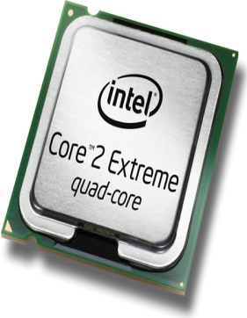

Add a Slicing Layer Between Planes
Slice 2
Control
Plane
Slice 1
Control
Plane
Slice 3
Control
Plane
Slice
Policies
Control/Data
Protocol
Rules
Excepts
Data
Plane
Notes:
"Each slice runs its own, custom control plane process and generates its own rules"
TODO: de-ugly-fy

Slide 8
Network Slicing Architecture
A network slice is a collection of sliced switches/routers
Data plane is unmodified
Packets forwarded with no performance penalty
Slicing with existing ASIC
Transparent slicing layer
each slice believes it owns the data path
enforces isolation between slices
i.e., rewrites, drops rules to adhere to slice police
forwards exceptions to correct slice(s)

Slide 9
Slicing Policies
The policy specifies resource limits for each slice:
Link bandwidth
Maximum number of forwarding rules
Topology
Fraction of switch/router CPU
FlowSpace: which packets does the slice control?

Slide 10
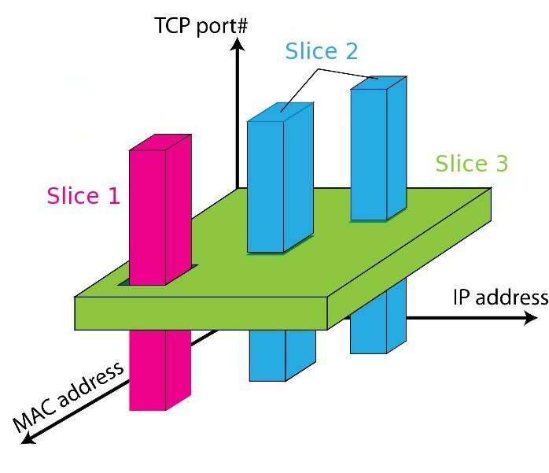
FlowSpace: Maps Packets to Slices
Notes:
"flowspace is a way of thinking about classes of packets"
"each slice has forwarding control of a specific set of packets, as specified by packet header fields"
"that is, all packets in a given flow are controlled by the same slice"
"each flow is controlled by exactly one slice" (ignoring monitoring slices for the purpose of the talk)
"in practice, flow spaces are described using ordered ACL-like rules"

Slide 11
Real User Traffic: Opt-In
Allow users to Opt-In to services in real-time
Users can delegate control of individual flows to Slices
Add new FlowSpace to each slice's policy
Example:
"Slice 1 will handle my HTTP traffic"
"Slice 2 will handle my VoIP traffic"
"Slice 3 will handle everything else"
Creates incentives for building high-quality services

Slide 12
Implemented on OpenFlow
Server
Custom
Control
Plane
OpenFlow
Controller
API for controlling packet forwarding
Abstraction of control plane/data plane protocol
Works on commodity hardware
via firmware upgrade
www.openflow.org
Network
OpenFlow
Protocol
Stub
Control
Plane
Control Path
OpenFlow
Firmware
Data
Plane
Data Path
Switch/
Router
Switch/
Router

Slide 13
FlowVisor Implemented on OpenFlow
Server
Servers
Custom
Control
Plane
OpenFlow
Controller
OpenFlow
Controller
OpenFlow
Controller
OpenFlow
Controller
OpenFlow
Network
OpenFlow
Protocol
FlowVisor
OpenFlow
Stub
Control
Plane
OpenFlow
Firmware
OpenFlow
Firmware
Data
Plane
Data Path
Data Path
Switch/
Router
Switch/
Router
Switch/
Router
Switch/
Router

Slide 14
FlowVisor Message Handling
Alice
Controller
Bob
Controller
Cathy
Controller
Rule
Policy Check:
Is this rule allowed?
OpenFlow
Policy Check:
Who controls this packet?
FlowVisor
OpenFlow
Full Line Rate
Forwarding
OpenFlow
Firmware
Exception
Packet
Data Path
Packet

Slide 15
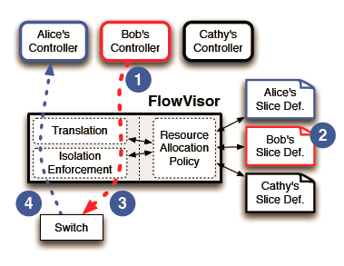
Message Interception

Slide 16
Message Interception
When Bob’s controller sends a flow entry to the switches (e.g., to redirect HTTP traffic to a particular server), FlowVisor intercepts it
Examines Bob’s slice policy
Rewrites the entry to include only traffic from the allowed source.
Similarly, messages that are sourced from the switch (e.g., a new flow event) are only forwarded to guest controllers whose flowspace match the message.

Slide 17
Message Translation
Depending on the resource allocation policy, message type, destination, and content, the FlowVisor will forward a given message unchanged, translate it to a suitable message and forward, or “bounce” the message back to its sender in the form of an OpenFlow error message.
For a message sent from slice controller to switch, FlowVisor ensures that the message acts only on traffic within the resources assigned to the slice.
For a message in the opposite direction (switch to controller), the FlowVisor examines the message content to infer the corresponding slice(s) to which the message should be forwarded.

Slide 18
Example
Alice: network admin; Bob: experimenter
Bob’s Experimental Network includes all HTTP traffic to/from users who opted into his experiment.
Allow: tcp port:80 and ip=user ip.
Alice’s Production Network is the complement of Bob’s network. For each user in Bob’s experiment, the production traffic network has a negative rule, and allow all other traffics:
Deny: tcp port:80 and ip=user ip.
Allow: all.

Slide 19
FlowVisor Implementation
Custom handlers for each of OpenFlow's 20 message types
Transparent OpenFlow proxy
8261 LOC in C
New version with extra API for GENI
Could extend to non-OpenFlow (ForCES?)
Code: `git clone git://openflow.org/flowvisor.git`

Slide 20
Message to Control Plane
First, FlowVisor only sends control plane messages to a slice controller if the source switch is actually in the slice’s topology.
Second, FlowVisor rewrites Open-Flow feature negotiation messages so that the slice controller only sees the physical switch ports that appear in the slice.
Third, OpenFlow port up/port down messages are similarly pruned and only forwarded to the affected slices.

Slide 21
Message to Forwarding Plane
The most important messages to the forwarding plane were insertions and deletions to the forwarding table.
FlowVisor rewrites the flow definition to intersect with the slice’s flowspace.
Example: Bob’s flowspace gives him control over HTTP traffic for the set of users—e.g., users Doug and Eric. If Bob’s slice controller tried to create a rule that affected all of Doug’s traffic (HTTP and non-HTTP), then the FlowVisor would rewrite the rule to only affect the intersection, i.e., only Doug’s HTTP traffic.

Slide 22
Message to Forwarding Plane
FlowVisor rewrites the flow definition to intersect with the slice’s flowspace.
Example: if Bob creates a rule to send out all ports, the rule is rewritten to send to just the subset of ports in Bob’s slice.

Slide 23
Isolation Techniques
Isolation is critical for slicing
Link bandwidth
Device CPU
Flow Entry
As well as performance and scaling numbers

Slide 24
Link bandwidth Isolation
The most recent versions of OpenFlow expose native bandwidth slicing capabilities in the form of per-port queues.
The FlowVisor re-writes all slice forwarding table additions from “send out port X” to “send out queue Y on port X ”, where Y is a slice-specific queue ID.
any queuing discipline can be used (weighted fair queuing, deficit round robin, strict partition, etc.), in implementation

Slide 25
Device CPU Isolation
Ensure that no slice monopolizes Device CPU
CPU exhaustion
prevent rule updates
drop LLDPs ---> Causes link flapping
Four main sources of load on a switch CPU:
generating new flow messages,
handling requests from controller,
forwarding “slow path” packets, and
internal state keeping.

Slide 26
Device CPU Isolation
New Flow Messages
FlowVisor rate limits the new flow message arrival rate.
In implementation, the FlowVisor tracks the new flow message arrival rate for each slice, and if it exceeds some threshold, the FlowVisor inserts a forwarding rule to drop the offending packets for a short period.
A token-bucket style counter for each flow space rule
Controller Requests
For each slice, the FlowVisor limits CPU consumption by throttling the OpenFlow message rate to a maximum rate per second.

Slide 27
Device CPU Isolation
Slow-Path Forwarding
Packets that traverse the “slow” path - i.e., not the “fast” dedicated hardware forwarding path—consume CPU resources.
Example, output two ports (unicast and broadcast are supported as fast path)
FlowVisor prevents slice controllers from inserting slow-path forwarding rules by rewriting them as one-time packet forwarding events, i.e., an OpenFlow “packet out” message.
As a result, the slow-path packets are rate limited by the above two isolation mechanisms: new flow messages and controller request rate limiting.

Slide 28
Device CPU Isolation
Internal Book Keeping
i.e., counters
Care must be taken to ensure that there is sufficient CPU available for the switch’s bookkeeping.

Slide 29
Flow Entry Isolation
The FlowVisor counts the number of flow entries used per slice and ensures that each slice does not exceed a preset limit.

Slide 30
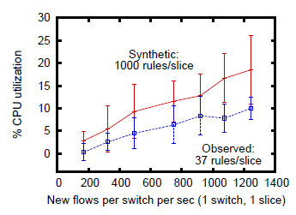
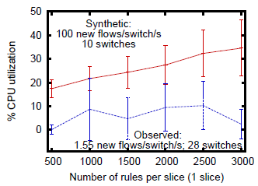
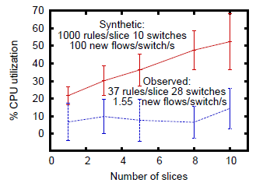
Performance: Scalability
FlowVisor’s CPU utilization scales linearly with new flow rate, number of slices, switches, and flowspace rules.

Slide 31
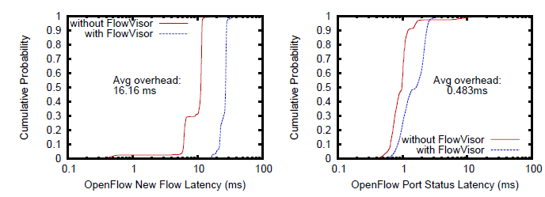
Performance: latency
connect a machine with two interfaces to a switch. One interface sends a packet every 20ms (50 packets per second) to the switch and the other interface is the OpenFlow control channel.
Measure the time between sending the packet and receiving the new flow message using libpcap.
Send port status requests from controller to switch.
Each for switch
Expensive for FlowVisor: remove statistics for ports that do not appear in a sliced topology.

Slide 32
Performance: Bandwidth Isolation
the first slice sends TCP-friendly traffic and the other slice sends TCP-unfriendly constant-bit-rate (CBR) traffic at full link speed (1Gbps).
With the bandwidth isolation disabled (“without Slicing”), the CBR traffic consumes nearly all the bandwidth and the TCP traffic averages 1.2% of the link bandwidth.
With the traffic isolation features enabled (“with 30/70% reservation”), the FlowVisor maps the TCP slice to a QoS class that guarantees at least 70% of link bandwidth and maps the CBR slice to a class that guarantees at least 30%.

Slide 33
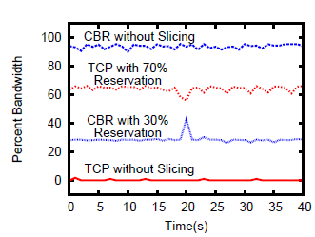

Slide 34
Performance: CPU Isolation
First experiment, the OpenFlow controller maliciously sends port stats request messages (as above) at increasing speeds.
Second experiment, the switch generates new flow messages faster than its CPU can handle and a faulty controller does not add a new rule to match them.
the faulty controller does not add rules on the switch, so the switch will packed in every packet, exhausting its CPU

Slide 35
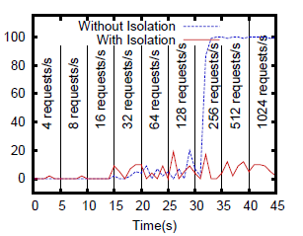
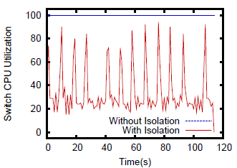

Slide 36
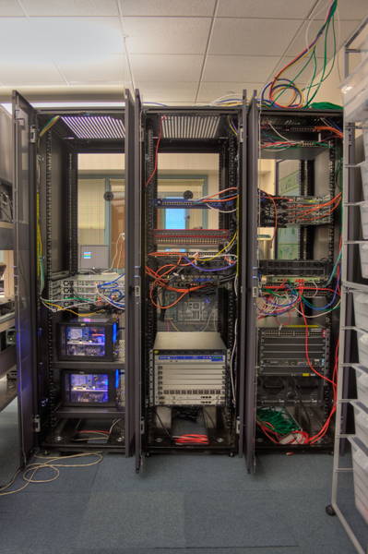
FlowVisor Deployment: Stanford
Our real, production network
15 switches, 35 APs
25+ users
1+ year of use
Author’s personal email and web-traffic!
Same physical network hosts Stanford demos
7 different demos

Slide 37
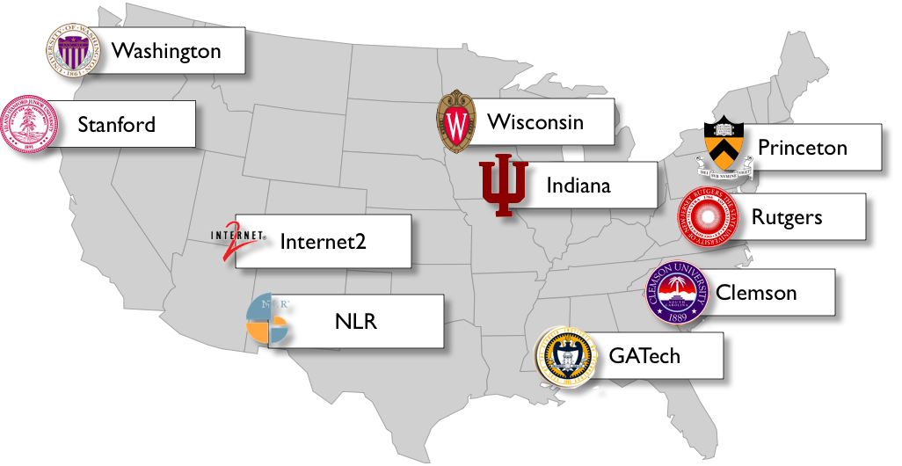
FlowVisor Deployments: GENI

Slide 38
Conclusion: Tentative Yes!
Network slicing can help perform more realistic evaluations
FlowVisor allows experiments to run concurrently but safely on the production network
CPU isolation needs OpenFlow 1.1 feature
Over one year of deployment experience
FlowVisor+GENI coming to a campus near you!

