Slide 1
NOX: Towards an Operating System for Networks
Natasha Gude, Teemu Koponen, Justin Pettit, Ben Pfaff, Martín Casado, Nick McKeown, Scott Shenker
SIGCOMM CCR, 2008
Presented by Ye Tian for Course CS05112

Slide 2
Overview
Background and Motivation
NOX Overview
Programming Interface
Example Applications
Review

Slide 3
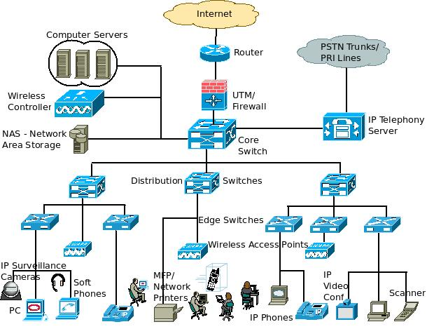
Background
Enterprise network is complex, hard to manage
  Many devices
  Different vendors
  Various protocols
  Various services
  and
  requirements

Slide 4
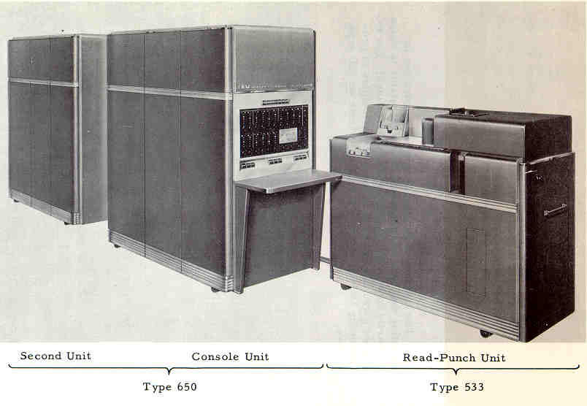
An Analogy with OS
In early days, programs were written in machine languages
  No common abstractions for the underlying physical resources.
  Programs are hard to write,
  port, reason about, and
  debug.
Modern operating systems
  Facilitate program
  development
  Provide controlled access to
  high-level abstractions for
  resources

Slide 5
Motivation
Networks are managed through low-level configuration of individual components.
  Blocking a user with ACL: need to known the user’s current IP address
  Forcing port 80 traffic to HTTP proxy requires extensive knowing the current network topology
An enterprise network resembles a computer without an operating system,
  Network-dependent component configuration is similar to hardware-dependent machine-language programming.

Slide 6
Motivation
Need a network operating system provides the ability to observe and control a network.
  Does not manage the network itself, but provides a programmatic interface.
  Applications implemented on top of the network operating system perform the actual management tasks.

Slide 7

Motivation
What’s the difference?
  Presents programs with a centralized programming model; programs are written as if the entire network were present on a single machine.
  Programs are written in terms of high-level abstractions (e.g., user and host names), not low-level configuration parameters (e.g., IP and MAC addresses).
The solution: NOX
  Available at http://www.noxrepo.org/

Slide 8
Overview
Background and Motivation
NOX Overview
Programming Interface
Example Applications
Review

Slide 9
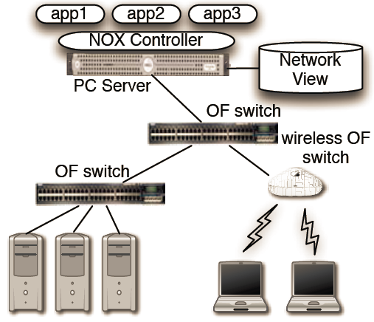
Components
Primary components
  A set of switches:
  support OpenFlow
  abstraction
  One or more network-
  attached servers:
  run NOX softwares;
  can be thought of as
  involving several
  different controller
  processes and a single
  network view.

Slide 10
Granularity
NOX’s network view:
  The switch-level topology; the locations of users, hosts, middle-boxes, and other network elements; and the services (e.g., HTTP or NFS) being offered.
  All bindings between names and addresses.
  Does not include the current state of network traffic.

Slide 11
Granularity
Choosing the granularity involves trading off between scalability vs. flexibility.
  A centralized per-packet control: infeasible to implement across any sizable network. No scalability.
  Prefix-based routing table: not allow sufficient control, since all packets between two hosts would have to follow the same path. No flexibility.
An intermediate flow-based granularity
  Once control is exerted on some packet, subsequent packets with the same header are treated in the same way.

Slide 12
Switch Abstraction
Independent of the particular switch hardware.
Support the flow-level control granularity.
Switches are represented by flow tables with entries like:
<header : counters; actions>
For each packet matching the specified header, the counters are updated and the appropriate actions taken. If a packet matches multiple flow entries, the entry with the highest priority is chosen.

Slide 13
Switch Abstraction
Basic set of OpenFlow actions
  Forward as default (i.e., forward as if NOX were not present)
  Forward out specified interface
  Deny
  Forward to a controller process
  Modify various packet header fields (e.g., VLAN tags, source and destination IP address and port).

Slide 14
Operation
At the switch, If an incoming packet matches a flow entry at a switch
  Updates the appropriate counters and applies the corresponding actions.
If doesn’t match:
  Forwarded to a controller process. Two cases:
  These packets often are the first packet of a flow
  The controller processes may choose to receive all packets from certain protocols. (e.g., DNS)

Slide 15
Operation
NOX applications use flow-initiations and other forwarded traffic to
  Observe: Construct the network view.
  Use DNS, DHCP, LLDP, and flow-initiations to construct the network view, including both the network topology and the set of name-address bindings.
  Control: Determine whether to forward traffic, and, if so, which route.
  Develop access-control and routing applications that determine if a flow should be allowed, compute an appropriate L2 route, install flow entries in all the switches along the path, and then return the packet to the originating switch

Slide 16
Scaling
Events in NOX
  Packet arrivals: millions per sec.
  Flow initiations: one or more orders of magnitude less than the packet arrival rate.
  Changes in the network view: tens of events per second for networks of thousands of hosts.
Persistency:
  The only network state that is global consistent is the network view, can be handled by the centralized controller.
  Neither packet state nor flow state are part of the network view, can be kept in local storage.

Slide 17
Scaling
Use parallelism to handle events that occur on rapid timescales
  A single controller process running on a generic PC can currently handle 100,000 flow initiations per second, more than sufficient for the large campus networks we’ve measured in previous work
Implementation status
  Implemented with Python and C++, 32,000 lines.
  Run in user space.
  Manage an internal network of roughly 30 hosts for over 6 months.

Slide 18
Overview
Background and Motivation
NOX Overview
Programming Interface
Example Applications
Review

Slide 19
Programmatic Interface
Events
  Use a set of handlers that are registered to execute when a particular event happens.
  Some events are generated directly by OpenFlow messages.
  Other events are generated by NOX applications as a result of processing these low-level events and/or other application-generated events.

Slide 20
Programmatic Interface
Network View and Namespace
  NOX includes a number of “base” applications that construct the network view and maintain a high-level namespace that can be used by other applications.
  Allow applications to be written in a topology independent manner.
  High-level declarations can be “compiled” against the network view to produce low-level lookup functions that are enforced per-packet.
  The worst result of a poorly written application is performance degradation, not incorrect function.

Slide 21
Programmatic Interface
Control
  Management applications exert network control through OpenFlow.
  OpenFlow will not include custom per-packet processing (e.g., deep packet inspection).
  NOX applications can direct traffic through specialized middle-boxes
Higher-Level Services
  A set of “system libraries” to provide efficient implementations of functions common to many network applications.

Slide 22
Overview
Background and Motivation
NOX Overview
Programming Interface
Example Applications
Review

Slide 23
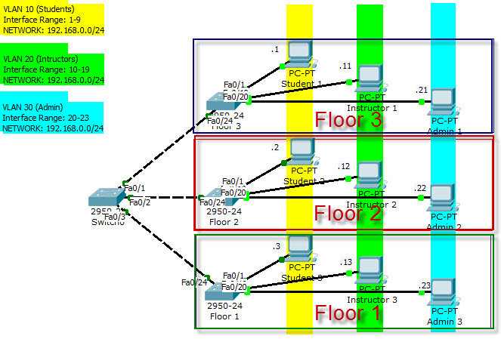
Example 1: User-based VLAN Tagging
VLAN

Slide 24
Example 1: User-based VLAN Tagging
# On user authentication, statically setup VLAN tagging
# rules at the user’s first hop switch
def setup_user_vlan(dp, user, port, host):
vlanid = user_to_vlan_function(user)
# For packets from the user, add a VLAN tag
attr_out[IN_PORT] = port
attr_out[DL_SRC] = nox.reverse_resolve(host).mac
action_out = [(nox.OUTPUT, (0, nox.FLOOD)), (nox.ADD_VLAN, (vlanid))]
install_datapath_flow(dp, attr_out, action_out)
# For packets to the user with the VLAN tag, remove it
attr_in[DL_DST] = nox.reverse_resolve(host).mac
attr_in[DL_VLAN] = vlanid
action_in = [(nox.OUTPUT, (0, nox.FLOOD)), (nox.DEL_VLAN)]
install_datapath_flow(dp, attr_in, action_in)
nox.register_for_user_authentication(setup_user_vlan)
Notes:
一个VLAN相当于OSI模型第2层的广播域，它能将广播控制在一个VLAN内部。而不同 VLAN 之间或 VLAN 与 LAN / WAN 的数据通信必须通过第3层（网络层）完成。

Slide 25
Simplistic Scan Detection
Count the number of unique L2 and L3 destinations a host tries to contact that have not authenticated.
Detect scanning hosts by tracking the number of unique, unknown L2 and L3 destinations attempted by a single host.

Slide 26
Simplistic Scan Detection
scans = defaultdict(dict)
def check_for_scans(dp, inport, packet):
dstid = nox.resolve_host_dest(packet)
if dstid == None:
scans[packet.l2.srcaddr][packet.l2.dstaddr] = 1
if packet.l3 != None:
scans[packet.l2.srcaddr][packet.l3.dstaddr] = 1
if len(scans[packet.l2.srcaddr].keys()) > THRESHOLD:
print nox.resolve_user_source_name(packet)
print nox.resolve_host_source_name(packet)
# To be called on all packet-in events
nox.register_for_packet_in(check_for_scans)

Slide 27
Ethane
Two requirements of Ethane
  Require knowledge of the principals on the network (e.g., users, nodes)
  Requires control over routing at the granularity of flow, 7-tuple (source user, source host, first-hop switch, protocol, destination user, destination host, last-hop switch)
  Both natively supported by NOX
How to efficiently check flows against the policy?
  Linear lookup, not efficient enough
  Dynamically construct efficient lookup trees from the policy declarations.

Slide 28
Review
Why flow-based granularity is better than the packet-level and the prefix-level ones?
In NOX, which is the global network view, which is not?
  Switch-level topology
  Name binding
  Traffic

