Slide 1
OpenFlow: Enabling Innovation in Campus Networks
Nick McKeown, Tom Anderson, Hari Balakrishnan, Guru Parulkar, Larry Peterson, Jennifer Rexford, Scott Shenker, Jonathan Turner,
SIGCOM CCR, 2008
Presented by Ye Tian for Course CS05112

Slide 2

About OpenFlow
OpenFlow
a protocol that structures communication between the control and data planes under the context of software defined network.
A specification for a switch that can function as an OpenFlow switch.
Proposed by Open Networking Foundation (ONF)
White paper: Software-Defined Networking: The New Norm for Networks

Slide 3
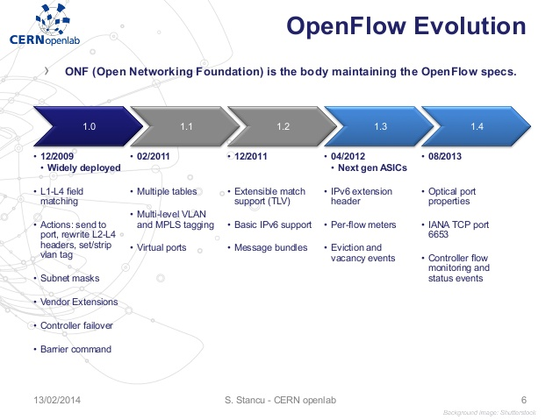
Current version: OpenFlow 1.6

Slide 4
Overview
Background
Software Defined Networking
The OpenFlow Protocol
Using OpenFlow
Review

Slide 5
New Computing Trends
Changing traffic patterns:
A flurry of “east-west” machine-to-machine traffic before returning data to the end user device in the classic “north-south” traffic pattern.
Private/public cloud, resulting in additional traffic across the wide area network.
The “consumerization of IT”:
IT needs to accommodate various personal devices while protecting corporate data and intellectual property and meeting compliance mandates.

Slide 6
New Computing Trends
The rise of cloud services:
Elastic scaling of computing, storage, and network resources, ideally from a common viewpoint and with a common suite of tools.
“Big data” means more bandwidth:
The rise of mega datasets is fueling a constant demand for additional network capacity in the data center.

Slide 7
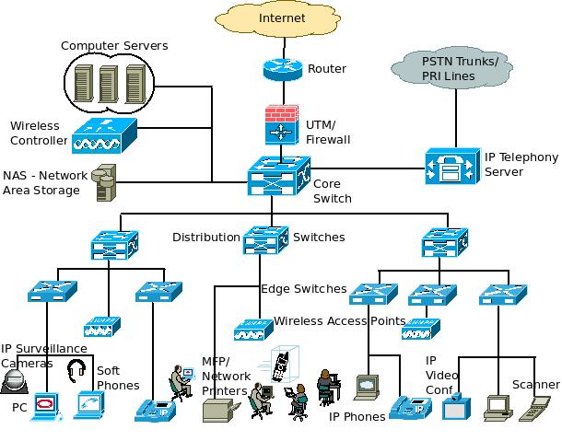
The Conventional Network
Hierarchical with tires of Ethernet switches
Tree structure

Slide 8
Limitations of Current Networking Technologies
Complexity that leads to stasis
Protocols tend to be defined in isolation, with each solving a specific problem and without the benefit of any fundamental abstractions. This has resulted in one of the primary limitations of today’s networks: complexity.
The static nature of networks is in stark contrast to the dynamic nature of today’s server environment. Applications are distributed across VMs.
Many operate an IP converged network for voice, data, and video traffic. While existing networks can provide differentiated QoS levels for different applications, the provisioning of those resources is highly manual.

Slide 9
Limitations of Current Networking Technologies
Inconsistent policies: To implement a network-wide policy, IT may have to configure thousands of devices and mechanisms.
Take hours.
Difficult to apply a consistent set of policies due to complexity.

Slide 10
Limitations of Current Networking Technologies
Inability to scale:
The network becomes vastly more complex with the addition of hundreds or thousands of network devices that must be configured and managed.
Mega-operators, such as Google, Yahoo!, and Facebook, need so-called hyperscale networks that can provide high-performance, low-cost connectivity among hundreds of thousands— potentially millions—of physical servers.
Such scaling CANNOT be done with manual configuration.

Slide 11
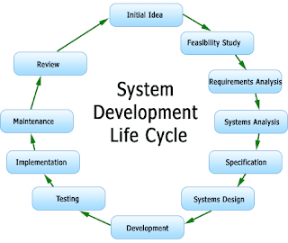
Limitations of Current Networking Technologies
Vendor dependence:
Carriers and enterprises seek to deploy new capabilities and services in rapid response to changing business needs or user demands.
Vendors’ equipment product cycle: 3 or more years.
Lack of standard, open interfaces limits the ability of network operators to tailor the network to their individual environments.

Slide 12
Overview
Background
Software Defined Networking
The OpenFlow Protocol
Using OpenFlow
Review

Slide 13
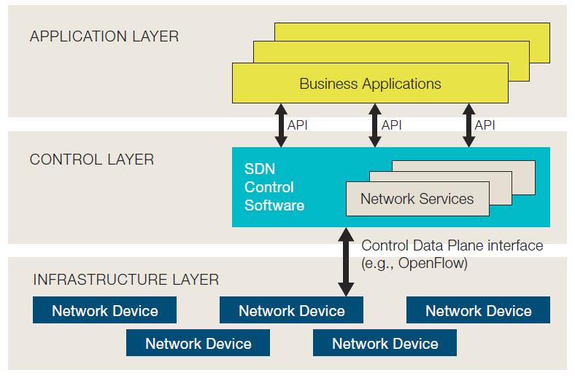
Software Defined Networking
Network control is decoupled from forwarding and is directly programmable.

Slide 14
Software Defined Networking
Network operators and administrators can programmatically configure this simplified network abstraction.
They can write these programs themselves and not wait for features to be embedded in vendors’ proprietary and closed software environments .
SDN architectures support a set of APIs that make it possible to implement common network services,
Routing, multicast, security, access control, bandwidth management, traffic engineering, quality of service, …, custom tailored to meet business objectives.

Slide 15
Overview
Background
Software Defined Networking
The OpenFlow Protocol
Using OpenFlow
Review

Slide 16
OpenFlow Switches
OpenFlow provides an open protocol to program the flow table in different switches and routers.
An OpenFlow Switch consists of at least three parts
A Flow Table, with an action associated with each flow entry, to tell the switch how to process the flow,
A Secure Channel that connects the switch to a remote control process (called the Controller), allowing commands and packets to be sent between a controller and the switch using
The OpenFlow Protocol, which provides an open and standard way for a controller to communicate with a switch.

Slide 17
OpenFlow Switches
What is a flow?
A flow could be a TCP connection, or all packets from a particular MAC or IP address, or all packets with the same VLAN tag, or all packets from the same switch port.
Each flow-entry has a simple action associated with it. At least three basic actions
Forward this flow’s packets to a given port (or ports).
Encapsulate and forward this flow’s packets to a controller.
Drop this flow’s packets.

Slide 18
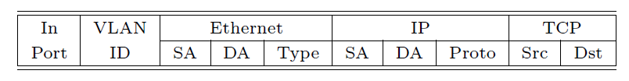
OpenFlow Switches
An entry in the Flow-Table has three fields:
A packet header that defines the flow,
The action, which defines how the packets should be processed,
Statistics, which keep the number of packets and bytes for each flow, and the time since the last packet match
A 10-tuple packet header

Slide 19
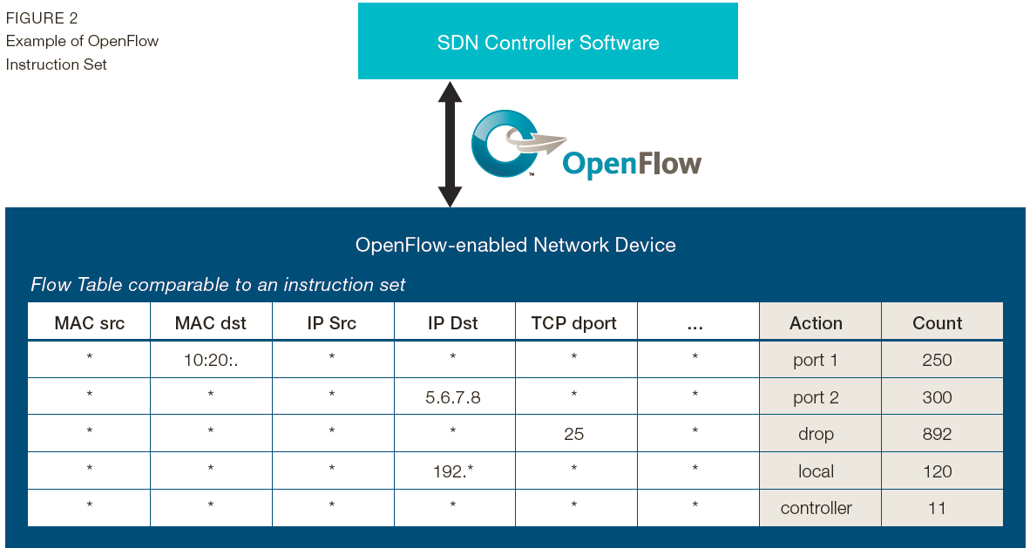
OpenFlow Controller
Adds and removes flow-entries from the Flow Table on behalf of experiments.

Slide 20
Benefit of Openflow-based SDN
Centralized control of multi-vendor environments
No need Cisco certification
Reduced complexity through automation
Higher rate of innovation
Increased network reliability and security
Can ensure that access control, traffic engineering, quality of service, security, and other policies are enforced consistently across the wired and wireless network infrastructures,
More granular network control
Per address block → per flow
Better user experience
For example, automatic video resolution adaption

Slide 21
Overview
Background
Software Defined Networking
The OpenFlow Protocol
Using OpenFlow
Review

Slide 22
Using OpenFlow
Example 1: Network Management and Access Control
Ethane: The basic idea is to allow network managers to define a network-wide policy in the central controller, which is enforced directly by making admission control decisions for each new flow.
A controller associates packets with their senders by managing all the bindings between names and addresses—it essentially takes over DNS, DHCP and authenticates all users when they join, keeping track of which switch port (or access point) they are connected to.

Slide 23
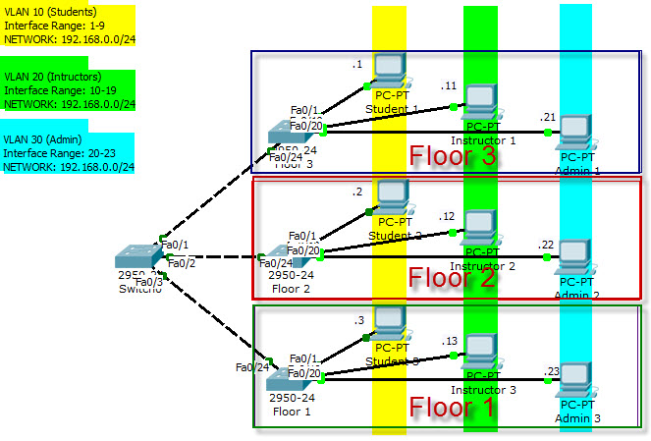
Using OpenFlow
Example 2: VLANs
The simplest approach is to statically declare a set of flows which specify the ports accessible by traffic on a given VLAN ID.
A more dynamic approach might use a controller to manage authentication of users and use the knowledge of the users’ locations for tagging traffic at runtime.
VLAN

Slide 24
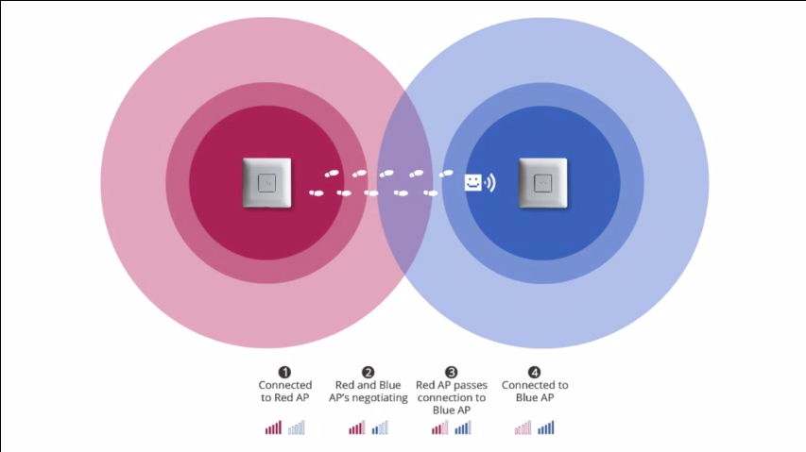
Using OpenFlow
Mobile wireless VoIP clients.
Support call- handoff mechanism for WiFi-enabled phones.
A controller is implemented to track the location of clients, re-routing connections — by reprogramming the Flow Tables —as users move through the network, allowing seamless handoff from one access point to another.

Slide 25
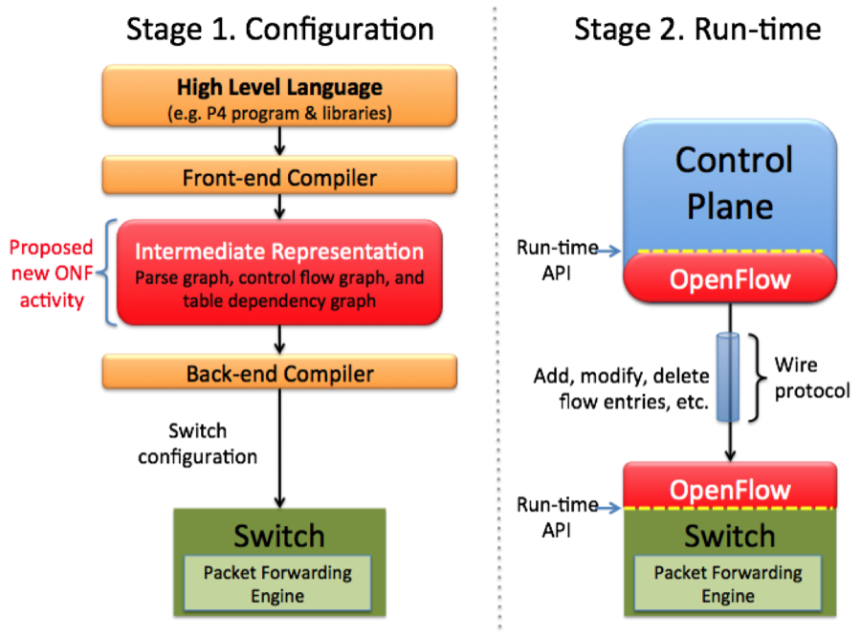
Using OpenFlow
An non-IP network
There are several ways an OpenFlow-enabled switch can support non-IP traffic. For example, flows could be identified using their Ethernet header.
What is going on?
Protocol Independent Forwarding
Protocol Oblivious Forwarding

Slide 26
Using OpenFlow
Example 5: Processing packets rather than flows.
Approach 1: force all of a flow’s packets to pass through a controller by default. More flexible, at the cost of performance.
Approach 2: route them to a programmable switch that does packet processing.

Slide 27
Review
How SDN works?
Three layers in SDN
Where OpenFlow is located?
How to user SDN?

Slide 28
Nick McKeown’s talk on SDN

