Slide 1
Modular SDN Programming with Pyretic
Joshua Reich, Christopher Monsanto, Nate Foster, Jennifer Rexford, and David Walker
USENIX, 2013
Presented by Ye Tian for Course CS05112

Slide 2

Pyretic Controller
One member of the Frenetic family of SDN programming languages.
Based on Python
Programmer friendly
Reference
http://www.frenetic-lang.org/
Tutorial
Documentation

Slide 3
Running Pyretic
Run Pyretic using “pyretic.py”
Options
-m MODE i|r0|p0
-v VERBOSITY low|high
$ pyretic.py –v high –m p0 pyretic.examples.pyretic_switch

Slide 4
Running Pyretic
MODE
i: every packet is processed in the controller runtime. Unsurpsingly slow, but useful for debugging.
r0: rules are reactively pushed to switches based on the Pyretic policy and the packets seen.
f0: rules are proactively pushed to switches based on the Pyretic policy. Generally the highest performance mode currently available.

Slide 5
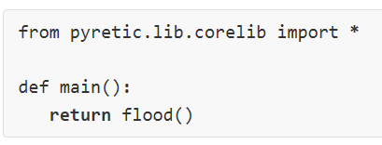
Main Method
Every Pyretic program must have a main method
Import at minimum the Pyretic core library.

Slide 6
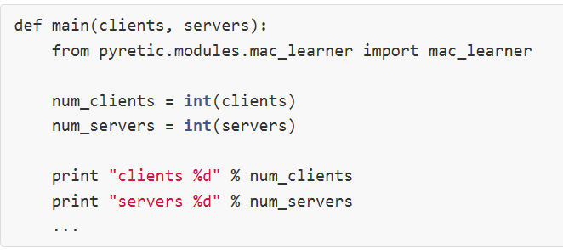
Main Method
Import in the main function

Slide 7
Packet Model
A packet contains all the OpenFlow recognized fields
srcmac, dstmac, ethertype, srcip, dstip, …
A packet also contains other information,
switch
inport
outport
…

Slide 8
Language Basics: Policy
A policy is a function that takes a packet as input and returns a set of packets.
Describes what the network switches should do with incoming packets.
Example:
A function that takes any packet and returns the empty set, cause the network to drop all packets.
A function that takes any packet arriving at a given location (switch and port) and returns the set of identical packets but located respectively at the ports at that switch which lie on the network spanning tree, cause the network to flood all packets. (modify outport)

Slide 9
Language Basics: Policy
POLICY | SYNTAX | SEMANTICS | EXAMPLE
match | match(f=v) | returns set containing packet if packet's field f matches value v, empty set otherwise | match(dstmac=EthAddr('00:00:00:00:00:01'))
drop | drop | returns empty set | drop
identity | identity | returns set containing copy of packet | identity
modify | modify(f=v) | returns set containing copy of packet where field f is set to value v | modify(srcmac=EthAddr('00:00:00:00:00:01'))

Slide 10
Language Basics: Policy
POLICY | SYNTAX | SEMANTICS | EXAMPLE
forward | fwd(a) | returns set containing copy of packet where outport field is set to a | fwd(1) (equals to modify(outport=1))
flood | flood() | returns set containing one copy of packet for each port on the spanning tree | flood()
parallel composition | A + B | returns the union of A's output and B's output | fwd(1) + fwd(2)

Slide 11
Language Basics: Policy
POLICY | SYNTAX | SEMANTICS | EXAMPLE
sequential composition | A >> B | returns B's output where A's output is B's input | modify(dstip=IPAddr(10.0.0.2)) >> fwd(2) match(switch=1) >> flood()
negation | ~A | returns logical negation of filter policies | ~match(switch=1)

Slide 12
Language Basics: Filter Policy
Filter policies are policies that don't change the packet - either a set containing just the packet is returned or the empty set is returned.
match, drop, identity
negation (~), conjunction (&), and disjunction (|) are only defined on filter policies

Slide 13
Language Basics: Filter Policy
A filter policy
A policy
~condition2 → type error
~condition1 → OK
condition1 = match(dstmac=EthAddr(00:00:00:00:00:01)) & match(srcmac=EthAddr(00:00:00:00:00:02))
condition2 = match(dstmac=EthAddr(00:00:00:00:00:01)) >> match(srcmac=EthAddr(00:00:00:00:00:02))

Slide 14
Language Basics: Conditional Execution
Use filters for conditional execution
or
split = (match(dstip=IPAddr('10.0.0.1')) >> fwd(1)) + (~match(dstip=IPAddr('10.0.0.1')) >> fwd(2))
split = if_(match(dstip=IPAddr('10.0.0.1')),fwd(1),fwd(2))

Slide 15
Query Policy
Network monitors are just another simple type of policy that may be conjoined to any of the other policies
Syntax | Summary
packets(limit = n, group_by = [f1,f2,...]) | callback on every packet received for up to n packets identical on fields f1, f2, ...
count_packets(interval = t, group_by = [f1,f2,...]) | count every packet received, callback every t seconds providing count for each group
count_bytes(interval = t, group_by = [f1,f2,...]) | count every byte received, callback every t seconds providing count for each group

Slide 16
Query Policy
For example, create a new query for the first packet arriving from each unique source IP and restrict it to web-traffic requests
To print each packet that arrives at Q, registers a callback routine to handle Q's callback,
Q = packets(limit=1,group_by=['srcip'])
match(dstport=80) >> Q
def printer(pkt):
print pkt
Q.register_callback(printer)

Slide 17
Dynamic Policy
Query policies are often used to drive changes to other dynamic policies.
Dynamic policies have behavior (defined by self.policy ) that changes over time, according to the programmer's specification.

Slide 18
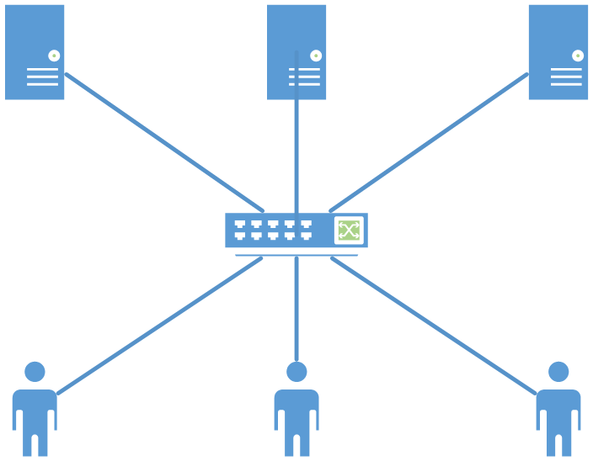
Dynamic Policy
For example, the routine round_robin takes the first packet from a new client (source IP address) and updates the policy's behavior (by assigning self.policy to a new value) so all future packets from this source are assigned to the next server in the sequence (by rewriting the destination IP address);

Slide 19
Dynamic Policy
Packets from all other clients are treated as before.
After updating the policy, round_robin also moves the "currently up" server to the next server in the list.
def round_robin(self,pkt):
self.policy = if_(match(srcip=pkt['srcip']),
modify(dstip=self.server),
self.policy)
self.client += 1
self.server = self.servers[self.client % m]

Slide 20
Dynamic Policy
Creates a new ``round-robin load balancer'' dynamic policy class rrlb by subclassing DynamicPolicy and providing an initialization method that registers round_robin as a callback routine:
class rrlb(DynamicPolicy):
def __init__(self, s, servers):
self.switch = s
self.servers = servers
...
Q = packets(limit=1,group_by=['srcip'])
Q.register_callback(self.round_robin)
self.policy = match(dstport=80) >> Q
def round_robin(self, pkt):
...

Slide 21
Dynamic Policy
Creates a new instance of rrlb (say one running on switch 3 and sending requests to server replicas at 2.2.2.8, 2.2.2.9 and 2.2.2.10) in the standard way
servers = [IP('2.2.2.8'),IP('2.2.2.9'),IP(‘2.2.2.10')] rrlb_on_switch3 = rrlb(3,servers)

Slide 22
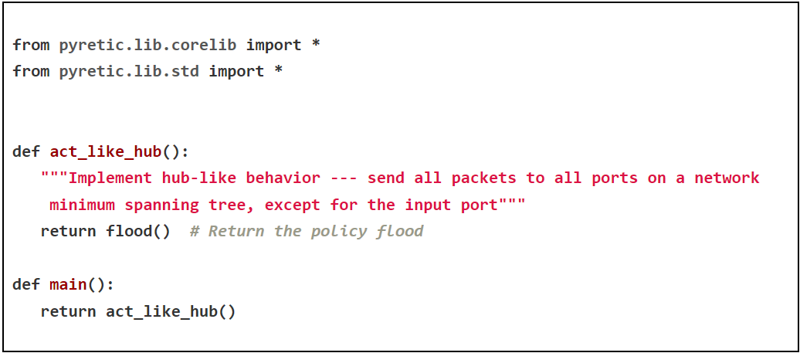
Hub

Slide 23
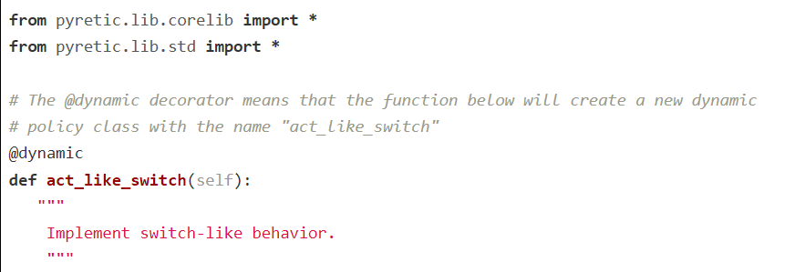
Learning Switch

Slide 24
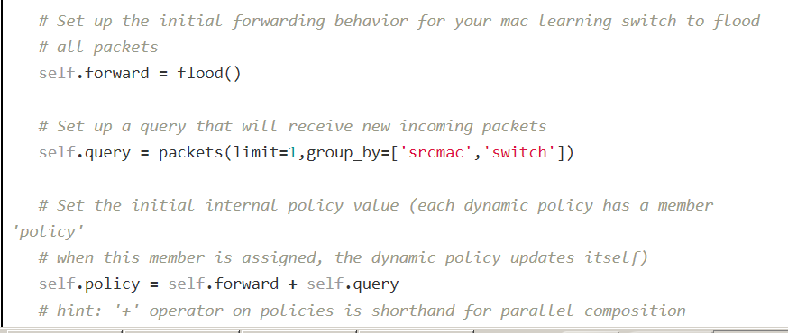
Learning Switch

Slide 25
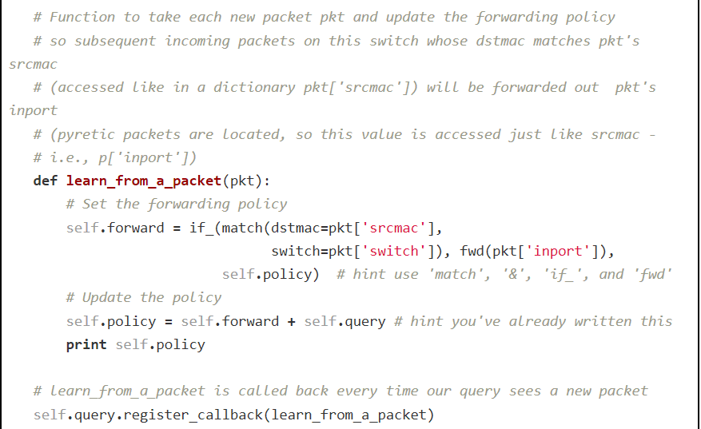
Learning Switch

Slide 26
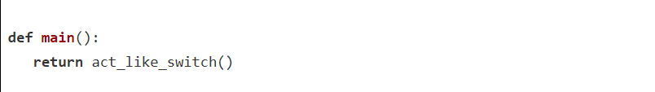
Learning Switch

Slide 27
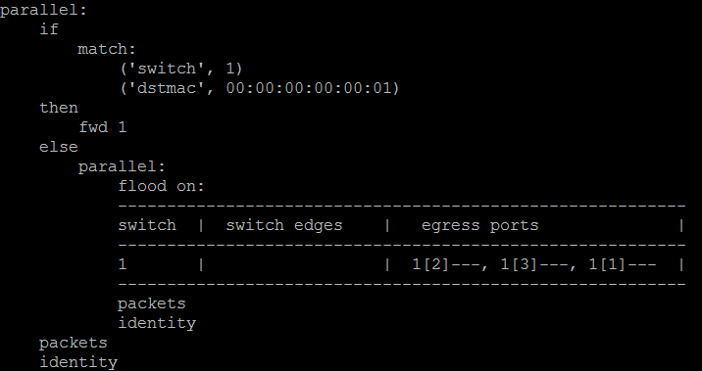
Learning Switch
When switch sees ICMP request from h1 to h2

Slide 28
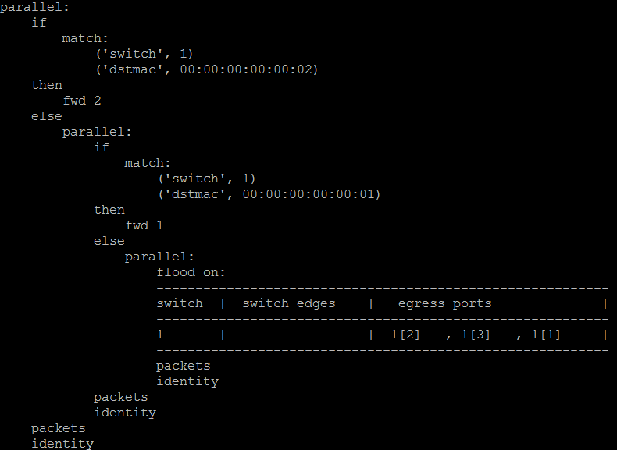
When switch sees ICMP response from h2 to h1

Slide 29
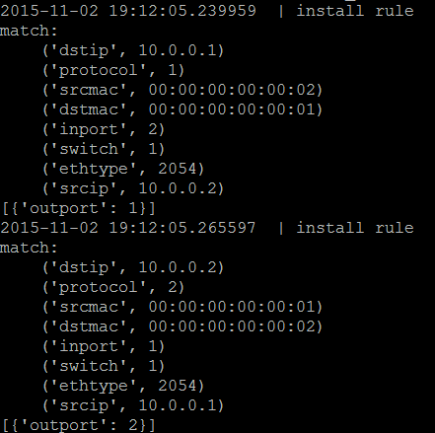
Flow table entries

