Slide 1
Composing Software-Defined Networks
Christopher Monsanto, Joshua Reich, Nate Foster, Jennifer Rexford, David Walker
NSDI 2013
Presented by Ye Tian for Course CS05112

Slide 2
Index
Abstractions for modular programming
The Pyretic programming language
Network objects
Example applications

Slide 3
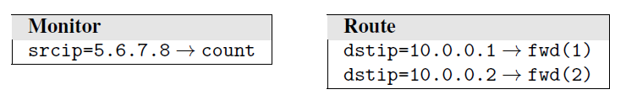
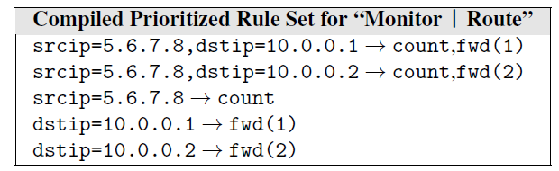
Parallel Composition (|)
Given two policy functions f and g operating on a located packet p, parallel composition computes the multiset union of f(p) and g(p)
every located packet produced by either policy.

Slide 4
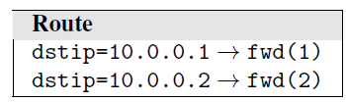
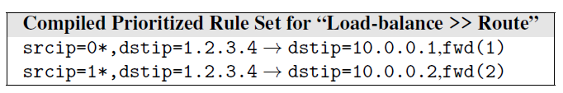
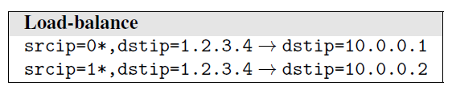
Sequential Composition (>>)
Given two policy functions f and g operating on a located packet p, sequential composition applies g to each of the located packets produced by f (p), to produce a new set of located packets.

Slide 5
Topology Abstraction
A network object consists of
an abstract topology
a policy function applied to the abstract topology.
Abstract topology could be
a subgraph of the real topology, or
a big virtual switch spanning the entire physical network, or
anything in between.

Slide 6
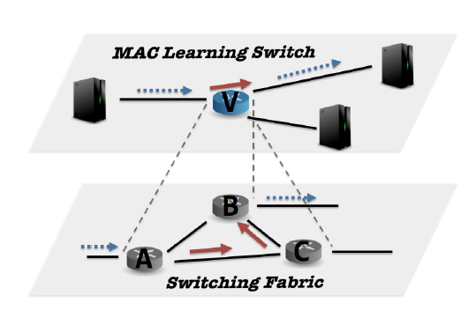
Example: Many-to-One
The MAC-learning module sees the network as one big switch V
The “switching fabric” of switch V is implemented by the switching-fabric module
Require some coordination between the two modules, so the MAC-learner can specify the chosen output port(s), and the switching-fabric module can direct traffic on a path to the egress port(s).

Slide 7
Example: Many-to-One
When the MAC-learning module directs traffic from an input port to an output port, the switching fabric module sees traffic with a virtual packet header indicating the corresponding ingress and egress ports in its view of the network.
A run-time system can perform the necessary mappings between the two abstract topologies, and generate the appropriate rules to forward traffic from the ingress port to the appropriate egress port(s).

Slide 8
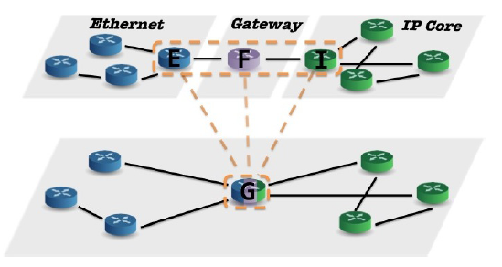
Example: One-to-Many
MAC-learning and flooding to unknown destinations for switches within Ethernet island
Shortest-path routing on IP prefixes for switches in the IP core
Gateway logic for devices connecting an island to the core.

Slide 9
Example: One-to-Many
Three virtual devices. Modules are written separately.
The Ethernet module generates a rule in switch E that matches traffic destined to the gateway’s MAC address and forwards out E’s right port.
The gateway module generates a rule in switch F that matches packets from F’s left port destined to the gateway’s MAC address and, after rewriting MAC headers appropriately, forwards out F’s right port.
The IP core module would generate rules in switch I that match packets based on the destination IP address to forward traffic to the next hop along a path to the destination.
A runtime system can combine these three sets of rules to generate the rules for the physical gateway switch G.

Slide 10
Pyretic: Abstract Packet Model
Each packet flowing through the network is a dictionary that maps field names to values.
Packet location
Header fields
Custom data
Every field (including non-virtual ones) to hold a stack of values instead of a single bitstring.
Example:
After pushing virtual switch V on top of A
Store in spare bits in the packet (e.g., MPLS)
{switch: A, inport: 3, vswitch: V, ... }
{switch: [V, A], inport: 3, ... }

Slide 11
Pyretic: Abstract Packet Model
All OpenFlow fields
Location fields
Virtual fields
Stacks of values
push(h=v)
pop(h)
Actions and matches use (currently) top value
Field | Val[0] | Val[1]
srcmac
dstmac
proto
srcip
…
switch
inport
outport
vswitch

Slide 12
Pyretic: Primitive actions
Goal: Drop packets (i.e., OpenFlow drop)
Write: drop
Means: eval(drop,p) = {}
evaluate
given policy
on packet
results in

Slide 13
Pyretic: Primitive actions
Goal: Forward packets out port a
Write: fwd(a)
Means: eval(fwd(a),p) = {p[outport:=a]}
located packet w/ fields for
switch
inport
outport

Slide 14
Pyretic: Primitive actions
drop fwd(port) flood mod(h=v)
0
packets
1
packets
0,1, or more
packets
1
packets
push, pop, and move, each yield a singleton set as their output:
push(h=v) pushes value v on to field h;
pop(h) pops a value off of field h;
move(h1=h2) pops the top value on field h2 and pushes it on to h1.

Slide 15
Pyretic: Predicates
Given an input packet p, the policy P[C], applies the policy function C to p if p satisfies the predicate P.
Example:
match(h=v)
Conjunction (&), disjunction (|), and negation (~) operators.
match(switch=s1,inport=2,srcip='1.2.3.4') [flood]

Slide 16
Pyretic: Policies
Parallel ‘|’: Do both C1 and C2 simultaneously
eval(C1 | C2,p) = eval(C1,p) U eval(C2,p)
Sequential ‘>>’: First do C1 and then do C2
eval(C1 >> C2,p) = {eval(C2,p’)
for p’ in eval(C1,p)}
Conditional ‘_if’: if_(P, drop, passthrough)
Example:
pop(dstip) >> push(dstip='10.0.0.1') >> fwd(3)
P5 = P3 | P4
P6 = ...
P7 = match(switch=s1)[P5] | match(switch=s2)[P6]

Slide 17
Pyretic: Queries
A query is an abstract policy that directs information from the physical network to the packet bucket in the controller platform.
Two queries
counts and packets
Applications register listeners (i.e., callbacks) with buckets; these callbacks are invoked to process the information contained in the bucket.
Query works with other policies
match(srcip='1.2.3.4') [Q]
Q=packets(limit=1,['srcip'])
match(srcip='1.2.3.4') [Q | fwd(3)]

Slide 18
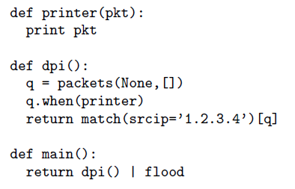
Pyretic: Queries
Monitoring: listener will be called each time a packet arrives at the packet_bucket to which q forwards.

Slide 19
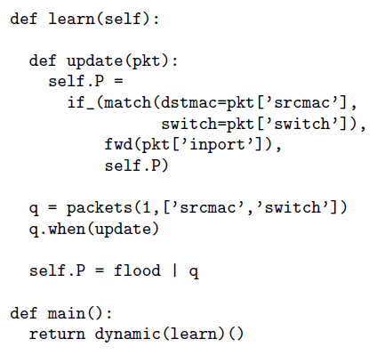
Pyretic: Dynamic policies
MAC-learning: listener updates the dynamic policy with a conditional policy that tests future packets to see if their destination MAC is equal to the current packet’s source MAC.

Slide 20
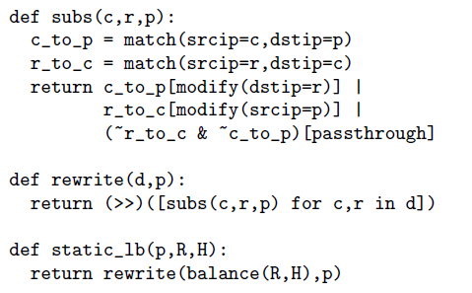
Pyretic: Dynamic policies

Slide 21
Pyretic: Dynamic policies
subs rewrites any packet whose source IP address matches c and destination IP address is p so the destination IP address is r, and vice versa.
c: client; p: server; r: replica
rewrite iterates subs over a dictionary d mapping IP prefixes to server replicas.
static_lb invokes rewrite with a function balance that partitions possible clients and assigns them to replicas, using a lists of server replicas R and a dictionary H containing a history of traffic statistics.

Slide 22
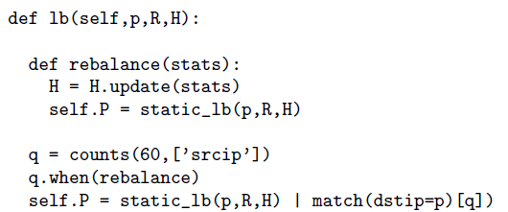
Pyretic: Dynamic policies

Slide 23
Pyretic: Dynamic policies
Dynamic load balancer: issues a query q that computes a dictionary mapping source IP addresses to packet counts every minute (60 seconds).
policy invokes rebalance, which updates the history H and recomputes a new load balancing policy using static_lb.

Slide 24
Network Objects
Network object: allow programmers to abstract away details of the physical topology and write policies in terms of abstracted views of that network
The base network object represents the physical network.
A derived network object’s mapping comprises the following functions:
A function to map changes to the underlying topology up to changes on the derived topology,
A function to map policies written against the derived topology down to a semantically equivalent policy expressed only in terms of the underlying topology.

Slide 25
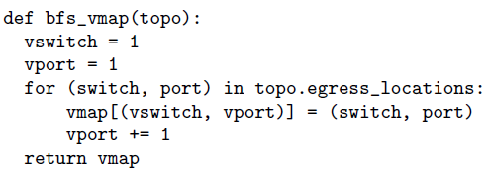
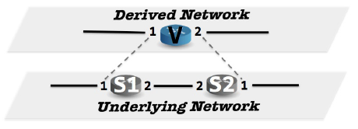
Transforming Topologies
Computes a dictionary that relates ports on the switch in the derived network to ports at the underlying network:

Slide 26
Transforming Policies
Three auxiliary policies
Ingress Policy: “lifts” packets in the underlying network up into the derived network by pushing appropriate switch and port identifiers onto the stack of values maintained in Pyretic’s abstract packet model.
Egress policy: “lowers” packets from the derived network to the underlying network by popping the switch and port identifier from the stack of values maintained in Pyretic’s abstract packet model.
Fabric policy: implements forwarding between adjacent ports in the derived network using the switches and links in the underlying topology.

Slide 27
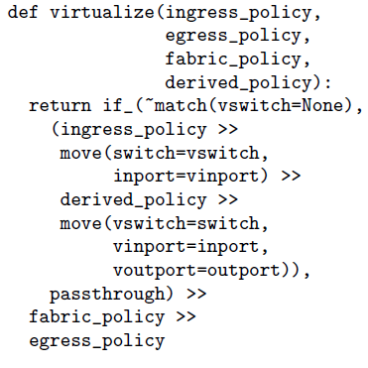
Composing Transforming Policies

Slide 28
Transforming Policies
Ingress: pushes the derived switch V and inport onto the corresponding “virtual” header stacks.
ingress_policy =
( match(switch=S1, inport=1) [push(vswitch=V, vinport=1)]
| match(switch=S2, inport=1) [push(vswitch=V, vinport=2)])

Slide 29
Transforming Policies
Egress: pops the derived switch, inport, and outport from the appropriate virtual header stacks if the switch is labeled with derived switch V, and otherwise passes the packet through unmodified.
egress_policy = match(vswitch=V) [if_(match(switch=S1, voutport=1) | match(switch=S2, voutport=2), pop(vswitch, vinport, voutport), passthrough)]

Slide 30
Transforming Policies
Fabric policy: forwards packets labeled with derived switch V along the (unique) path between S1 and S2:
fabric_policy = match(vswitch=V)[
( match(switch=S1, voutport=1)[fwd(1)]
| match(switch=S1, voutport=2)[fwd(2)]
| match(switch=S2, voutport=1)[fwd(2)]
| match(switch=S2, voutport=2)[fwd(1)])]
Policy execution sequence:
ingress policy → derived policy → fabric policy → egress policy.

Slide 31
Example
After ingress_policy
After push stack and evaluate the user policy (flood)
Move headers to virtual header stacks
{ switch:S1, inport:1, vswitch:V, vinport:1, ... }
{ switch:[V, S1], inport:[1, 1], outport:2, ...}
{ switch:S1, inport:1, vswitch:V, vinport:1, voutport:2 }

Slide 32
Example
After fabric_policy and egrees_policy at S1
After fabric_policy and egreee_policy at S2
{ switch:S2, inport:2, vswitch:V, vinport:1, voutport:2 }
{ switch:S2, inport:2, outport:1 }

Slide 33
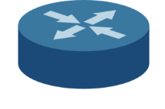

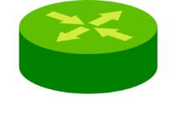



Module 1
MAC Learner
Module 2
MAC Rewriter
Module 3
IP Router
Derived Network
1
E
F
I
4
2
3
1
2
1
3
1
G
4
2
3
Underlying Network
Notes:
We’re gonna move to something slightly more interesting,
which is how we actually apply this to a one to many translation.
So we have this gateway abstraction.
In order to make this efficient,
we need to make one physical switch appear logically as if it were these three virtual switches.
Each will do mac learning, mac rewriting, and ip routing.

Slide 34
Packet arrives at G
Field | V₀
switch | G
inport | 2
srcmac | 00:00:00:00:00:02
dstmac | 00:00:00:00:00:01
srcip | 10.0.0.2
dstip | 1.2.3.4
Derived Network
1
E
F
I
4
2
3
1
2
1
3
1
G
4
2
3
Underlying Network
Notes:
We’re gonna start by having a packet traveling in the physical network,
arriving at port 2 on a gateway.
And when it arrives, we’ve got a variety of different fields, I’m just showing you the applicable ones here.

Slide 35
Apply Ingress policy
Field | V₀
switch | G
inport | 2
srcmac | 00:00:00:00:00:02
dstmac | 00:00:00:00:00:01
srcip | 10.0.0.2
dstip | 1.2.3.4
vswtich | E
vinport | 2
Derived Network
1
E
F
I
4
2
3
1
2
1
3
1
G
4
2
3
Underlying Network
Notes:
The first thing we’re going to do is to apply our ingress policy.
We’re going to immediately tag our arrived packet /
as being at the corresponding virtual port.

Slide 36
Lift packet to virtual network
Field | V₀ | V₁
switch | G | E
inport | 2 | 2
srcmac | 00:00:00:00:00:02
dstmac | 00:00:00:00:00:01
srcip | 10.0.0.2
dstip | 1.2.3.4
Derived Network
1
E
F
I
4
2
3
1
2
1
3
1
G
4
2
3
Underlying Network
Notes:
And we’re gonna lift up our packet into our virtual network.
We get to use our neat stackable field values.
We’re pushing E and 2 on the stack,
And now if we have a client policy which operates on the
topmost layer of pyretic packet,
This packet is considered as if it is at the physical location of network E2

Slide 37
Run MAC-Learning
Field | V₀ | V₁
switch | G | E
inport | 2 | 2
srcmac | 00:00:00:00:00:02
dstmac | 00:00:00:00:00:01
srcip | 10.0.0.2
dstip | 1.2.3.4
outport | 3
Derived Network
1
E
F
I
4
2
3
1
2
1
3
1
G
4
2
3
Underlying Network
Notes:
And we can run that policy, in this case a MAC learner,
which is gonna determine the physical outport on what it thinks as physical switch

Slide 38
Lower packet
Field | V₀ | V₁
switch | G | E
inport | 2 | 2
srcmac | 00:00:00:00:00:02
dstmac | 00:00:00:00:00:01
srcip | 10.0.0.2
dstip | 1.2.3.4
vswitch | E
vinport | 2
voutport | 3
Derived Network
1
E
F
I
4
2
3
1
2
1
3
1
G
4
2
3
Underlying Network
Notes:
Once we’ve learnt our client policy,
we’re gonna lower our packet back down
by pushing the physical headers we have
back to virtual ones

Slide 39
Apply Fabric policy
Field | V₀
switch | G
inport | 2
srcmac | 00:00:00:00:00:02
dstmac | 00:00:00:00:00:01
srcip | 10.0.0.2
dstip | 1.2.3.4
at | Vswitch=F Vinport=1
Derived Network
1
E
F
I
4
2
3
1
2
1
3
1
G
4
2
3
Underlying Network
Notes:
And we apply our fabric policy which determines what we need to do next
In this case, if we were at E3 as a outport,
the next place that our packet is going to move is F1.
Now what’s interesting here is that /
we’re going to take advantage /
of the ability to write this recursive.
Because we essentially need to run one switch, another switch, and then another switch, three times in one evaluation cycle. So we recurse the routine which applys the ingress policy from the scratch.

Slide 40
Start with Ingress policy
Field | V₀
switch | G
inport | 2
srcmac | 00:00:00:00:00:02
dstmac | 00:00:00:00:00:01
srcip | 10.0.0.2
dstip | 1.2.3.4
vswtich | F
vinport | 1
Derived Network
1
E
F
I
4
2
3
1
2
1
3
1
G
4
2
3
Underlying Network
Notes:
In this case the packet is tagged with virtual switch F and virtual inport 1

Slide 41
Lift packet
Field | V₀ | V₁
Switch | G | F
Inport | 2 | 1
Srcmac | 00:00:00:00:00:02
Dstmac | 00:00:00:00:00:01
srcip | 10.0.0.2
dstip | 1.2.3.4
Derived Network
1
E
F
I
4
2
3
1
2
1
3
1
G
4
2
3
Underlying Network
Notes:
We’re gonna lift our packet up which is going to pop some values… .
So now it appears the physical location of our packet is F1

Slide 42
Forward
Field | V₀ | V₁
Switch | G | F
Inport | 2 | 1
Srcmac | AA:AA:AA:AA:AA:AA
Dstmac | BB:BB:BB:BB:BB:BB
srcip | 10.0.0.2
dstip | 1.2.3.4
outport | 2
Derived Network
1
E
F
I
4
2
3
1
2
1
3
1
G
4
2
3
Underlying Network
Notes:
And we apply our client policy which is gonna do some non interesting mac header rewriting and also determine new forwarding port which is F2

Slide 43
Lower packet
Field | V₀
Switch | G
Inport | 2
Srcmac | AA:AA:AA:AA:AA:AA
Dstmac | BB:BB:BB:BB:BB:BB
srcip | 10.0.0.2
dstip | 1.2.3.4
vswitch | F
vinport | 1
voutport | 2
Derived Network
1
E
F
I
4
2
3
1
2
1
3
1
G
4
2
3
Underlying Network
Notes:
We’re then going to lower the packet,

Slide 44
Apply Fabric policy
Field | V₀
switch | G
inport | 2
srcmac | AA:AA:AA:AA:AA:AA
dstmac | BB:BB:BB:BB:BB:BB
srcip | 10.0.0.2
dstip | 1.2.3.4
at | Vswitch=I Vinport=1
Derived Network
1
E
F
I
4
2
3
1
2
1
3
1
G
4
2
3
Underlying Network
Notes:
And apply the fabric policy once again
And of course we’ve written a recursive fabric policy, so,

Slide 45
Start with Ingress policy
Field | V₀
switch | G
inport | 2
srcmac | AA:AA:AA:AA:AA:AA
dstmac | BB:BB:BB:BB:BB:BB
srcip | 10.0.0.2
dstip | 1.2.3.4
vswtich | I
vinport | 1
Derived Network
1
E
F
I
4
2
3
1
2
1
3
1
G
4
2
3
Underlying Network
Notes:
We’re going to apply our ingress one more time,

Slide 46
Lift packet
Field | V₀ | V₁
Switch | G | I
Inport | 2 | 1
Srcmac | AA:AA:AA:AA:AA:AA
Dstmac | BB:BB:BB:BB:BB:BB
srcip | 10.0.0.2
dstip | 1.2.3.4
Derived Network
1
E
F
I
4
2
3
1
2
1
3
1
G
4
2
3
Underlying Network
Notes:
Lift our packet up one more time,

Slide 47
Route
Field | V₀ | V₁
Switch | G | I
Inport | 2 | 1
Srcmac | AA:AA:AA:AA:AA:AA
Dstmac | BB:BB:BB:BB:BB:BB
srcip | 10.0.0.2
dstip | 1.2.3.4
outport | 4
Derived Network
1
E
F
I
4
2
3
1
2
1
3
1
G
4
2
3
Underlying Network
Notes:
Apply whatever the routing policy that our legacy IP core component does,

Slide 48
Lower packet
Field | V₀
Switch | G
Inport | 2
Srcmac | AA:AA:AA:AA:AA:AA
Dstmac | BB:BB:BB:BB:BB:BB
srcip | 10.0.0.2
dstip | 1.2.3.4
vswitch | I
vinport | 1
voutport | 4
Derived Network
1
E
F
I
4
2
3
1
2
1
3
1
G
4
2
3
Underlying Network
Notes:
Finally, lower our packet down
And we’ve established that we’re doing Voutport 4 which is,

Slide 49
Apply Fabric policy
Field | V₀
Switch | G
Inport | 2
Srcmac | AA:AA:AA:AA:AA:AA
Dstmac | BB:BB:BB:BB:BB:BB
srcip | 10.0.0.2
dstip | 1.2.3.4
vswitch | I
vinport | 1
vourport | 4
outport | 4
Derived Network
1
E
F
I
4
2
3
1
2
1
3
1
G
4
2
3
Underlying Network
Notes:
Now when we apply the fabric policy
Going to tell us the actual physical ourport should also be 4

Slide 50
And Egress policy
Field | V₀
Switch | G
Inport | 2
Srcmac | AA:AA:AA:AA:AA:AA
Dstmac | BB:BB:BB:BB:BB:BB
srcip | 10.0.0.2
dstip | 1.2.3.4
outport | 4
Derived Network
1
E
F
I
4
2
3
1
2
1
3
1
G
4
2
3
Underlying Network
Notes:
And the egress policy gets rid of all our virtualized headers

Slide 51
Packet continues journey on Link
Field | Value
srcmac | AA:AA:AA:AA:AA:AA
dstmac | BB:BB:BB:BB:BB:BB
srcip | 10.0.0.2
dstip | 1.2.3.4
Derived Network
1
E
F
I
4
2
3
1
2
1
3
1
G
4
2
3
Underlying Network
Notes:
And sends our packet along the way

Slide 52
Review
Abstract packet model
Benefits
How to implement?
What is network object?
Base network object
Derived network object
Mapping?
Policy transforming
Ingress_policy
Egress_policy
Fabric_policy

