Slide 1
Datacenter Network Simulation using ns3
Course Project for CS05112

Slide 2
Objective
Simulate a datacenter network using ns3.
Experiment two traffic patterns.
Examine the network.
Improve the network.

Slide 3
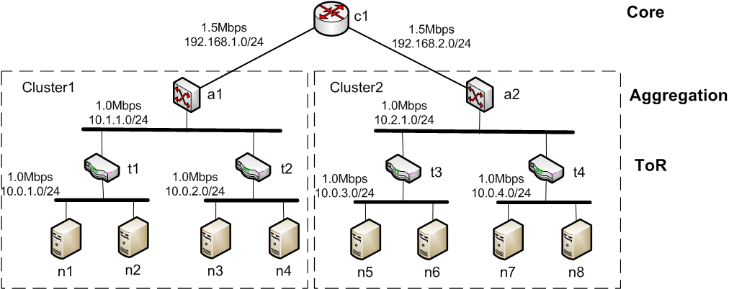
Datacenter network topology

Slide 4
Datacenter network topology
Description
8 servers: n1~8; 4 ToR switches: t1~4; 2 aggregation switches: a1~2; 1 core switch: c1
The network is partitioned into two clusters
The links connecting to c1 are PPP, or the other networks are Ethernets, the networks’ capacities are shown on the topology graph.
All the end-end delays on the networks are 500ns.
IP address assignment is shown on the topolog.
All the switches behaves like OSPF routers.

Slide 5
Traffic patterns
Pattern 1: inter-cluster traffic
Each server communicates using TCP with another server that comes from different cluster
For example, 1-5, 6-2, 3-7, 8-4
Pattern 2: many-to-one traffic
Select one server as the sink, and all the other servers communicate to it
Simulate the two patterns separately, obtain the throughput that the network can achieve, and find out the network bottleneck, how to improve the network.

Slide 6
Submit your project
Your ns3 source code and readme file.
Your project report document, in which you should:
Explain how you simulate the DC network and the two traffic patterns, present the simulation outputs (trace, graph, statistics)
Identify the network bottleneck, show your evidence, and explain how you can improve the network?
Add more core switches and enable ECMP routing to improve the network, how many core switches should be added?
Testify your solution by experiment (code + simulation outputs)

Slide 7
Scoring criteria
Submit: source code + report + trace files
The report should：
Explain your source code
Present your simulation results: how and where you measure the traffics, what is the evaluation metrics, etc.
Analysis on the evaluation results (Important)
Results and analysis on how to improve the network. (5 bonus pt.)
Topology
Code
Results + analysis (Important)

