Slide 1
ns-3 Tutorial

Slide 2
Get the Environment
Hypervisor
VirtualBox, freeware, https://www.virtualbox.org/
VMWare Workstation (not freeware)
Linux
Ubuntu, http://www.ubuntu.org.cn/
Fedora, https://getfedora.org/
USTC has a mirror, http://mirrors.ustc.edu.cn/

Slide 3
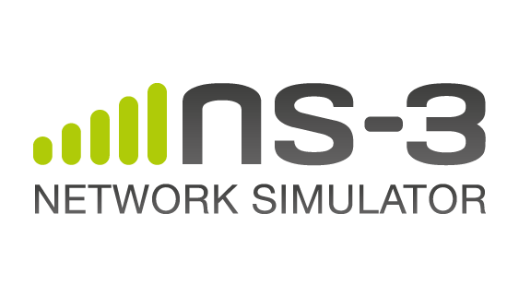
About ns-3
Event-driven network simulator
Open sourced
Website http://www.nsnam.org/
Installation package (Linux)
Document and technical support –"Doxygen"
The ns-3 programming environment
The simulation script is written with C++ or python, using ns-3 APIs
Reference:
ns-3 Tutorial, May 14, 2013

Slide 4
Download and Install ns-3
Download and unpack
Build ns-3
Enable examples
Enable tests
Use the 3.17 version
cd
mkdir workspace
cd workspace
wget http://222.195.68.57/CS05112/ns-allinone-3.27.tar.bz2
tar xjf ns-allinone-3.27.tar.bz2

Slide 5



Download and Install ns-3
Or, use "waf" to build ns-3
waf supports many arguments, to show them
Test ns-3
Run first ns-3 simulation script
The simulation has only one line output

Slide 6
Concepts in ns-3
Node
Represents host, router, switch on the physical network
ns-3 defines the Node class
Application
Represents the network applications, such as server applications, client applications, etc.
ns-3 defines the Application class

Slide 7
Concepts in ns-3
Channel
The communication channel between nodes
ns-3 defines the Channel class, some subclasses
CsmaChannel、PointToPointChannel、WifiChannel
Net Device
The communication device (including driver) attached on the node; a node without a net device can not communicate in ns-3
ns-3 defines the NetDevice class, some subclasses
CsmaNetDevice、PointToPointNetDevice、WifiNetDevice

Slide 8
Concepts in ns-3
Topology Helper
There are many different topology helpers
Use a topology helper to attach NetDevice to Node and Channel
Use a topology helper to configure NetDevice and Channel
For example, allocating IP addresses

Slide 9
PointToPoint Network Simulation
Simulation script "first.cc", in "example/tutorial"
Include header files
Use the ns3 namespace (no need to use "ns3::" afterwards)
Define a log component
#include "ns3/core-module.h"
#include "ns3/network-module.h"
#include "ns3/internet-module.h"
#include "ns3/point-to-point-module.h"
#include "ns3/applications-module.h"

Slide 10
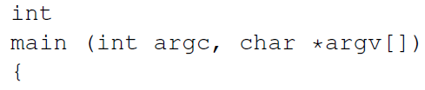
PointToPoint Network Simulation
The Main function
Enable two log components
The log components will print messages when sending and receiving packets
LogComponentEnable ("UdpEchoClientApplication", LOG_LEVEL_INFO);
LogComponentEnable ("UdpEchoServerApplication", LOG_LEVEL_INFO);

Slide 11

PointToPoint Network Simulation
Topology Helper
NodeContainer: To create, access and manage the Node objects

Slide 12
PointToPoint Network Simulation
PointToPointHelper: use this helper to configure and connect PointToPointNetDevice and PointToPointChannel
Set Device's data rate as 5Mbps
Set Channel's delay as 2ms
pointToPointHelper pointToPoint;
pointToPoint.SetDeviceAttribute ("DataRate", StringValue ("5Mbps"));
pointToPoint.SetChannelAttribute ("Delay", StringValue ("2ms"));

Slide 13
PointToPoint Network Simulation
NetDeviceContainer：
Use the helper's Install method to install a pointToPointNetDevice at each node, the devices are kept in NetDeviceContainer, and create a PointToPointChannel

Slide 14

PointToPoint Network Simulation
InternetStackHelper: install the protocol stack on the nodes (IP, TCP, UDP, …)
Ipv4AddressHelper: allocate IPv4 addresses
Attach IP addresses on the devices, beginning from 10.1.1.1 to 10.1.1.254
Ipv4InterfaceContainer interfaces = address.Assign (devices);

Slide 15
PointToPoint Network Simulation
Applications：UdpEchoServerApplication and UdpEchoClientApplication
UdpEchoServerHelper
Use UdpEchoServerHelper to create and configure UdpEchoServerApplication
Create an echoServer working on UDP port 9
UdpEchoServerHelper echoServer (9);

Slide 16
PointToPoint Network Simulation
Use the Install method to install the Application on Node #1
Application starts at the 1st sec., stops at the 10th sec.
ApplicationContainer serverApps = echoServer.Install (nodes.Get (1));
serverApps.Start (Seconds (1.0));
serverApps.Stop (Seconds (10.0));

Slide 17
PointToPoint Network Simulation
UdpEchoClientHelper
Specify the address and port number of the server application that the client connects to
Set the maximum number of packets to send, sending interval, and packet size.
UdpEchoClientHelper echoClient (interfaces.GetAddress (1), 9);
echoClient.SetAttribute ("MaxPackets", UintegerValue (1));
echoClient.SetAttribute ("Interval", TimeValue (Seconds (1.0)));
echoClient.SetAttribute ("PacketSize", UintegerValue (1024));

Slide 18
PointToPoint Network Simulation
ApplicationContainer clientApps = echoClient.Install (nodes.Get (0));
clientApps.Start (Seconds (2.0));
clientApps.Stop (Seconds (10.0));
Use the Install method to create echoClient on Node 0
Starts at the 2nd sec., stops at the 10th sec.
Run the simulation
Run from 0 to 10 seconds, event driven
Destroy, clean and recycle the resources
Simulator::Run ();
Simulator::Destroy ();
return 0;

Slide 19

PointToPoint Network Simulation
Compile and run the script
Copy the script under the "scratch" directory
Compile
Run

Slide 20
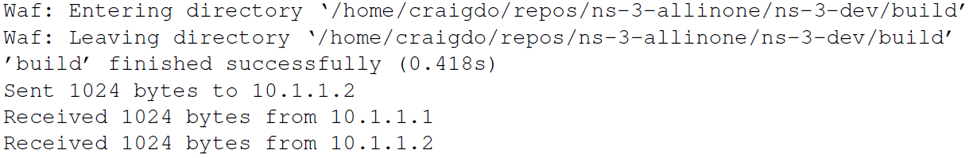
PointToPoint Network Simulation
Simulation output
The output messages are generated by the log components.

Slide 21
Log Components in ns-3
Seven log types in ns-3
LOG_ERROR, error message
LOG_WARN, warning messages
LOG_DEBUG, debug messages
LOG_INFO, simulation outputs
LOG_FUNCTION
LOG_LOGIC
LOG_ALL
For each level, "LOG_LEVEL_TYPE“ means to output any messages no lower than TYPE
For example, LOG_LEVEL_INFO

Slide 22
Log Components in ns-3
Sourcecode related to Log components
Define a log component
Output a line of log message:
Enable the "FirstScriptExample" log component
LogComponentEnable("FirstScriptExample", LOG_LEVEL_INFO);

Slide 23
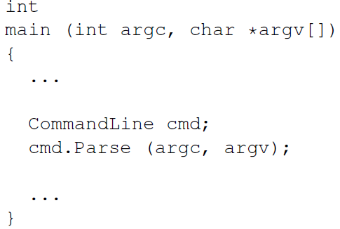
Command Line Arguments
The command line parser
Parser will parse the command line arguments, for example

Slide 24

Command Line Arguments
Print attributes of NetDevice
Set attributes of NetDevice and Channel in the command line
./waf --run "scratch/myfirst --PrintAttributes=ns3::PointToPointNetDevice"

Slide 25
Command Line Arguments
Set the user-defined attributes
Declare an argument "nPackets" indicating how many packets to send
int
main (int argc, char *argv[])
{
uint32_t nPackets = 1;
CommandLine cmd;
cmd.AddValue("nPackets", "Number of packets to echo", nPackets);
cmd.Parse (argc, argv);
...
echoClient.SetAttribute ("MaxPackets", UintegerValue (nPackets));

Slide 26
Command Line Arguments
Set "nPackets" in the command line
Use to see all the user-defined command line arguments
./waf --run "scratch/myfirst --PrintHelp"

Slide 27
Tracing
ASCII tracing
Put all the tracing message to an ASCII file
Add the following code right above "Simulator::Run()”
The "EnableAsciiAll" method enables ASCII tracing on all the devices on the point-to-point network
AsciiTraceHelper ascii;
pointToPoint.EnableAsciiAll (ascii.CreateFileStream ("myfirst.tr"));

Slide 28
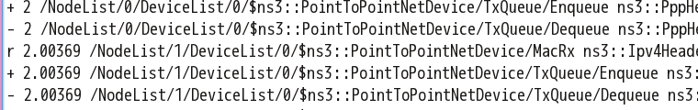
Tracing
ASCII tracing output file
Each line represents a trace event, four types of events
+: an enqueue event happens on the device
-: a dequeue event happens on the device
d: a packet is dropped on the device
r: the device receives a packet

Slide 29
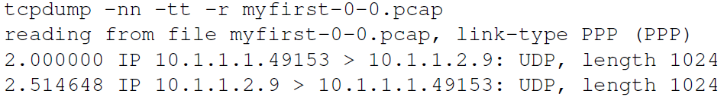
Tracing
PCAP tracing
Enable PCAP tracing enable a pcap packet capture on every device on the point-to-point network
The packet traces are output to "myfirst-0-0.pcap" and "myfirst-1-0.pcap", the numbers indicate the node in the network and the device on the node
Use tcpdump to show the trace

Slide 30
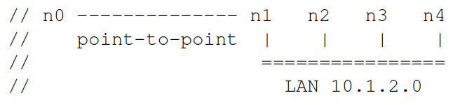
CSMA Network Simulation
The object network
Two networks: a point-to-point network and a CSMA network, containing 2 and 4 nodes respectively
n1 belongs to both networks, should have both NetDevice
The nodes should have the packet forwarding capacity
Source code: example/tutorial/second.cc

Slide 31
CSMA Network Simulation
Declare "nCsma", which is the number of the "other" nodes on the CSMA network
bool verbose = true;
uint32_t nCsma = 3;
CommandLine cmd;
cmd.AddValue ("nCsma", "Number of \"extra\" CSMA nodes/devices", nCsma);
cmd.AddValue ("verbose", "Tell echo applications to log if true", verbose);
cmd.Parse (argc,argv);
if (verbose) {
LogComponentEnable ("UdpEchoClientApplication", LOG_LEVEL_INFO);
LogComponentEnable ("UdpEchoServerApplication", LOG_LEVEL_INFO);
}
nCsma = nCsma == 0 ? 1 : nCsma;

Slide 32
CSMA Network Simulation
Create NodeContainer
n1 has already been created in the pointtopoint network, only need to create three other nodes for the CSMA network
NodeContainer p2pNodes;
p2pNodes.Create (2);
NodeContainer csmaNodes;
csmaNodes.Add (p2pNodes.Get (1));
csmaNodes.Create (nCsma);

Slide 33
CSMA Network Simulation
Construct the pointtopoint network topology
Create the CSMA network topo. (DataRate is a Channel attribute)
PointToPointHelper pointToPoint;
pointToPoint.SetDeviceAttribute ("DataRate", StringValue ("5Mbps"));
pointToPoint.SetChannelAttribute ("Delay", StringValue ("2ms"));
NetDeviceContainer p2pDevices;
p2pDevices = pointToPoint.Install (p2pNodes);
CsmaHelper csma;
csma.SetChannelAttribute ("DataRate", StringValue ("100Mbps"));
csma.SetChannelAttribute ("Delay", TimeValue (NanoSeconds (6560)));
NetDeviceContainer csmaDevices;
csmaDevices = csma.Install (csmaNodes);

Slide 34

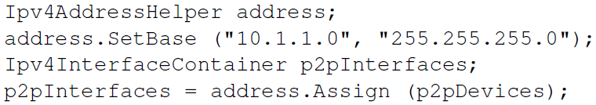
CSMA Network Simulation
Install protocol stack (a node can have only one stack)
Allocate addresses on the p2p network
node0：10.1.1.1；node1： 10.1.1.2

Slide 35
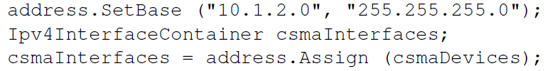
CSMA Network Simulation
Allocate addresses on the CSMA network
n1：10.1.2.1，n2~4：10.1.2.2~4
n1 has two devices, two addresses, two interfaces
Install echoServer on the most far node on the CSMA network
UdpEchoServerHelper echoServer (9);
ApplicationContainer serverApps = echoServer.Install (csmaNodes.Get (nCsma));
serverApps.Start (Seconds (1.0));
serverApps.Stop (Seconds (10.0));

Slide 36
CSMA Network Simulation
Install echoClient on n0
Enable global routing: so that every node on the network forward packets using the shortest path
UdpEchoClientHelper echoClient (csmaInterfaces.GetAddress (nCsma), 9);
echoClient.SetAttribute ("MaxPackets", UintegerValue (1));
echoClient.SetAttribute ("Interval", TimeValue (Seconds (1.)));
echoClient.SetAttribute ("PacketSize", UintegerValue (1024));
ApplicationContainer clientApps = echoClient.Install (p2pNodes.Get (0));
clientApps.Start (Seconds (2.0));
clientApps.Stop (Seconds (10.0));

Slide 37
CSMA Network Simulation
Configure the PCAP tracing
Two tracing output files by two devices on the pointtopont network
Tracing on the #1 device (n2) in the CSMA network, the device is set as promiscuous mode
Compile and execution

Slide 38
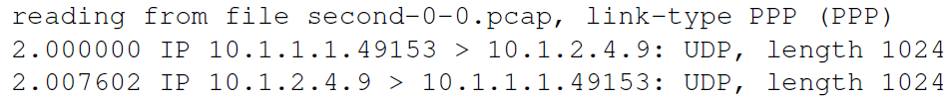
CSMA Network Simulation
Three pcap tracing files are generated two for the p2p devices and one for the selected device on the CSMA network
second-0-0.pcap
second-1-0.pcap

Slide 39
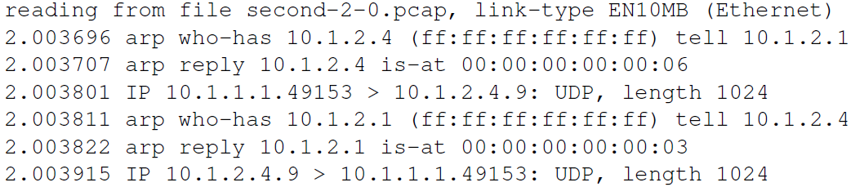
CSMA Network Simulation
second-2-0.pcap (n2, under the promiscuous mode)
Use the GetId method to identify node and device numbers
pointToPoint.EnablePcap ("second", p2pNodes.Get (0)->GetId (), 0);
csma.EnablePcap ("second", csmaNodes.Get (nCsma)->GetId (), 0, false);
csma.EnablePcap ("second", csmaNodes.Get (nCsma-1)->GetId (), 0, false);

Slide 40
CSMA Network Simulation
Simulate a CSMA network with 101 nodes
second-101-0.pcap
reading from file second-101-0.pcap, link-type EN10MB (Ethernet)
2.003696 arp who-has 10.1.2.101 (ff:ff:ff:ff:ff:ff) tell 10.1.2.1
2.003696 arp reply 10.1.2.101 is-at 00:00:00:00:00:67
2.003801 IP 10.1.1.1.49153 > 10.1.2.101.9: UDP, length 1024
2.003801 arp who-has 10.1.2.1 (ff:ff:ff:ff:ff:ff) tell 10.1.2.101
2.003822 arp reply 10.1.2.1 is-at 00:00:00:00:00:03
2.003822 IP 10.1.2.101.9 > 10.1.1.1.49153: UDP, length 1024

Slide 41
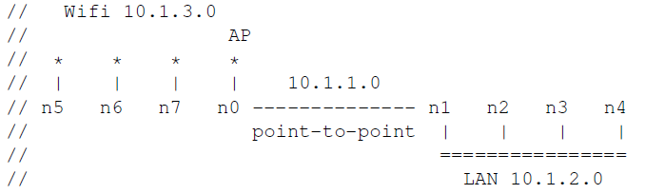
Wifi Network Simulation
The object network
n0 and n1 belong to two different networks, they should have two NetDevice
Nodes in the network should have the forwarding capacity
There are station and AP nodes on the Wifi network, station nodes are capable to move
Source code: example/tutorial/third.cc

Slide 42
Wifi Network Simulation
Command line arguments: nCsma、nWifi
int
main (int argc, char *argv[])
{
bool verbose = true;
uint32_t nCsma = 3;
uint32_t nWifi = 3;
CommandLine cmd;
cmd.AddValue ("nCsma", "Number of \"extra\" CSMA nodes/devices", nCsma);
cmd.AddValue ("nWifi", "Number of wifi STA devices", nWifi);
cmd.AddValue ("verbose", "Tell echo applications to log if true", verbose);
cmd.Parse (argc,argv);

Slide 43
Wifi Network Simulation
Create pointtopoint nodes and network
NodeContainer p2pNodes;
p2pNodes.Create(2);
PointToPointHelper pointToPoint;
pointToPoint.SetDeviceAttribute ("DataRate", StringValue ("5Mbps"));
pointToPoint.SetChannelAttribute ("Delay", StringValue ("2ms"));
NetDeviceContainer p2pDevices;
p2pDevices = pointToPoint.Install (p2pNodes);

Slide 44
Wifi Network Simulation
Create CSMA nodes and network
NodeContainer csmaNodes;
csmaNodes.Add (p2pNodes.Get (1));
csmaNodes.Create (nCsma);
CsmaHelper csma;
csma.SetChannelAttribute ("DataRate", StringValue ("100Mbps"));
csma.SetChannelAttribute ("Delay", TimeValue (NanoSeconds (6560)));
NetDeviceContainer csmaDevices;
csmaDevices = csma.Install (csmaNodes);

Slide 45
Wifi Network Simulation
Create Wifi nodes, including station and AP
Configure channel and phy helper, associate phy to channel, so that all the physical layers generated by phy share the same channel
NodeContainer wifiStaNodes;
wifiStaNodes.Create (nWifi);
NodeContainer wifiApNode = p2pNodes.Get (0);
YansWifiChannelHelper channel = YansWifiChannelHelper::Default ();
YansWifiPhyHelper phy = YansWifiPhyHelper::Default ();
phy.SetChannel (channel.Create ());

Slide 46
Wifi Network Simulation
Configure WifiHelper, set the rate control algorithm; create the mac helper
WifiHelper wifi = WifiHelper::Default ();
wifi.SetRemoteStationManager ("ns3::AarfWifiManager");
NqosWifiMacHelper mac = NqosWifiMacHelper::Default ();

Slide 47
Wifi Network Simulation
Configure the mac layer for the Wifi station nodes, including the ssid
Configure the mac layer for the AP node
Ssid ssid = Ssid ("ns-3-ssid");
mac.SetType ("ns3::StaWifiMac", "Ssid", SsidValue (ssid), "ActiveProbing", BooleanValue (false));
NetDeviceContainer staDevices;
staDevices = wifi.Install (phy, mac, wifiStaNodes);
mac.SetType ("ns3::ApWifiMac", "Ssid", SsidValue (ssid));
NetDeviceContainer apDevices;
apDevices = wifi.Install (phy, mac, wifiApNode);

Slide 48
Wifi Network Simulation
Configure the mobility model for the wifi station, first put the nodes on a 2D grid
MobilityHelper mobility;
mobility.SetPositionAllocator ("ns3::GridPositionAllocator",
"MinX", DoubleValue (0.0),
"MinY", DoubleValue (0.0),
"DeltaX", DoubleValue (5.0),
"DeltaY", DoubleValue (10.0),
"GridWidth", UintegerValue (3),
"LayoutType", StringValue ("RowFirst"));

Slide 49
Wifi Network Simulation
Set the mobility model as "randomwalk2d"
AP doesn't move
mobility.SetMobilityModel ("ns3::RandomWalk2dMobilityModel",
"Bounds", RectangleValue (Rectangle (-50, 50, -50, 50)));
mobility.Install (wifiStaNodes);
mobility.SetMobilityModel ("ns3::ConstantPositionMobilityModel");
mobility.Install (wifiApNode);

Slide 50
Wifi Network Simulation
Install stack
Allocate addr.
InternetStackHelper stack;
stack.Install (csmaNodes);
stack.Install (wifiApNode);
stack.Install (wifiStaNodes);
Ipv4AddressHelper address;
address.SetBase ("10.1.1.0", "255.255.255.0");
Ipv4InterfaceContainer p2pInterfaces;
p2pInterfaces = address.Assign (p2pDevices);
address.SetBase ("10.1.2.0", "255.255.255.0");
Ipv4InterfaceContainer csmaInterfaces;
csmaInterfaces = address.Assign (csmaDevices);
address.SetBase ("10.1.3.0", "255.255.255.0");
address.Assign (staDevices);
address.Assign (apDevices);

Slide 51
Wifi Network Simulation
Put echoserver at the most far node on the CSMA network
UdpEchoServerHelper echoServer (9);
ApplicationContainer serverApps = echoServer.Install (csmaNodes.Get (nCsma));
serverApps.Start (Seconds (1.0));
serverApps.Stop (Seconds (10.0));

Slide 52
Wifi Network Simulation
Put echoclient at the Wifi station with the largest #
UdpEchoClientHelper echoClient (csmaInterfaces.GetAddress (nCsma), 9);
echoClient.SetAttribute ("MaxPackets", UintegerValue (1));
echoClient.SetAttribute ("Interval", TimeValue (Seconds (1.)));
echoClient.SetAttribute ("PacketSize", UintegerValue (1024));
ApplicationContainer clientApps = echoClient.Install (wifiStaNodes.Get (nWifi - 1));
clientApps.Start (Seconds (2.0));
clientApps.Stop (Seconds (10.0));

Slide 53
Wifi Network Simulation
Enable shortest path routing
Sicne Wifi AP's periodical beacon, we need to tell the simulator when to stop
Trace at the p2p network, AP in the Wifi network, and the first node in Csma
Ipv4GlobalRoutingHelper::PopulateRoutingTables ();
Simulator::Stop (Seconds (10.0));
pointToPoint.EnablePcapAll ("third");
phy.EnablePcap ("third", apDevices.Get (0));
csma.EnablePcap ("third", csmaDevices.Get (0), true);
Simulator::Run ();
Simulator::Destroy ();

Slide 54


Wifi Network Simulation
4 pcap trace files obtained after simulation
P2p network

Slide 55
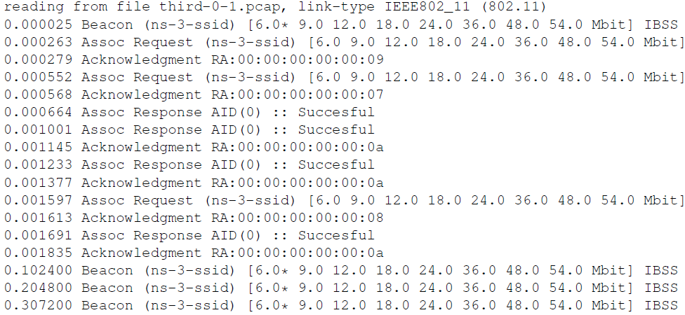
Wifi Network Simulation
Trace on wifi AP

Slide 56
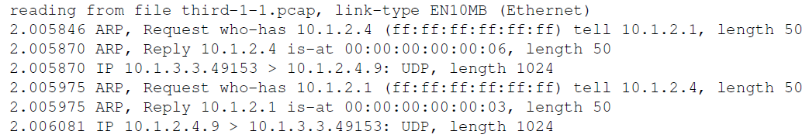
Wifi Network Simulation
Trace on Csma node

Slide 57
Wifi Network Simulation
Tracing mobility of Wifi station
Define the recall function, recall on the event
void
CourseChange (std::string context, Ptr<const MobilityModel> model)
{
Vector position = model->GetPosition ();
NS_LOG_UNCOND (context <<
" x = " << position.x << ", y = " << position.y);
}

Slide 58
Wifi Network Simulation
Before Simulator::Run, associate the CourseChange event with the recall function.
std::ostringstream oss;
oss <<"/NodeList/" << wifiStaNodes.Get (nWifi - 1)->GetId () <<
"/$ns3::MobilityModel/CourseChange";
Config::Connect (oss.str (), MakeCallback (&CourseChange));
/NodeList/7/$ns3::MobilityModel/CourseChange

Slide 59
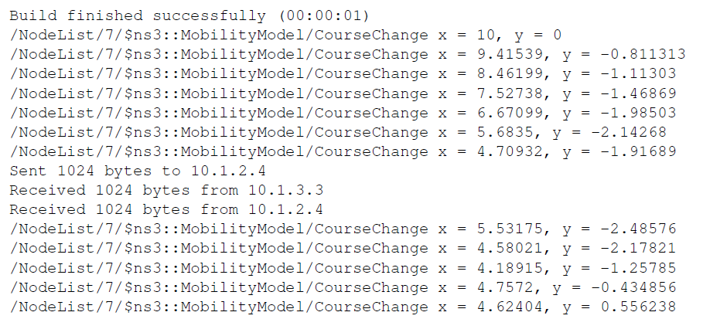
Wifi Network Simulation
Simulation results, mobility traced

Slide 60
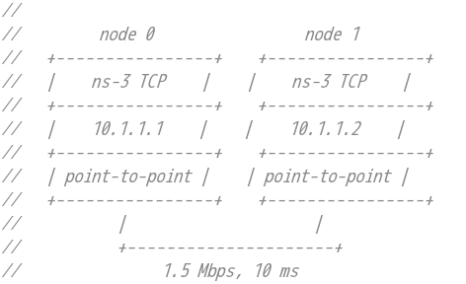
TCP Single Flow Simulation
Simulate a single TCP flow

Slide 61
TCP Single Flow Simulation
Define and enable log components
using namespace ns3;
NS_LOG_COMPONENT_DEFINE ("SingleFlow");
int
main (int argc, char *argv[])
{
LogComponentEnable ("PacketSink", LOG_LEVEL_INFO);
LogComponentEnable ("OnOffApplication", LOG_LEVEL_INFO);

Slide 62
TCP Single Flow Simulation
Construct pointtopoint network
NodeContainer nodes;
nodes.Create (2);
PointToPointHelper pointToPoint;
pointToPoint.SetDeviceAttribute ("DataRate", StringValue (“1.5Mbps"));
pointToPoint.SetChannelAttribute ("Delay", StringValue (“10ms"));
NetDeviceContainer devices;
devices = pointToPoint.Install (nodes);

Slide 63
TCP Single Flow Simulation
Install protocol stack, allocate address
InternetStackHelper stack;
stack.Install (nodes);
Ipv4AddressHelper address;
address.SetBase ("10.1.1.0", "255.255.255.0");
Ipv4InterfaceContainer interfaces = address.Assign (devices);

Slide 64
TCP Single Flow Simulation
Set up SinkApplication at n1 at port 8080
Sink接收tcp流数据
int16_t sinkPort = 8080;
Address sinkAddress(InetSocketAddress(interfaces.GetAddress(1),sinkPort));
PacketSinkHelper packetSinkHelper("ns3::TcpSocketFactory",InetSocketAddress(Ipv4Address::GetAny(),sinkPort));
ApplicationContainer sinkApps = packetSinkHelper.Install(nodes.Get(1));
sinkApps.Start(Seconds(0.));
sinkApps.Stop(Seconds(50.));

Slide 65
TCP Single Flow Simulation
Set up OnOffApplication at n0, send out TCP traffic
On state has a mean period of 50 sec., but Off state has the period of 0 sec.
OnOffHelper client("ns3::TcpSocketFactory", InetSocketAddress(interfaces.GetAddress (1), sinkPort));
client.SetAttribute ("OnTime", StringValue("ns3::ConstantRandomVariable[Constant=50]"));
client.SetAttribute ("OffTime", StringValue("ns3::ConstantRandomVariable[Constant=0]"));
client.SetAttribute ("DataRate", DataRateValue (DataRate ("1.5Mbps")));
client.SetAttribute ("PacketSize", UintegerValue (2000));
ApplicationContainer clientApp = client.Install (nodes.Get (0));
clientApp.Start(Seconds (1.0 ));
clientApp.Stop (Seconds (51.0));

Slide 66
TCP Single Flow Simulation
PCAP tracing, and run
pointToPoint.EnablePcapAll ("sflow");
Simulator::Stop (Seconds(50));
Simulator::Run ();
Simulator::Destroy ();

Slide 67
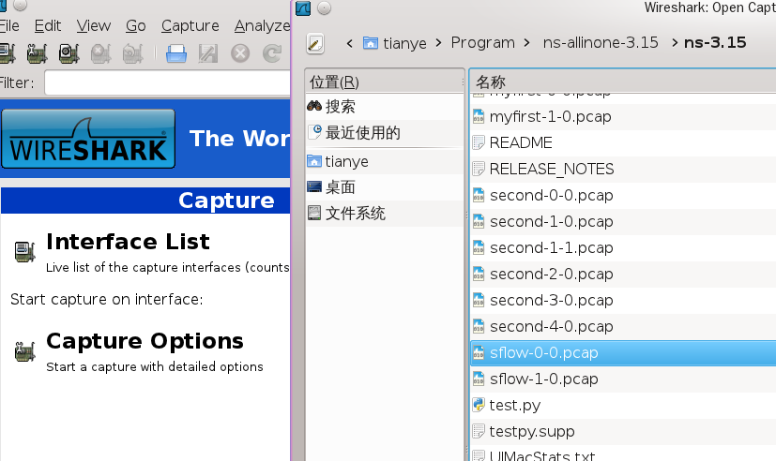
TCP Single Flow Simulation
Use wireshark to analyze the trace

Slide 68
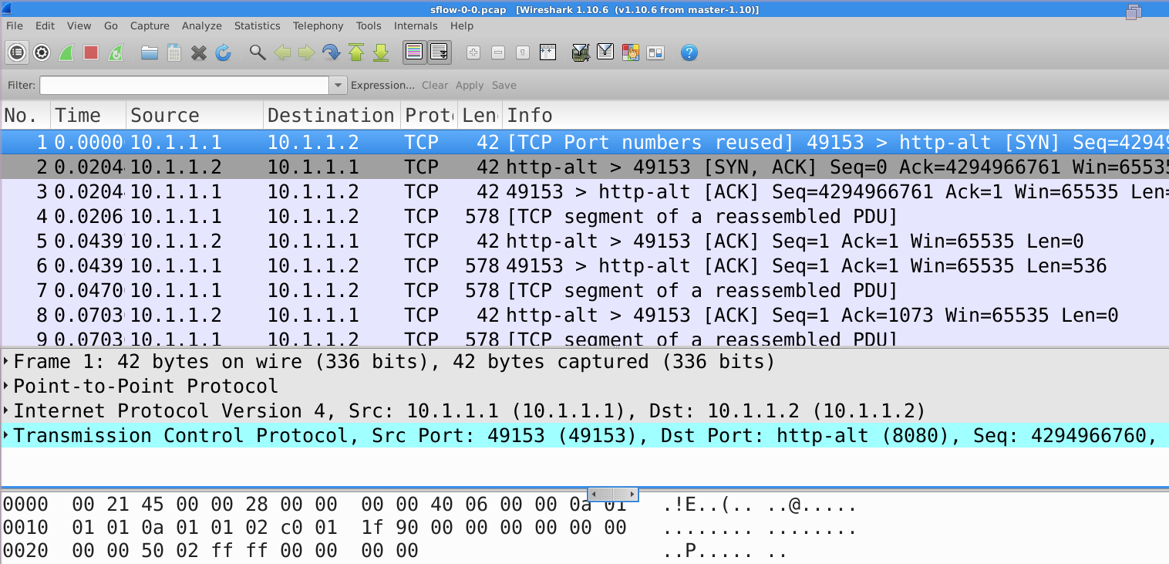
TCP Single Flow Simulation
The packets displayed in wireshark

Slide 69
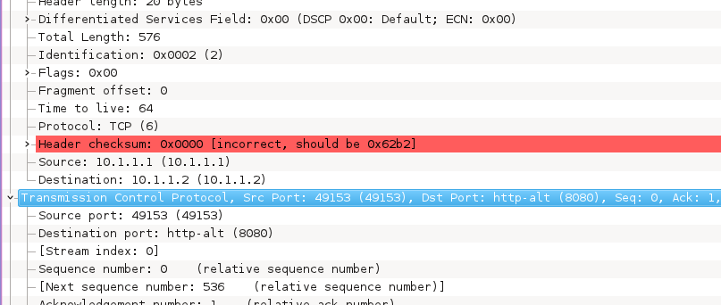
TCP Single Flow Simulation
Examine the packet

Slide 70
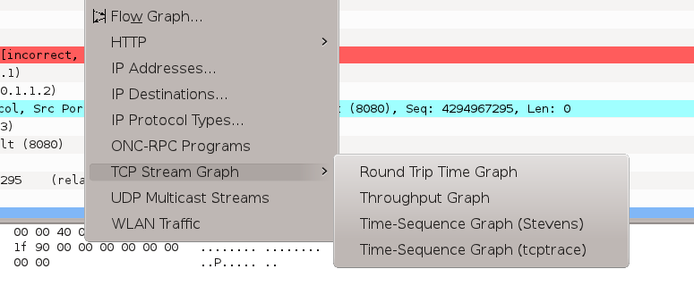
TCP Single Flow Simulation
Throughput and rtt
Select the first packet of the flow, select the menu "Statistics->TCP Stream Graph"

Slide 71
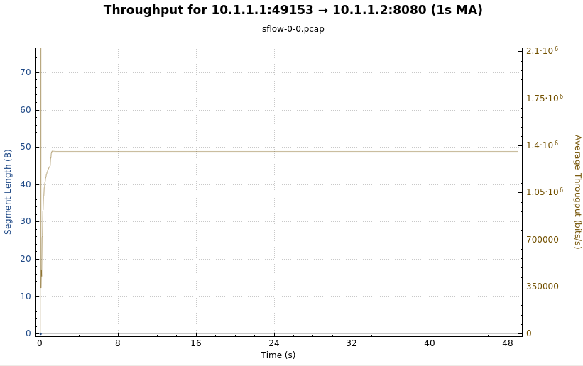
TCP Single Flow Simulation
Throughput

Slide 72
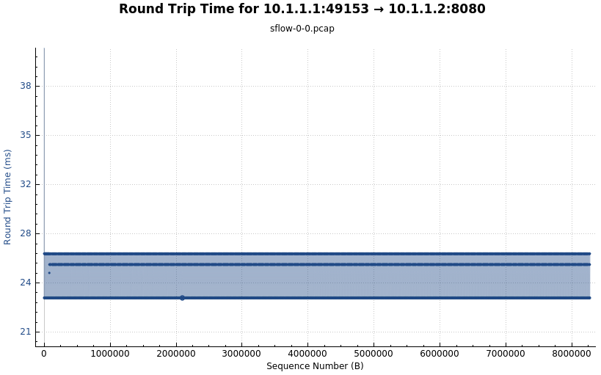
TCP Single Flow Simulation
rtt

Slide 73
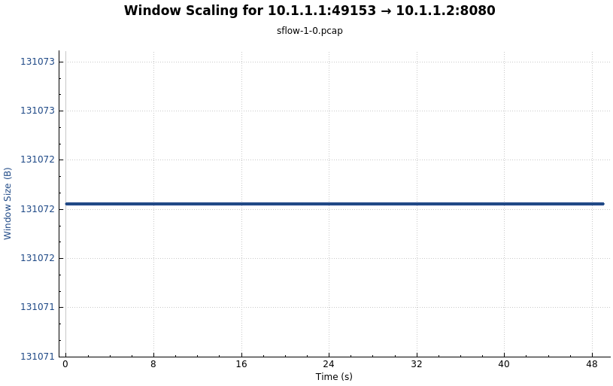
TCP Single Flow Simulation
Window size

Slide 74
TCP Multiple Flow Simulation
Simulate multiple TCP flows on a single p2p link
The mutiple flows compete for bandwidth
Cmd line arguments and log components
int
main (int argc, char *argv[])
{
uint32_t nFlows = 5;
uint16_t port = 50000;
CommandLine cmd;
cmd.AddValue("nFlows", "Number of parallel flows", nFlows);
cmd.Parse(argc, argv);
LogComponentEnable ("PacketSink", LOG_LEVEL_INFO);
LogComponentEnable ("OnOffApplication", LOG_LEVEL_INFO);

Slide 75
TCP Multiple Flow Simulation
Construct pointtopoint network
NodeContainer nodes;
nodes.Create (2);
PointToPointHelper pointToPoint;
pointToPoint.SetDeviceAttribute ("DataRate", StringValue ("1.5Mbps"));
pointToPoint.SetChannelAttribute ("Delay", StringValue ("10ms"));
NetDeviceContainer devices;
devices = pointToPoint.Install (nodes);
InternetStackHelper stack;
stack.Install (nodes);
Ipv4AddressHelper address;
address.SetBase ("10.1.1.0", "255.255.255.0");
Ipv4InterfaceContainer interfaces = address.Assign (devices);

Slide 76
TCP Multiple Flow Simulation
Set up multiple sinkApplications on n1, each sink uses a different port
ApplicationContainer clientApp[nFlows];
ApplicationContainer sinkApp[nFlows];
for(unsigned int i = 0; i < nFlows; i++)
{
PacketSinkHelper packetSinkHelper ("ns3::TcpSocketFactory", InetSocketAddress(interfaces.GetAddress (1), port + i));
sinkApp[i] = packetSinkHelper.Install (nodes.Get (1));
sinkApp[i].Start(Seconds (1.0));
sinkApp[i].Stop(Seconds (60.0));
}

Slide 77
TCP Multiple Flow Simulation
Set up multiple OnOffApplications on n0, resulting multiple flows
for(unsigned int i = 0; i < nFlows; i++)
{
OnOffHelper client("ns3::TcpSocketFactory", InetSocketAddress(interfaces.GetAddress (1), port + i));
client.SetAttribute ("OnTime", StringValue("ns3::ConstantRandomVariable[Constant=50]"));
client.SetAttribute ("OffTime", StringValue("ns3::ConstantRandomVariable[Constant=0]"));
client.SetAttribute ("DataRate", DataRateValue (DataRate ("1.5Mbps")));
client.SetAttribute ("PacketSize", UintegerValue (2000));
clientApp[i] = client.Install (nodes.Get (0));
clientApp[i].Start(Seconds (1.0 + (i * 8)));
clientApp[i].Stop (Seconds (51.0));
}

Slide 78
TCP Multiple Flow Simulation
Tracing and run
pointToPoint.EnablePcapAll ("nflow");
Simulator::Stop (Seconds(50));
Simulator::Run ();
Simulator::Destroy ();

Slide 79
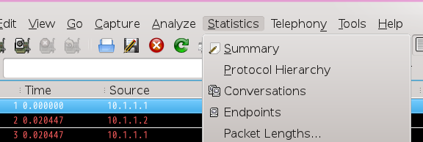
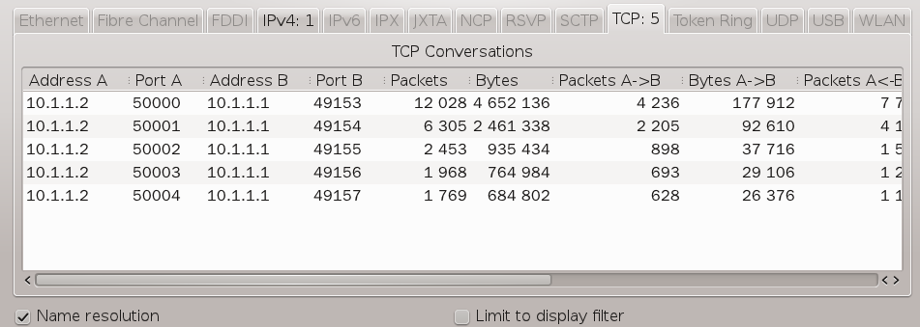
TCP Multiple Flow Simulation
The TCP conversations

Slide 80
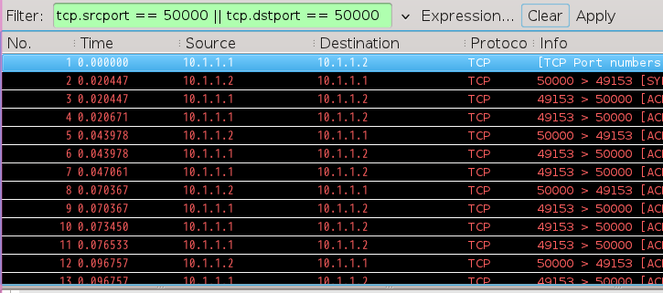
TCP Multiple Flow Simulation
Select the 1st tcp flow
In the filter, input the condition
Select the first packet to see the throughput
tcp.srcport == 50000 || tcp.dstport == 50000

Slide 81
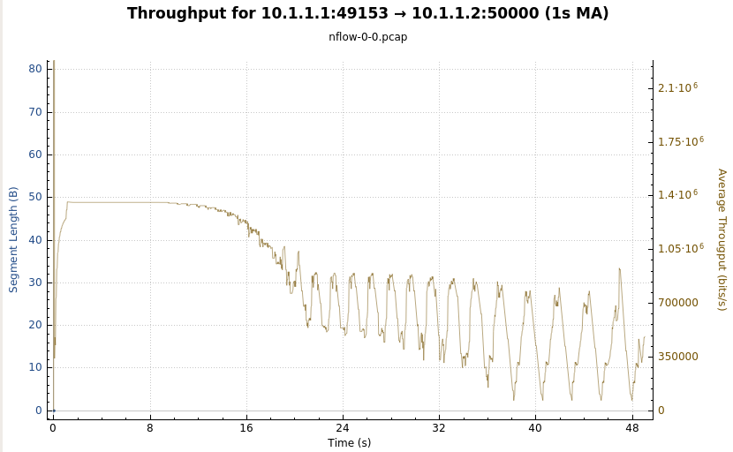
TCP Multiple Flow Simulation
Throughput of the first flow

Slide 82
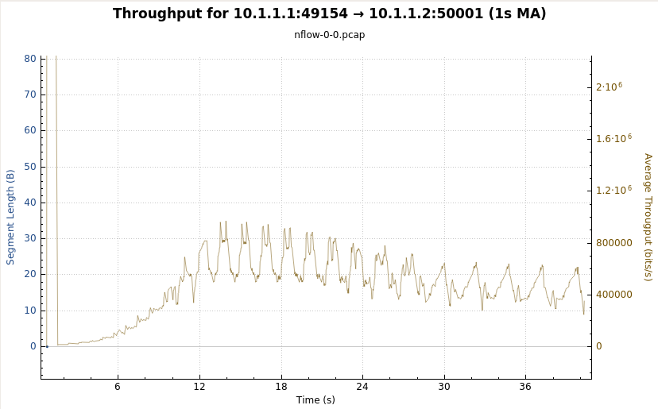
TCP Multiple Flow Simulation
The 2nd flow's throughput
tcp.srcport == 50001 || tcp.dstport == 50001

Slide 83
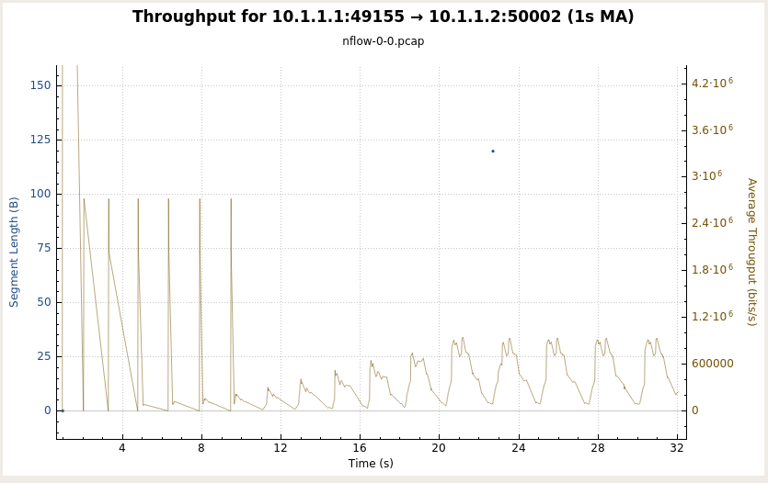
TCP Multiple Flow Simulation
The 3rd flow's throughput
tcp.srcport == 50002 || tcp.dstport == 50002

Slide 84
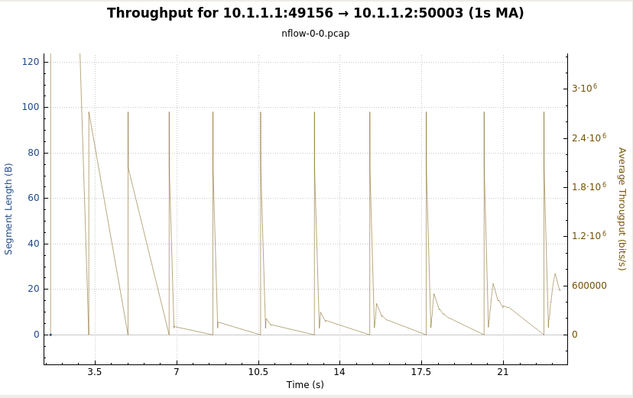
TCP Multiple Flow Simulation
The 4th flow's throughput
tcp.srcport == 50003 || tcp.dstport == 50003

Slide 85
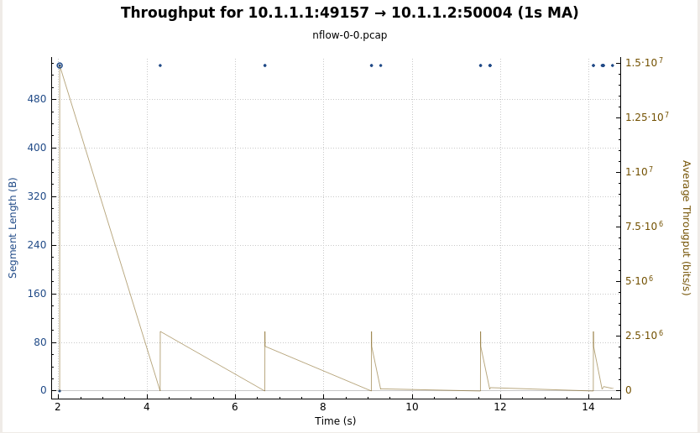
TCP Multiple Flow Simulation
The 5th flow's throughput
tcp.srcport == 50004 || tcp.dstport == 50004

Slide 86
Assignment
Install the ns3 simulator
Run the five experiments discussed in this tutorial
first.cc
second.cc
third.cc
sflow.cc
nflow.cc

