Slide 1
Mininet Simulation

Slide 2
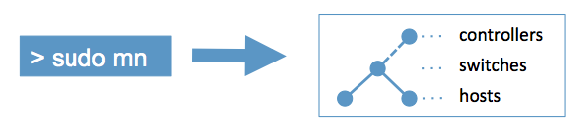
Mininet
Mininet creates a realistic virtual network, running real kernel, switch and application code, on a single machine, in seconds, with a single command: Mininet is at http://mininet.org/
An easy and fun way to experiment with OpenFlow and SDN!

Slide 3
Reference
Mininet workthrough http://mininet.org/walkthrough
Openflow Tutorial http://archive.openflow.org/wk/index.php/OpenFlow_Tutorial

Slide 4
Install Required Software
Download mininet virtual machine image
http://222.195.68.57/CS05112/pyretic_0.2.0_32bit.ova
(32 bit image, pyretic_0.2.0_32bit.ova)
Virtualization software
Windows: VMWare, VirtualBox

Slide 5
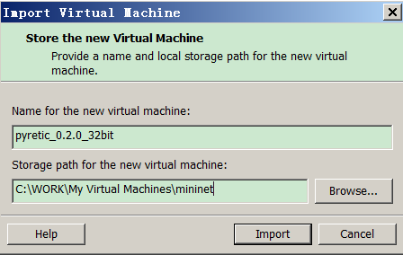
Install VM
File-open, select the image ova file
Specify the path for the virtual machine
User name – mininet; Password -- mininet

Slide 6
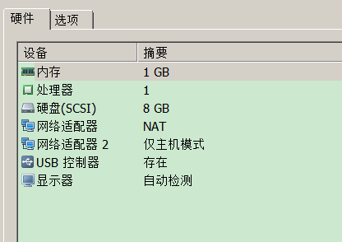
Enable SSH
Make sure the VM has two network interfaces
Network Adapter: NAT; eth0
Network Adapter: Host-only; eth1
Both are configured using DHCP
The host-only interface is used to communicate with the host machine

Slide 7


Enable SSH
Find out the assigned IP addresses
Assign IP address on interface (if not assigned)

Slide 8
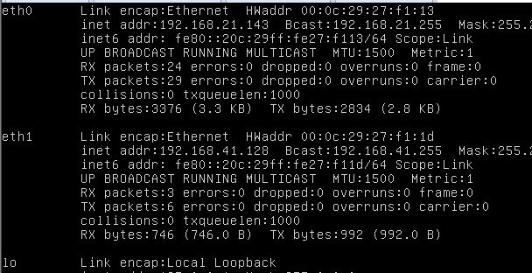
Enable SSH

Slide 9

Enable SSH
Download and install “Xming”
An X-Window server running on the host machine
Log on to VM
Run Xming
Download and run puTTY
-X means enabling the X window
Test X-Window

Slide 10
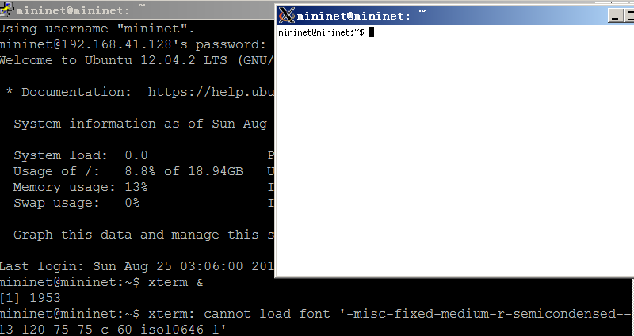
Enable SSH

Slide 11
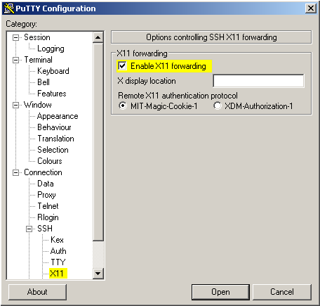
Enable SSH
Or, use puTTY GUI to log in
Install any needed software, e.g.,

Slide 12
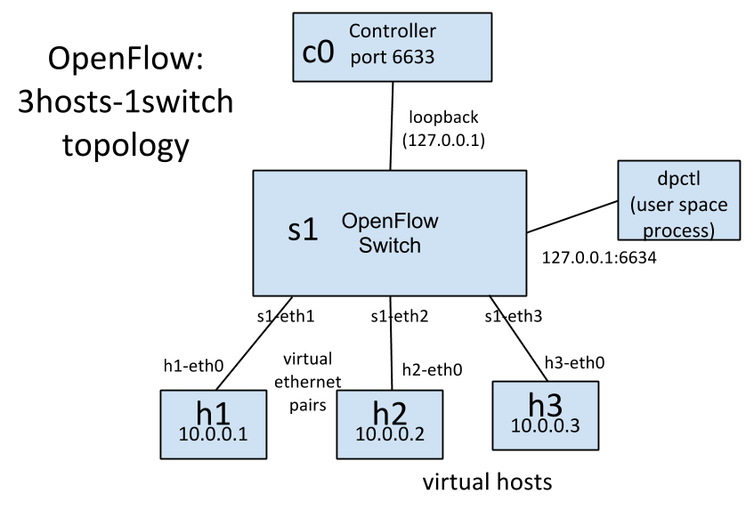
Development Tools
Simulate 3-host single switch topology

Slide 13
Development Tools
In SSH terminal, enter
Created 3 virtual hosts, each with a separate IP.
Created a single OpenFlow software switch in the kernel with 3 ports (Open vSwitch).
Connected each virtual host to the switch with a virtual Ethernet cable.
Set the MAC address of each host equal to its IP.
Configure the OpenFlow switch to connect to a remote controller.

Slide 14
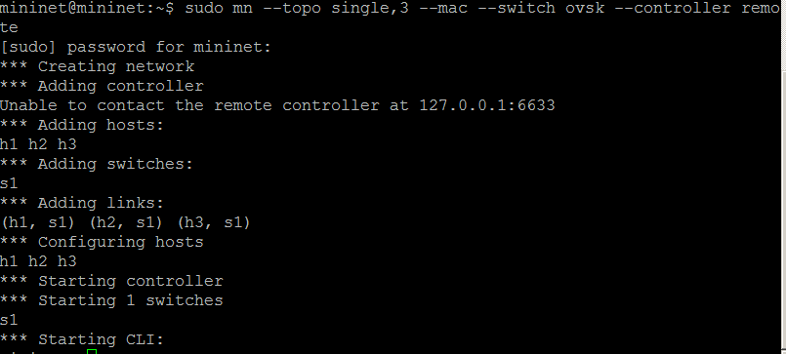
Development Tools
No controller to connect

Slide 15



Mininet Intro
Lists all nodes
Run a single command on a node
Spawn an xterm for one or more hosts
Use exit command to quit mininet, and clearing residual state or processes

Slide 16

dpctl
dpctl is a utility that comes with the OpenFlow reference distribution and enables visibility and control over a single switch's flow table.
Connects to the switch and dumps out its port state and capabilities or
Show nothing

Slide 17

Ping test
Try to ping h2 from h1
Do not get any reply.
There is no controller connected to the switch, the switch doesn't know what to do with incoming traffic
Manually install flows on the switch
Dump flows on switch

Slide 18
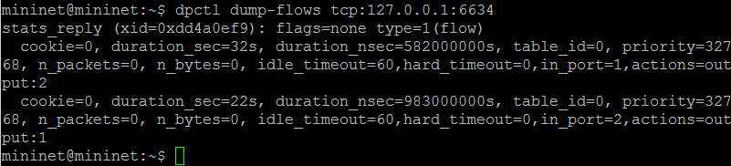

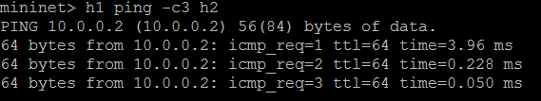
Ping test
Dump flows on switch
Ping again

Slide 19
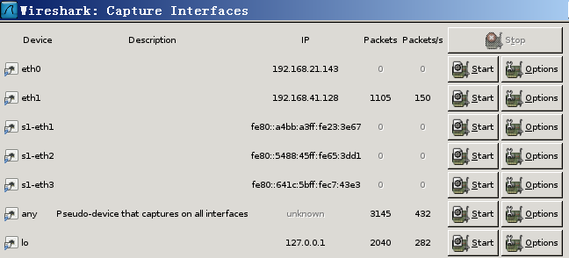
Start Wireshark
Start Wireshark on the VM
Capture on the lo interface
Filter packet with “of”: only display the OpenFlow packets

Slide 20

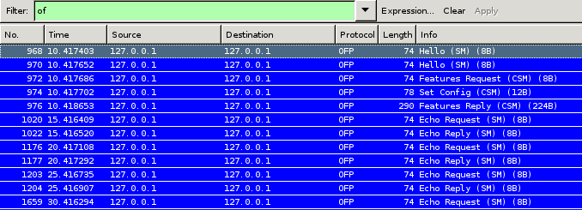
Start Controller
Start the OpenFlow reference controller
Acts as a learning switch without installing any flow-entries

Slide 21
OpenFlow Messages
Openflow messages:
Hello: Controller ←→ Switch TCP handshake
Features Request: Controller → Switch controller asks to see which ports are available
Set Config: Controller → Switch controller asks the switch to send flow expirations
Features Reply: Switch → Controller switch replies with a list of ports, port speeds, and supported tables and actions.

Slide 22
OpenFlow Messages for Ping
ignore the echo-request/reply messages
Ping
Some message types:
Packet-In: Switch → Controller a packet received and doesn't match any entry
Packet-Out: Controller → Switch controller send a packet out to one or more switch ports.
Flow-Mod: Controller → Switch instructs a switch to add a particular flow

Slide 23
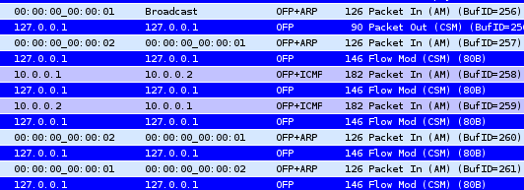
OpenFlow Messages for Ping
Three steps in ping
ARP request/response (h1 learns h2's MAC)
Ping request/reply
ARP request/response (h2 polls h1 for liveness)
Controller here helps to broadcast instead of replying ARP directly

Slide 24

Performance Test
Run iperf command
runs an iperf TCP server on one virtual host, then runs an iperf client on a second virtual host.
Mininet wraps the original iperf command to automatically test from the first host to the last host

Slide 25
The POX Controller
POX is a Python-based SDN controller platform
VM should already contain POX, if not, download POX
Simulate the network again

Slide 26
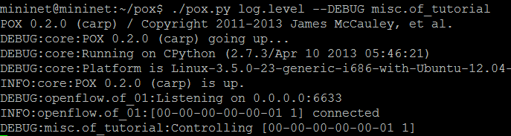
The POX Controller
Run POX controller
Enable verbose logging
The switch will behave like a hub

Slide 27


Verify Hub Behavior with tcpdump
Open xterm at h1, h2, h3
At h2 and h3 terminal, run tcpdump
Ping h2 from h1
Try ping a non-existent host

Slide 28
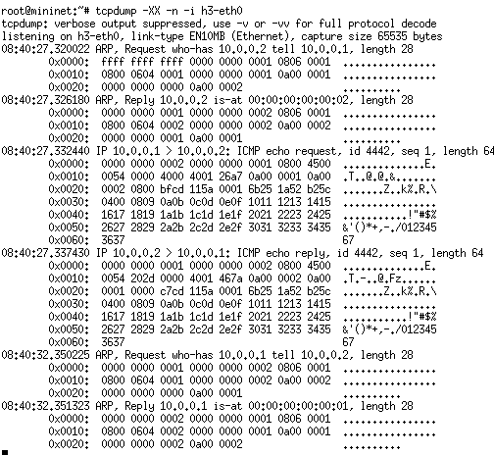
Verify Hub Behavior with tcpdump
Same packets captured at h2 and h3 (since connected to hub)

Slide 29


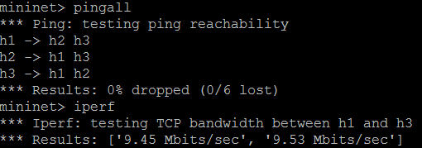
Ping and performance test
Connectivity test
Performance test

Slide 30
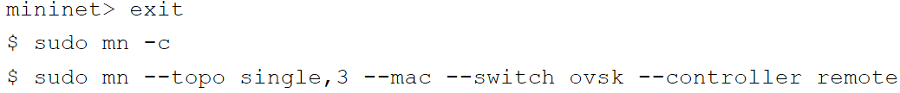
The Pyretic Controller
Pyretic: a programmer friendly controller
Clean up and re-simulate the network
Download and run the controller script
The controller behaves like a hub
$ cd ~/pyretic/pyretic/examples
$ wget http://222.195.68.57/CS05112/mininet/pyretic_hub.py

Slide 31
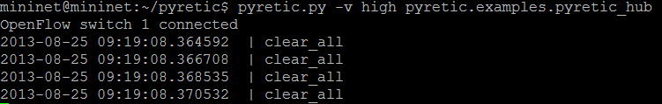
Hub
Run the controller
h1 ping h2 and h3, use tcpdump to verify hub

Slide 32
Learning Switch
Download learning switch
Run the learning switch
Verify the learning switch behaviors
$ cd ~/pyretic/pyretic/examples
$ wget http://222.195.68.57/CS05112/mininet/pyretic_switch.py

Slide 33
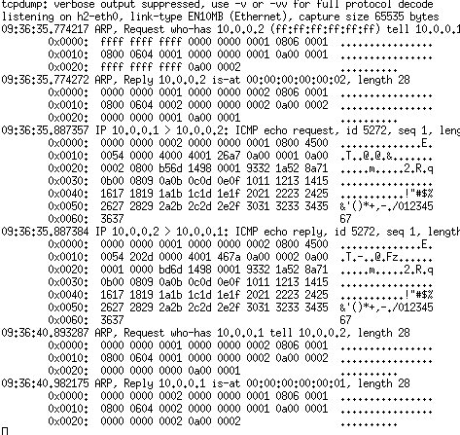


Slide 34
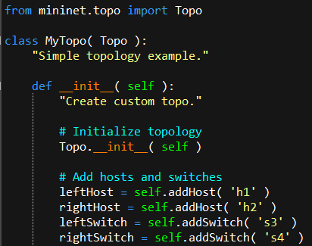
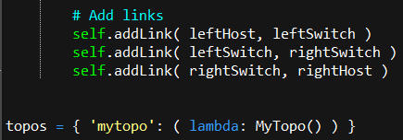
Custom Topology
Create a custom topology
2 switch 2 host

Slide 35
Classes, methods, functions and variables
Topo: the base class for Mininet topologies
addSwitch(): adds a switch to a topology and returns the switch name
addHost(): adds a host to a topology and returns the host name
addLink(): adds a bidirectional link to a topology (and returns a link key, but this is not important). Links in Mininet are bidirectional unless noted otherwise.

Slide 36
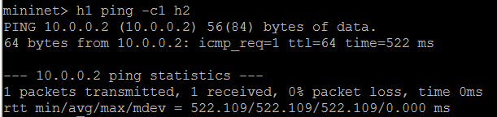
Custom Topology
Simulate the network from command line
Run an external controller
$ sudo mn --custom ~/mininet/custom/topo-2sw-2host.py --topo mytopo --controller remote
$ ./pyretic.py -v high pyretic.examples.pyretic_hub

Slide 37
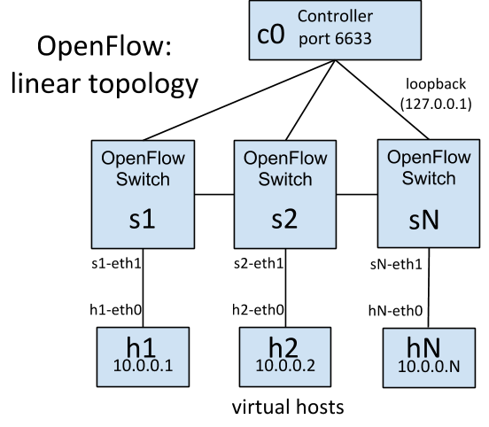
All in One Program
A number of hosts (h1 through hN) connected to their individual switches (s1 through sN)

Slide 38
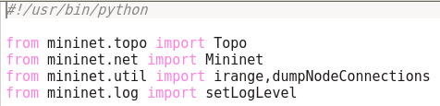
Source Code
Import components

Slide 39
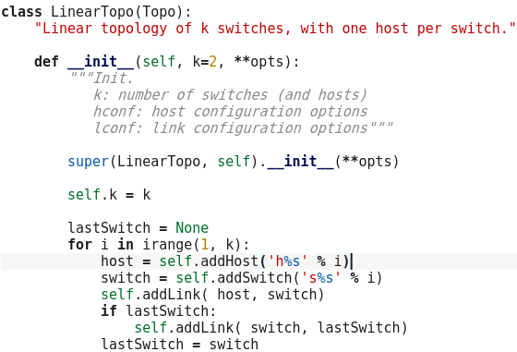
Source Code
Construct the topology

Slide 40
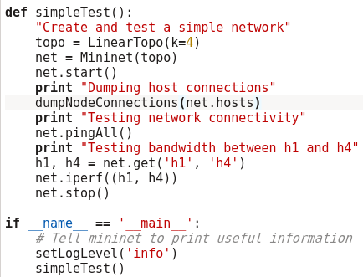
Source Code
Test the network

Slide 41
Classes, methods, functions and variables
Mininet: main class to create and manage a network
start(): starts your network
pingAll(): tests connectivity by trying to have all nodes ping each other
stop(): stops your network
net.hosts: all the hosts in a network
dumpNodeConnections(): dumps connections to/from a set of nodes.
setLogLevel( 'info' | 'debug' | 'output' ): set Mininet's default output level;
'info' is recommended as it provides useful information.

Slide 42
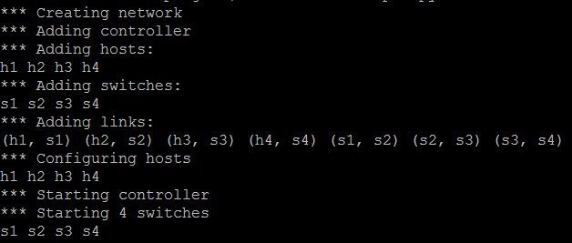
Run Simulation
Run simulation script
Simulation output

Slide 43
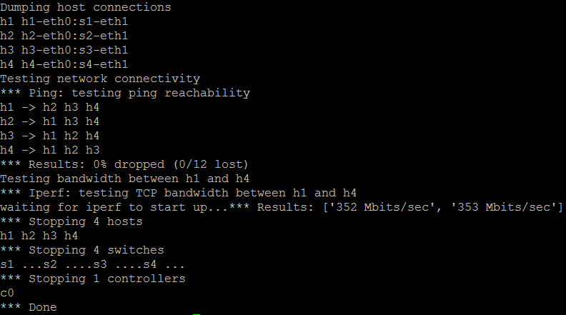
Run Simulation

Slide 44
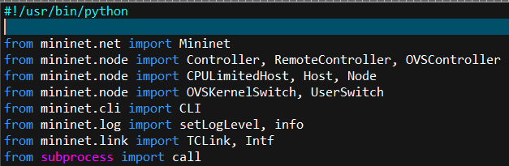
Another Example
Multiple choices for controller, switch, and host

Slide 45
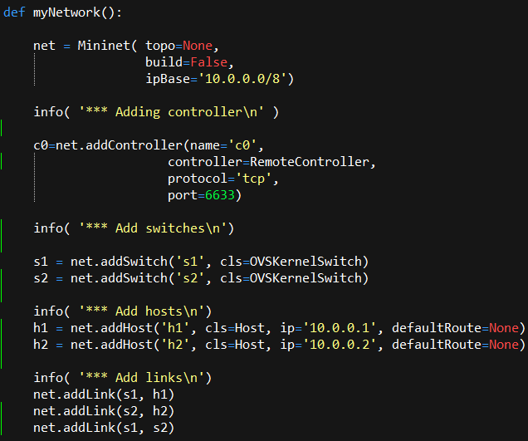
Source Code

Slide 46
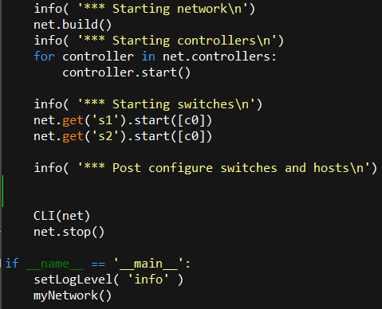
Source Code

Slide 47

With Controller
Run the network without controller
Run the remote controller
Emulate link down
$ chmod a+x Test.py
$ sudo ./Test.py
$ ./pyretic.py -v high pyretic.examples.pyretic_hub

Slide 48

Without Controller
Manually add flow entries

Slide 49
Assignment
Build Mininet simulation environment
Experiment with various networks, controllers, and software
3-host single-controller network
Custom topology
Linear topology network
OpenFlow referred controller
POX, Pyretic
Wireshark, tcpdump

