Slide 1
Datacenter Network Simulation using Mininet
Course Project for CS05112

Slide 2
Objective
Simulate the FatTree datacenter network using Mininet and MinEdit.
With controller: spamming tree, link failures
Without controller: implement FatTree’s routing rules with switch flow rules

Slide 3
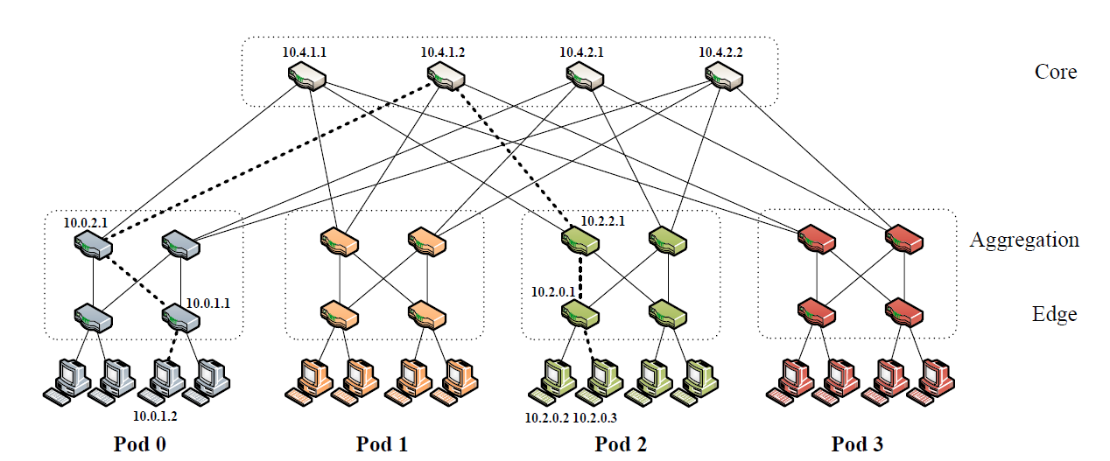
FatTree topology

Slide 4
Experiment 1 (with controller)
The physical topology has loops, you need to first build a logical spamming tree (hint: use the existing component)
Figure out and draw the logical spamming tree topology
Make OpenFlow switches to behave like address learning switches
Using pingall to testify, examine the flow tables on switches
Introduce link failure events with at least three simultaneously failed links
However, the physical network shouldn’t be partitioned.
Reconstruct the spamming tree and re-populate the flow tables with pingall
Topology, pingall result, flows table on switches

Slide 5
Experiment 2 (without controller)
Do not use any controller
In simulation script, insert appropriate flow table entries in OpenFlow switches to make the network behaves like FatTree.
Test the routing rules with pingall
Prove that the traffic is evenly distributed on FatTree with flow table entry statistics.

Slide 6
Submit your project
Your simulation source code and readme file if necessary.
Your project report document
Explain your code and report the experiment results on experiment 1 and 2.

