Slide 1
Create a fully functional layer-2 Firewall application using Pyretic
Course Project for CS05112

Slide 2
Objective
Implement a layer 2 firewall that runs alongside the MAC learning module on the Pyretic runtime

Slide 3
Network topology

Slide 4
Pyretic
Pyretic runtime system
Verify Hub behavior with tcpdump
Verify Switch behavior with tcpdump
Understand pyretic_hub.py and pyretic_switch.py
Details can be find in the “The Pyretic Controller” part in the tutorial

Slide 5
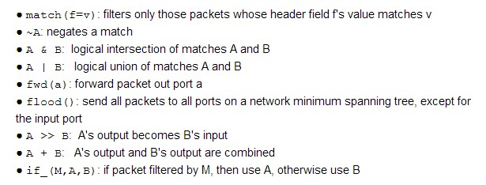
Useful Pyretic policies

Slide 6
Firewall
pyretic_firewall.py: a skeleton class which you will update with the logic for installing firewall rules.
firewall-policies.csv: a list of MAC pairs (i.e., rules) read as input by the firewall application. These pairs are the hosts can’t communicate with each other.
You can provide the firewall rules in firewall-policies.csv and read it into the main function
Rules are decided by you!
These 2 files can be downloaded on the course webpage

Slide 7
Submit your project
Your pyretic_firewall.py , firewall-policies.csv and readme file.
Your project report document, in which you should:
Explain your code and how the code implements the firewall function along side the MAC learning forwarding.
List the firewall rules and record pingall screenshot.
Show self.policy on the screen shot after some pings (e.g., h1 ping h3, h4 ping h6), explain the policy.

