Slide 1
IDE & Visual Studio
2018/05/08
#2 Student Seminar

Slide 2
Contents
1. What is IDE
2. What is Visual Studio
3. Functions of VS
4. How to download VS
5. How to install VS
6. Who can use VS
7. How to use VS

Slide 3
1. What is IDE
1. What is IDE
2. What is Visual Studio
3. Functions of VS
4. How to download VS
5. How to install VS
6. Who can use VS
7. How to use VS

Slide 4
2. What is Visual Studio(VS)
1. What is IDE
2. What is Visual Studio(VS)
3. Functions of VS
4. How to download VS
5. How to install VS
6. Who can use VS
7. How to use VS

Slide 5
3. Functions of VS
1. What is IDE
2. What is Visual Studio
3. Functions of VS
4. How to download VS
5. How to install VS
6. Who can use VS
7. How to use VS

Slide 6
4. How to download VS
You can download Visual Studio using a license of UT
<4 steps to download>
1. Search by 東京大学 - 工学部 - Microsoft Imagine Premium
2. Register
ID: Use your 10-digit-ID on your student card rearranging like
①②③①④⑤⑥⑦⑩⑧⑨⑩ ex.) 0123456789 → 012034569789
3. Add the latest version to cart
Visual Studio Enterprise 2017 32/64-bit (Multilanguage)
4. Purchase(\0) & Download
Either Download version or Web Installer is OK

Slide 7
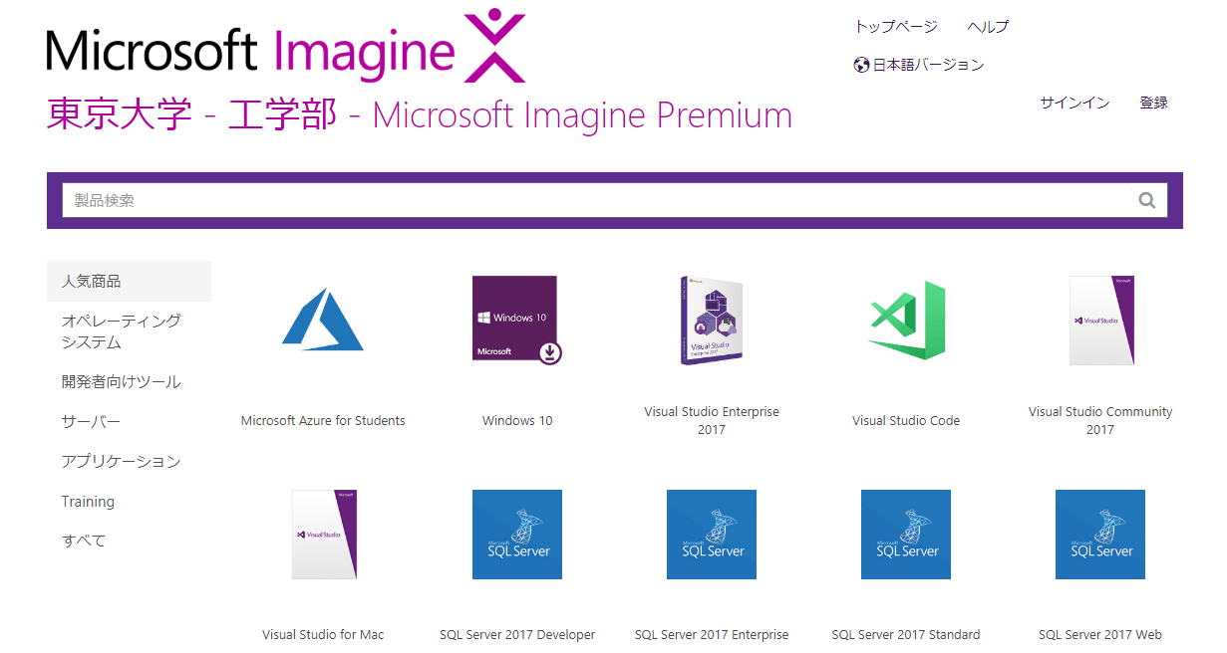
4. How to download VS
<Screen>
②Register
③Add cart

Slide 8
5. How to install VS
<2 Steps to install>
1. Follow the guide after downloading
・If you want to get more functions, you easily can do it later
・It’s good to select programming language before you install
・Recommend Visual C++ and Python
2. Sign-in by Microsoft Account (don’t have to)
・You can login by UTokyo Account
・ID: xxxxxxxxxx(10-digit-ID)@utac.u-tokyo.ac.jp
・Password: The same as UTAS

Slide 9
6. Who can use VS
<>
<>

Slide 10
7. How to use VS
1. What is IDE
2. What is Visual Studio
3. Functions of VS
4. How to download VS
5. How to install VS
6. Who can use VS
7. How to use VS

