Slide 1
IDE & Visual Studio
2018/05/08
#2 Student Seminar

Slide 2
Contents
1. What is IDE
2. What is Visual Studio(VS)
3. Functions of VS
4. How to download VS
5. How to install VS
6. Who can use VS
7. How to use VS

Slide 3
1. What is IDE
1. What is IDE

Slide 4
2. What is Visual Studio(VS)
1. What is IDE

Slide 5
3. Functions of VS
1. What is IDE

Slide 6
4. How to download VS
You can download Visual Studio using a license of UT
<4 steps to download>
1. Search by 東京大学 - 工学部 - Microsoft Imagine Premium
2. Register
ID: Use your 10-digit-ID on your student card rearranging like
①②③①④⑤⑥⑦⑩⑧⑨⑩ ex.) 0123456789 → 012034569789
3. Add the latest version to cart
Visual Studio Enterprise 2017 32/64-bit (Multilanguage)
4. Purchase(\0) & Download
Either Download version or Web Installer is OK

Slide 7
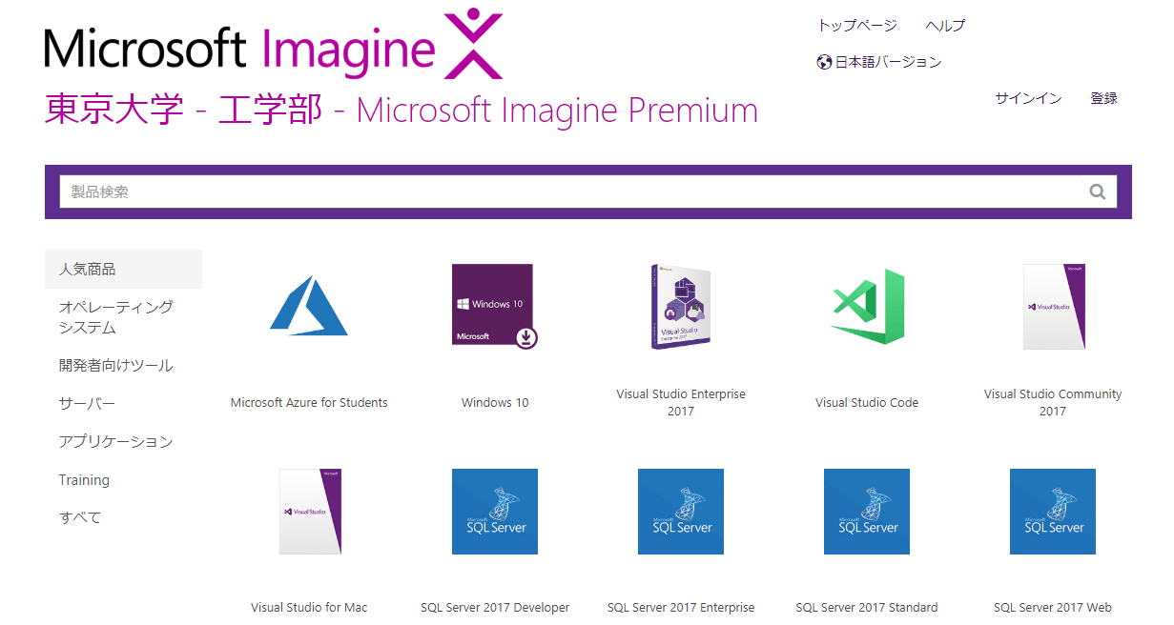
4. How to download VS
<Screen>
②Register
③Add cart

Slide 8
5. How to install VS
<2 Steps to install>
1. Follow the guide after downloading
・If you want to get more functions, you easily can do it later
・It’s good to select programming language before you install
・Recommend Visual C++ and Python
2. Sign-in by Microsoft Account (don’t have to)
・You can login by UTokyo Account
・ID: xxxxxxxxxx(10-digit-ID)@utac.u-tokyo.ac.jp
・Password: The same as UTAS

Slide 9
6. Who can use VS
<User>
students and staffs who belong to
Faculty of Engineering, School of Engineering,
Graduate school of Information Science and Technology
<Purpose>
Education, Academic projects, Non-commercial research
<Device>
Private PC or lab PC of students and staffs
Ex.) your computer at home
You can do research at home!

Slide 10
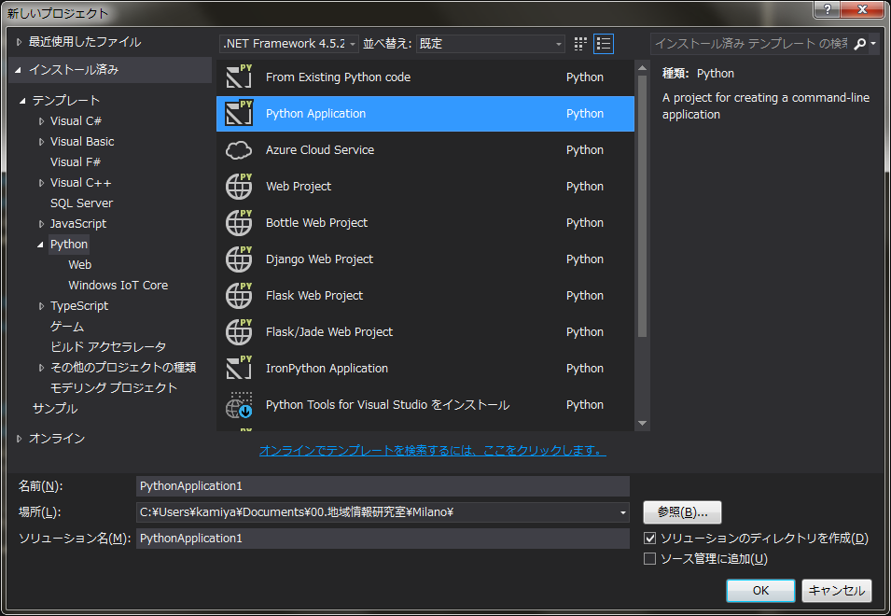
7. How to use VS ①
1. Create a project
Project: put source files necessary to create a project in one
[File] - [New] – [Project]
2. Settings by [New Project] dialogue
① Select a programming language
② Select the type of a program
Console application and so on
③ Name of a project
④ Directory to save
⑤ Name of a solution (same as ③)
①
②
③
④
⑤

Slide 11
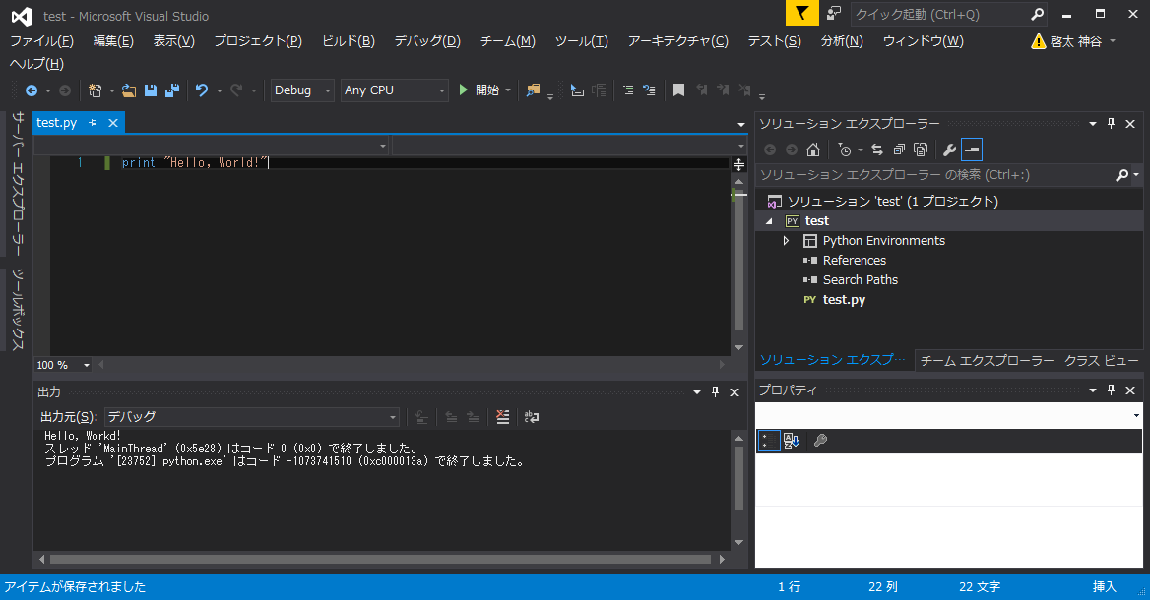
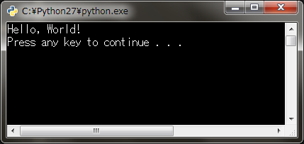
7. How to use VS ②
<Screen>
Execute Project here
1. What is IDE
Editor Screen: where you write a code
Solution Explorer:
You can add source files
Output Screen: Errors and Messages are displayed
Execution Result

Slide 12
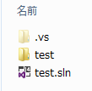
7. How to use VS ③
<How to open the solution which you saved>
Open .sln file in the directory to save
<The difference between solution and project>
One software is consist of projects (ex. .exe and .dll files)
Project: one project is needed to create one program
Solution: Container to combine and manage projects to create
one software
※You don’t have to care the difference so much in out lab
If you uncheck [Create the directory of solution] at
[New Project] dialogue, two folders will be integrated
Project Folder
Solution File

