Slide 1

IDE & Visual Studio
2018/05/08
#2 Student Seminar
M2 Yuki Kajihara

Slide 2

Contents
1. What is IDE
2. What is Visual Studio(VS)
3. Functions of VS
4. How to download VS
5. How to install VS
6. Who can use VS
7. How to use VS
1
2
3
4-5
6
7
8-10

Slide 3




1. What is IDE
<Definition>
・IDE: Integrated Development Environment
・Interactive operation environment
which consists of text editor, compiler, debugger and so on
・Most of IDE are GUI (Graphical User Interface) ⇔ CUI
<Examples of IDE>
Visual Studio
Eclipse
Xcode
NetBeans
by Microsoft
by IBM
by Apple
by Oracle(mainly)
1

Slide 4
2. What is Visual Studio(VS)
<Description>
・IDE provided by Microsoft
・Mainly for Windows (Mac is also OK)
・C++, C#, Visual Basic, JavaScript, Python and so on
・Visual Studio Community for free
・Other Editions for a fee
Visual Studio Professional
Visual Studio Test Professional
Visual Studio Enterprise: Almighty → We can get it for free
2

Slide 5
3. Functions of VS
<Main Functions>
・Code writing and editing
・Compilers and Build Engines: produce executable files
・Debugging Tools: Troubleshoot problems in the code
・Testing Tools: Unit test, Performance and code analysis tests
<Other Functions>
・Visual Studio overview for beginners
https://www.linkedin.com/learning/visual-studio-essential-training-01-exploring-the-visual-studio-ecosystem/visual-studio-overview-for-beginners
・【Visual Studio 2017】オススメの拡張機能 その1（16個）
http://baba-s.hatenablog.com/entry/2017/10/04/100000
3

Slide 6
4. How to download VS
You can download Visual Studio using a license of UT
<4 steps to download>
1. Search by 東京大学 - 工学部 - Microsoft Imagine Premium
2. Register
・ID: Use your 10-digit-ID on your student card rearranging like
①②③①④⑤⑥⑦⑩⑧⑨⑩ ex.) 0123456789 → 012034569789
3. Add the latest version to cart
・Visual Studio Enterprise 2017 32/64-bit (Multilanguage)
4. Purchase(\0) & Download
・Either Download version or Web Installer is OK
4

Slide 7
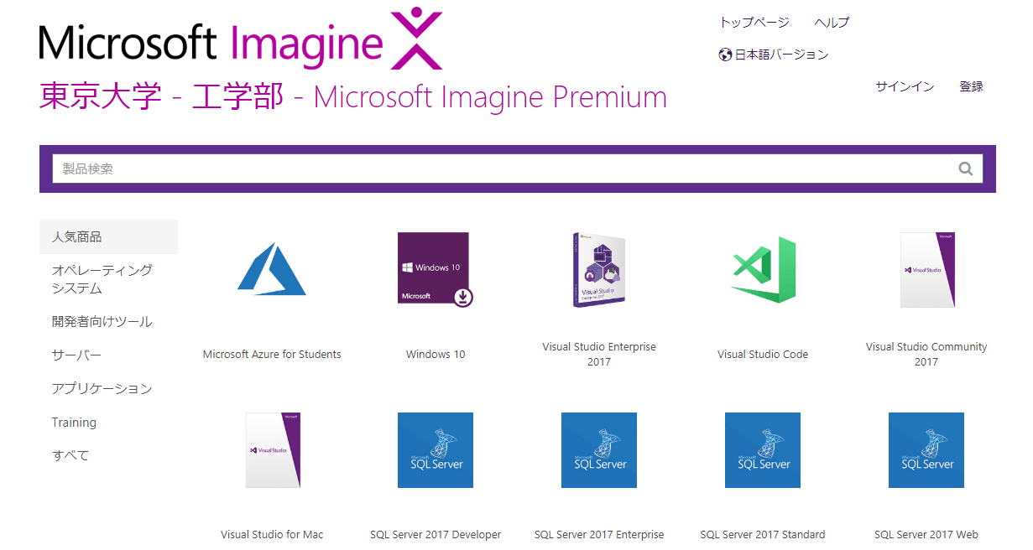
4. How to download VS
<Screen>
②Register
③Add cart
5

Slide 8
5. How to install VS
<2 Steps to install>
1. Follow the guide after downloading
・If you want to get more functions, you easily can do it later
・It’s good to select programming language when you install
・Recommend Visual C++ and Python
2. Sign-in by Microsoft Account (don’t have to)
・You can login by UTokyo Account
・ID: xxxxxxxxxx(10-digit-ID)@utac.u-tokyo.ac.jp
・Password: The same as UTAS
6

Slide 9
6. Who can use VS
<User>
・Students and staffs who belong to
Faculty of Engineering, School of Engineering,
Graduate school of Information Science and Technology
<Purpose>
・Education, Academic projects, Non-commercial research
<Device>
・Private PC or lab PC of students and staffs
Ex.) your computer at home
You can do research at home!
7

Slide 10
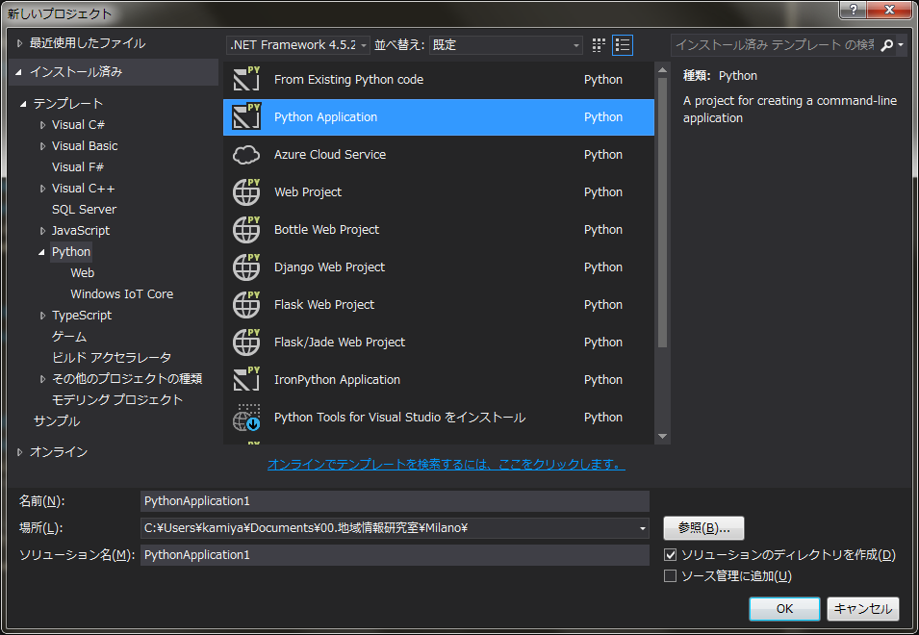
7. How to use VS ①
1. Create a project
・Project: put source files necessary to create a project in one
[File] - [New] – [Project]
2. Settings by [New Project] dialogue
① Select a programming language
② Select the type of a program
Console application and so on
③ Name of a project
④ Directory to save
⑤ Name of a solution (same as ③)
①
②
③
④
⑤
8

Slide 11
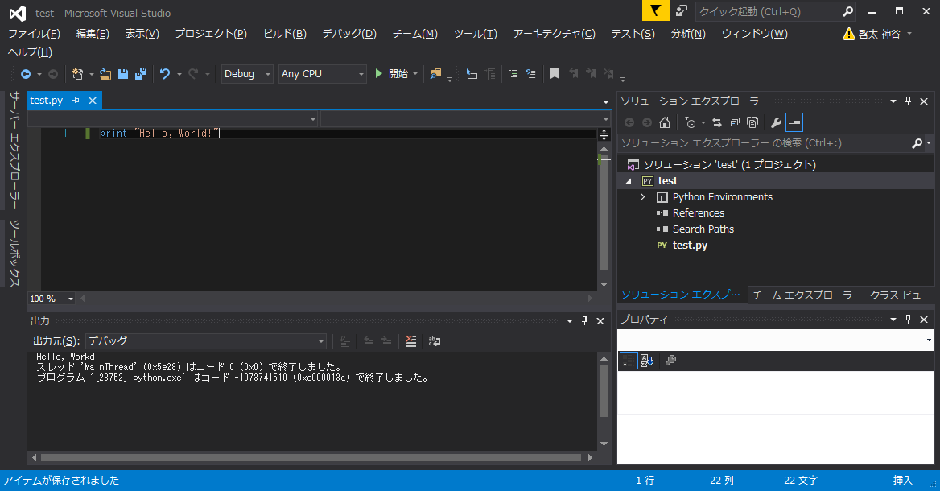
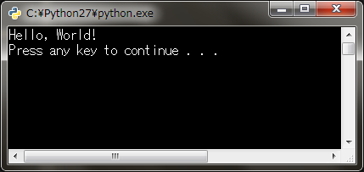
7. How to use VS ②
<Screen>
Execute Project here
1. What is IDE
Editor Screen: where you write a code
Solution Explorer:
You can add source files
Output Screen: Errors and Messages are displayed
Execution Result
9

Slide 12
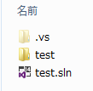
7. How to use VS ③
<How to open the solution which you saved>
・Open .sln file in the directory where you work
<The difference between solution and project>
・One software is consist of projects (ex. .exe and .dll files)
Project: one project is needed to create one program
Solution: Container to combine and manage projects to create
one software
※You don’t have to care about the difference so much in our lab
・If you uncheck [Create the directory of solution] at
[New Project] dialogue, two folders will be integrated
Project Folder
Solution File
10

