Slide 1
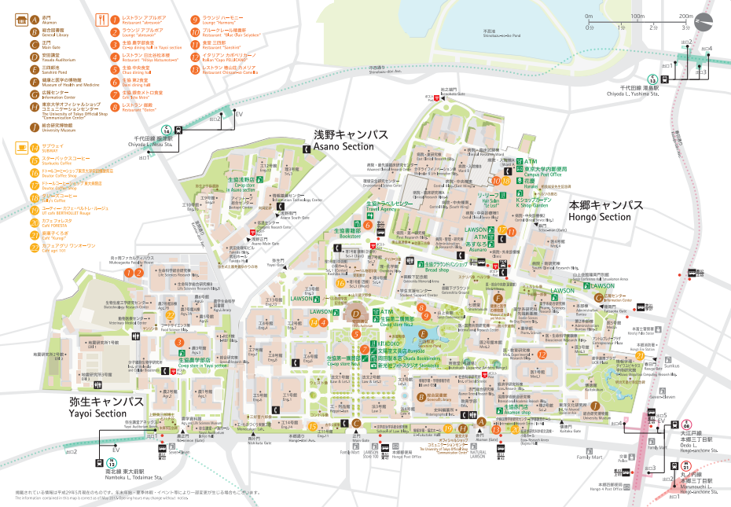
University of Tokyo Campus Tour 2018/02/11
: Lunch Spot
⑥Bookstore
⑤Hospital
⑦Yasuda Auditorium
⑧Souvenir Shop
④Sanshiro Pond
⑨Engineering Department Square
②Kaitokukan
③Library
⑩Agr. And Life Sciences Museum
GOAL
①Akamon(Red gate)
START

