Slide 1
Bayesian Data Analysis CHAPTER 17: Metric Predicted Variable with One Metric Predictor
Student Seminar #9 (2018/06/26)
M2 Yuki Kajihara

Slide 2
Contents
Overview of Chapter17
17.1 Simple Linear Regression
17.2 Robust Linear Regression
17.3 Hierarchical Regression on Individuals Within Groups
17.4 Quadratic Trend and Weighted Data
17.5 Procedure and Perils for Expanding a Model
1
2-3
4-9
10-12
13-16
17-19

Slide 3
Overview of Chapter 17
1
Purpose
Predict one metric variable from one metric predictor
ex.)
Structure
y
x
weight
height
Specific Model
Hierarchical
Regression
Hierarchical
Expanding
a Model
Nonhierarchical
Linear
Nonlinear
Simple Linear
Regression
Robust Linear
Regression
Nonlinear
Regression

Slide 4
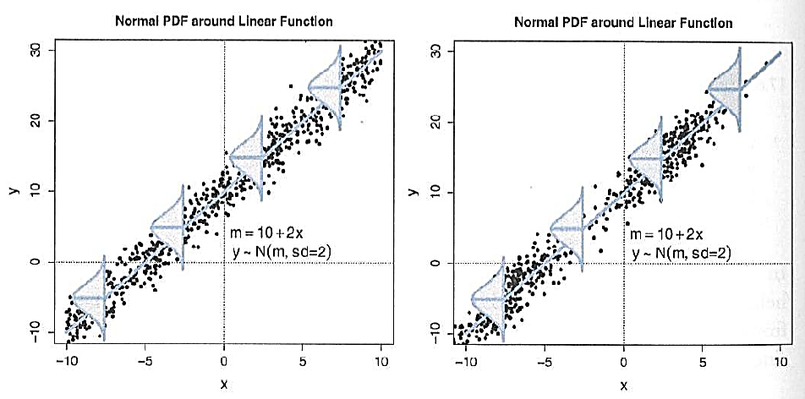
17.1 Simple Linear Regression
2
Step
Generate any random x
Compute the mean predicted value of y by μ = β0 + β1 x
Generate random variable for datum y from a normal distribution
( μ : mean, σ : standard deviation)
Figure
Generate x from
Left :
a uniform distribution
Right :
a bimodal distribution
Both shows data from
the same model

Slide 5
17.1 Simple Linear Regression
3
Assumption
Homogeneity of variance
At every value of x, the variance of y is the same
Figure
Note
Simple Linear Regression describes tendencies, not causality
Both assumes
Homogeneity of variance
But hard to see it
on the right figure
because there is an area
which x is sparse

Slide 6
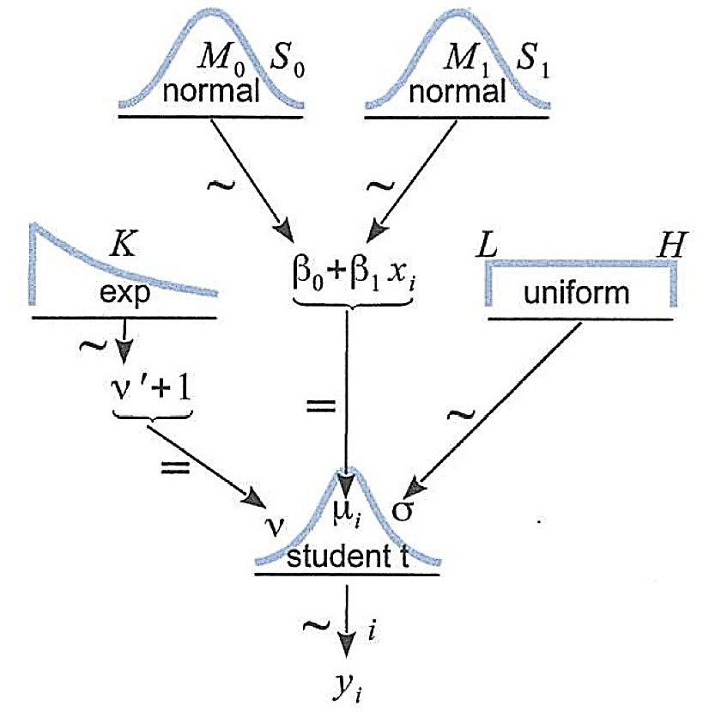
17. 2 Robust Linear Regression
4
Object
Data which have outliers
Assumption
The datum yi is a t-distributed random value
around the central tendency μi = β0 + β1 xi
Diagram

Slide 7
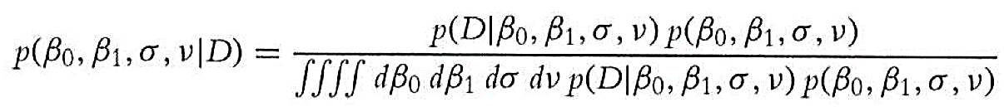
17. 2 Robust Linear Regression
5
Goal
Determine what combinations of β0, β1, σ, v are credible, given the data
The answer (from Bayes’ rule) :
→ Complicated…
Use JAGS or Stan!
What we have to do
Specify sensible priors
Make sure that the MCMC process generates a trustworthy sample
that is converged and well mixed
→ Talk about it later

Slide 8
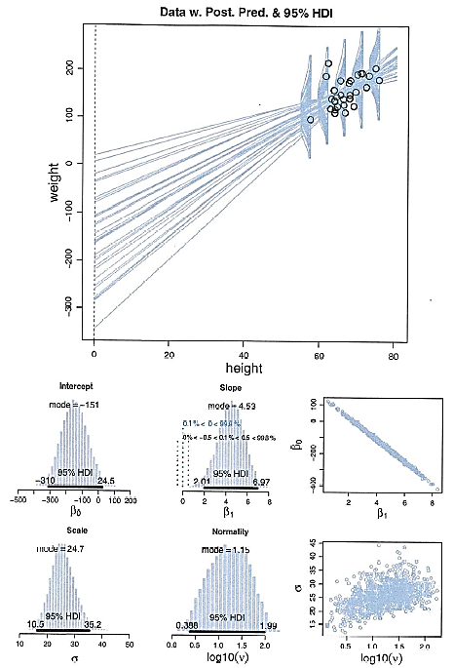
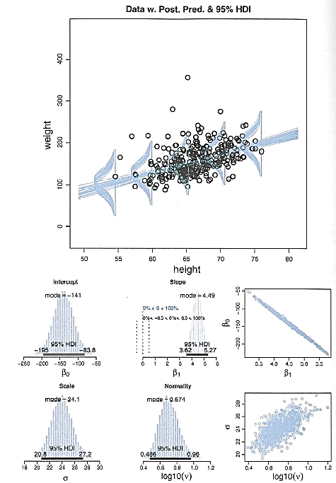
17. 2 Robust Linear Regression
6
Figure
N = 30
N = 300
weight
weight
height
height

Slide 9
17. 2 Robust Linear Regression
7
Problem with using raw data
Parameter-correlation problem
The credible slopes and intercepts trade off
When the slope is small, the intercept is big
When the slope is big, the intercept is small
→ MCMC sampling is difficult
Two parameter values change slowly
Ways to make the sampling more efficient
Change the sampling algorithm → Stan : HMC
Transform the data → JAGS : Standardization
0

Slide 10

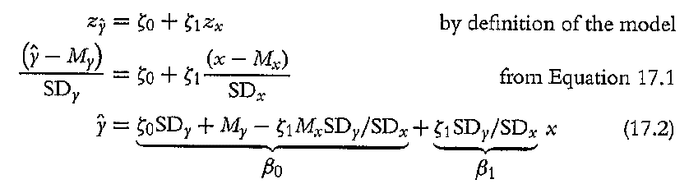
17. 2 Robust Linear Regression
8
Mean centering
Slide the axis
so that zero falls under the mean
→ The Slope changes without any big
changes on the intercept
→ Solve parameter-correlation problem(???)
Standardize data
Re-scaling the data relative to their mean(M )
and standard deviation(SD ):
Linear Regression using standardized data
0
0
ζ0 : the slope with the data
ζ1 : the intercept with the data

Slide 11

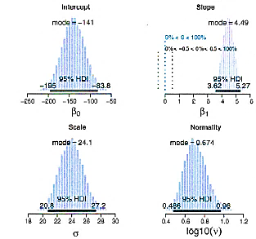
17. 2 Robust Linear Regression
9
Interpreting the posterior distribution
Compare N=30 regression and N=300 one
The slope, intercept and scale are about the same
The certainty of the estimate for N=300 is tighter than for N=30
The normality parameter for N=300 is bigger than for N=30
N=30
N=300

Slide 12
17. 3 Hierarchical Regression on Individuals Within Groups
10
Object
Data that each individual contributes multiple observations
ex.) Reading-ability scores of children across several years
Family income for different size of the family, for different regions
Assumption
Each individual is representative of the group
→ Every individual informs the estimate of the group slope and intercept
Get sharing of information across individuals
Goal
describe each individual with a linear regression
Estimate the typical slope and intercept of the group overall

Slide 13
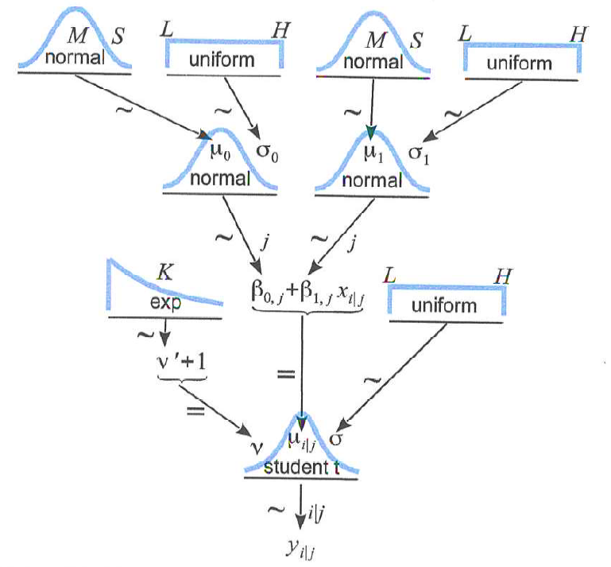
17. 3 Hierarchical Regression on Individuals Within Groups
11
The model and implementation in JAGS
Diagram
μ0 : typical slope of
the individuals
σ0 : variability of
those individual
slopes
μ1 : typical intercepts
of the individuals
σ1 : variability of
those individual
intercepts

Slide 14
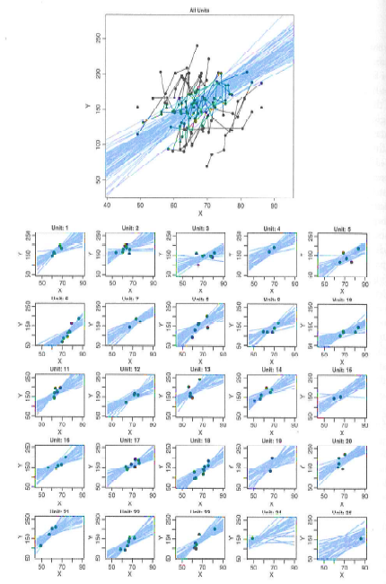
17. 3 Hierarchical Regression on Individuals Within Groups
12
The posterior distribution : Shrinkage and prediction
Overall : Clearly positive by integrating each individual slope
Individual : Notable shrinkage of the estimates of the individuals
The estimates are tightly
constrained by each data
Overall
Individual

Slide 15
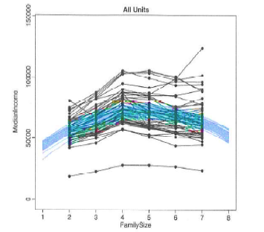
17. 4 Quadratic Trend and Weighted Data
13
Object
Data that y appears to have a nonlinear trend as x increases
Example
Family size and family income for each state in the U.S
Model
μi = b0 + b1 x + b2 x^2
If b2 = 0 → linear model
If |b2 | is big
→ nonlinear model is reasonable
Median income
Family size

Slide 16
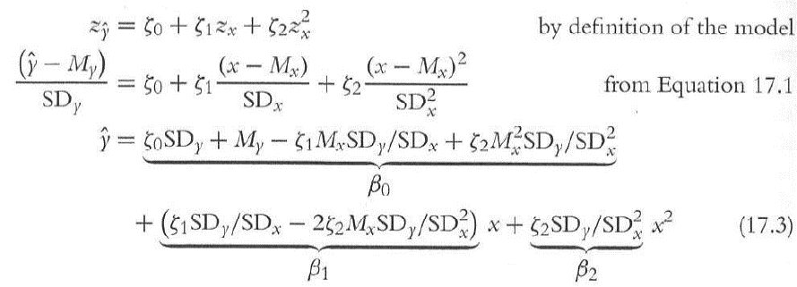
17. 4 Quadratic Trend and Weighted Data
14
Nonlinear Regression using standardized data
Weighting data
The data report the median income
based on different numbers of families at each size
→ every median has a different amount of sampling noise
Consider “margin of error”
If margin of error is high, noise parameter should be increased
If margin of error is small, noise parameter should be decreased
ζ0 , ζ1 , ζ2 : coefficients using the data

Slide 17
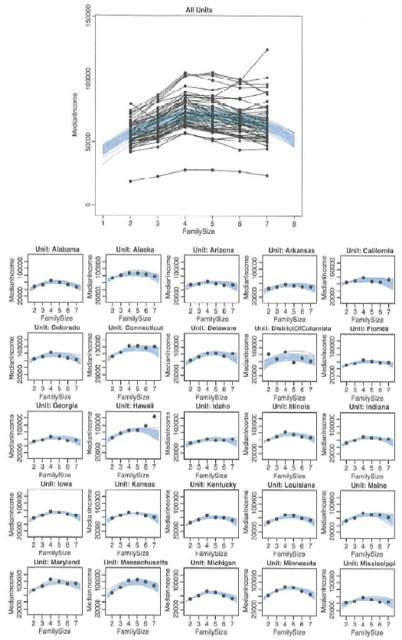
17. 4 Quadratic Trend and Weighted Data
15
Results and interpretation
The quadratic coefficient is -2200 ~ -1700
→ Nonlinear model is reasonable
Hawaii (the amount of data is not big)
→ The trend is upward, but the curve is downward curvature
→ Shrinkage from the group
California
→ a narrow spread at family size 2
a large spread at family size 7
→ Most of the data for large
family sizes have
large standard errors
Hawaii
California

Slide 18
17. 4 Quadratic Trend and Weighted Data
16
Further extensions
 | An example of family income and family size | Extensions
Trend | linear quadratic | higher-order polynomial Sinusoidal exponential
Noise distribution | a single lying noise for all individuals | vary among individuals
Distribution for parameters | normal distribution | t distribution
Considering Covariation | No | Use a multivariate normal prior on the intercept and slope

Slide 19
17. 5 Procedure and Perils for Expanding a Model
17
Posterior predictive check
Visualize the data and the posterior predictions
→ If the prediction doesn’t seem to fit the data, change the model
→ New model should be both meaningful and computationally tractable
Create a posterior predictive sampling distribution
→ measure of discrepancy between the predictions and the data
Ways to extend a model
Add a parameter
ex.) μi = β0 + β1 x → μi = β0 + β1 x + β2 x^2
You can check the validity of the model by considering β2
Try a completely different model
→ Compare models by Bayesian model comparison
“double dipping” : data are used to change the prior distribution

Slide 20
17. 5 Procedure and Perils for Expanding a Model
18
Steps to extend a JAGS or Stan model
Carefully specify the model with its new parameters
→ Draw a diagram
Be sure all the new parameters have sensible priors
Define initial values for all the new parameters
→ You can let JAGS initialize parameters automatically
Tell JAGS to track the new parameters
→ Stan automatically tracks
Modify the summary and graphics output to properly display the
extended model
→ You should write R code because graphics are displayed by R

Slide 21
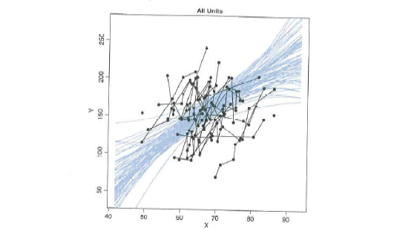
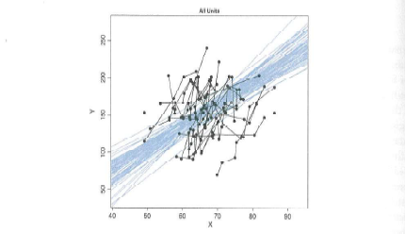
17. 5 Procedure and Perils for Expanding a Model
19
Perils of adding parameters
Increase in uncertainty of a parameter estimate
→ The curvature and slope trade-off strongly
→ Even if curvature is 0, the certainty of slope decreases
The one of the ways to solve the problem is standardizing the data
Quadratic trend
Linear trend

Slide 22
Contents
Overview of Chapter17
17.1 Simple Linear Regression
17.2 Robust Linear Regression
17.3 Hierarchical Regression on Individuals Within Groups
17.4 Quadratic Trend and Weighted Data
17.5 Procedure and Perils for Expanding a Model
1
2-3
4-9
10-12
13-16
17-19

