Slide 1
MINOR PROJECT
MADE UNDER THE GUIDANCE OF
MR.ANIL SINGH PARIHAR
PAWNESH KUMAR SINGH(DTU/2K14/CO/077)
RAJA KUMAR RANJAN(DTU/2K14/CO/092)
RAJIT MEENA(DTU/2K14/CO/094)
SIDDHARTH CHAUDHARY(DTU/2K14/CO/121)

Slide 2
IMAGE ENHANCEMENT USING IMAGE PROCESSING

Slide 3
CONTENTS
What is image enhancement?
Image enhancement techniques
Histogram Equalization
Bi-histogram equalization
Retinex method
Retinex image enhancement algorithm
Proposed System
Conclusion
References

Slide 4
What is image enhancement??
Process of improving perception of images for human vision and providing better input for automated image processing techniques.
Main objective of image enhancement is to change image attributes to make it suitable for a specific application or observer

Slide 5
Image Enhancement Techniques
Histogram Equalization
Bi-histogram equalization
Retinex equalization

Slide 6
Histogram equalization
Histogram of an image represents the relative frequency of occurrence of various gray levels in the image
Improves the visibility of an image by enhancing the difference in brightness of objects and their backgrounds
Flattens the histogram to occupy the entire range of gray levels values and thus improves the contrast of the image

Slide 7
For a given image X, the probability density function p(X_{k}) is defined as
p(X_{k}) = n^{k}/n
for k = 0, 1, …, L – 1, where n_{k} represents the number of times that the intensity level X_{k} appears in the input image X and L is the total number of intensity samples in the image.
The plot of n_{k} vs. X_{k} is known histogram of X. Based on the probability density
function, the cumulative density function is defined as
Define a transform function f(x) based on the cumulative density function as-
CDF as f(x)=X_{o} + (X_{L-1} -X_{o} ) c(x)
Then the output image of the Histogram Equalization, Y = {Y(u,v)}, can be expressed as
Y=f(X)

Slide 8
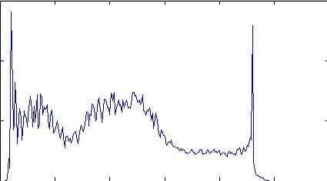
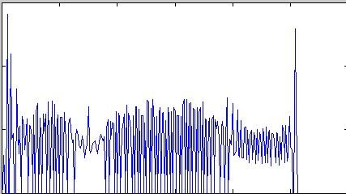
(a)
(b)
Contrast Enhancement using histogram equalization
(a) Histogram of unprocessed image
(b)Histogram of histogram – equalized image

Slide 9
(a)
(b)
Contrast Enhancement using histogram equalization
(a) Histogram of unprocessed image
(b)Histogram of histogram – equalized image

Slide 10
Performance of histogram equalization
Histogram equalization(HE) enhances the contrast of the image by the effect of expansion in the entire dynamic range.
HE also flattens a histogram. As per information theory, the entropy of source will be the maximum when the message has the property of uniform distribution.
Histogram equalization tends to combine gray levels of relatively low probability density, and results in decrease of entropy although such action tends to increase the contrast of an image.

Slide 11
BI-HISTOGRAM EQUALIZATION

Slide 12
This method was proposed to correct the problems of histogram equalization method. BBHE first separates the histogram of input image into two, dividing using its mean.
Thus, one has a range from minimum gray level to mean gray level and the other ranges from mean to the maximum gray level.
Next, it equalizes the two histograms independently.
It has been analyzed both mathematically and experimentally that this technique is capable to preserve the original brightness to a certain extent, better than histogram equalization

Slide 13
Let X_{m} denotes the mean of the image X and X_{m} ∈ {X₀, X₁, …, X_{L-1}}.
Based on the mean, the input image is divided into two sub-images X_{L} and X_{U} as
X=X_{L} U X_{U}
where X_{L} ={X(u,v) | X(u,v) ≤ X_{m} ∀ X(u,v) ∈ X}
X_{U} ={X(u,v) | X(u,v) ≥X_{m} ∀ X(u,v) ∈ X}
Thus, the sub-image X_{L} is composed of {X₀, X₁, …, X_{m}} and the other image X_{U} is composed of {X_{m+1}, X_{m+2}, …,X_{L-1}}.The respective probability density functions of the sub-images X_{L} and X_{U} as
pL(X_{k}) = n^{k}L / n_{L}
p_{U}(X_{k}) = n^{k}_{U} / n_{U}
where k = m+1, m+2, …, L-1, in which n^{k}_{L} and n^{k} _{U} represent the respective numbers of X_{k} in X_{L} and X_{U}, and n_{L} and n_{U} are the total number of samples in X_{L} and X_{U}, respectively.

Slide 14
Similarly, c_{L}(x) and c_{U}(x) are respective cumulative density functions for X_{L} and X_{U.} Note that c_{L} (X_{m}) = 1 and c_{U} (X_{L-1}) = 1 by definition.
Similar to the case of HE where a cumulative density function is used as a transform function, following transform functions are used to calculate equalized sub images:
f_{L}(x)= X_{o}+(X_{m}-X_{o}) c_{L}(x)
f_{U}(x)= X_{m+1}+(X_{L+1}-X_{m+1}) c_{U}(x)
Sub images are equalized independently and the composition of the resulting equalized sub-images constitute the output of BBHE. That is, the output image of BBHE, Y, is finally expressed as
Y ={Y(u,v)}
= f_{L}(x_{L}) ∪ f_{U}(x_{U} )

Slide 15
The input image X is equalized over the entire dynamic range (X₀, X _{L-1}) with the constraint that the sample less than the input mean are mapped to (X₀, X _{m}) and the samples greater than the mean are mapped to (X _{m+1}, X _{L-1}).
The preservation of mean intensity of input image indicates the brightness preserving capability of an algorithm. The output mean of the BBHE is a function of the input mean brightness X_{m}.
This fact clearly indicates that the BBHE preserves the brightness compared to the case of typical HE where output mean is always the middle gray level.

Slide 16
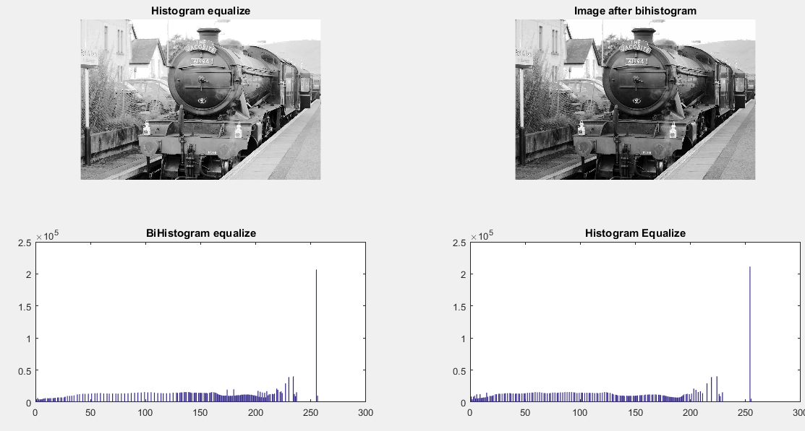

Slide 17
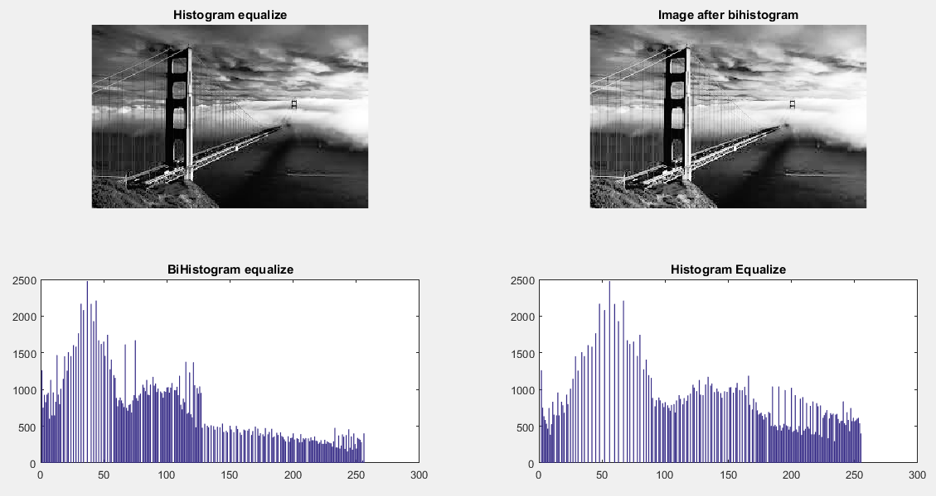

Slide 18
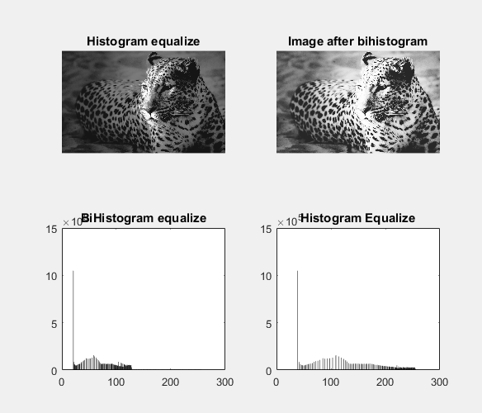

Slide 19
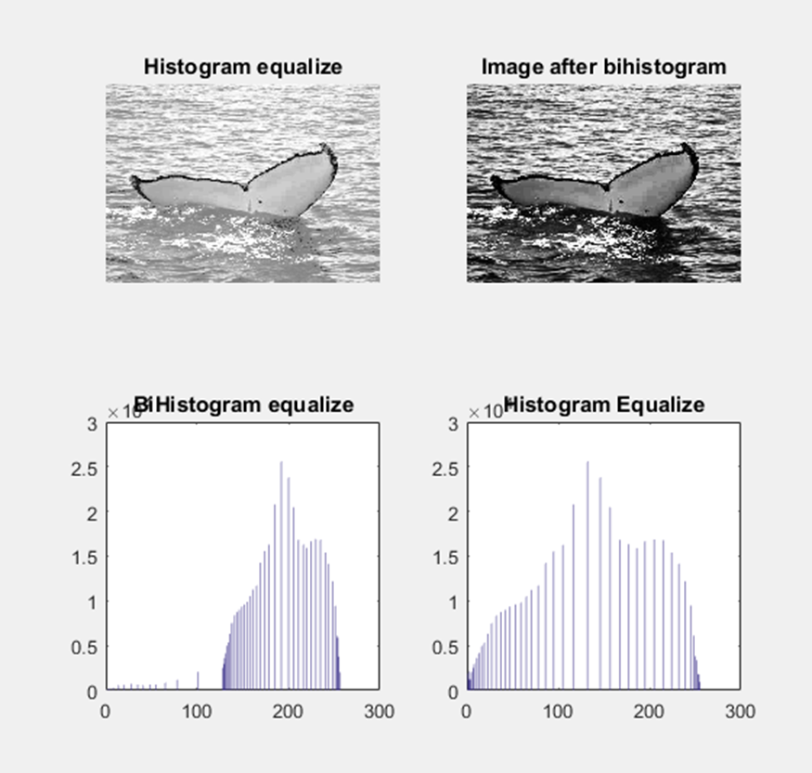

Slide 20
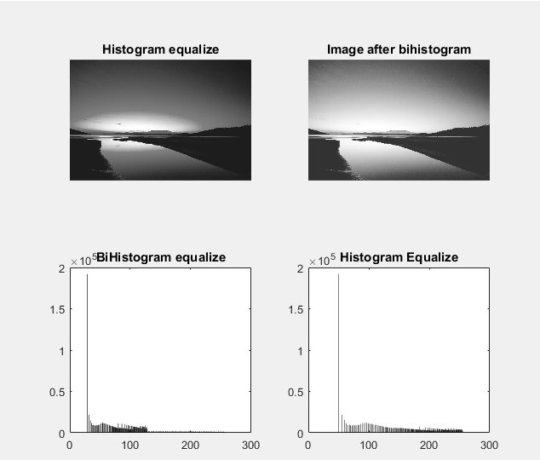

Slide 21
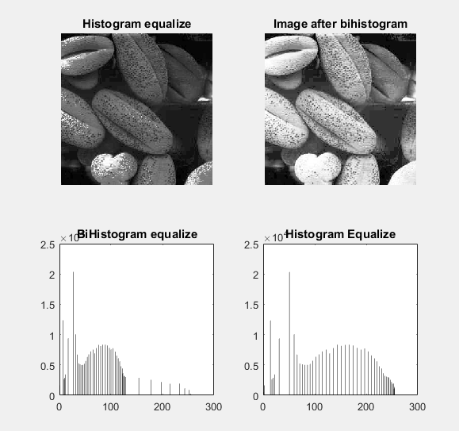

Slide 22
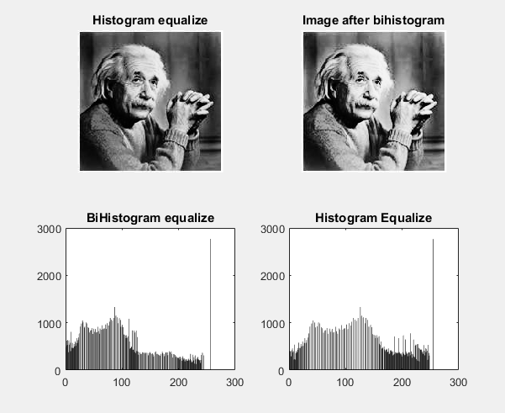

Slide 23
RETINEX METHOD

Slide 24
Retinex algorithm is actually an image enhancement algorithm based on illumination compensation method.
It explains the phenomena of colour constancy and contrast in which it is consider that perceived colors of objects are largely independent of the chromaticity of the light incident upon them.
These color constancy algorithms modify the RGB values at each pixel to give an estimate of the color sensation. Hence Retinex improves visual rendering of an image when lighting conditions are not good.

Slide 25
Besides digital photography, this algorithm is used to make the information in astronomical photos visible and detect, in medicine, poorly visible structures in X-rays or scanners.
It helps to achieve many features such as sharpening, color constancy processing and dynamic range compression

Slide 26
RETINEX IMAGE ENHANCEMENT ALGORITHM

Slide 27
The Retinex Image Enhancement Algorithm is an automatic image enhancement method that enhances a digital image in terms of dynamic range compression, color independence from the spectral distribution of the scene illuminant, and color/ lightness rendition.
The digital image enhanced by the Retinex Image Enhancement Algorithm is much closer to the scene perceived by the human visual system, under all kinds and levels of lighting variations, than the digital image enhanced by any other method.
Captured 2D image can be decomposED into two sub images-one depends on their reflectance properties of the surface of the imaged object while other depends on the illumination conditions

Slide 28
The enhanced image is obtained by combining the reflectance and the adjusted illumination. The naturalness of enhanced images can be preserved while details enhanced.
This method has good clarity on naturalness preservation and detail enhancement due to the illumination adjustment and precise computed reflectance.

Slide 29
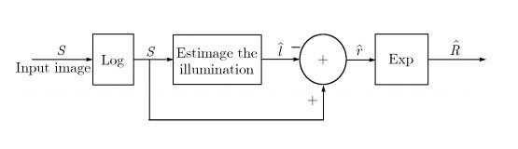
The Retinex image enhancement algorithm is an image enhancement method that enhances an image with dynamic range compression. It also provides color constancy. It gives a computational human vision model.
It deals separates two parameters-
At first the illumination information is estimated and then the reflectance is obtained from using division. It is based on the image formation model which is given by I (x, y) = L(x, y) r(x, y)
Where I is the input image, L is illumination and r is reflectance.

Slide 30
The image is first converted into the logarithmic domain in which multiplications and divisions are converted to additions and subtractions that makes the calculation simple.
The given centre pixel value is compared with the surrounding average pixel values to get the new pixel value.
The input value of the center surround functions is obtained by its centre input value and its neighborhood. An array of photoreceptor responses is there for each image location. This is given as input to the retinex algorithm which has the receptor class for each location in the image.

Slide 31
The algorithm calculates a series of paths. For computing each path, a starting pixel (x1) is first selected.Then a neighboring pixel (x2) is randomly selected. The difference of the logarithms of the sensor responses at the two positions is then calculated.
The position of pixel x2 is obtained by adding the previous step with the accumulator register which is given by: A(x2) =A(x2) +log(x2) −log(x1) (2) Where A(x2) is the accumulator registers for pixel (x2).
Counter register N(x2) for position x2 is incremented. All registers and counters are set to zero when the calculation starts.
The mathematical form of a Retinex is given by:
Ri (x, y) = log Ii (x, y) − log [F (x, y) ∗ Ii (x, y)],
Where I is the input image, R is the Retinex output image and F is the Gaussian filter (surround or kernel) which is given by:
F(x, y) =Kexp [−(x 2 +y 2 )/σ 2 ] Where K is a normalization factor

Slide 32
TYPES OF RETINEX ALGORITHMS
Single Scale Retinex algorithm (SSR)
Multiscale Retinex algorithm (MSR)
Multiscale Retinex with Color Restoration algorithm (MSRCR).

Slide 33
SINGLE SCALE RETINEX ALGORITHM(SSR)

Slide 34
SSR is the most basic method for Retinex algorithm. A low pass filter is applied on Ii (x, y) which is the input color image to estimate the illumination. This illuminations log signal is subtracted to get the output color image Ri(x,y).
It is given by Ri (x, y) = logIi (x, y) − log [F (x, y) ∗ Ii (x, y)] (6) Where i=1...S. Here, F (x, y) = K exp [−(x 2 + y 2 )/c2 ] is Surround Function, S is the number of spectral bands, c is surround constant or scale value and selection of K is such that ∫∫F(x,y) dx dy =1.
The log function in SSR is placed after the Gaussian surround function. A canonical gain offset is used as a post retinex signal processing

Slide 35
A single scale cannot simultaneously provide dynamic range compression and tonal rendition. The images are either locally or globally grayed out or suffered from color distortion due to violations of the gray world assumptions. These are the drawbacks of SSR.

Slide 36
MULTI SCALE RETINEX ALGORITHM(MSR)

Slide 37
Multi Scale Retinex (MSR) is developed to combine the strength of different surround spaces. The Gaussian filters of different sizes are used to process input image several times. The resulting images are weighted and summed to get output of MSR
It is given by Ri(x, y) = Wn logIi(x, y) - log [Fn(x, y) * Ii(x, y)] Where i=1, .S. Here, Wn represents the weight for the net scale, N is number of scales.
MSR provide color enhancement.
It also provides dynamic range compression and tonal rendition.
The halos are reduced by using MSR.

Slide 38
MSR output images violate gray world assumptions. So it suffers from greying out of the image, either globally or locally. This gives a washed out appearance. This is the main drawback of MSR algorithm.

Slide 39
MULTI SCALE RETINEX WITH COLOR RESTORATION ALGORITHM(MSRCR)

Slide 40
To restore color, MSR is modified by adding a color restoration function.
The color restoration factor is given by: αi (x, y) = f[Ii (x, y)/ N∑n=1In(x, y)].
It is the color restoration coefficient in the ith spectral band. The number of spectral bands is given by K.
MSRCR algorithm is given by,
Ri (x, y) = αi (x, y) K∑k=1Wk logIi (x, y) − log [Fk (x, y) ∗ Ii (x, y)].
MSR algorithm fails to meet Grey World Assumption. This problem can be removed by using color restoration method. Thus a color restoration factor (CRF) block is added with the MSR block to obtain the MSRCR algorithm

Slide 41
Main problems of MSRCR algorithm are the presence of halo artifacts at edges, graying out of low contrast areas and bad color rendition.
The MSRCR has halo artifacts in high contrast edges. The greying out effect of MSRCR is reduced by using adaptive filtering on luminance channel. At high contrast edges, these adaptive filter adapt the shape of the filter. In this way they reduces the greying out and halo artifacts.
But even then halo artifacts remains in images enhanced by using adaptive image enhancement methods. Halo artifacts in color images using, a fast edge preserving filter.But it reduces the contrast. The Gaussian surround function is modified in to reduce halo artifacts. But still it results in desaturation of color.

Slide 42
PROPOSED SYSTEM

Slide 43
The proposed system is a modification of multiscale scale retinex with color restoration algorithm. It reduces the halo artifacts and graying out of images of multiscale retinex with color restoration algorithm and increases clarity of images.
The improved MSRCR method uses multiscale retinex with color restoration algorithm and contrast limited adaptive histogram equalization(CLAHE).
The Contrast limited adaptive histogram equalization and the multiscale retinex with color restoration methods are applied to the low contrast image separately. The image fusion is used to combine their outputs. The output image obtained has more clarity than the output of existing multiscale retinex with color restoration algorithm.

Slide 44
CLAHE is Contrast Limited Adaptive Histogram Equalization. It operates on small regions of the image.These small regions are called tiles. The bilinear interpolation is used to combine these small regions of the image. By limiting the contrast in homogeneous areas, it reduced the noise in the images.
It enhances the contrast of these small regions of the image. The edge based color constancy can be attained by using CLAHE. It improves the local contrast of images. So graying out of the images and halo artifacts at the edges can be reduced using CLAHE.

Slide 45
CLAHE cannot be applied directly to the color channels in a color image as it changes the color balance of the image. So the image is first converted to the LAB color space. Then the algorithm is applied. After that the output image is converted back to the RGB color space.
The image fusion is used to combine the information in the two images into a single image which has more information than any of the two input images. Here image fusion block combines the output image of MSRCR and output image of CLAHE to produce single enhanced output image.
It merges the two images by wavelet decompositions.So the output image compare to the old MSRCR output image thus improving the clarity of the MSRCR output image.

Slide 46
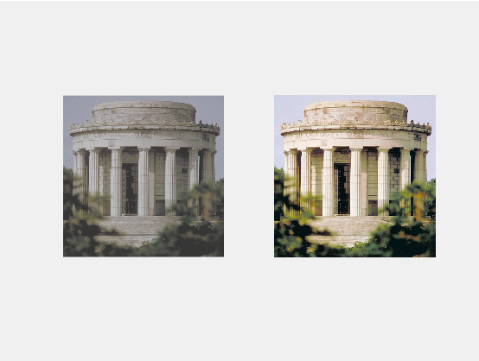

Slide 47
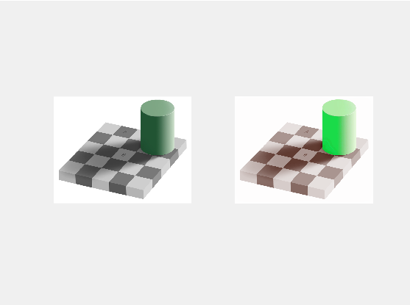

Slide 48
CONCLUSION
Histogram equalization method enhances the image’s contrast by normalizing the intensity distribution within the image in such a way that areas with very high intensity and very low intensity are equalized in terms of intensity distribution.
However , Histogram equalization technique does not preserve the mean brightness of the image.

Slide 49
So BBHE technique has been used which preserves the mean brightness of the image along with the contrast enhancement of the image.
However above two techniques don’t work on the coloured images because of the dynamic range of colours.
So the Retinex technique is used where the aim is to transform the visual characteristics of the digital image so that the rendition of the transformed image approaches that of the direct observation of scenes. Retinex is just the computerized form of the human eye visual system.
Here emphasis is placed on increasing the local contrast in the dark zones of images of wide dynamic range scenes.

Slide 50
REFERENCES
[1] Yong-Tae Kim, “Contrast Enhancement Using Brightness Preserving Bi- Histogram Equalization,” IEEE Trans Consumer Electronics, vol. 43, no. 1, pp. 1-8, Feb. 1997.
[2] E. H. Land and J. McCann, “Lightness and retinex theory,” J. Opt. Soc. Amer., vol. 61, no. 1, pp. 1–11, Jan 1971.
[3] E. H. Land, “The Retinex theory of colour vision,” Scientific American, vol. 237, no. 6, pp. 108–128, Dec 1977.
[4] Zia-ur Rahman , Daniel J. Jobson, and Glenn Woodell. “ Retinex processing for automatic image enhancement.” Journal of Electronic Imaging 13(1): 100-110 (January 2004).
[5] L. Lei, Y. Zhou, and J. Li, “An investigation of retinex algorithms for image enhancement,” Journal of Electronics (China), vol. 24, no. 5, pp. 696–700, 2007.
[6] Z. ur Rahman and G. A. Woodell, “A multiscale retinex for bridging the gap between color images and the human observation of scenes,” IEEE Transactions on Image Processing, vol. 6, pp. 965– 976, 1997.
[7] D. Jobson and G. Rahman, Woodell, “Properties and performance of a center / surround retinex,” IEEE Transactions on Image Processing, vol. 6, no. 3, pp. 451–462, Mar 1997.
[8]. R. C. Gonzalez, R. E. Woods, Digital image processing (second edition), Publishing House of Electronics Industry, Beijing, China, 2007.
[9]. Ana Bel´en Petro, Catalina Sbert, Jean-Michel Morel

