Slide 1

Smart Rotation System
Team Member
Lei, jiewei (EMC)
Wang, yifan (DMC)
Liu, xiu (AMC)
He, zhenqian (PMC)
Notes:
功能截图

Slide 2



Motivation – Rotation Process
01
02
03
04
Upload
Learn
Interview
Match

Slide 3



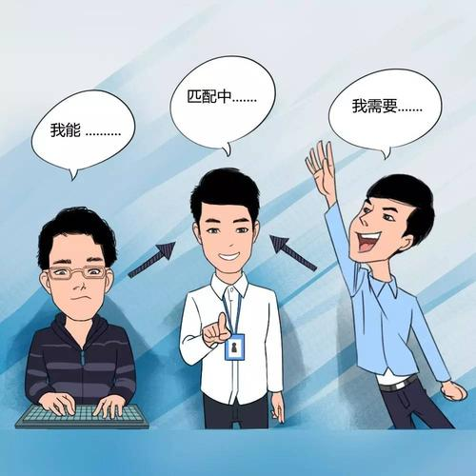
Motivation-Current issue
Inefficient file management
Difficulty in finding information
01
02
03
04
Which team/analyst is suitable ？
Manual matching inefficiency
Notes:
1.简历，职位描述 管理困难
2.信息分散，数据较多 导致找到想要的analyst和team的信息困难
3.Analyst不知道我适合去哪个组，learder不知道什么样的analyst适合我们组
4. 人工匹配过程漫长

Slide 4







System Outline
Role
Function
Profile
Placement
Program manager
Manager
Recommend
Analyst
Match
Notes:
三种角色：analyst，teamleader，rotation manager
三种核心功能：文档管理（准备），查询、推荐（了解），匹配（行动）

Slide 5
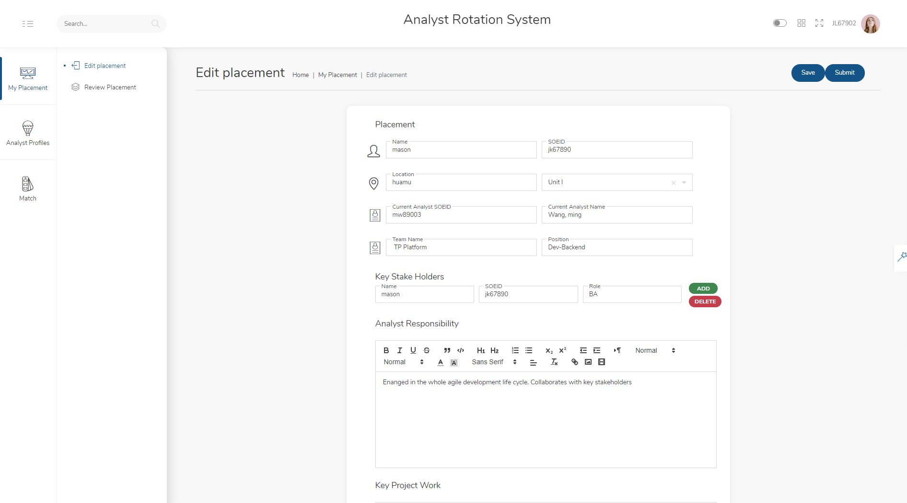
Manager-Edit Job Description
Notes:
功能截图

Slide 6
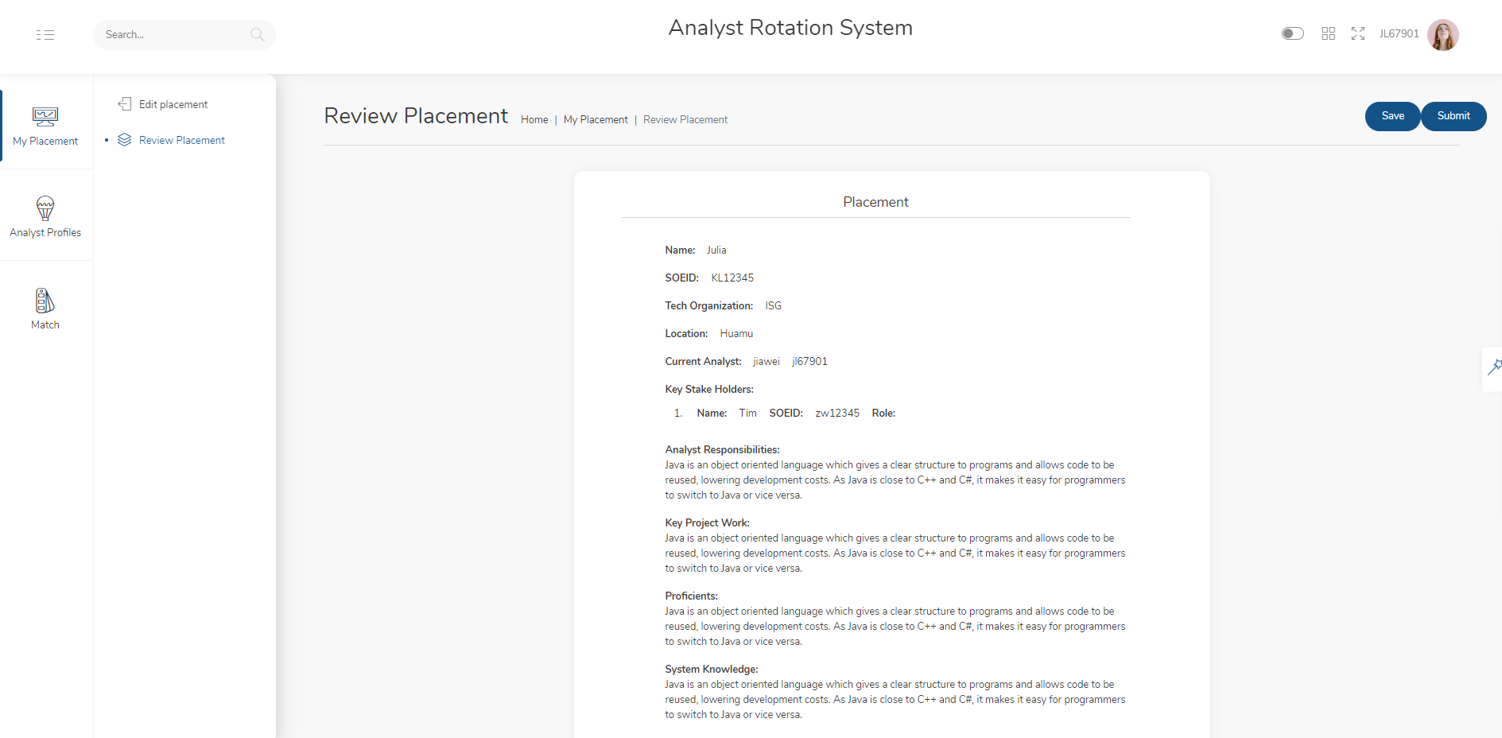
Manager-Review Job Description
Notes:
功能截图

Slide 7
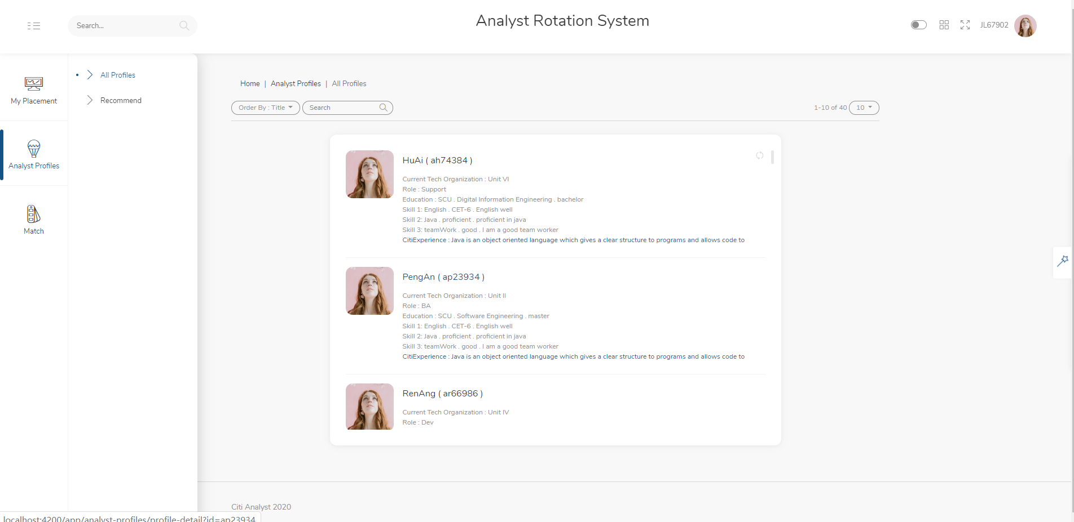
Manager-Review Profiles
Notes:
功能截图

Slide 8
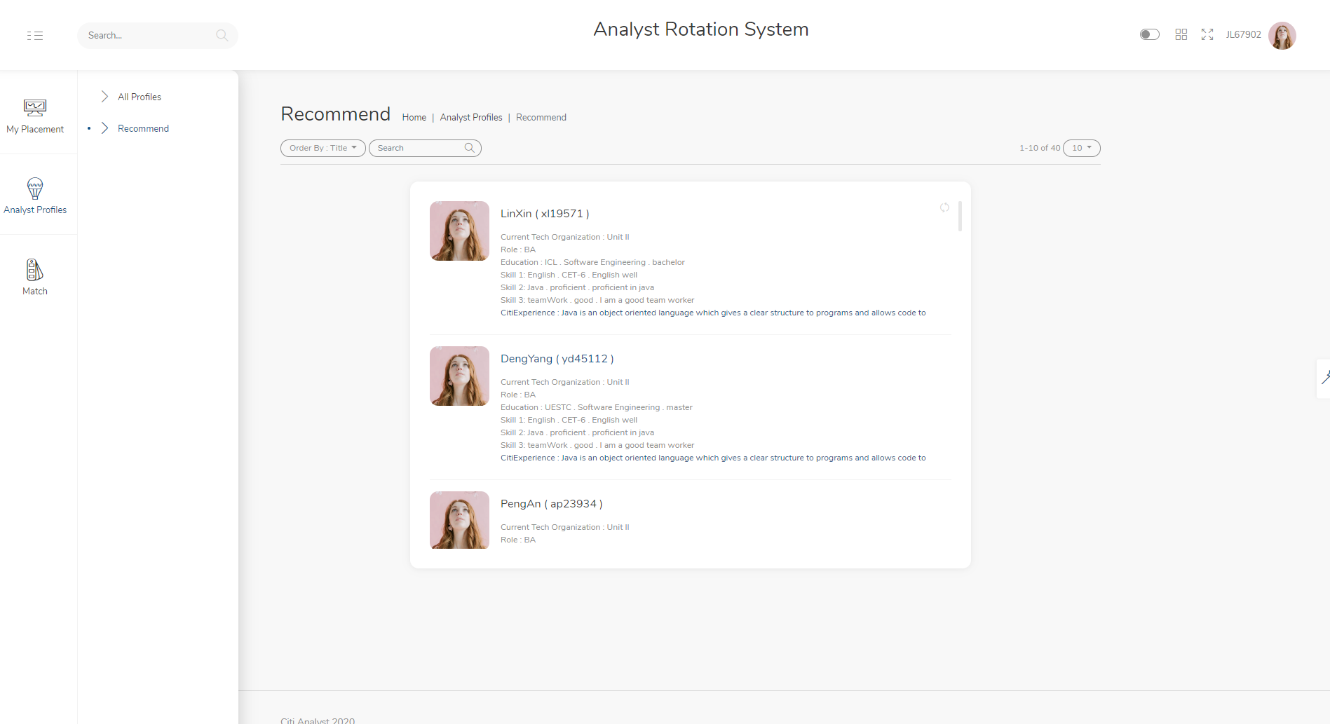
Manager-Review Recommend Result
Notes:
功能截图

Slide 9
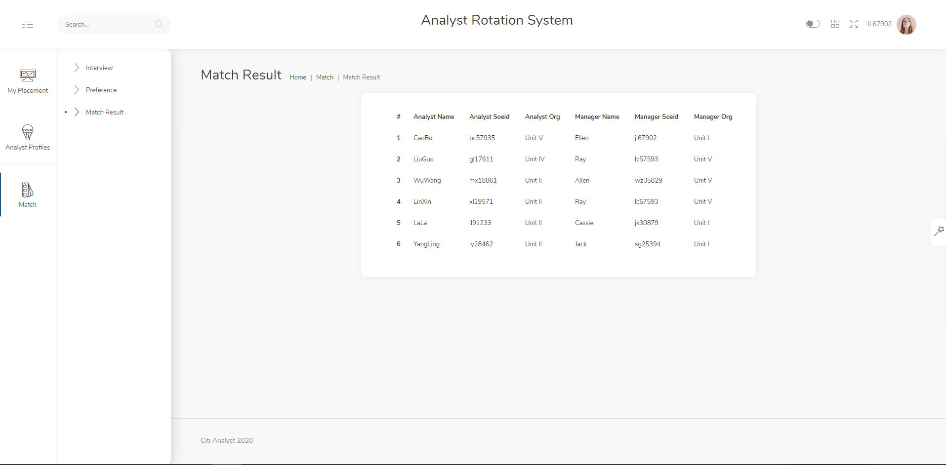
Manager-Match
Notes:
功能截图

Slide 10
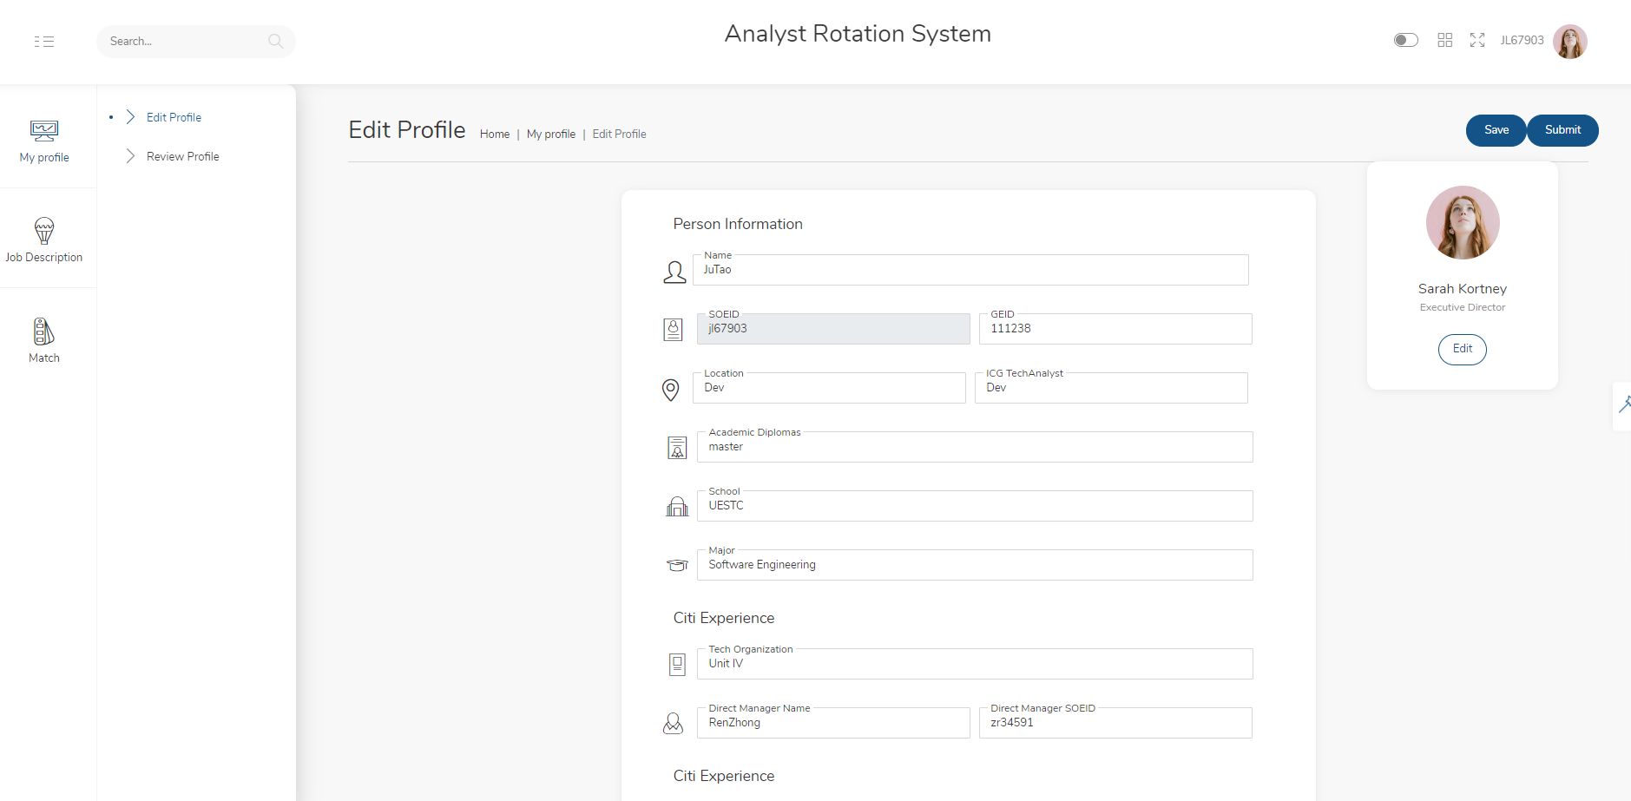
Analyst-edit profile
Notes:
功能截图

Slide 11
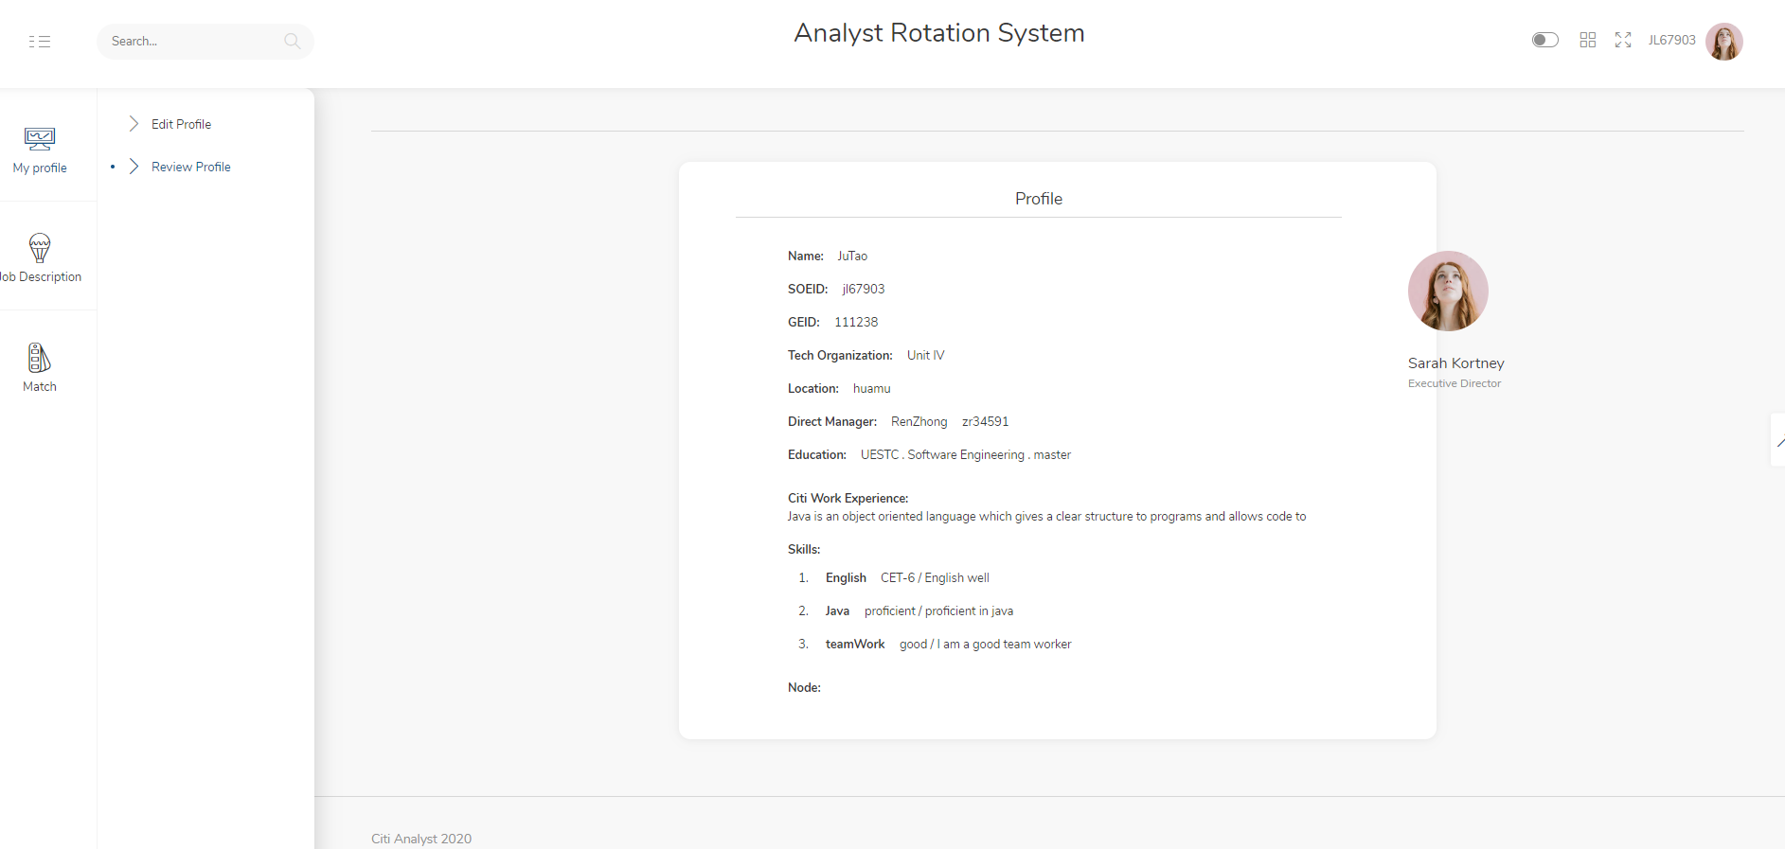
Analyst-review profile
Notes:
功能截图

Slide 12
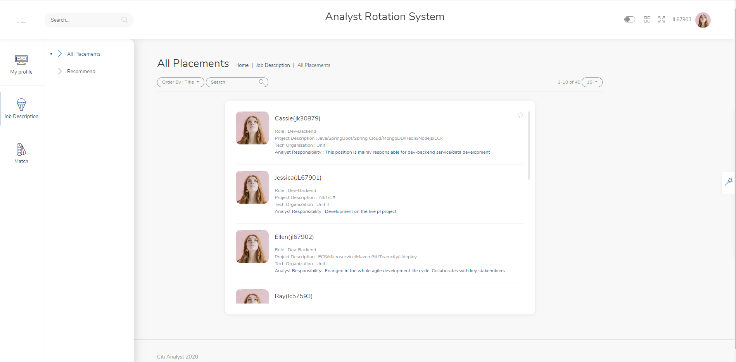
Analyst-review Job Description
Notes:
功能截图

Slide 13
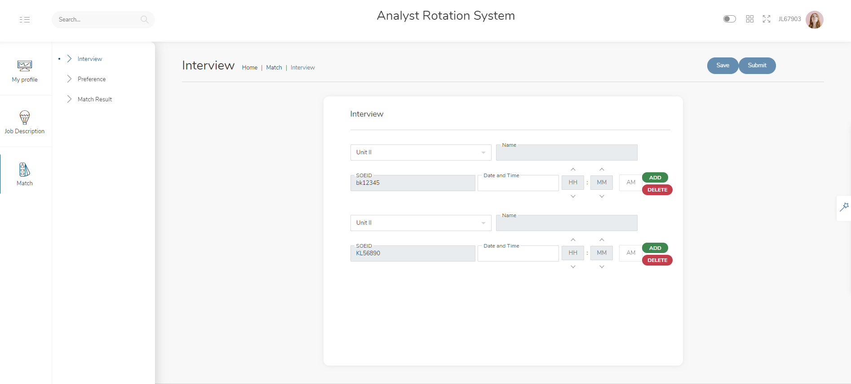
Analyst-Submit Interview Schedule
Notes:
功能截图

Slide 14
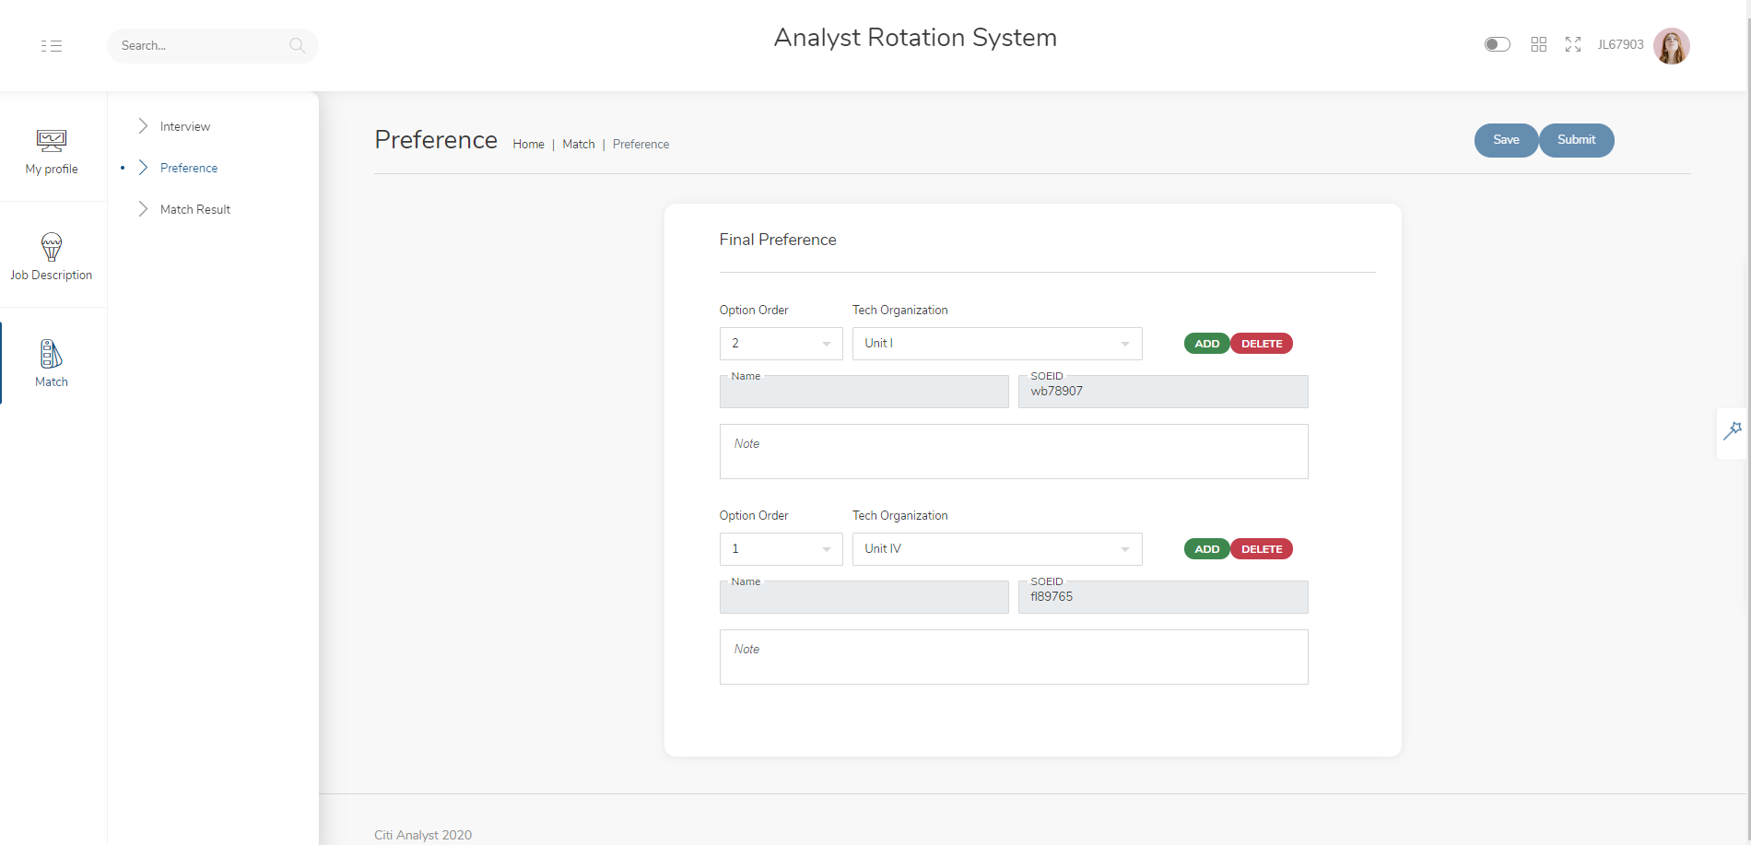
Analyst-Submit Preference
Notes:
功能截图

Slide 15
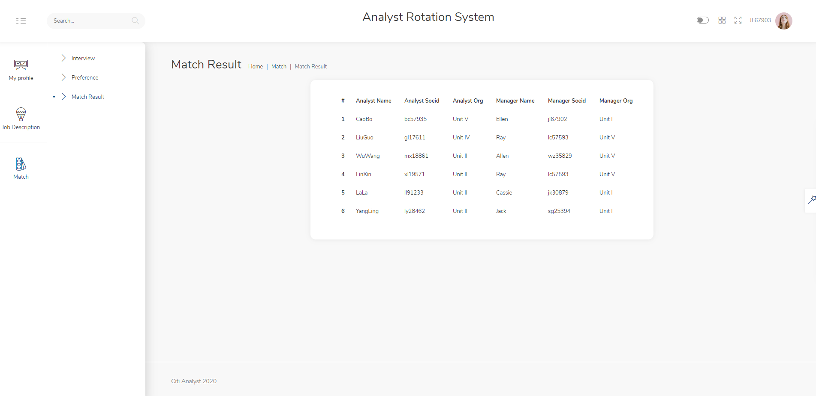
Analyst-Match Result
Notes:
功能截图

Slide 16
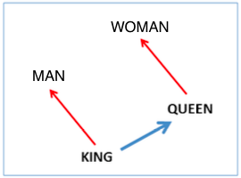
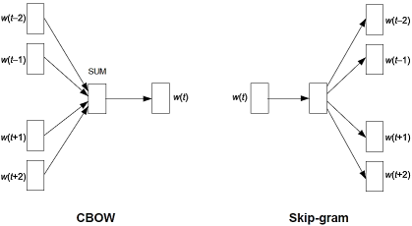
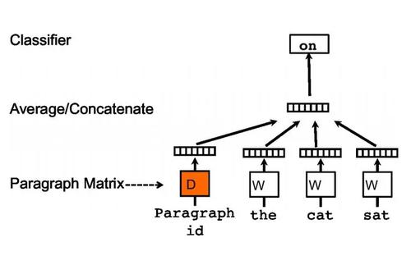
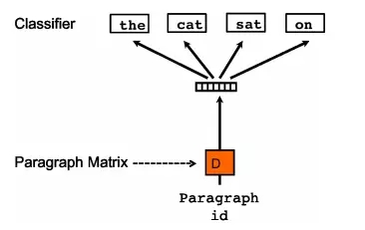
Recommendation Algorithm
Word2Vec
Doc2Vec
train model

Slide 17
Recommendation Algorithm
Corpus
Internet
Scrapy
Pre-train
Doc2Vec
Model
Technology Skills
Soft Skills
Language Skills
Convert to Doc Vector
Profile
Experience in Citi
Cal_Similarity
Weighted Hybrid
Score
Somewhat Proficient
Highly Proficient
General Proficient
Placement
Cal_Overlap
Responsibility
System Knowledge
Convert to Doc Vector

Slide 18
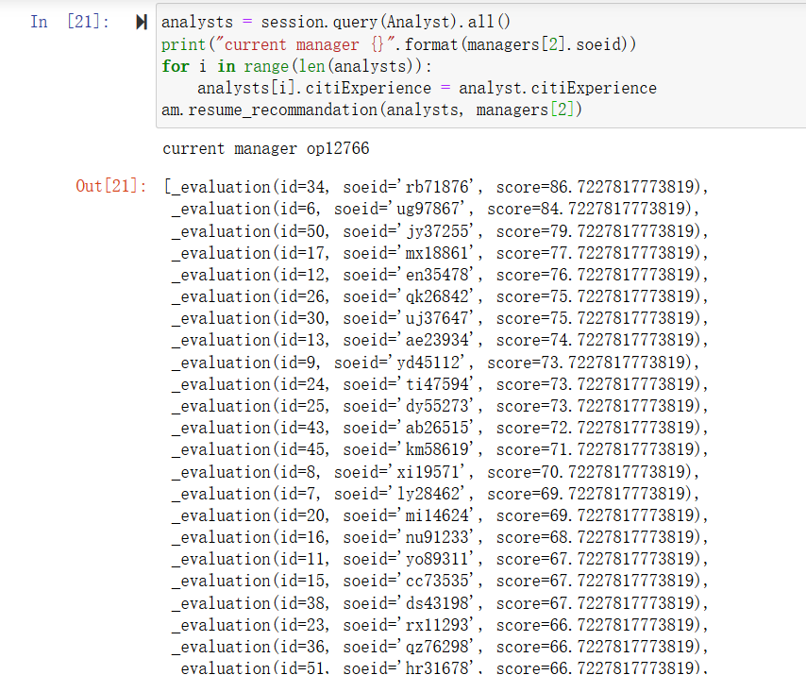
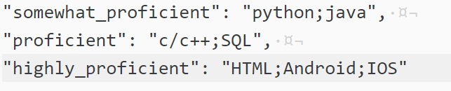
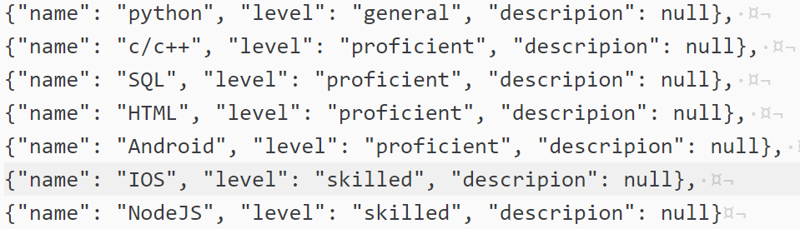
Recommendation Algorithm
Demo Presentation
SoeId:op12766
Compare
SoeId: rb71876

Slide 19
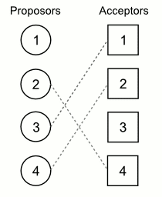
Match Algorithm
Stable Marriage Algorithm
Problem Description:
Each Man or Woman has his own ranking for his lovers, how to guarantee everyone find the most appropriate lover?
Algorithm Description
Every Round, if there is no single man or woman, ending the algorithm.
First Round,
  Every Single man proposes to his top ranking
  Woman been proposed can
    accept, if the man is her top ranking
    Reject, otherwise
    If accepted, two people have engaged; otherwise, they still stay single
Other Rounds,
  Every Single man still proposes to his later ranking, whatever the woman has engaged or not.
  Woman been proposed can
    accept, If not engaged or although has engaged but the proposer has better ranking on her list.

Slide 20
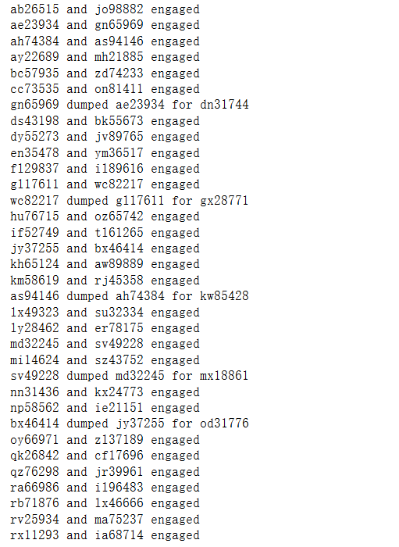
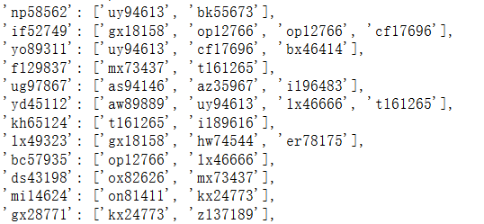
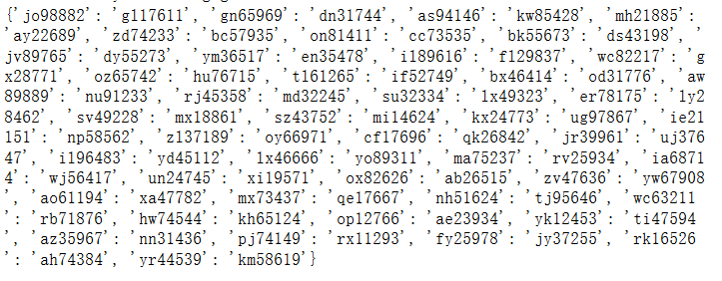
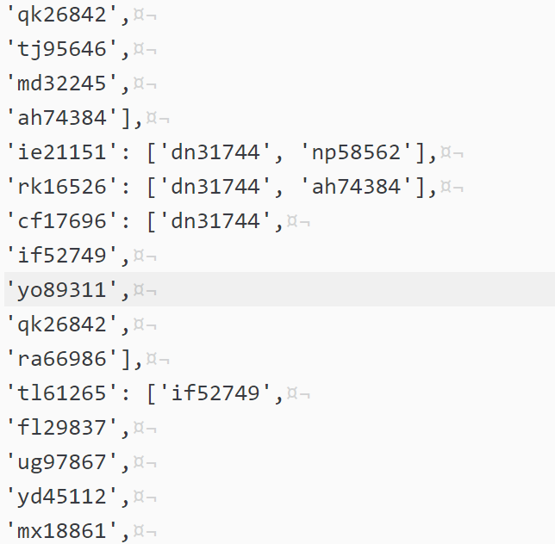
Match Algorithm
Analyst Rank
Manager Rank

Slide 21





Forward
Tuning
UI / Performance
Analyst Transfer
Knowledge Document
Leader Upload
Interview Feedback

Slide 22
THANK YOU ！
Notes:
功能截图

