Slide 1

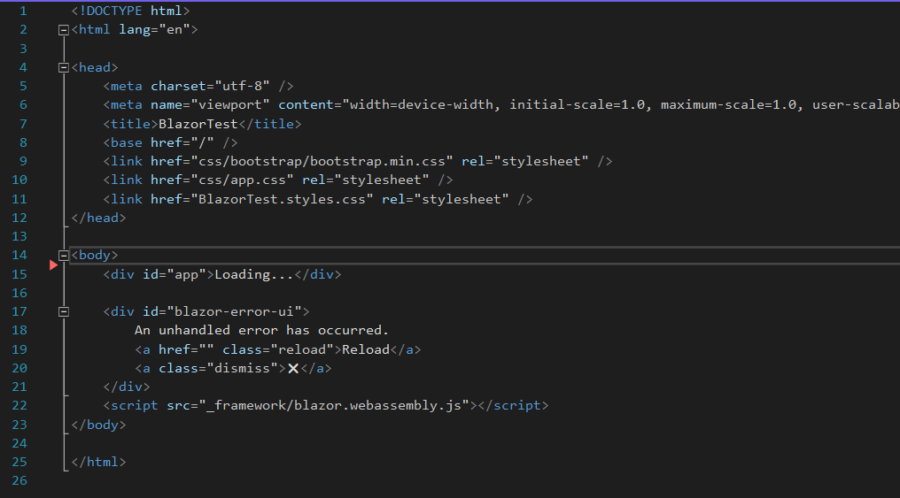
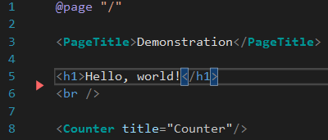
Introduction to Microsoft Blazor
What is Blazor?
Blazor is an ASP.NET web application that lets you write client-side code using C#.
vs
HTML
Blazor

Slide 2



Self Introduction
Computer Science B.S. from Lock Haven University
I studied mobile application and game development
I have worked two corporate jobs as a
.NET web developer and work as a
freelance web developer
My dog, Piper!

Slide 3
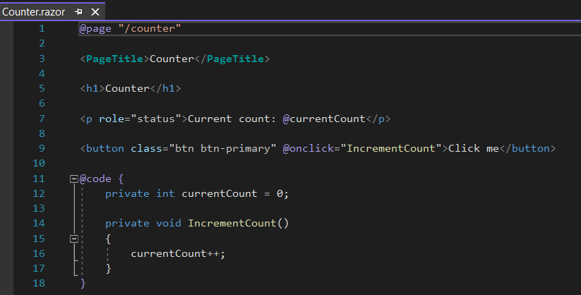
What is Blazor?
Pieces of UI are called components.
There can be more than one component per page.
Blazor takes more of a plug and play approach towards web development.
Pieces of UI are called components.
There can be more than one component per page.
Blazor takes more of a plug and play approach towards web development.

Slide 4
Blazor WebAssembly
Blazor WebAssembly¹ (WASM) is a single-page application (SPA) framework.
  C# and Razor code is compiled and downloaded by the browser.
  Page loading is significantly faster.
  If you have a larger web app (payload size), it will take longer for the browser to initially download.
  Single-threaded.
¹ WebAssembly is a binary instruction format for a stack-based virtual machine. Designed as a portable compilation target for
programming languages, enabling deployment on the web for client and server applications.

Slide 5
Blazor Server
Blazor Server hosts the components on the server
  UI updates are handled over a connection to the server.
  All execution happens on the server.
  The server initially prerenders the page to HTML which is sent to the client.
    This is more secure, as no .NET/C# code/assemblies are sent to the client.
  No offline support.

Slide 6

Quiz Time!
Navigate to this website to take the small quiz!
https://nicholaspage.net/
The quiz is 5 questions! Good luck!

Slide 7
Wrap-Up
Blazor is not the ultimate development for web development.
Blazor is the definitive C#/.NET solution for SPAs or always-online web development.
All code and this presentation can be found on my public GitHub repo: https://github.com/wheat32/BlazorTest

