Slide 1
Exploring Correlates of Age and Religion
Ian Reucroft
1/7/2018

Slide 2
Creating new columns
Curious about relations involving the following features:
Number of essays left blank
Checked for NaN entries in essay columns, then summed those along the row
essay_cols = ["essay0","essay1","essay2","essay3","essay4","essay5","essay6","essay7","essay8","essay9"]
df['blank_essay_count'] = df[essay_cols].isnull().sum(axis=1)
Length of Essay 4 (Favorite books, TV shows, movies)
Split essay4 strings where space occurred, then counted number of items
df['essay4_len'] = df.essay4.str.split().str.len()
Number of times “family” is mentioned in Essay 5 (Things you could not live without)
Counted wherever the string “family” occurred in essay5
df['essay5_family'] = [df.essay5[i].count('family') for i in range(len(df.essay5))]

Slide 3
Creating new columns
Other categorical data were converted to a numerical form by assigning each possible answer to a number, e.g.
drugs_map = {'never': 0, 'sometimes': 1, 'often': 2}
df['drugs_code'] = df.drugs.map(drugs_map)

Slide 4
Exploring the dataset
Do any of the features of interest correlate with age or religion?

Slide 5
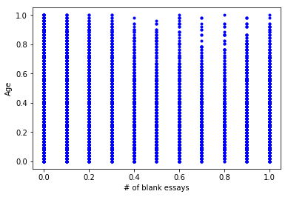
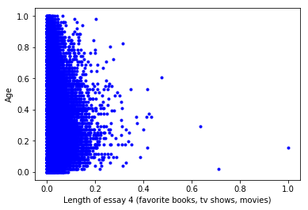
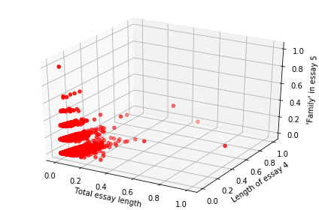
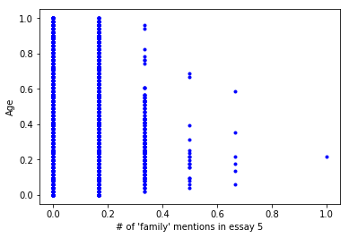
Relation to age? Grouping among 3 features?
Lower number of higher age individuals who leave essays blank, write long entries for essay 4, and mention “family” multiple times in essay 5
Possible clustering when looking at the 3 features pictured in red (mostly just due to the small number of discrete values at play)

Slide 6
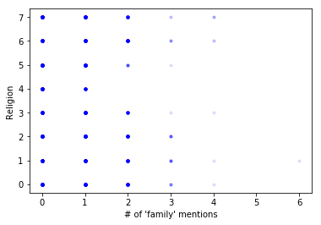
Relation to religion?
Individuals of certain religious classifications mention “family” fewer times than others.

Slide 7
Questions
Given the observed trends:
Can age be predicted with number of blank responses, essay 4 length, and number of “family” mentions in essay 5?
Can religion be predicted with some combination of factors potentially associated with religions? (e.g. abstaining from drinking and drugs, being more likely or less likely to mention family as something they can’t live without)

Slide 8
REGRESSION APPROACHES
 | Multiple Linear Regression | KNN Regression
Time to fit (s) | 0.051 | 0.140
Time to predict (s) | 0.011 | 0.062
Validation Set, R² | 0.019 | 0.918
Prediction/Test Set, R² | 0.017 | -0.188

Slide 9
REGRESSION APPROACHES
On the same dataset, MLR displayed significantly better runtime for fitting and predicting as compared to KNNR on average
MLR resulted in a poor fit for the training data as well as the test data
Individual age cannot reliably be predicted from these 3 features using that model
KNN regression produced good fit to the training data, but poor results when predicting age from the test data
Possible overfitting to the training data

Slide 10
CLASSIFICATION APPROACHES
Predicting religion using:
Body type
Drug use
Drinking
Sex (M or F)
Total length of essays
Number of blank essays
Length of essay 4 (favorite books, TV shows, movies)
Number of times “family” mentioned in essay 5 (things you couldn’t live without)
Age

Slide 11
Religious Classifications
Simplified to only the main religious category, ignoring how strongly the individual subscribed to the belief
'other’ : 0
'christianity’ : 1
'catholicism’ : 2
'judaism’ : 3
'islam’ : 4
'buddhism’ : 5
'agnosticism’ : 6
'atheism’ : 7

Slide 12
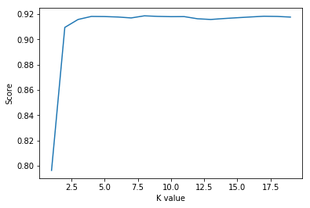
CLASSIFICATION APPROACHES Choosing best K for KNN
Chose K = 8, since accuracy already plateaued by that point, and there are 8 religious classifications in the data

Slide 13
CLASSIFICATION APPROACHES Runtime
 | Support Vector Machine | K-Nearest Neighbors
Time to fit (s) | 36.805 | 0.219
Time to predict (s) | 0.062 | 0.375
SVM takes longer to fit, but then predicts relatively quickly compared to KNN

Slide 14
CLASSIFICATION APPROACHES Accuracy
 | Support Vector Machine | K-Nearest Neighbors
Training/Validation Set | 0.213 | 0.406
Prediction/Test Set | 0.208 | 0.246
Though KNN yielded better fit to the training set, both KNN and SVM had relatively low accuracy when presented with the test set

Slide 15
CLASSIFICATION APPROACHES Precision
 | SVM (Validation) | KNN (Validation) | SVM (Test) | KNN (Test)
0 : Other | 0.361 | 0.387 | 0.667 | 0.261
1 : Christianity | 0 | 0.386 | 0 | 0.247
2 : Catholicism | 0 | 0.392 | 0 | 0.212
3 : Judaism | 0 | 0.339 | 0 | 0.095
4 : Islam | 0 | 0.800 | 0 | 0
5 : Buddhism | 0 | 0.337 | 0 | 0.063
6 : Agnosticism | 0.213 | 0.444 | 0.213 | 0.264
7 : Atheism | 0 | 0.457 | 0 | 0.263
Precision measures how many “positive” responses were true positive responses vs. false positive responses.
SVM model performed poorly with respect to most categories, but was able to correctly identify individuals labeled as “Other” in the test set notably more than any other category.
KNN model produced variable but mostly unremarkable results. It could correctly identify individuals whose religion was “Islam” in the training set but was performed poorly at labeling such individuals in the test set. This could indicate overfitting.

Slide 16
CLASSIFICATION APPROACHES Recall
 | SVM (Validation) | KNN (Validation) | SVM (Test) | KNN (Test)
0 : Other | 0.003 | 0.598 | 0.004 | 0.400
1 : Christianity | 0 | 0.495 | 0 | 0.305
2 : Catholicism | 0 | 0.342 | 0 | 0.191
3 : Judaism | 0 | 0.116 | 0 | 0.036
4 : Islam | 0 | 0.044 | 0 | 0
5 : Buddhism | 0 | 0.072 | 0 | 0.012
6 : Agnosticism | 0.999 | 0.429 | 1 | 0.263
7 : Atheism | 0 | 0.342 | 0 | 0.184
Recall measures the proportion of correct “positive” classifications over the total number of “positive” items in the set.
SVM model was very good at identifying individuals labeled as Agnostic in both the training and test set, mislabeling very few of these samples. However it was very poor at identifying any other classification
KNN model produced variable but mostly unremarkable results. Though it succeeded in identifying some groups over others, for most of the religions it was not significantly better than chance.

Slide 17
Conclusion and next steps
The various models demonstrated some ability to pick out certain categories (e.g. SVM identified Agnostic individuals very well), but mostly were only somewhat better than or worse than chance.
MLR took longer to train than KNN regression, but KNNR produced predictions more quickly
SVM took much longer to train but produced predictions much faster than KNN
The low effectiveness of these classifiers may at least in part be due to overfitting (in the cases where the fit to the training data was excellent but the ability to predict was poor)
A future step may be to link multiple layers of perceptrons and train that network on the data used here
Other data that may be useful would be other forms of numerical data
Weight (in lbs/kgs, as opposed to self-reported description)
# of times attended religious observance this year
# of pets owned
Etc.

