Slide 1
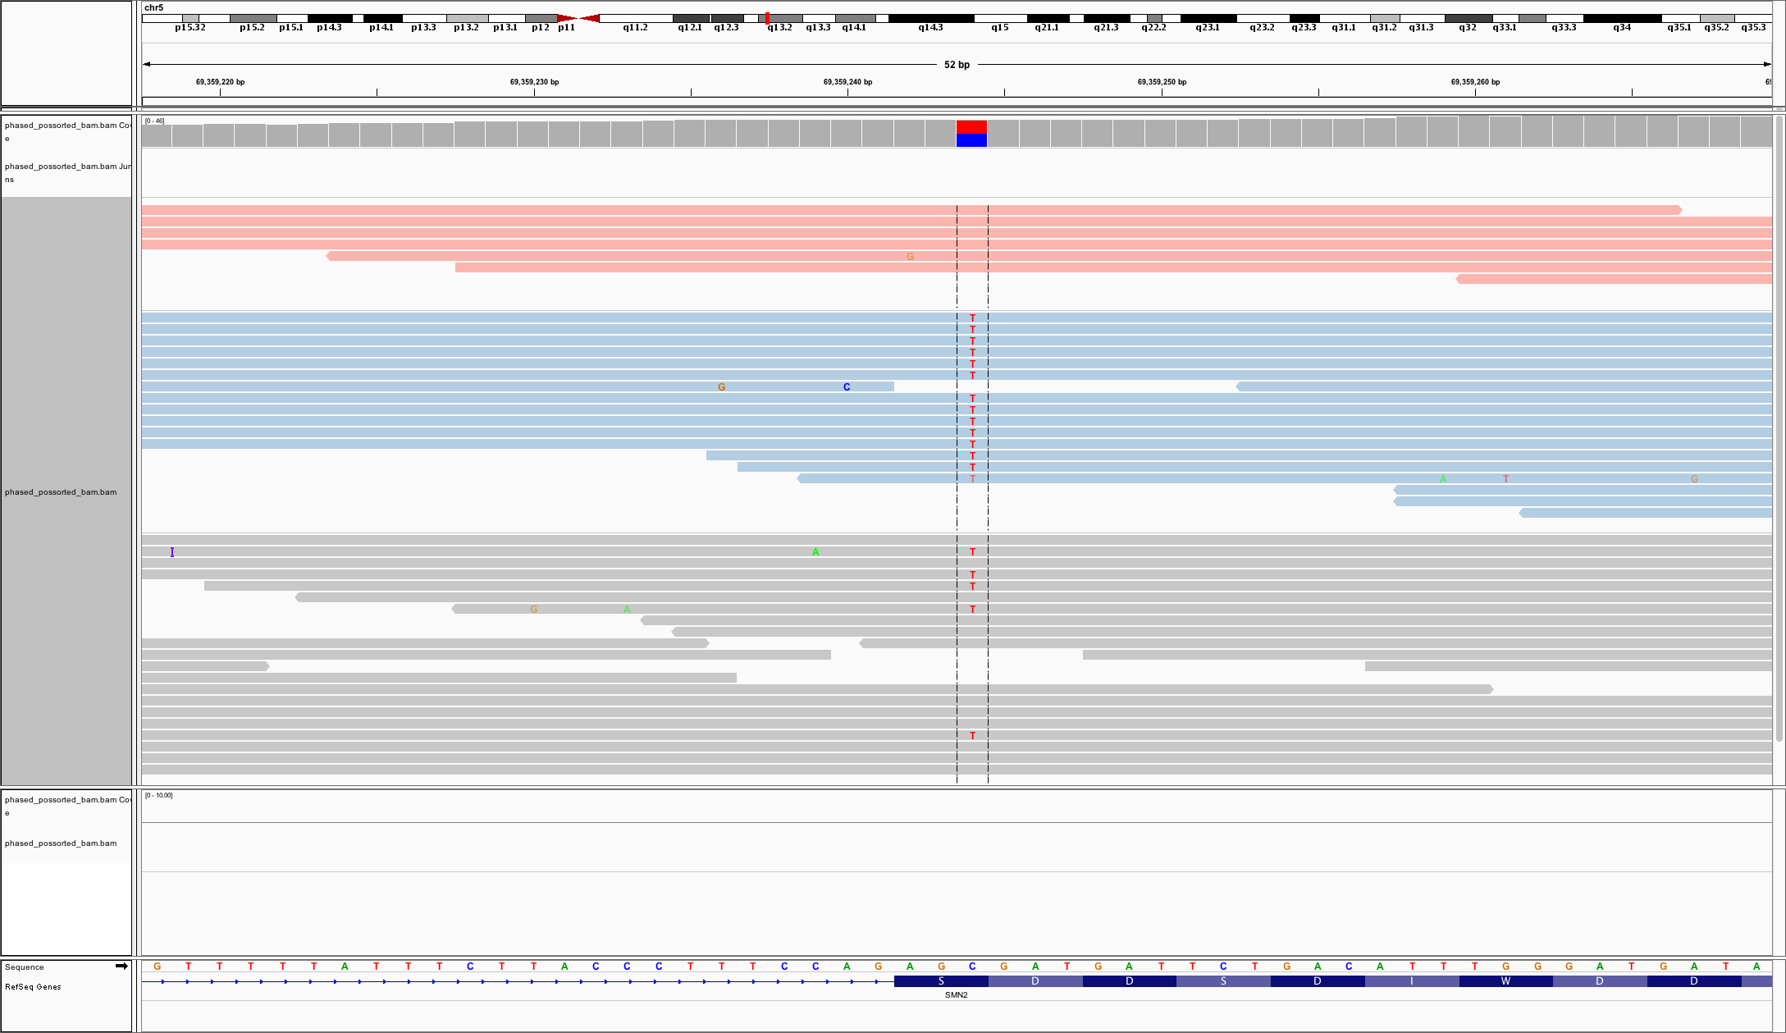
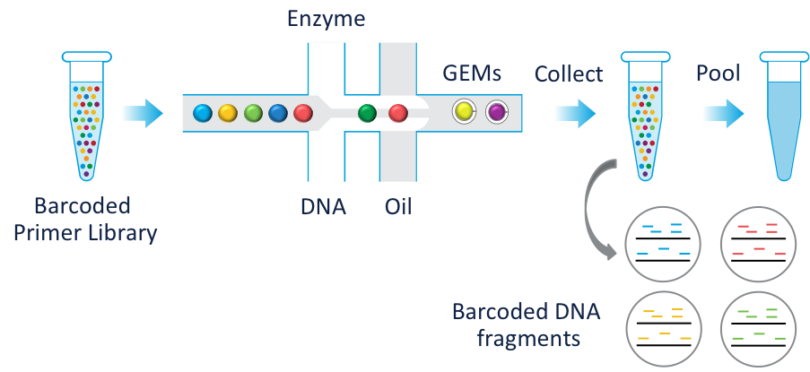

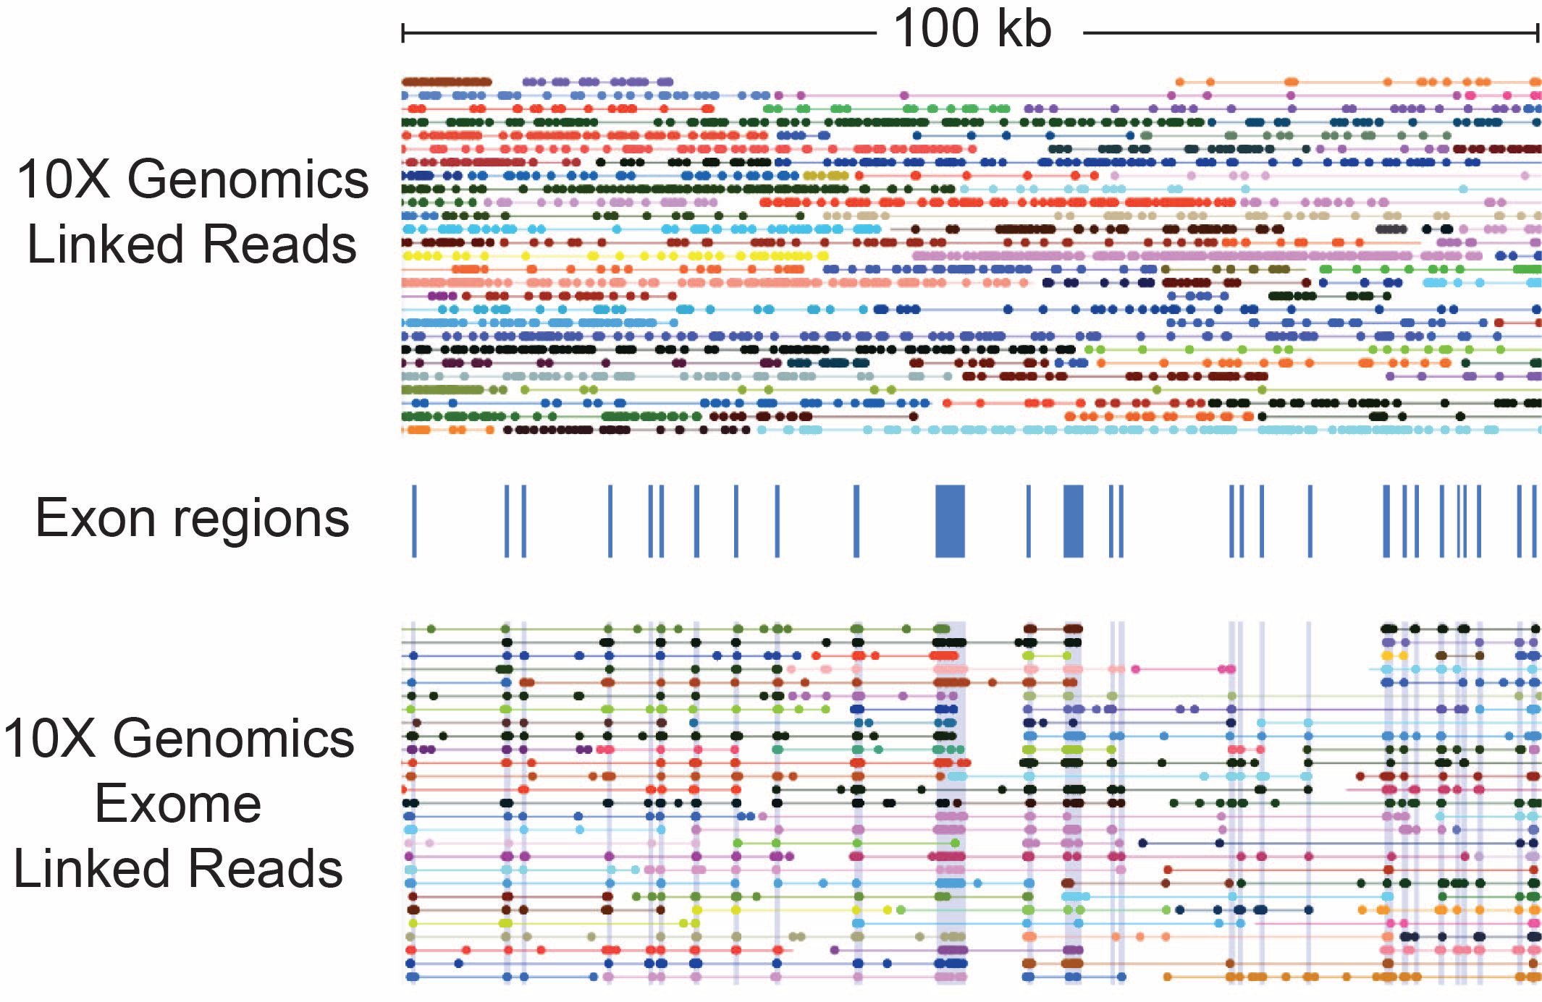
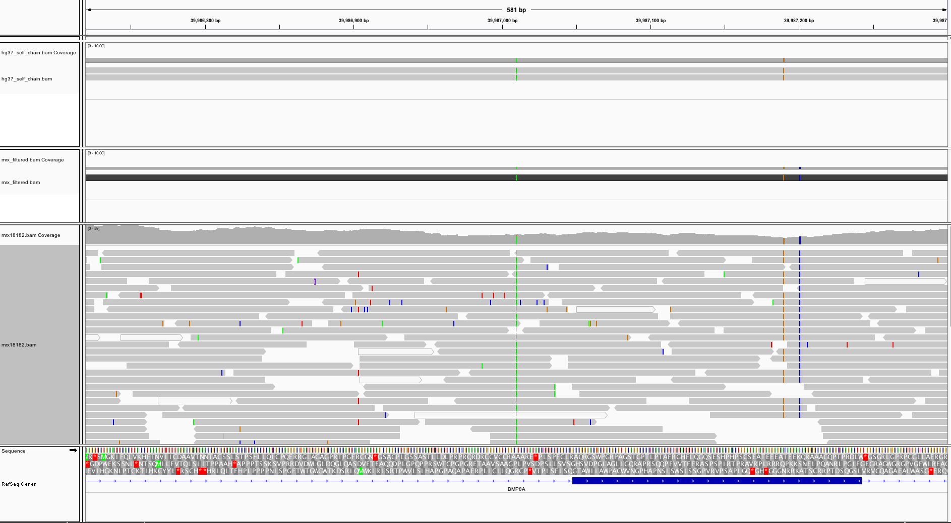
Alignment and Variant Calling in Segmental Duplications
with Linked-Read Data
Haynes Heaton¹, Patrick Marks¹, Matt Sooknah¹, Sofia Kyriazopoulou-Panagiotopoulou¹, Sarah Garcia¹, Brendan Galvin¹,
Heather Ordonez¹, Deanna M. Church¹, Michael Schnall-Levin¹
¹10x Genomics, Inc., Pleasanton, CA
Introduction
Mapping in Complex Repeat Regions
High-identity segmental duplications cover ~5% of the genome including many medically relevant genes. Mapping degeneracy prevents investigation of these regions with standard NGS approaches[2]. We demonstrate that ‘Linked-Read’ sequencing is able to accurately recover variation in a large fraction of segmental duplications.
We demonstrate improved MAPQs over ~2% of the human genome, mostly in segmental duplication with >99% sequence identity, including challenging medically relevant genes such as SMN1/2, STRC and PMS2. This yields 75k novel variant calls over the union of benchmark sets (GIAB 3.2.2 / NA12878) and a Truseq sample. 94% of these novel variants are validated by orthogonal long-read sequence data.
The Chromium™ Platform
Haplotype 1 Reads
Figure 4. SMN1 and SMN2: part of an inverted tandem duplication on chr5
- Differ by 8 nucleotides (3 exonic)
SMN1: causative of spinal muscular atrophy
SMN2: low function copy, not disease-causing
Using the Chromium platform from 10x Genomics, long DNA molecules are partitioned into >1M individual reactions each containing a unique barcode. Short reads from each partition have the same barcode. The resulting libraries maintain haplotype and other long-range information and are compatible with standard short-read whole genome or exome sequencing.
The resulting datatype is called Linked-Reads. In a Linked-Read dataset, structural rearrangements manifest as unexpected barcode overlaps.
Chromium Genome
~10 molecules/partition
Haplotype 2 Reads
1ng
Standard Genome
~150 physical molecule coverage.
~40 linked reads per molecule
~1M partitions/barcodes diversity
Whole-genome or exome sequencing
SMN2
~0.01 genomes equivalents per partition
Overcoming Reference Bias
Some reads that have a better alignment outside of the place supported by the molecule information. While Lariat places them correctly, these reads then get low mapq and variants do not get called at that locus.
Figure 1. Chromium™ platform. (Top) Chromium Partitioning and barcoding process. (Note 1ng DNA is loaded w/ 50% loss) (Bottom) Linked-Reads. Each dot represents an NGS read-pair. Groups of reads joined by a horizontal line share a barcode from the pool of ~1M barcodes.
Figure 5. 10X data aligned with Lariat agrees with BAC assembly for same sample at a locus which is the only difference between two loci in the genome (showed by the self chain alignments).
GRCh37 self chain alignments
BAC assembly aligned to reference
10x data aligned with Lariat
How Does This Arise?
We determined that this seemingly unlikely phenomenon could be explained by the following population genetics model. If the reference is generated from an individual whose repeat has mutations that are not fixed but circulating in the population, those with the reference allele show this phenomenon.
Figure 2. For low copy-number repeats, there is strong prior that only a single copy is present in a partition. Mapping of these elements can be improved by considering unique flanking alignments that determine which copy is present.
.
ancestor
Locus 1
A
Duplication event
Locus 1
A
Locus 2
A
mutation
ancestral allele
Locus 1
A
Locus 2
C
Locus 1
A
Locus 2
A
Reference created from this individual
Sample created from this individual. Locus 2 will have “variant” at same location as difference between duplication loci
Algorithm
Our method, ‘Lariat’ initially follows the ‘RFA’ method of Bishara et. al.[3] Using BWA MEM[4] as a backend, we generate candidate alignments for each read in a barcode group, followed by a simulated-annealing optimization step that finds maximum-likelihood placement of long molecules on the genome and alignments within those molecules.
Algorithm
We use cross-barcode information as confirmatory evidence to boost the mapq’s of these loci.
Results
We identify 37k variants that show strong evidence of this effect. Our method recovers 15k additional variant calls for the following totals.
chr1
 | 10x validated | Truseq validated | Diff
SNPs | 289k | 237k | 55k
Deletions | 73k | 54k | 19k
Insertions | 58k | 42k | 16k
chr3
source
chr5
chr11
Figure 6. These include those Lariat uncovers as well as the reference bias rescue. These variants are novel when compared to GIAB 3.2.2 on GRCH37. For a fair comparison we also subtract out the number of novel calls a standard truseq library makes versus the same standard. Validation rates were 94% for 10X and 89% for Truseq.
chr13
sink
Figure 3. Braces show candidate molecules. Green reads are active, or currently chosen. The move type is picking a source and sink molecules and moving all reads that have alignments in both molecules from the source to the sink. We score this according to a probabilistic model and keep or discard according to metropolis hastings rules.
.
References
Zheng, Grace XY, et al. Nature Biotechnology (2016).
Samonte, Rhea Vallente, and Evan E. Eichler. Nature Reviews Genetics 3.1 (2002): 65-72.
Bishara A et al. Genome Res, 25 (2015):1570-1580.
Li, Heng, and Richard Durbin. Bioinformatics 25.14 (2009): 1754-1760.

