Slide 1



Covid_cal_dashboard
View in Power BI
Last data refresh:
1/12/2022 4:29:50 AM UTC
Downloaded at:
1/12/2022 4:39:33 AM UTC

Slide 2
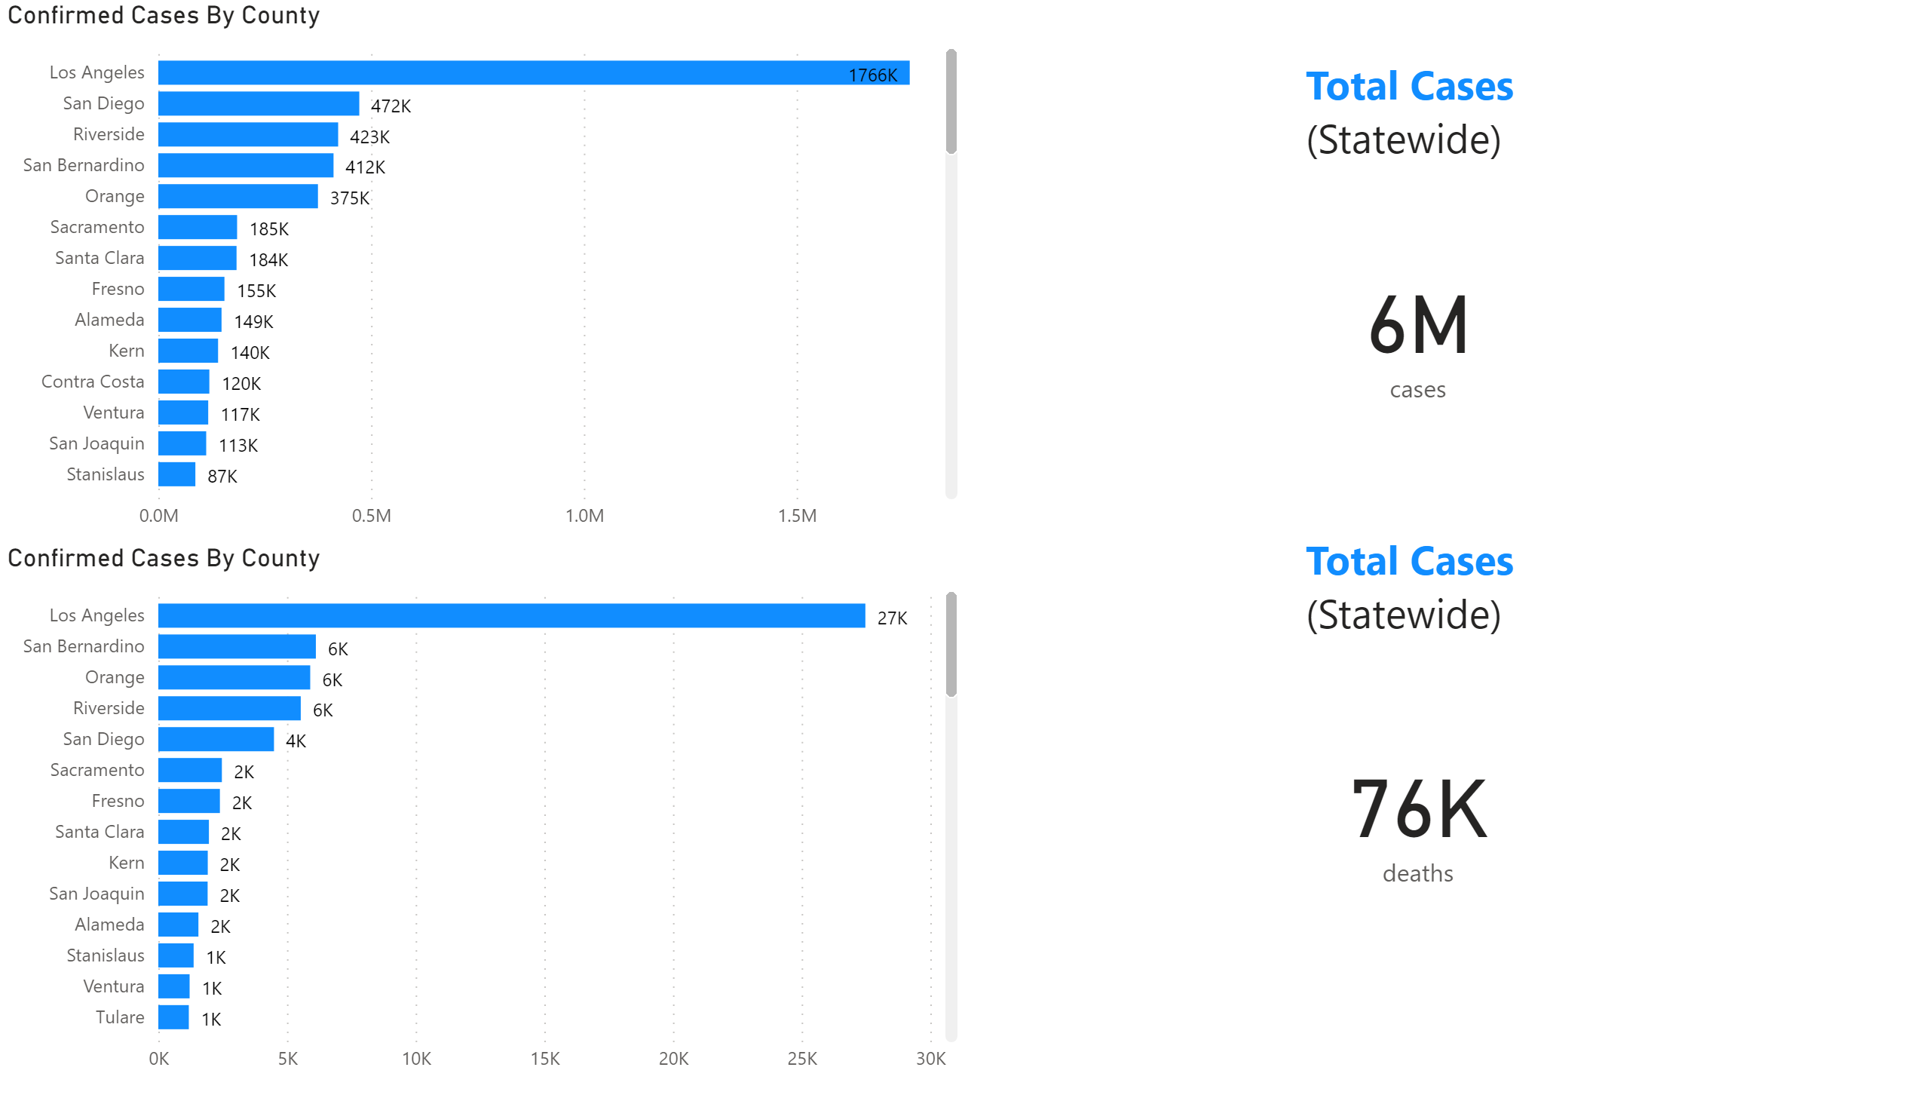
CA Cases/Deaths
Notes:
Confirmed Cases By County
No alt text provided
Confirmed Cases By County
No alt text provided
card
No alt text provided
textbox
No alt text provided
textbox
No alt text provided
card
No alt text provided

Slide 3
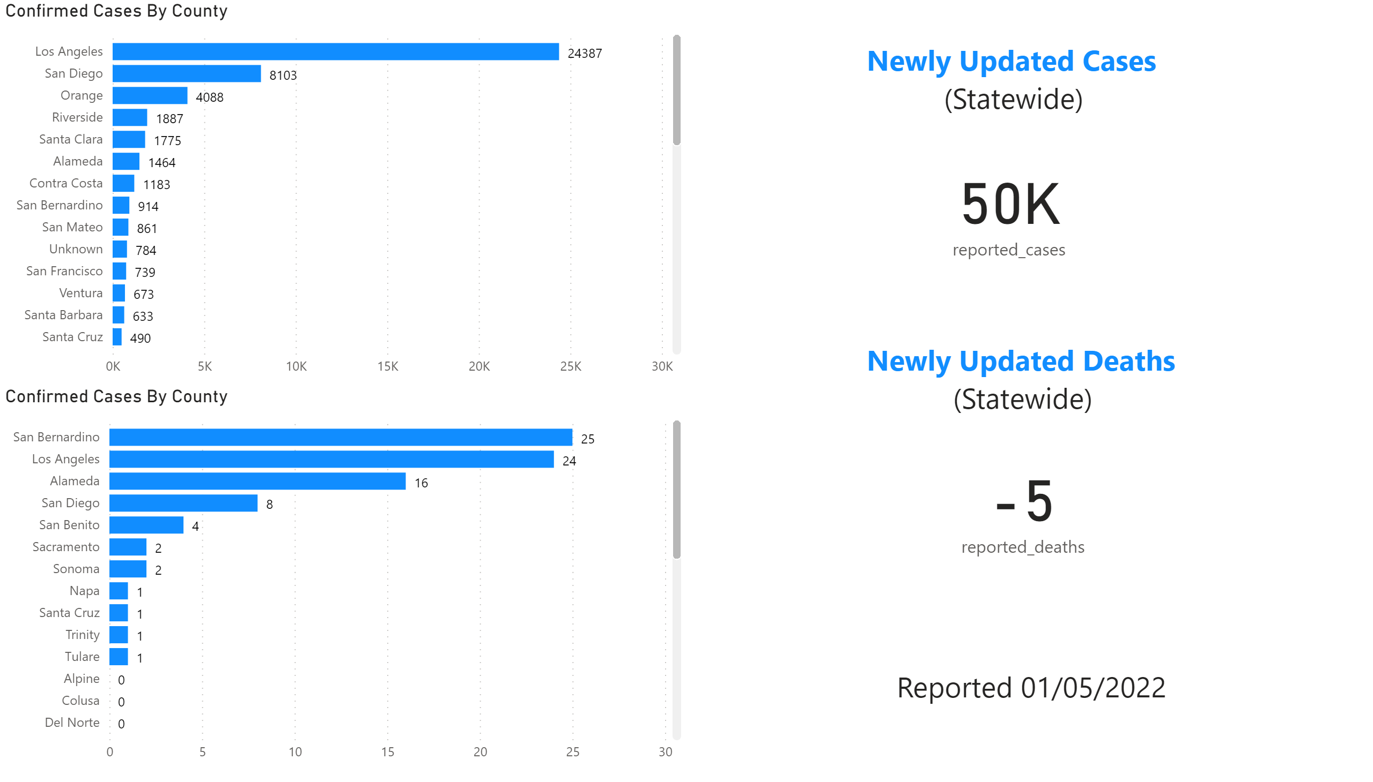
Newly Updated CA Cases/Deaths
Notes:
Confirmed Cases By County
No alt text provided
Confirmed Cases By County
No alt text provided
card
No alt text provided
textbox
No alt text provided
textbox
No alt text provided
card
No alt text provided
textbox
No alt text provided

Slide 4
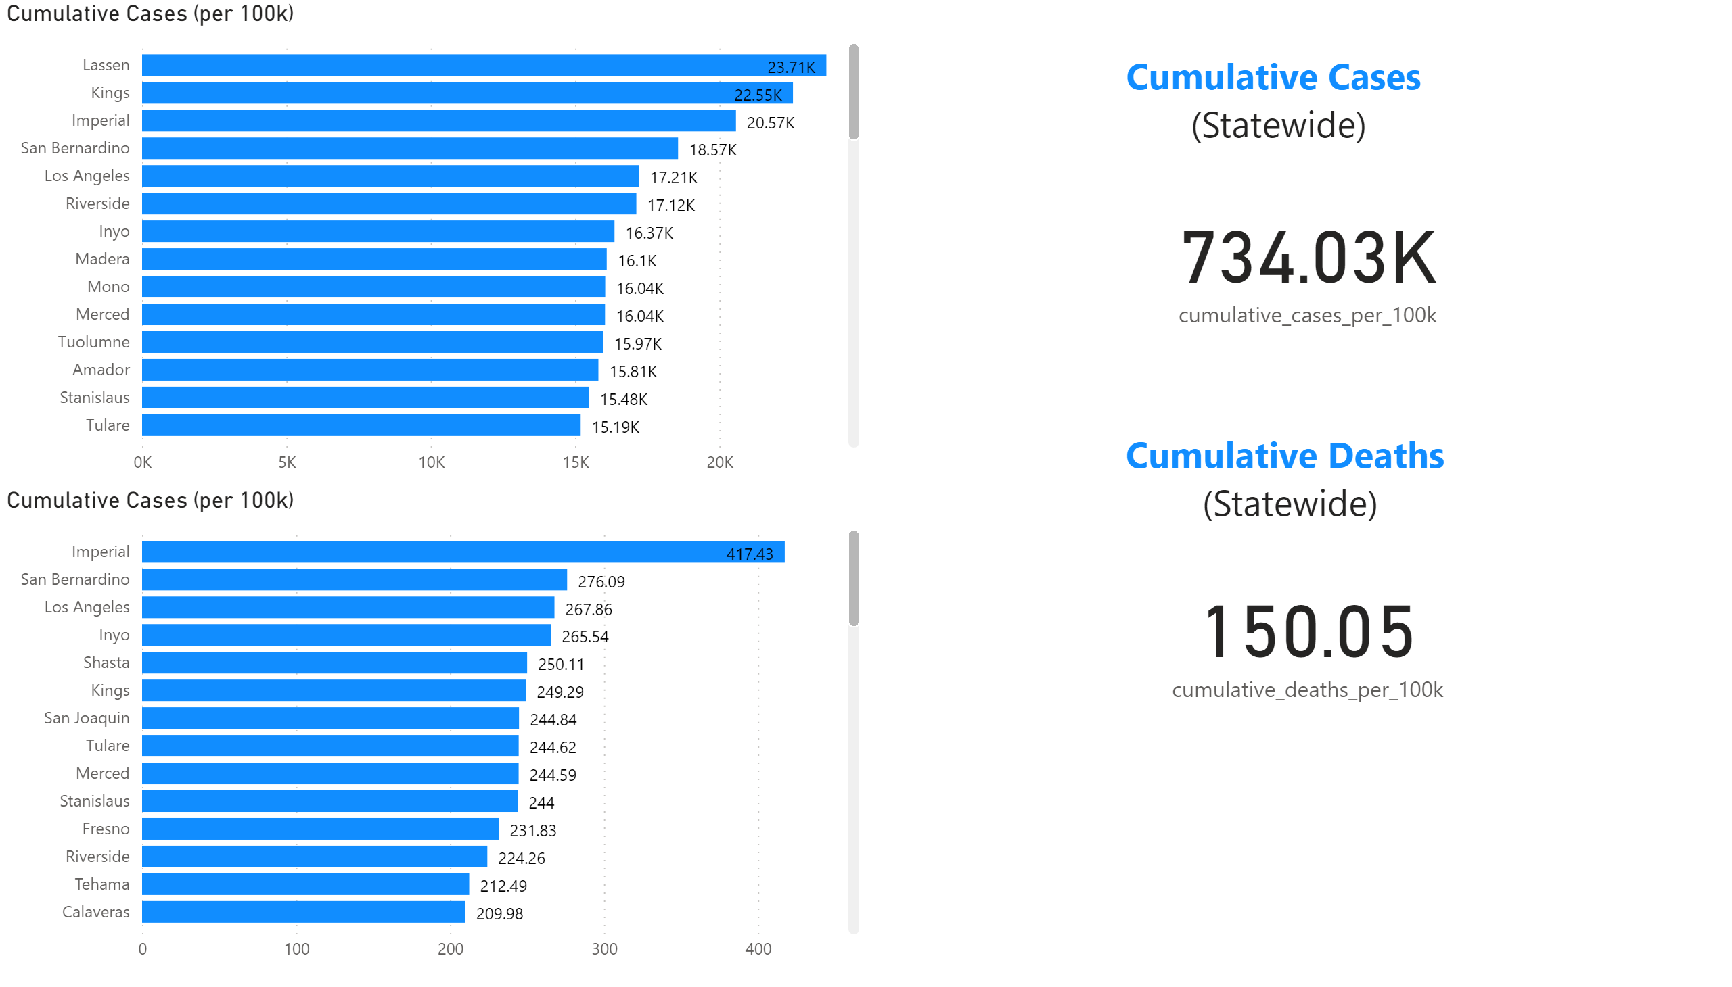
Cumulative CA Cases/Deaths
Notes:
Cumulative Cases (per 100k)
No alt text provided
textbox
No alt text provided
textbox
No alt text provided
card
No alt text provided
card
No alt text provided
Cumulative Cases (per 100k)
No alt text provided

Slide 5
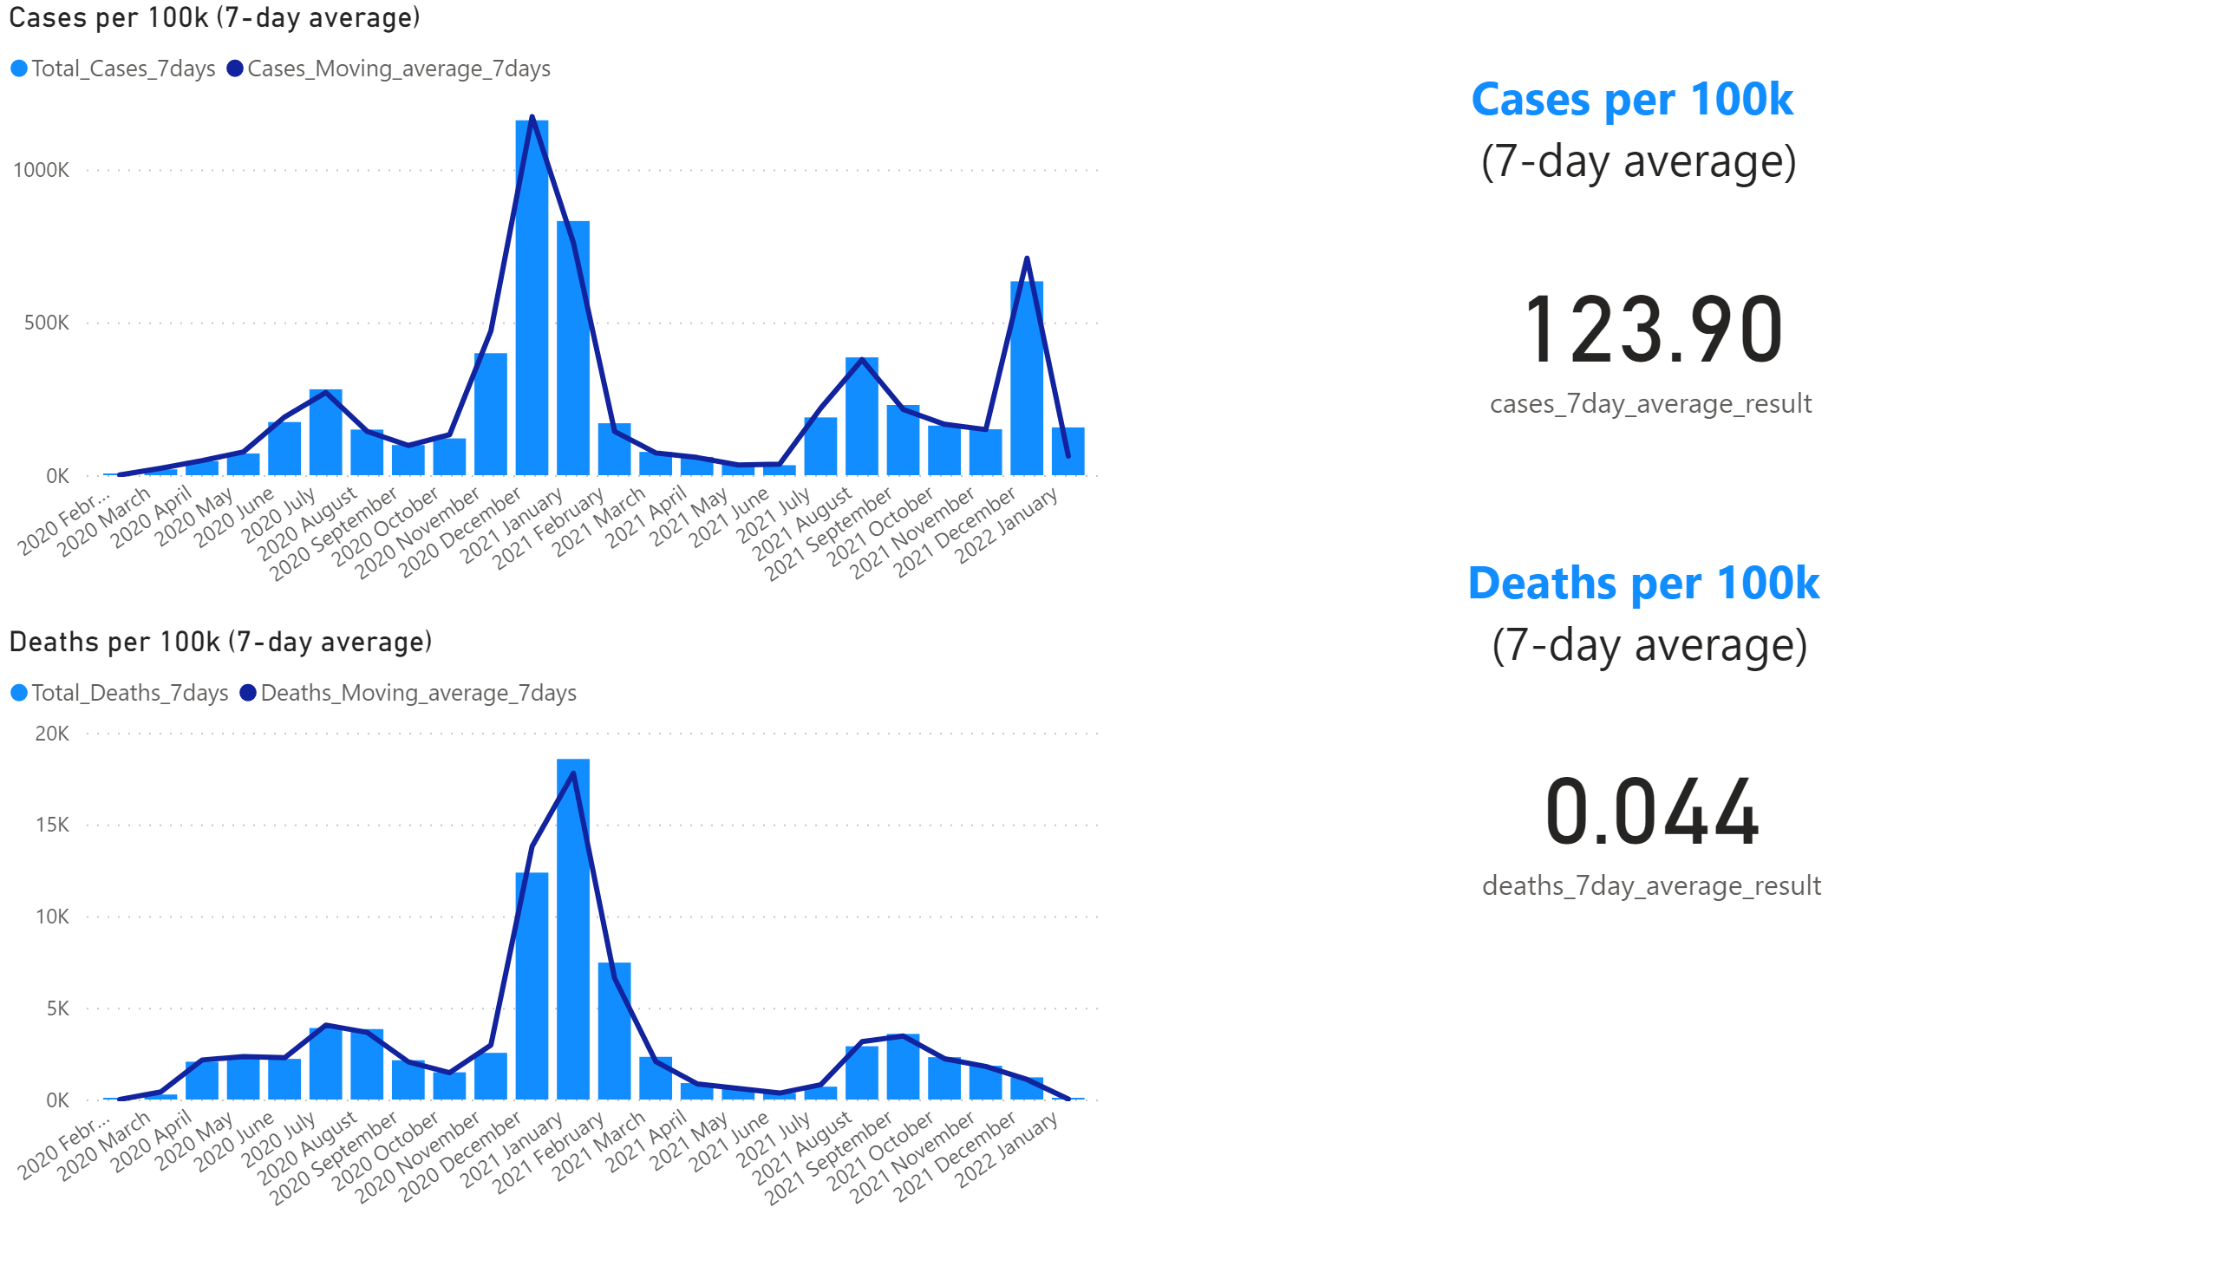
Moving 7-day average per 100k
Notes:
textbox
No alt text provided
textbox
No alt text provided
card
No alt text provided
Deaths per 100k (7-day average)
No alt text provided
card
No alt text provided
Cases per 100k (7-day average)
No alt text provided

Slide 6
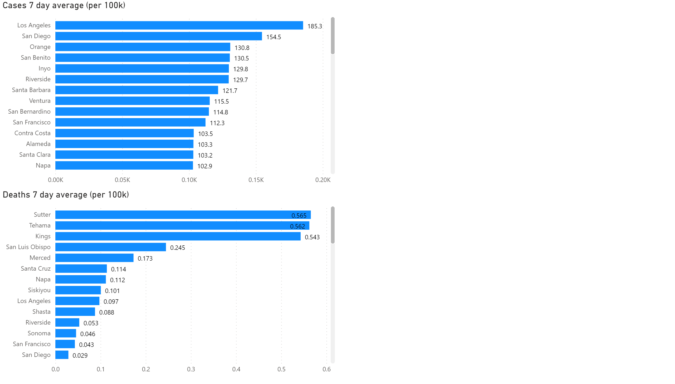
7-day average per 100k by CA counties
Notes:
Cases 7 day average (per 100k)
No alt text provided
Deaths 7 day average (per 100k)
No alt text provided

