Slide 1
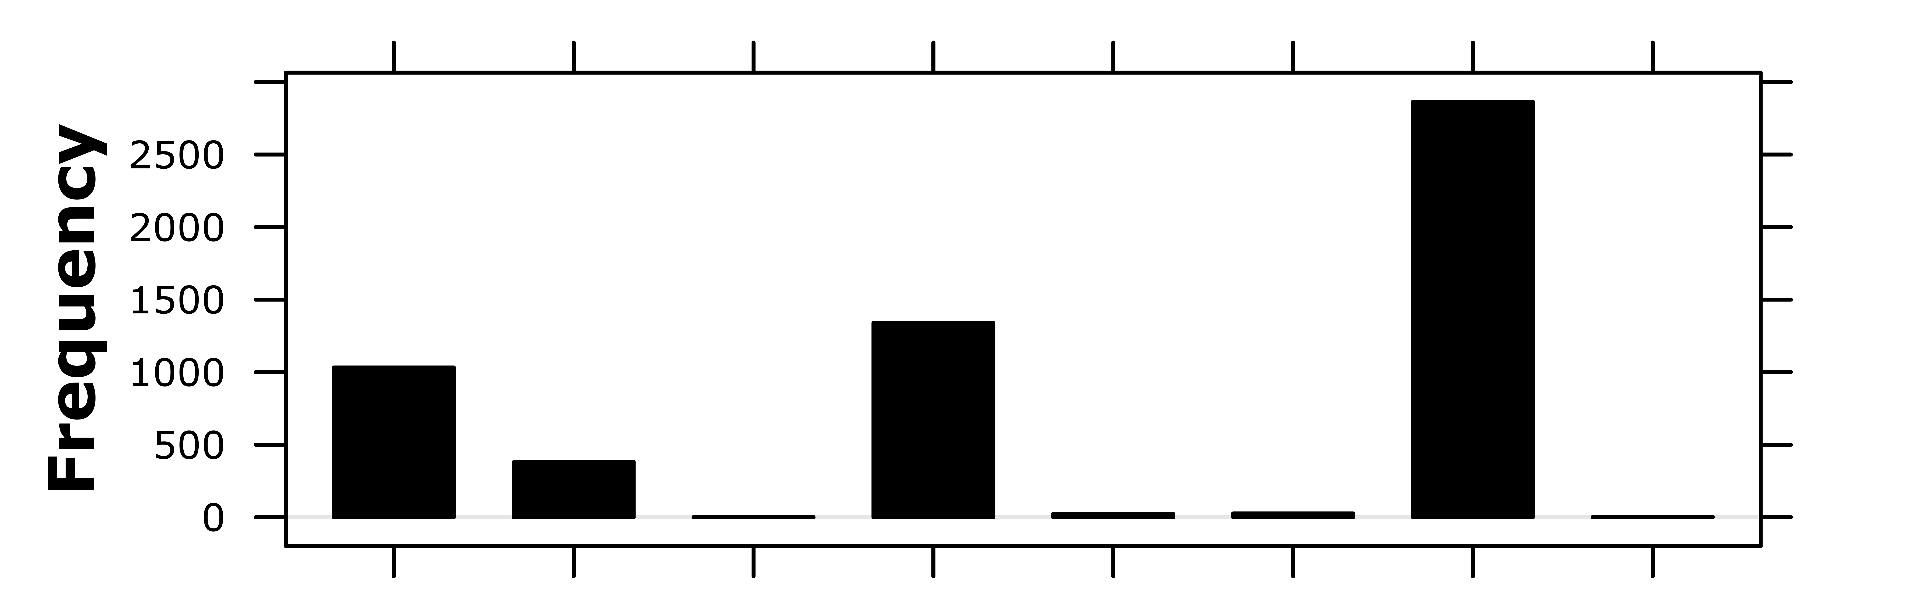

Slide 2
True Class True Counts
Predicted Class Predicted Counts

