Slide 1



ESRC Festival of Social Science 2015 – WISERD Data Portal demonstration
11th November 2015
Scott Orford, Ian Harvey, Sam Jones
Wales Institute of Social and Economic Research, Data and Methods (WISERD)

Slide 2
WiserData
Data key resource for social science / policy research
Large number of datasets available in Wales/UK BUT:
Lack of awareness/knowledge about what data exists
Discovering data is not straightforward
£££ data is under-used
Awareness and discovery of social science data needs improving
Existing data needs to be optimised/repurposed/reused

Slide 3
WISERD DataPortal
Data:
Standards compliant meta-data for search and discovery
Quantitative / Qualitative socio-economic data
Web mapping services (WMS) feeds
API data feeds (NOMIS)
Geographic as well as thematic and temporal metadata searches
Portal:
Web-based system for discovering data resources- allows remote 24/7 searching

Slide 4
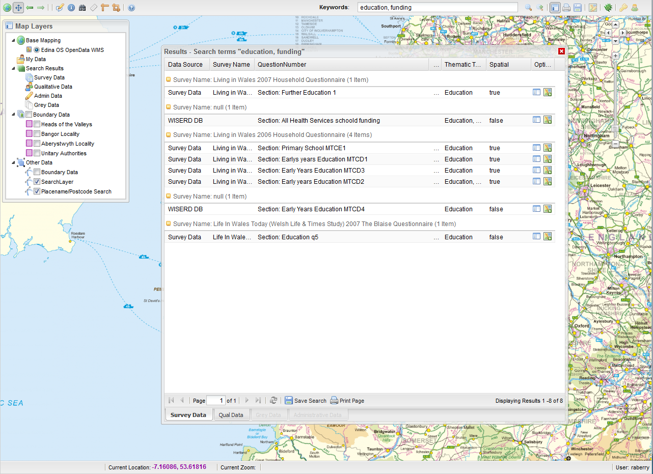
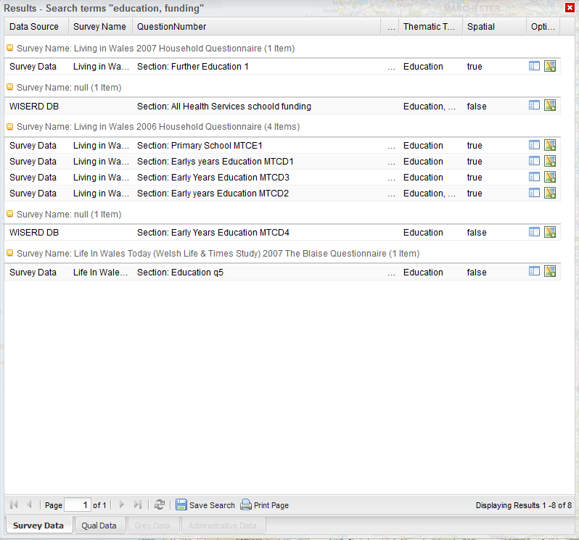
Mash up of metadata, source data and mapping data
Source Data
(e.g. NOMIS)
Meta-data
(WISERD)
Mapping Data
(e.g. OpenStreetmap)

Slide 5
Example Queries
Text: “Show me all the surveys conducted in Wales that contain questions on health.”
Spatial: “I need to find out what socio-economic data exists for Cardiff.”
Spatial: “Show me all the existing data for this (user-defined) area”
Text/Spatial: “I’m conducting a project on schools in Merthyr Tydfil – I want a printed report of all the relevant data within the Merthyr UA”
Notes:
OK so how might a researcher or policy analyst actually use this

Slide 6
WISERD Metadatabase
WISERD Metadatabase innovations:
Metadata for surveys down to question-response level in a fully relational database
Semi-automated metadata generation for qualitative research data (keywords and place names)
Good metadata is the basis for effective:
Data discovery
Data management
Data sharing
Data harvesting
Data publishing
Data archiving

Slide 7
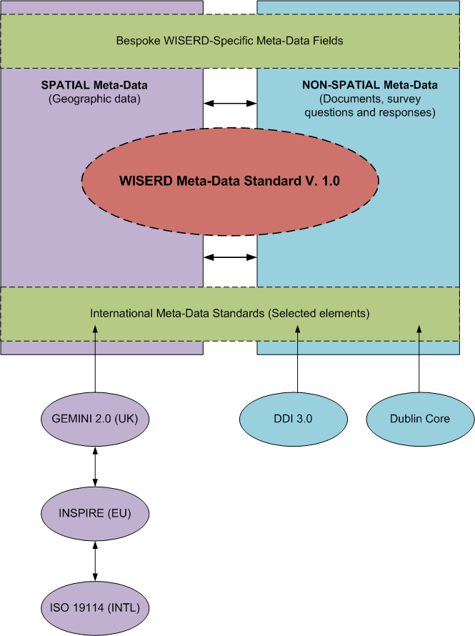
Standards compliant metadata

Slide 8
The WISERD Metadatabase
Surveys Include:
Census (1991, 2001)
Labour Force Surveys
Living in Wales Surveys (2004-2008)
National Survey for Wales
Shelter Cymru HAC data
Skills Surveys (various - 1997-2006)
Social Change and Economic Life Surveys (1986-1987)
Wales Rural Obs. Rural Business Surveys (2004-2010)
Wales Rural Obs. Household Surveys (2004-2010)
Welsh Health Surveys
Welsh Election Study
Welsh Referendum Study
Working in Britain Surveys (1999-2002)
Workplace Employment Relations Surveys (1998-2011)
WISERD Knowing Localities Stakeholder Interviews
Notes:
8

Slide 9
DataPortal Core functionality
Textual database searching
Keyword / term search
Geographic/spatial searching
Place name gazetteer
Drop pin + circular distance buffer
Click and drag rectangular search area
Draw ‘freehand’ search area
Metadata reporting
Tabular output of question and responses
Metadata visualisation
Mapping
Word clouds

Slide 10
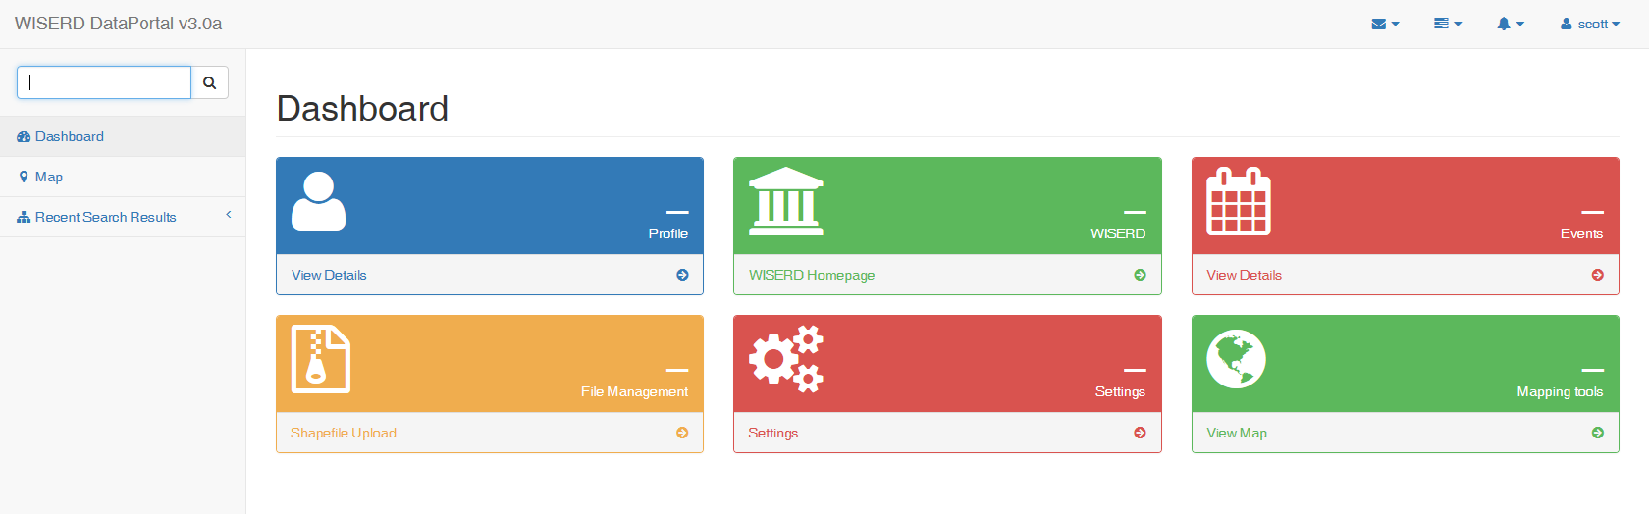
The WISERD DataPortal Home Page

Slide 11
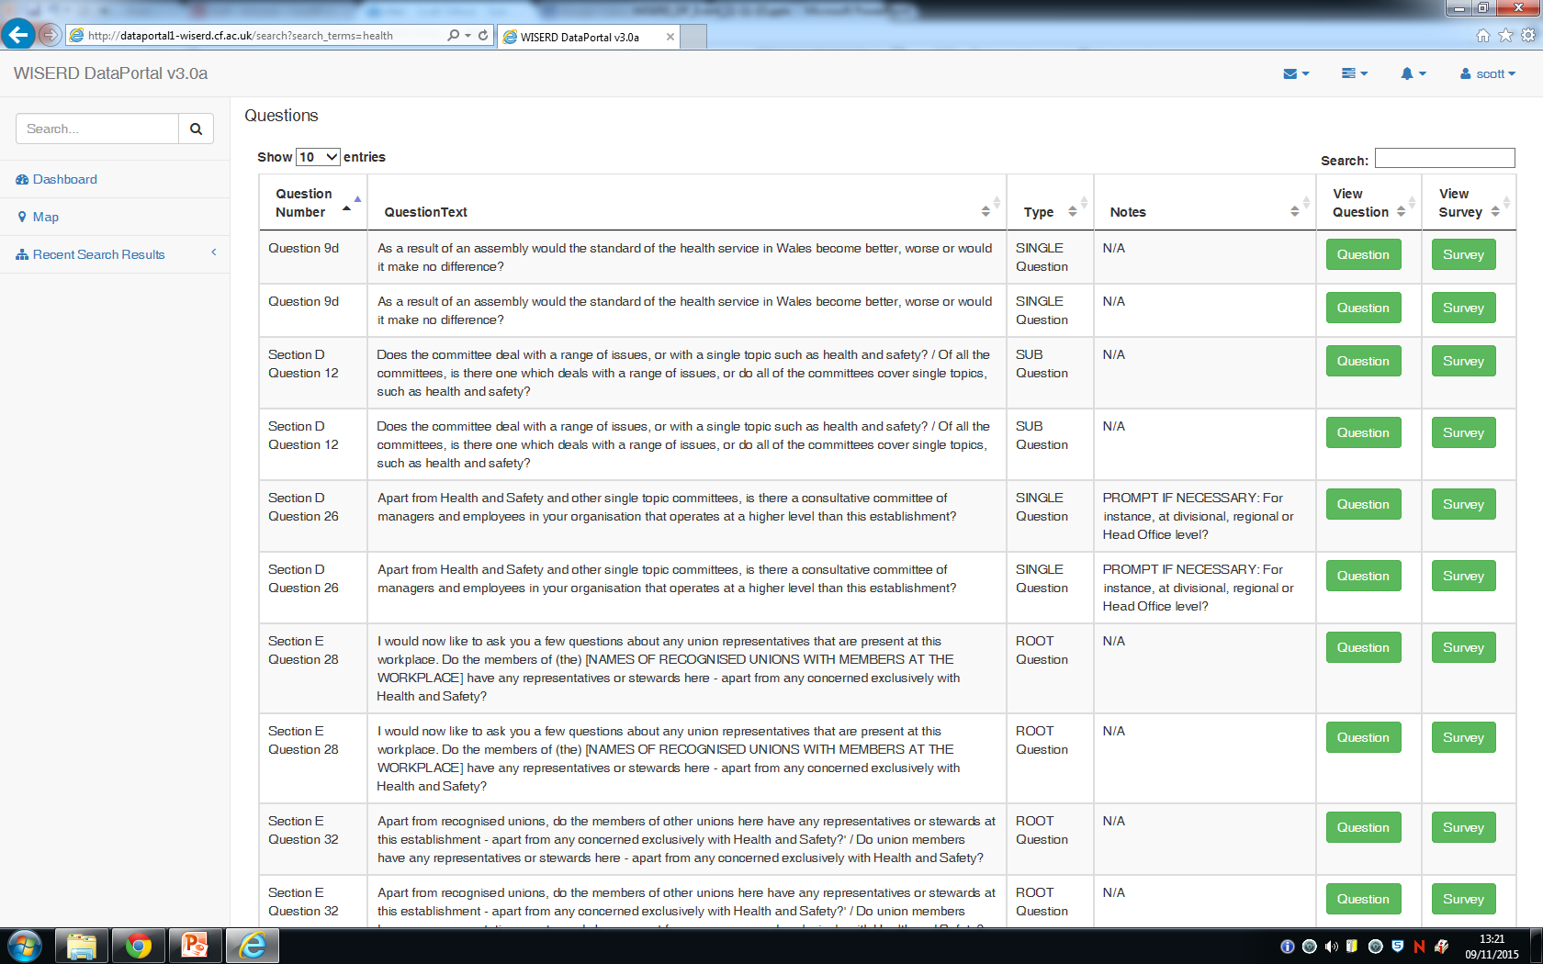
Meta-data Survey Question Tables

Slide 12
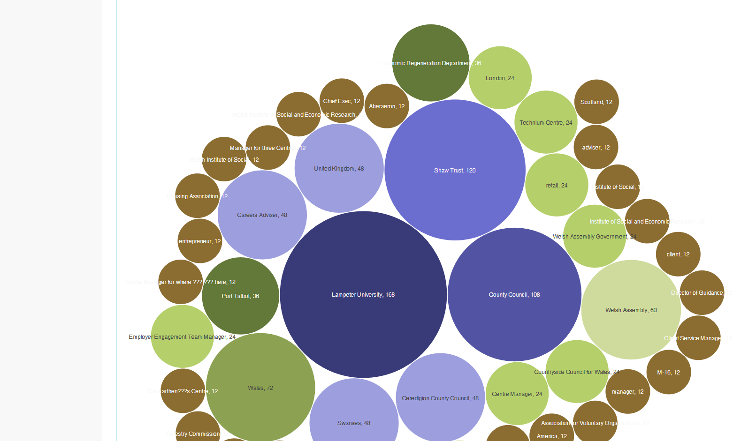
Word Cloud of WISERD Knowing Locality transcript

Slide 13
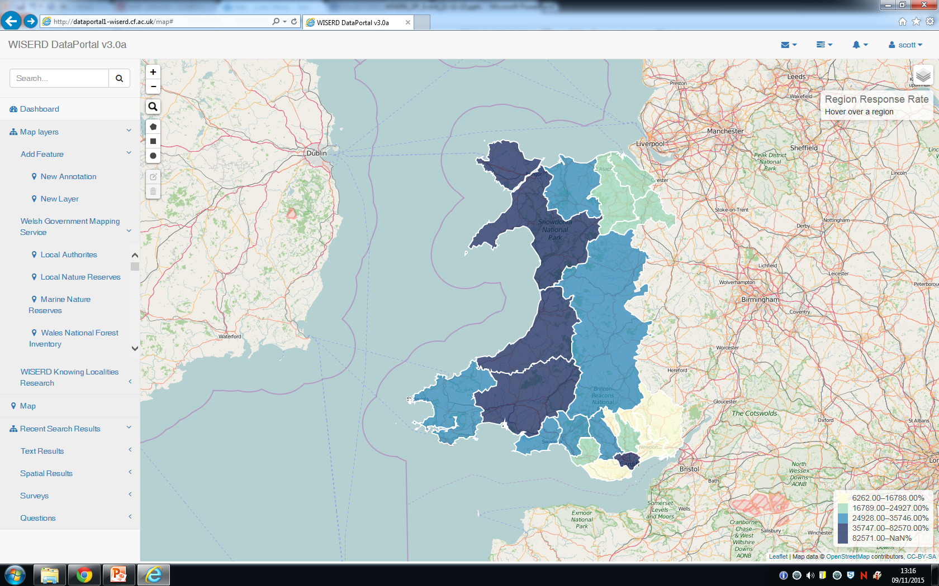
NOMIS data mapping tool

Slide 14
Future Developments
To develop further links between metadata to source data via data feeds to NOMIS, ONS, WG……
Explore methods of publishing/harvesting metadata and data
JSON based feeds of text and map data
Negotiate and explore direct data access:
Secure login (e.g. Shibboleth authentication; Oauth2)
Explore and manage disclosure risks of source data and search indexes
Reports and exporting data

Slide 15
http://dataportal1-wiserd.cf.ac.uk/

