Slide 1

Forecasting and Time Series Models
Steve Elston
Copyright 2018, 2019, 2020, 2021, 2022, 2023 2024, Stephen F Elston. All rights reserved.

Slide 2
Why Are Time Series Useful?
Data are often time-ordered
Estimates show that 30% of data science problems include time series data
Must use specific time series models

Slide 3
Why Are Time Series Useful?
“It’s tough to make predictions, especially about the future!”
Karl Kristian Steincke, Danish politician, ca 1937
Demand forecasting: Electricity production, Internet bandwidth, Traffic management, Inventory management, sales forecasting
Medicine: Time dependent treatment effects, EKG, EEG
Engineering and Science: Signal analysis, Analysis of physical processes
Capital markets and economics: Seasonal unemployment, Price/return series, Risk analysis

Slide 4
Why Are Time Series Data Different?
Models must account for time series behavior
Most statistical and machine learning assume data samples are independent identically distributed (iid)
But, this is not the case for time series data
Time series values are correlated in time
Time series data exhibit Serial correlation
Serial correlation of values
Serial correlation of model errors
Violate iid assumptions of many statistical and ML Models `

Slide 5
Properties of Time Series
Fundamental elements of time series
Fundamental components which cannot be predicted
White noise
Random walks
Nonstationary components
Trend
Seasonal components
Autocorrelation and partial autocorrelation
Fundamental properties of stationary time series
Differencing to transform to stationarity
Seasonal differencing
Non-seasonal differencing
Stationarity tests
augmented Dicky-Fuller test
KPSS test

Slide 6
Time Series Forecasting Models
Forecasting is the goal of much of time series analysis
Forecasting models attempt to predict future values conditional on past observations
Here, we focus on ARIMA and SARIMAX models
Models support inference
Work for many nonstationary time series
Many alternatives
Expert judgement or subjective forecasting is widely applied, e.g. an experienced purchasing manager
Exponential smoothing Holt-Winters models create robust forcasts; see Chapter 7 of Hyndman and Athanaosopoulos, 3rd edition
To date, LSTM models and LLM models, have not been shown to provide significantly better forecasts than conventional models

Slide 7
Time Series Forecasting Models
Large and growing volume of time series modeling and forecasting software and literature
For comprehensive introduction see Forecasting: Principles and Practice, Hyndman and Athanaosopoulos, 3rd edition, 2018, available as book or free online
Rob Hyndman’s blog is a source of many interesting ideas and example in time series analysis
Another applied source, The Analysis of Time Series, Chatfield and Xing, 2019
The long-time go to text for theory by Box, Jenkins, Reinsel and Ljung, now in the 5th edition

Slide 8
Time Series Models
The ARIMA model for time series comprises three components:
Autoregressive component (AR) accounts for partial autocorrelation
Serial correlation of observations
Integrative component (I) accounts random walks and trend
Differencing provides stationary series for AR and MA components
Moving Average (MA) accounts for autocorrelation
Serial correlation of model error
ARIMA models are often called Box-Jenkins models

Slide 9
Time Series Models
Many types of time series models
SARIMA: seasonal autoregressive integrative moving average, adds seasonal components
seasonal AR accounts for serial correlation of seasonal values
seasonal component accounts for random walk and trend of seasonal components
seasonal MA accounts for seasonal serial correlation of errors
SARIMAX: seasonal autoregressive integrative moving average with exogenous variables
Add effect of external factors
Example; effect of specific holiday
Example; effect arising from factors not incorporated in endogenous variable

Slide 10
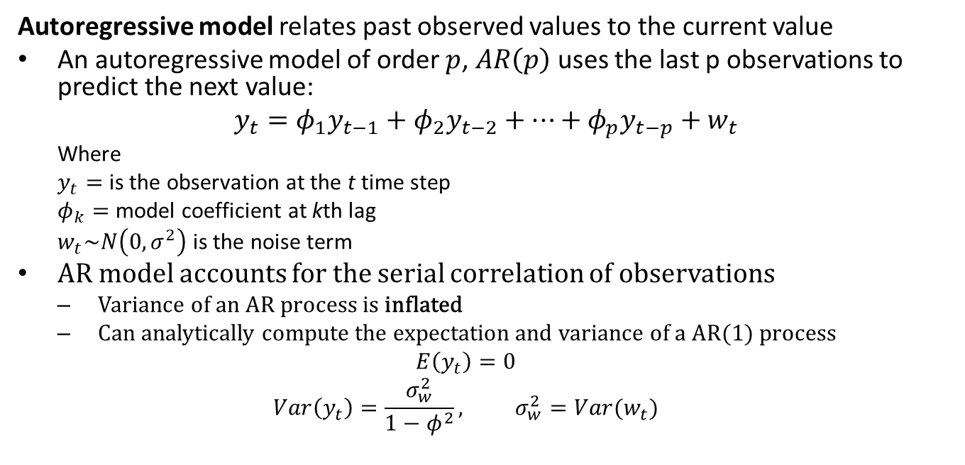
The Autoregressive Model
Autoregressive model relates past observed values to the current value
An autoregressive model of order $p$, $AR\left(p\right)$ uses the last p observations to predict the next value:
$$y_{t}=φ_{1}y_{t−1}+φ_{2}y_{t−2}+…+φ_{p}y_{t−p}+w_{t}$$
Where
$y_{t}=$ is the observation at the t time step
$φ_{k}=$ model coefficient at kth lag
$w_{t}\sim N\left(0,σ^{2}\right)$ is the noise term
AR model accounts for the serial correlation of observations
Variance of an AR process is inflated
Can analytically compute the expectation and variance of a AR(1) process
$$E\left(y_{t}\right)=0$$
$$Var\left(y_{t}\right)=\frac{σ_{w}^{2}}{1−φ^{2}}, σ_{w}^{2}=Var(w_{t})$$

Slide 11
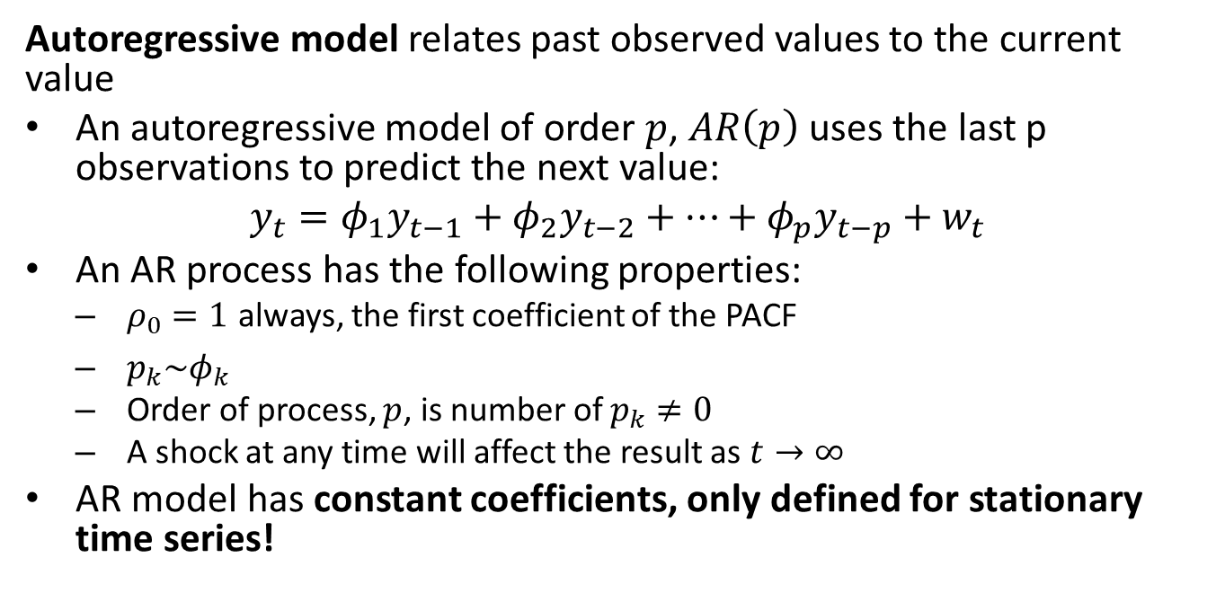
The Autoregressive Model
Autoregressive model relates past observed values to the current value
An autoregressive model of order $p$, $AR\left(p\right)$ uses the last p observations to predict the next value:
$$y_{t}=φ_{1}y_{t−1}+φ_{2}y_{t−2}+…+φ_{p}y_{t−p}+w_{t}$$
An AR process has the following properties:
$ρ_{0}=1$ always, the first coefficient of the PACF
$p_{k}\sim φ_{k}$
Order of process, $p$, is number of $p_{k}≠0$
A shock at any time will affect the result as $t→∞$
AR model has constant coefficients, only defined for stationary time series!

Slide 12






The Autoregressive Model
$$φ_{2}y_{t−2}$$
$$φ_{1}y_{t−1}$$
$$y_{t−2}$$
$$y_{t−1}$$
$$y_{t}$$
$$y_{t}=φ_{1}y_{t−1}+φ_{2}y_{t−2}+w_{t}$$
Illustration of the AR(2) model

Slide 13
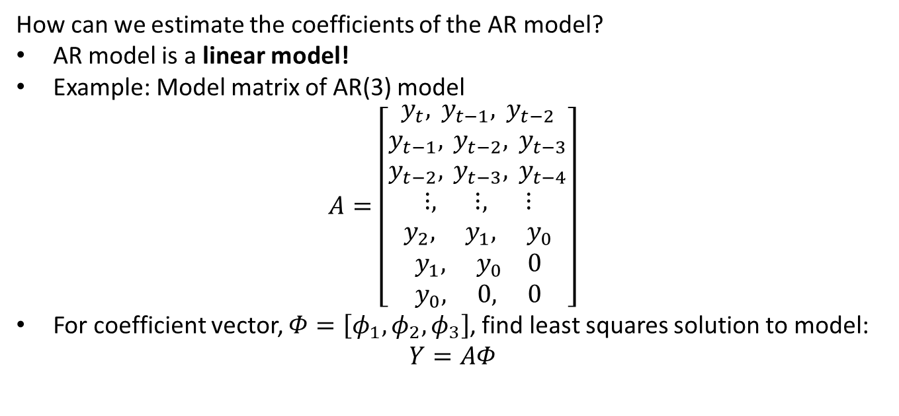
The Autoregressive Model
How can we estimate the coefficients of the AR model?
AR model is a linear model!
Example: Model matrix of AR(3) model
$$A=\left[\begin{matrix}y_{t}, y_{t−1}, y_{t−2} \\ y_{t−1}, y_{t−2}, y_{t−3} \\ y_{t−2}, y_{t−3}, y_{t−4} \\ ⋮, ⋮, ⋮ \\ y_{2}, y_{1}, y_{0} \\ y_{1}, y_{0} 0 \\ y_{0}, 0, 0\end{matrix}\right]$$
For coefficient vector, $Φ=\left[φ_{1},φ_{2},φ_{3}\right]$, find least squares solution to model:
$$Y=AΦ$$

Slide 14
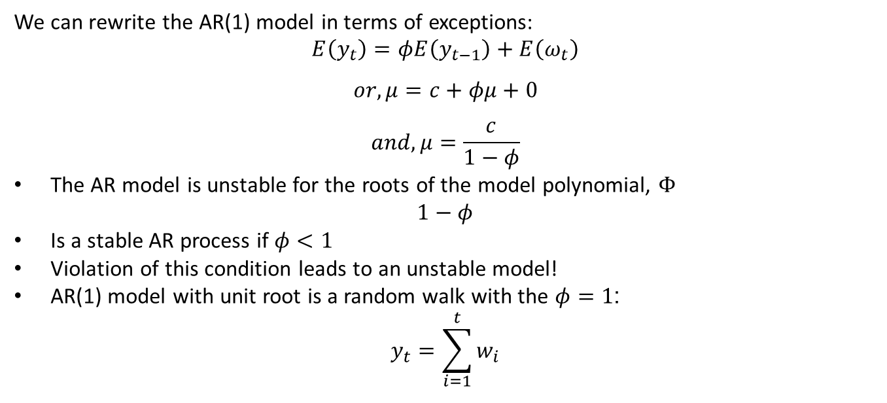
The Autoregressive Model
We can rewrite the AR(1) model in terms of exceptions:
$$E\left(y_{t}\right)=φE\left(y_{t−1}\right)+E\left(ω_{t}\right)$$
$$or, μ=c+φμ+0$$
$$and, μ=\frac{c}{1−φ}$$
The AR model is unstable for the roots of the model polynomial, $Φ$
$$1−φ$$
Is a stable AR process if $φ<1$
Violation of this condition leads to an unstable model!
AR(1) model with unit root is a random walk with the $φ=1$:
$$y_{t}=\sum_{i=1}^{t}{w_{i}}$$

Slide 15
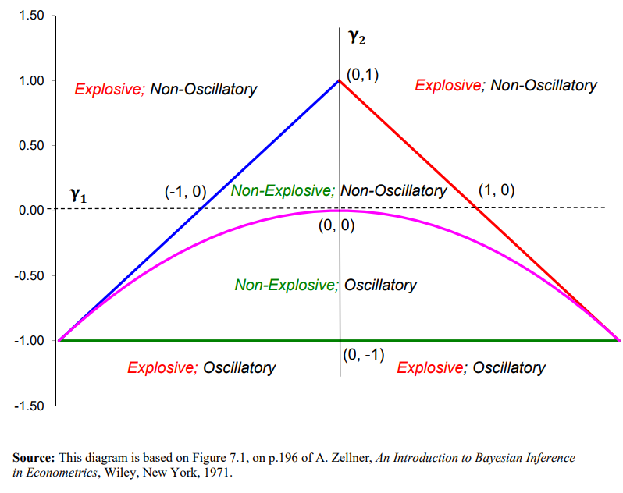
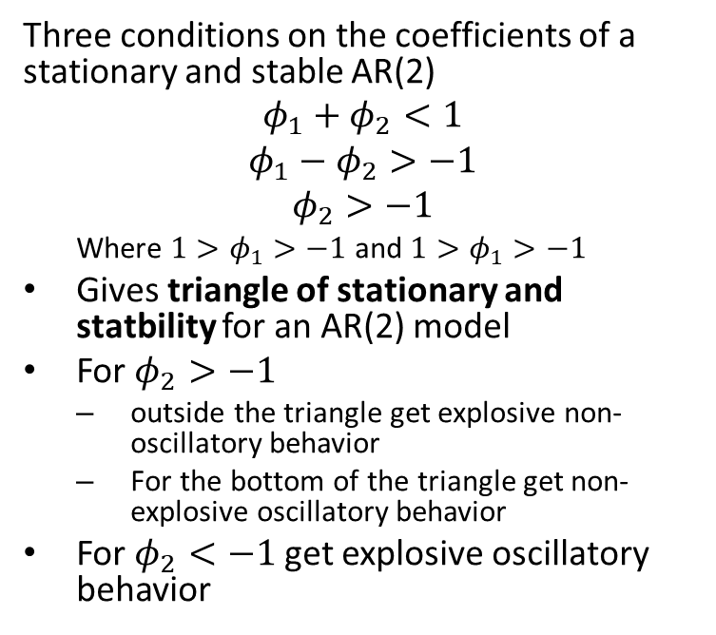
The Autoregressive Model
Three conditions on the coefficients of a stationary and stable AR(2)
$$φ_{1}+φ_{2}<1$$
$$φ_{1}−φ_{2}>−1$$
$$φ_{2}>−1$$
Where $1>φ_{1}>−1$ and $1>φ_{1}>−1$
Gives triangle of stationary and statbility for an AR(2) model
For $φ_{2}>−1$
outside the triangle get explosive non-oscillatory behavior
For the bottom of the triangle get non-explosive oscillatory behavior
For $φ_{2}<−1$ get explosive oscillatory behavior
Stationarity of AR(2) model
From lecture notes by David E. Giles, Simon Fraser University

Slide 16
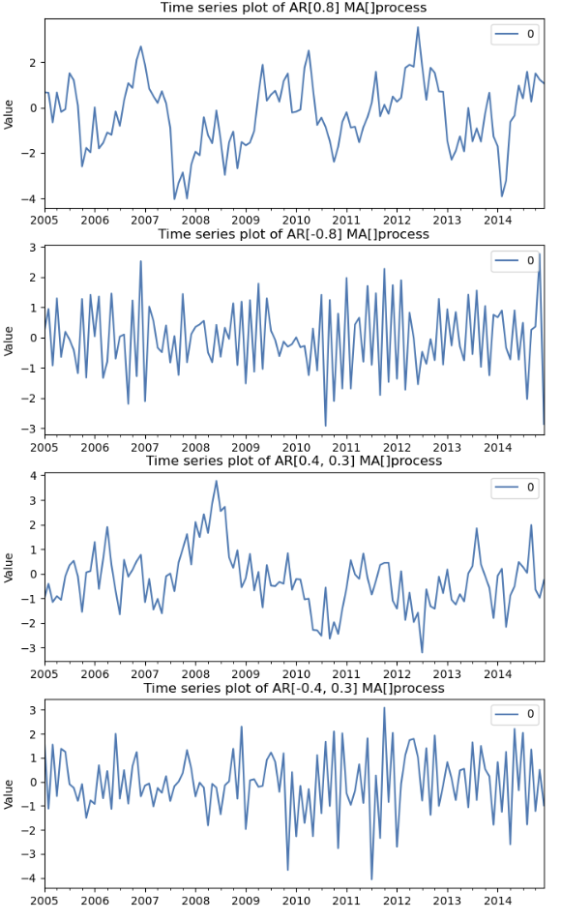
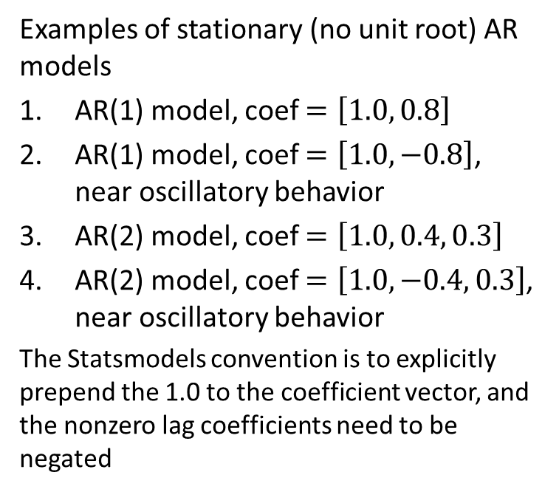
Example: Autoregressive Model
Examples of stationary (no unit root) AR models
AR(1) model, coef $=\left[1.0, 0.8\right]$
AR(1) model, coef $=\left[1.0, −0.8\right]$, near oscillatory behavior
AR(2) model, coef $=\left[1.0, 0.4, 0.3\right]$
AR(2) model, coef $=\left[1.0, −0.4, 0.3\right]$, near oscillatory behavior
The Statsmodels convention is to explicitly prepend the 1.0 to the coefficient vector, and the nonzero lag coefficients need to be negated

Slide 17
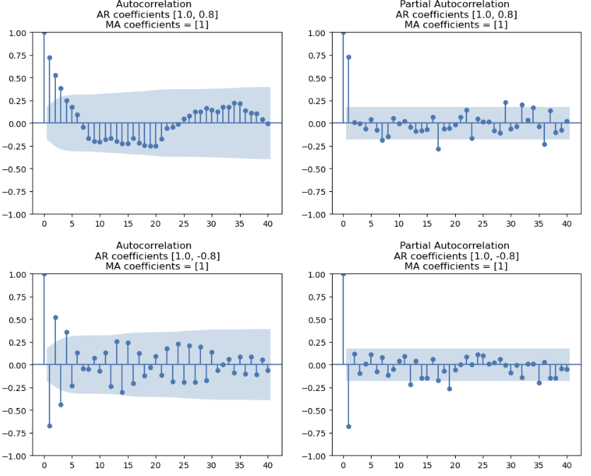
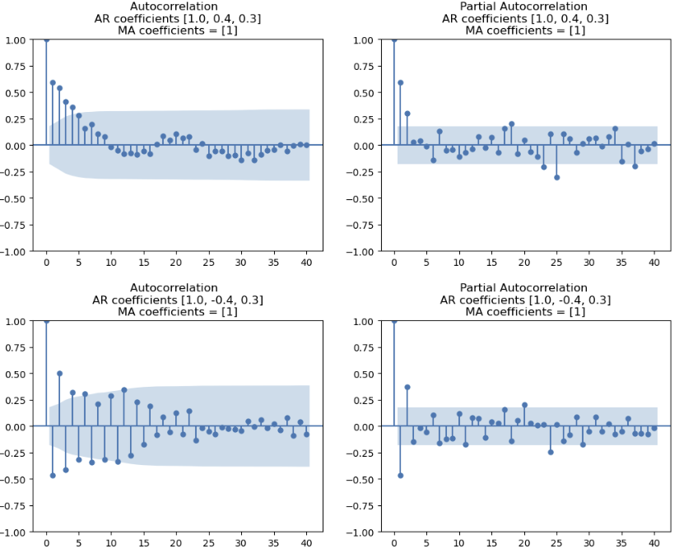
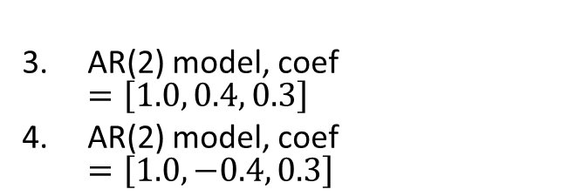
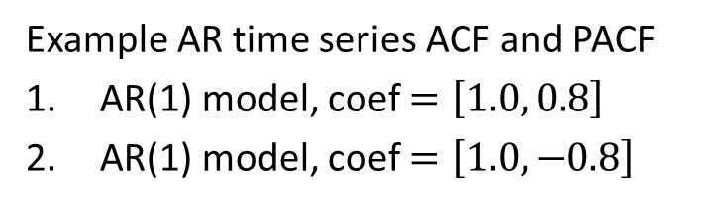
Example: Autoregressive Model
AR(2) model, coef $=\left[1.0, 0.4, 0.3\right]$
AR(2) model, coef $=\left[1.0, −0.4, 0.3\right]$
Example AR time series ACF and PACF
AR(1) model, coef $=\left[1.0, 0.8\right]$
AR(1) model, coef $=\left[1.0, −0.8\right]$

Slide 18
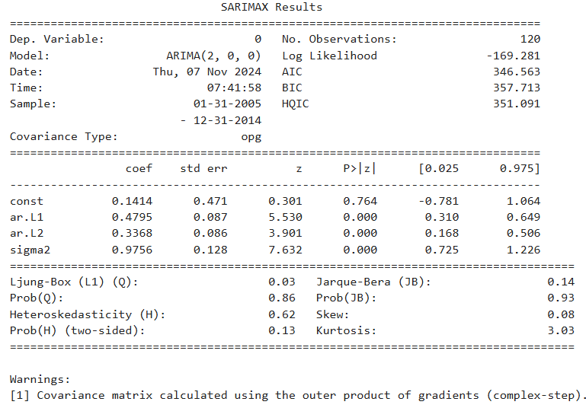
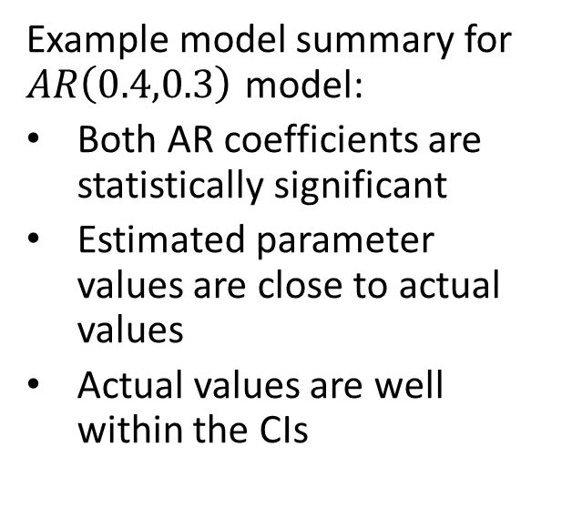
The Autoregressive Model
Example model summary for $AR\left(0.4,0.3\right)$ model:
Both AR coefficients are statistically significant
Estimated parameter values are close to actual values
Actual values are well within the CIs

Slide 19
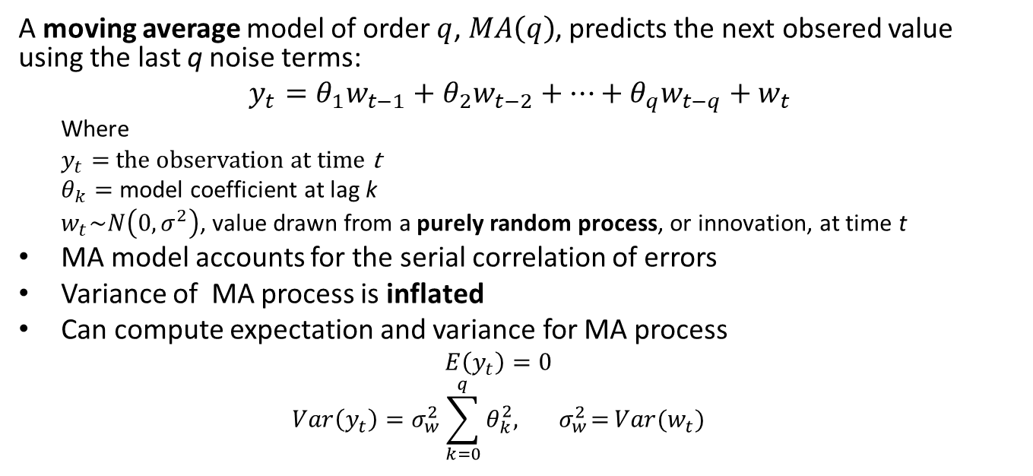
The Moving Average Model
A moving average model of order $q$, $MA\left(q\right)$, predicts the next obsered value using the last q noise terms:
$$y_{t}=θ_{1}w_{t−1}+θ_{2}w_{t−2}+…+θ_{q}w_{t−q}+w_{t}$$
Where
$y_{t}=$ the observation at time t
$θ_{k}=$ model coefficient at lag k
$w_{t}\sim N\left(0,σ^{2}\right)$, value drawn from a purely random process, or innovation, at time t
MA model accounts for the serial correlation of errors
Variance of MA process is inflated
Can compute expectation and variance for MA process
$$E\left(y_{t}\right)=0$$
$$Var\left(y_{t}\right)=σ_{w}^{2}\sum_{k=0}^{q}{θ_{k}^{2},{ σ}_{w}^{2}=}Var(w_{t})$$

Slide 20
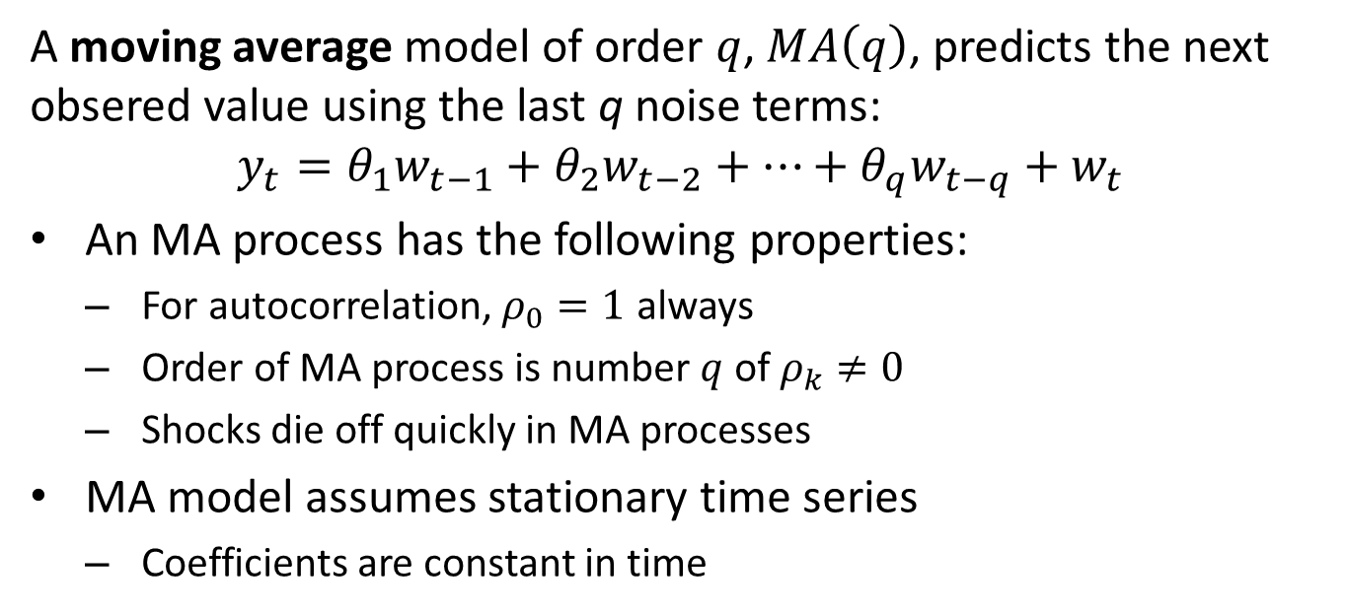
The Moving Average Model
A moving average model of order $q$, $MA\left(q\right)$, predicts the next obsered value using the last q noise terms:
$$y_{t}=θ_{1}w_{t−1}+θ_{2}w_{t−2}+…+θ_{q}w_{t−q}+w_{t}$$
An MA process has the following properties:
For autocorrelation, $ρ_{0}=1$ always
Order of MA process is number $q$ of $ρ_{k}≠0$
Shocks die off quickly in MA processes
MA model assumes stationary time series
Coefficients are constant in time

Slide 21
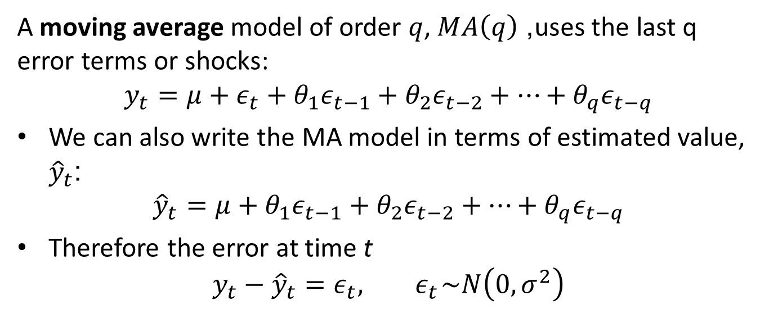
The Moving Average Model
A moving average model of order $q$, $MA\left(q\right)$, uses the last q error terms or shocks:
$$y_{t}=μ+ε_{t}+θ_{1}ε_{t−1}+θ_{2}ε_{t−2}+⋯+θ_{q}ε_{t−q}$$
We can also write the MA model in terms of estimated value, ${\hat{y}}_{t}$:
$${\hat{y}}_{t}=μ+θ_{1}ε_{t−1}+θ_{2}ε_{t−2}+⋯+θ_{q}ε_{t−q}$$
Therefore the error at time t
$$y_{t}−{\hat{y}}_{t}=ε_{t},{ ε}_{t}\sim N\left(0,σ^{2}\right)$$

Slide 22
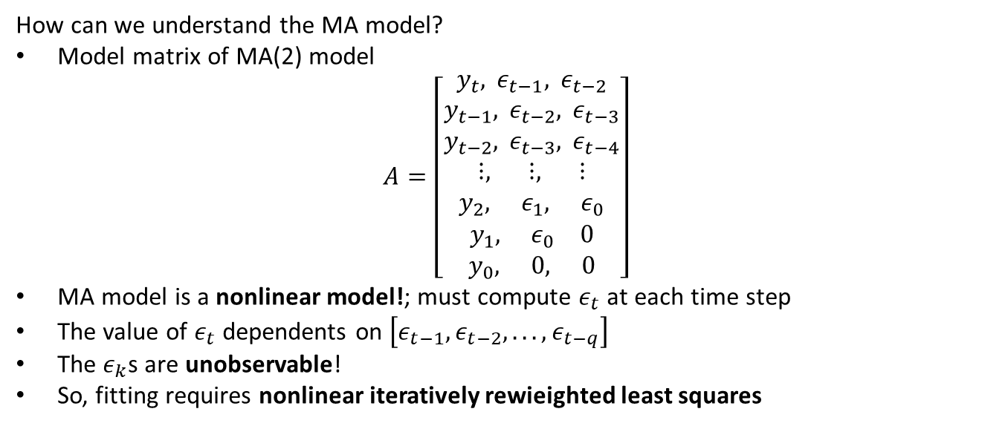
The Moving Average Model
How can we understand the MA model?
Model matrix of MA(2) model
$$A=\left[\begin{matrix}y_{t}, ε_{t−1}, ε_{t−2} \\ y_{t−1}, ε_{t−2}, ε_{t−3} \\ y_{t−2}, ε_{t−3}, ε_{t−4} \\ ⋮, ⋮, ⋮ \\ y_{2}, ε_{1}, ε_{0} \\ y_{1}, ε_{0} 0 \\ y_{0}, 0, 0\end{matrix}\right]$$
MA model is a nonlinear model!; must compute $ε_{t}$ at each time step
The value of $ε_{t}$ dependents on $\left[ε_{t−1},ε_{t−2},...,ε_{t−q}\right]$
The $ε_{k}$s are unobservable!
So, fitting requires nonlinear iteratively rewieighted least squares

Slide 23
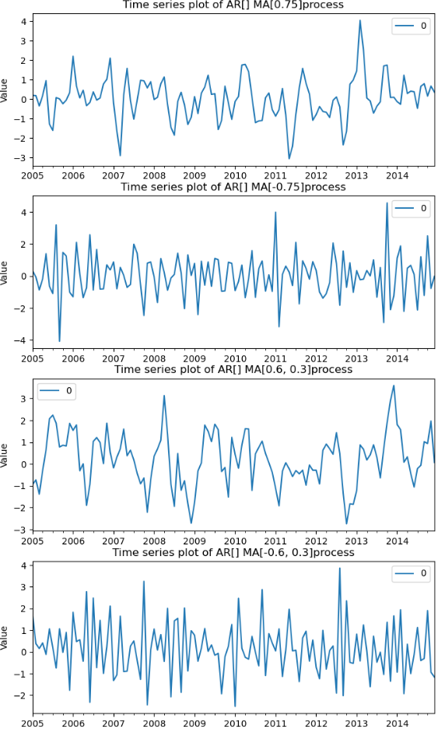
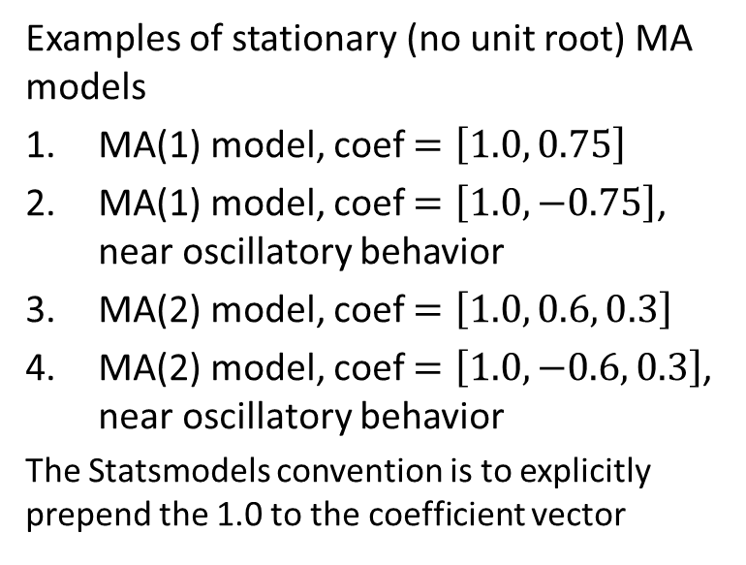
Example: Moving Average Model
Examples of stationary (no unit root) MA models
MA(1) model, coef $=\left[1.0, 0.75\right]$
MA(1) model, coef $=\left[1.0, −0.75\right]$, near oscillatory behavior
MA(2) model, coef $=\left[1.0, 0.6, 0.3\right]$
MA(2) model, coef $=\left[1.0, −0.6, 0.3\right]$, near oscillatory behavior
The Statsmodels convention is to explicitly prepend the 1.0 to the coefficient vector

Slide 24
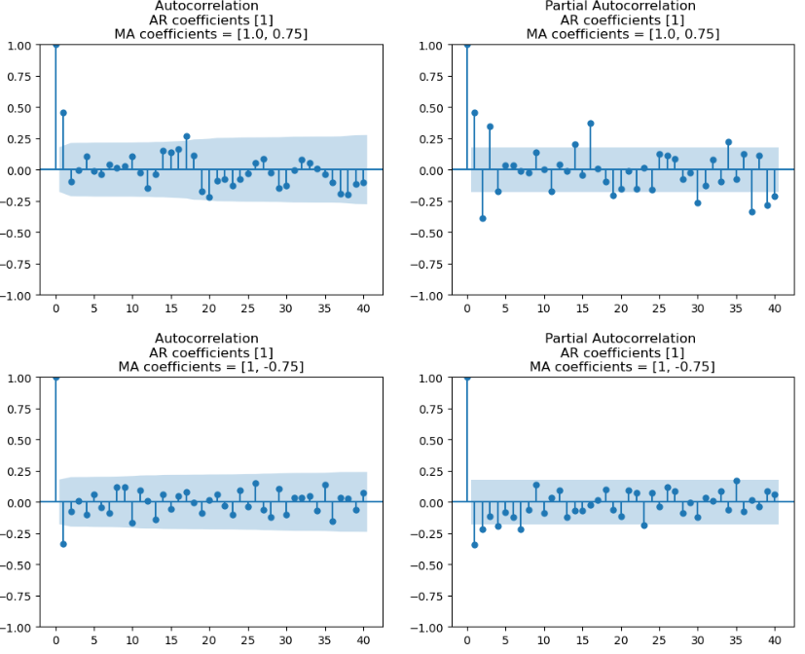
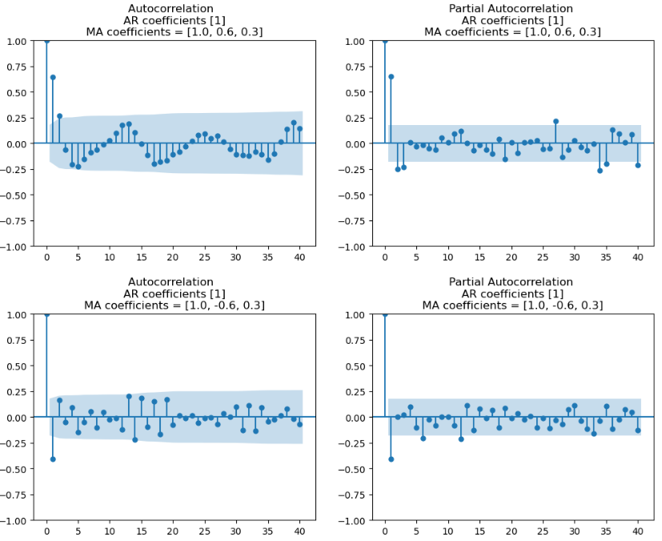
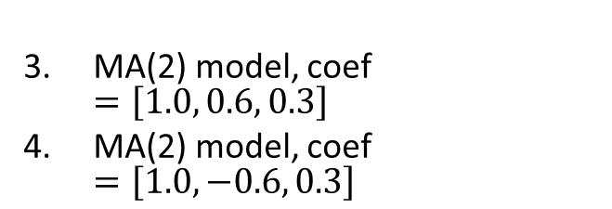
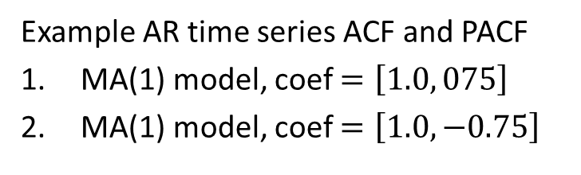
Example: Moving Average Model
MA(2) model, coef $=\left[1.0, 0.6, 0.3\right]$
MA(2) model, coef $=\left[1.0, −0.6, 0.3\right]$
Example AR time series ACF and PACF
MA(1) model, coef $=\left[1.0, 075\right]$
MA(1) model, coef $=\left[1.0, −0.75\right]$

Slide 25
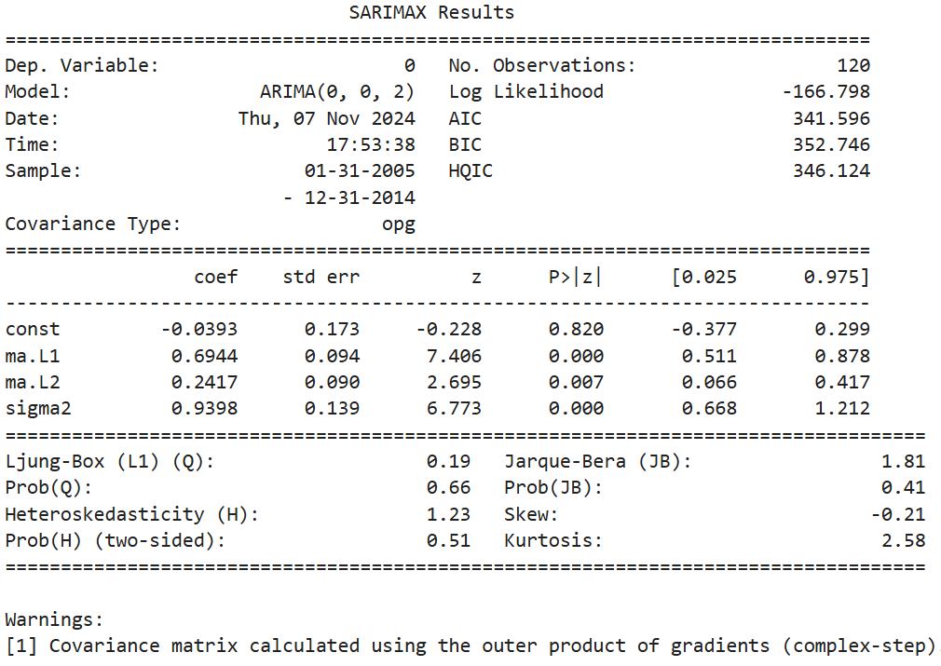
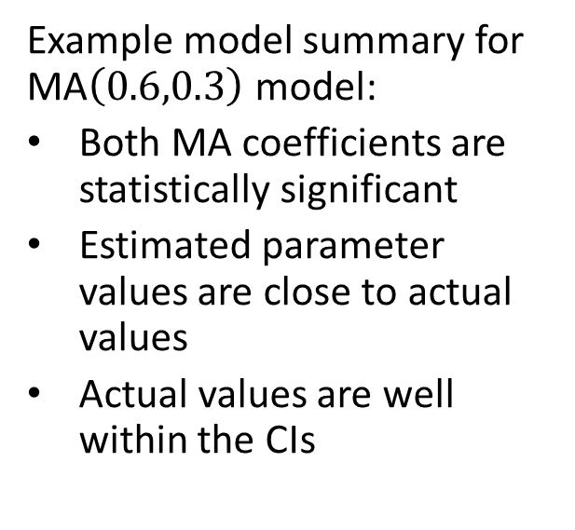
Example: Moving Average Model
Example model summary for MA$\left(0.6,0.3\right)$ model:
Both MA coefficients are statistically significant
Estimated parameter values are close to actual values
Actual values are well within the CIs

Slide 26
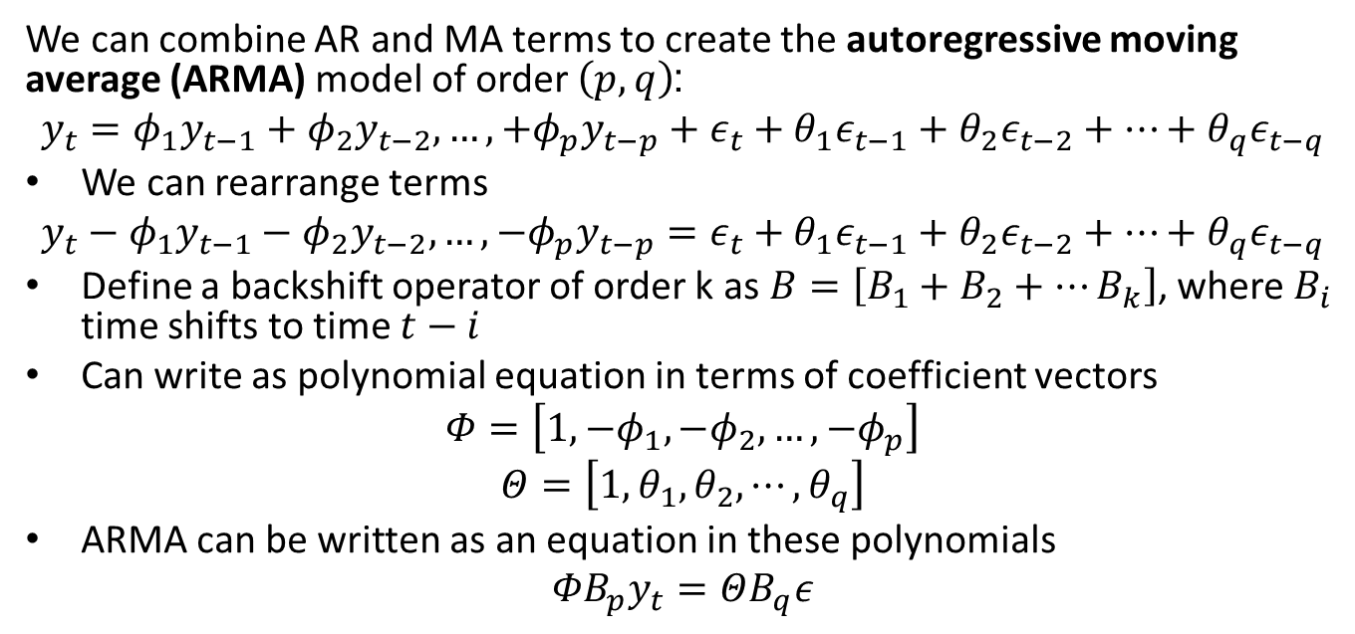
Autoregressive Moving Average Model
We can combine AR and MA terms to create the autoregressive moving average (ARMA) model of order $\left(p,q\right)$:
$$y_{t}=φ_{1}y_{t−1}+φ_{2}y_{t−2},…,+φ_{p}y_{t−p}+ε_{t}+θ_{1}ε_{t−1}+θ_{2}ε_{t−2}+⋯+θ_{q}ε_{t−q}$$
We can rearrange terms
$$y_{t}−φ_{1}y_{t−1}−φ_{2}y_{t−2},…,−φ_{p}y_{t−p}=ε_{t}+θ_{1}ε_{t−1}+θ_{2}ε_{t−2}+⋯+θ_{q}ε_{t−q}$$
Define a backshift operator of order k as $B=\left[B_{1}+B_{2}+…B_{k}\right]$, where $B_{i}$ time shifts to time $t−i$
Can write as polynomial equation in terms of coefficient vectors
$$Φ=\left[1,{−φ}_{1},−φ_{2},…,{−φ}_{p}\right]$$
$$Θ=\left[1,θ_{1},θ_{2},⋯,θ_{q}\right]$$
ARMA can be written as an equation in these polynomials
$${{ΦB}_{p}y}_{t}=ΘB_{q}ε$$

Slide 27
The ARIMA Model
An integrative term addresses some non-stationary components of a time series
Random walks
Trends
Based on difference operator
Typically first order seasonal and non-seasonal differences
Is deterministic, no model coefficient to estimate

Slide 28
The ARIMA Model
The autoregressive integrative moving average (ARIMA) model includes AR, integrative and MA terms
The order of an ARIMA is specified as (p,d,q)
p is the AR order
d is the order of differencing
q is the MA order
The integrative term transforms time series with trend and random walks to stationarity
First order differencing does not account for seasonal effect

Slide 29
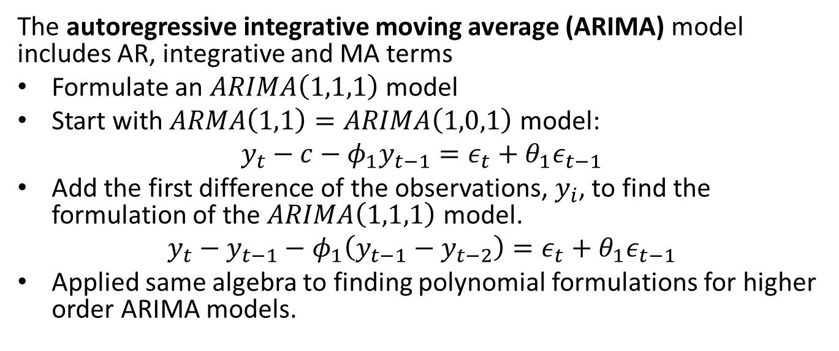
The ARIMA Model
The autoregressive integrative moving average (ARIMA) model includes AR, integrative and MA terms
Formulate an $ARIMA\left(1,1,1\right)$ model
Start with $ARMA\left(1,1\right)=ARIMA\left(1,0,1\right)$ model:
$$y_{t}−c−φ_{1}y_{t−1}=ε_{t}+θ_{1}ε_{t−1}$$
Add the first difference of the observations, $y_{i}$, to find the formulation of the $ARIMA\left(1,1,1\right)$ model.
$$y_{t}−y_{t−1}−φ_{1}\left(y_{t−1}−y_{t−2}\right)=ε_{t}+θ_{1}ε_{t−1}$$
Applied same algebra to finding polynomial formulations for higher order ARIMA models.

Slide 30
Seasonal Models
Several possible seasonal models
Seasonal effects can be periodic or single event (e.g. holiday, game day, etc.)
Linear regression model to find effect for each time step in period
STL decomposition
Fourier decomposition
Accommodates multiple periods of seasonality
Used by PROFIT model, Statsmodels and others
SARIMAX, the S term, requires:
Known period of the cycle or time of seasonal event
Additive or logarithmic transformation (multiplicative)

Slide 31
SARIMAX Model
The SARIMAX model adds seasonal and exogenous terms
Order of SARIMAX model is specified as (p,d,q)(P,D,Q,S)
ARIMA terms are same, (p,d,q)
Seasonal terms:
Seasonal ARIMA model, order (P,D,Q,S)
Must specify period, S, seasonal difference order, D
See Statsmodels State Space User Guide for more details and examples

Slide 32
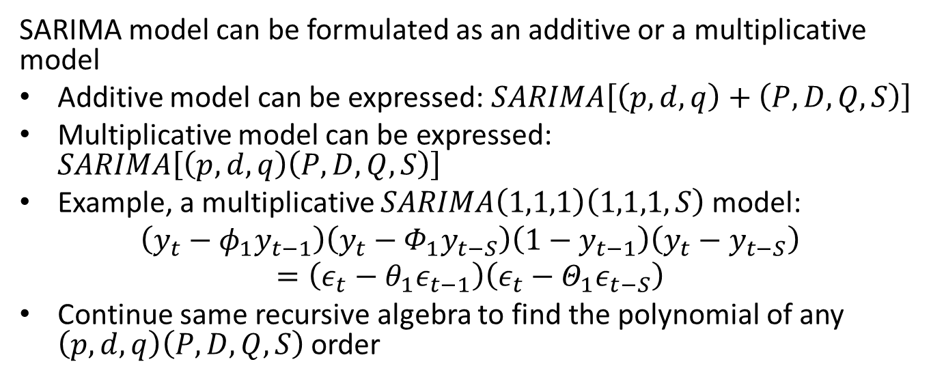
SARIMAX Model
SARIMA model can be formulated as an additive or a multiplicative model
Additive model can be expressed: $SARIMA\left[\left(p,d,q\right)+\left(P,D,Q,S\right)\right]$
Multiplicative model can be expressed: $SARIMA\left[\left(p,d,q\right)\left(P,D,Q,S\right)\right]$
Example, a multiplicative $SARIMA\left(1,1,1\right)\left(1,1,1,S\right)$ model:
$$\left(y_{t}−φ_{1}y_{t−1}\right)\left(y_{t}−Φ_{1}y_{t−S}\right)\left(1−y_{t−1}\right)\left(y_{t}−y_{t−S}\right)=\left(ε_{t}−θ_{1}ε_{t−1}\right)\left(ε_{t}−Θ_{1}ε_{t−S}\right)$$
Continue same recursive algebra to find the polynomial of any $\left(p,d,q\right)\left(P,D,Q,S\right)$ order

Slide 33
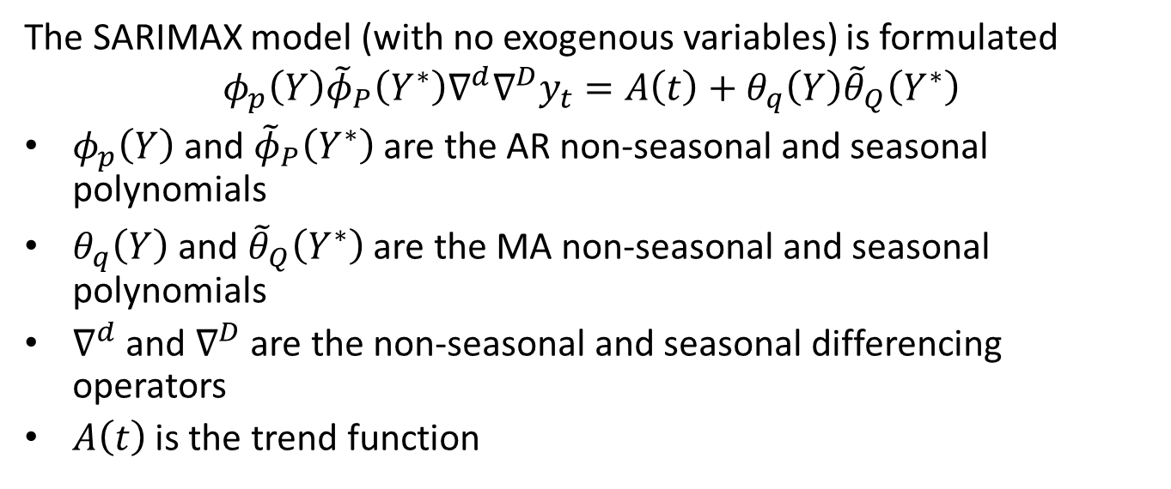
SARIMAX Model
The SARIMAX model (with no exogenous variables) is formulated
$$φ_{p}\left(Y\right){\tilde{φ}}_{P}\left(Y^{∗}\right)∇^{d}∇^{D}y_{t}=A\left(t\right)+θ_{q}\left(Y\right){\tilde{θ}}_{Q}\left(Y^{∗}\right)$$
$φ_{p}\left(Y\right)$ and ${\tilde{φ}}_{P}\left(Y^{∗}\right)$ are the AR non-seasonal and seasonal polynomials
$θ_{q}\left(Y\right)$ and ${\tilde{θ}}_{Q}\left(Y^{∗}\right)$ are the MA non-seasonal and seasonal polynomials
$∇^{d}$ and $∇^{D}$ are the non-seasonal and seasonal differencing operators
$A\left(t\right)$ is the trend function

Slide 34
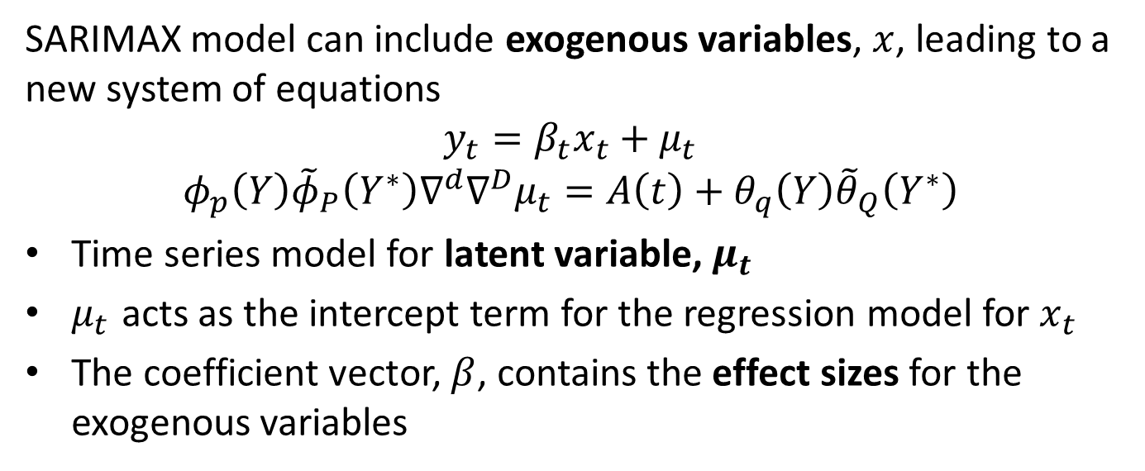
SARIMAX Model
SARIMAX model can include exogenous variables, $x$, leading to a new system of equations
$$y_{t}=β_{t}x_{t}+μ_{t}$$
$$φ_{p}\left(Y\right){\tilde{φ}}_{P}\left(Y^{∗}\right)∇^{d}∇^{D}μ_{t}=A\left(t\right)+θ_{q}\left(Y\right){\tilde{θ}}_{Q}\left(Y^{∗}\right)$$
Time series model for latent variable, $μ_{t}$
$μ_{t}$ acts as the intercept term for the regression model for $x_{t}$
The coefficient vector, $β$, contains the effect sizes for the exogenous variables

Slide 35
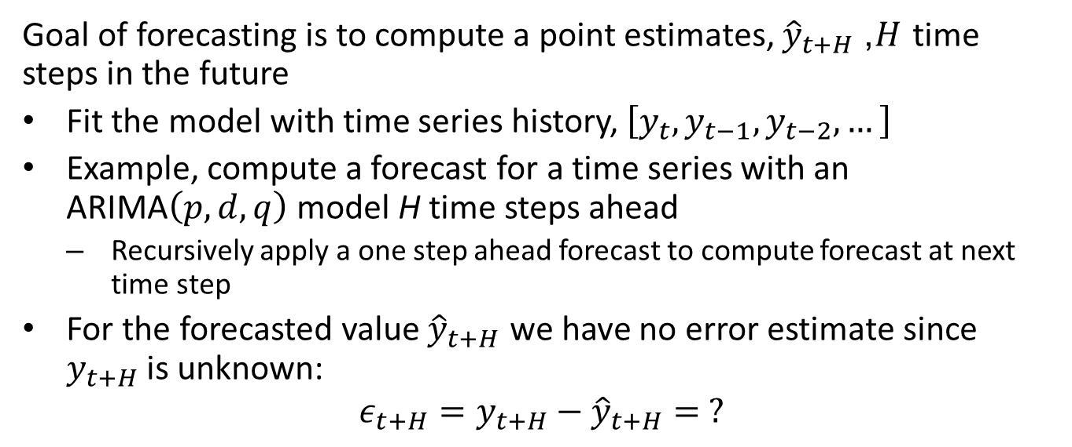
Forecasting with the ARIMA model
Goal of forecasting is to compute a point estimates, ${\hat{y}}_{t+H}$, $H$ time steps in the future
Fit the model with time series history, $\left[y_{t},y_{t−1},y_{t−2},…\right]$
Example, compute a forecast for a time series with an ARIMA$\left(p,d,q\right)$ model H time steps ahead
Recursively apply a one step ahead forecast to compute forecast at next time step
For the forecasted value ${\hat{y}}_{t+H}$ we have no error estimate since $y_{t+H}$is unknown:
$$ε_{t+H}=y_{t+H}−{\hat{y}}_{t+H}= ?$$

Slide 36
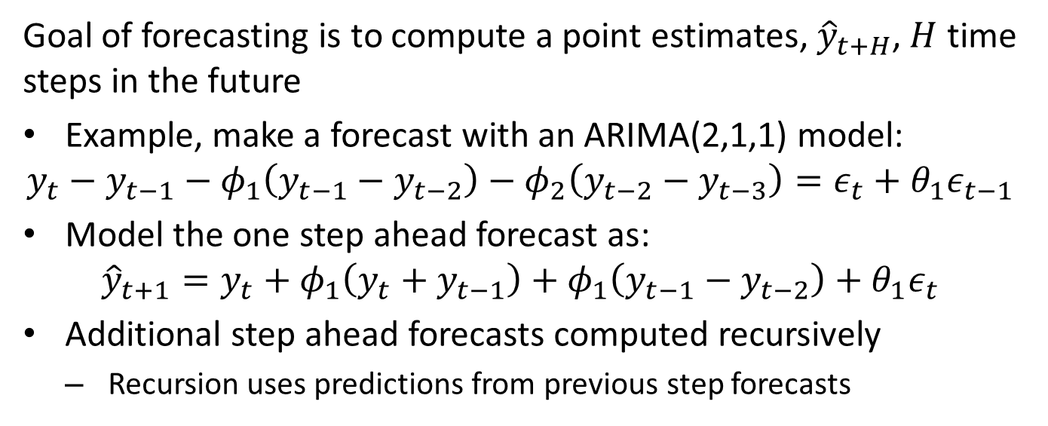
Forecasting with the ARIMA model
Goal of forecasting is to compute a point estimates, ${\hat{y}}_{t+H}$, $H$ time steps in the future
Example, make a forecast with an ARIMA(2,1,1) model:
$$y_{t}−y_{t−1}−φ_{1}\left(y_{t−1}−y_{t−2}\right)−φ_{2}\left(y_{t−2}−y_{t−3}\right)=ε_{t}+θ_{1}ε_{t−1}$$
Model the one step ahead forecast as:
$${\hat{y}}_{t+1}=y_{t}+φ_{1}\left(y_{t}+y_{t−1}\right)+φ_{1}\left(y_{t−1}−y_{t−2}\right)+θ_{1}ε_{t}$$
Additional step ahead forecasts computed recursively
Recursion uses predictions from previous step forecasts

Slide 37
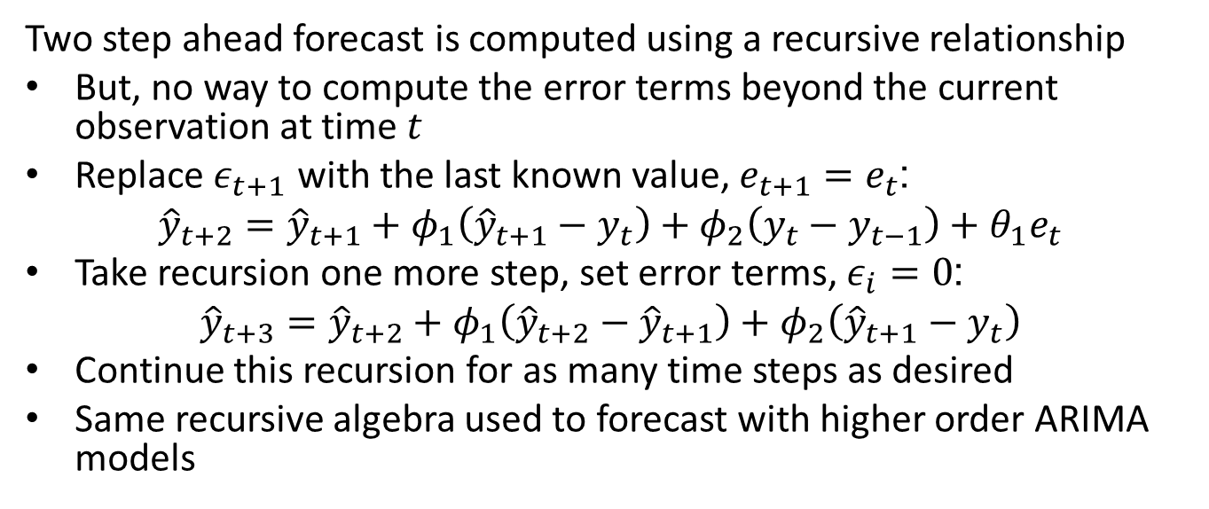
Forecasting with the ARIMA model
Two step ahead forecast is computed using a recursive relationship
But, no way to compute the error terms beyond the current observation at time $t$
Replace $ε_{t+1}$ with the last known value, $e_{t+1}=e_{t}$:
$${\hat{y}}_{t+2}={\hat{y}}_{t+1}+φ_{1}\left({\hat{y}}_{t+1}−y_{t}\right)+φ_{2}\left(y_{t}−y_{t−1}\right)+θ_{1}e_{t}$$
Take recursion one more step, set error terms, $ε_{i}=0$:
$${\hat{y}}_{t+3}={\hat{y}}_{t+2}+φ_{1}\left({\hat{y}}_{t+2}−{\hat{y}}_{t+1}\right)+φ_{2}\left({\hat{y}}_{t+1}−y_{t}\right)$$
Continue this recursion for as many time steps as desired
Same recursive algebra used to forecast with higher order ARIMA models

Slide 38
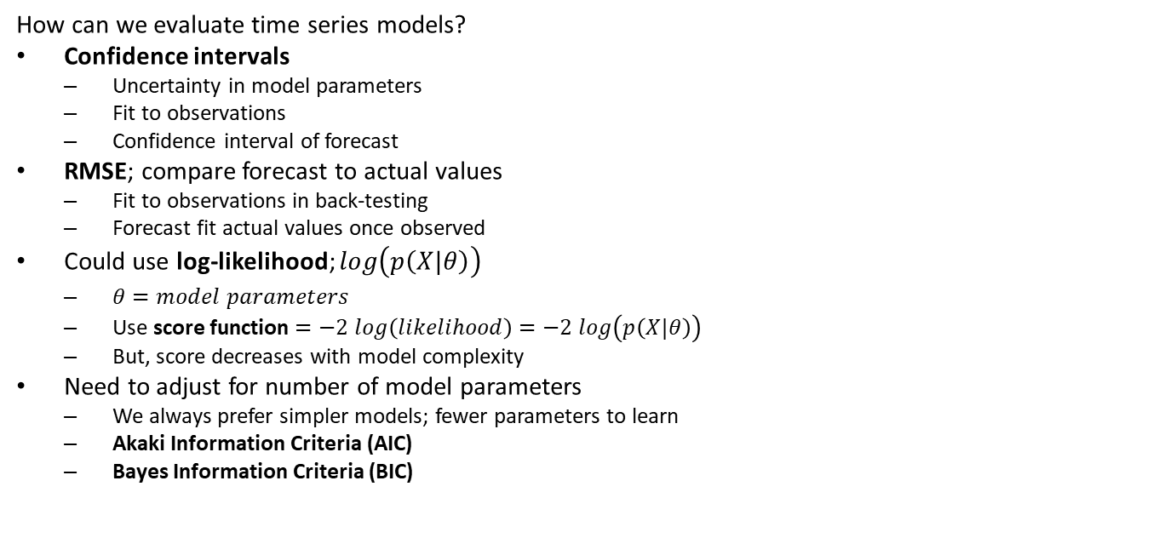
Evaluating and Comparing Time Series Models
How can we evaluate time series models?
Confidence intervals
Uncertainty in model parameters
Fit to observations
Confidence interval of forecast
RMSE; compare forecast to actual values
Fit to observations in back-testing
Forecast fit actual values once observed
Could use log-likelihood; $log\left(p\left(X|θ\right)\right)$
$θ=model parameters$
Use score function $=−2 log\left(likelihood\right)=−2 log\left(p\left(X|θ\right)\right)$
But, score decreases with model complexity
Need to adjust for number of model parameters
We always prefer simpler models; fewer parameters to learn
Akaki Information Criteria (AIC)
Bayes Information Criteria (BIC)

Slide 39
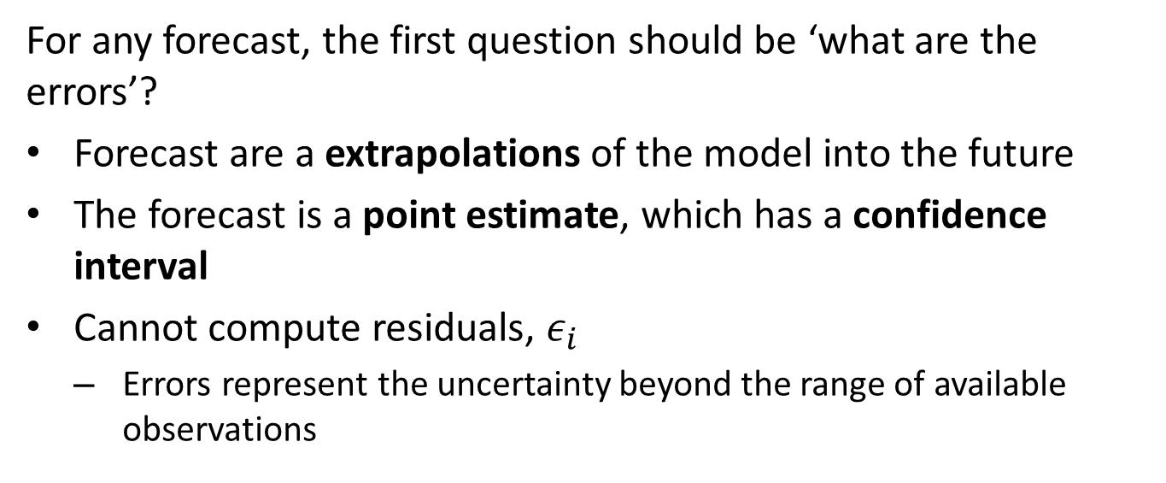
Forecast Confidence Intervals
For any forecast, the first question should be ‘what are the errors’?
Forecast are a extrapolations of the model into the future
The forecast is a point estimate, which has a confidence interval
Cannot compute residuals, $ε_{i}$
Errors represent the uncertainty beyond the range of available observations

Slide 40
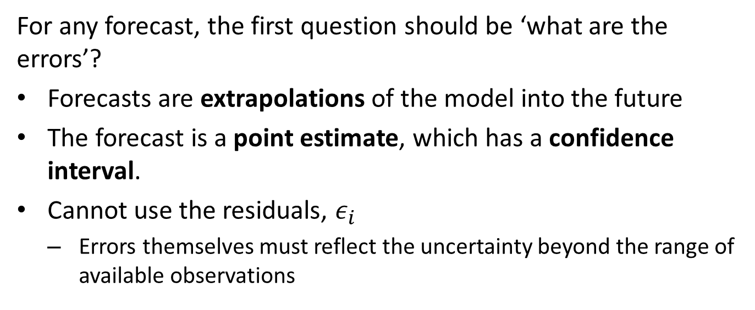
Forecast Confidence Intervals
For any forecast, the first question should be ‘what are the errors’?
Forecasts are extrapolations of the model into the future
The forecast is a point estimate, which has a confidence interval.
Cannot use the residuals, $ε_{i}$
Errors themselves must reflect the uncertainty beyond the range of available observations

Slide 41
Forecast Confidence Intervals
Several methods commonly used to compute confidence intervals:
Theoretical sampling distribution:
Compute confidence intervals from a theoretical sampling distribution
Deriving a suitable distribution can be difficult
Actual sampling distribution is invariably different
Bootstrap resampling:
Use bootstrap resampling to compute a non-parametric sampling distribution
Bootstrap resampling of time series requires block sampling methods
Confidence intervals are computed from emperical sampling distribution
Back-testing:
Time series model is trained on a portion of the data
Forecasts are made several time steps ahead, and errors calculated based on held-back observations
The training and forecast windows are moved n steps forward
Sampling distribution and the confidence intervals are computed
Compute RMSE, MAE, etc. from the back test

Slide 42
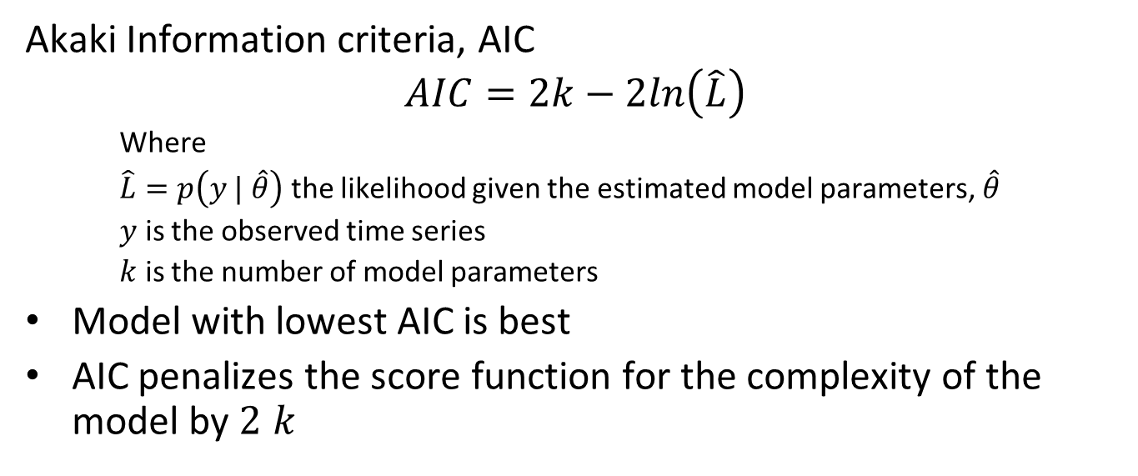
Evaluating and Comparing Time Series Models
Akaki Information criteria, AIC
$$AIC=2k−2ln\left(\hat{L}\right)$$
Where
$\hat{L}=p\left(y | \hat{θ}\right)$ the likelihood given the estimated model parameters, $\hat{θ}$
$y$ is the observed time series
$k$ is the number of model parameters
Model with lowest AIC is best
AIC penalizes the score function for the complexity of the model by $2 k$

Slide 43
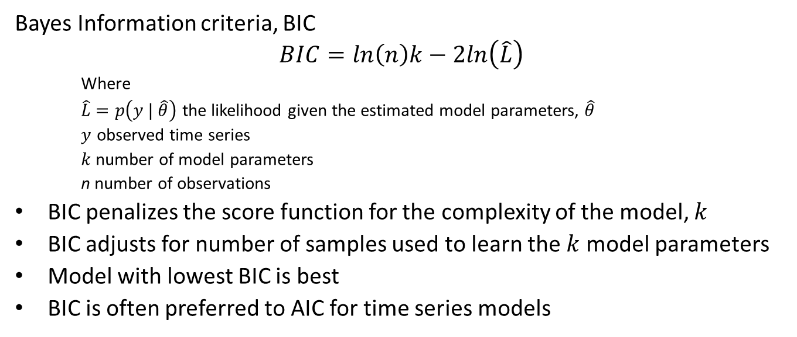
Evaluating and Comparing Time Series Models
Bayes Information criteria, BIC
$$BIC=ln\left(n\right)k−2ln\left(\hat{L}\right)$$
Where
$\hat{L}=p\left(y | \hat{θ}\right)$ the likelihood given the estimated model parameters, $\hat{θ}$
$y$ observed time series
$k$ number of model parameters
n number of observations
BIC penalizes the score function for the complexity of the model, $k$
BIC adjusts for number of samples used to learn the $k$ model parameters
Model with lowest BIC is best
BIC is often preferred to AIC for time series models

Slide 44
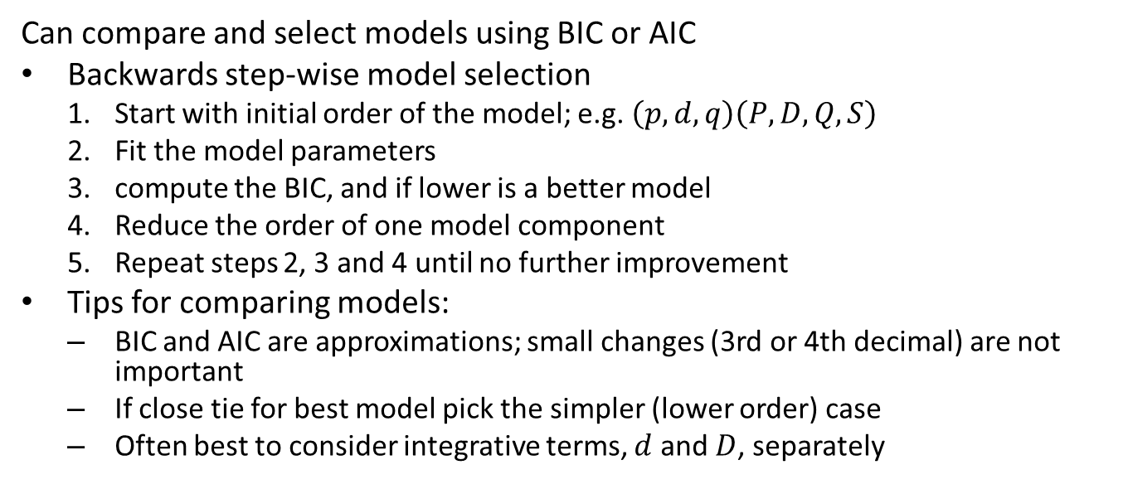
Evaluating and Comparing Time Series Models
Can compare and select models using BIC or AIC
Backwards step-wise model selection
Start with initial order of the model; e.g. $\left(p,d,q\right)\left(P,D,Q,S\right)$
Fit the model parameters
compute the BIC, and if lower is a better model
Reduce the order of one model component
Repeat steps 2, 3 and 4 until no further improvement
Tips for comparing models:
BIC and AIC are approximations; small changes (3rd or 4th decimal) are not important
If close tie for best model pick the simpler (lower order) case
Often best to consider integrative terms, $d$ and $D$, separately

Slide 45
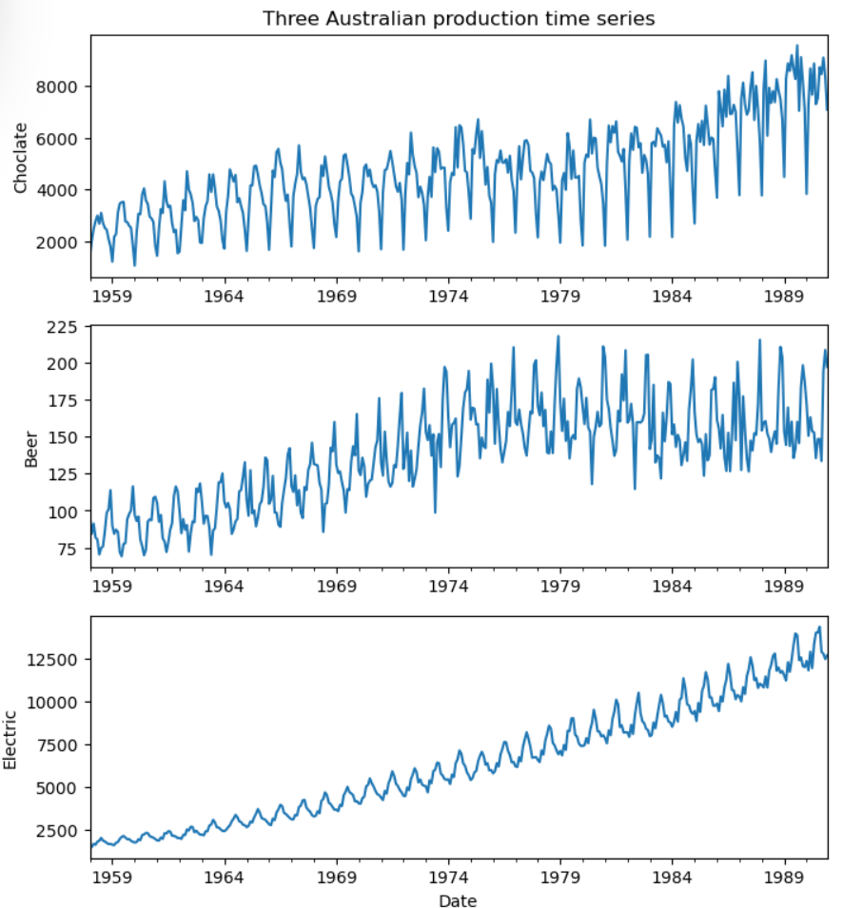
SARIMA Example
Forecasting example dataset
Three time series from Australia
Chocolate production
Beer production
Electricity production
Series have nonlinear trend component
Notice increase in seasonal variation with trend of series

Slide 46
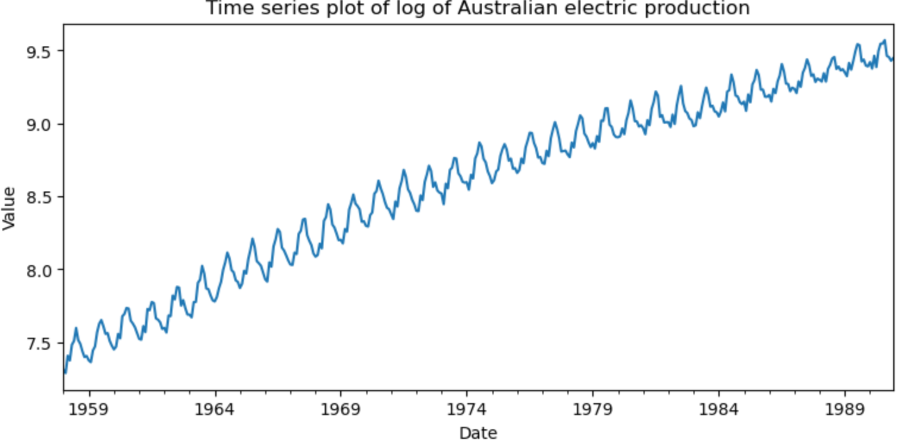
SARIMA Example
Log transform to multiplicative model
Account for seasonal dependency on trend
After log transformation seasonal variation is near constant

Slide 47
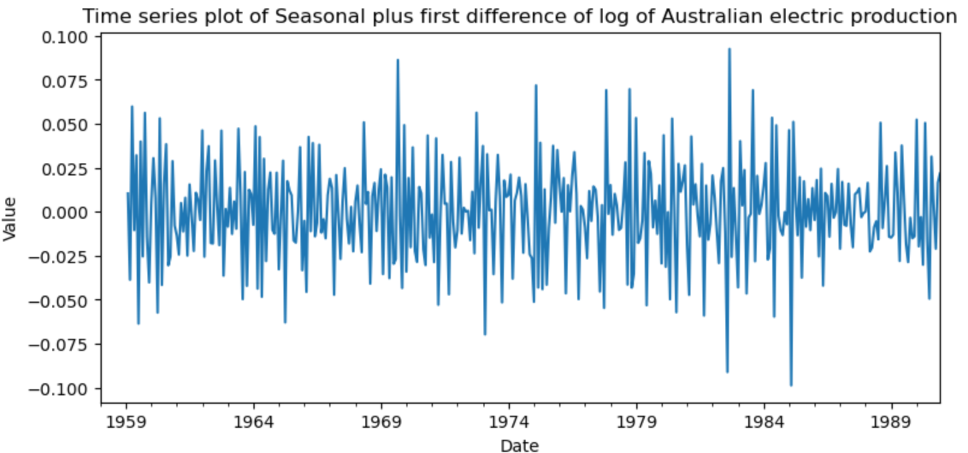
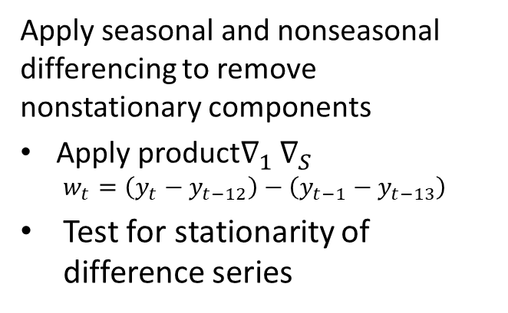
SARIMA Example
Apply seasonal and nonseasonal differencing to remove nonstationary components
Apply product$∇_{1}$ $∇_{S}$
$$w_{t}=\left(y_{t}−y_{t−12}\right)−\left(y_{t−1}−y_{t−13}\right)$$
Test for stationarity of difference series

Slide 48
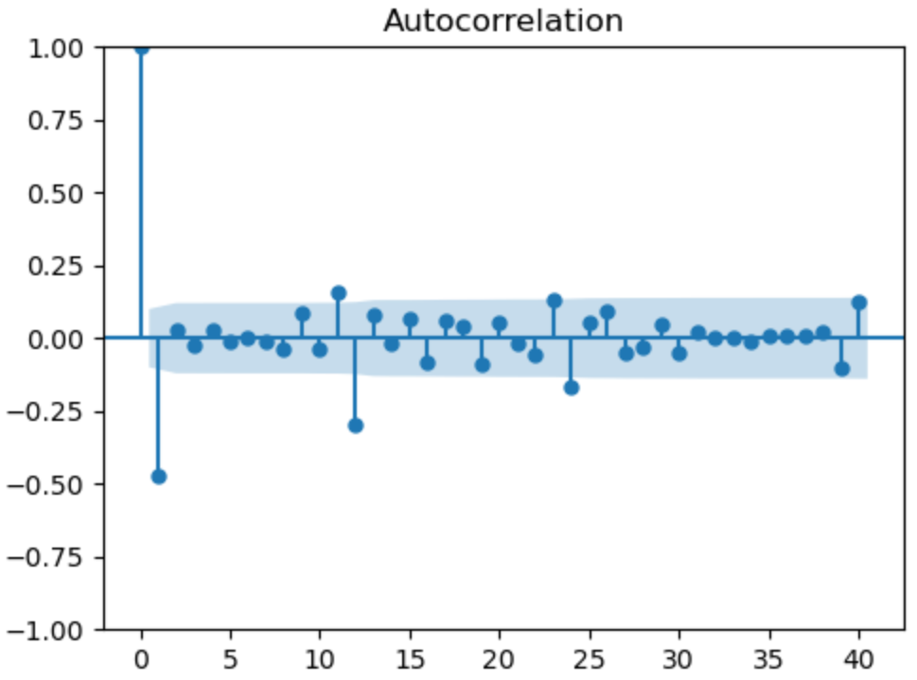
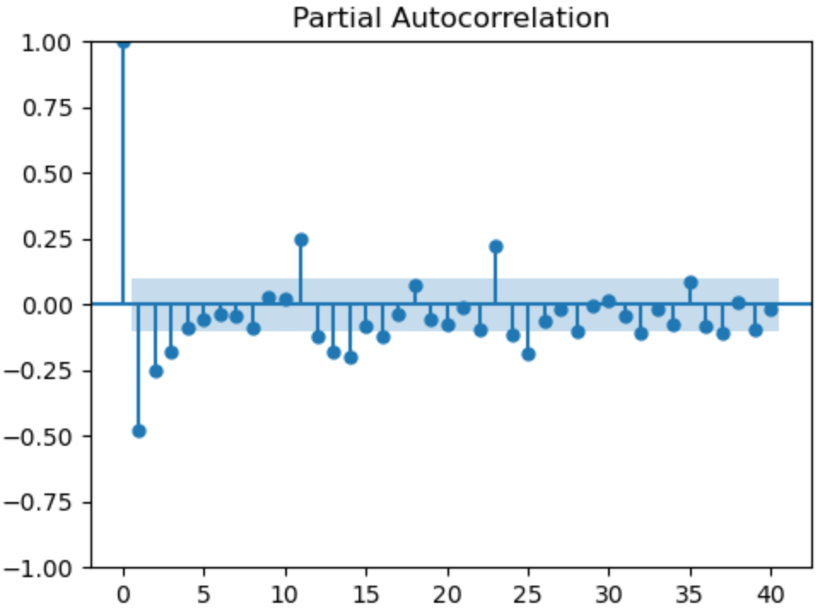
SARIMA Example
Verify the statistical properties of the difference series
ACF and PACF show serial correlation
Nonseasonal dependency
Seasonal dependency

Slide 49
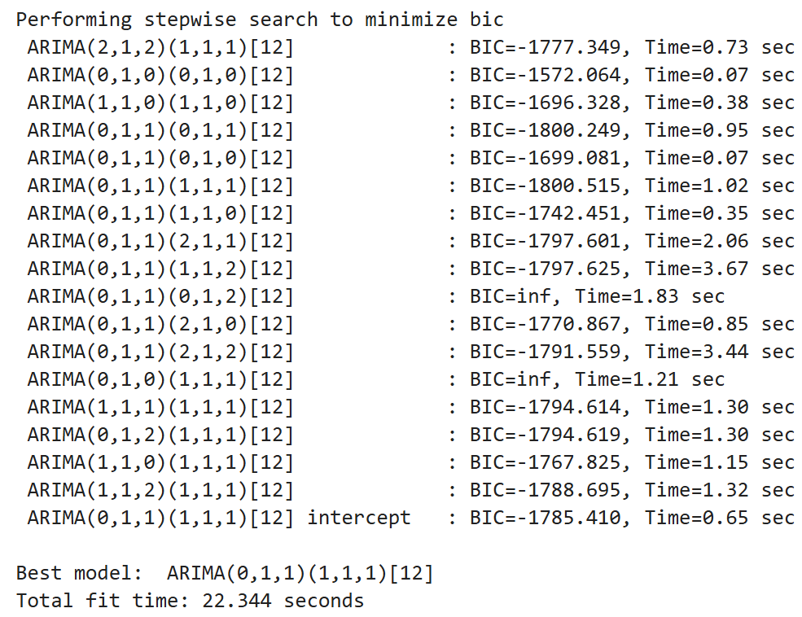

SARIMA Example
Stepwise hyperparameter search for SARIMA parameters by minimum BIC
Based on EDA, fix $d=1, D=1$
Lowest BIC model
$$\left(p,d,q\right)\left(P,D,Q\right)=\left(0,1,1\right)\left(1,1,1\right)$$
Minimum BIC model is nearly identical to simpler model
$$\left(p,d,q\right)\left(P,D,Q\right)=\left(0,1,1\right)\left(1,1,0\right)$$
We choose the more parsimonious (simpler) model

Slide 50


SARIMA Example
Fit the parsimonious model
$$\left(p,d,q\right)\left(P,D,Q\right)=\left(0,1,1\right)\left(1,1,0\right)$$
Coefficients are all significant
Small standard error and CIs
Ljung-Box statistic shows no significant serial correlation
Overall a good model fit!

Slide 51

SARIMA Example
Examine the fit of the prediction
Last 12 months of observations have been held back from training
Compare 12 month forecasts to the held-back observations
Fit looks good
Notice confidence interval increases with forecast time steps

Slide 52

SARIMA Example
Examine the residuals of the forecasts
Residuals are approximately Normally distributed
Residuals have no statistically significant ACF for lag > 0
Residuals have no statistically significant PACF for lag > 0
Short test period, with small number of samples, 12

Slide 53
PROFIT Model
The PROFIT model from Meta Research is a deterministic model well suited for some business forecasting
Uses a sophisticated piece-wise linear trend model
Trend computed between breakpoints
Breakpoints found with Bayesian model
Complex trend model confounded by random walks
Multi-seasonal component modeled by Fourier decomposition
Multiple harmonics per seasonal period
Flexible modeling of complex seasonal patterns
Supports exogenous variables
PROFIT model assumes residual is non-informative

Slide 54

PROFIT Model
The PROFIT model from Meta Research is a deterministic model well suited for some business forecasting
Multi-seasonal component modeled by Fourier decomposition
For component with period, p, we can write the harmonics
$$\sin\left(\frac{2πkt}{p}\right), \cos\left(\frac{2πkt}{p}\right), k=1,2,..k_{max}$$
In most cases, choose $k_{max}≤3−5$ to limit model complexity
Example; a time series with hourly (period=24) and daily (period=7*24=168), the harmonics are written
$$\sin\left(\frac{2πkt}{24}\right), \cos\left(\frac{2πkt}{24}\right), \sin\left(\frac{2πkt}{168}\right), \cos\left(\frac{2πkt}{168}\right), k=1,2,3,..k_{max}$$
If $k_{max}$=4 there are $4×4=16$ coefficients to estimate

Slide 55
PROFIT Model
The PROFIT model from Meta Research is a deterministic model well suited for some business forecasting
PROFIT model assumes residual is non-informative
Model assumes no stochastic components in time series
ACF and PACF must have no significant nonzero lags
If significant ACF and PACF use SARIMAX
Uses information in stationary residual
Gives superior results for time series with stochastic components

Slide 56
Future Directions For Forecasting Models
There is an ongoing explosion of research in forecasting models
As of now, there is little evidence that deep NN models outperform properly applied conventional models
Are Transformers Effective for Time Series Forecasting?, Zeng, et. al., 2022
Are LLMs Actually Useful for Forecasting?, Tan, et. al., 2024
A comparative assessment of SARIMA, LSTM RNN and Fb Prophet models forecast total and peak monthly energy demand for India, Chaturvedi, et.al., 2022
There are a number of promising research directions including,
N-HiTS: Neural Hierarchical Interpolation for Time Series Forecasting, Challu, et.al. 2020
N-BEATS: Neural basis expansion analysis for interpretable time series forecasting, Oreshkin, et. al., 2020

Slide 57
Summary
Time series models must account for serial correlation
e.g. ARIMA and SARIMAX
AR components for serial correlation of values
MA components for serial correlation of errors
Integrative components for random walk and trend, I
Seasonal, (P,D,Q,S)
Exogenous variables, X

Slide 58
Summary
Evaluation and model comparison
RMSE
AIC and BIC, penalize score function for model complexity
Use BIC (or AIC) to perform backwards step-wise model selection

Slide 59

Exponential Smoothing Models
Exponential smoothing models are simple and widely used
Consider the simple first order model
Set initial conditions:
$$s_{0}=y_{0}$$
The smoothed update is:
$$ s_t = \alpha y_t + (1-\alpha) s_{t-1}\\ = s_{t-1} \alpha(y_t - s_{t-1}),\\ t \gt 0 $$
And, the smoothing coefficient is, $0≤α≤1$
But, model only works if no trend

Slide 60

Exponential Smoothing Models
Decay and exponential smoothing
We can understand the smoothing parameter $α$ in terms of a decay constant, $τ$
$$α=1−e^{\left(\frac{ΔT}{τ}\right)}$$
An innovation or shock has an effect for all future time
Effect decays exponentially with time, $ΔT$

Slide 61

Exponential Smoothing Models
Can extend exponential smoothing model to accommodate trend
Algorithm known as double exponential smoothing or Holt-Winters double exponential smoothing
Update smoothed values and slope at each time step
Start with initial values
$$s_1 = y_1\\ b_1 = y_2 - y_1$$
Update relationships for both smoothed value and slope
$$s_t = \alpha y_t + (1-\alpha) (s_{t-1} + b_{t-1})\\ b_t = \beta(s_t - s_{t-1}) + (1 - \beta)b_{t-1}$$
Additional slope smoothing hyperparameter, $0≤β≤1$
Use third order update includes seasonality in Holt-Winters smoother

Slide 62

Exponential Smoothing Models
Exponential smoothing models are useful for forecasting
Forecast dependent on the choice of smoothing parameters
Can forecast with first, second, third order models
For second order model (with trend) the forecast $m$ steps ahead is:
$$F_{t+m}=s_{t}+mb_{t}$$
Third order update include seasonal terms
Holt-Winters smoother is a linear model!

Slide 63


Exponential Smoothing Models
Example of smoothing trend plus white noise series
Decreasing the smoothing parameter, $α$, increases smoothing
Additionally, smooth trend
Additional examples in Statsmodels user documentation

