Slide 1
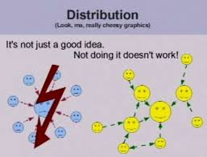
Git is for distributed development

Slide 2
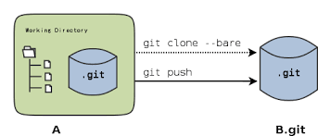
We are all peers
A developer gets not only a complete working copy of the files in a repository, but a complete copy of the repository itself with which to work.
Each git repository is independent and autonomous. All git repositories of the same project should be considered peers, including the centrally based "remote" repository.

Slide 3
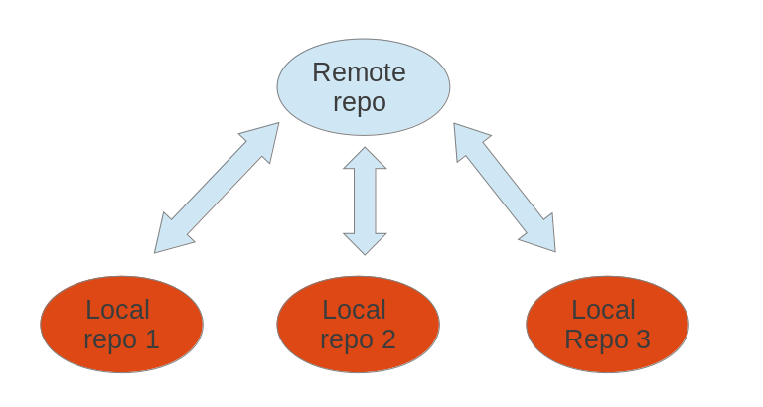
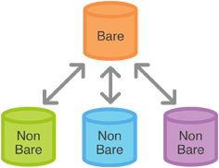
A remote repository is just another git repository that contributors have agreed to be the staging point used to coordinate changes among other distributed repositories.
The only real difference is a remote repository (like a one hosted on github) has is that it is not used for development and is "bare", meaning it has no working directory and is merely the .git folder you see at the root of a development repository.

Slide 4
C:\whennemuth\documentation\bu\git\Git - Git Basics.html

Slide 5
C:\whennemuth\documentation\bu\git\Git - Branches in a Nutshell.html

