Slide 2
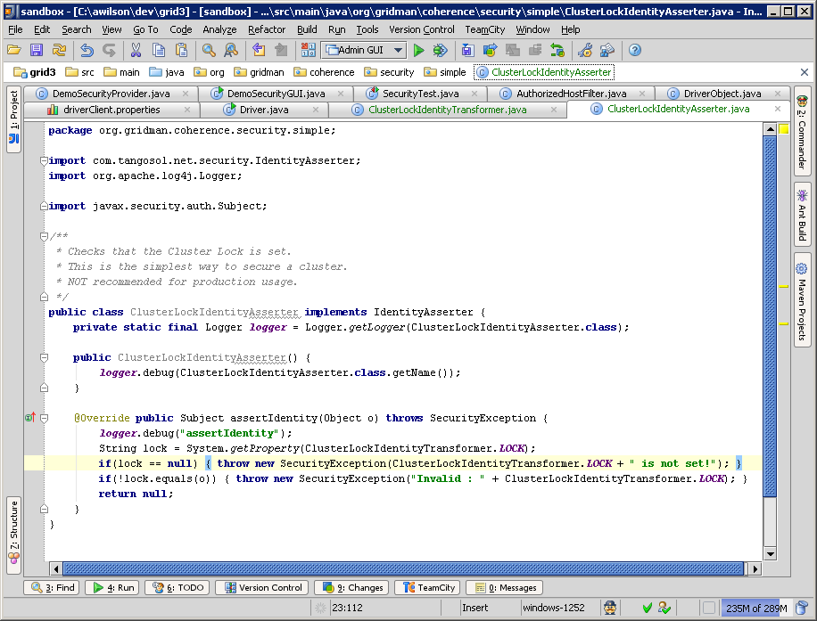
Cluster Lock Asserter

Slide 3
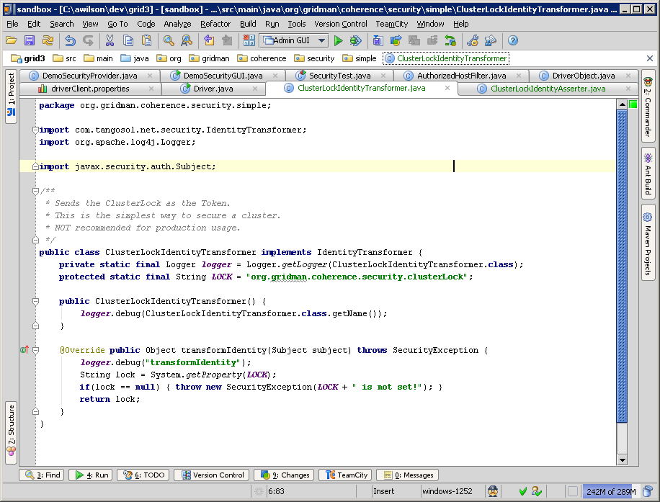
Cluster Lock Transformer

