Slide 1

GRIDMAN
http://code.google.com/p/gridman

Slide 2
Security
Authentication
Authorization
Encryption

Slide 3
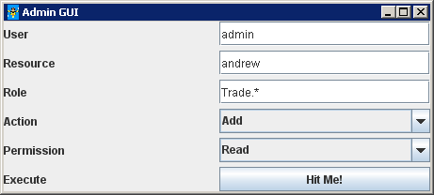
Demo

Slide 4
Key Points
Session Based Security
Cache Based Security
Object level is possible, but may be slow!
Security / Audit hooks
Make sure you perform!
Make sure you scale!

Slide 5
Demo Permission Cache
private String role;
private String resourceName;
private boolean cacheRatherThanInvoke;
private boolean readOnly;

Slide 6
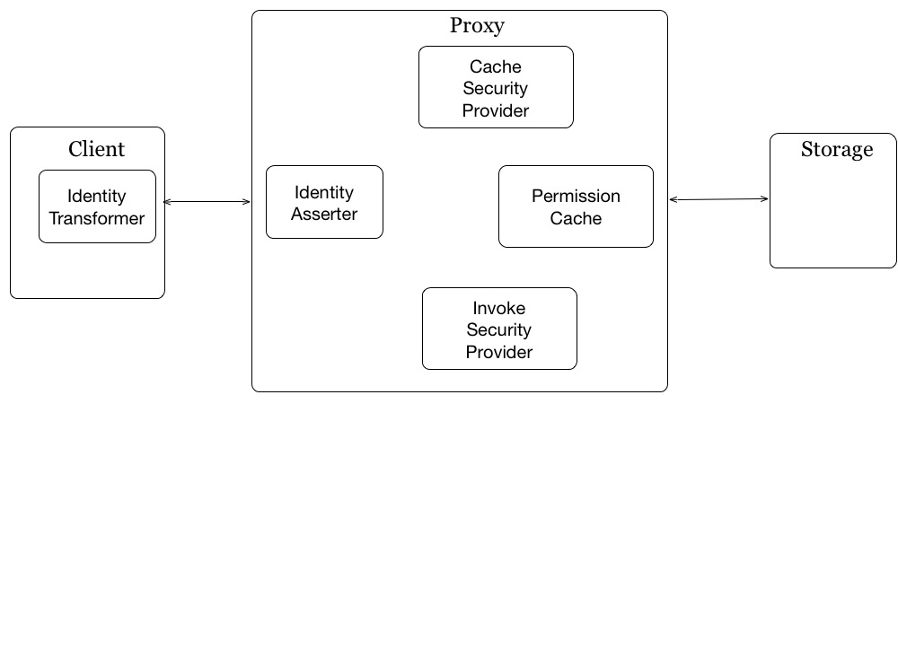
How does it work?

Slide 7
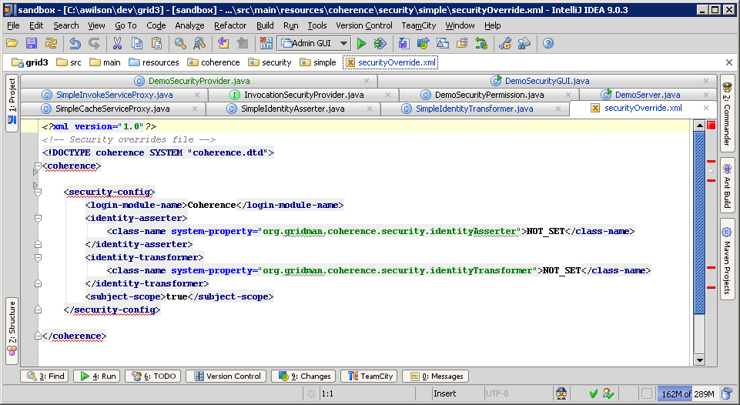
Override Config

Slide 8
How does it work?

Slide 9
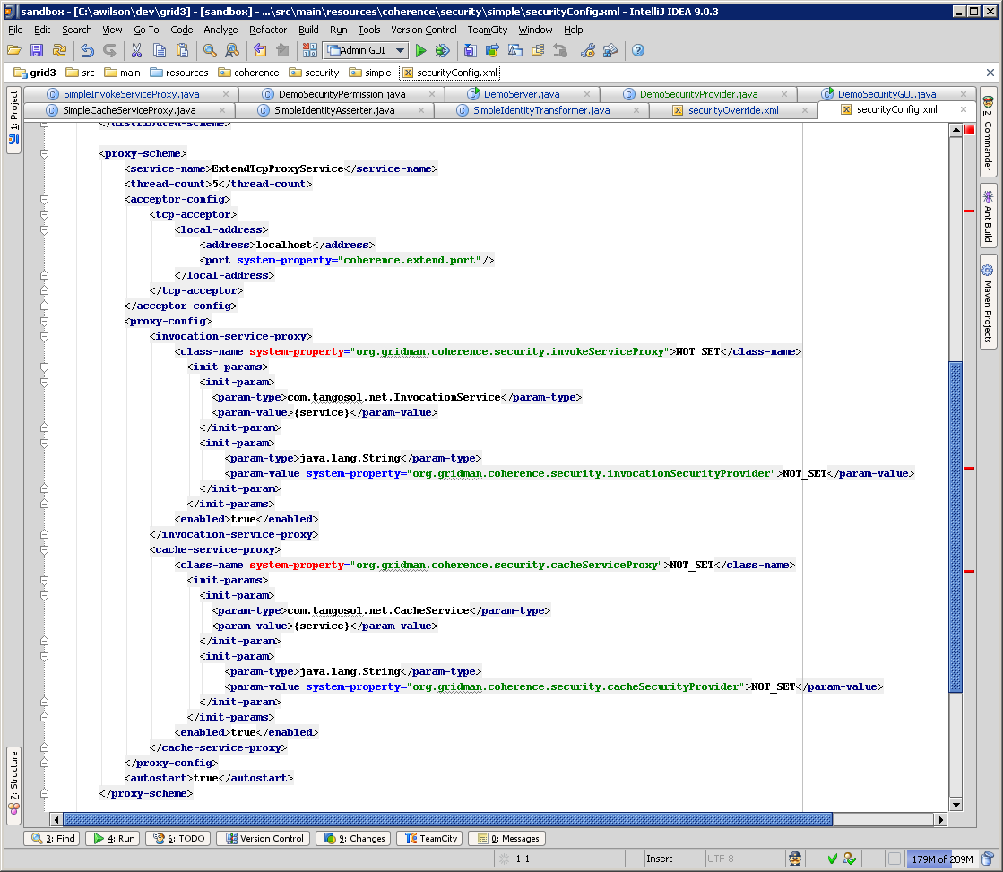
Proxy Config

Slide 10
How does it work?

Slide 11
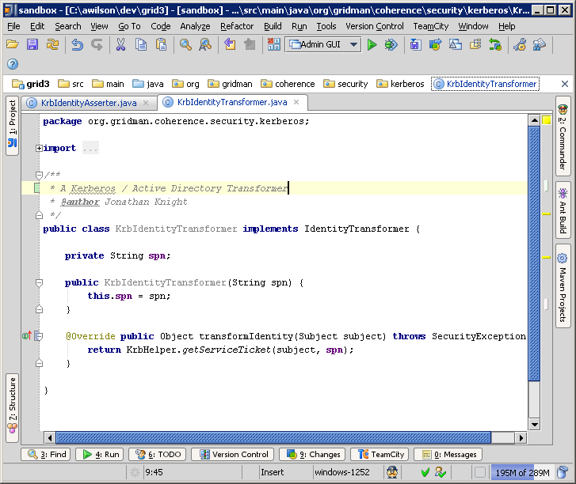
Identity Transformer

Slide 12
How does it work?

Slide 13
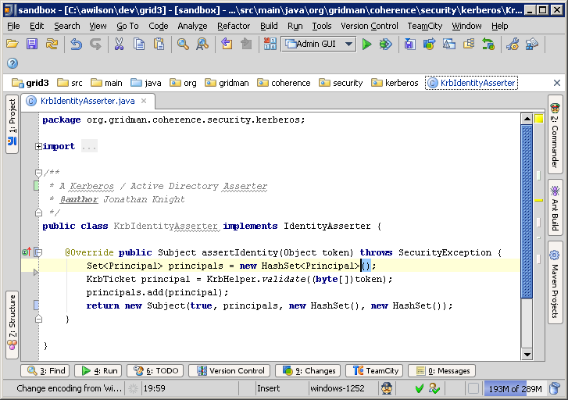
IdentityAsserter

Slide 14
How does it work?

Slide 15
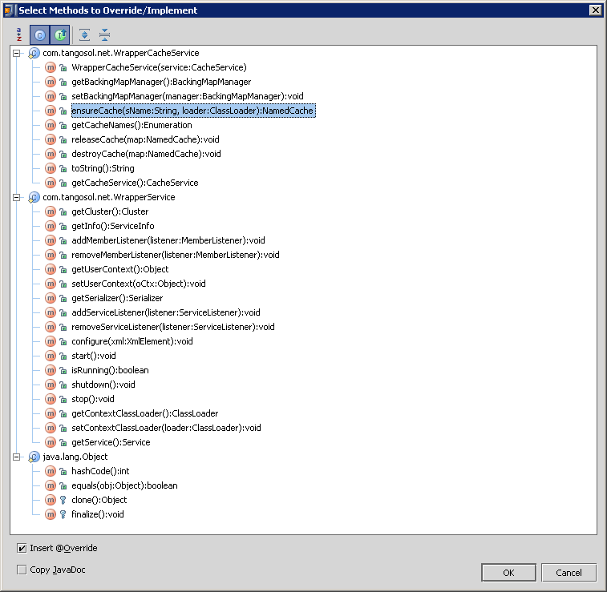
CacheServiceProxy

Slide 16
How does it work?

Slide 17
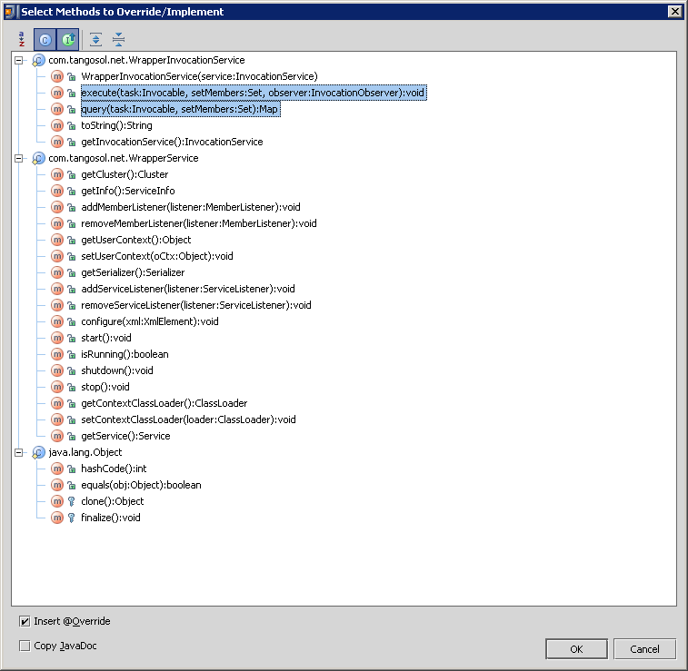
InvocationServiceProxy

Slide 18
How does it work?

Slide 19
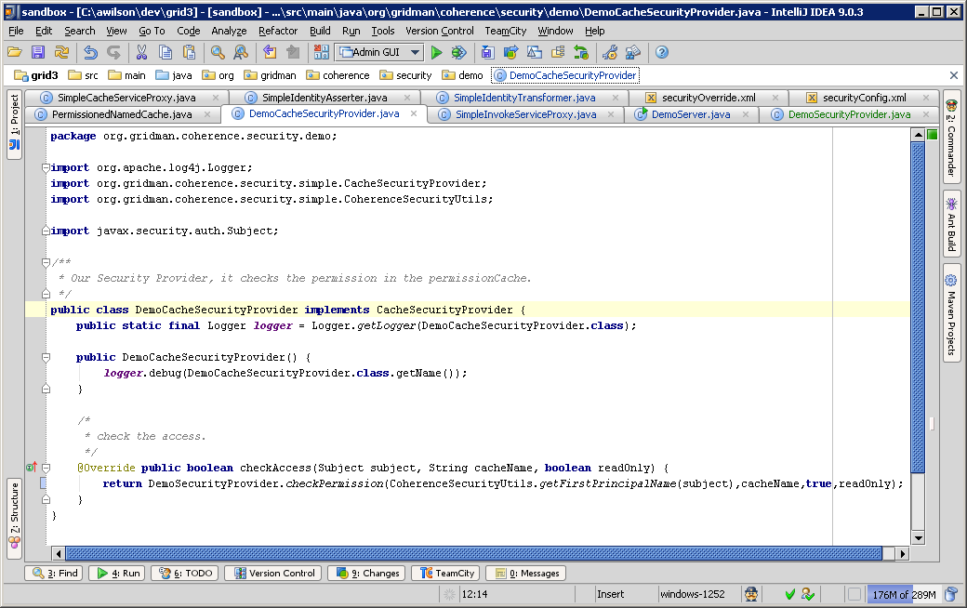
CacheSecurityProvider

Slide 20
How does it work?

Slide 21
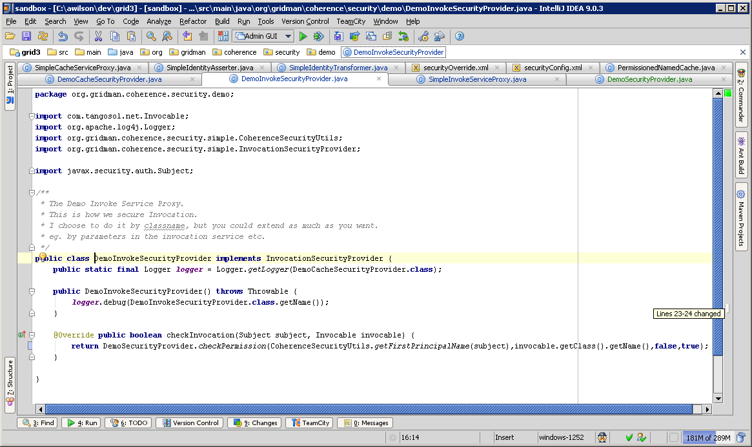
InvocationSecurityProvider
public boolean checkInvocation(Subject subject, Invocable invocable);

Slide 22
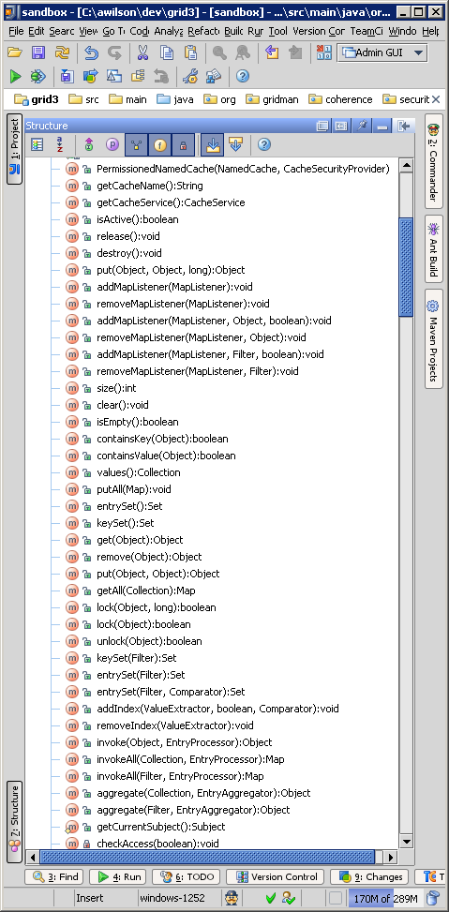
PermissionedNamedCache

Slide 23
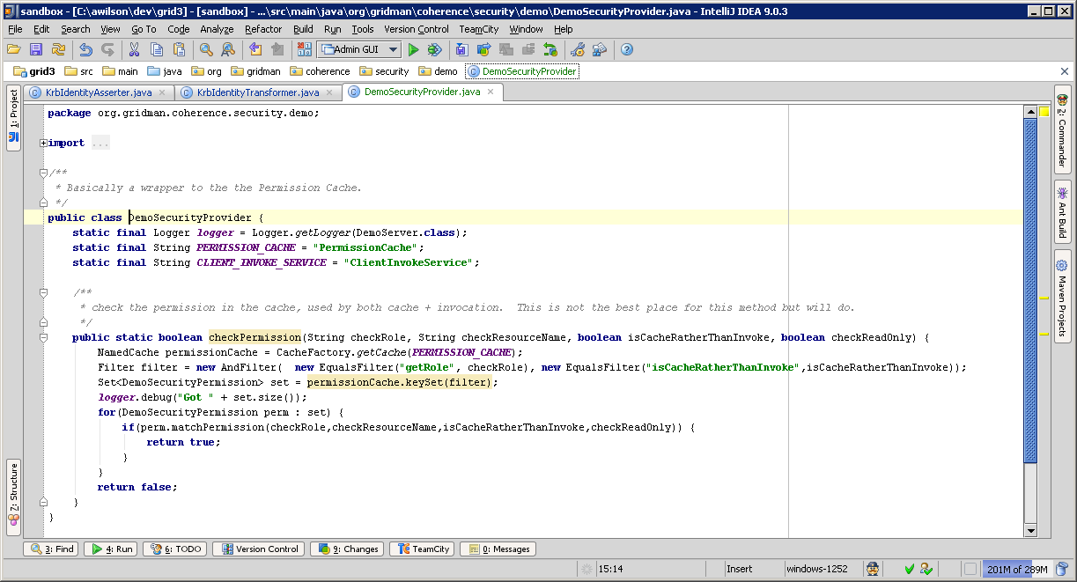
Demo Security Provider

Slide 24
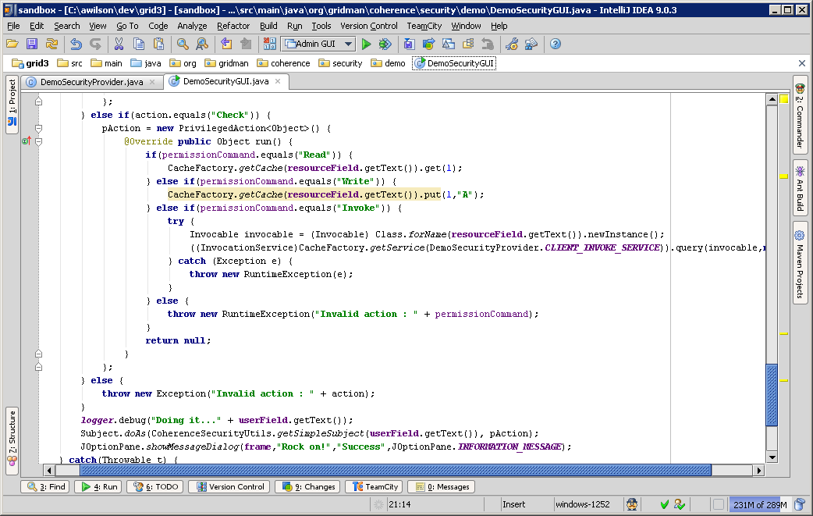
GUI

Slide 25
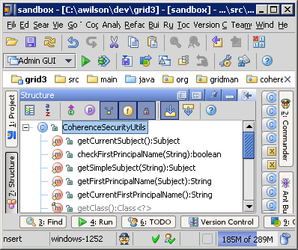
Coherence Security Utils

Slide 26
Gridman
Open Source Coherence Project
  Coherence Security Code (AD)
  ClassloaderCluster
  WAN Replication tests
  Filters / Indexes code
  POFExtractor
  …

Slide 27
ClassLoader Cluster
Test Suite
Storage
Node
Proxy
Node
Storage
Node

Slide 28
Founder members
Andrew Wilson
Jonathan Knight
Keith Loose
… <insert your name here>
TeamCity build : http://teamcity.netance.com

Slide 29
Questions?
http://code.google.com/p/gridman

