Slide 1

GRIDMAN
http://code.google.com/p/gridman

Slide 2
Gridman
Open Source Coherence Project
  Coherence Security Code
  (Kerberos/ActiveDirectory)
  Classloader Cluster
  WAN Replication tests
  Filters / Indexes code
  POFExtractor
  …

Slide 3
Security
History
Authentication
Authorization
Encryption
( Symmetric Encrypted Network Filter )
Make sure you perform!
Make sure you scale!

Slide 4
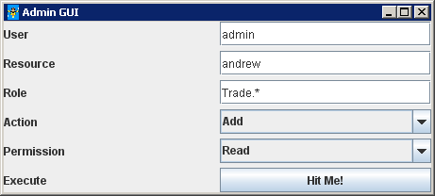
Demo

Slide 5
Key Points
JAAS Security
Proxy security
Session based security
Cache based security
Object level is possible, but may be slow!
Security / Audit hooks

Slide 6
Demo Permission Cache
private String role;
private String resourceName;
private boolean cacheRatherThanInvoke;
private boolean readOnly;

Slide 7
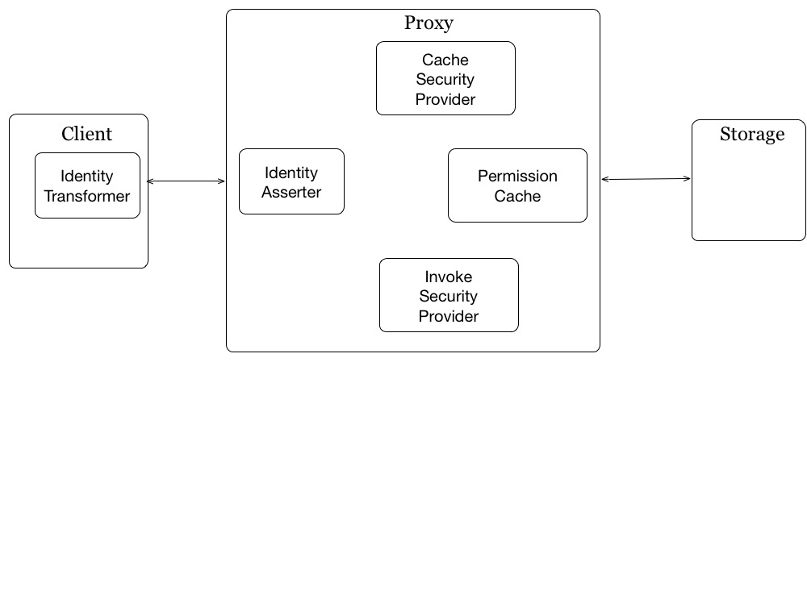
How does it work?

Slide 8
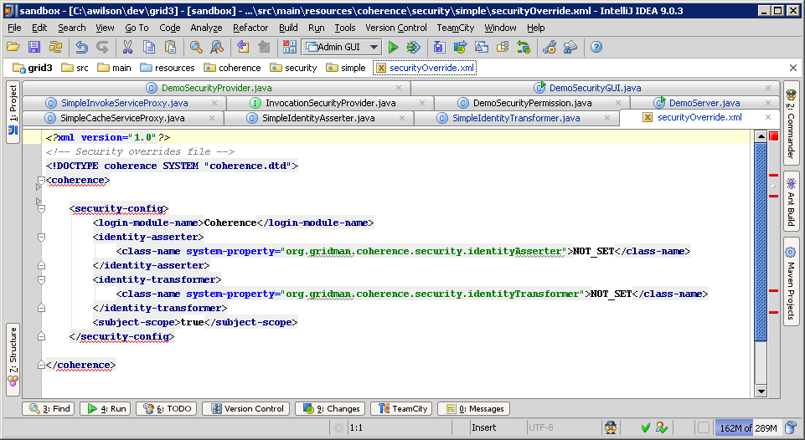
Override Config

Slide 9
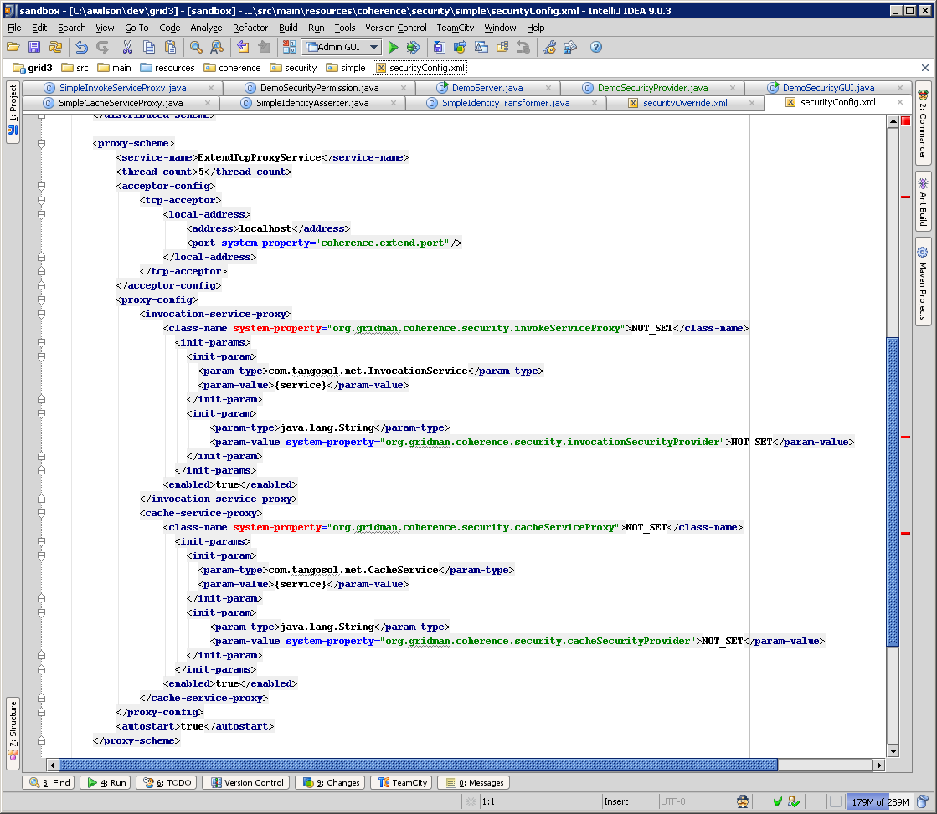
Proxy Config

Slide 10
Identity Transformer

Slide 11
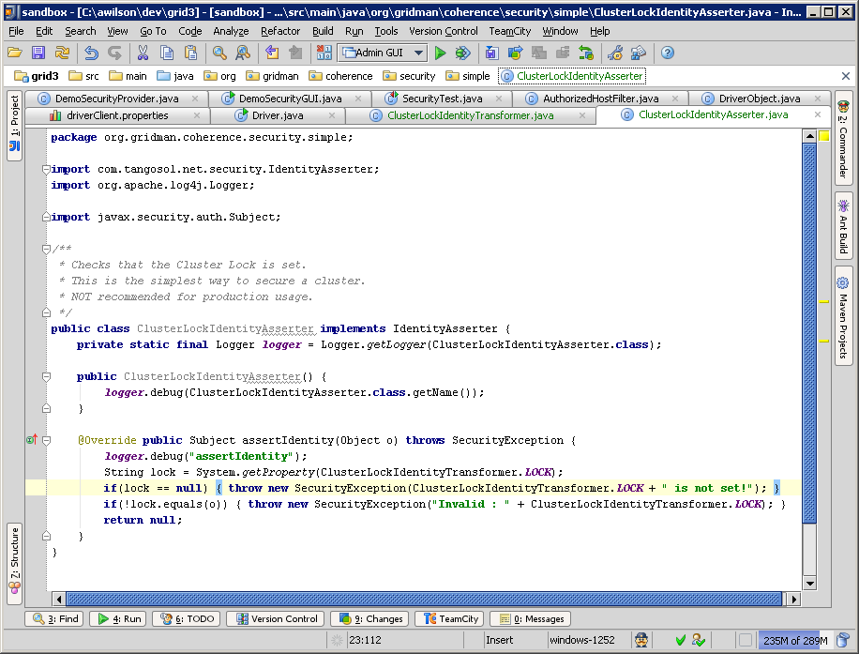
Cluster Lock Asserter

Slide 12
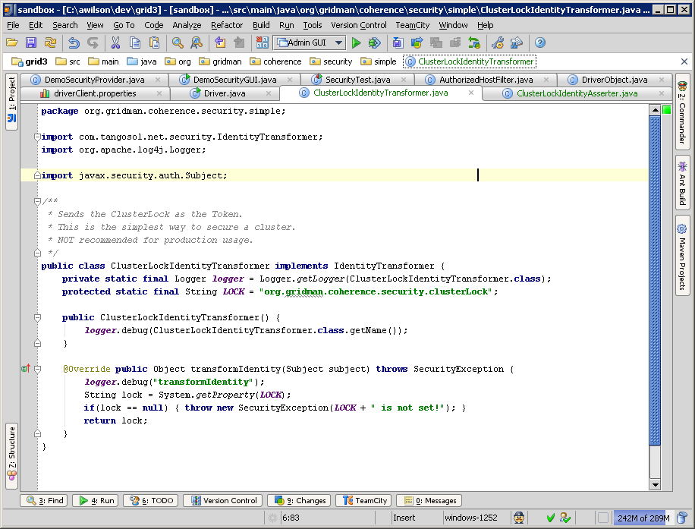
Cluster Lock Transformer

Slide 13
CacheSecurityProvider

Slide 14
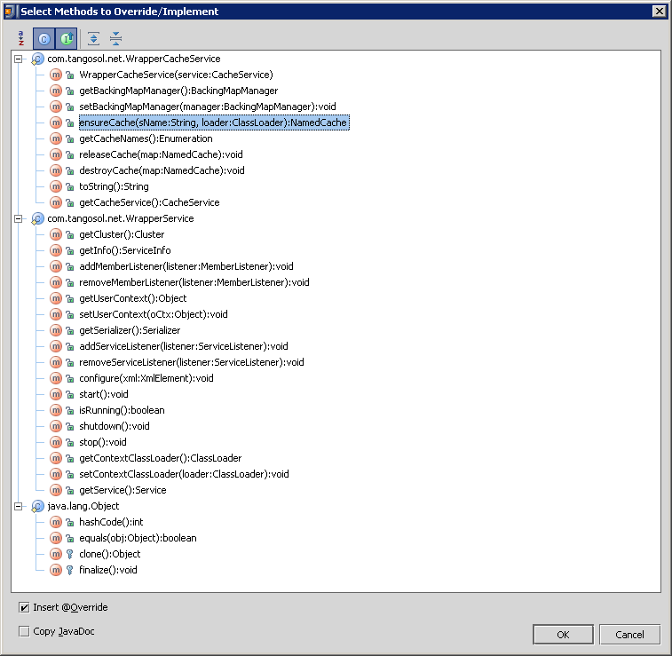
CacheServiceProxy

Slide 15
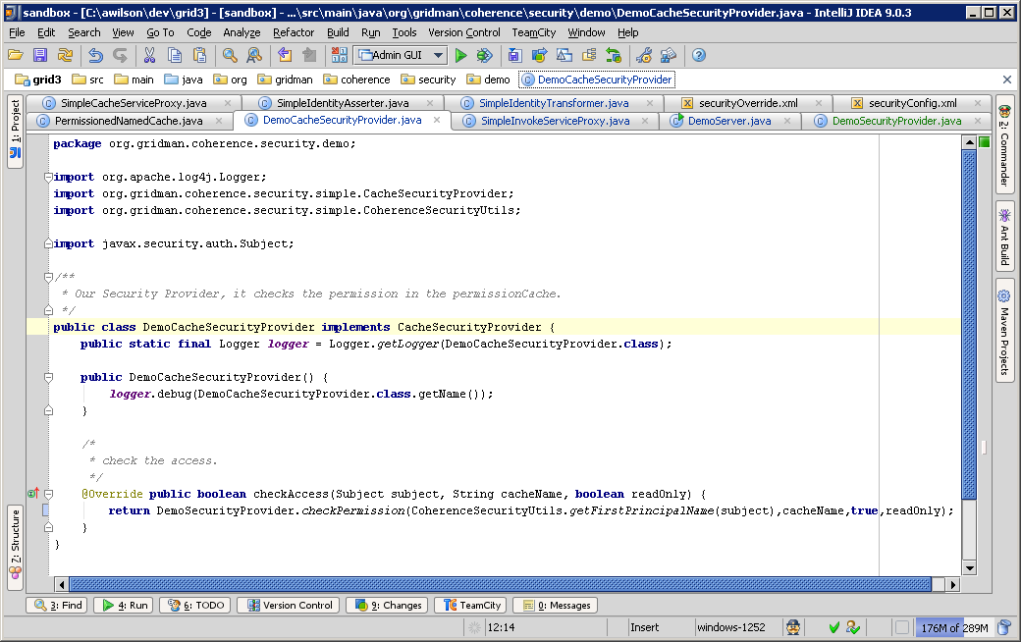
CacheSecurityProvider

Slide 16
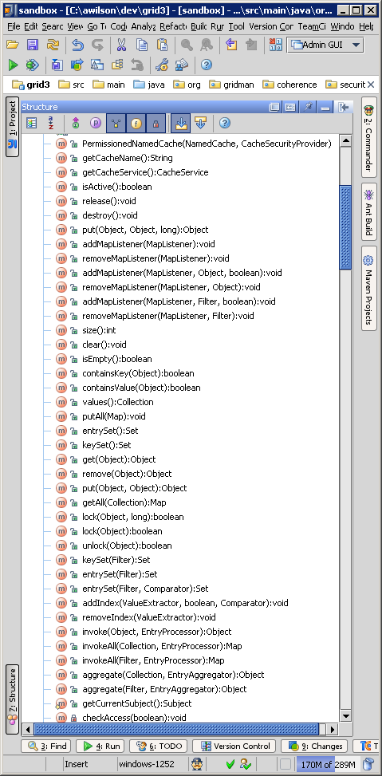

Slide 17
InvocationSecurityProvider

Slide 18
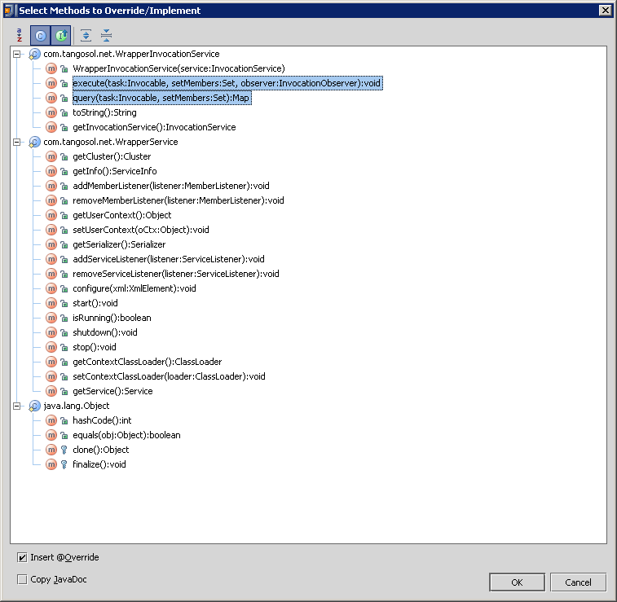

Slide 19
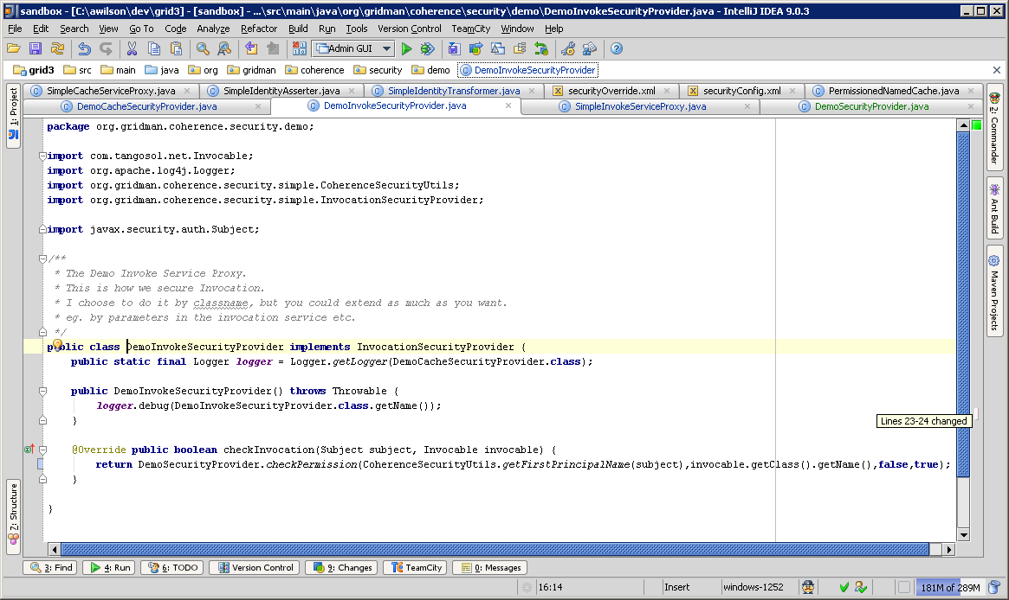
InvocationSecurityProvider
public boolean checkInvocation(Subject subject, Invocable invocable);

Slide 20
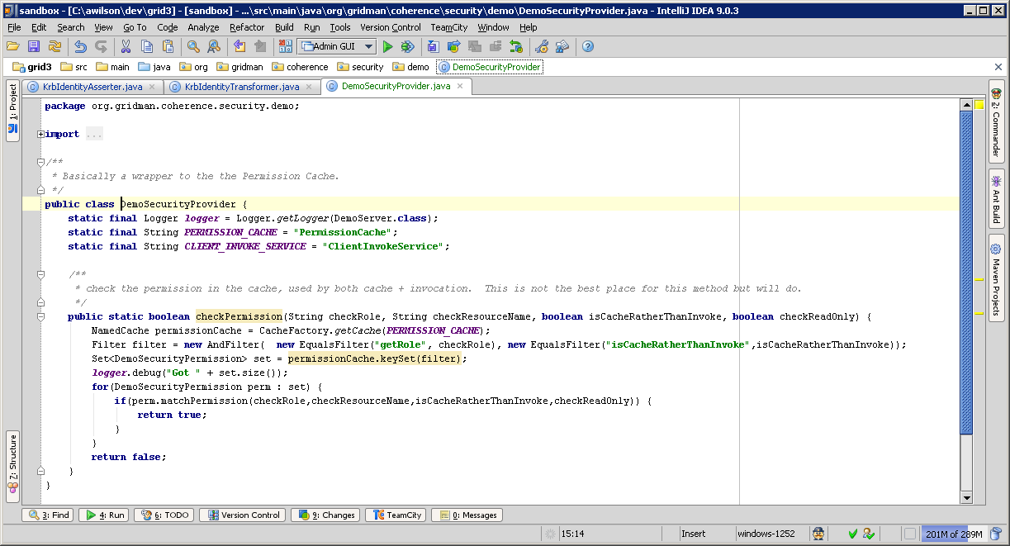
Demo Security Provider

Slide 21
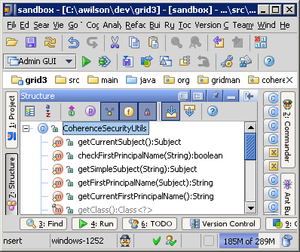
Coherence Security Utils

Slide 22
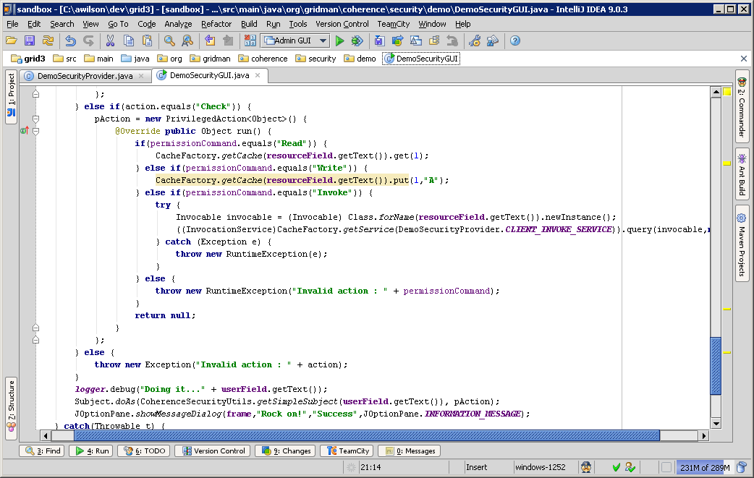
GUI

Slide 23
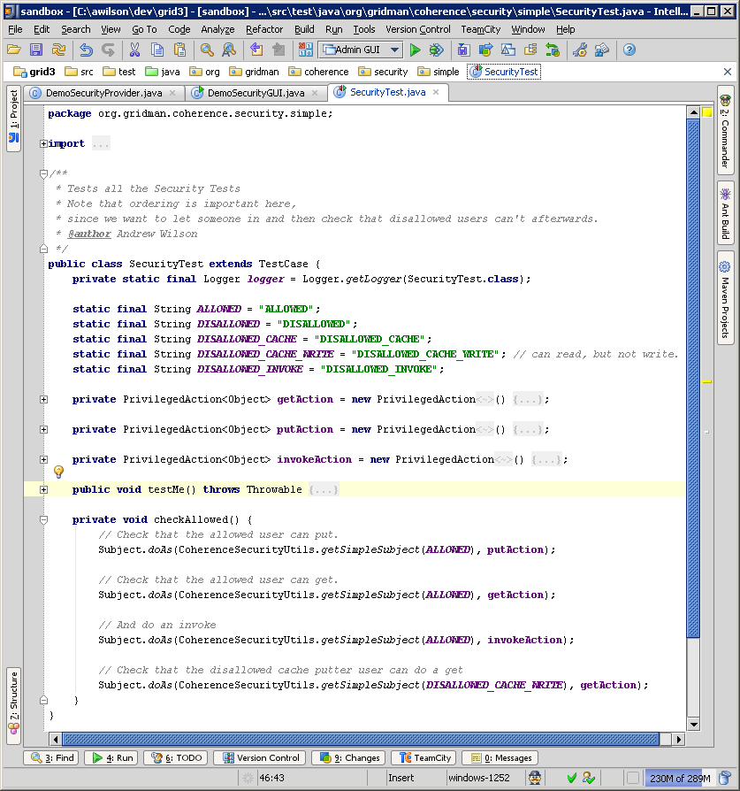
Security Test

Slide 24
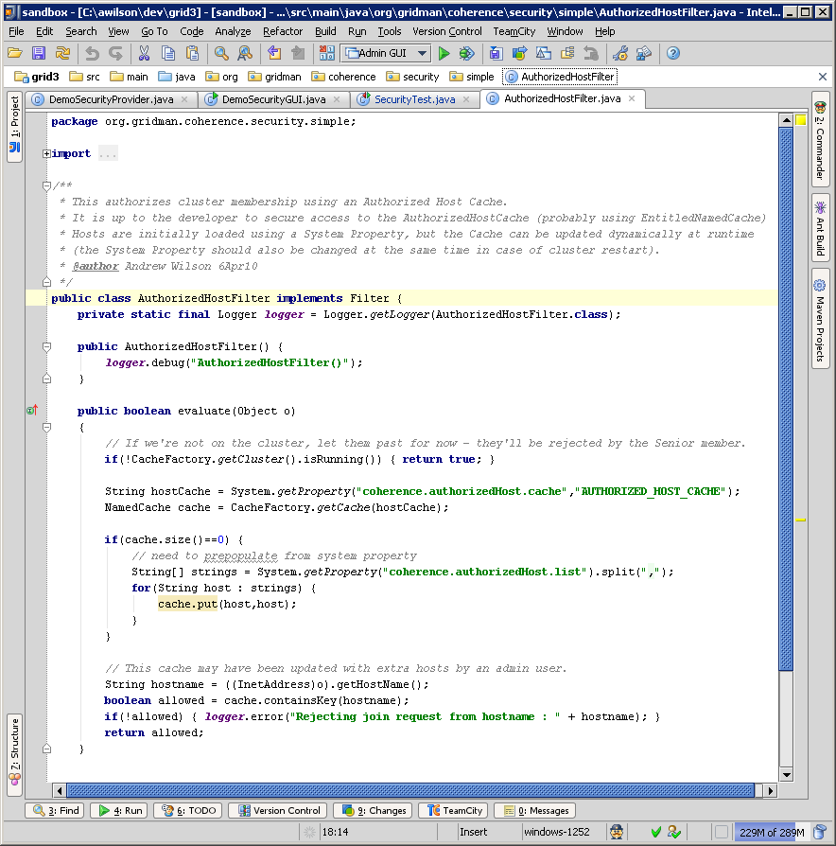
Authorized Host Filter

Slide 25
ClassLoader Cluster
Test Suite
Storage
Node
Proxy
Node
Storage
Node

Slide 26
Founder members
Andrew Wilson
Jonathan Knight
Keith Loose
… <insert your name here>
TeamCity build : http://teamcity.netance.com

Slide 27
Gridman
Open Source Coherence Project
  Coherence Security Code (AD)
  ClassloaderCluster
  WAN Replication tests
  Filters / Indexes code
  POFExtractor
  …

Slide 28
Questions?
http://code.google.com/p/gridman

