Slide 1


Report on
*Git&GitHub*
By
*Ayush Shekhar* (201900375)
In partial fulfillment of requirements for the award of degree in
Bachelor of Technology in Computer Science and Engineering
(2021)
DEPARTMENT OF COMPUTER SCIENCE AND ENGINEERING
SIKKIM MANIPAL INSTITUTE OF TECHNOLOGY
(A constituent college of Sikkim Manipal University)
MAJITAR, RANGPO, EAST SIKKIM – 737136

Slide 2
LIST OF CONTENTS
ABSTRACT 3
INTRODUCTION 4
WHAT IS GIT 5
FEATURES OF GIT 6
REPOSITORY 7
WORKFLOW OF GIT 8
BRANCH 9
GITHUB 10
PULL&PUSH 11
REFERENCES 12

Slide 3

ABSTRACT
This course is great for beginners who wants to learn and gain knowledge of the GitHub world. It teaches the basics and intermediate concepts of git and focuses more on how to track changes in any set of files, and how coordinate work among programmers collaboratively developing source code during software development. This course also gives us various tips and tricks on how to include speed, data integrity, and support for distributed, non-linear workflows

Slide 4
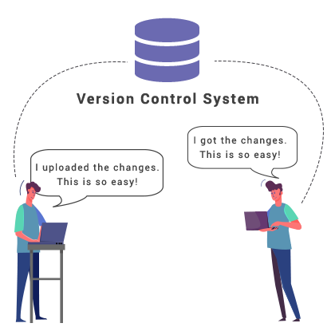
INTRODUCTION
Git is a free open-source distributed version control system designed to handle everything from small to very large projects with speed and efficiency.
Git and GitHub are separate things but linked. Git is the software that runs on your computer and manages your files. You don’t need to use it with GitHub. GitHub is an online platform that allows you to synchronize your local Git repository onto the web.

Slide 5
What is GIT?
Git is version control system or a source control management system. SCM/VCS is collaborative platform for the software developer.
Git is used to tracking changes in the source code
The distributed version control tool is used for source code management
It allows multiple developers to work together
It supports non-linear development through its thousands of parallel branches

Slide 6
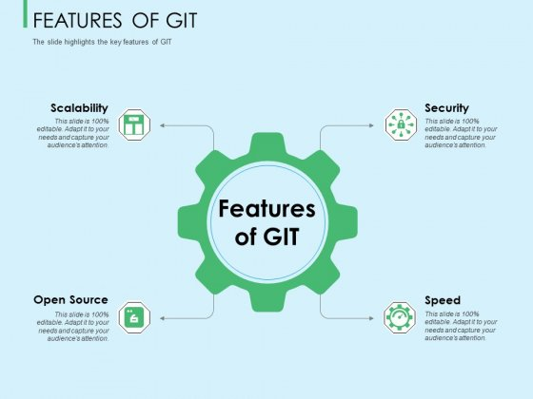
FEATURES OF GIT

Slide 7
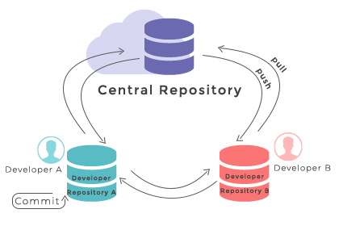
REPOSITORY
Git Repository: It is a virtual storage of your project. It allows you to save versions of your code, which you can access when needed. When you use Git, you create one repository for each program or project that you work on. Create a directory for the respective repository
Commands:
Commit
Add
Push
Pull
fetch
Merge
Clone
Tag
Status

Slide 8
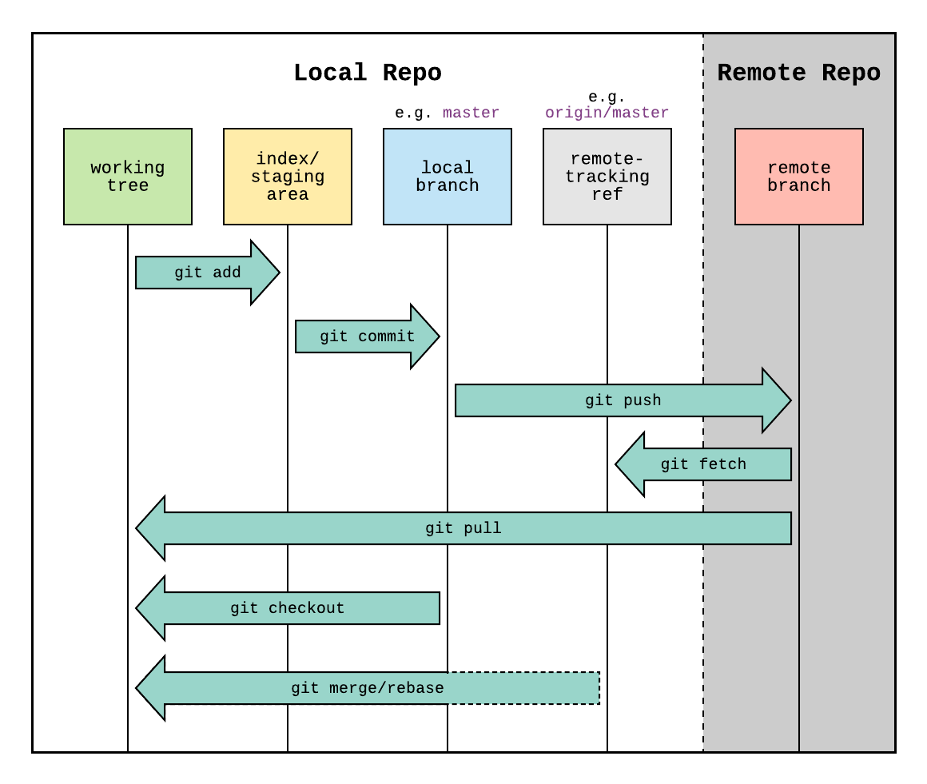
WORKFLOW OF GIT
The workflow is divided in 3 states
Working directory - Modify files in your working directory
Staging area (Index) - Stage the files and add snapshots of them to your staging area
Git directory (Repository) - Perform a commit that stores the snapshots permanently to your Git directory. Checkout any existing version, make changes, stage them and commit

Slide 9
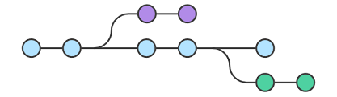

BRANCH
‘A branch in Git is simply a lightweight movable pointer to one of these commits.’ For instance, if you want to add a new page to your website you can create a new branch just for that page without affecting the main part of the project. Once you're done with the page, you can merge your changes from your branch into the primary branch.
CREATION:
MERGING:

Slide 10
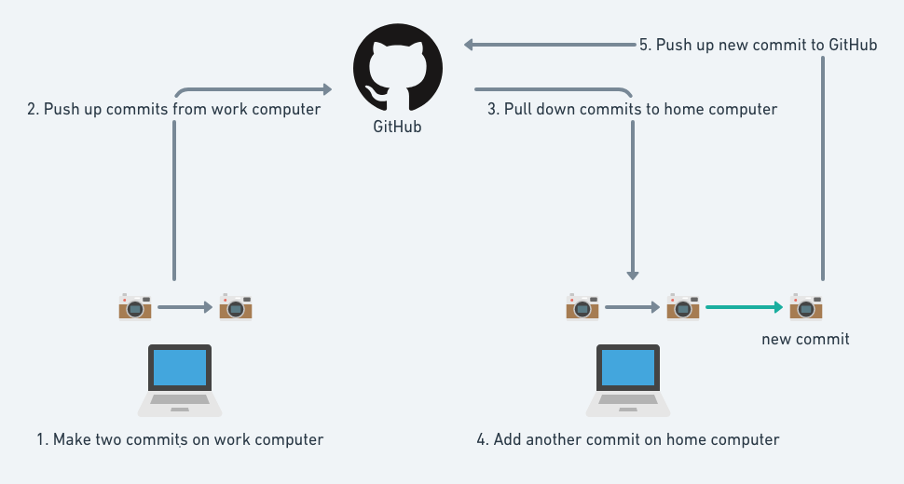
GITHUB
GitHub is a code hosting platform for version control and collaboration. It lets you and others work together on projects from anywhere. You don’t need to know how to code, use the command line, or install Git. You just need a user account on github.com.

Slide 11
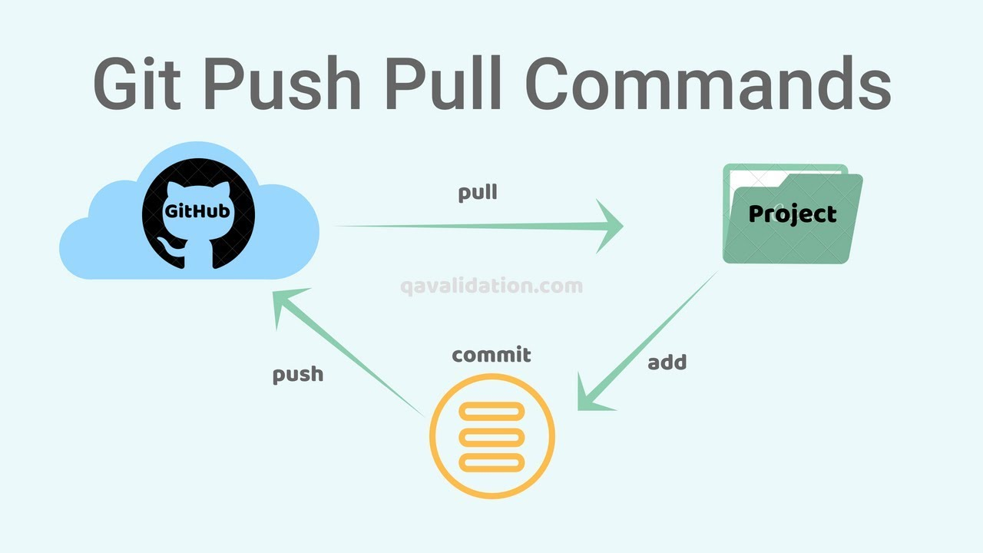
PUSH&PULL
Pushing sends your changes up to GitHub, so they can be shared with the rest of the world. It also serves as a hedge against data loss.
Pulling is the opposite of pushing--it retrieves changes from the remote location and applies them to your local repository.

Slide 12
REFERENCES
https://trainings.internshala.com/dashboard/
https://github.com/
https://docs.github.com/en
https://guides.github.com/activities/hello-world/

