Slide 1


Task Manager
Authors: Kyle Bluemel, Javi Gutierrez, Jake Michie & Osvaldo Saldana

Slide 2


Project Overview
Simple website that keeps track of tasks that are needed to be completed. We want to be able to filter all of the tasks by status and priority, and then sort it by Date added, Priority, Due date, and Title. The actual tasks have variables including, Title, Description, Priority, Due date, and notes.

Slide 3


Demo

Slide 4
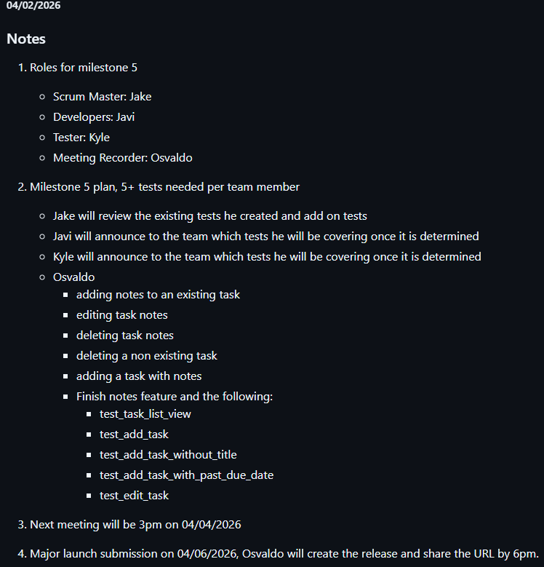
Two Weekly Meetings
Stand-up meetings for 15 minutes and one-hour in depth meetings

Slide 5
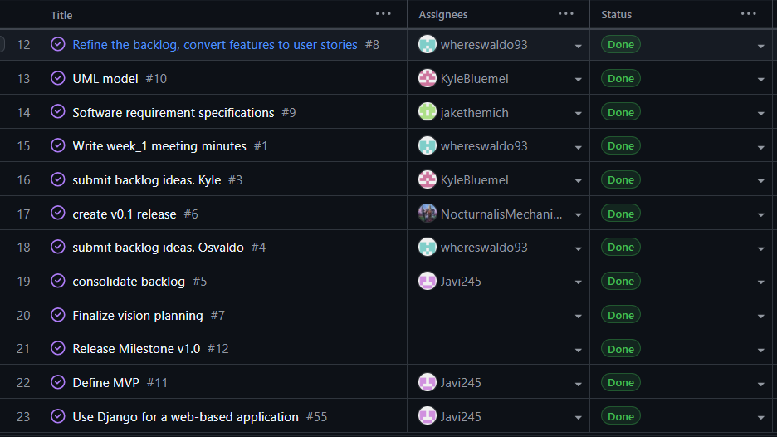
Git Project Board
Major tasks were created and assigned to team members on a weekly basis

Slide 6
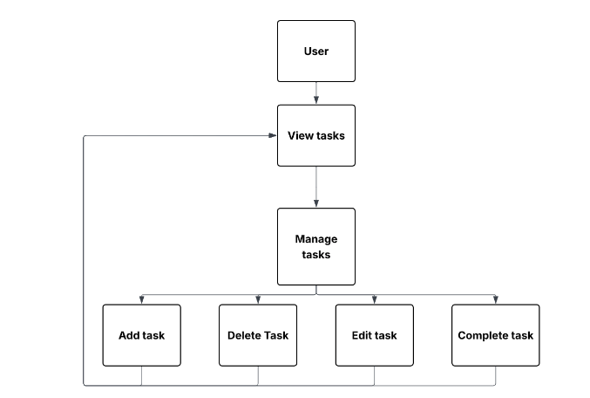
Foundation UML
Core functions are top priority

Slide 7
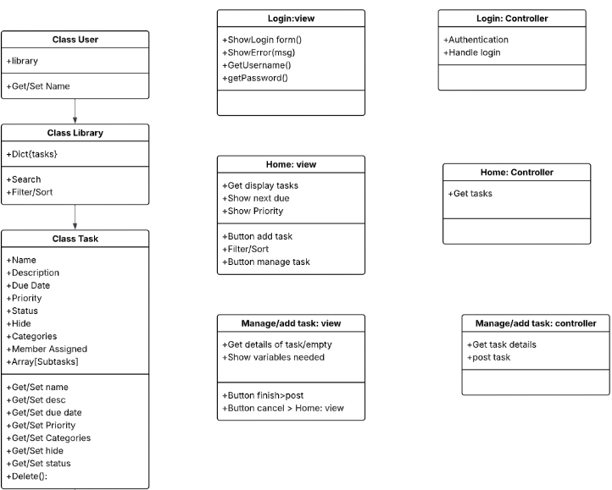
Requirements
Developed
As the App was Built

Slide 8
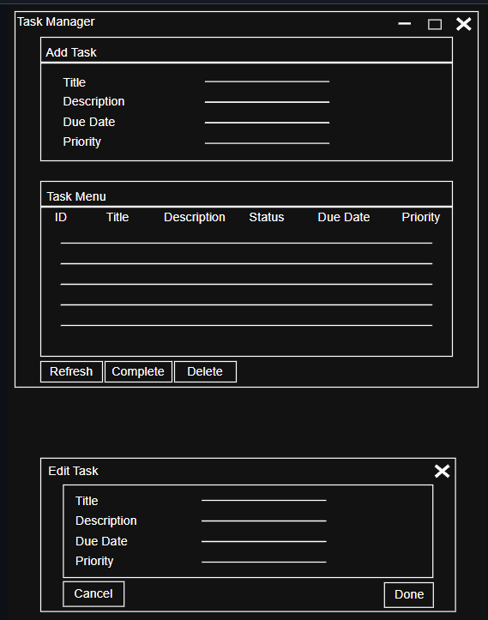
GUI Wireframe
Initial structure

Slide 9
Outstanding Features
01
Smart Stats Dashboard
Total, pending, completed, and auto-calculated overdue — pending tasks past their due date are flagged in real time.
02
Filtering & Sorting
Filter by status and priority simultaneously, sort by id, priority, due date, or title — all composable on the URL.
03
Per-user Auth & Isolation
Full signup and login flow. Every task is scoped to the logged-in user — users never see each other's data.
UVU

Slide 10
Engineering Practices
01
JSON → Django ORM Migration
Started with JSON file storage, migrated to Django ORM + SQLite when we needed real multi-user support, auth, and integrity guarantees.
02
Defense-in-depth Validation
Task.save() calls full_clean() — invalid data never hits the DB, even if a view forgets to validate.
03
Security by Default
@login_required, user-scoped queries, and get_object_or_404 prevent IDOR. require_http_methods locks state-changing routes.
UVU

Slide 11
Defense-in-depth Validation
models.py
class Task(models.Model):
def clean(self):
today = timezone.now().date()
if self.due_date and self.due_date < today:
raise ValidationError("Due date in past.")
if self.priority not in self.Priority.values:
raise ValidationError("Invalid priority.")
def save(self, *args, **kwargs):
self.full_clean() # defense in depth
super().save(*args, **kwargs)
UVU

Slide 12
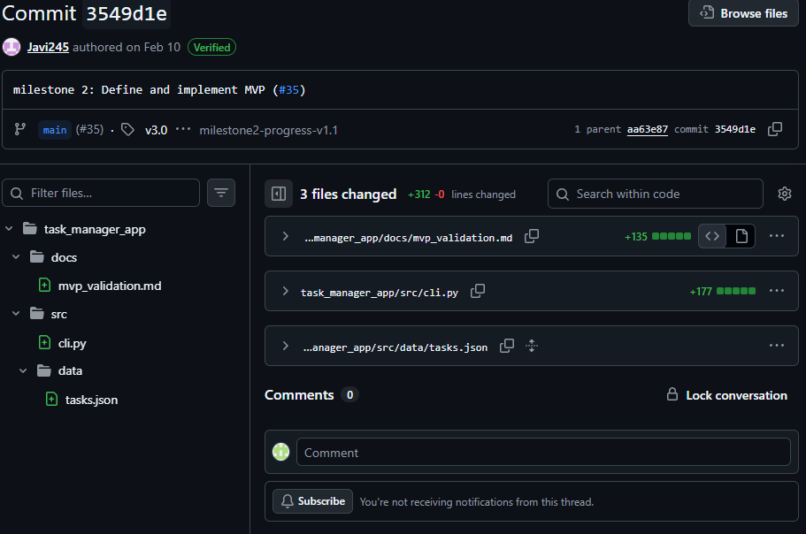
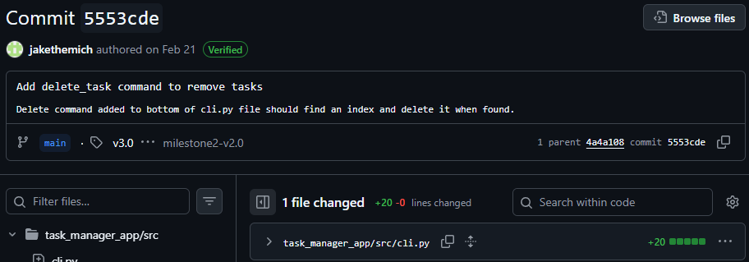
Relevant Git Commits Timeline
MVP: Feb. 10
Introduced our Command Line Interface under cli.py with 177 lines of code
Laid the functional groundwork of our application beyond initial documentation
CRUD Finalized: Feb. 21
Create, Read, Update, and Delete tasks completed for our CLI.
Established basis of app before being further built.

Slide 13
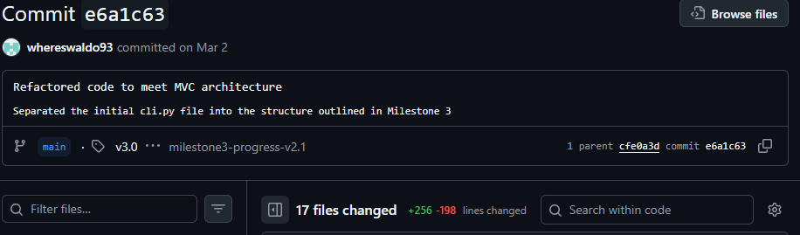
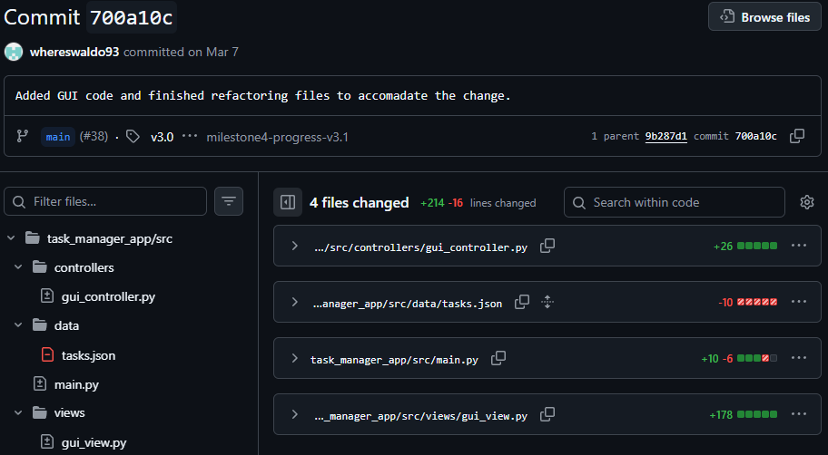
Commit Timeline cont.
MVC Pattern Refactor: Mar. 2
Refactored cli.py file into Model-View-Controller architecture
Logic split to 5 files (2 models, 1 view, 2 controllers)
GUI Integration: Mar. 7
Moved outside command line to a Graphical User Interface with components like gui_view.py and gui_controller.py handling visual interactions.
Updated main.py to initialize visual interface.

Slide 14
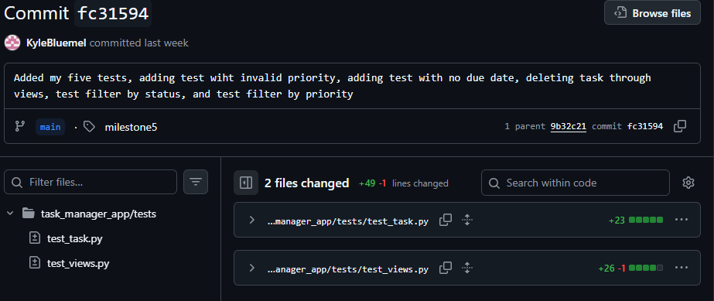
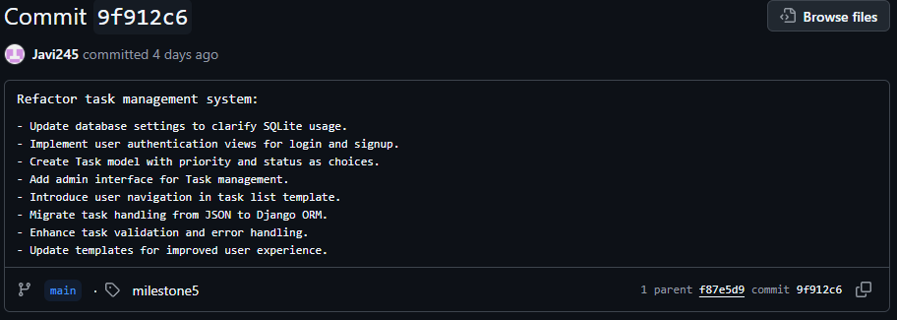
Commit Timeline cont.
Full Test Suite: Apr 3
Advanced features and functions need to be tested for complete functionality and validation
Application is now fully prepared for complete Django Migration
Django Migration: Apr. 5
Largest refactor in development from local JSON storage to an SQLite database
Added user authentication, admin interface, full restructure of task management

Slide 15
Future Enhancements
Subtasks: Breaking down larger complex items into trackable sub-items.
Rich Attachments: File upload and link handling for quick user references.
Interactive Calendar: Due date focused view for a visual representation of a timeline.
Bulk Operations: Mass delete/update priority function to reduce clicks.
Team Workspaces: Functionality to include task assignment to online group members.
Expanded Data Portability: Import/exports for data migration, team sharing, backups.

Slide 16
Thank you!

