Slide 1
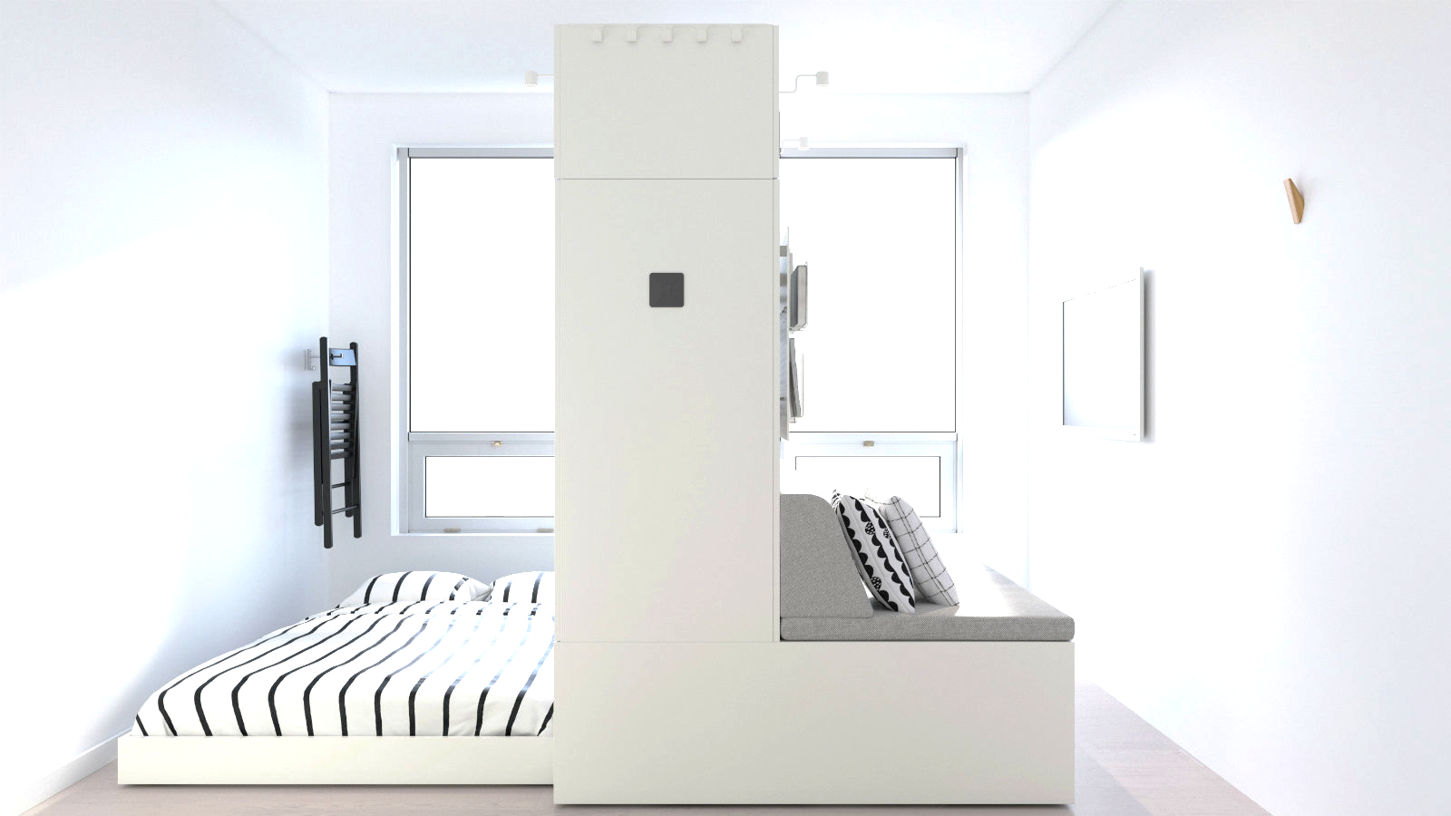

Psychology / Emotion
Analysis and Recording Application using
“Art Psychological Test” & “Drawing diary”
Senior Project 3
Kim Junho
Lee Sang-un
Lee Saeyoung
Jung Hyeonseo

Slide 2
GitHub, Wiki, Youtube Link
 | URL
GitHub | https://github.com/whfwkr2020/Psychological-Projective-Drawings-analysis-app
Wiki | https://github.com/whfwkr2020/Psychological-Projective-Drawings-analysis-app/wiki
Youtube | https://www.youtube.com/watch?v=ED_5TrNTheo

