Slide 1
Multimodal: DeepFake Detection
Advisor & Guide：David Woodruff; Vito
Presenter: Jovanna; Whileaf; Issac; Brooke

Slide 2
Part 1 introduction
Part 2 Literature Review
Content
Part 3 Project Purpose
Part 4 Methodology
Part 5 Project Progress

Slide 3
1
Introduction

Slide 4
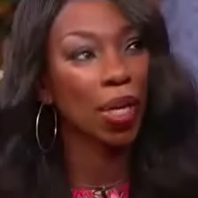
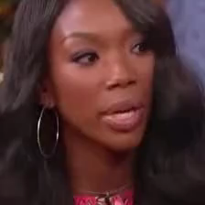
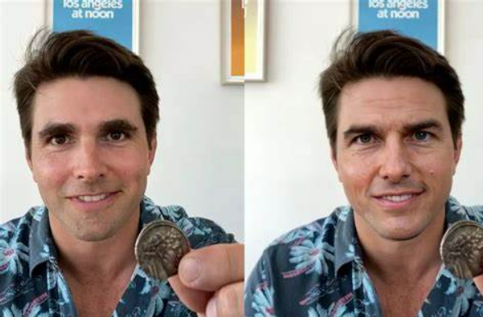
Fake & Real
Deepfake
Pros:
Visual Effects
Entertainment
Historical and Cultural Preservation
Cons:
Misinformation and Manipulation
Reputation Damage
Privacy Invasion

Slide 5
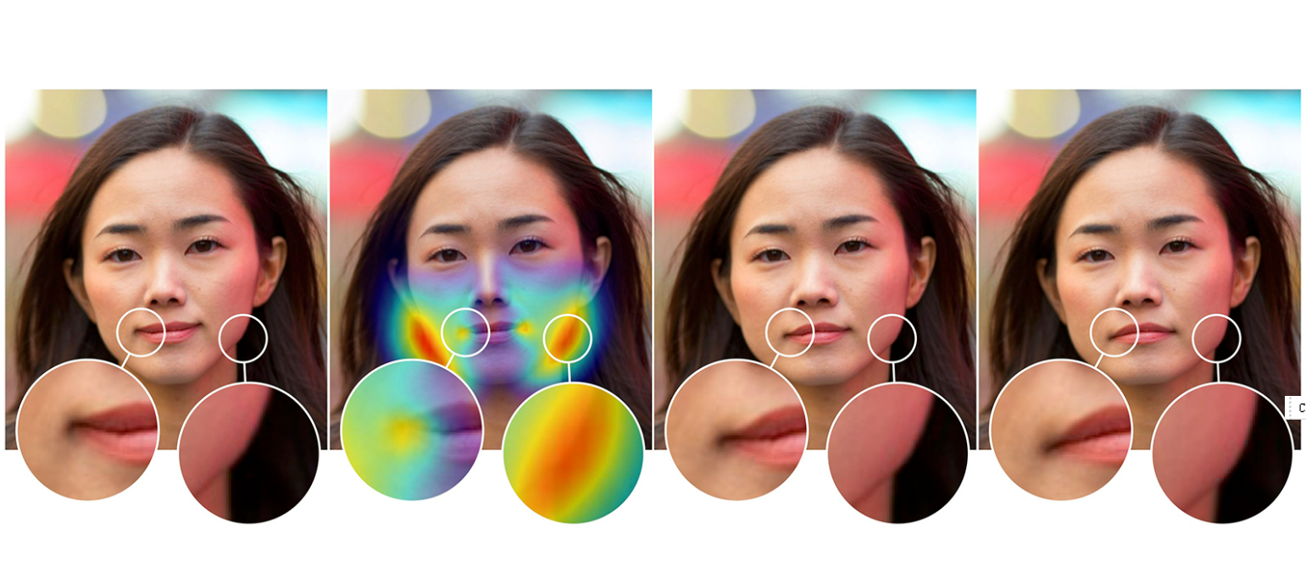
Deepfake Detection
Traditionally: Analyzing visual artifacts or ficial features
Examining the image quality, Unnatural facial movements
Blurring, Misalignment of facial features, or Strange reflections in the eyes.

Slide 6
2
Literature Review

Slide 7
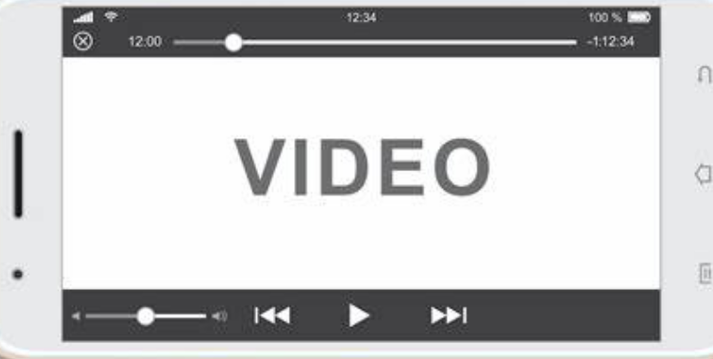
Multi-modality
Salvi and his team propose a novel approach to leverage data multi-modality to detect deepfake videos
Frame Feature
Audio Feature
Text Feature

Slide 8
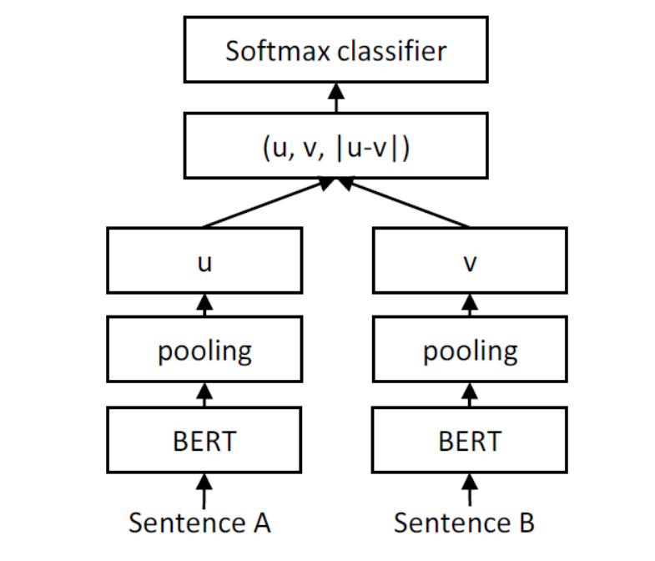
SBert
The authors of Sentence-BERT (SBERT) modified the pre-trained BERT by using Siamese and Triplet Network to generate Embedding vectors of sentences with semantic meaning.

Slide 9
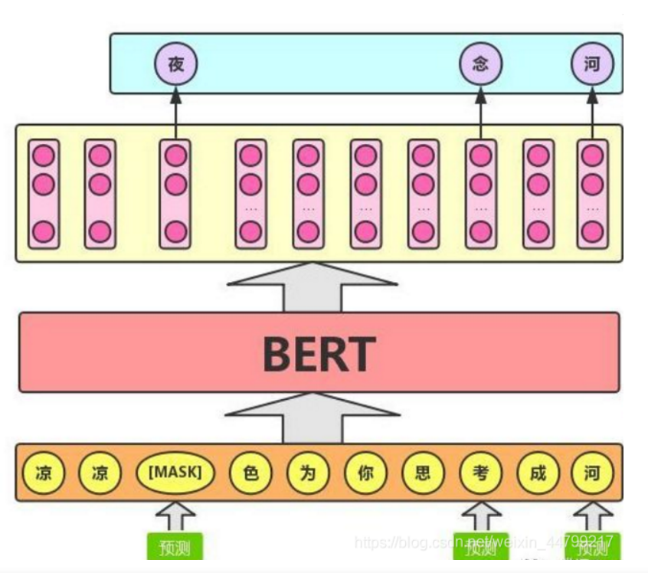
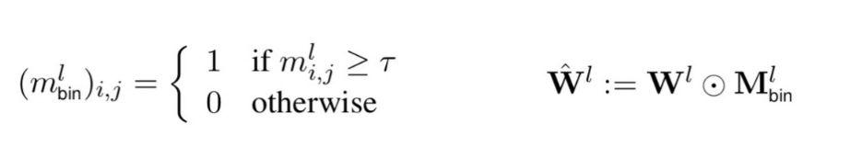
Masking
Masking refers to the process of selectively ignoring or manipulating certain elements of the input data during training or prediction. It involves applying a binary mask to specific regions or features of the input. For each Transformer layer, a 0-1 matrix is learned, which is then used to scale all the fully connected weights of the layer.

Slide 10
3
Project Purpose

Slide 11
Project Purpose
Video
Frame
Face Detection
1
Detection
Extract images from the original video;
Go through the images to do DETECTION.
2
Search
For fake videos, using tags to locate the identity of the person;
Using multimodal, compare feature vector to find the original person.
Notes:
This section is an overview of the purpose of our entire program.
To solve the existing problem, we use the FakeAVCeleb dataset to develop a multimodal deepfake detectors that seeks to detect fake faces more accurately and find the original person from three modalities: text, video, and audio.
In the search, for the fake videos, we using tags to locate the identity of the person. And then use multimodal, , compare feature vector to find the original person.

Slide 12
4
Methodology

Slide 13
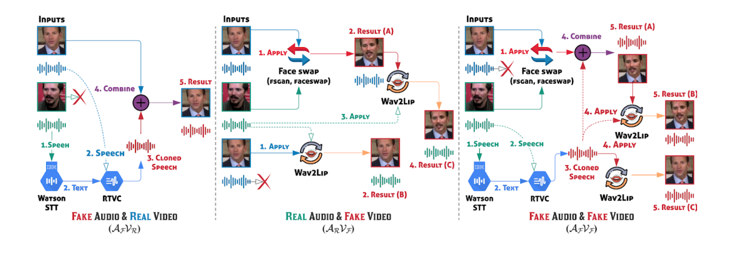
Dataset: FakeAVCeleb
Introduction
Component
Novel Audio-Video Multimodal Deepfake Detection dataset
Deepfake videos & Respective synthesized lip-synced fake audios.
Five racial backgrounds
Four deepfake generation/synthesis methods:
FaceSwap, FSGAN, Wav2Lip, SV2TTS
Notes:
Next is the methodology we used in this project engineering
Dataset FakeAvCeleb
FakeAVCeleb is a novel Audio-Video Multimodal Deepfake Detection dataset, which contains not only deepfake videos but also respective synthesized lip-synced fake audios.
To generate a more realistic dataset, they selected real YouTube videos of celebrities having five racial backgrounds to counter the racial bias issue.
The dataset uses a total of 4 deepfake generation/synthesis methods: This graphic depicts their way of it

Slide 14
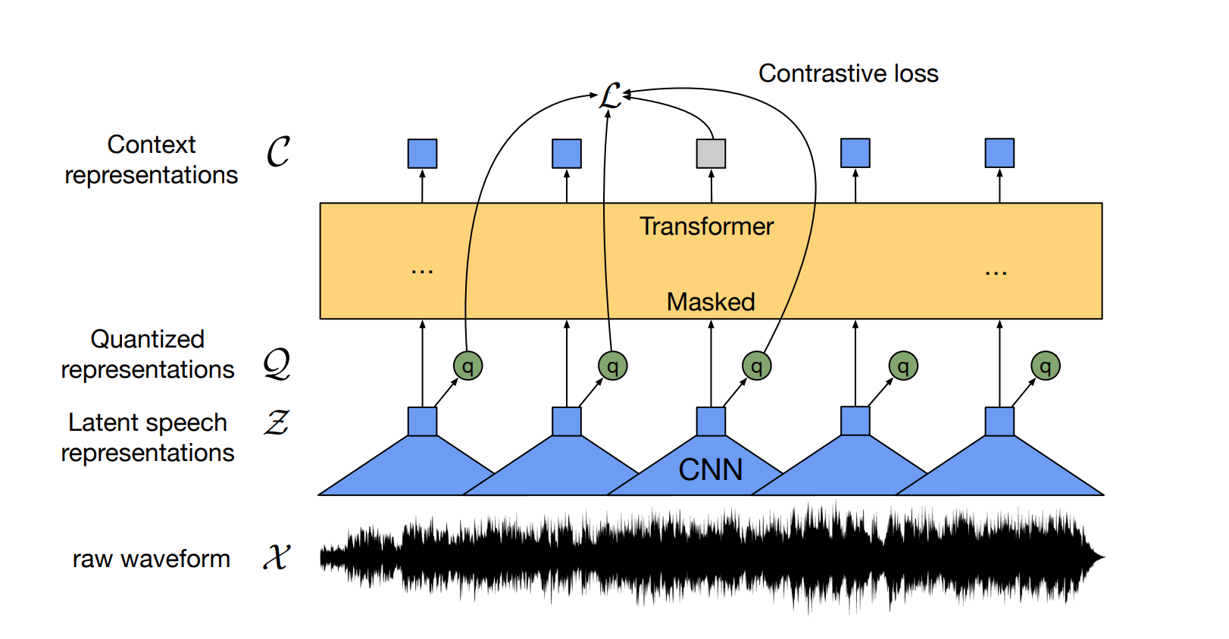
Wav2Vec2.0 - Extraction
Feature Extraction
_get_feature_extractor Function
ConvLayerBlock Object
forward
FeatureExtractor Object
_get_feature_extractor Function
ConvLayerBlock Object
construct a conv1d model for feature extraction of the original audio.
Designing the structure of conv1d
Forword Function
Run the data into the model
FeatureExtractor Object
Notes:
_get_frature_extractor Function
The main thing this function does is construct a conv1d model for feature extraction of the original audio.
The forword function uses to pass data into the model runs
Feature extraction requires the _get_frature_extractor method, where the _get_frature_extractor method mainly calls the ConvLayerBlock object and the FeatureExtractor object for the construction and use of the feature extraction model.

Slide 15
Transformer-encoder construction
Transformer-encoder Setting
_get_encoder
Encoder
FeatureProjection
Transformer
Encoder Layer
ConvolutionalPositionalEmbedding
SelfAttention
FeedForward
https://github.com/pytorch/fairseq
Notes:
This is the flowchart of Wav2Vec's source code for Transformer-encoder construction.
Detailed code function content can go to the original address to view, here we will skip the

Slide 16
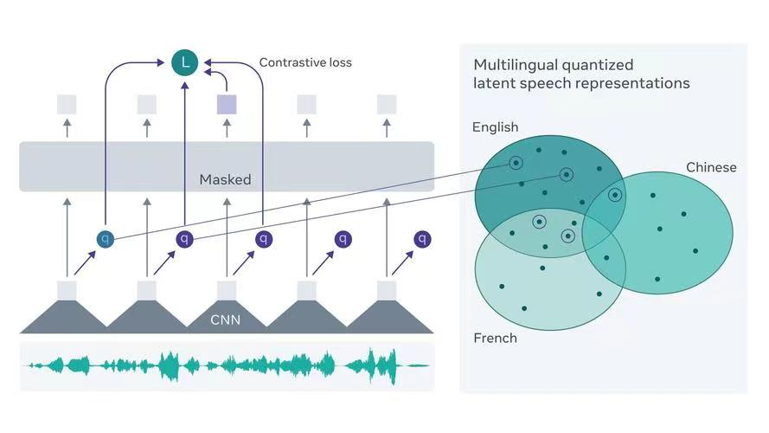
Wav2Vec2.0 Audio To Text
Introduction
self-supervise the learning of representations from raw audio data.
Timing Classification (CTC)
Wav2Vec2Tokenizer
16kHz
Hugging Face Transformer
Process
1. Librosa Library
2. pre-trained Wav2Vec2.0 model
3. Get the input values
4. PyTorch format return_tensors = "pt“
5. Get logit values &Get predictions - softmax
6. Get the transcription
Notes:
The Wav2Vec2.0 model converts speech to text which is A framework used to self-supervise the learning of representations from raw audio data.
This model is trained using Connected Timing Classification (CTC), so the output must be decoded using the Wav2Vec2Tokenizer. Hugging Face Transformer comes with Wav2Vec2.0.
We will use the Wav2vec 2.0 model to convert audio files to text. Then install the Transformer library and necessary libraries.
The Wav2Vec model has been pre-trained at a frequency of 16kHz, so we make sure that the original style audio file is also resampled to 16kHz. use the librosa library to load the audio file and convert the audio segments into an array to be stored in the audio variable.
Import the pre-trained Wav2Vec2.0 model.
Get the input values, pass the audio (array) to the tensors (tokenizer), we want the tensor to be in PyTorch format, not Python integer format. return_tensors = "pt", which is the PyTorch format.
Get logit values , pass logit values to softmax to get predictions, convert audio to text.
The last step is to pass the prediction to a splitter decoder to get the transcription.

Slide 17
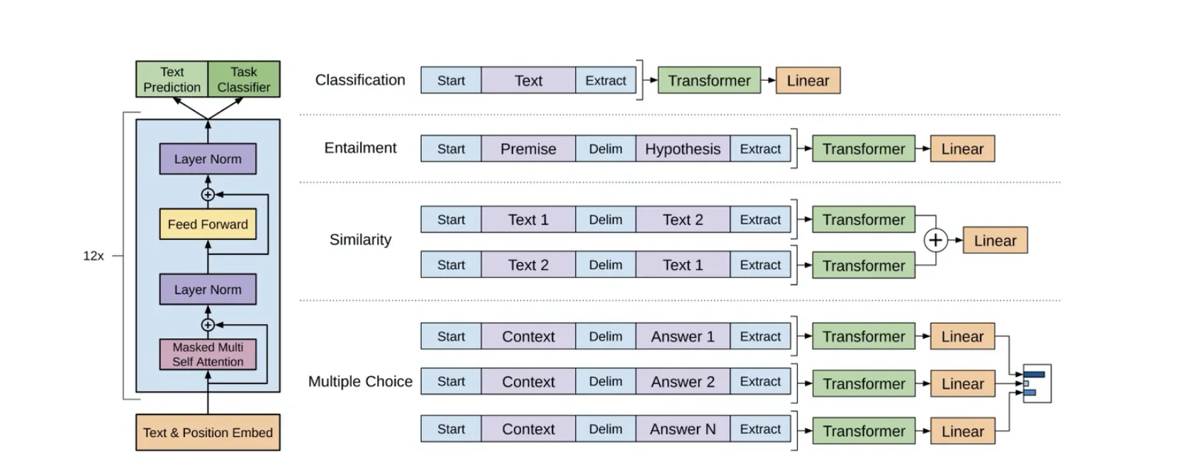
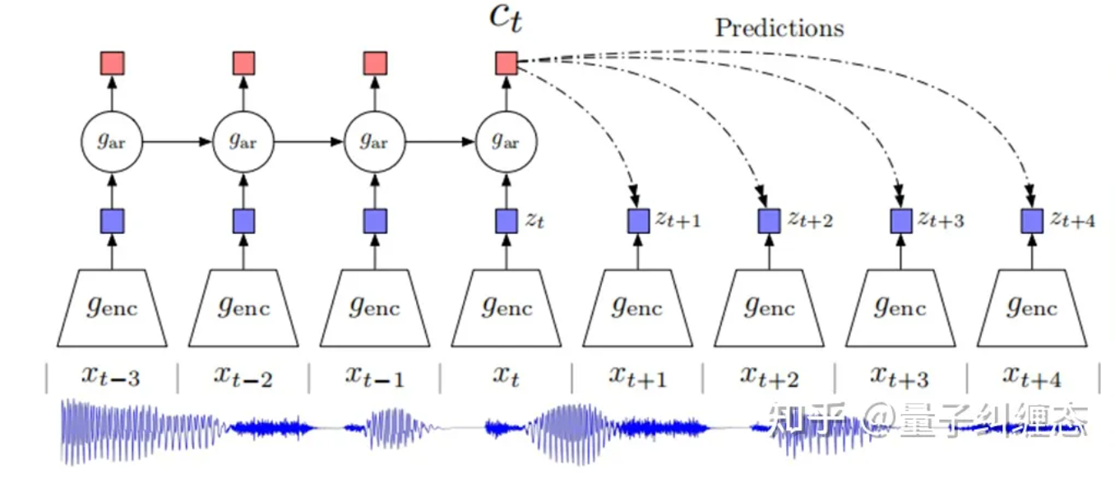
Wav2Vec-Finetune
Process
Trained encoder
A small fine-tuning network
Downstream tasks->cross entropy or CTC.
The algorithmic fine-tuning is done by attaching a linear layer behind the transformer for fine-tuning.
Notes:
In order to save a lot of computational resources and time improve computational efficiency
When the encoder part is trained, for different downstream tasks, it is only necessary to string a small fine-tuning network behind c(t), and then the downstream tasks can be realized by cross entropy or CTC.
Supervised finetune part Adding a layer of linear transformation on top of pretrain's network, combining finetune with different task's loss , like this pic.

Slide 18
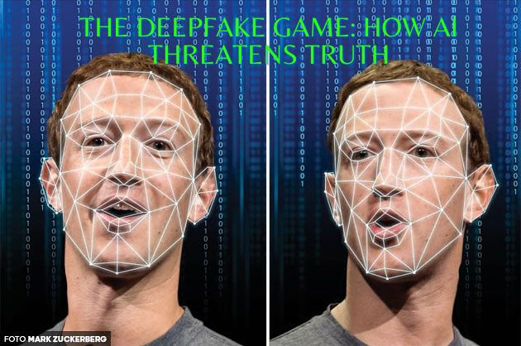
Visual Part
Key Frames Extraction
Face Detection and Bounding
Visual features Extraction
Detecting Forgery

Slide 19
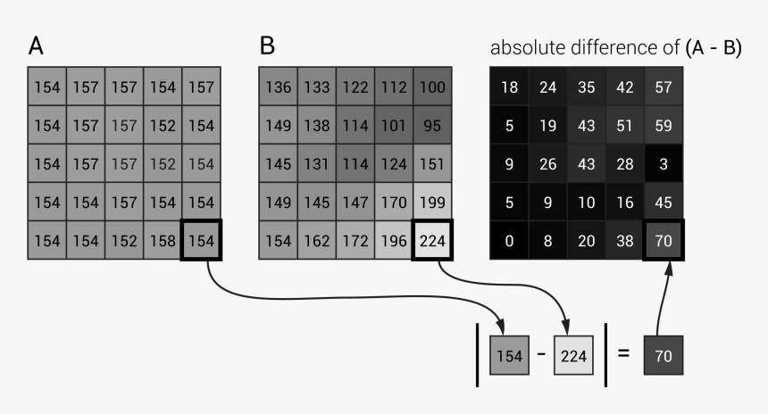
Key Frames Extraction
Comparing two images by computing the absolute differences between corresponding pixel values and then summing up all the differences
SAD:Sum of Absolute Differences

Slide 20
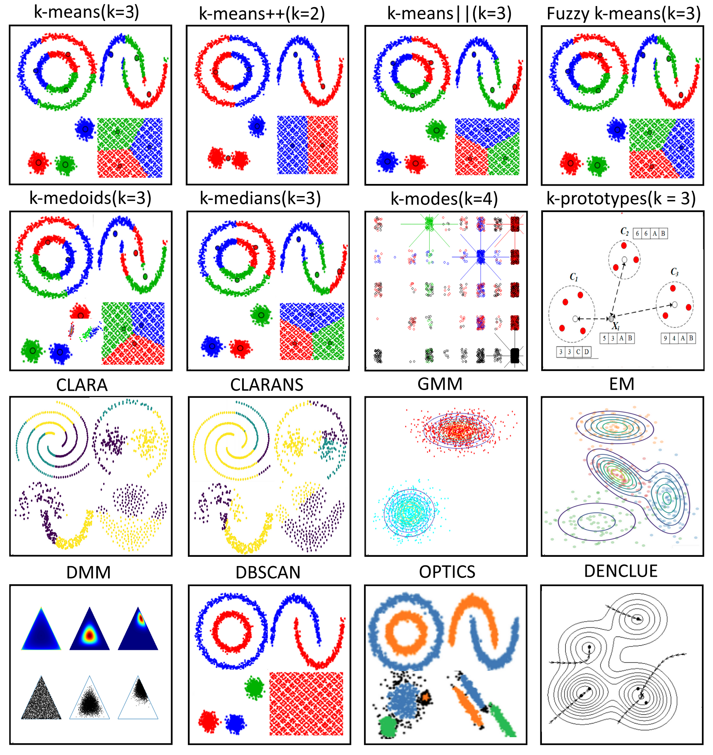
Key Frames Extraction
Numbers of clusters for frames
Capturing complex information
Clustering

Slide 21
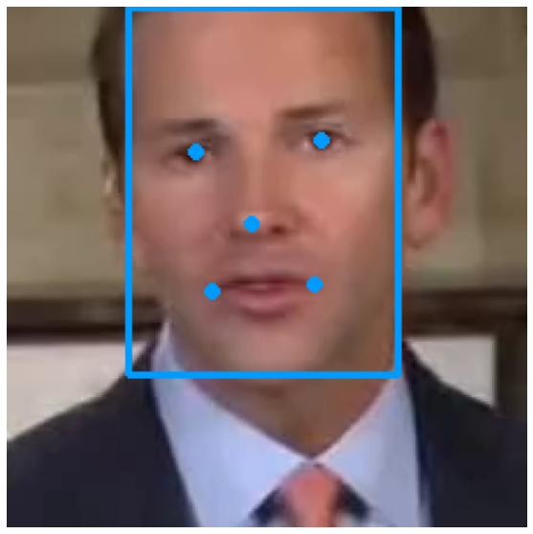
2.Face Detection and Bounding
To avoid interference from the background environment, we need to perform face detection and bounding on the faces in the video.
Our detection and bounding example

Slide 22
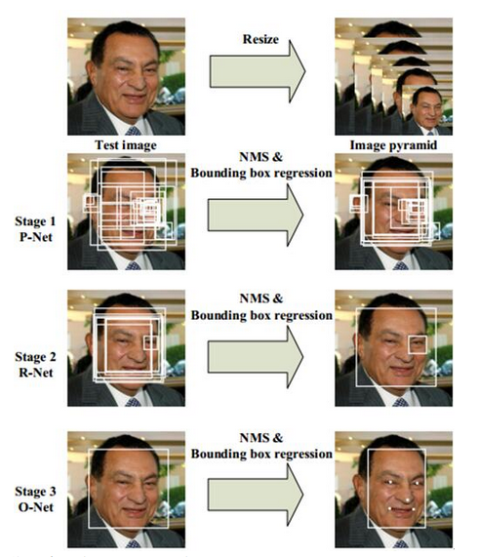
2.Face Detection and Bounding
P-Net (Proposal Network): Quickly generating candidate face bounding boxes and their corresponding facial landmarks
2.R-Net (Refine Network): Filters and refines the candidate bounding boxes proposed by P-Net.
3.O-Net (Output Network): It further filters and adjusts the candidate boxes proposed by R-Net and predicts the locations of facial landmarks.
MTCNN

Slide 23
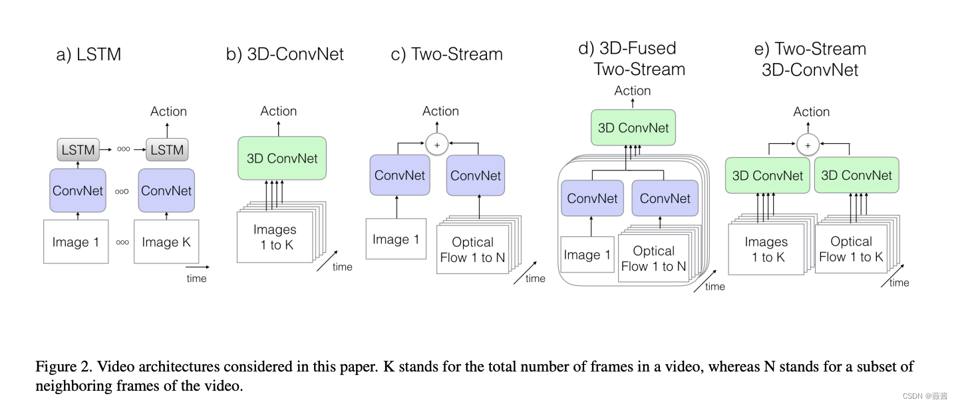
3.Visual features Extraction
Extraction for multimodality
Several models for video features Extraction

Slide 24
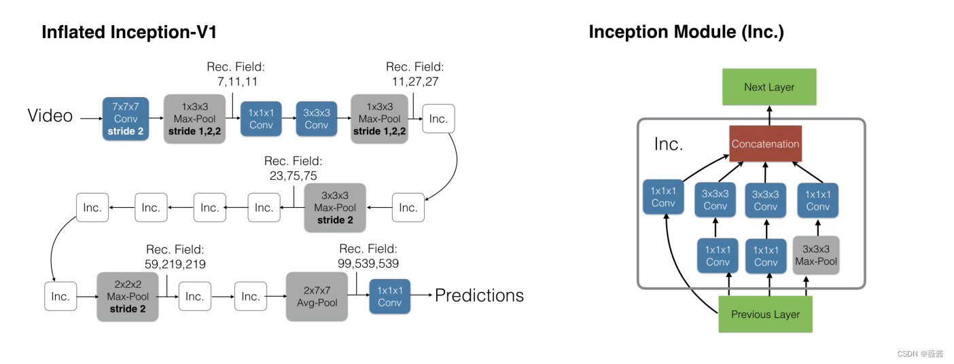
3.Visual features Extraction
Extraction for multimodality
Time Information Capture :
  Perform feature learning simultaneously in both the temporal and spatial dimensions, effectively capturing the temporal dynamics of the video and obtaining more advanced feature representations

Slide 25
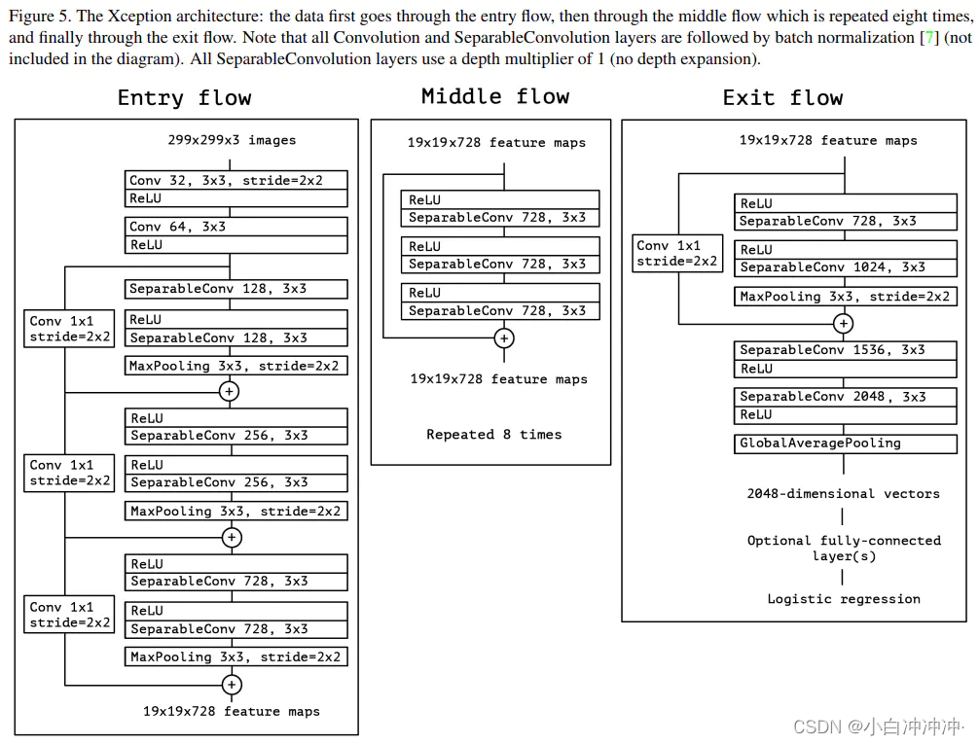
4. Detecting Forgery
Extraction for Forgery Detection
The Xception model evaluates all keyframes in the video and makes judgments based on voting to determine whether they are forged.

Slide 26
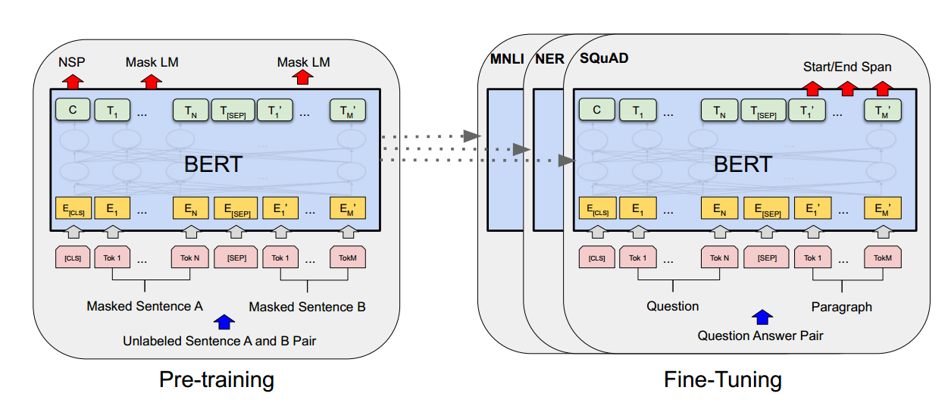
Sentence2Vector
PreModel + Finetuning
Sentence2Vector
PreModel: “bert-base-uncased”
Finetuning: BertForMaskedLM
Feature Vector: Output of Bert
Notes:
For the feature extraction of sentences, we use Bert pre-trained model and fine tune the model, and we take the output of Bert model as the sentence feature vector.

Slide 27
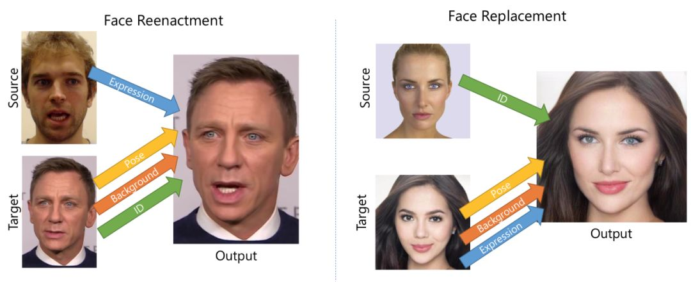
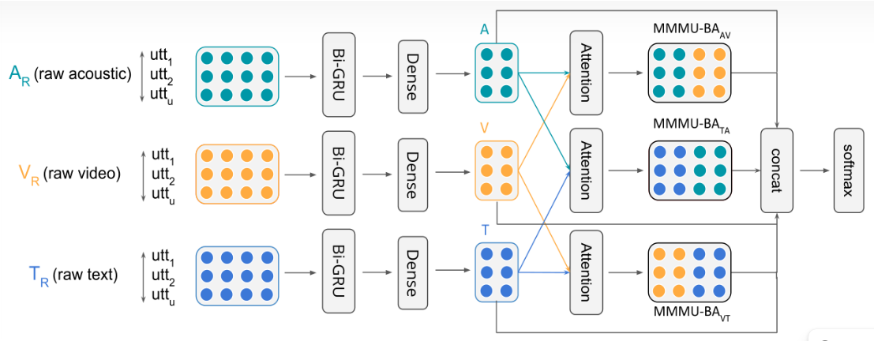
Multimodal Identity Features
Information We Already Know
What We Want
Feature vectors for the three modes of ‘real’ people and ‘forged’ people.
Label of people(real or forged)
For the training set, the labels are from the data set; For the test set, the labels are predicted by the Xception.
Multimodal feature vectors for every ‘real’ person.
Find the original video of the fake video by comparing the similarity of the vectors.
Notes:
Okay, let's stop here and see what we've done and what we want to do. So far, we have converted the three modes into corresponding feature vectors;
We have done the deepfake detection of the test set, so we have the labels for all the videos - the training set label comes from the data set label, and the test set label comes from the deepfake detection;
Ok, let me explain our goal again: to find the original video. Our method is to obtain every real human multimodal feature vector through the MMMU-BA model, using videos of real people for training, that is, the output of the concatenate layer is used as the feature vector. (click*2)
And then, for example, here's a sourse face, here's a target face, they're both real people; The output is a "fake" person, and since we use multimodal features, this person's feature vector will be similar to these two people. So we can find the target person by comparing vectors.

Slide 28

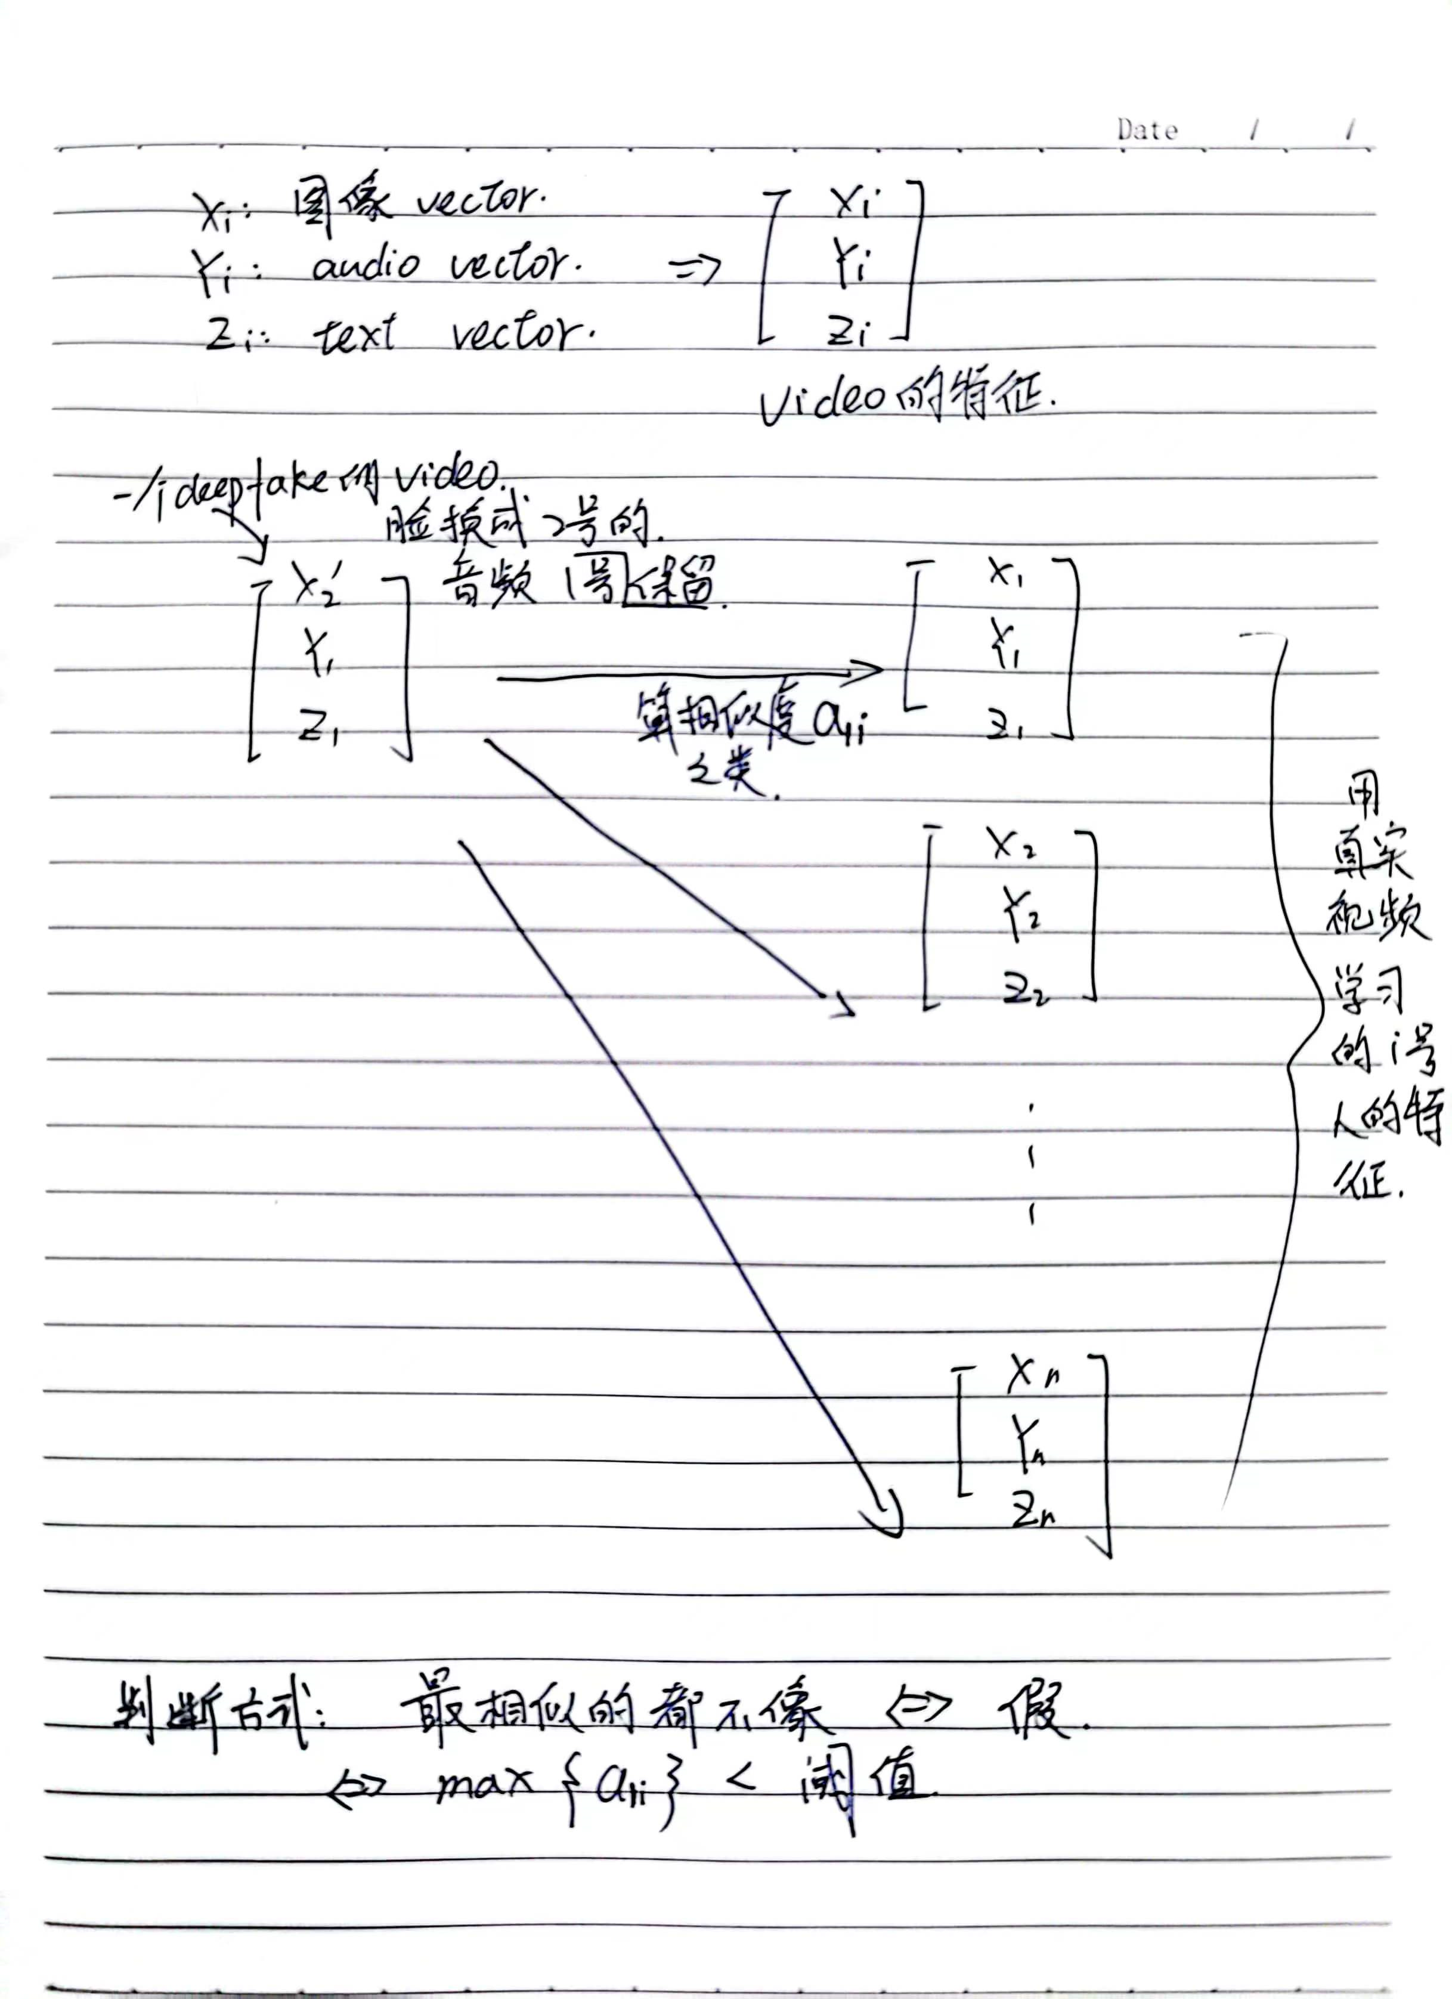
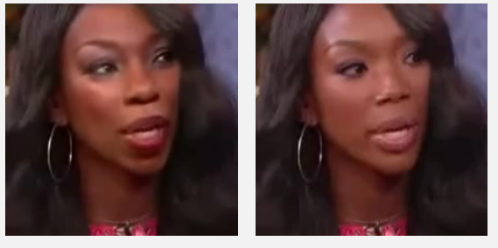
Locating Original Video
Multimodal Features
Multimodal Features
Calculating similarity
fake video
Feature vector of real people
feature extractor
A(fake)
B
A
B
C
...
Get a video with a false prediction
Put the fake video in MMMUBA
Use label to exclude the self, and compare the vector of the fake video with the remaining vectors
Notes:
Okay, so I'll go into more detail about how to locate the original video, the target.
First, we get a video that is known to be forged, and input it into the MMMUBA network, and get the multimodal feature vector of the forged person. At this time, the MMMUBA network is equivalent to a feature extractor.(click)
Once we know the video is fake, we can use the data set to get the label of source person. For example, we know that this fake face is the face of A, that is, the source said before, and its original video is B, but we don't know now (click), we want to find B. Therefore, we can remove the feature of A from the features of the real person (click), so that only B among the remaining features of the real person is most similar to the features of the forged person. By comparing the features of the fake video with the features of all the real people, we can find that the most similar vector is B, which is target.

Slide 29
Optimization in Implementation
MMMU-BA
Bert-finetuning
Loss1
Sentence Feature
Wav2Vec-finetuning
Loss2
Audio Feature
Loss4
InceptionResnet
Loss3
Video Feature
Calculate the loss function four times!
Notes:
Ok, the Optimization in Implementation
At first, we intend to use these large models as feature extractors directly, but this will cause the calculation of loss three times, and when we put the features into MMMUBA, the loss will be calculated again, which may reduce our model effect.

Slide 30
Optimization in Implementation
MMMU-BA
Bert-finetuning
Sentence Feature
Wav2Vec-finetuning
Audio Feature
Loss
InceptionResnet
Video Feature
Freeze some layers and only train the remaining layers
The feature that was originally output from models and then input to MMMU-BA becomes the variable transmitted in the middle layer of the BIG model
The loss needs to be calculated only once
Notes:
So we added these three models to MMMUBA to form a large model, Freeze some layers and only train the remaining layers. Then We can train all the variable parameters together, so that only one large model needs to be trained, in such a case only one loss needs to be calculated, which can improve the accuracy.

Slide 31
5
Project Progress

Slide 32
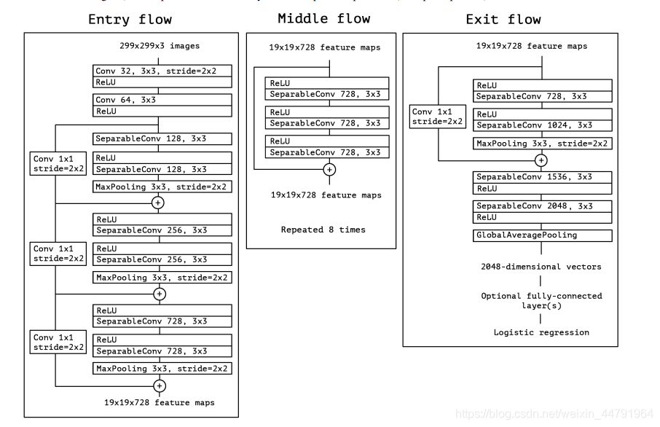
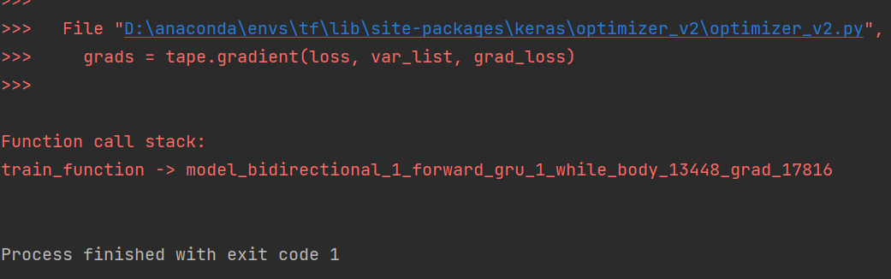
Project Progress
Multimodal Features
deepfake detection
fake video
feature extractor
To-Do List
Gradient explosion solution
Vector comparison
Model optimization
Gradient explosion
Notes:
Unfortunately, we did not complete our entire project within these two weeks, so there is no experiment result and conclusion. We finished this part, but there was a gradient explosion while training MMMUBA.
After reflecting on the process, I think it is mainly because we are too hesitant in choosing the topic and selecting the method, for example, I said before that we wanted a deepfake detector with good effect too much. At the same time, our model implementation has been optimized many times, and each optimization requires reading new papers and writing new codes.
Anyway, through this project, our team learned a lot of new knowledge and methods, including coding and information search. Finally, thanks to David, Vito and box for your help,

Slide 33
THANK YOU FOR WATCHING
Advisor & Guide：David Woodruff; Vito
Presenter: Jovanna; Whileaf; Issac; Brooke

