Slide 1


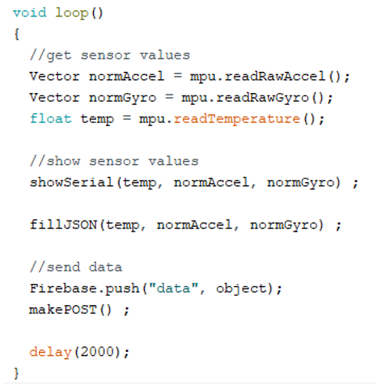
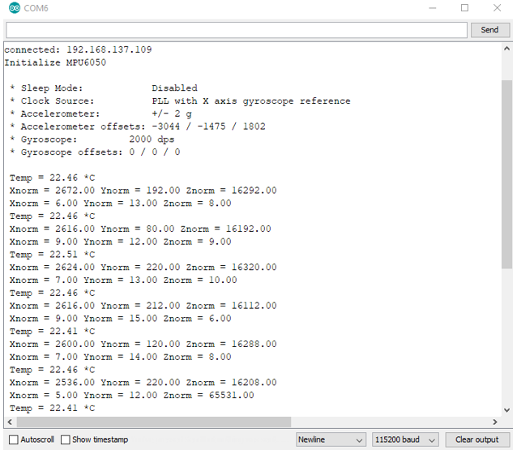
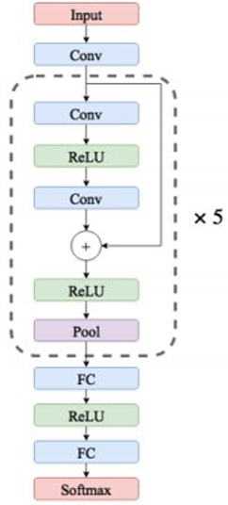
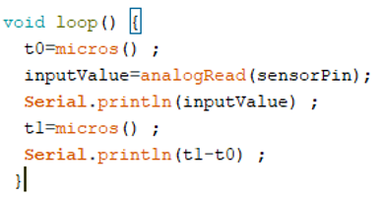
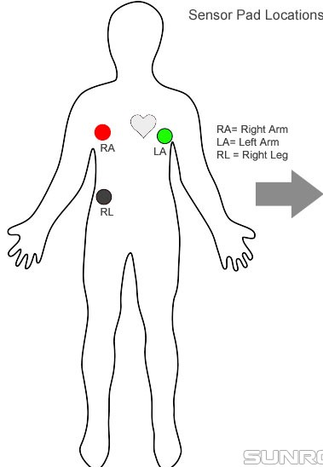
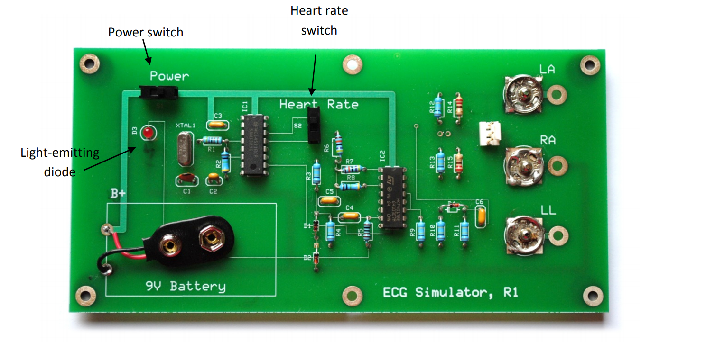
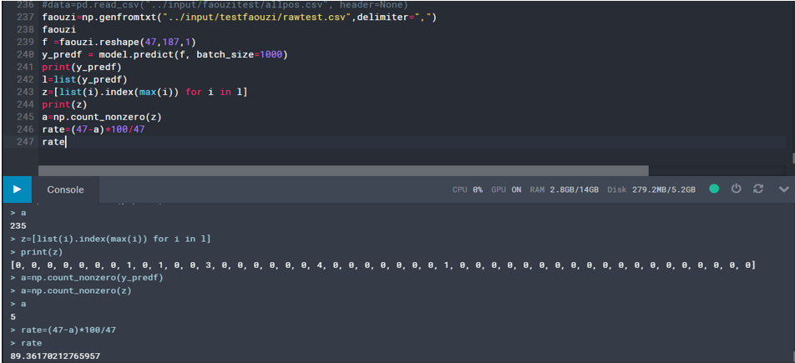

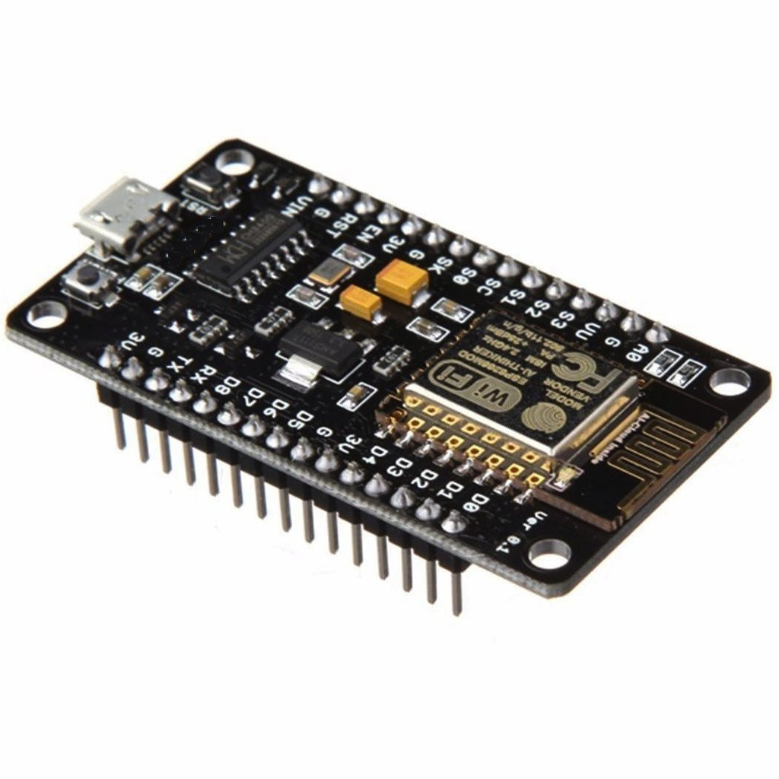



PISTE Project N°1 : eHealth
Realized by : Ayoub Ben Ameur | Fatma Bouaziz | Mohamed Ouhibi | Ahmed Saad | Zeineb Abdali | Zahra Zribi | Faouzi El Ghoul | Souhail Bel Haj Dit Mdalsi
Supervised by : Ridha Bouallegue | Sahar Ben Yaala | Imen Abidi
Introduction
Embedded and electronic part
Machine learning part
As part of the track project, our team designed the eHealth solution that addresses the following issues:
1. Difficulty to intervene quickly in case of emergency
2. Many hospitalizations
3. Difficulty to generate reports for the patients
4. Time wasting
5. Manual control
This solution's goals are :
1. Quick response in case of emergency
2. Reduce the duration and number of re-hospitalizations
3. Automating
4. Periodic inspections
Signal acquisition :
GY-521 sensor :
Connect to WIFI
Get sensor data
Make JSON structure
Send data to the server
ECG sensor :
We need a sampling frequency of 125 Hz
125 Hz ==> Ts = 8 ms
Data treatment time : 0.25 ms
Stages of the machine learning workflow :
Gathernig data
Data pre-processing
Finding the best model for the data type
Training and testing the model
Evaluation
Dataset :
Arrhythmia Dataset :
Number of samples = 109446
Number of categories = 5
Sampling frequency : 125 Hz
Data source : Physionet's MIT-BIH Arrhythmia
The model architecture :
This figure illustrates the network architecture proposed for the beat classification task. Extracted beats are used as inputs. Here, all convolutional layers are applying 1-D convolution through time and each have 32 kernels of size 5.
We also use maxpooling of size 5 and stride 2 in all pooling layers. The predictor network consists pf five residual blocks followed by two fully-connected layers with 32 neurons each and a softmax layer to predict output class.
Conception of the eHealth solution
Signal acquisition
Model performance :
Signal processing
Patient phone / Tablet
Web and mobile developpment
Conclusion
This project of Designing and Implementing an Intelligent Solution for Remote Patient Monitoring was a very interesting topic that was perfectly in line with our curriculum because it allowed us to combine both opportunity to improve our autonomy and group work and face the challenges of the future.
Doctor's instructions
Notification in case of emergency
References
Doctor's desktop

